Slide 1
TrAMS Certifications and Assurances Module How to View and Complete the C&As February 14, 2018 (Version 1.0)
Notes:
This presentation provides narrative and screenshots on how to complete your Certifications and Assurances in the new TrAMS C&A module

Slide 2
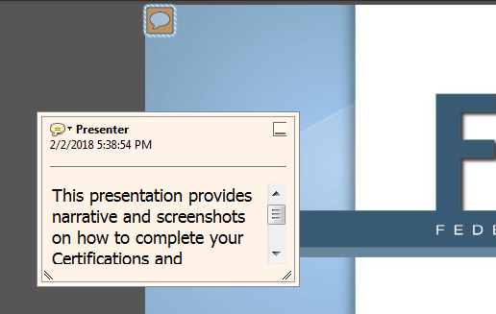
How to view presentation notes
Click on the message icon to populate the notes. You can scroll or adjust the comment box size to display information.

Slide 3
What’s Covered?
General Overview
How To steps in TrAMS
The first several slides can be used to understand how to view current and past C&As
It is recommended to print this presentation in the notes format
Notes:
The presentation covers the following:
A general overview on Certifications & Assurances
How-to steps to complete your C&As in TrAMS
Video demonstrations are available on FTA’sc website

Slide 4
Overview

Slide 5
C&A Submission Requirements
Certified C&As are a prerequisite to award
The certified date must be populated in TrAMS
Category (Group) #1 must be selected
Notes:
Your C&As will be reviewed at several steps during the application review process. FTA will review prior to assigning an application Federal Award Identification Number. Your application may be considered complete and ready for submission when your C&As are certified.
The certified date must be populated in TrAMS
Category 1 must be selected. The module now has a validation check to ensure all recipients select Category #1.
Recipients are encouraged to select all C&A categories, however it is not required.
Review the annual Federal Register Notice or other FTA published notice for instructions.
Review the Certifications and Assurances and the Master Agreement to fully understand the requirements of your awards. Review the fund program Circulars and applicable regulations and guidance to ensure you select the appropriate certifications.

Slide 6
User Roles to Complete C&As
TrAMS User Roles
Official User Role
Attorney User Role
All recipient user roles have access to view the current and past C&As. They will only display if the organization electronically submitted their C&As.
Notes:
There are two user roles associated with completing the C&As
The Official User Role, and
The Attorney User Role
All recipient user roles have access to view the C&As.
Note that TrAMS will display your past C&As only if your organization completed the C&As electronically.
If you get an error message, you may want to review your recipient documents.

Slide 7
Certify on Behalf of the Official and Attorney
If you are pinning the C&As on “Behalf of Both,” have your hard copy of the C&As ready to upload. It must be signed and dated and have the same category selections.
Notes:
FTA encourages independent certification by the Official and Attorney. However, FTA allows for either the Attorney or Official to complete the electronic certification process on “Behalf of Both” only when the other individual has signed and made the same category selections on a paper or hard copy.
The document must be uploaded to TrAMS to complete your certification.
Attach the document within the C&As module. Do not add the document to the recipient profile.
As previously noted, the user MUST have both user roles, and enter a PIN for each affirmation

Slide 8
C&A Workflow
The Official, Attorney and Submitter user role groups receive email notification when the C&As are published
The Official must initiate the process
The Attorney is then notified to act, to certify or return
The Submitter and Official are notified when certified.
TrAMS Notifications
Official Certifies
Attorney Certifies or Returns
Certs Complete
TrAMS Notifies Attorney
Notes:
A Workflow was added to the module; this means the C&As must be completed using a sequence of steps.
The workflow includes notifications to alert recipients that the C&As are published in TrAMS
The workflow requires the Official to initiate the process by completing the certification first.
Once the Official PINs in TrAMS, the Attorney is then notified via email to take action.
The Attorney can affirm to complete the certifications. The attorney can no longer make corrections to the categories selected.
The new workflow does allow the Attorney to return the certifications to the Official if a correction is needed.
Only once both have certified, or PINed in TrAMS, the C&As are complete.
The new module allows recipients to recertify if it is determined additional certifications are needed. A history log will display prior versions.

Slide 9
Incomplete Certifications
Users will be prompted during application development about the status of the C&As
Notes:
If FTA has not published the C&As or if you have not certified yet, the system will flag that your C&As are “missing” or not yet complete when you are working on a new application or a new amendment..
The status will change to completed once you have certified to the Certifications and Assurances.
The example warning message will display when you are transmitting an application for initial review.
To date there are no hard stops in the application development and award process.

Slide 10
HOW-TO STEPS

Slide 11
View the C&As
All users can view the C&As provided they were electronically submitted in either TEAM or TrAMS.
See the next two slides to simply search and view the C&As.
The remaining “how-to” slides will help you better understand the information displayed in TrAMS.

Slide 12
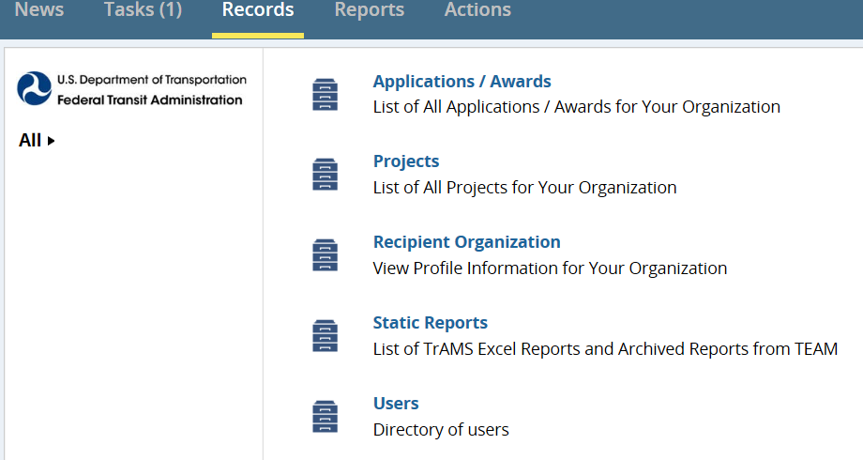
Step 1 – Find Recipient Profile
As the Official, to take action, use the Records Tab
Select Recipient Organization
Select the hyperlink to the applicable organization
Notes:
You must have the Official User Role to initiate the C&A certification process. Notifications go to the Official User Role Group; that means if you have more than one user assigned the Official User Role, you will need to determine who will take action in TrAMS.
Log in
Click on the Recipient Organization from the menu
If you have access to multiple recipient organizations you may filter using the search feature to identify and select your organization.
Proceed to step 2

Slide 13
Step 2 – Locate the C&As Module
Use the Related Actions and select the Certifications & Assurances option from the menu list
You will be prompted to select the applicable Fiscal Year
Notes:
Click on Related Actions to populate the menu
Select Certifications and Assurances from the menu
The next screen will display a form to select the Fiscal Year.
The filter displays the current fiscal year for you to act on, and provides a history of the past 9 years. For example, this is Fiscal Year 2018, so you can see back to FY 2008.
Your past C&As will only display if you completed your C&As electronically in TEAM and/or TrAMS. If you only submitted paper copies you must refer to the Recipient Organization Profile Documents to determine if they were uploaded.
Reminder: TrAMS holds the file on record with FTA.

Slide 14
Dates Explained
Fiscal Year: Year selected
Assigned Date: Date C&As are Published in TrAMS
Due Date: 90 dates from date of publication
Original Certified Date: Initial Date Certified
Last Certification Date: Original or Last Recertified Date
Notes:
The Certification and Assurances Information is defined in the above slide
The last certification date will be the same as the original certification date for the first time the organization certifies. The original certification date does not change.

Slide 15
Step 3 – Select Certifications
Top box in Category header will “Select All”
Use the category box to select individual C&As
Selected Categories will go from red to green after you PIN
#1 is REQUIRED
Notes:
If you want to select all categories you can select the top box to auto populate all selections.
You can also select them individually.
Click on a box to select. If incorrectly selected, click on the box to unselect.
The certified will be red until you have certified.
Category #1 is required and you will not pass the certification form unless it is selected. An error message will display if not selected.

Slide 16
Step 4 - Document Management
Official can delete/add documents prior to certification
Once certification is complete, to modify documents you must recertify your C&As
You only need to upload if you are Certifying on behalf of both the Official and Attorney
Notes:
Documents must be added prior to certification.
You must add documentation when certifying on behalf of both the Official and Attorney.
If separate individuals are certifying, documentation is not required.
You may add one or more documents. The documents only live in the module and not on the recipient profile. FTA requests that you use only the C&A module for related documents.
If you need to change your document after certification, you must recertify your C&As. This is acceptable. Notify your FTA awarding office of the action so they are aware.
Note that the C&A module does not keep a history of prior documents once deleted.

Slide 17
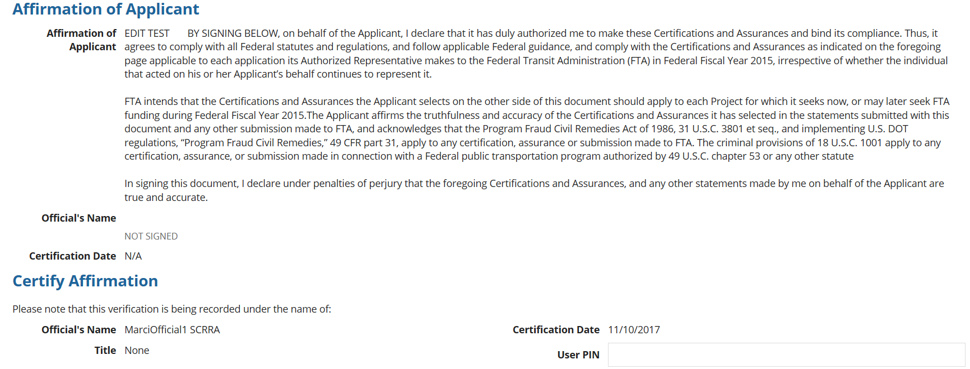
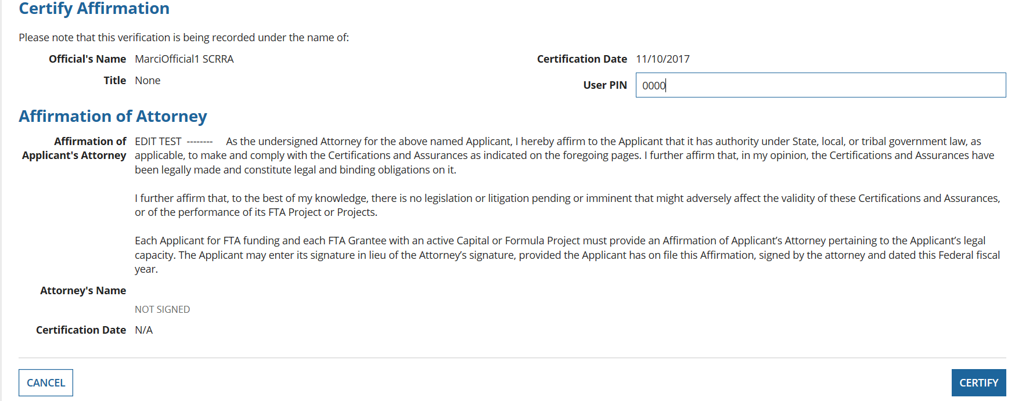
Step 5 - PIN Cert by Official
Enter your 4-digit PIN number in the field and select the Certify button
Notes:
Enter your PIN and Click the Certify Button.
If you only have the Official User Role, only 1 PIN field should display.
If you see two PIN fields you have both roles. See notes below and the next slide.
If you don’t believe you should have both roles to PIN as the Official and on Behalf of the Attorney, select the Cancel button and coordinate with your staff. You will not be able to proceed with only one field entered.
If you need to remove the Attorney User Role, contact your designated User Manager.

Slide 18
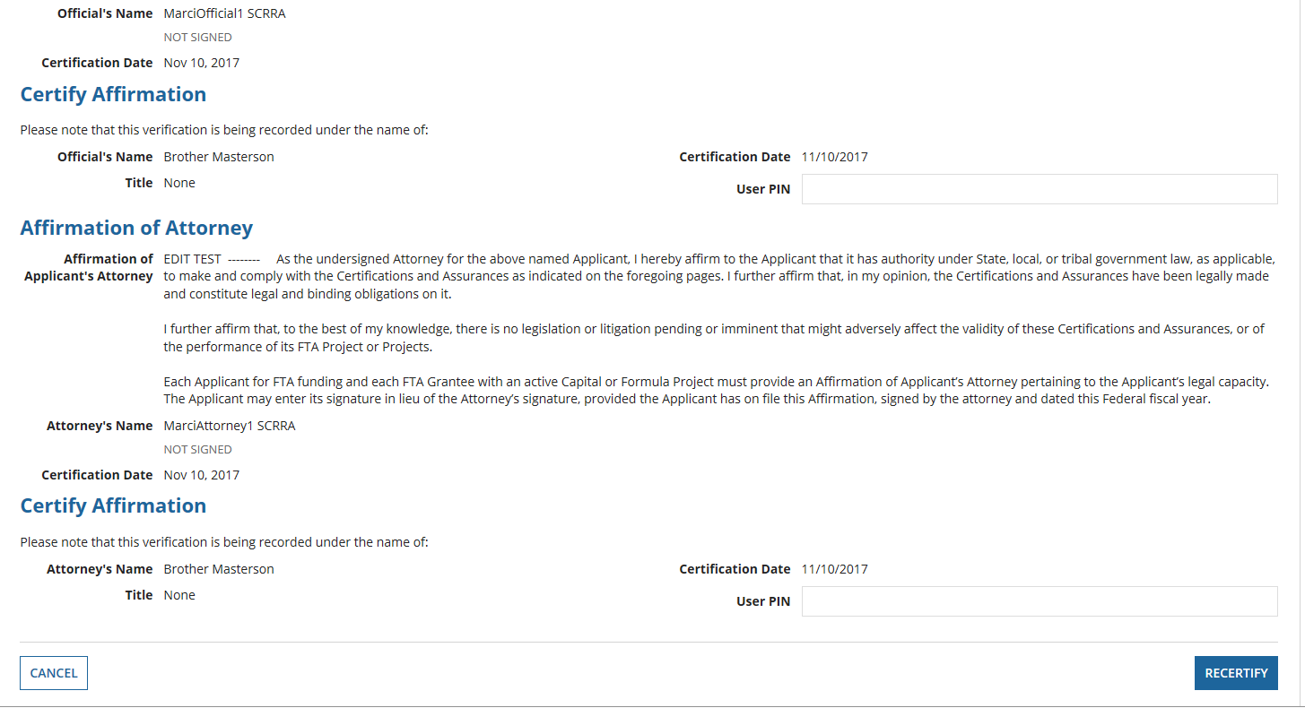
Certify on Behalf of Both
When you have both the Official and Attorney User Roles you will see the PIN field for both affirmations. You must enter your PIN in each field to certify/recertify. You Must Add Documents!
Notes:
If you see two PIN fields you have both the Official and Attorney user roles
You should only proceed here if you have the signed document from the Attorney
You must upload the signed and dated certification before you certify.
The category selections must be the same.
If you do not have your documentation, select the Cancel Button to exit the form.
If you have your documentation you must ENTER PIN IN BOTH FIELDS and then select the Certify Button.

Slide 19
Messages
Validation checks are built in to ensure a valid PIN is entered
Message once Official has certified. An email notification will now be sent to the Attorney
Notes:
Your PIN must be 4 digits long
Refer to the FACES User Guide if you need help on how to create a PIN or rest your PIN.
All users were required to create a new PIN in November with the update of the FACES User Management Module.
After the Official certifies the above message will display indicating that additional steps are needed to complete certification.
A system generated email will notify the Attorney they must PIN to finalize the certification.

Slide 20
Step 6 – PIN C&As by Attorney
The Attorney can follow the same steps as the Official to get to the C&As module.
The C&A selections are static for the Attorney.
The Attorney can certify to complete the CA process or return the C&As to the Official for modifications.
Notes:
The Attorney cannot make changes to the selection
If the selections are correct, Enter your PIN to Certify and complete the C&As process
The Attorney will then see a success message
If the selections are incorrect, the C&As can be returned to the Official. See next slides for more information .

Slide 21
Return C&As to Official
The Attorney will be prompted to enter comments and return to the Official. A confirmation prompt will populate to confirm action.
Sample email sent to Official with Comments. Same Comment will populate on the C&As form.
Notes:
The attorney can select the return to Official.
The Attorney will be prompted to confirm the action
The Attorney must provide comments to return the C&As, provide clear directions to the Official.
The comments entered will display in the email to the Official User Group. The Comments will also display on the form when the Official revisits the C&As to make changes. See next slide for example.
Note that some language in the prompts here may have changed since deploying the module.

Slide 22
Return to Official Feature
The comments from the Attorney will appear in the email notification and on the form.
Notes:
See new information on form – Comments from Attorney.
The comments do not remain, nor are they tracked in the history.
Once the Official PINs the comments will drop off the form.
The Official must make any modifications and PIN the certification again.
Attorney will again be notified by email to complete the certification process.
The process can be repeated if necessary.

Slide 23
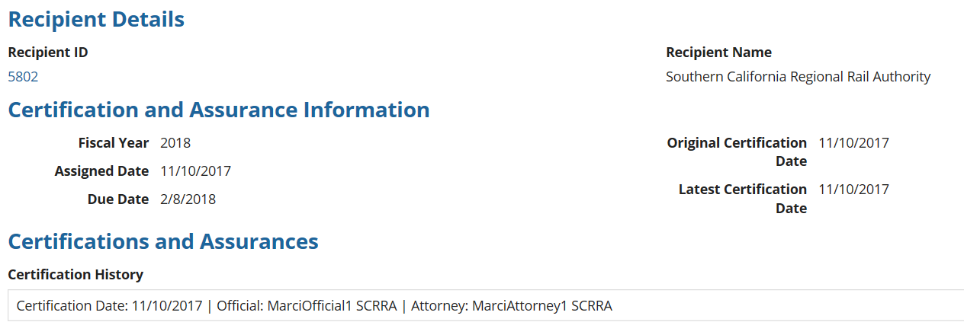
A Complete Certification
A complete certification will display a date in the Original and latest Certification Date field.
History shows who certified, the date, and status. If recertified, you can select and view the different versions of what was certified.
Notes:
The Certified date will populate once both the Official and Attorney have taken action.
The Attorney certification will reflect the latest certification date (it was the last action taken).
The history log will identify who to action and when the person took action.

Slide 24
A Complete Certification
Certified categories have a green circle and check mark. Those not certified are red with a negative sign.
Notes:
Read Slide

Slide 25
Q: What if I need to make changes to the selections or add a new/updated document to the C&As for the current fiscal year?
A: You must recertify your Certifications. The original will still be available for reference under the history log.

Slide 26
Recertification Process
The Official may begin the recertification process at any time in the current fiscal year.
You cannot recertify or correct past fiscal years.
Notes:
Within the fiscal year, it may be determined that an additional category must be certified.
The Official user an follow the prior steps to view the C&As
At the bottom of the C&A form the user can select the “begin recertification” button to open the C&As to make new selections or change selections or add/remove documents
The original/last certification will be retained in the history log for reference.
The Attorney must also complete their review and certification to complete the recertification process.

Slide 27
Recertification Process
Uses the same workflow. The user will see the last certification date populated. Select the ‘Recertify’ Button at the bottom of the page. Once recertified a new history will populate in the last certification date.
Notes:
The original date is retained to demonstrate that the grantee satisfied the requirement at the time of certification and awards made.
You can always go back and review the history of selections made in prior certifications. See next slide.

Slide 28
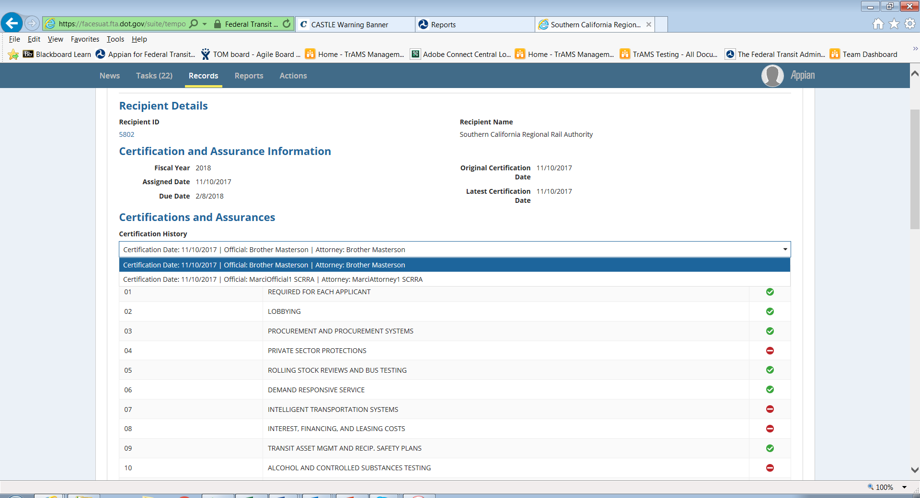
History Log Example
jkllk
Notes:
The example here shows the green check marks for the categories selected
The red circle for those not selected
And you can see that three actions were taken on the C&As in the history. Once selected it will display what actions were taken on that date. You can easily see in the history and in the affirmations who took action in TrAMS.
The last certification date will populate the most recent action.

Slide 29
VIDEO Demo
You may use the link(s) on the FTA public page to view a prerecorded demonstration of the workflow described in this presentation.

