Slide 1
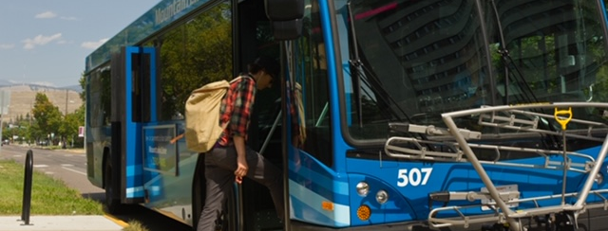

Advancing Mobility Management: A State Perspective
18th Biennial State Programs Meeting and
Public Transportation Partnerships Conference
August 14-16, 2019

Slide 2

Agenda
18th Biennial State Programs Meeting and
Public Transportation Partnerships Conference
Marianne Stock, FTA, Federal Perspective
Susan Weber, FTA Region 5, Support from a Region
State Perspectives
  Mary Ann Hayes, Maine DOT
  Macie Moore, Ohio DOT
  Kristin Haar, Iowa DOT
Judy Shanley, Easterseals-NCMM, State of the States Study
A Conversation with State Leaders
Discussion

Slide 3
Mobility Management: Federal Perspective
Marianne Stock
Chief, Rural and Targeted Programs, FTA
18th Biennial State Programs Meeting and
Public Transportation Partnerships Conference
August 14-16, 2019

Slide 4
Mobility Management and Coordination
18th Biennial State Programs Meeting and
Public Transportation Partnerships Conference
Provide more service more efficiently
Serve community needs, especially in rural areas and for targeted populations that need it most

Slide 5
Mobility for All
Coordinated transportation ensures that otherwise underserved populations, such as older adults, people with disabilities, and people of low income (including rural populations and those in opportunity zones), are able to contribute to their community and the economy and lead healthy, productive lives.
Availability and Accessibility
Efficiency
Innovation
Provide more transportation options by streamlining policies and encouraging collaboration.
Share resources, save funds, and reduce redundancy within the 120+ Federal programs that fund transportation.
Improve customer service by developing and implementing future transportation models.
ACTIONS
ACTIONS
ACTIONS
Clarify allowable use of funds for transportation services
Gather and disseminate promising practices on coordinated planning
Develop cost sharing policy across Federal programs
Demonstrate innovative technologies

Slide 6
FTA Mobility Management Initiatives
18th Biennial State Programs Meeting and
Public Transportation Partnerships Conference
August 27-28, 2019
Coordinating Council on Access and Mobility
  11 federal agencies that fund transportation for targeted populations
  Federal program inventory
  Federal fund “braiding”
  NCMM Survey about coordination

Slide 7
CCAM Membership
What federal programs fund transportation?
Below is a sample of the 80 federal programs that may fund transportation services for people with disabilities, older adults, and individuals of low income.
Department of Health and Human Services
Children’s Health Insurance Program (CHIP) Medicaid Block Grant for Community Mental Health Services Centers for Independent Living (CILs) Older Americans Act (OAA) programs Health Center Program
Department of Agriculture
Supplemental Nutrition Assistance Program (SNAP) Community Facilities Loan and Grant Program
Did you know?
If an organization receives funding from one of these programs, a portion of the funds may be used for transportation services.
Funding recipients may collaborate across these federal programs to provide more transportation options for the community.
Department of Veterans Affairs
Veterans Transportation Program (VTP) Beneficiary Travel Service
Department of Transportation
Formula Grants for Rural Areas Enhanced Mobility of Seniors and Individuals with Disabilities Urbanized Area Formula Program
Department of Labor
Workforce Innovation and Opportunity Act (WIOA) programs JobCorps

Slide 8
FTA Mobility Management Initiatives
18th Biennial State Programs Meeting and
Public Transportation Partnerships Conference
August 27-28, 2019
Advanced Mobility Management course offered by National Transit Institute
  September 25-26, 2019 – St. Cloud, MN
  February 5-6, 2020 -Phoenix, AZ
  February 24-25, 2020 – Nashville, TN
  March 25-26, 2020 – Springfield, MA
  May 5-6, 2020 – Denver, CO
  June 16-17, 2020 – Ithaca, NY

Slide 9
Mobility Management and Coordination
18th Biennial State Programs Meeting and
Public Transportation Partnerships Conference
August 27-28, 2019
Where it really happens:
In states and communities all over the US

Slide 10
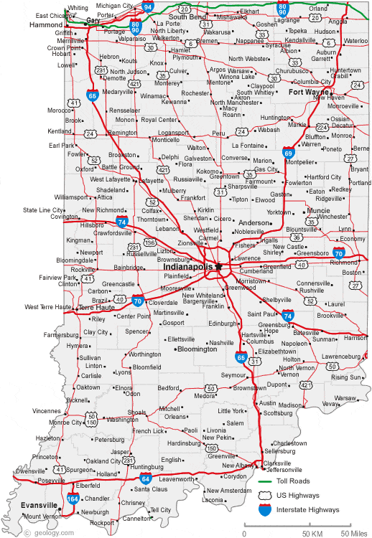
Mobility Management Efforts in Indiana
18th Biennial State Programs Meeting and
Public Transportation Partnerships Conference
August 27-28, 2019
FTA Region V
Susan Weber, Community Planner

Slide 11










18th Biennial State Programs Meeting and
Public Transportation Partnerships Conference
Organizations/Agencies in Indiana
Notes:
Health by Design works at the intersection of the built environment and public health, collaborating across sectors and disciplines to ensure Indiana communities have neighborhoods, public spaces and transportation infrastructure that promote active living for all.
Indiana Statewide Independent Living Council (INSILC), was established by the Rehabilitation Act of 1973, as amended. INSILC is a 501c3 non-profit, governor-appointed council, independent and autonomous from the state, federally-required to be led by a majority of individuals with disabilities from all regions of Indiana with different backgrounds and experiences tasked with promoting the philosophy of Independent Living. INSILC believes people with disabilities should have the same civil rights, choices, options, and control over their lives as do people without disabilities.
FSSA was established by the Indiana General Assembly in 1991 to consolidate and better integrate the delivery of human services by state government. FSSA is a health care and social services funding agency.
Maya Cox, M.Ed., is a research associate with the Indiana Institute's Center on Community Living and Careers at Indiana University. In this position, she provides technical assistance and training to improve employment outcomes for individuals with disabilities across the state of Indiana. Her areas of interest include employment, family supports, research to practice, and autism spectrum disorders. Maya has worked to improve outcomes for individuals with disabilities through direct service, technical assistance and training, and research. Maya received her Bachelor’s Degree from the University of Notre Dame, and her Master’s degree from the University of Louisville.

Slide 12
Bridging the Silos
MaineDOT / Mary Ann Hayes
18th Biennial State Programs Meeting and
Public Transportation Partnerships Conference
August 14-16, 2019

Slide 13
Levers of Change
18th Biennial State Programs Meeting and
Public Transportation Partnerships Conference
August 27-28, 2019
Aging Population
  Many can’t (or shouldn’t) drive
  Younger retirees have time to volunteer
  Age-Friendly Community Movement (65 certified with AARP)
Dispersed Rural Settlement Pattern
Workforce Shortage
Missed Medical Appointments
Growing Use of Technology (raises expectations)
Congestion and Parking Crunch in Portland
Millennials Prefer No Car
Locally Coordinated Plan
Public Transit Advisory Council Recommendations
Governor Mills’ Climate Initiative

Slide 14
Barriers to Change
18th Biennial State Programs Meeting and
Public Transportation Partnerships Conference
Cultural
  Independent Travel
  Unfamiliarity with public transportation
  Sprawled development pattern
Fiscal/Political
  Transportation service historically private responsibility
  State funding = 86 cents/capita for transit operations*
  How does public sector pay for this?
  Already have $200M annual backlog for maintaining roads and bridges
  Questions around who benefits and who pays
  *Excluding Maine State Ferry Service and Downeaster Passenger Rail

Slide 15
18th Biennial State Programs Meeting and
Public Transportation Partnerships Conference
Locally Coordinated Plan
Key Findings and Recommendations
TOP RECOMMENDATIONS
Grow Partnerships
Improve Rider Information Systems
Develop Last Mile Solutions
Invest in Transit Provider Infrastructure
Increase Funding
PRIORITY STRATEGIES IN EACH
Create multi-sector mobility network (“Moving Maine”)
Expand GO Maine to full on-line trip planner (GO Vermont Demo Project as model)
Support volunteer driver networks
Accelerate fleet modernization, AVL, electronic payment systems
Increase state $ to $5/capita (national median)

Slide 16
Moving Maine Mobility Network
18th Biennial State Programs Meeting and
Public Transportation Partnerships Conference
  Outgrowth of May 2018 conference
  4 Foundation Organizations
    Greater Portland COG (coordinator)
    Maine Cancer Foundation
    Maine Primary Care Association
    MaineDOT
  Needs dedicated staff
  Pending FTA grant award will enable moving forward
  Need to merge with volunteer network support

Slide 17
Challenges to Silo-Bridging
(besides budgets, authority and egos)
18th Biennial State Programs Meeting and
Public Transportation Partnerships Conference
  Coordination – whose job is it?
  “Leading” from the middle
  Trying to influence private-sector driven decisions such as location of housing and employment centers without significant incentives or regulatory authority
  Hampered by capacity and resources – trying to do new big things on top of full plate doesn’t work

Slide 18
FTA State Programs Meeting• Washington, D.C., August 15, 2019
Notes:
Welcome and intro

Slide 19
Advancing mobility management: the state’s perspective
Macie Moore

Slide 20
A LOOK BACK
Ohio’s Coordination Program Began January, 1996
  Taskforce of (13) State Agencies
  Goal: fund administration/implementation of human service transportation coordination in underserve communities
  Key Contributions: Handbook for Coordination Transportation Services, DRIVE Training Program, Guide for Implementing Coordinated Transportation Systems
  Funded solely by State General Revenue Funds

Slide 21
The EVOLUTION
Ohio’s Coordination Program become solely funded through the Section 5310 Program in CY 2009 as an 80/20 Capital Project
Remained focused on underserved counties without public transportation systems
Project eligibility shifted to the cost of a “Mobility Manager”
Goals:
  Improve and expand transportation services in counties without public transit
  Increase efficiency and effectiveness of transportation service delivery
  Develop Coordination Models which can be applied to other communities

Slide 22
404: ERROR COORDINATION NOT FOUND
ODOT still isn’t seeing coordination occur…why?
Problem | Solution
Still transitioning roles from State-funded Coordination Program to 5310 Mobility Management Program | Develop clear Program Guidance and Requirements, hire staff member to oversee Program
Lack of Consistency in Coordinated Planning | Develop Plan Guidance, Template, and Toolkit
Coordination effectiveness impacted by siloed approach | Regional Coordinated Planning Pilot Program

Slide 23
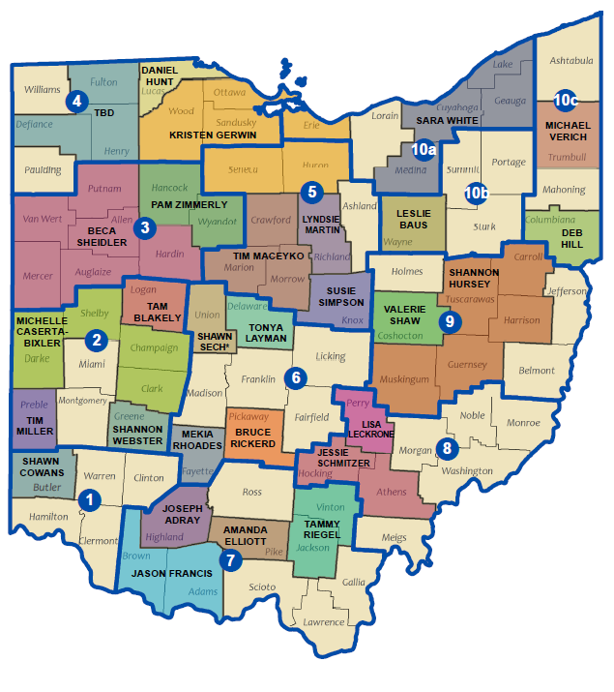
Building a network
Ohio Mobility Management Network:
29 Total Mobility Managers
  24 Rural
  5 Urban
  11 Regional Managers
Program Attributes:
Program Standard
Quarterly Roundtable Meetings
Monthly Phone Calls
Resource Sharing
Assignment of Duties
  Friday Feature and Updates
  OPTA Committee
  Training Committee

Slide 24
Maintaining a network
Develop standards, manage to those standards
Educate locals and transportation partners on benefits of Mobility Management and how to leverage a Mobility Manager to solve transportation issues
Provide resources, tools, and training
  Mobility Manager Evaluation
  Mobility Management Training Guide
  Mobility Management 101

Slide 25
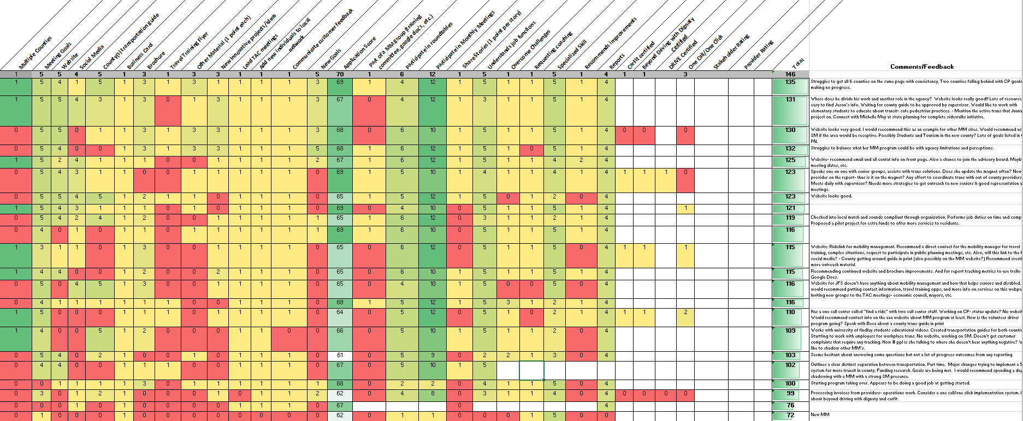
Evaluation

Slide 26
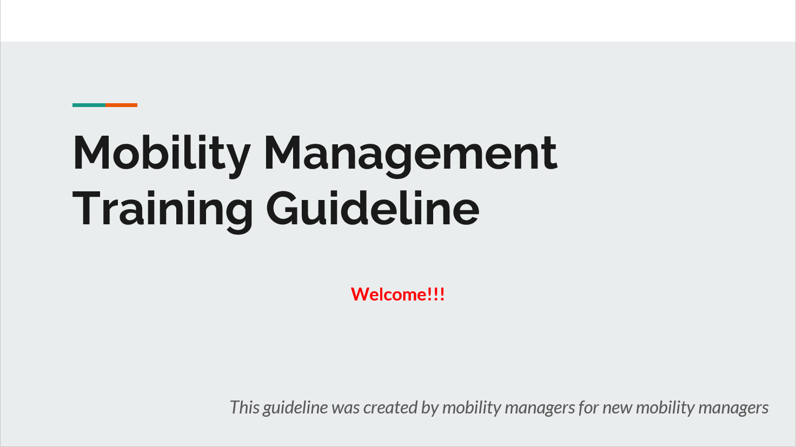
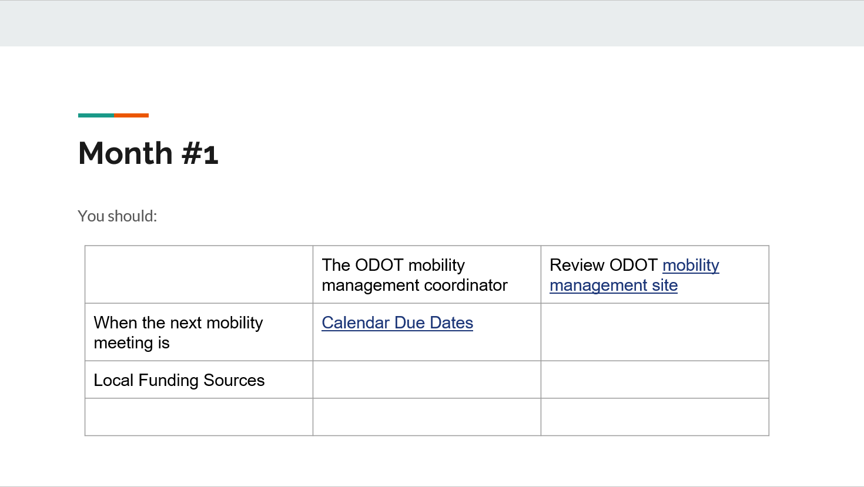
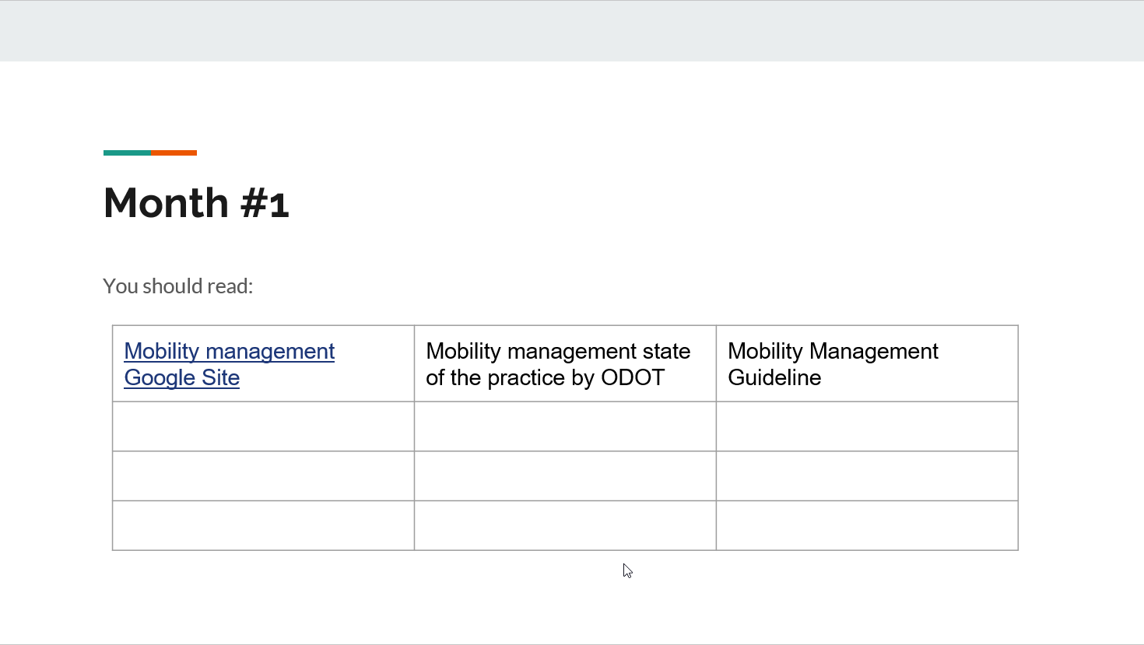
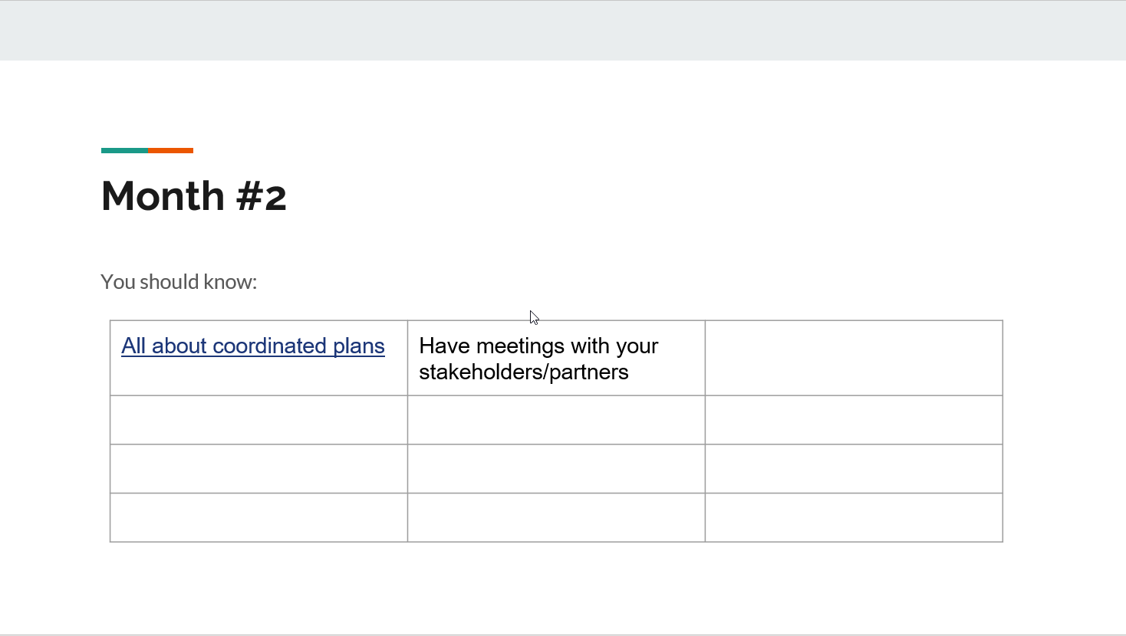
Training
Mobility Management 101
Coordinated Planning Intro and Background
Outreach Efforts
Identifying Transportation Needs and Gaps
Assessment of Available Services
Coordinated Planning Module – Developing Goals and Strategies
Coordinated Planning Module – Plan Adoption and Annual Reviews
Identifying Funding Opportunities
Final Exam

Slide 27
Regional approach
Coordinated Plan Template, Guidance and Toolkit seeks to create consistency in transportation planning and funding selections
Regional Implementation is necessary to break down county silos and look at transportation holistically
Mobility Transformation creates a level playing field for all providers to participate in the newly coordinated network

Slide 28
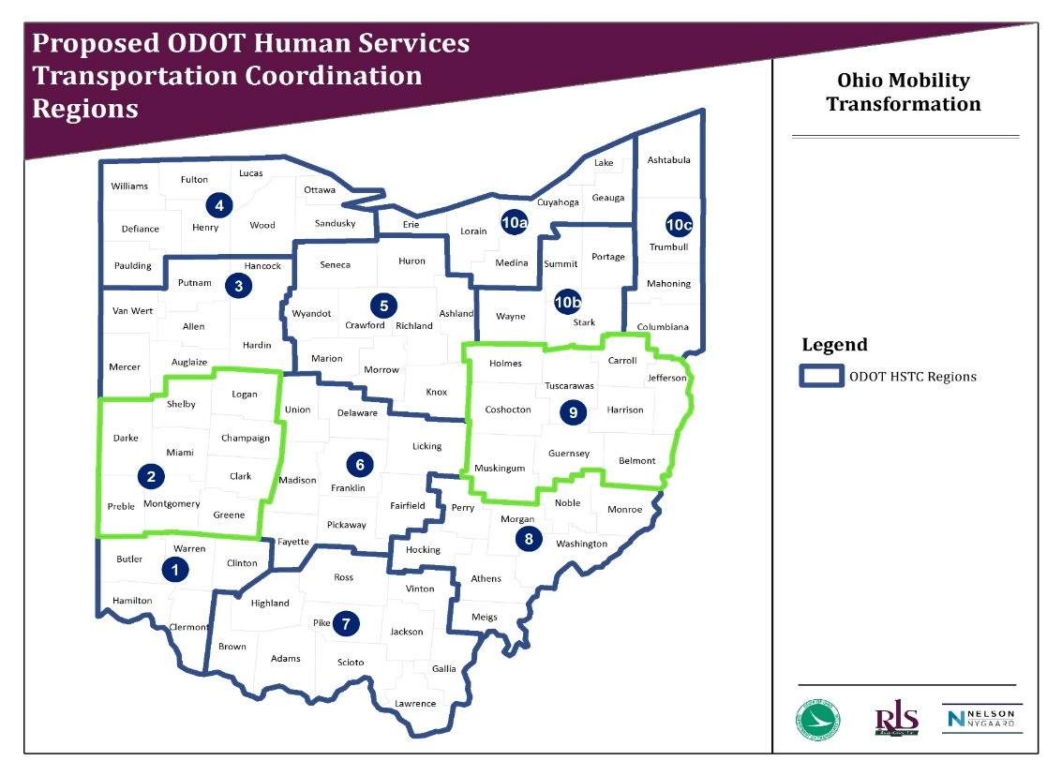
Region pilot project
Started January 1, 2018
Goals:
  Establish Regional Coordinated Plans – Estimated Completion December, 2019
  Implement Health and Human Service Transportation Standards – Estimated Completion November, 2020
  Develop Cost Allocation Methodology – Estimated Completion November, 2020

Slide 29
Mobility transformation

Slide 30
In CLOSING
MOBILITY MANAGEMENT HAS ALLOWED OHIO TO:
  Standardize Coordinated Transportation Planning
  Educate the public on transportation options
  Provide representation for rural/urban communities needs when implementing a regional approach
  Create a foundation to eventually coordinate all transportation services in a more efficient and holistic way

Slide 31
Resources for more information
Mobility Management Program Webpage - http://www.dot.state.oh.us/Divisions/Planning/Transit/Pages/Coordination.aspx
  Program Guide
  Brochure
  Mobility Management Stories
  Mobility Manager Contact Info and Maps
  Program Contact
  Olivia Hook
  Statewide Mobility Coordinator
  614.466.8957
  Olivia.hook@dot.ohio.gov

Slide 32
Mobility Management: The Iowa Perspective
Iowa DOT/Kristin Haar
18th Biennial State Programs Meeting and
Public Transportation Partnerships Conference
August 14-16, 2019

Slide 33
Iowa Overview
18th Biennial State Programs Meeting and
Public Transportation Partnerships Conference
Population: 3,046,355 (2010)/3,156,145 (2018 estimate)
    Persons 65 years and older: 17.1%
    Persons under 18 years: 23.2%
    Persons with a disability, under 65 years: 7.9%
    White alone, not Hispanic or Latino: 85.3%
    Black or African American alone: 4.0%
    Hispanic or Latino: 6.2%
    Persons in poverty: 10.7%

Slide 34
Iowa Public Transit Overview
18th Biennial State Programs Meeting and
Public Transportation Partnerships Conference
35 Public Transit Agencies
    16 regional, multi-county systems
    7 small urban systems (under 50,000 population)
    12 large urban systems (population over 50,000)
24.9 million rides provided in FY18
1,700+ vehicles (all buses or vans)

Slide 35
Evolution of Mobility Management in Iowa
18th Biennial State Programs Meeting and
Public Transportation Partnerships Conference
Started with two regional transit agencies applying to the Iowa DOT for New Freedom dollars to hire mobility managers ~2009
Through United We Ride initiative, an ambassador worked with the Iowa Transportation Coordination Council to encourage the hire of a statewide mobility manager to help grow the network statewide
    Hired in 2011 by the COG association using state and federal transit funds
    Goal was 16 mobility managers statewide, one per region
Notes:
The original two regions learned about mobility management by attending conferences and learning of its eligibility under New Freedom and JARC programs. They hired mobility managers with the goals of boosting ridership and to advocate for additional needed services. Working to “Go Beyond the ADA.”
Because the Iowa DOT was not in a position to hire any FTEs at the time, we had to be creative to start the Statewide Mobility Manager position. The Iowa DOT worked with the Iowa Association of Regional Councils (IARC, now ICOG) to sponsor the position. One of the member COGs with a public transit agency was the employer of the statewide mobility manager and the Statewide Mobility Manager reported to that COG, IARC, and to the Iowa DOT.

Slide 36
Evolution of Mobility Management in Iowa
18th Biennial State Programs Meeting and
Public Transportation Partnerships Conference
Network did continue to grow until the stand-alone JARC and New Freedom programs were eliminated under MAP-21 and mobility management activities became eligible for funding under the 5310 and 5311 programs instead
  Not enough extra money added to 5310 and 5311 to continue expanding the network
  Current positions spent down remaining JARC and New Freedom dollars and then either eliminated positions or fully funded locally
Notes:
At the height, Iowa had 10 mobility coordinators.

Slide 37
Evolution of Mobility Management in Iowa
18th Biennial State Programs Meeting and
Public Transportation Partnerships Conference
After the original Statewide Mobility Manager resigned in 2014, one of the Iowa DOT’s current employees with a mobility management background took over Statewide Mobility Management
  Point of contact for areas without mobility managers
  Provides resources & advice to mobility managers in state and around the country
Notes:
Many of you know or have seen Jeremy Johnson-Miller at various conferences around the country presenting on mobility management. He is also a Transit Programs Administrator, managing5310, 5311, and 5339 contracts for about half of Iowa’s public transit agencies.

Slide 38
Evolution of Mobility Management in Iowa
18th Biennial State Programs Meeting and
Public Transportation Partnerships Conference
Currently learning that mobility management doesn’t necessarily need to be a job title
  Many positions include mobility management duties
  Including the people in those positions in the Iowa Mobility Managers Network to expand the reach of mobility management work
Mobility managers now officially number at 8, including the Statewide Mobility Manager
Notes:
As I shared earlier, at the height of the mobility management push, in 2014, Iowa had 10 mobility coordinators. Now having 8 doesn’t sound like we’ve lost many, but in that eight is the loss of full-time dedicated mobility managers. Many of the mobility managers today have other positions within the transit organizations and will answer questions and assist riders when called, but have many other responsibilities in their jobs.

Slide 39
Using Mobility Management to Make Connections
18th Biennial State Programs Meeting and
Public Transportation Partnerships Conference
Mobility managers in Iowa have been valuable in fostering new relationships between agencies and organizations
  Examples:
    Working with local public health to start free transit rides to the farmers market
    Learning from refugee agencies that an area’s newest residents actually speak French, leading to translation of transit materials into French

Slide 40
Using Mobility Management to Make Connections
18th Biennial State Programs Meeting and
Public Transportation Partnerships Conference
Mobility managers in Iowa have been valuable in fostering new relationships between agencies and organizations
  Examples, continued:
    Working with local refugee agencies to create a pictorial checklist of items needed to obtain a state ID, streamlining the process for refugees
    Providing travel training for the aging population

Slide 41
Using Mobility Management to Make Connections
18th Biennial State Programs Meeting and
Public Transportation Partnerships Conference
The Statewide Mobility Coordinator also makes connections:
  Examples:
    Working with Iowa Department of Corrections to learn of a residential facility needing transit service. A route was extended slightly and those ex-offenders now have a new transportation option.
    Partnering with Iowa DOT Driver and Identification Services Bureau to create a website useable no matter your mode of transportation… Get There Your Way!
Notes:
The Get There Your Way webpage isn’t active yet, but it will address all types of transportation concerns. From those needing to reinstate their licenses because of legal matters, to those losing a license due to age or health reasons, to those needing an ID preferring or unable to drive.
The number of mobility managers around the state may grow in the next few years as preliminary talks are underway between the Iowa DOT, the Iowa Department of Corrections, and Iowa Workforce Development to add mobility managers to assist prisoners about to be released to figure out all of their transportation options once they are released thus lessening one barrier to re-integrating into the community.

Slide 42
Contact Information
18th Biennial State Programs Meeting and
Public Transportation Partnerships Conference
Kristin Haar
Compliance & Training Officer/Iowa Transportation Coordination Council Chair
Iowa DOT, Public Transit Bureau
kristin.haar@iowadot.us
515.233.7875

Slide 43
Advancing Mobility Management
Judy L. Shanley, Ph.D.
Easterseals, Nat. Ctr. For Mobility Management
18th Biennial State Programs Meeting and
Public Transportation Partnerships Conference
August 14-16, 2019

Slide 44
Why Mobility Management?
18th Biennial State Programs Meeting and
Public Transportation Partnerships Conference
Means to “put into practice” coordinated plans
Creates increased efficiency of resources
Identify new partners
Looks like CCAM at the state and local levels

Slide 45
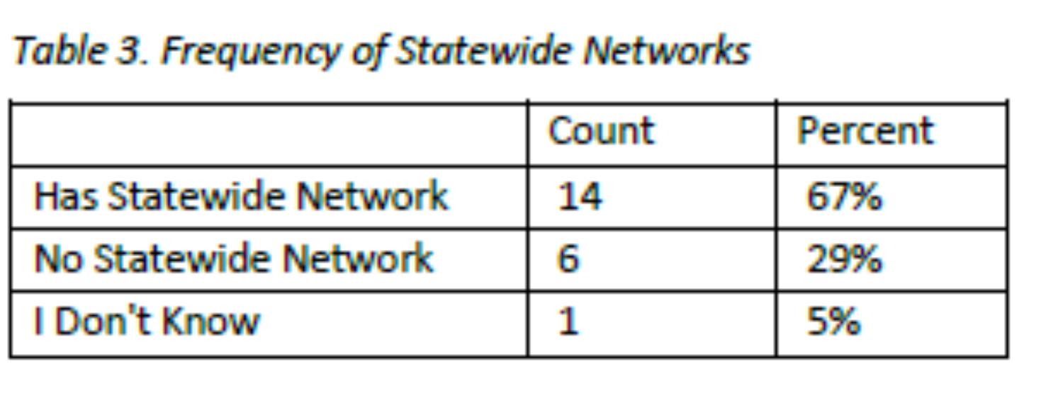
Mobility Management State of the States Study
18th Biennial State Programs Meeting and
Public Transportation Partnerships Conference
August 27-28, 2019
Reached out to 49 state professionals
Thirty States responded

Slide 46
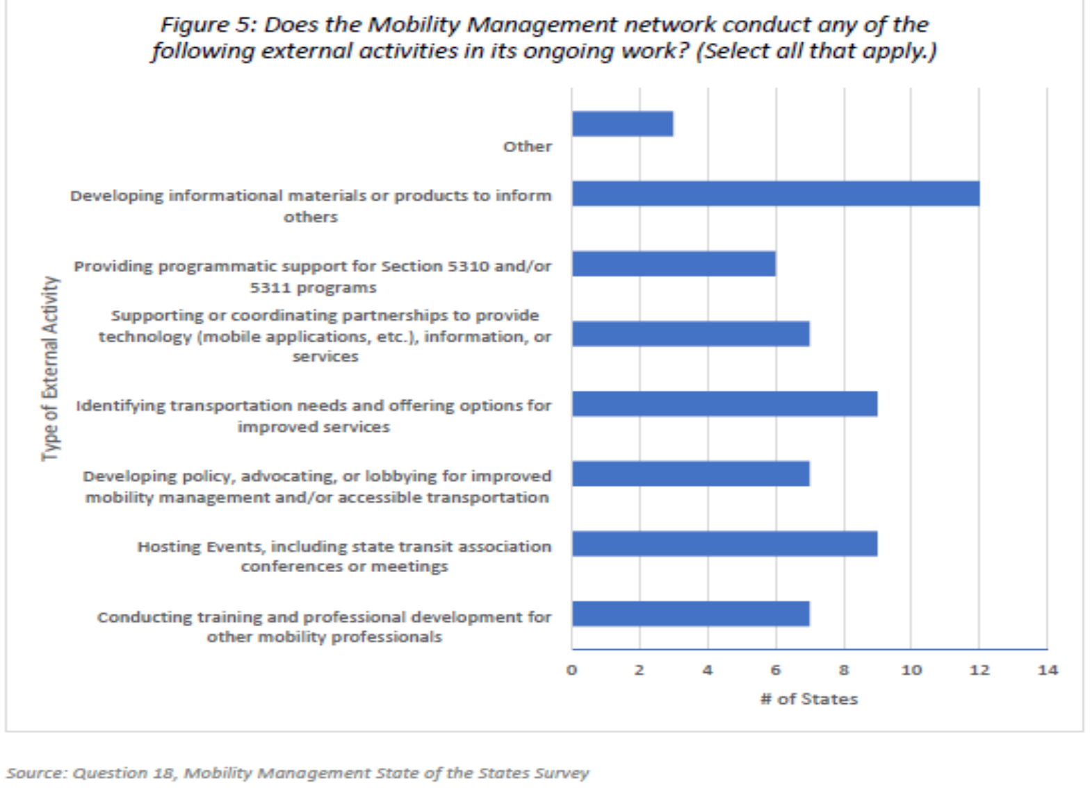
State Mobility Management Activities
18th Biennial State Programs Meeting and
Public Transportation Partnerships Conference
August 27-28, 2019

Slide 47
What Can Coordination/Mobility Management Look Like?
18th Biennial State Programs Meeting and
Public Transportation Partnerships Conference
August 27-28, 2019
Implement policy guidance & informational materials across agencies
Establish Cost Sharing for transportation services
Develop vehicle sharing programs
Share staff across agencies
Include a focus on mobility and transportation in priorities and grants
Host joint events, conferences, webinars
Invite personnel from partner agencies to serve on review panels or in advisory capacities
Develop performance measures across agencies

Slide 48
Measuring Performance
18th Biennial State Programs Meeting and
Public Transportation Partnerships Conference
August 27-28, 2019
Multi-level Measures
    Individual mobility managers
    Performance of process
    Performance of network (Outcomes- Impact - ROI)
Notes:
Meeting process & communications
Increase in communications across partners outside of scheduled meetings
Number of meetings, attendance at meetings
Achieve established meeting objectives
Participants come prepared and informed
Communications result in action items
Meeting content
Topics addressed align with current research & practice regarding coordination
Reflects topics raised by community and riders – aligned with rider needs
Mutual respect
Participants like convening – happy partners – people walk away thinking…” this was a good use of my time”.
High quality deliverables
Activities – products produced reflect RCC; External feedback is positive
RCC learns about application of products/materials

Slide 49
Using Return on Investment Data
18th Biennial State Programs Meeting and
Public Transportation Partnerships Conference
August 27-28, 2019
Use as a roadmap – self-assessment
Help to inform others – outreach – marketing
Provide a rationale to funders
Support continued growth
Boost morale

Slide 50





About the NCMM
National Technical assistance center
Launched in early 2013
Jointly operated by three national organizations:
  Easterseals
  American Public Transportation Association
  Community Transportation Association of America
Through a cooperative agreement with the Federal Transit Administration (FTA), U.S. DOT

Slide 51





Tap into Resources
National Center for Mobility Management
National Aging and Disability Transportation Center
Rural Transit Assistance Program
ACL Inclusive Transportation Partnerships
Shared-use Mobility Center

Slide 52
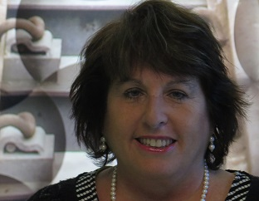

Judy Shanley, Ph.D.
jshanley@easterseals.com
312-551-7227

