Slide 1
National Transit Database
NTD Reporting for State DOTs
Report Year 2018

Slide 2
Contact Information
National Transit Database
943 Glenwood Station Lane, Suite 102
Charlottesville, VA 22901
Help Desk
(888) 252-0936
NTDHelp@dot.gov
Monday- Friday
8:00am-7:00pm Eastern

Slide 3
Presenters
Bailey Krouse
bailey.krouse.ctr@dot.gov
434-218-3275
Erik Chadwell
erik.chadwell.ctr@dot.gov
434-218-0723

Slide 4
Agenda
NTD Overview
2018 Changes and Clarifications
Interface Review and Account Management
Report Year Kickoff
Completing the 2018 Annual Report
Reporting Issues
Report Submission
Closeout Process

Slide 5
NTD Overview

Slide 6
What is the National Transit Database?
The NTD was established by Congress to be the Nation’s primary source for information and statistics on all public transportation modes of the United States.
Conditions and Performance Report
  FTA’s biennial report on the nationwide capital investment needs for public transportation
Source of data for performance measurement benchmarking
Research

Slide 7
Who Reports?
All States, Tribes, and Territories benefiting from the FTA Chapter 53 funding
  States report on behalf of current subrecipients (sub-grantees) that operate public transportation
Previous subrecipients of 5311 funds that have continuing grant requirements
Future subrecipients of 5311 funding (voluntary reporters)

Slide 8
Why Do I Report?
The Secretary shall:
“award a grant under section…5311 only if the applicant, and any person that will receive benefits directly from the grant, are subject to the reporting and uniform systems.”
(Chapter 53 of title 49, §5335(b), as amended by MAP-21)

Slide 9
Uses of NTD Data
Formula Apportionments
  Urbanized Area Formula – $5.4 billion –
  Rural Formula – $659 million –
  Tribal Formula - $30 million –
  State of Good Repair Formula – $2.6 billion –
Performance Benchmarking
Academic Research
Conditions and Performance Report
Government Performance Results Act (GPRA)

Slide 10
RY 2018 Reporting Deadlines
Fiscal Year End | Annual Report Due Date
June 30 | October 31*
September 30 | January 31
December 31 | April 30
*Update for RY 2018
All reporters with the fiscal year end date of June 30th will be due October 31st

Slide 11
2018 Changes and clarifications

Slide 12
USOA Updates
The NTD uses uniform categories to collect public transportation financial and operating information and defines these in the Uniform System of Accounts (USOA).
  Updates to the USOA and the NTD reporting requirements are intended to clarify reporting concepts to the reporters and increase the quality of the data that is collected by the NTD.

Slide 13
Changes to Rural General Public RR-20
The changes to the RR-20 form are as follows:
  Reporting of fare revenues by revenue type
    Passenger-Paid Fares
    Organization-Paid Fares
  Removal of Donations
  Removal of Contract Revenues

Slide 14
RR-20 Rural Reporter
Change: Passenger Fares has split into New Object Classes:
Passenger-Paid Fares
Passenger-Paid Fares will now capture the more direct type fares that are traditionally considered as passenger fares
  Examples: Full Adult Fares, Senior Citizen Fares, Student Fares, Child Fares, Fares for Individuals with Disabilities, No-show Fines
Organization-Paid Fares
Organization-Paid Fares will now capture fares earned from organizations for providing transit service
  Examples: Universities, State and Local Government, Reduced Fare Reimbursements, Special Route Guarantees, Other Special Contract Transit Fares

Slide 15
Donations and Total Recoveries
Donations will now be reported to the Other Directly Generated Funding line.
All insurance recoveries are to be reported as a new revenue class called "total recoveries“.
  Instead of being netted out, “total recoveries” will be reported as Other Directly Generated Funds on the RR-20.
  These revenues include insurance pay outs, dividends/rebates, and funds that may be netted out towards future bills.

Slide 16
Contract Revenues
Funding previously reported to Contract Revenues will now be reported to either:
  Revenues Accrued through a Purchased Transportation (PT) Agreement
    NTD Reporter or Non-NTD Provider
    Full Cost Contracts
  Other Directly Generated Funds
    Partial Cost Contracts where the agency is unable to report the original source of funds

Slide 17
Transit Asset Management (TAM)
The forms and fields included Expanded Asset Inventory Module Reporting will be required in RY2018
  State DOTs are required to offer to sponsor a group plan
  Your TAM asset inventory will be more inclusive than the asset data you already report to the NTD.
  New required forms: A-15, A-35, A-90

Slide 18
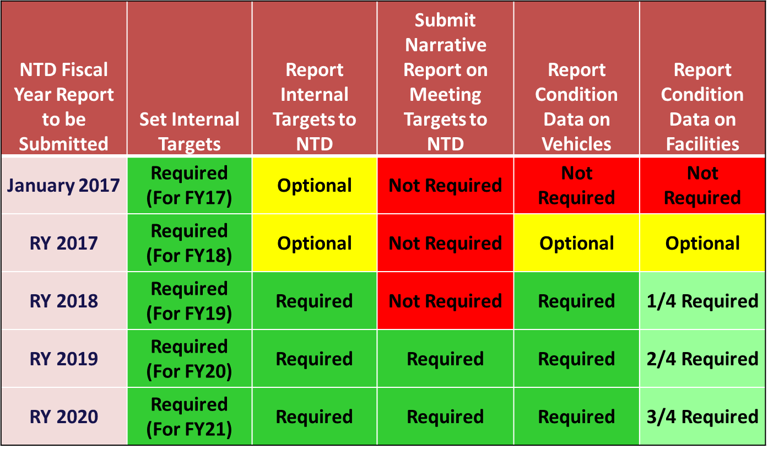
TAM Phase-In Schedule

Slide 19
Review: Modal Definitions
Motor Bus (MB)
Demand Response (DR)
Motor Bus service is powered by a motor and fuel contained within a vehicle. Transit agencies must report any route deviation, point deviation, or deviated fixed route as MB service.
Shared-ride demand response service is scheduled in response to calls from passengers. A transit agency employee operates demand response (DR) vehicles. Many transit systems operate DR service to meet the requirements of the ADA.
To make modal changes or updates, go to the subrecipient’s P-20 form found in their profile.

Slide 20
Review: Accounting Requirements
Accrual accounting
  Revenue recorded when earned, regardless of when payment is received
    A passenger purchases $10 worth of fare, but only uses $5, you would report the fare as revenue when the customer redeems the ride, not when medium is sold.
  Expenses recorded when liability occurs, regardless of when payment is made
    An employee receives a paycheck 10 days after it was issued. The receipt date is in a new fiscal year.

Slide 21
Review: Operating Expenses
Day-to-day expenses that a transit agency incurs.
  Operating and maintaining vehicles;
  Maintaining other equipment, buildings, and grounds.
  General Admin
    Marketing & Customer support
    Finance and procurement
    Planning and service development
Examples:
  Fuel
  Salaries, Wages, Benefits
  Materials and Supplies
  Equipment lease and rental
  Insurance

Slide 22
Review: Direct vs. Shared Expenses
To report the total costs of delivering each mode of transportation, agencies with two or more modes must calculate both direct and shared costs of providing service.
  Determine which expenses are direct expenses traced to a particular mode
  Determine which expenses are shared expenses
Once the shared expenses have been identified and separated from direct expenses, you may allocate the shared expenses based on an approved cost allocation method.

Slide 23
Review: Capital Expenses
Expenses related to the purchase of equipment. Equipment means an article of non-expendable personal property having a useful life of more than one year
An acquisition cost which equals the lesser of
  The capitalization level established by the government unit for financial statement purposes
  $5,000 (Office of Management and Budget)
Examples: Vehicles, Maintenance Facilities, Equipment
  When reporting new vehicle related capital expenses, please enter the expenses under the mode that the vehicle supports the majority of the time.

Slide 24
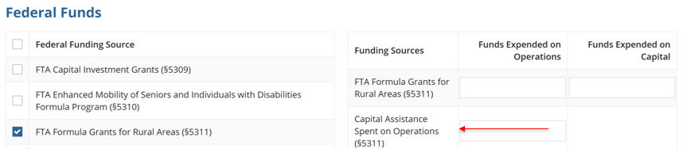
Review: Capital Assistance Spent on Operations
Capital Assistance Spent on Operations is reported when capital funding is spent on activities that are normally considered operating, such as preventive maintenance and the purchase of tires.
Please make sure to report this separately from your 5311 Operating funding (matched at 50/50)

Slide 25
NTD Key Reference Documents
NTD Glossary and NTD Annual Reporting User Guide
  NTD Glossary: Glossary of NTD Terminology
  NTD Annual Reporting User Guide: Step-by-step user guide for navigation and data entry within NTD.
    https://www.transit.dot.gov/ntd/manuals
Uniform System of Accounts (USOA)
  Outlines the basic accounting structure all NTD reporters must follow
    https://www.transit.dot.gov/ntd/ntd-uniform-system-accounts

Slide 26
**NEW Reference Documents**
Policy Manual and NTD Asset Inventory Module Reporting Guide
  Reduced Reporting Policy Manual: Issued annually to provide detailed guidance on what data to report to NTD
  NTD Asset Inventory Module Reporting Guide: Defines expanded asset inventory data elements
    https://www.transit.dot.gov/ntd/manuals
TAM Facility Performance Measure Reporting Guidebook
  Transit Asset Management Guidebook: Details the methods for transit agencies regarding measuring and reporting TAM facility condition assessments to NTD.
    https://www.transit.dot.gov/regulations-and-guidance/asset-management/tam-facility-performance-measure-reporting-guidebook

Slide 27
NTD Asset Inventory Reporting

Slide 28
Who does this apply to?
TAM Rule applies to all recipients of Chapter 53 funds that either own, operate or manage capital assets used in providing public transportation services.
This means:
  All agencies that receive 5307 and 5311 funds (existing reporters) must comply.
  Agencies that may only receive 5310, 5339, etc. may begin reporting
    They must operate public transit
    Recipients of 5310(b)(1)(D) funds for alternatives to public transportation that assist seniors and persons with disabilities with transportation are exempt from the requirements of the TAM rule because assets funded under the program are not used to provide “public transportation.”

Slide 29
States and TAM Plans
Any direct recipient of Chapter 53 funds which passes along some or all of those funds to subrecipients that own or operate capital assets used in providing public transportation must sponsor a group TAM plan on behalf of any of its subrecipients that are not 5307 direct recipients themselves.
  This rule applies to most State DOTs

Slide 30
Review: Tier Thresholds
Tier I
Tier II
Operates Rail
Own, operate, or manage 101 or more VOMS across all fixed route mode of transportation
Own, operate, or manage 101 or more VOMS in one non-fixed route mode of transportation
Own, operate, or manage 100 or less VOMS across all non-rail fixed route modes
Own, operate, or manage 100 or less VOMS in any one non-fixed route mode
Are a subrecipient under the 5311 Rural Area Formula Program
Are an American Indian tribe

Slide 31
Participants in a State TAM Plan
Agencies must be Tier II in order to participate
May already report to NTD
  Urban agencies – Will be become independent participants
  Rural agencies – Will report as normal, state will complete the asset forms on their behalf (in most cases)
May be new to NTD
  Managed participants
  In most cases, the plan sponsor will report on their behalf
State DOT managed participant reports will be submitted along with your annual report package

Slide 32
interface review and user management

Slide 33
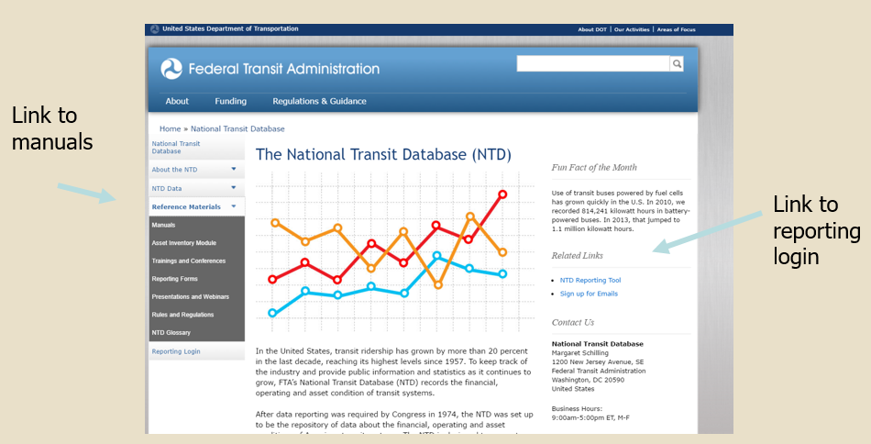
NTD Home Page: www.transit.dot.gov/ntd

Slide 34
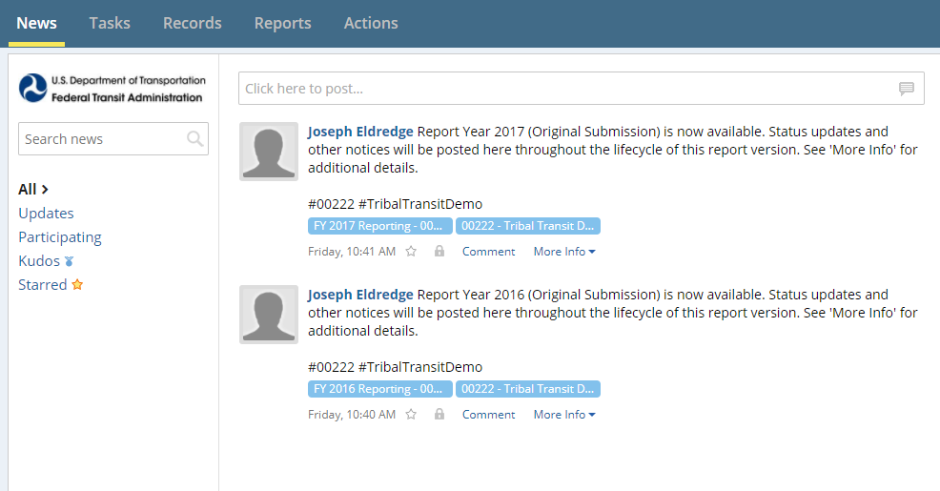
Interface Review - News
All users land on the News feed
Updates from NTD staff will display here

Slide 35
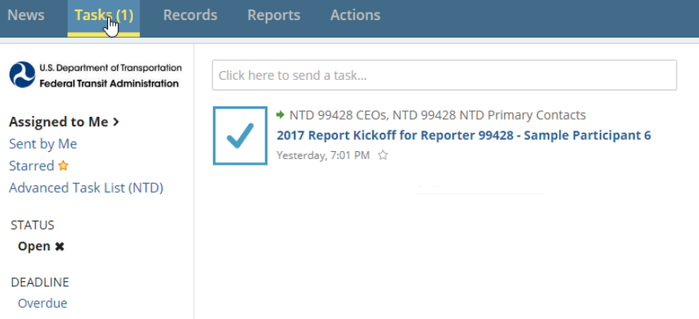
Tasks
Tasks are assigned to CEOs, CEO delegates, and NTD Contacts
Typically prompted by incomplete/unsaved forms

Slide 36
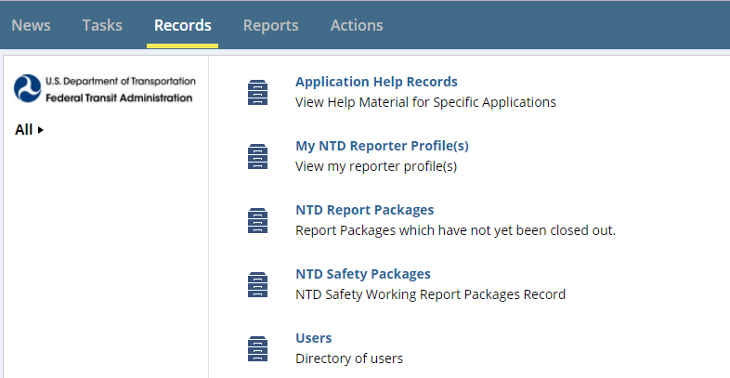
Records
Agency reporting forms and profile information are accessed through “Records”

Slide 37
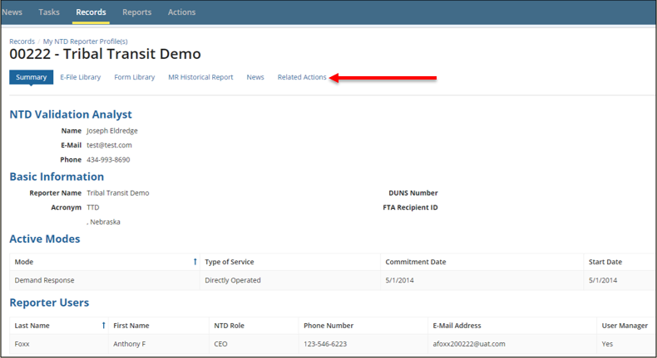
Reporter Profiles
These forms contain data that normally doesn’t change from year to year:
  Basic Information (P-10)
  Reporter Modes (P-20)
  Report Users (P-30)

Slide 38
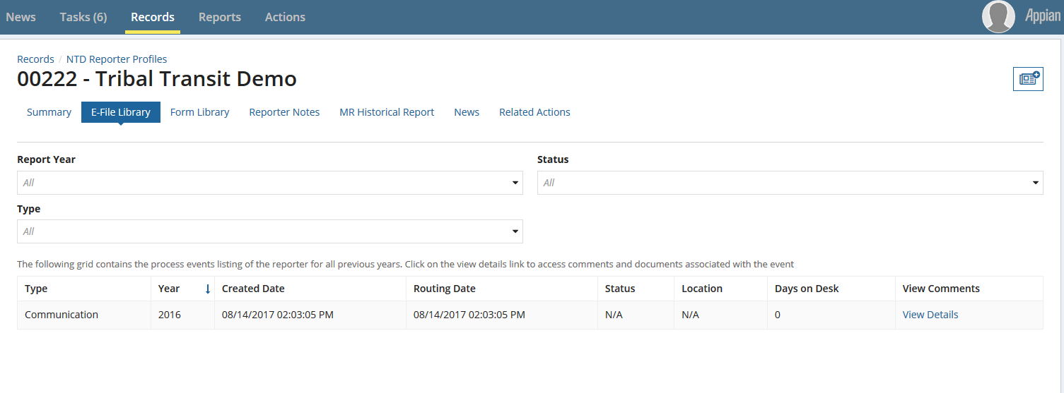
Reporter Profile – E-File and Form Library
E-File Library - Filter through communications
Form Library - Search for data from previous years or revisions

Slide 39
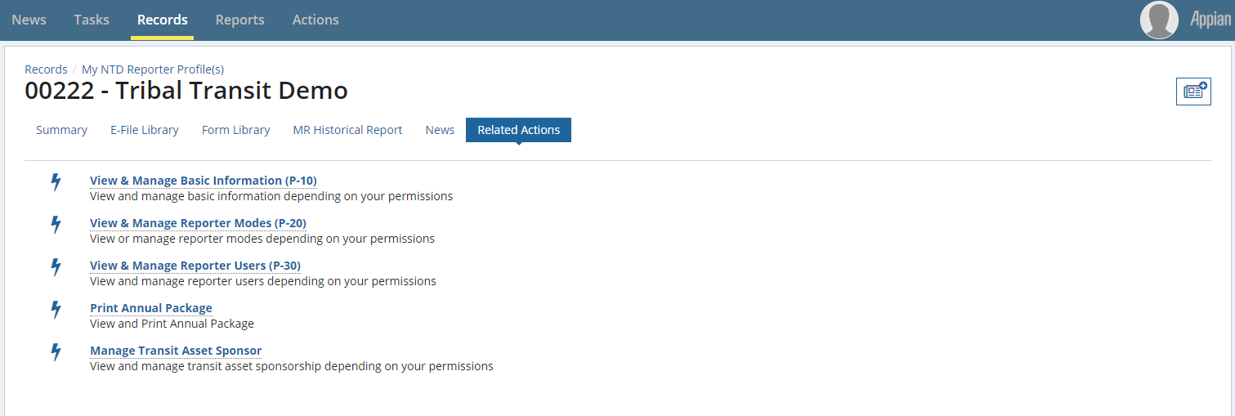
Reporter Profiles
Related Actions
  View and Manage Profile Forms
  Print Annual Package
  Manage Transit Asset Sponsor

Slide 40
User Manager
Each agency must submit an official letter designating an employee as the User Manager (UM).
  User Managers create accounts for the CEO and NTD Contact as well as accounts for editors and viewers.
The UM can also fill a NTD Role - for example, the CEO can also be the agency’s UM.
FTA FACES User Guide (User Management) found in the following link under System Reporting Guides: https://www.transit.dot.gov/ntd/manuals

Slide 41
Permissions by Role
CEO & CEO Delegate:
Create reporter requests (waivers, extension requests, etc.)
Submit annual report package
View and edit forms and issues
NTD Contact:
Submit all annual report after the original submission by the CEO
View and edit forms and issues
Editor:
View and edit forms and issues
Viewer:
View forms and issues

Slide 42
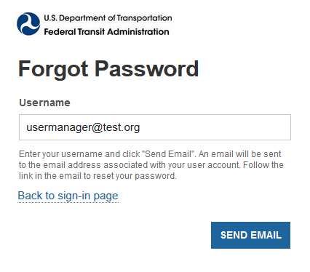
Resetting Passwords
Click “Forgot Password” from main login screen
Enter the email address used for your user name (all lower case) and click
“Request Password Reset”
A link will be sent to your email
and will expire in 15 minutes.
Follow the procedure again if the
15 minutes has passed.

Slide 43
Unlocking User Account
There are two methods to unlock an account
  1. The user can unlock their own account using security questions.
    Go to Actions > Answer Security Questions
    You will have three attempts to correctly answer
  2. The user can submit an unlock request; it will go to their User Manager for further action.
    Go to Actions > Request to Unlock Account
    UM will get new Task to unlock the user account once logged into the system.
    Must use this option if questions haven’t been created

Slide 44
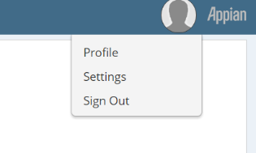
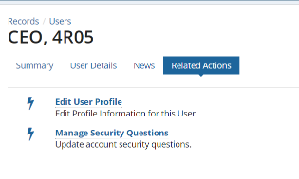
Creating Security Questions
Under your Profile name select “Profile” from the dropdown menu
Select Related Actions from the top list
Select Manage Security Questions
The Manage Security Questions Screen will populate to complete three questions.

Slide 45
Self-Reporting Subrecipients
Subrecipients have the ability to enter and edit their own data within the National Transit Database (NTD) online reporting system.
  Completely optional
  State DOT CEO/NTD Contact can grant self-reporting privileges to some, none, or all at their discretion
  Grants subrecipients ability to save forms, not submit
  Subrecipients should contact the state for technical assistance with the reporting system
  All correspondence with the NTD analyst, via email or phone, should go through the State Contact or include the State Contact

Slide 46
Standard Procedures: Self-Reporting
Subrecipients taking part in self-reporting will be required to submit a User Manager letter for accounts in the NTD Reporting System
  Self-reporting subrecipient users are subject to User Management requirements
  DOTs should send User Manager letters to their assigned analyst
  NTD will not be able to process or accept User Manager letters sent directly from subrecipients

Slide 47
Report Year kickoff

Slide 48
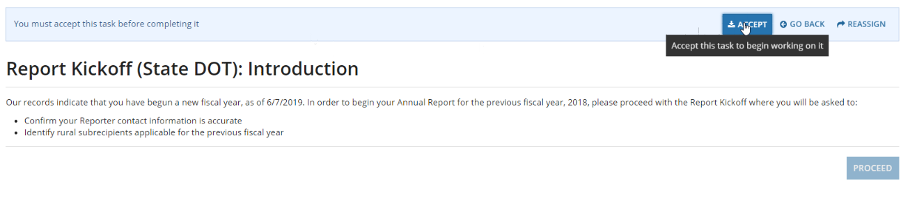
Report Year Kickoff – State DOTs
  From the Task tab, click on the Report Year Kickoff
  “Accept” the task and then select “Proceed”
  Note: the kickoff task is only available to the CEO, CEO Delegate, and NTD Contact

Slide 49
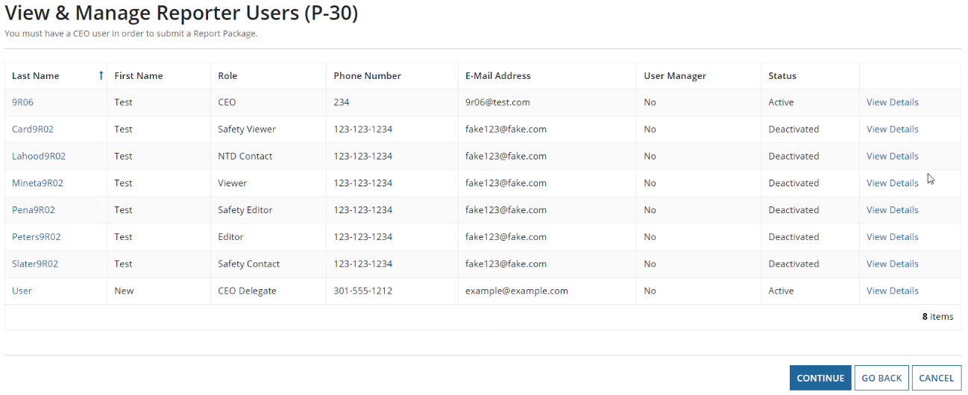
Verify DOT Information
Update Users
  The CEO, NTD Contact, and User Manager (UM) can edit user roles
  Only the UM can add new users
  Individual users can edit their own profile

Slide 50
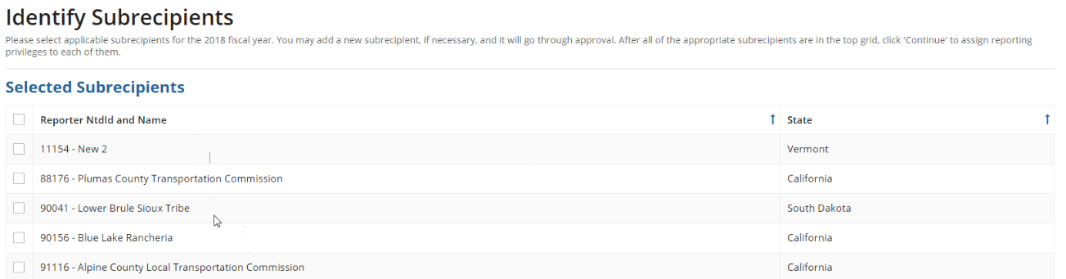
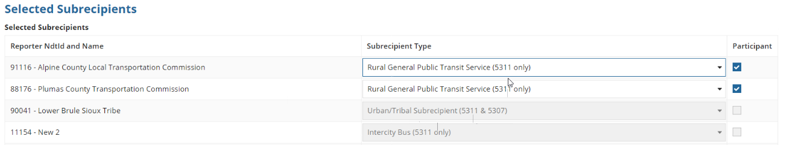
Identifying Subrecipients
Identify Subrecipients
  Subrecipients from RY2017 are pre-loaded. Please verify this list.
  New subrecipients can be added from a list of existing agencies or created during kickoff.

Slide 51
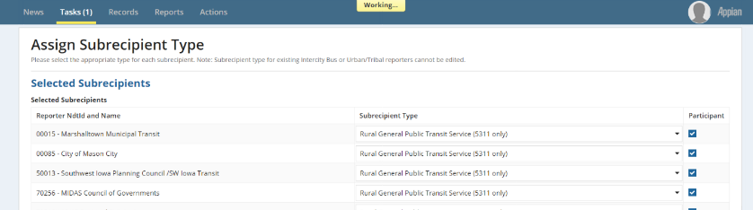
Assign Subrecipient Type
Assign Subrecipient Type
  The type is pre-loaded from RY2017 Closed Report.
  To change, select an option from the dropdown menu under “Subrecipient Type”
  Before changing subrecipient type from Rural General Public Transit service to another type, please consult your analyst.

Slide 52
Assign Participation
Assign Participation in State TAM Plan
  States will be required to identify asset participants during this step
    Your Rural General Public subrecipients participant boxes will be automatically checked off
    Any Reduced Asset Reporters either new or previously existing, will also have the box checked. In this case the box cannot be unchecked.

Slide 53
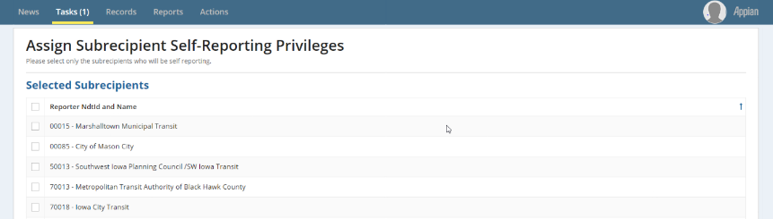
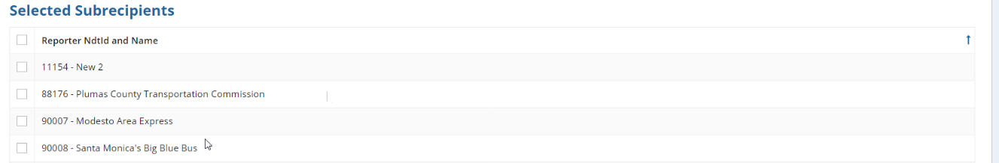
Assign Self-Reporting Privileges
Assign Self-Reporting Privileges
  To select the subrecipient, check the box to its left.
  Once all are selected, finish the kickoff

Slide 54
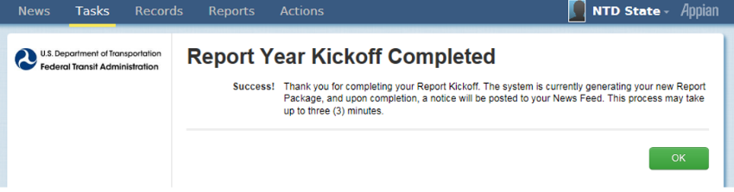
Complete Report Year Kickoff
Form Generation
  Profiles and Report Packages (Annual Forms) take at least three minutes to generate
    Note: Newly created subrecipients and reduced asset participants will require NTD approval before generating
  Click “OK” to end the task
  The process is not complete until you see this message.

Slide 55
Completing the 2018 Annual Report

Slide 56
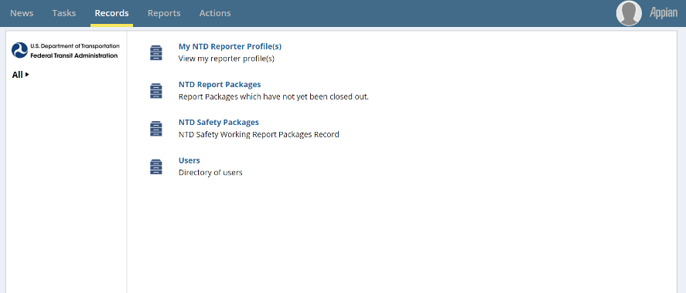
Updating Report Packages
Step 1: Click on Records
Step 2: Click on NTD Report Packages
  These packages will contain the annual forms for all of your subrecipients

Slide 57
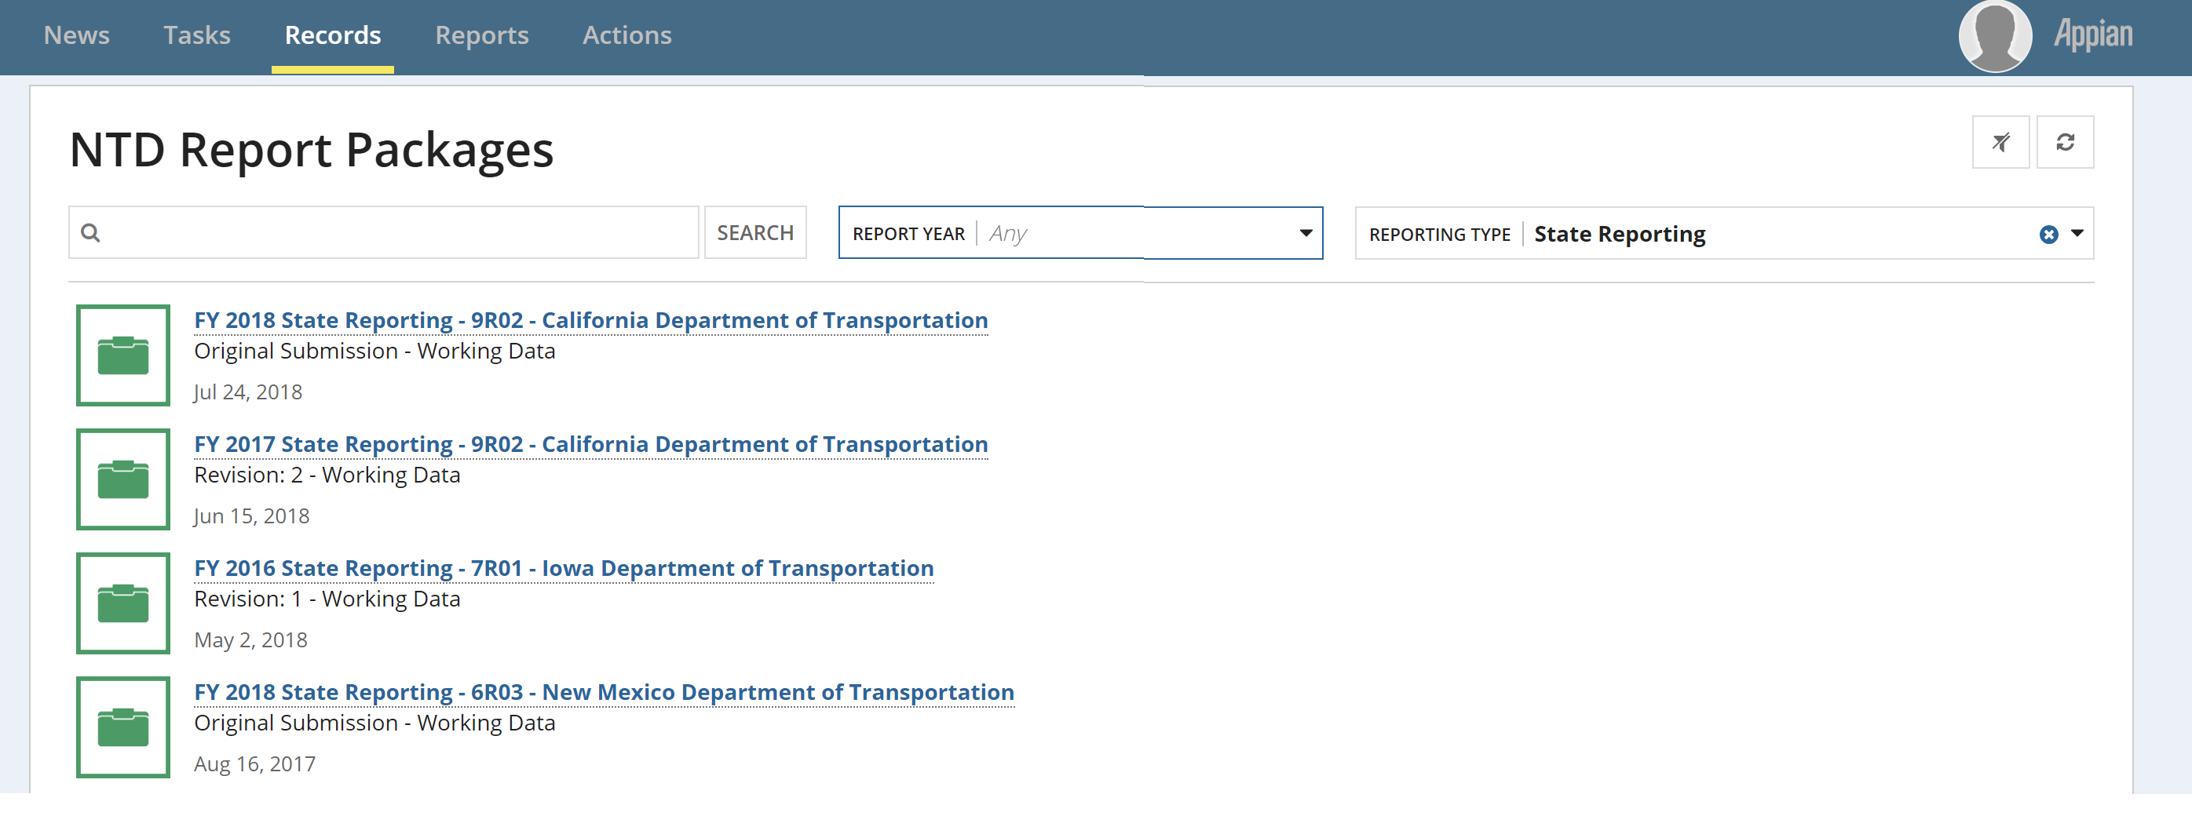
Package Selection
Step 3: Select the State Package to review all subrecipient package or the individual package you want to edit

Slide 58
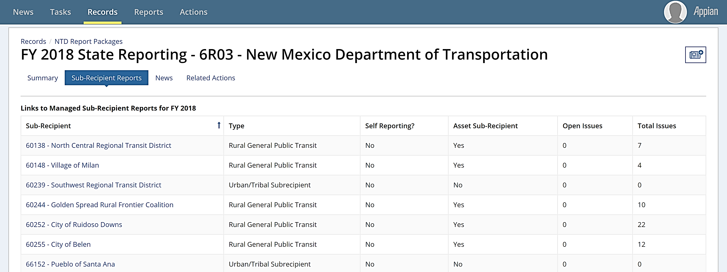
Report Year Kickoff Steps
Step 4: Select “Sub-Recipient Reports” then select the package you want to work on
  Helpful Hint: You sort the table by clicking on the headings
    Application: Sorting on Open Issues to review which subrecipients have remaining issues to resolve

Slide 59
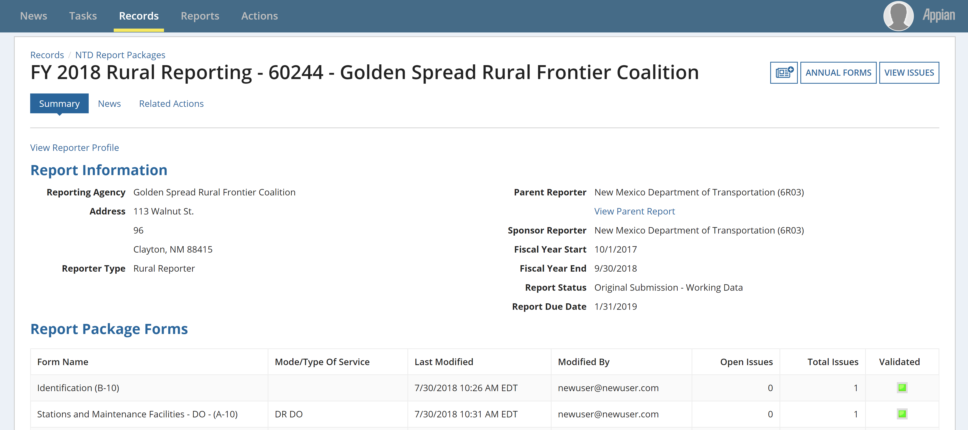
Select Annual Forms
Step 5: Select “Annual Forms” to be brought to the editable list of forms

Slide 60
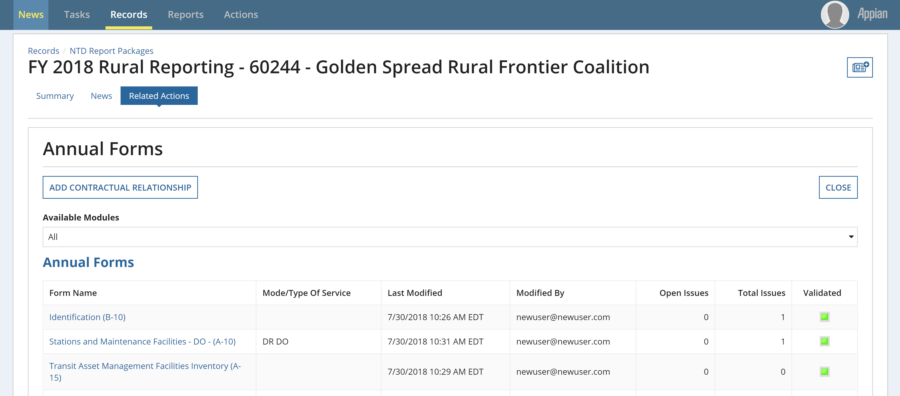
View Form
Step 6: Click the hyperlinked form name

Slide 61
Subrecipient types and forms
Annual Forms

Slide 62
Rural General Public Transit (RGPT)
Definition: Agencies that provide rural service and receive or benefit from 5311 funding. (Does not include those receiving §5307 funding or Tribes)
Required Forms:
B-10: Organization Type and Fiscal Year End Date
A-10: Maintenance Facilities (one per mode)
A-15: Transit Asset Management Facilities Inventory
A-30: Revenue Vehicle Inventory (one per mode)
A-35: Service Vehicle Inventory
RR-20: Reduced Reporting
  Financial Data
  Service Data
  Safety Data
  Volunteer Data

Slide 63
Reduced Asset Subrecipient
Definition: Agencies that receive or benefit from FTA funding (Chapter 53) other than§5307 or§5311 funding (e.g., §5310), and owns, manages, or operates an FTA-funded capital asset used in providing public transportation services.
Required Forms:
B-10: Organization Type and Fiscal Year End Date
A-15: Transit Asset Management Facilities Inventory
A-30: Revenue Vehicle Inventory (one per mode)
A-35: Service Vehicle Inventory

Slide 64
Urban/Tribal Subrecipients
Definition: Transit agencies that commonly provide service to both Urban and Rural areas, may receive or benefit from §5307 funding.
Required Forms:
B-10: Organization Type and Fiscal Year End Date
RR-20 Urban/Tribal Subrecipient
Section 5311 Funds

Slide 65
Intercity Bus Subrecipients
Definition: Regularly scheduled bus service for the general public that:
  Operates with limited stops between two urbanized areas;
  Connects rural areas to an urbanized area; or
  Has the capacity for transporting luggage.
Required Information:
B-10 - Organization Type and Fiscal Year End Date
RR-20 Intercity Bus Subrecipient
Section 5311 Funds
Vehicle Revenue Miles travelled during §5311 revenue service.
Unlinked Passenger Trips during §5311 revenue service.

Slide 66
B-10
Basic Information

Slide 67
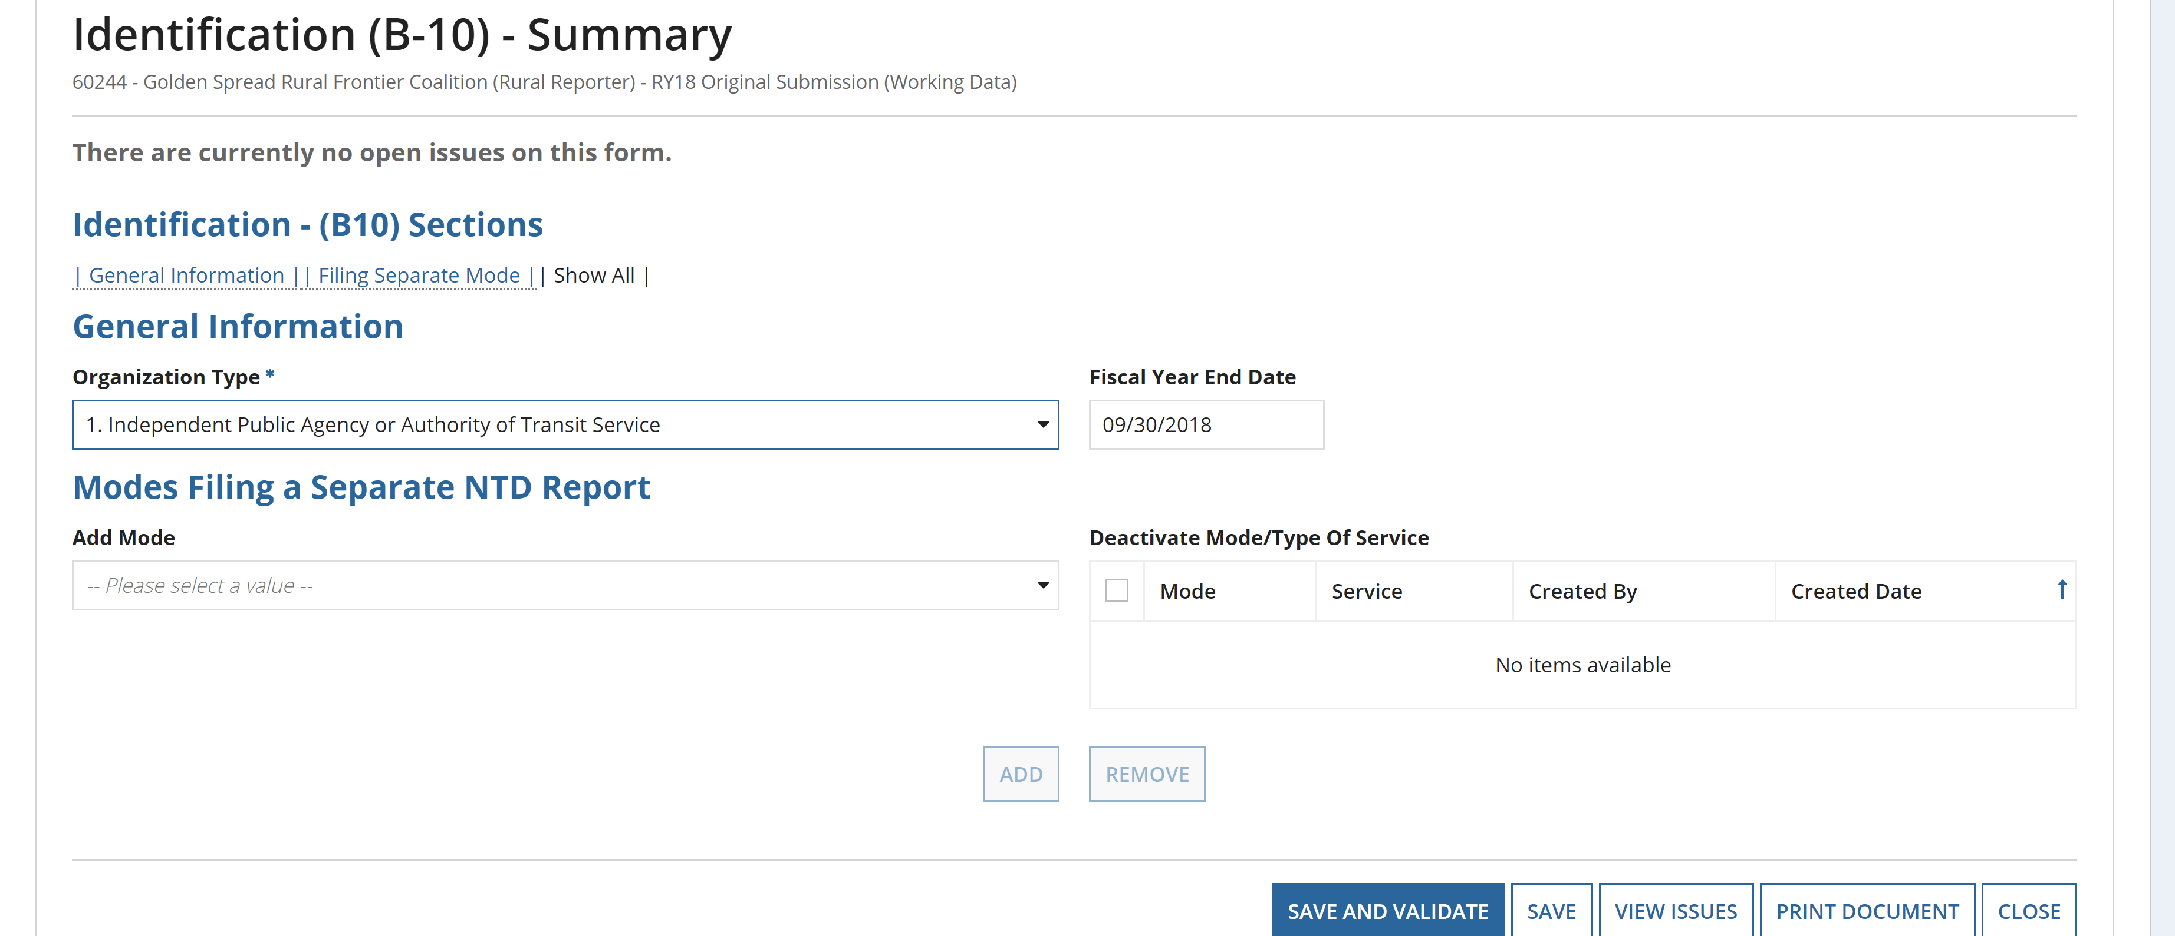
General Information
Once the B-10 form is open:
  Select an Organization Type from the drop down menu.
  Update the Fiscal Year End Date.
    Dependent on what dates the data are from – may be different from the State’s FY.
  “Save and Validate” and “Close” when finished.

Slide 68
A-10
Stations & Maintenance Facilities

Slide 69
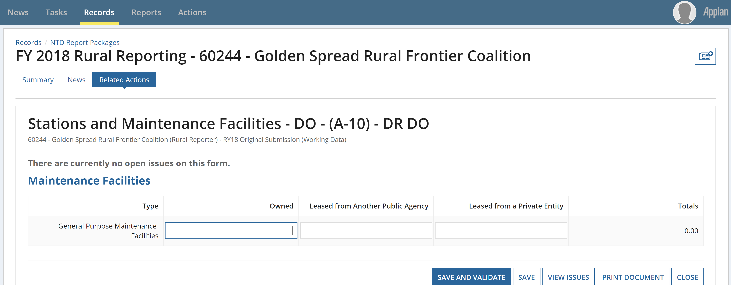
Enter Data and Click Save
  Once the A-10 form is open:
  Enter Data and Click “Save and Validate”
  If facility is used by more than one mode, report a pro-rated share based on the amount of vehicles it services

Slide 70
Example: Allocation of Assets
A subrecipient operates a Demand Response (DR) service and a fixed-route bus (MB) service
  Subrecipient owns 1 maintenance facility
  Subrecipient owns 20 vehicles total – 15 used for DR and 5 used for MB
    DR A-10 Form shows .75 for Owned Facility
      (15 DR Vehicles/20 Total Vehicles) = 0.75 owned
    MB A-10 Form shows .25 for Owned Facility
      (5 MB Vehicles/20 Total Vehicles) = 0.25 owned

Slide 71
A-15
Asset Inventory Management - Facilities Inventory

Slide 72
Facilities Inventory - What to Report
Administrative and Maintenance Facilities for which the agency has Capital Responsibility.
Passenger/Parking Facilities that are used in revenue service – Regardless of Capital Responsibility
Capital Responsibility
  An agency has direct capital responsibility for an asset if any of the following are true:
    The agency owns the asset,
    The agency jointly owns the asset with another entity, or
    The agency is responsible for replacing, overhauling, refurbishing, or conducting major repairs on an asset, or the cost of those activities is itemized as a capital line item in the agency’s budget.

Slide 73
Asset Management Facilities Inventory
Examples of Facility Types (more found in Policy Manual page 82)
Administrative buildings
  Facilities and offices which house the executive management and supporting activities for transit operations, with the exception of vehicle maintenance
Combined Administrative and Maintenance Facility
  Any facility with combined functions of at least one of the administrative facilities listed above and one of the maintenance facilities listed above.
    If selected, describe specific facility in “Notes” field in form.
Maintenance facilities
  Facilities were routine maintenance and repairs or heavy maintenance or unit rebuilds are conducted. Agencies must not report maintenance facilities where third-party vendors perform services, such as a local gasoline service or body shop.

Slide 74
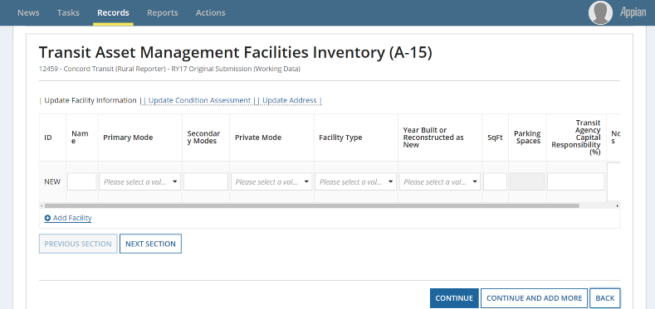
A:15 – Add a New Facility
To add a new facility, click “Add Facility”
May add multiple facilities at once if you choose to
There are three sections to this form:
Update Facility Information, Update Condition Assessment, and Update Address

Slide 75
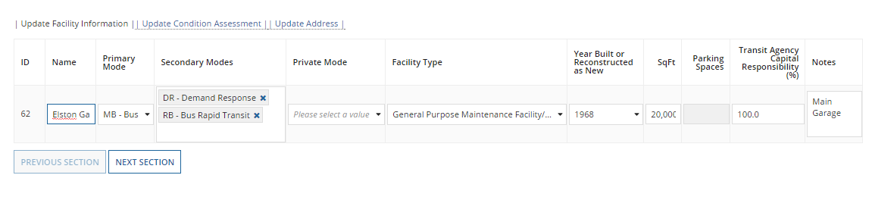
A-15 – Update Facility Information
Name
Primary Mode ― Pull-down Menu
Secondary Modes ― Type two-letter code
Private Mode ― Pull-down Menu
Facility Type ― Pull-down Menu
Year Build or Reconstructed as New
Square Feet/Parking Spaces ― Choice based on facility type
Capital Responsibility – Entered as a percentage

Slide 76
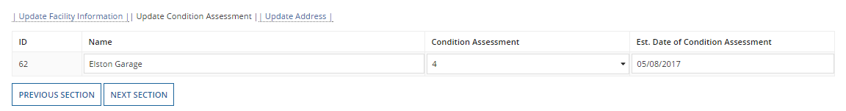
A-15 - Update Condition Assessment
Agencies must report a condition assessment for having capital replacement responsibility, but not if they are under construction.
  Pull-down of integer values 1-5
  Methodology (NTD web site)
    TAM Facility Performance Measure Reporting Guidebook: Condition Assessment Calculation (April 2017)
Date of Assessment

Slide 77
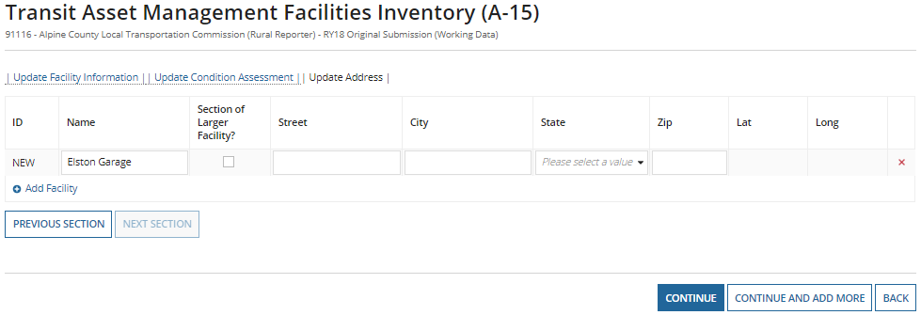
A-15 – Update Address
Name will populate from previous sections
Add the address of the facility
When complete, click “Continue”

Slide 78
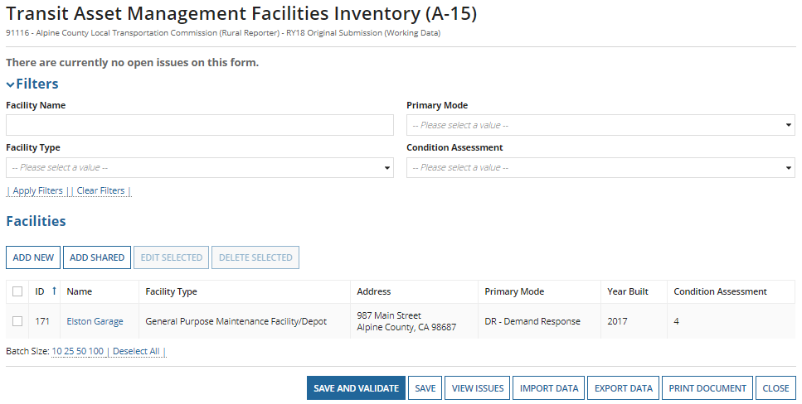
A-15 Summary and Saving
Once all information is entered, you can edit, delete, or “Save and Validate” the data entered.
  Edit by clicking the radio button then “Edit Selected” or by clicking on the name of the facility.

Slide 79
A-30
Revenue Vehicle Inventory

Slide 80
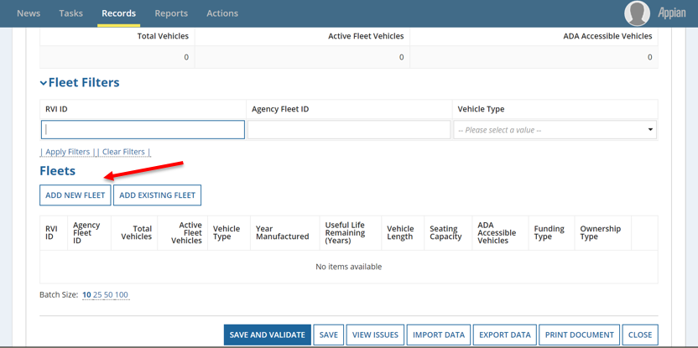
A-30: Revenue Vehicle Inventory
Fleet information is pre-populated from the 2017 Report Year.
Add new fleets or edit existing fleets

Slide 81
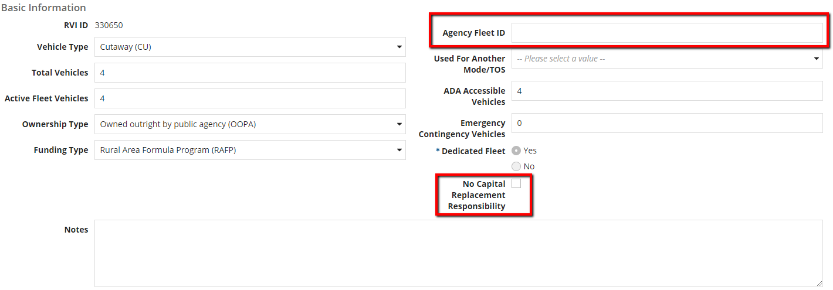
A-30 Fields Introduced in RY2017
Agency Fleet ID – If an agency uses an internal tracking number for their fleet
No Capital Replacement Responsibility – If the agency or sponsor has no capital replacement responsibility towards the fleet, they will check the box. This will remove the requirement for reporting a useful life benchmark.

Slide 82
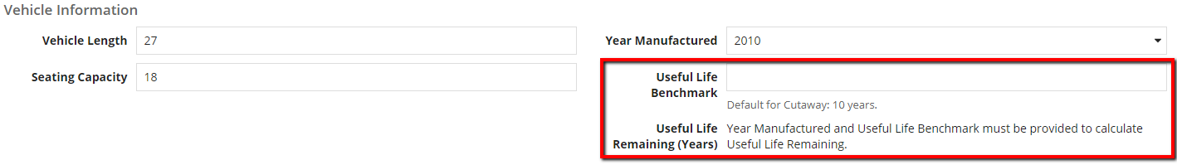
A-30 Fields Introduced in RY2017
Agencies are required to report a useful life benchmark for all fleets for which they have capital replacement responsibility for.
FTA has outlined default useful life benchmarks for each vehicle type, but transit agencies may adjust the ULB as applicable.

Slide 83
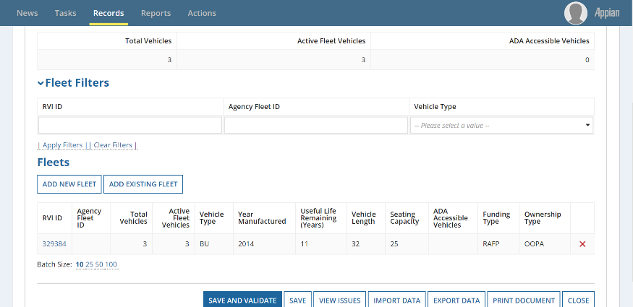
New RVI
Once finished, Click “Save and Validate”
  Saving assigns the RVI ID
  Click “Add Fleet” to add another or “Close” to go back to the list of annual forms.

Slide 84
Review: Manufacture Year
Transit agencies are required to report the year the vehicle was manufactured and built, not the vehicle model year.
  The manufacture year will typically be different than the model year for the vehicle(s).
  Correctly labeling this will help further determine the useful life benchmark of the vehicle and fleet.

Slide 85
Review: Active vs Inactive Vehicles
Transit agencies must report the number of active vehicles in fleet at fiscal year end
Active Vehicles
  Regularly provide revenue service
    Includes spares/backups and vehicles temporarily out of service for routine maintenance
Inactive Vehicles
  Vehicles that have been sold or awaiting sale
  Vehicles in storage and FTA emergency contingency plan
  Vehicles out for long-term, major repairs

Slide 86
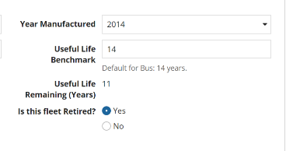
Review: Retire vs Deleting Fleet
Retire
  Retire a fleet when there are no more active vehicles.
  When a fleet is no longer in use, change Active Vehicles to 0, and the “Is This Fleet Retired?” notification will appear.
Delete
  Delete a fleet ONLY if it is mistakenly included in the A-30 form.

Slide 87
Common Validation Issues
Shared Fleets do not match across modes
  If a fleet is shared between modes, enter data on the first mode, then on the second mode’s A-30 form select “Add Existing Fleet” and select the applicable fleet and add.
New Vehicles, no Capital Funding Reported
  If you report new vehicles, you must also report the capital purchase on the RR-20
Missing Data
  All fleet data must be reported prior to submission

Slide 88
A-35
Asset Inventory Management - Service Vehicle Inventory

Slide 89
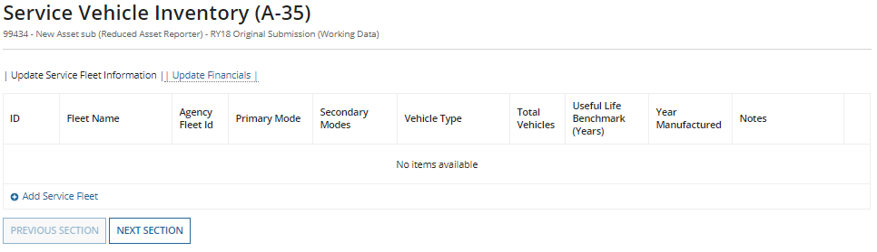
A-35 Service Vehicle Inventory
Agencies are required to report on service vehicle fleets for which they have capital responsibility.
Service Vehicles are defined as:
  Road worthy, self-propelled or major pieces of construction equipment that are used to support revenue operations, maintain revenue vehicles, or perform transit-oriented administrative activities
    Examples: Cars used for admin staff, transit police cars, tow trucks, service trucks, etc.
    Agencies should not report small fork lifts, golf carts, etc.

Slide 90
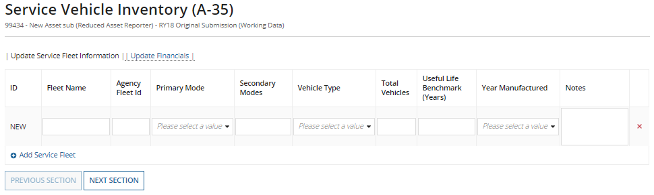
A-35 – Update Service Fleet Information
Service Vehicles are categorized into three types
  Automobiles
  Truck and other rubber tired vehicles
  Steel wheel vehicles

Slide 91
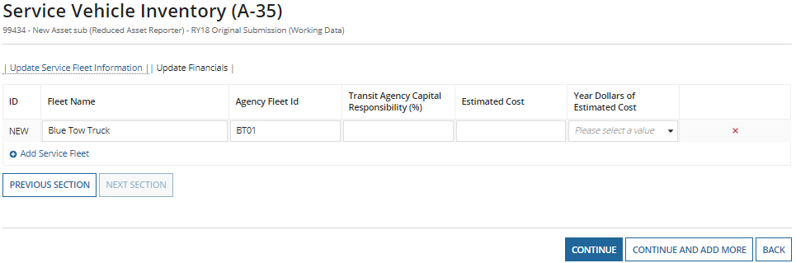
A-35 – Update Financials
Estimated Cost
  Full cost to replace the fleet
Year Dollars of Estimated Cost
  Corresponding year to the dollar value reported
Once complete click “Continue”

Slide 92
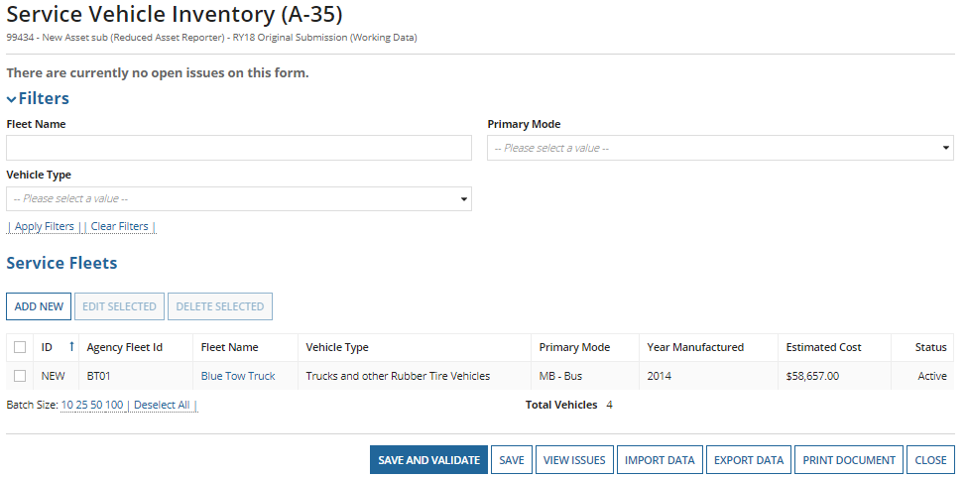
A-35 Summary and Saving
Once all information is entered, you can edit, delete, or “Save and Validate” the data entered. (same as A-15)
  Edit by clicking the radio button then “Edit Selected” or by clicking on the fleet name.

Slide 93
RR-20
Rural General Public Transit (RGPT)

Slide 94
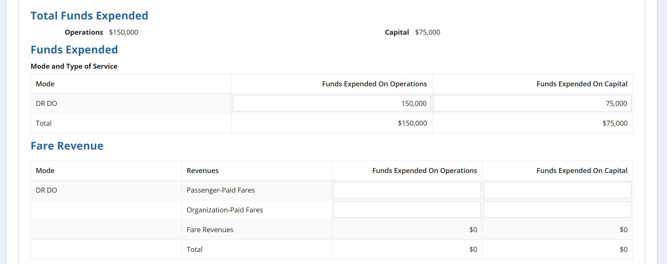
Total Funds Expended
Once the RR-20 form is opened, enter the following financial info:
  Annual expenses by mode
    (Total Funds Expended need to match show in red circles)
  Expended fare revenues by mode

Slide 95
Financial Information
Report revenues expended, NOT earned
  The grant award amount can be larger than the amount actually expended
Reporters must
  Report the original source of funds
  Report the total amount used for reimbursement NOT the total grant or award.
    Example: An agency receives a $750,000 grant and expends $300,000 during the fiscal year.
    Solution: The agency report would an expenditure of $300,000 to NTD

Slide 96
Fare Revenues
Fare revenues represent all income received and expended directly from passengers. This includes:
    Any donations received on board as payment for a ride, either suggested or unsolicited, should be recorded as fare revenues.
As mentioned previously, fare revenues were broken into Passenger-Paid Fares and Organization-Paid Fares starting RY2018.

Slide 97
Allocating Fare Revenues
Agencies with more than one mode are required to capture and report fares expended from each mode separately and not allocate based on a data point
Exceptions to this requirement happen when:
  There is a fixed fare for the initial segment of a multi-mode trip and the transfer charge is not equal to the fare charged for a single ride trip on the next mode;
  A large portion of passengers use prepaid fare media that is accepted on all modes.
If your agency is an exception to the rule, please make sure to explain your methodology during the validation process

Slide 98
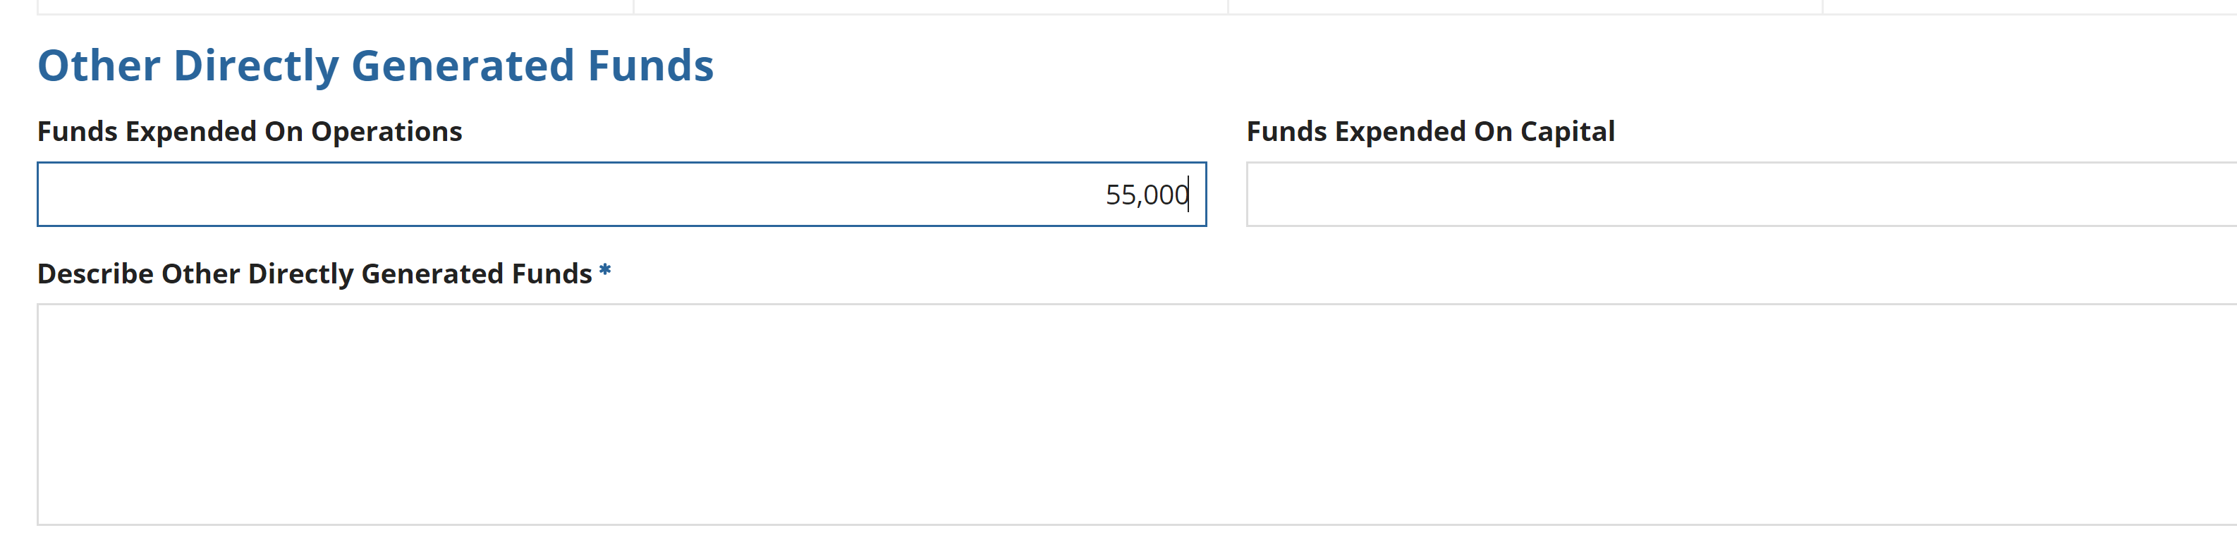
Other Directly Generated Funds
Other Directly Generated Fund examples:
  Advertising Revenues
  Concession Revenues
  Fundraisers
  Park and Ride Revenues
  Interest on Investments
  Non-full cost contracts
  Donations and Insurance Recoveries – New for RY18

Slide 99
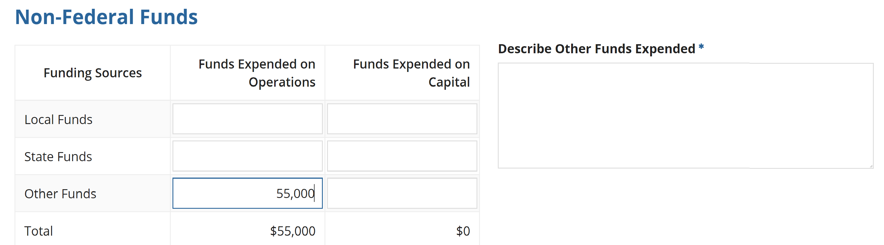
Non-Federal Funds
Required to describe Other Non Federal Funds.
  These include any Non-Federal grants that are not covered by the above funding types. These are typically not dedicated to transit or from the annual budget. (Sale of asset)

Slide 100
Local and State Funds
Local sources:
  Tax levies
  General Funds
  Specified contribution
  Finances from the local entities
State sources:
  State programs that support public transit
  Includes State portions of Medicaid Fund

Slide 101
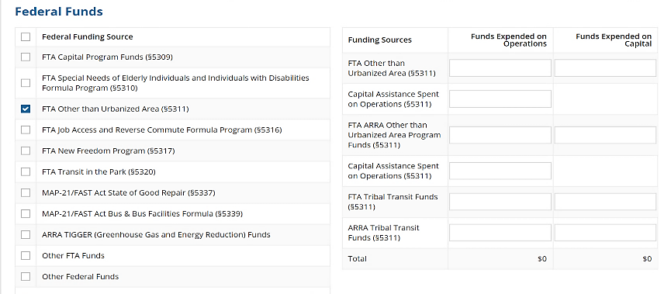
Federal Funds
Select your Federal Funding source
“Other Federal Funds” and “Other FTA Funds” require a description

Slide 102
Federal Funding Section - Other Funds
Other FTA Funds
  Funds from an FTA grant not listed
  FTA Clean Fuels Program (5308)
Other Federal Funds
  Funds from a Federal grant not listed
  Housing and Urban Development (HUD), Department of Health and Human Services (HHS), Federal Highway Administration (FHWA)
  Medicaid

Slide 103
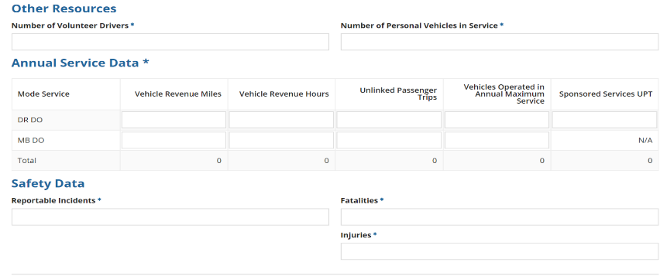
Resource, Service and Safety
Data is required in all fields
Volunteer Resources, enter zeroes
Reportable Incidents, enter zeroes

Slide 104
Revenue Service
A transit vehicle is in revenue service when it is providing public transportation and is available to carry passengers.
Service data should include:
  Miles and hours when vehicle is in revenue service
  Layover/Recovery Time
Service data should exclude:
  Deadhead
  Training
  School Bus or Charter Service
  Maintenance Testing
  Fueling
  Lunch Breaks

Slide 105
Deadhead
Agencies must exclude deadhead when reporting service data
  When transit vehicles are deadheading, they operate closed-door and do not carry passengers.
Deadhead includes:
  Leaving or returning to the garage or facility to or from the starting or ending point of revenue service
  Changing routes
  When the driver does not have the duty to carry passengers
Please see the NTD Policy Manual for further clarifications between Revenue Service and Deadhead for each Mode.

Slide 106
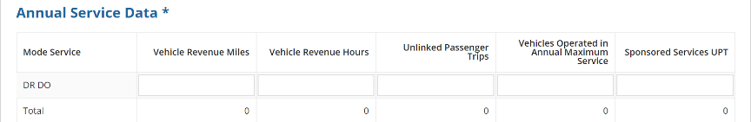
Unlinked Passenger Trips
Unlinked Passenger Trips are Total passenger trips (regular + sponsored trips)
  These are the number of passengers who board public transit vehicles.
  Passengers are counted each time they board the vehicle no matter how many vehicles they use from their origin to their destination

Slide 107
Sponsored Trips
Sponsored service is paid, in who or in part, directly to transit provider by a third party.
These services may be offered by transit providers as part of a Coordinated Human Services Transportation Plan.
Common sponsors include the Veterans Administration, Medicare, sheltered workshops, The Arc, Assisted Living Centers, and Head Start programs.
Sponsored Trips are a subset of total UPT.
  Total UPT = Non Sponsored UPT + Sponsored UPT

Slide 108
VOMS
Vehicles Operated in Annual Maximum Service (VOMS)
  The number of revenue vehicles an agency operates to meet the annual maximum service requirement
  Count VOMS based on the peak season of the year on the busiest day
  Excludes atypical days or one-time special events
  Do not report highest number of vehicles available for service; report vehicles actually operated

Slide 109
Revenue Service Example
Bob’s Dial-a-Ride cutaway departs from garage at 10:45, drives 3 miles to pick-up point
Arrives at 11:00, 5 passengers board vehicle at 11:02
Drops off passengers at destination 3 miles away at 11:15
Resulting Data
  3 vehicle revenue miles
  0.25 vehicle revenue hours
  5 unlinked passenger trips

Slide 110
Safety Data
Reportable Incidents include:
  Fatalities, injuries, or property damage >$25,000
  Collisions involving revenue vehicles that require towing away from the scene for either vehicle involved
  An evacuation for life safety reasons
Fatalities are reported when deaths occur within 30 days of the event
Injuries are reported when passengers are immediately transported away from the scene for medical attention
If no reportable incidents, enter “0” in all fields

Slide 111
Reporting issues

Slide 112
Common Clarifications
Reporting scheduled hours or driver’s availability instead of actual vehicle revenue hours
Calculating vehicle revenue miles based on routes or odometers
Including deadhead in revenue service.
Reporting only Federal Funds
  Agencies should report total operating expenses to show the true cost of transit service including matching sources

Slide 113
Common Clarifications
Funds Expended on Operations or Capital
Does not match Sources of Funds identified for Operations or Capital
VOMS reported is equal to or higher than Active Vehicles on the A-30 Form for corresponding mode
  VOMS are the amount of vehicles on the road at once during peak service times – not total available (VAMS)
Reporting more Sponsored Unlinked Passenger Trips than Total Unlinked Passenger Trips
  Total UPT includes the Sponsored UPT subset

Slide 114
Key Performance Ratios
Cost per Hour (CPH)
  The average cost to operate one vehicle for one hour of revenue service.
  Operating Expenses divided by modal VRH.
Trips per Mile – (TPM)
  How many passengers per revenue mile.
  Modal UPT divided by modal VRM.
These are commonly raised when there is a deviation of data compared to the prior year or if the data calculations are higher or lower compared to other Rural Transit systems

Slide 115
Intercity Bus
If the §5311(f) funds expended are for only planning activities or capital projects and are not expended for operations, do not complete the VRM and UPT data fields.
If a route is only partially subsidized by the §5311 funds, report all the VRM and UPT for that route—it is not necessary to track or allocate service for a partial subsidy of the route.

Slide 116
Urban/Tribal Subrecipient
5311 Funding not matching between the State’s RR-20 form and the directly reporting subrecipient’s form (RR-20/F-10).
  If the State and subrecipient operate on the same fiscal year, the amounts between the forms should match
  Report only the 5311 funding that the State grants the agency
Please note Tribes can receive State granted 5311 funding in addition to 5311 Tribal Transit Funds
  Tribes receive Tribal Transit Funds directly from FTA – do not include this funding type on the tribal subrecipient RR-20

Slide 117
RU-30
Statewide Characteristics

Slide 118
Statewide Characteristics
§5311 Expended on State Administration
  §5311 revenues expended on state admin cost as a result of administering the program.
Number of Counties with§5311 Service
  Total number of counties in the state that are currently served, in whole or in part, by§5311 funded operators. States are to include counties that are served by directly-reporting Indian tribes in this total.
    A county is served if the subrecipient picks up or drops off passengers.

Slide 119
A-90
Transit Asset Management Performance Measure Targets

Slide 120
What is the A-90?
Agencies report the portion of their assets that have met or exceeded the “Useful Life Benchmark”
Compares current year targets to actual data pulled from current year asset forms.
  Vehicles
    Useful Life Benchmark (A-30 & A-35)
  Facilities
    Condition Assessment (A-15)
Reporting on behalf of their managed and independent participants. This form represents the plan for whole group

Slide 121
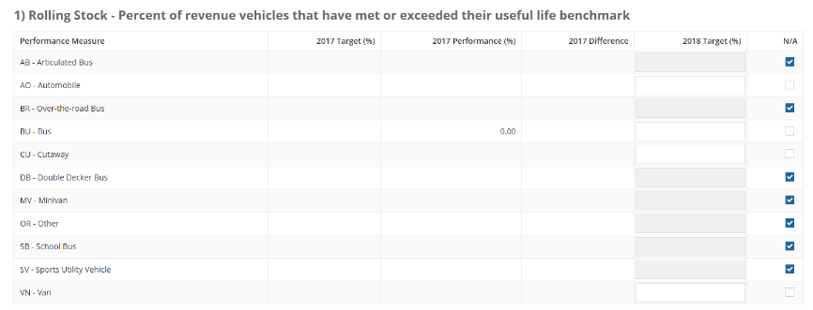
A-90 Sections: Rolling Stock
Refers to vehicles used in revenue service (A-30)
Vehicle types are populated from active modes. Select N/A for vehicle types your agency doesn’t operate.

Slide 122
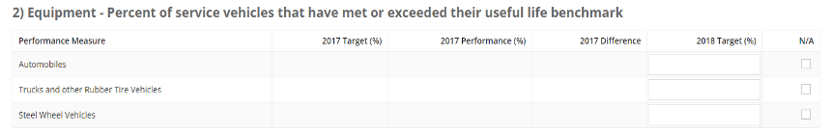
A-90 Sections: Equipment
Refers to service vehicles used to support revenue service (A-35)
  Automobiles
  Truck and other rubber tired vehicles
  Steel wheel vehicles

Slide 123
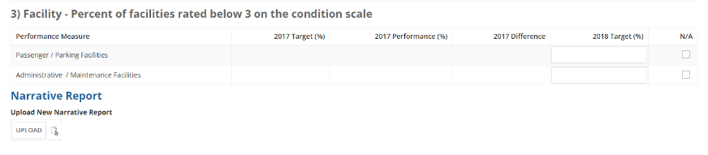
A-90 Sections: Facilities
Refers to facilities used in revenue service and those used to support revenue service (A-15)
Report the percentage of facilities that rate below a 3 on the condition scale.
You can also submit your agency Narrative Report
  This outlines performance targets and your agency’s progress towards those targets and may include any changes to transit system.

Slide 124
Report Submission

Slide 125

How to Submit
Step 1: Open the State Package and click on “Related Actions”
  CEO and CEO Delegate can submit the Original Submission
  NTD Contact is able to submit any revisions after OS.
Step 2: Click Submit Annual Report Package

Slide 126

Unable to Submit Report
This screen will appear when you try to submit the report if the report has:
  Open Issues
  Non Validated forms
  Incomplete Required Field forms
Click on the forms and/or issues to resolve

Slide 127

Confirm Package Submission
Step 3: If all data is filled out and no issues are firing, you will be able to Confirm Report Package Submission, and click “Continue”
Step 4: A new box will prompt where you will “Submit” the Report Package
The top of the page will notate “Action Completed Successfully” when done.

Slide 128
Closeout process

Slide 129
Validation Process
Analysts validate for deviation from reporting requirements, missing data and data irregularities
  Significant data fluctuations from previous report year
  Incomplete forms
  Data reported to an incorrect field
Smooth the process by providing detailed responses about your operating environment or changes from 2017
  Avoid providing generalized answers i.e. “data is correct”
  Explain service/route changes, staff changes, funding changes, etc.

Slide 130
Validation Process
Reports will be sent back to the State for them to resolve open issues. Each time the report is sent back, the timetable to return is shortened.
Be sure to address and correct any issues cited in the previous year closeout letter or noted to your by analyst.
Any issues that aren’t resolved from the prior year report may be marked as Questionable.

Slide 131
Reporting Issues
Incomplete reports:
  Non-conformance with definitions, accounting principles, accrual accounting
  Failure to respond to validation issues – all identified issues must be fully addressed
  Copying and pasting other answers that don’t relate to the issue being questioned
  Resubmitting report without properly saving data changes
When these issues occur, FTA cites them in the closeout letter

Slide 132
Resolving Issues
Provide a thorough and detailed explanation to each validation issue.
Provide information to give your analyst a clear picture of a subrecipient’s service
Explain changes in service, even if they may seem insignificant
If last year’s data is wrong, show:
  What it should have been
  How it was reported incorrectly in the prior year
  Why this year’s data is correct

Slide 133
Questions and Comments
NTD Operations Center
Monday – Friday
8:00 a.m. – 7:00 p.m. (ET)
NTDHelp@dot.gov or 1-888-252-0936
Maggie Schilling
maggie.schilling@dot.gov
202-366-2054
Joseph Eldredge
joseph.eldredge.ctr@dot.gov
434-993-8690
Melissa Conte
melissa.conte.ctr@dot.gov
434-207-8336
Bailey Krouse
bailey.krouse.ctr@dot.gov
434-218-3275
Courtney Springer
c.springer.ctr@dot.gov
434-260-6116
Erik Chadwell
erik.chadwell.ctr@dot.gov
434-218-0723

