Slide 1

Access and Mobility Partnership Grants:
Innovative Coordinated Access and Mobility (ICAM) and Human Services Coordination Research (HSCR)
Learning Collaborative #1
Kelly Tyler, Program Manager
Notes:
Welcome to today’s webinar on Access and Mobility Partnership Grant Opportunities. My name is Kelly Tyler and I am the program manager for the Access and Mobility Partnership Grants and the Section 5310 Enhanced Mobility of Seniors and Individuals with Disabilities Program.
I would like to quickly introduce my colleagues. Danielle Nelson who manages the very important work of the Coordinating Council on Access and Mobility (CCAM) work. We are also joined by our fearless leader, the chief of the rural and targeted programs division, Marianne Stock.

Slide 2

Agenda
Welcome & Introductions - Kelly Tyler, Section 5310 Program Manager, U.S. DOT, Federal Transit Administration
- Program Requirements and Grantee Reporting
- Overview of the Center for Urban Transportation Research (CUTR),
NADTC & Regional Offices Roles
National Aging and Disability Transportation Center (NADTC) - Virginia Dize & Carol Wright, NADTC Co-Directors
- Learning Collaborative
- Performance Measures
Discussion/Questions
FTA’s Grants Management System (TrAMS) - Donna Schultz & Alexis Fisher, Program Guidance
Discussion/Questions
Wrap-Up - Kelly Tyler
Notes:
Good afternoon Everyone! My name is Kelly Tyler. I am the program manager for FTA’s Formula funded program known as Enhanced Mobility for Seniors and Individuals
Welcome and congratulations to you all for your successfully getting your projects. We are pleased with each proposed project funded either through ICAM Funding or the HSCR Funding. I wish you all the best in this endeavor. And, so we are actually partners in this endeavor as it is FTA’s mission to make transit accessible to all communities across the country, in urbanized areas and especially in rural and suburban communities where there are more barriers to accessing transportation. So we are very excited about this partnership as it helps to further our mission.

Slide 3
Access and Mobility Partnership Grants
2 Funding Sources
ICAM Projects are Funded by Section 3006(b) of the Fixing America’s Surface Transportation (FAST) Act (Pub. L. 114-94, Dec. 4, 2015) authorizes FTA to award grants for innovative coordinated access and mobility projects for the transportation disadvantaged population that improve the coordination of transportation services and non-emergency medical transportation services.
HSCR program is funded through the Public Transportation Innovation Program (49 U.S.C §5312) and will build upon identified gaps in services or planning activities for the improvement of services, as outlined in a Coordinated Human Services Transportation Plan.
Notes:
Access and Mobility Partnership Grant Program is comprised of two funding programs…1) Innovative Coordinated Access and Mobility (ICAM) , 2) Human Services Transportation Research (HSCR) As you may know FTA funded 37 projects across 37 states. There are 23 ICAM projects funded and thery are 14 HSCR projects funded making a total of 37 total projects.

Slide 4
Reporting Requirements
  Milestone Progress Reports (MPR) submitted Quarterly
  Federal Financial Report (FFR) submitted at year end, September 30
  Performance Measures Quarterly (i.e. Ridership, gaps in service filled, operations improvements)
Notes:
All FTA Grantees are required to submit the following reports….

Slide 5
Overview of Roles
National Aging and Disabilities Transportation Center (NADTC)
  Establishing Performance Measures
  Collecting Performance Data for ICAM Funded Projects Only
  Technical Assistance Resources
Center for Urban Transportation Research (CUTR)
  Collecting Performance Data for HSCR funded Projects Only
FTA Regional Offices
  Assist with all things relating to TrAMS or grants management, submission of reports
Notes:
FTA has designated the National Aging and Disabilities Transportation Center (NADTC) to support grantees with project performance evaluations and provide technical assistance. NADTC will also develop and host a Leaming Collaborative available to all Access and Mobility Partnership Grantees. Grantees will be contacted by NADTC regarding participation in the Learning Collaborative.

Slide 6

Annual Report to Congress
FTA’s Reporting Requirements
The Fixing America’s Surface Transportation (FAST) Act, Pub. L. 114-94 requires that:
    The Secretary shall make publicly available an annual report on the pilot program carried out under this subsection for each fiscal year not later than December 31 of the calendar year
ICAM and HSCR Reporting Requirements
As the grantee, submit reports quarterly of your project milestones
    ICAM – expect monthly reporting to NADTC
    HSCR – expect at least quarterly reporting to CUTR
Notes:
Each Funding Source 49 U.S.C 5312 and 3006 (b) funds require an independent evaluation of the demonstration grant at various points in the deployment process and at the end of the pilot project
Annually, FTA must submit an Annual Report to Congress on the outcomes of each funding source

Slide 7
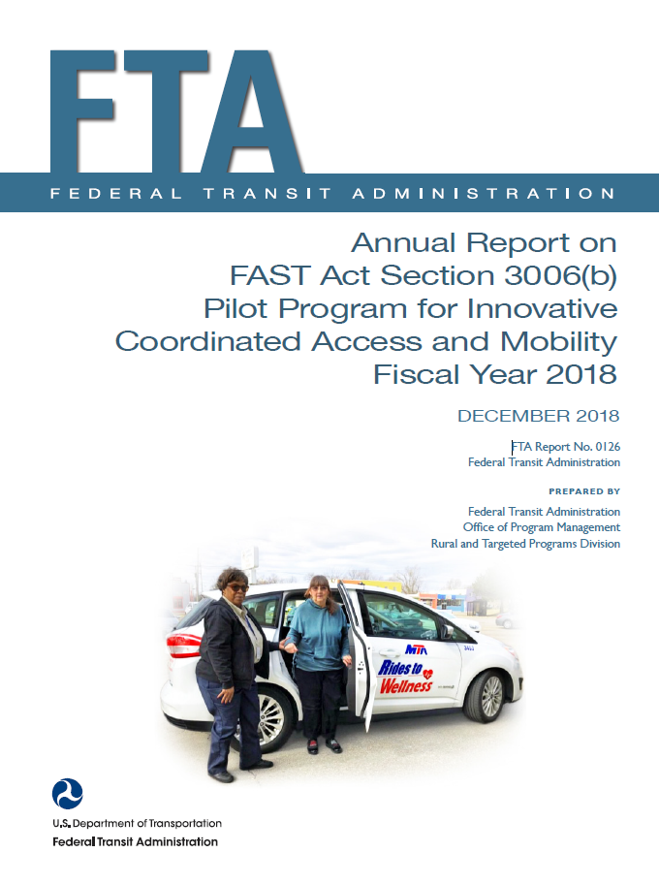

2018 Annual Reports
https://www.transit.dot.gov/funding/grants/grant-programs/pilot-program-innovative-coordinated-access-and-mobility-grants-fy2018
Notes:
Feel free to visit the link below to review each Annual Report to get examples of the type of performance measures have been reported in previous years.

Slide 8
Contact Information
Kelly Tyler, Program Manager
Access and Mobility Partnership Grants
Office of Program Management, Rural and Targeted Programs
USDOT | Federal Transit Administration
Email: Kelly.Tyler@dot.gov
Phone: 202-366-3102
Website: https://www.transit.dot.gov/funding/grants/grant-programs/access-and-mobility-partnership-grants
Notes:
Any issues you run into feel free call me directly.

Slide 9
Questions?
Notes:
9
I would like to hold all questions to the end but if there are any clarifying questions regarding what I just talked about. I am pretty certain by the end of the webinar many of your questions will be answered.

Slide 10



ICAM & HSCR Grants
August 12, 2019 Webinar
NADTC 2017 1st Place Photo Contest Winner:
Public Transportation, Inc., Indianapolis, IN:

Slide 11

National Aging & Disability Transportation Center
  Partnership of two national organizations – National Association of Area Agencies on Aging (n4a) and Easterseals, Inc.
  Co-Directors: Virginia Dize, n4a
  Carol Wright Kenderdine, Easterseals
  National Technical Assistance Center
  Funded by: Federal Transit Administration
  U.S. Department of Transportation

Slide 12
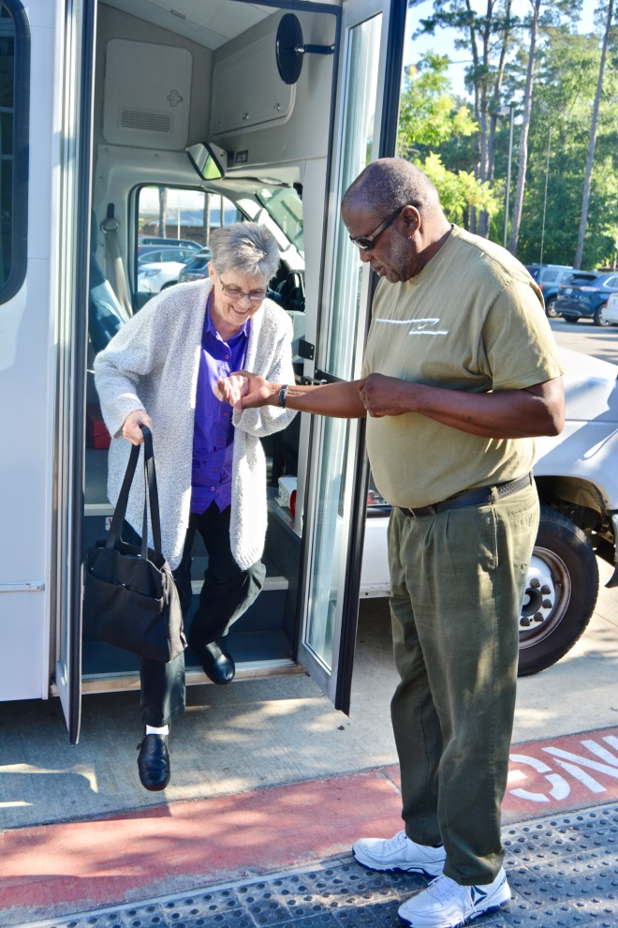

  MISSION: To promote the availability of accessible transportation options that serve the needs of Older Adults, People with Disabilities, Caregivers and Communities.
MAJOR OBJECTIVES:
Person-centered technical assistance and information & referral
Training: webinars, online courses/forums
Interactive communication and outreach strategy
Coordination and partnership strategy, including stakeholder engagement
Investment in community solutions
Independent program evaluation
www.nadtc.org

Slide 13

Learning Collaborative
Provide person-centered technical assistance
Create opportunities for learning and knowledge exchange
Host monthly meetings with grantees
Track and report grantee progress on performance measures and goals
Metrolina Association for the Blind
Charlotter, NC

Slide 14
Performance Measures
Performance measures are tools to determine what a grantee accomplishes and whether the desired results are being achieved.
NADTC will work with grantees to evaluate existing performance measures. Performance measures should be:
  Meaningful
  Tangible: link activities to specific outputs or outcomes
  Measurable
  Easily understood & easy to know that they have been accomplished

Slide 15
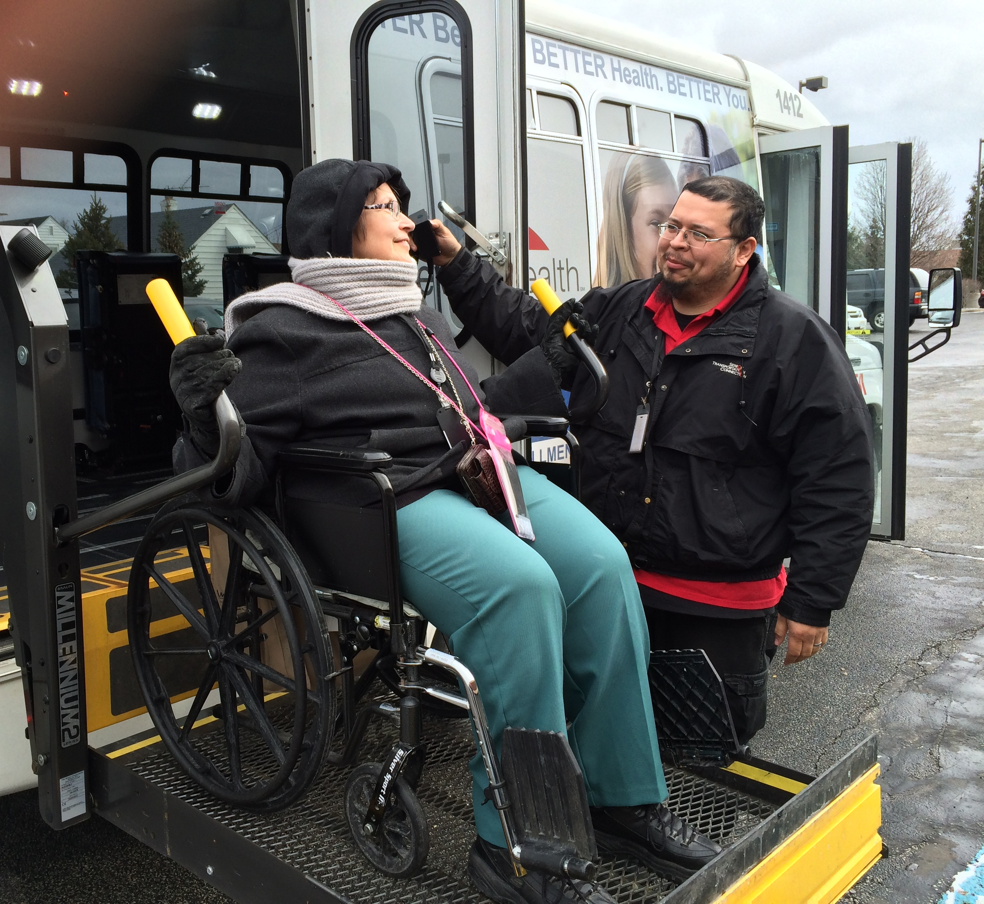
Outputs & Outcomes
NADTC will look at the grantees’ outputs and outcomes.
Outputs – represent the products and services delivered.
Outcomes represent the unique aspect of your innovation – the specific result your grant project is intended to achieve. An outcome is not what the project produced, but the impact of the project on the individual, community or program in your service area.
Senior Transportation Connection
Cleveland, OH

Slide 16
Next Steps
Notification of grantee assignment to either n4a or Easterseals
Notification of project managers who will monitor your grant projects and serve as your primary contact for technical assistance
Upcoming webinars
Working with project managers on performance measures for grant progress tracking

Slide 17


www.nadtc.org
Toll Free 866-983-3222

Slide 18

Questions?

Slide 19
Introduction to TrAMS
Training for New Users
FTA Office of Program Management
Division of Grants Management and Analysis
August 12, 2019
Access and Mobility Partnership Grant Recipients
Notes:
Good afternoon and welcome to “Introduction to TrAMS” for new users.
I’m Donna Shultz.
Today’s session is focused on a basic introduction to the FTA on-line grants management system, TrAMS, along with a few slides presented by my colleague, Alexis Fisher, highlighting the prerequisites needed for an FTA award.
Please download this presentation, which will be located in the File Share pod. The PowerPoint version has embedded links, so that you can bookmark web pages and resources.

Slide 20
Objectives
1. What is TrAMS
2. User roles, access and your profile
Layout of the system and navigation
Prerequisites for FTA Awards
Where to attached required documents
Financial Federal Report and Milestone Progress Report
7. Resources
Notes:
Today’s objectives are:
What is TrAMS
2. The layout and navigation of the system
3. User roles and how data flows through the system based on a user role
Recipients and FTA Users have different roles, which perform different functions within TrAMS
4. Required documents to execute an award
5. Required reporting – FFR and MPR
6. Resources available to help you use the system

Slide 21
TrAMS
Transit Award Management System
  https://faces.fta.dot.gov/suite/
  Web based tool, using various workflows, to manage an award through it’s life cycle.
    Application
    Award
      Revisions/Amendments
    Payment Requests
    Reporting
    Close out
Notes:
TrAMS automates the workflow associated with creating, awarding, and administrating FTA awards.
As I mentioned earlier, this is a screen with an embedded link. When opening the PowerPoint presentation, just hover your mouse over the web page, press Control and click the web page.
Each workflow step is associated with a specific user role responsible for completing the step.
As part of the workflow, TrAMS assigns ‘Tasks’ to users with the appropriate user roles to prompt completion of the next “step” or “action” in the process.

Slide 22
User roles, ACCESS and YOUR PROFILE
Objective 2

Slide 23
Most Common User Roles
Official
User Manager
Submitter
FFR Reporter
Civil Rights
MPR Reporter
Developer
Attorney
Notes:
TrAMS is a workflow based system.
Users are assigned roles, with each role having authority to move documents, applications or other submissions through a workflow in order to accomplish tasks or take an action, such as the approval of an application or a budget revision.
Shown here are some of the various user roles in TrAMS. An employee can be assigned multiple roles by the recipient’s User Manager.
There is also a read only role that can be assigned.

Slide 24
How do I access TrAMS?
Is your organization registered with FTA?
  Yes, find out who your organization’s User Manager is.
    The User Manager is designed by the organizations Official.
  No, contact the FTA Regional Office
    Multiple system’s need to be setup for a new organization.
Meet with your office’s User Manager about what role(s) you need.
The User Manager can activate your account in TrAMS and assign you the right roles.
Once an account has been created, an email will be sent to the new user.
Notes:
By registered I am referring to a 4 digit number issued by FTA, called Vendor ID.
If your organization has never had an FTA grant or cooperative agreement, reach out to your local FTA regional office.
The User Manager, assigned by your organization, will be the main point of contact for accessibility to TrAMS. There should be more than one User Manager, so that if one is out the other can still take action.
A User Manager can create a new account, assign the role(s), modify or deactivate users.
An automated email notification will be sent after the User Manager creates a new account, which will contain the username, a temporary password and access/login directions.
There is a resource page at the end of this presentation with an embedded link to the User Manager Handbook.

Slide 25
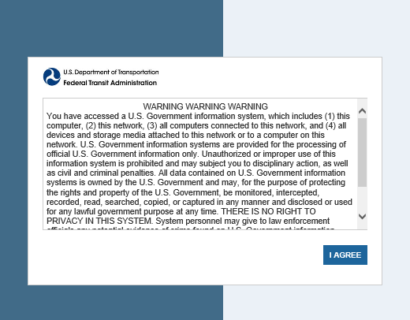
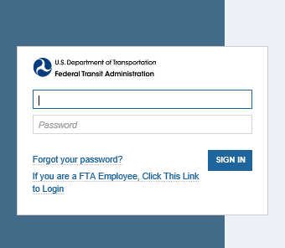
Logging into TrAMS
https://faces.fta.dot.gov/suite/
Notes:
When you click the link, a warning message will pop up letting you know you are about to access a government information system, click I Agree.
The next screen that pops up, shown on the right, will be the place to put your username and password, both of which are located in the automated email notification sent to you.
There is a hyperlink embedded on this page that will take you right to TrAMS.

Slide 26
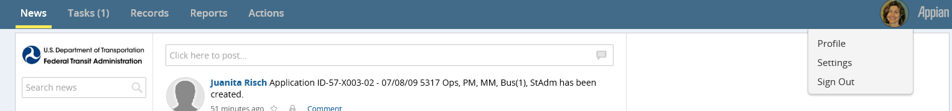
User Profile
Notes:
Once you have access, I suggest you set up your user profile.
Within the Navigation Bar, right side of the screen, you will find circular a Profile Icon. Mine is shown here with my picture.
Click on the icon/picture. The following options are available:
Profile – see roles, edit profile details, add a photo, see who is following you
Settings – language, time zone and calendar type
Sign Out
It is preferred that you sign out here; but you can also simply close your browser without an error message.

Slide 27
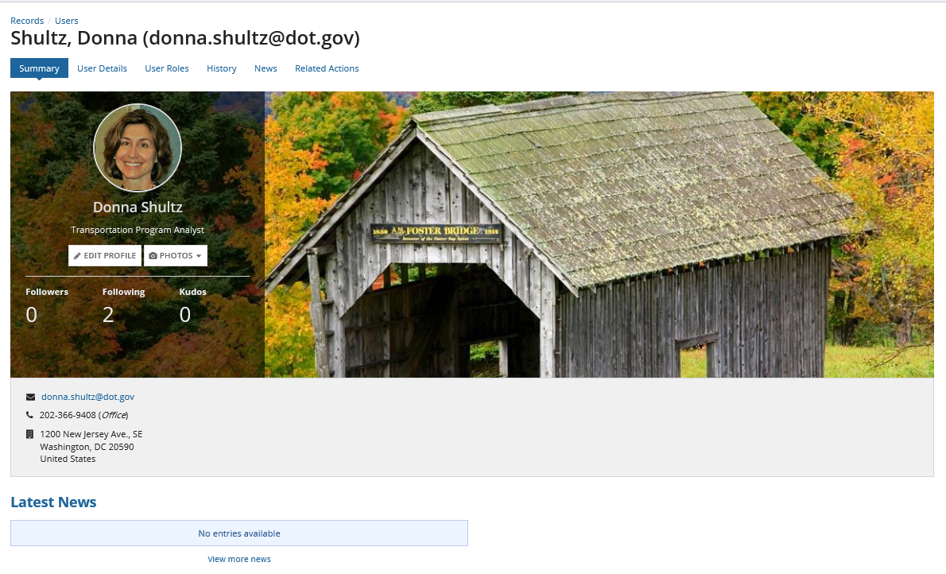
Your Profile
Notes:
Once you click your profile this is what you see. The system opens to the summary page.
There are several options here, shown as tabs underneath your name:
Summary, which is the landing page, upload a photo, add your contact information by Edit Profile, see who is following you or who you are following
User Details will list the information you have added in Edit Profile
User Roles will list all roles you have been assigned
History will show role history, account history and profile history – all indicating changes to those specific areas of your profile and who changed the information along with the date it was changed
News will show any news you are following or have added
Related Actions is where you set up and manage your security questions
Note: if you add a photo that photo will appear on the News Feed, any time you send tasks or take some other actions in the system.

Slide 28
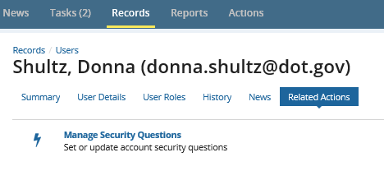
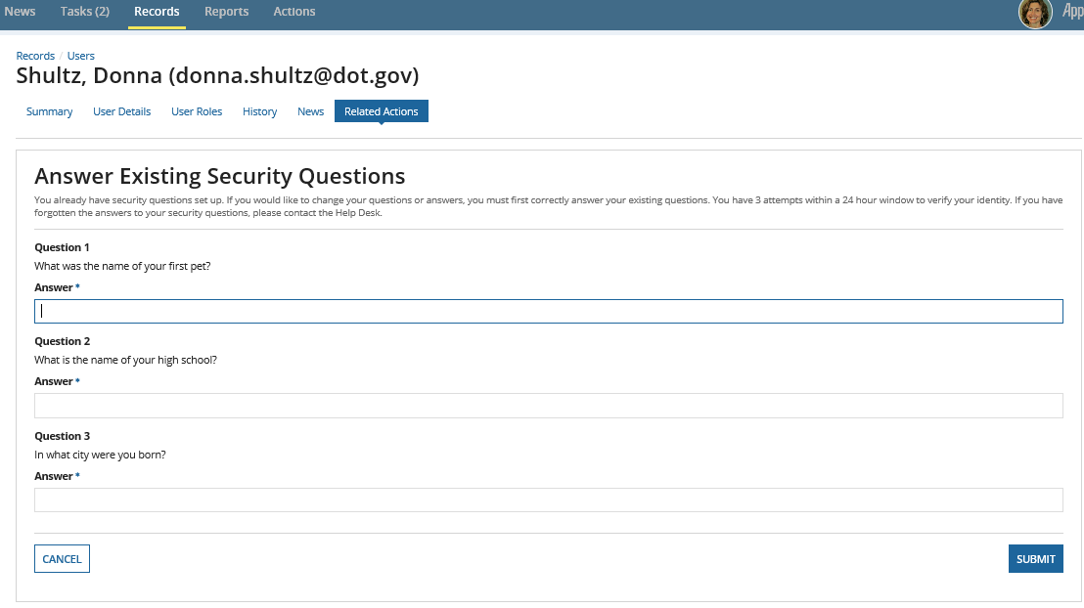
Setting up your Security Questions
Notes:
Please reminder to set up security questions, under the Related Actions tab. These will help you get back into the system, if you get locked out due to inactivity.

Slide 29
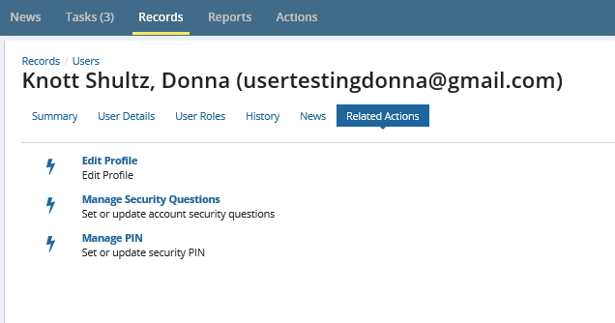
PIN
Notes:
There are some roles that require a PIN in order to move a task through workflow. These roles are Submitter, Attorney and Official
The PIN is a 4 digit number, which you set up within your user profile, related actions tab.
If you forget your PIN you can change it yourself by answering the security questions.

Slide 30
Lockouts
The following security procedures are in place to comply with agency requirements:
If you have not logged in after 60 days, TrAMS will lock you out.
If you separate from the organization, your TrAMS account will be deactivated automatically.
TrAMS will time out, if you have not taken action in the system after 30 minutes.

Slide 31
What if I’ve been locked out of TrAMS?
There are two ways to unlock your account:
  Answer previously established security questions
  Submit an unlock request to your local User Manager
Notes:
Although you are prevented from accessing most TrAMS functions while locked out, you are allowed access to the “Actions” tab.
Select the Unlock Account option under the Actions tab, choose Answer Security Questions or send a request to unlock to account approvers.
If you choose to send an unlock request, that email notification will be sent to the User Managers, Local or Global Security Managers associated with your organization. Once the User Manager reviews the request to unlock, they can either approve or deny the request. That decision is sent via an email notification back to the user. This process can take up to 48 hrs.
If it’s the User Manager whose account is locked, the request will go to the next level of authority, so the Local Security Manager.

Slide 32
Layout of the system and navigation
Objective 3

Slide 33




System Accessibility
System works on multiple browsers.
Safari Explorer
Chrome Firefox
Notes:
TrAMS can use any browser, such as Safari, Chrome, Firefox.
External users can use the Appian app to use TrAMS on their mobile phone.

Slide 34
TrAMS Home Page
Notes:
Navigation Tabs:
Located across the top of the screen are five (5) tabs. The tabs are used to navigate through the system. Each tab represents a different way to see or pull data. The exact information displayed on each tab will reflect the role(s) the user has. More on role assignment later.
All TrAMS users regardless of the User Roles assigned, will see these five tabs:
1. News
2. Tasks
3. Records
4. Reports
5. Actions
2) User Account Information:
Located at the top right corner of the screen, the circular shaped icon provides quick access to your user account:
a. User’s Profile – Allows the user to view and update their individual profile information and to set up their Personal Identification Number (PIN). See the FACES User Guide for PIN Set up.
Settings - The user settings page is where the user can set the language, time zones, update your password settings and subscribe to news feeds. Non-FTA users can change their passwords here.
Sign out - User can select the sign-out from the dropdown to close the application.
For more details about your TrAMS roles and user account, see TrAMS User Access and Management User Guide.
3) Navigation Menu:
The navigation menu appears on the left-hand side of the screen.
Filters and menu items vary by tab and data type selected.
In some cases, a search bar is available to allow you to quickly find specific items.
4) Main Content:
This area displays primary information for the specific page.
Information displayed is specific to the functionality of the tab.
For example, only tasks will display when working in the ‘Tasks’ tab.
If you print from this page while open in a web browser only the content in this main content area will print.

Slide 35
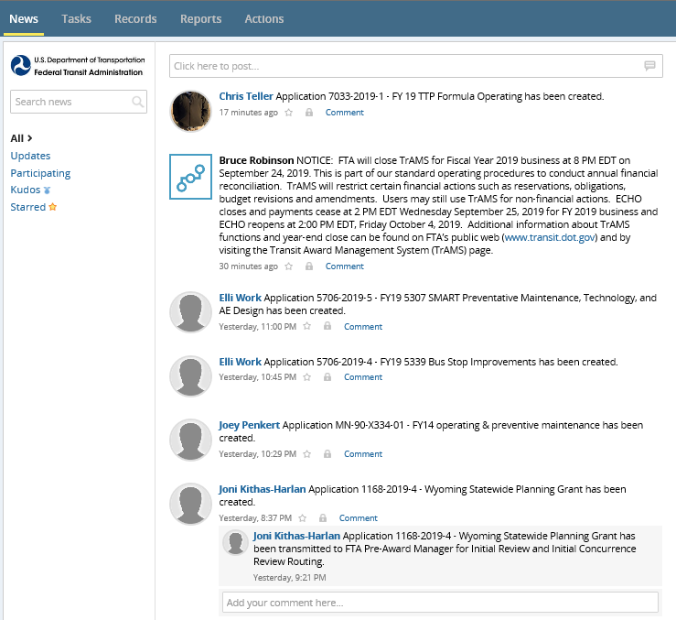
Navigation Tab News
Notes:
When you log into TrAMS, the system opens on the News tab.
News feed information displays in chronological order with the most recent posting found at the top of the list. The messages are grouped by award application and viewable by recipient organization users and FTA users.
Users may also use this tab to add their own comments to the news feeds, to communicate with other users or groups using the post or message options, to assign a social task, or to send kudos.
The left-hand navigation may be used to search for specific events or to filter down to a selected view. Users may manage their feeds further by following specific users or groups.
Messages are automatically posted when:
Applications are created
Applications are returned for comments and/or changes
Applications are transmitted to FTA for review/concurrence
Applications are submitted to FTA for review/concurrence
Flag important entries by clicking the start next to a news entry. A filter can be created looking for the starred entries by selecting the Starred option on the left hand Navigation menu.
NOTE: Any posts made cannot be deleted and will be seen by all users in your organization.

Slide 36
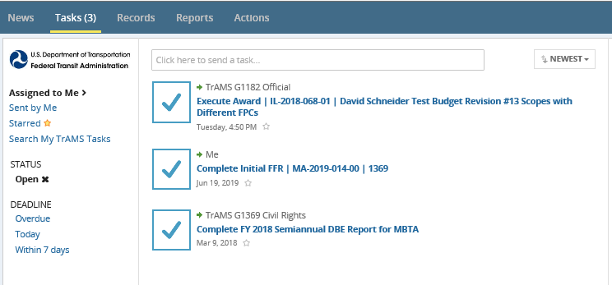
Navigation Tab Tasks
Notes:
The Tasks tab displays a list of specific work items that have been assigned to a user or to a group of users for completion.
The number of open tasks assigned to the user displays next to the Tasks tab title. This screen shot shows 3 tasks pending.
Selecting the individual task causes a page to open requiring the user to fill out several areas in order to complete the task.
If you look above the task name you can tell if this task was assigned directly to you or to a group.
If directly assigned to you the word “Me” is shown, if the task is for anyone in a group the group name is shown.
When tasks are assigned to anyone in a group, any user can take action to complete the task. Once the task has been claimed, no one else in the group can complete the task.
If you select a task, then decide not to complete the task, you can return the task to the group.
Once a task is completed, the task will be removed from your task list.
If you click on an option from the selections on the left, such as Search My TrAMS tasks, deciding that you no longer want to search, click the Tasks tab to get back to the original navigation menu, shown on the left.

Slide 37
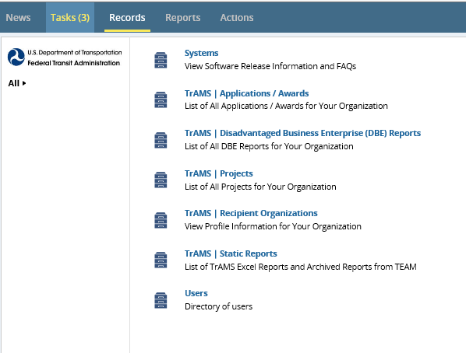
Navigation Tab Records
Notes:
The Records tab is the place to search for records within TrAMS such as looking for a recipient organization or a particular application.
No matter your role, everyone has access to all of the options shown. Recipient users can see only records for their Recipient Organization and FTA users can see records for their Region.
Systems
Provides a space for sharing TrAMS system updates, such as software release information.
Application/Awards
Search for applications and awards associated with your recipient organization or regional cost center.
Disadvantaged Business Enterprise (DBE) Reports
Lists the DBE reports for your recipient organization or region’s recipient organization.
Projects
Access to individual projects that make up applications and awards.
Recipient Organization
View the recipients’ organizational information; you will only see information for the organizations of which you are assigned.
I have an arrow pointing at this option because it’s important to review the information listed for your organization and make it’s sure accurate as that information is used in multiple places throughout TrAMS.
Static Reports
Historical nightly generated reports and archived reports from TEAM.
Users
Contains information about all users, that have access to TrAMS, within the recipients’ organization or regional cost center, if an FTA employee.

Slide 38
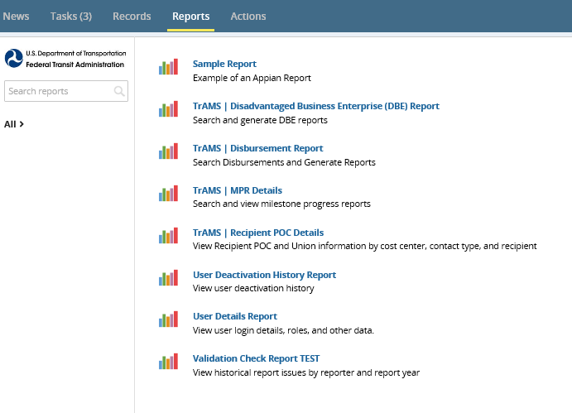
Navigation Tab Reports
Notes:
Reports tab provides access to a suite of reports accessed by clicking on the report name link (in blue). There are some additional reports available under the Actions tab.
Once you select on a report name, the report will open. To get back to the main selections page, click the Reports tab.

Slide 39
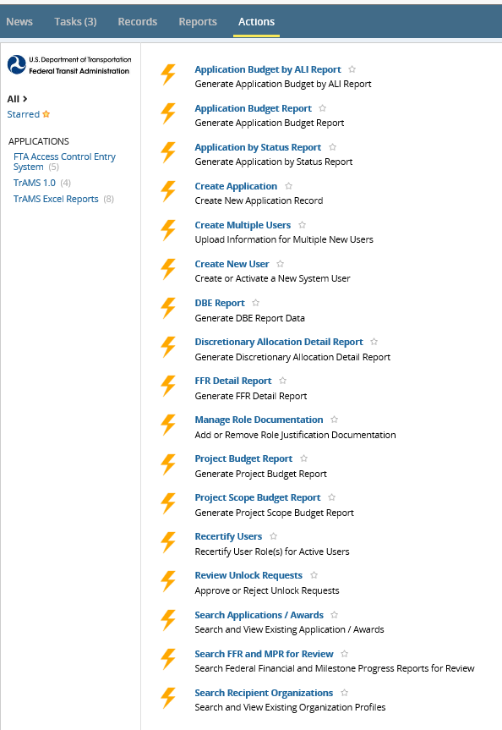
Navigation Tab Actions
Notes:
The Actions tab lists activities a user can execute. The options are based on your user role. The screen shot here shows the options for a recipient user with multiple roles.
Records can be searched for and reports can be generated from the options under this tab. Exports to Excel can be made from any of these options.
When an option is selected, the search criteria screen will open, after selecting whatever information you want to search on a report link will be shown in the upper left allowing you to open the newly created report. Anything with an asterisk is a required field.

Slide 40
Prerequisites for an FTA award
Objective 4

Slide 41
FTA’s Prerequisites
Recipients must be able to implement FTA funded projects. This includes the ability to:
  Be eligible to receive federal funds through FTA awards
  Plan, manage, and complete projects
  Provide for the use and control of federal funds, project property and provided equipment.
  Comply with terms of the award
  Make sure activities remain on budget and schedule
  Have sound management practices to satisfy/maintain legal, financial and technical capacity
  Comply with the annual Certifications and Assurances and all applicable Federal laws, regulations and directives

Slide 42
Legal Capacity
Authorizing Resolution
Must cite the legal authority that enables grantee to apply for, receive and spend FTA funds and to provide local match, if required.
Opinion of Counsel
Must affirm that there are no legal impediment to grantee’s implementing the project if funds are awarded.
Delegation of Authority
Must authorize an official responsible for executing grants and legally committing grantee to compliance with grant terms.
Generally this in is the form of a Resolution (or equivalent) from grantee’s Board of Directors (or equivalent) must be adopted/executed.
Must be attached to the Recipient Profile in TrAMS.
This may be a specified person or cite the position, the latter is preferable.
Notes:
Grantees must be eligible and authorized under state and local law to request, receive and dispense FTA funds and to execute and administer FTA funded projects.
These documents are generally a one time submission, but the grantee is also required to notify the FTA Counsel of any change in local or state law and/or pending litigation that may significantly affect the grantee’s eligibility to receive grants or ability to perform projects in accordance with the terms of the Master Agreement. Any significant change in status will require a new opinion of counsel, resolution, etc.

Slide 43
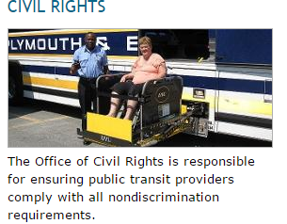
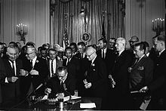
Civil Rights
A prospective applicant must be evaluated to determine what related Civil Rights (CR) Programs are applicable and is dependent upon the type of organization, transit services, etc.
The specifics of Civil Rights compliance will be further explained later in the application process and is specific to individual circumstances and awards.
Notes:
The Office of Civil Rights is responsible for ensuring public transit providers comply with all nondiscrimination requirements. The office oversees the implementation of laws and regulations that prohibit discrimination on the basis of race, color, national origin, religion, sex, disability, and age in the provision of services to the public. Regional Civil Rights officers provide technical assistance, training, and investigations and assist with onsite compliance reviews to ensure public transit providers fulfill civil rights requirements. Major programs the office implements include:
Title VI of the Civil Rights Act of 1964
Americans with Disabilities Act of 1990
Disadvantaged Business Enterprise program
Equal Employment Opportunity program
Civil rights reviews will be addressed later on in the presentation. However, it is a good idea to start the conversation within your FTA working group and with the applicant to make sure that they are aware of requirements.

Slide 44
Certifications and Assurances
FTA publishes its Certs and Assurances in the Federal Register to relay requirements for federal assistance each fiscal year.
FTA may not provide financial assistance to an applicant or recipient until submits its Certifications and Assurances.
Recipients applying for federal assistance under any of FTA’s competitive capital programs or formula programs, are expected to PIN or certify, within 90 days from the date they were published in the Federal Register, or with their first application of the fiscal year, whichever is first.
Reviewing and understanding each Certification and Assurance should be an annual activity for recipients to make sure they fully understand what is expected of them.
Notes:
FTA publishes annually,
Recipients do not need to certify annually if they were, for example, a one time recipient with one grant that will take 3 years to complete. The initial C&As will suffice unless it is significantly amended

Slide 45

Echo Access
FTA recipients must be set up in FTA’s payment system to seek reimbursement from awards.
ECHO is the reimbursement vehicle for grants
Recipients using ECHO must complete the applicable forms included in the ECHO-Web 2.0 User Manual to establish a new recipient ECHO account and assign users access to the ECHO system. Key information includes but is not limited to the following:
  ACH Payment Form (Banking information and Tax Identification Number)
  ECHO User Form
  ECHO Rules of Conduct (signed by the users)
  ECHO Access and Certification on the agency Letterhead

Slide 46
Recipient/Vendor IDs
Vendor IDs are unique to FTA to identify an Organization and should only be created once. The ID is used:
  In TrAMS in FTAs award documentation, recipient profile information, and reports
  In FTA’s FMS (Delphi, I Supplier, and ECHO) for the obligation and disbursement of funds
The Vendor ID is associated with the organization’s Tax Identification Number
If there is an organizational change it may require a new Vendor ID. Coordinate with HQ first!
Notes:
Because of the multiple ways the Vendor ID is used, it is important avoid creating issues with multiple ID numbers for the same organization. It is all a one to one relationship.
This is not simply a TrAMS thing but also a Financial Systems thing… information is shared and must be consistent.

Slide 47
Lobbying & Indirect Costs
For applications and awards over $100,000, must file a written certification that states that no Federal funds have been paid for lobbying by completing Group 02 of the annual Certifications and Assurances. Applicants and recipients that use non-FTA funds for lobbying must submit a “Disclosure of Lobbying Activities” form (SF LLL) to report these.
Indirect costs may be included in FTA awards if there is an approved indirect cost rate proposal (ICRP) or an approved cost allocation plan (CAP) from the appropriate cognizant federal agency for indirect costs. Indirect costs may not be included in the award without documentation.
If the applicant does not have an existing indirect cost rate, program office staff must work with the grantee to determine if it is eligible for the de minimis 10 percent rate permitted under the Uniform Guidance (200.414) or direct the applicant or recipient to negotiate an ICRP or CAP with their cognizant federal agency.
Notes:
May or may not be applicable to your award

Slide 48
Setting up a New FTA Recipient
Financial, Technical, and Legal Capacity has been determined sound.
All Documentation has been submitted (including civil rights program information as applicable).
Financial information is submitted (ACH Form and Tax Identification Information, Banking Information and Delphi – all linked to the recipient/vendor ID).
Notes:
Setting up a new grantee takes time to review and should not be taken lightly to push a grantee through to establish a Vendor ID without determining if they are viable.
Each grantee ID and their DUNS information is linked to their financial information

Slide 49
How TrAMS uses DUNS and SAM
TrAMS uses the grantee’s DUNS number to sync with the System for Award Management (SAM).
TrAMS only allows for a one to one relationship – this means there should only be one DUNS associated with SAM registration AND associated with an FTA Vendor ID.
DUNS numbers and information cannot be shared among recipients; it is unique for each organization.
DUNS
SAM
Recipient ID
TrAMS
Tax ID #
Notes:
TrAMS pulls information from SAM based on the applicant or recipient’s DUNS. The “Sync with SAM” feature in TrAMS pulls up information from the repository into FTA’s grants management system. This sync does not, however, pull up the full recipient registration and restriction information available from the complete record.
The TIN or Tax Identification number was recently added to this slide to enforce the fact that all of this information is also associated with the agency’s TIN and it is linked to FTA’s financial systems. This too, is a number that should never change. If a TIN changes, it is likely that the agency has significantly changed its structure and may require a new DUNS, new SAM, New Vendor ID –call TPM for help.
If there is a consortia application, the lead DUNS and Registration should be used.

Slide 50
Resources & Useful Sites
https://www.transit.dot.gov/sites/fta.dot.gov/files/Appendix_A_Legal_Capacity_Documents.pdf
https://www.transit.dot.gov/sites/fta.dot.gov/files/docs/Delegation%20of%20Authority%20Sample%20for%20PIN%20User%20Roles.pdf
https://www.transit.dot.gov/regulations-and-guidance/civil-rights-ada/civil-rightsada
https://www.transit.dot.gov/funding/grantee-resources/certifications-and-assurances/certifications-assurances
http://www.whitehouse.gov/sites/default/files/omb/grants/sflllin.pdf.
https://www.transit.dot.gov/funding/grantee-resources/echo/electronic-clearing-house-operation-echo
https://www.dandb.com/dunsnumberlookup/
https://www.sam.gov/
https://www.transit.dot.gov/funding/grantee-resources/certifications-and-assurances/certifications-and-disclosure-lobbying

Slide 51
Where to Attach Required Documents
Objective 5
Notes:
I wanted to show you where to find any attached documents required for the award.

Slide 52
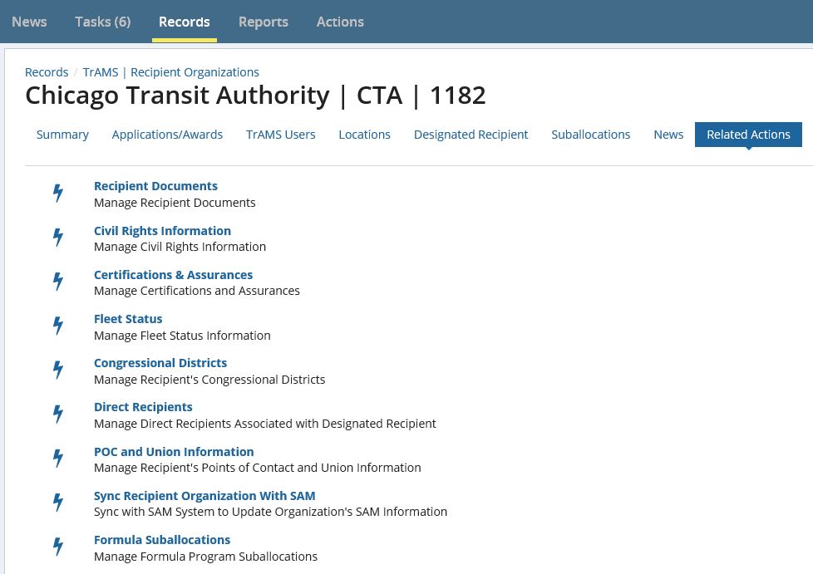
Recipient Organization
Notes:
The majority of the documents we just discussed will be attached and maintained within a Recipient Organizations profile in TrAMS.
You find your organizations profile by clicking the Records tab, selecting the TrAMS/Recipient Organizations option. Click on your organization, go to the Related Actions tab. Here are all of the selections to attach and manage recipient documents.

Slide 53
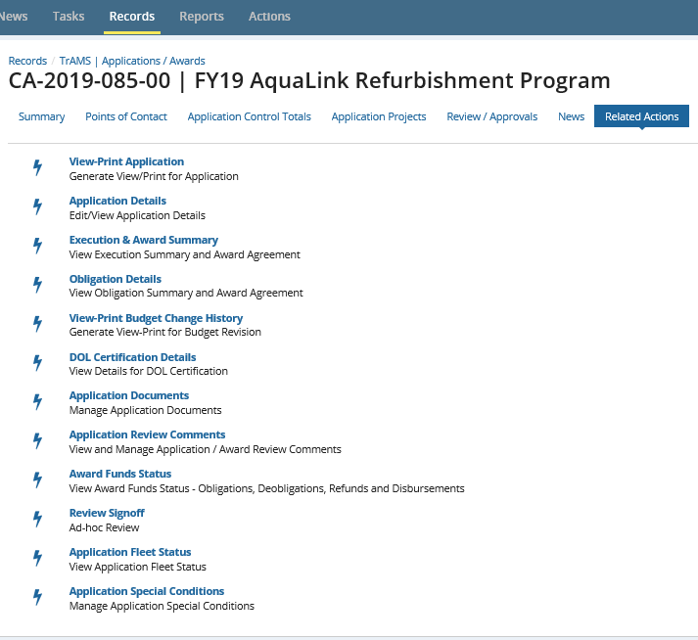
Related Actions Application Documents
Notes:
If you need to find a document that was attached to an Application or award, search for the award in Records, once the award is found and the record open, go to the Related Action tab, Application Documents. Once you click the option, the cumulative list of all documents are shown (screen shot on the next slide).
The documents you will find here are environmental findings, application support documents, program plans. The next slide will show a sample listing.

Slide 54
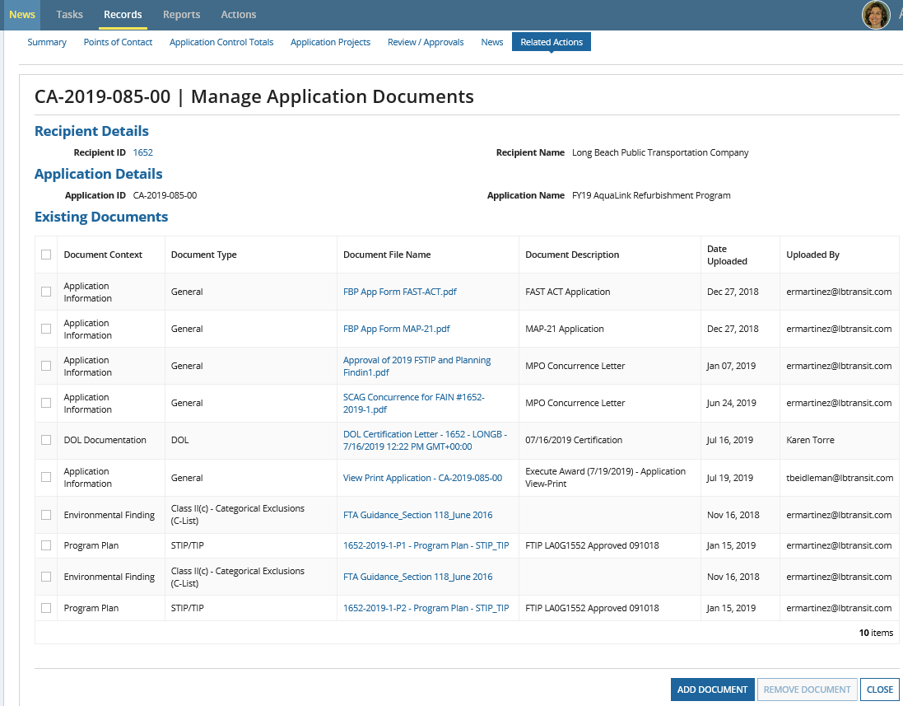
Manage Award Documents
Notes:
You will always find any documents attached during application creation or afterwards here . If you need to update a document or add a new document this is the place to do that. Click the Add Document button shown in blue.

Slide 55
Federal Financial Report (FFR)
&
Milestone Progress report (MPR)
Objective 6
Notes:
We will talk about required reporting in TrAMS
There are two reports that are required when accepting an FTA award.
First, the Federal Financial Report (FFR), which is a financial reporting form
Second is the Milestone Progress Report (MPR), which is for reporting to FTA the status of your projects, to include successes and any challenges.

Slide 56
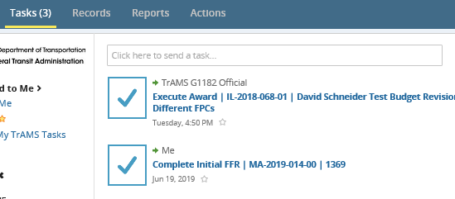
Post Award Reporting
TrAMS Post Award Reporting
Notes:
Once your award is in place, a pre determined schedule of the required financial and progress reports releases a task to the person(s) with an FFR Reporter or an MPR Reporter role.
The link embedded into the presentation takes you to the TrAMS post award reporting guidance document.

Slide 57
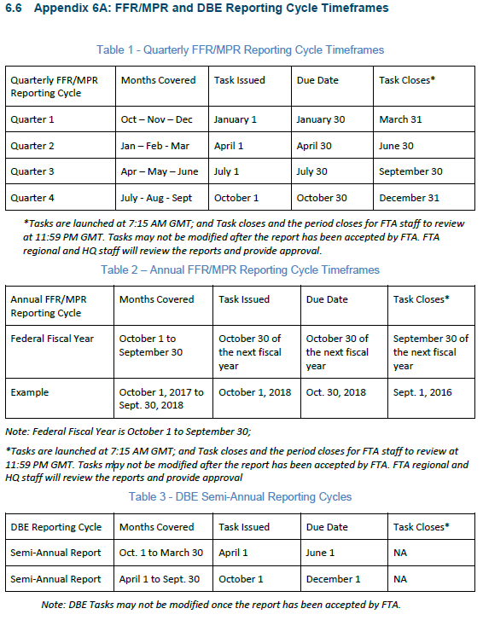
FFR/MPR and DBE Reporting Cycles
Notes:
Here is a chart of reporting cycles for the FFR, MPR and DBE reports. This chart is found in Appendix 6A, Post Award guidance document, whose link was on the prior slide.

Slide 58
resources
Objective 7

Slide 59
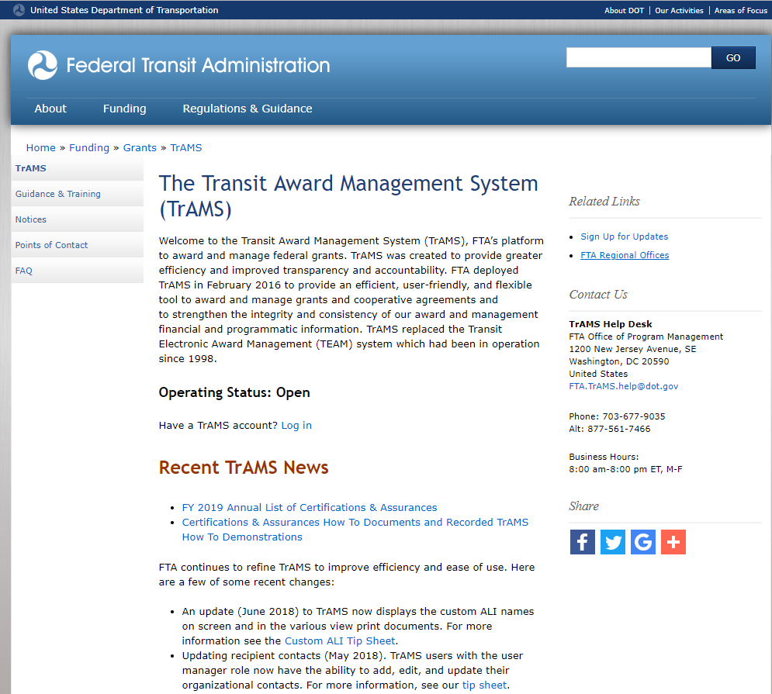
FTA’s Public TrAMS Page
FTA TrAMS Main Page
Notes:
https://www.transit.dot.gov/funding/grantee-resources/teamtrams/transit-award-management-system-trams
There is an embedded link in the presentation, which will take you directly to the TrAMS main page.
I would suggest signing up for the Gov Delivery option, shown on the right side, Sign up for Updates. This allows you to be notified any time we make a change to this web page.
Most recent updated documents can be found under Recent TrAMS News.
Certifications and assurances are found here as well as new tip sheets.
You can see the status of the system here as well as sign up for updates to be notified if something is added.
Also to the left you will see a Guidance and Training option. There you will find all of the guidance documents and recorded training sessions.

Slide 60
Technical Assistance
FTA.TrAMS.Help@dot.gov
(877) 561-7466 or (703) 677-9035
Business hours M-F 8:00 am - 8:00 pm (EST)
FACESHelp@dot.gov
Notes:
TrAMS Help Desk will log all inquires in order to track questions and any technical issues reported by FTA users and recipients.
FACES Help will assist with access into TrAMS and user roles.

Slide 61
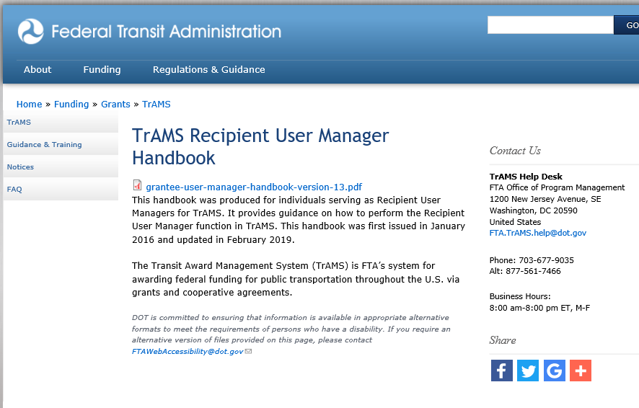
User Manager Handbook
Notes:
For all who are User Managers or will be designed as a User Manager for your organization, embedded in this slide is a link to the User Manager Handbook.
https://www.transit.dot.gov/funding/grantee-resources/teamtrams/trams-recipient-user-manager-handbook

Slide 62
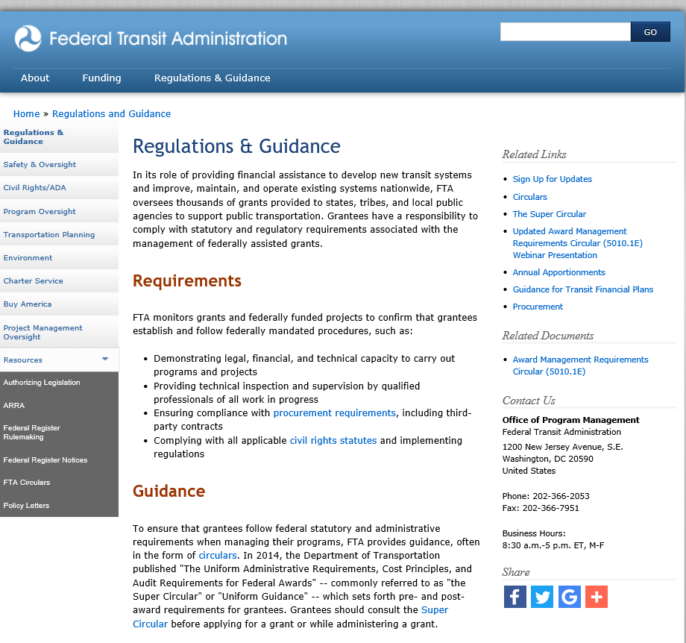
Authority and Legislation
Notes:
Here is an embedded link to the FTA regulations, circular and other guidance.
https://www.transit.dot.gov/regulations-and-guidance/regulations-and-guidance

Slide 63
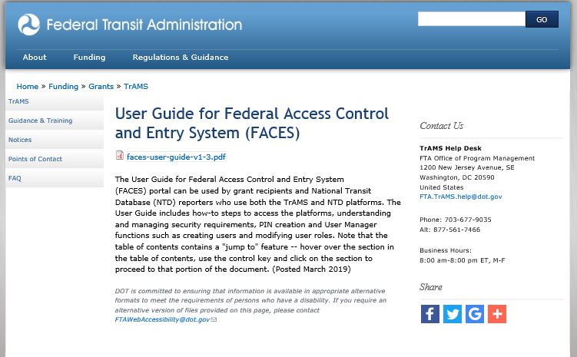
FACES User Guide
Notes:
https://www.transit.dot.gov/funding/grantee-resources/teamtrams/user-guide-federal-access-control-and-entry-system-faces
There is an embedded link in the slide which will take you to the FACES webpage.
Federal Access Control and Entry System – FACES is used by all individuals accessing TrAMS.

Slide 64


