Slide 1
FY 2020 TrAMS User Recertification
Webinar for TrAMS Recipient User Manager
November 14th, 2019
and
November 19th, 2019

Slide 2
Please record this session

Slide 3
Contents
Introduction to Recertification
Demonstration
Question & Answer

Slide 4
Why Are We Offering this Training Now?
It’s been over 4 years since we deployed TrAMS—time for a refresher.
The window for recertification that User Managers must perform is coming up soon.

Slide 5
Recertification Overview
To satisfy DOT security requirements, all system (TrAMS, NTD, OTrak, DGS etc.) user roles must be reviewed and approved on an annual basis.
Recertification is the role review process and determines whether a user's roles are re-approved or removed.
Recertification is an audit process where users who have role management responsibilities review and re-approve other users.
Annual recertification occurs on a standard, reoccurring cycle.

Slide 6
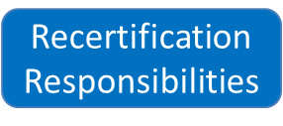
Recertification Hierarchy
The recertification process starts with users with the most responsibilities and moves down the hierarchy from there.

Slide 7
Recertification Time Frame
Recertification 'windows' are the time frames (start and end dates) in which a group of roles must be recertified.
Each recertification window includes the roles being certified and their certifiers.

Slide 8
TrAMS Recertification Windows for 2019-2020
Certification Group | Certified By | Start Date | End Date
TrAMS User Managers | Local Security Managers (LSMs) | 11/1/2019 | 11/30/2019
TrAMS Organization Users | User Managers | 12/1/2019 | 1/31/2020

Slide 9
Recertification Process
The recertification period opens on December 1st, 2019.
Automatic emails from “noreplyFACES@dot.gov” are sent to users with role management responsibilities (certifiers) notifying them that the recertification window is about to open.
Certifiers access the “Recertify Users” action, review user roles, and certify users.
Certifiers receive email reminders 14, 7, and 1 day(s) prior to the end of their recertification window; and on the day window ends.
The recertification period closes on January 31, 2020.
Users who have not been recertified are locked from accessing the platform or have their uncertified roles removed.
After two weeks, users locked by recertification are deactivated and lose all access to TrAMS.

Slide 10
14, 7, and 1-Day Email Reminders for User Managers Prior to Recertification Window’s Closure

Slide 11
Recertifying Recipient Organization Users Overview
Recipient User Managers (UMs) will recertify users within their agency during the certification windows.
UMs can access the ‘Recertify Users’ Action and can certify one or more users at a time.
UMs can also opt to manage a user’s role(s) using the existing ‘Manage User Role’ related action functionality.
If users have multiple roles, only uncertified roles will be removed. The users will retain access to any system for which they have roles.

Slide 12
FAQs
What happens to users with multiple roles?
Users who have multiple roles will have to have each role recertified by their Certifier.
Can you only recertify some of the roles?
The Certifier may elect to only recertify some of a user's roles. In this situation, the user will lose only those roles and will not be locked out of the system.
What if I’ve been locked out or am missing roles after recertification?
Users who have lost roles or have been locked out of the system will contact their Certifier in order to reinstate their roles.

Slide 13
FAQs
Can UMs recertify their own roles ?
No, you cannot recertify your own TrAMS roles. However, another UM in your organization can recertify your roles or an FTA LSM can recertify a UM’s roles.

Slide 14
Who to Contact With Questions
Your local security manager
The TrAMS Help Desk: FTA.TrAMS.Help@dot.gov
TrAMS Roles and Role Management (FACES) User Guide

Slide 15
How to Recertify Users

Slide 16
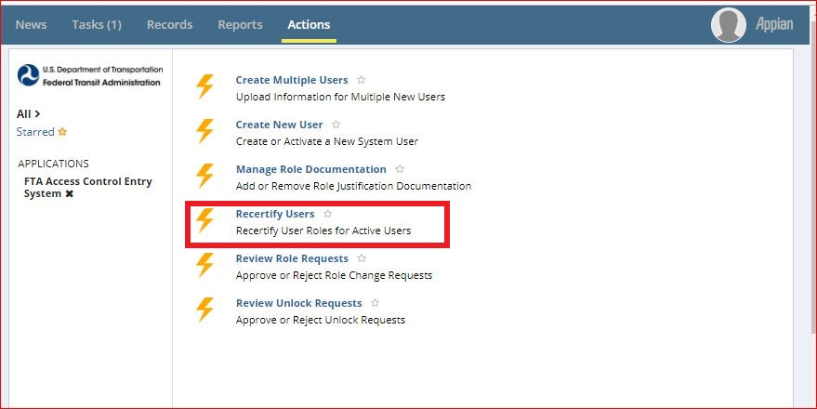
Step 1 – Navigate to FACES Application
Log into: https://faces.fta.dot.gov/suite/
Click Actions, and then click on Recertify Users

Slide 17
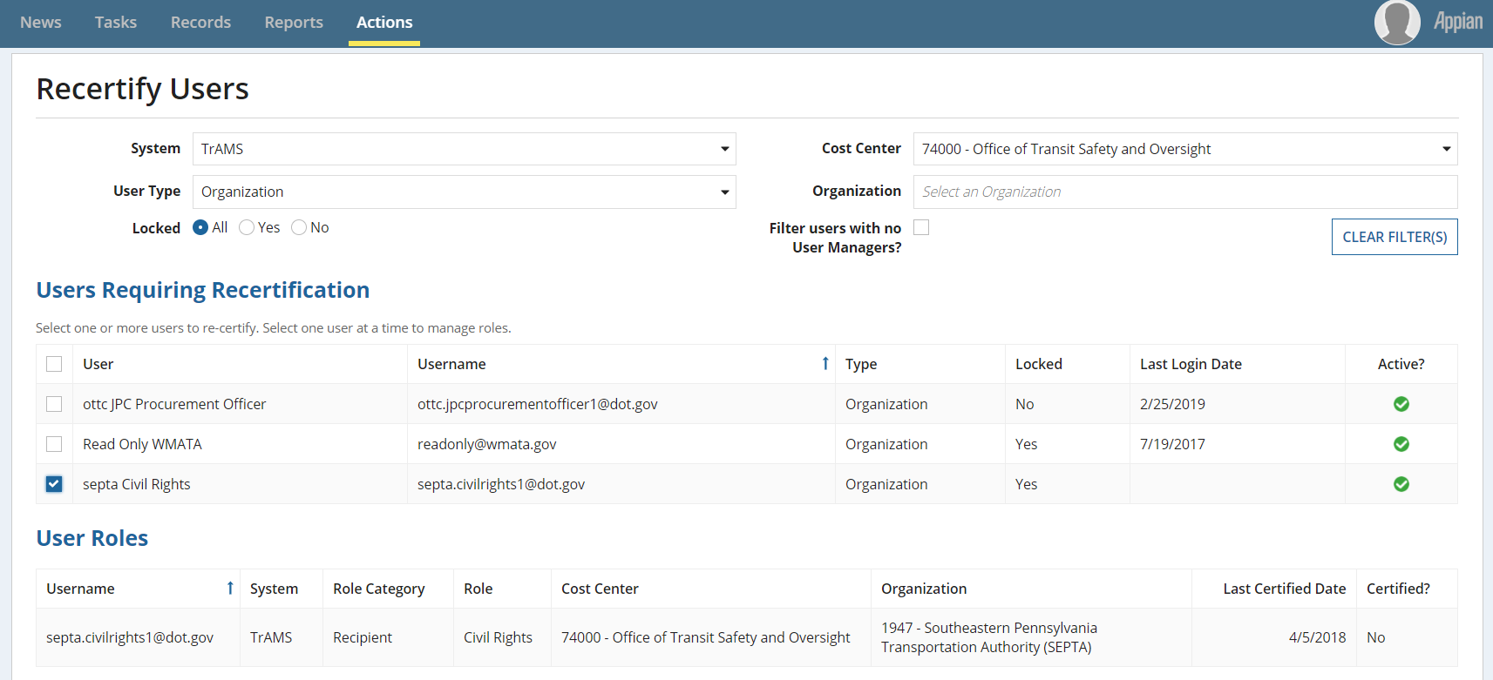
Step 2 – Select users to certify:
On the Recertify Users page, you can select a user to recertify by clicking the checkbox next to their name.
You can select multiple users at once.

Slide 18
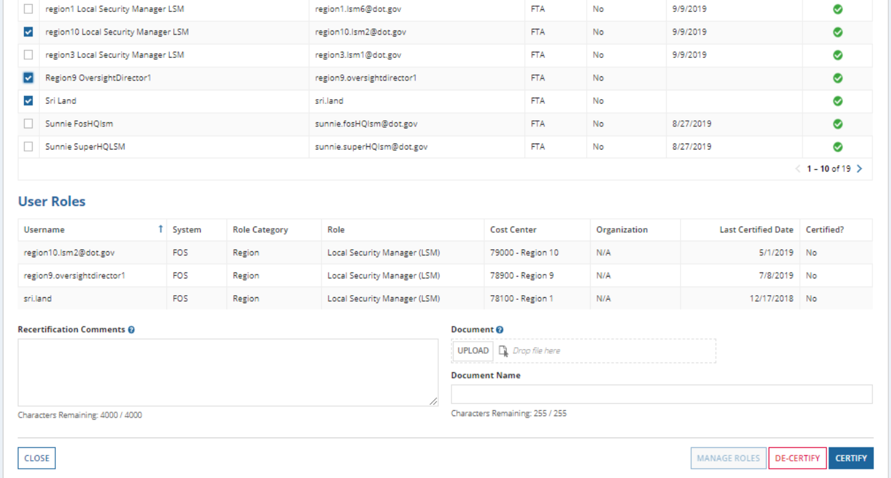
Step 3 - Verify Roles:
Review the selected user(s) role(s) and details.
Use this to verify that the user has the appropriate roles.

Slide 19
Step 4 – (Optional) Provide Comments:
The Certifier (User Manager) may enter recertification comments and upload supporting documentation.
Certifiers can do this whenever they want to provide additional information.

Slide 20
Step 5a - Return to Actions Page:
Clicking on Close will return the Certifier to the Actions page.
Use this when you want to exit the recertification page without making changes.

Slide 21
Step 5b – Manage User Roles:
To manage user roles click on Manage Roles which will allow the certifier to manage the selected user’s role(s).
This will allow the Certifier to modify existing roles before completing recertification.
The Certifier will only be able to manage roles for one user at a time.

Slide 22
Step 5c – De-certify User Roles:
Only click on the De-certify button if the user should not have the listed roles in the coming year.
Clicking on De-certify will prompt the system to display a confirmation message.
If a user has no other certified roles the decertify action will deactivate the user.

Slide 23
Step 5d – Certify Selected User(s):
Use the Certify button to complete recertification for the selected user(s)
Clicking on Certify will prompt the system to display a confirmation message.
User’s role is certified until the next recertification period.

Slide 24
Roles Removed Notification
If a UM recertifies some of a user’s roles but not other roles, the user will receive an email notification informing them that they must submit a request to their User Manager, Local Security Manager, or Global Security Manager to certify and re-instate role/roles.

Slide 25
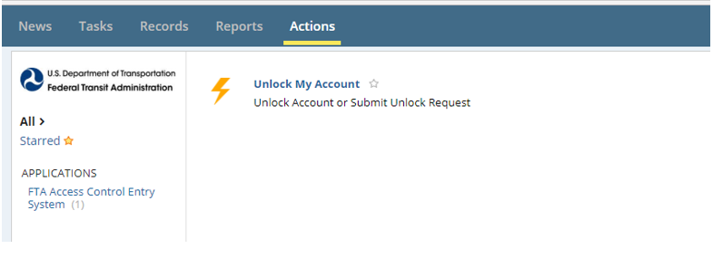
Locked Users
A user is locked if all of their roles are not recertified within the recertification window.
A user who is locked due to uncertified roles can only access the submit recertification Unlock Account request From Action.

Slide 26
Roles Locked Notification
If all of a user’s roles are not certified within the window, the user will be locked and an email notification will be sent.
From: FTA Lock Subject: ALERT: Account Locked
Our records indicate that you were not recertified for the following applications: TrAMS Your account has been automatically locked. You can log in to your account for the purpose of submitting an unlock request; however, you will no longer have access to any functions or records. If you require access you may login and use the 'Request to Unlock Account' action to submit an Unlock Request. If your account is not unlocked within 14 days your account will be deactivated. Please do not reply to this email. This is an automated message.

Slide 27
Self Unlock is Disabled
The normal self-unlock method of answering security questions is disabled if a user is locked due to uncertified roles.
The user must submit an unlock request to their certifier if they want to be unlocked.

Slide 28
Reviewing Unlock Requests
Certifier logs into FACES and navigates to their Actions tab to review unlock requests.

Slide 29
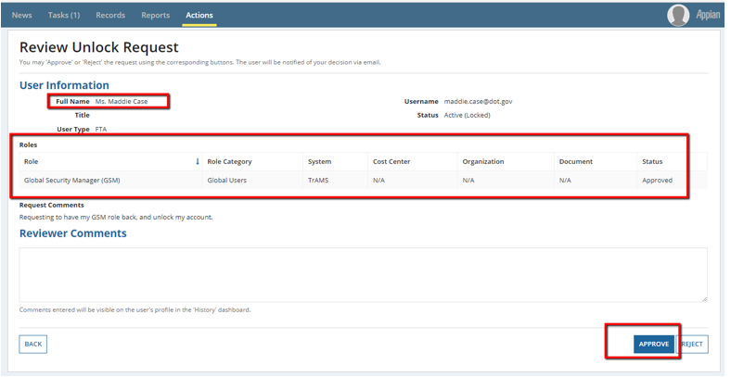
Role is Certified if User is Unlocked
When an unlock request is approved the role is automatically certified. No further action is need to recertify the user.

Slide 30
Unlock Request Approved Notification
Once the account is unlocked by the certifier, the user will get an email.

Slide 31
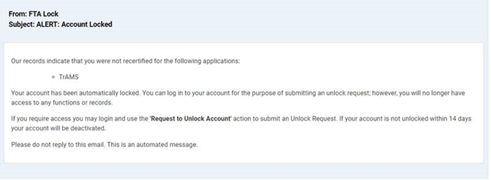
Deactivated from the System
If the Locked user is not certified/unlocked within two weeks, the user is deactivated from the system.
Deactivated users will receive the following email:

