Slide 1

You Served Our Country, Now Let Us Serve YOU
Name of Program
Tagline
[Here the grantee should insert name of the organization
and the logo for the program i.e. “One Click One Call”]

Slide 2
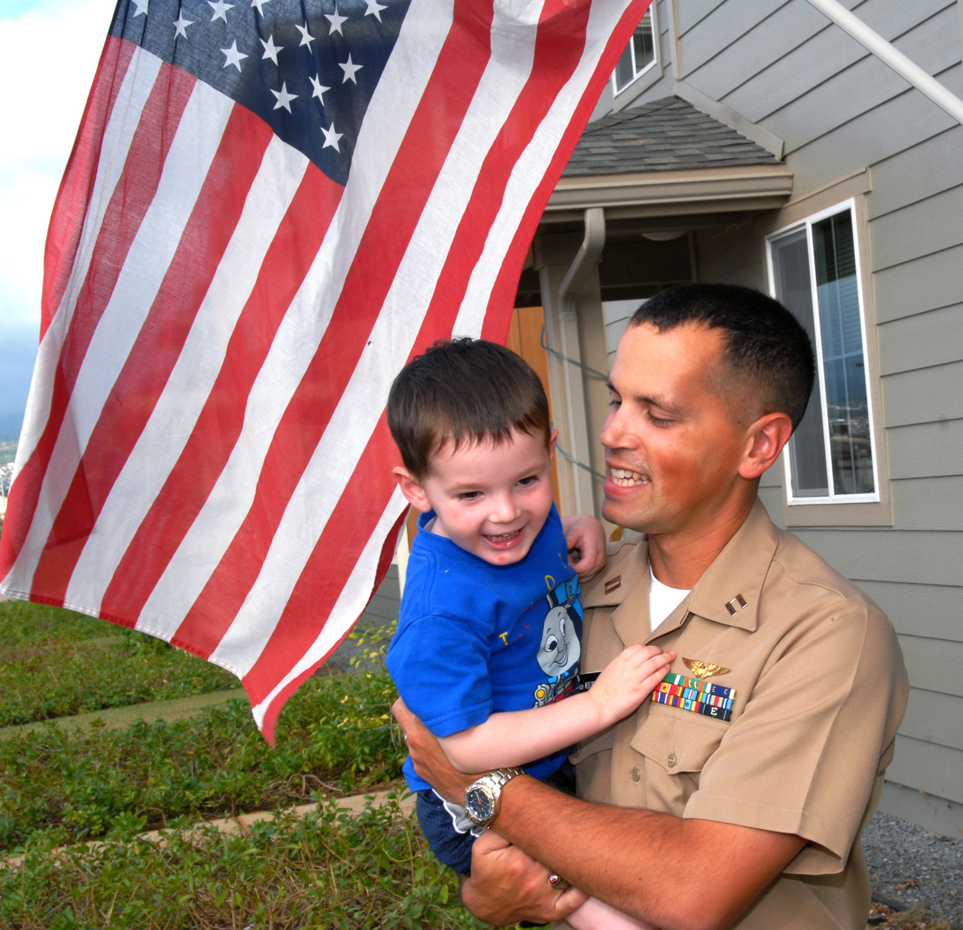
You Served Us, Let Us Serve You
Insert Logo Here
Your community wants to say THANK YOU for your service to our nation by helping you find a reliable ride.
Better transportation coordination means easy access for participants!

Slide 3
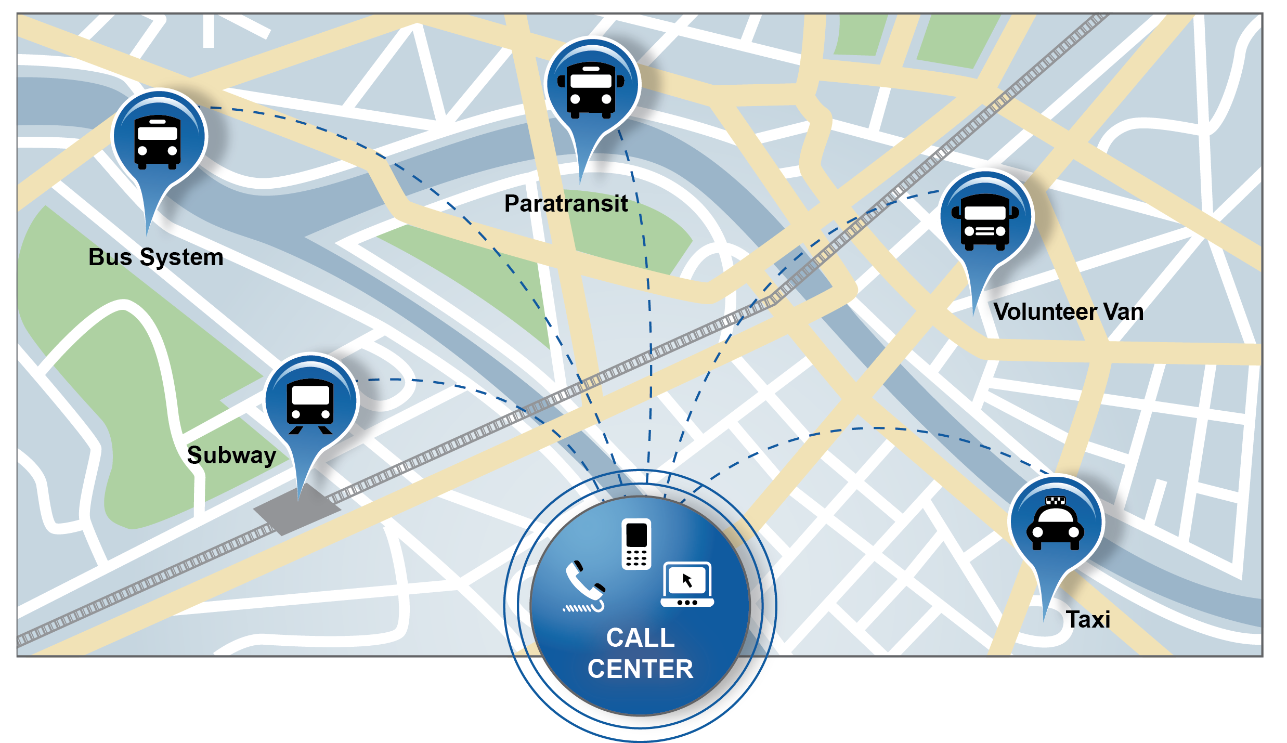
[INSERT NAME OF PROGRAM]
Insert Logo Here
We offer one place to access and connect Service members, Veterans, and military Families to local transportation options!
Just [SELECT APPROPRIATE: CALL, TEXT, EMAIL] [1-800-XXX-XXXX or EMAIL@SERVER.COM] to connect to all of the available modes of transportation in [INSERT COMMUNITY LOCATION]
A call center representative will be available from [INSERT TIME FRAME] to [INSERT TIME FRAME] to respond to your transportation requests
  Transportation drop off and pick up locations may be to: [LIST TRANSPORTATION DROP OFF LOCATIONS I.E. WORK, PRACTICES, SHOPPING, APPOINTMENTS, ETC.]
Connecting America's Military Community to the Opportunities they Deserve

Slide 4



Military Community Engagement
Insert Logo Here
Data Collection [LIST THE MILITARY AND SERVICE ORGANIZATIONS YOU CONTACTED BELOW]
Identified and engaged military installation(s) in your area to determine transportation needs
Identify and engaged Veteran, military and military Family service organizations in your area to determine transportation needs
Transportation Planning
Determined the transportation gaps by comparing the feedback from the military community and service organizations to current transportation options
Worked with the military community and assessed feasibility of additional transportation options in the community
Results
Based on the results from the assessment, the following transportation recommendations were identified:
[INSERT KEY ELEMENTS OF YOUR PROGRAM BASED ON ASSESSMENT RESULTS]
Military Engagement Process
1
2
3
Data Collection
Transportation Planning
Results

Slide 5



Services Offered
Insert Logo Here
CALL
TEXT
EMAIL
"One-click, one-call" centers will better connect you with a range of reliable and affordable transportation options to:
  [INSERT APPROPRIATE EXAMPLES FOR YOUR PROGRAM – SAMPLES BELOW]
  Your job
  The supermarket
  Your child’s day care center or school
  Medical facilities
  And other essential destinations

Slide 6



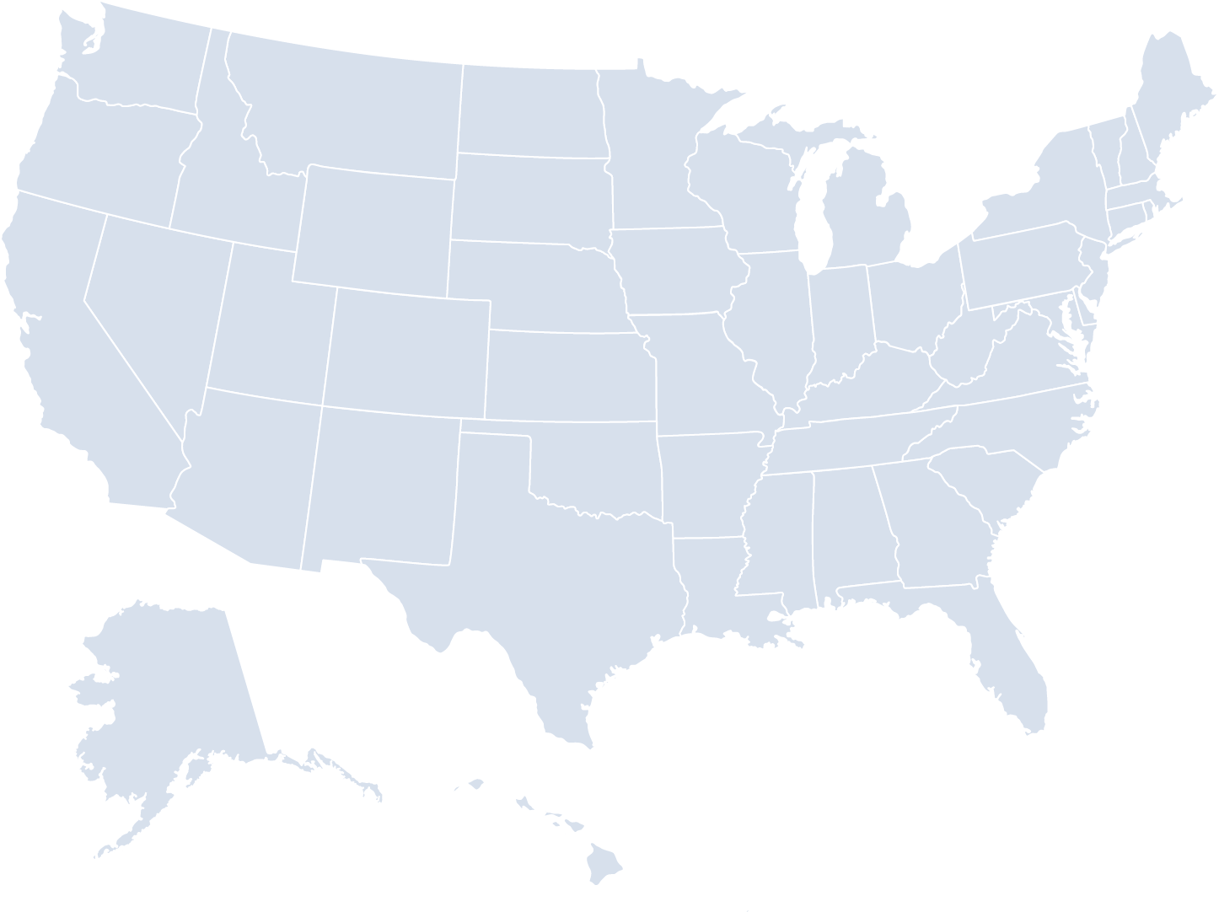
Transportation Options & Partners
Insert Logo Here
Service | Who Qualifies? | Operating Hours | Geographic Coverage
[INSERT TYPE OF SERVICE AVAILABLE I.E. SUBWAY, BUS, PARATRANSIT, ETC] | [INSERT QUALIFING FACTORS FOR EXAMPLE, ONLY DISABLED INDIVIDUALS QUALIFY FOR PARATRANSIT] | [INSERT HOURS OF OPERATION FOR THE SERVICE LISTED] | [INSERT THE GEOGRAPHIC COVERAGE FOR SERVICE LISTED. FOR EXAMPLE, THE SUBWAY MAY ONLY SERVICE WITHIN CITY LIMITS]

Slide 7
Who We Are
Insert Logo Here
[INSERT A BRIEF OVERVIEW ABOUT YOUR ORGANIZATION]
For addition information about [INSERT NAME OF PROGRAM], please contact [INSERT APPROPRIATE CONTACT INFORMATION]

Slide 8


Department of Transportation (DOT)
Insert Logo Here
The Veterans Transportation and Community Living Initiative is a collaboration between the Department of Transportation (DOT) and the Federal Transit Administration (FTA) to help Veterans, Service members and military Families bridge the transportation gap.
The FTA is investing in 55 different "one-click, one-call" transportation resource centers across the country, bringing more transportation choices to our military heroes and their Families.
This project will bridge the transportation gap by helping communities build or expand centers that offer information on local transportation options by phone, internet or both.
This program is a way to thank America's military community for their tremendous service.

Slide 9

QUESTIONS
Insert Logo Here

