Slide 1
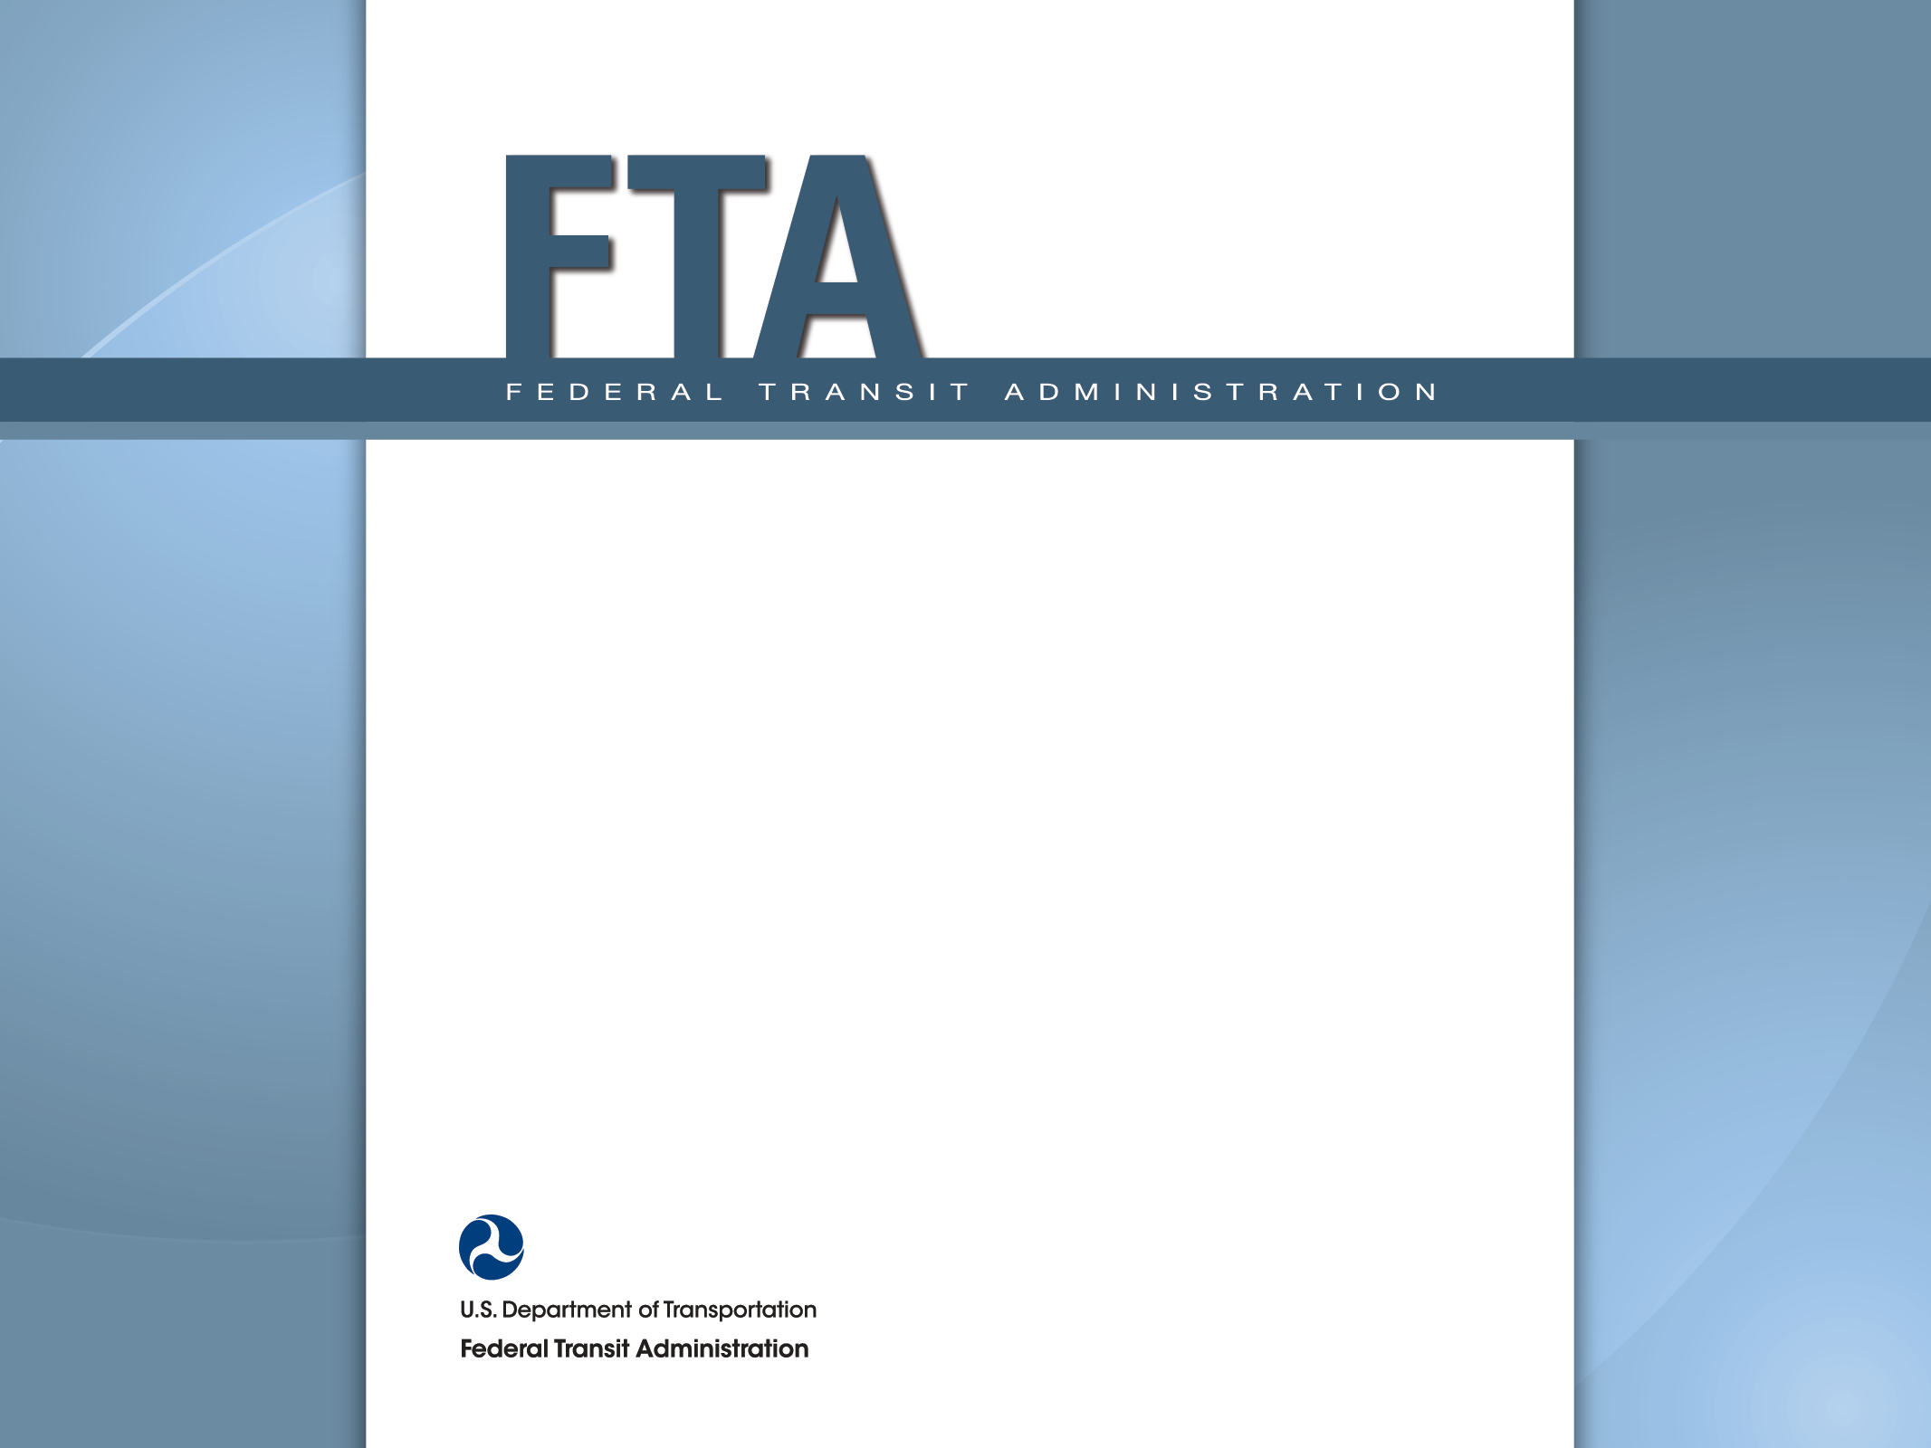
Guidance Overview for Disposition of Real Property Acquired with FTA Financial Assistance May 20, 2014 Valencia McFerrin Director, Office of Grants Management and Guidance

Slide 2
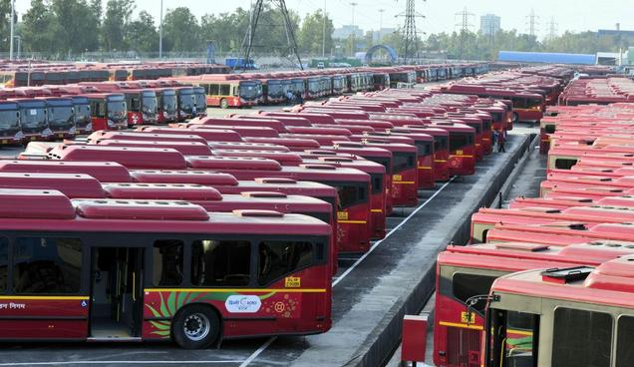
DISPOSITION
What it means……..
The settlement of the federal interest in property that is no longer needed for the originally authorized purpose.

Slide 3
When real property is no longer needed for any transit purpose, the grantee must request disposition instructions from FTA.

Slide 4
Overview of Guidance For Disposition of Real Property
The Office of Management and Budget (OMB) has established guidance standards for disposition of real property.
FTA Circular 5010.1D provides specific guidance for FTA grantees regarding the disposition of real property acquired with FTA financial assistance.

Slide 5
Grantee Requirements
Grantee should prepare an excess property inventory and utilization plan for all property that is no longer needed to carry out any transit purpose
Grantee inventory plan should identify and explain the reason for excess property
Grantee must request disposition instructions from FTA when real property is no longer needed for any transit purpose

Slide 6
Disposition Methods Property used for Original Authorized Purpose
Sell and reimburse FTA - competitively market and sell the property and pay FTA;
Offset – sell property and apply proceeds from sale to replacement property under the same program;
Sell and use proceeds for another capital project – sell property and use proceeds to reduce the project cost of another FTA eligible transit project;

Slide 7
Disposition Methods (cont’d) Property used for Original Authorized Purpose
4) Sell and keep proceeds in open project - if grant is still open, grantee may sell excess property and apply proceeds to original cost of real property purchased for that project;
5) Transfer to public agency for non-transit use - transfer property to a public agency with no repayment to FTA;

Slide 8
Disposition Methods (cont’d)
Property used for Original Authorized Purpose
6) Transfer to other project - transfer property to another FTA eligible project;
7) Retain title and remit federal interest - compensate FTA by computing percentage of FTA participation in the original cost

Slide 9
Disposition
Property not used for Original Authorized Purpose
Dispose of property
Repay FTA amount of original investment or
Repay FTA share of FMV whichever is greater

Slide 10
For follow up questions or comments, contact:
Valencia McFerrin
Director, Office of Grants Management and Program Guidance at:
valencia.mcferrin@dot.gov or
(202) 366-1254

Slide 11
Federal Transit Administration
www.fta.dot.gov

