Slide 1
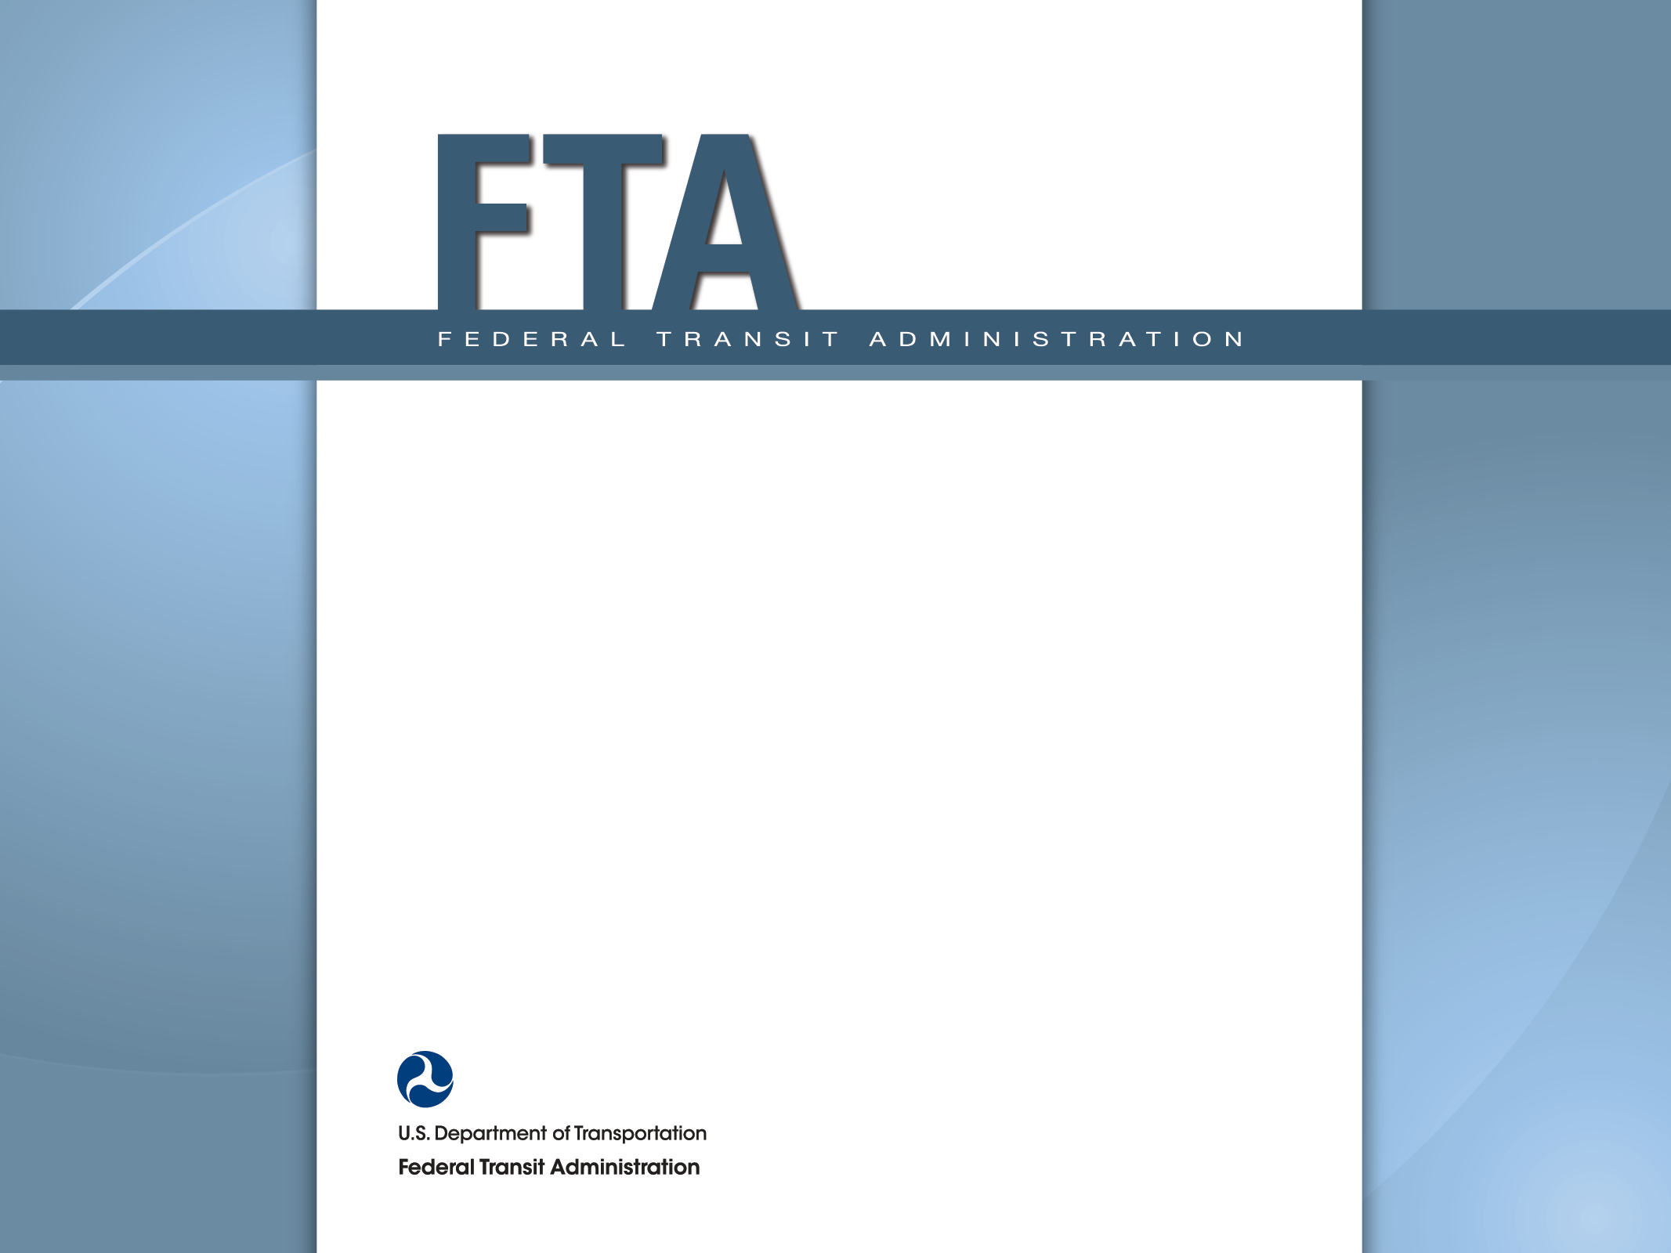
APTA Annual Meeting Safety Rulemaking Update October 6, 2015

Slide 2
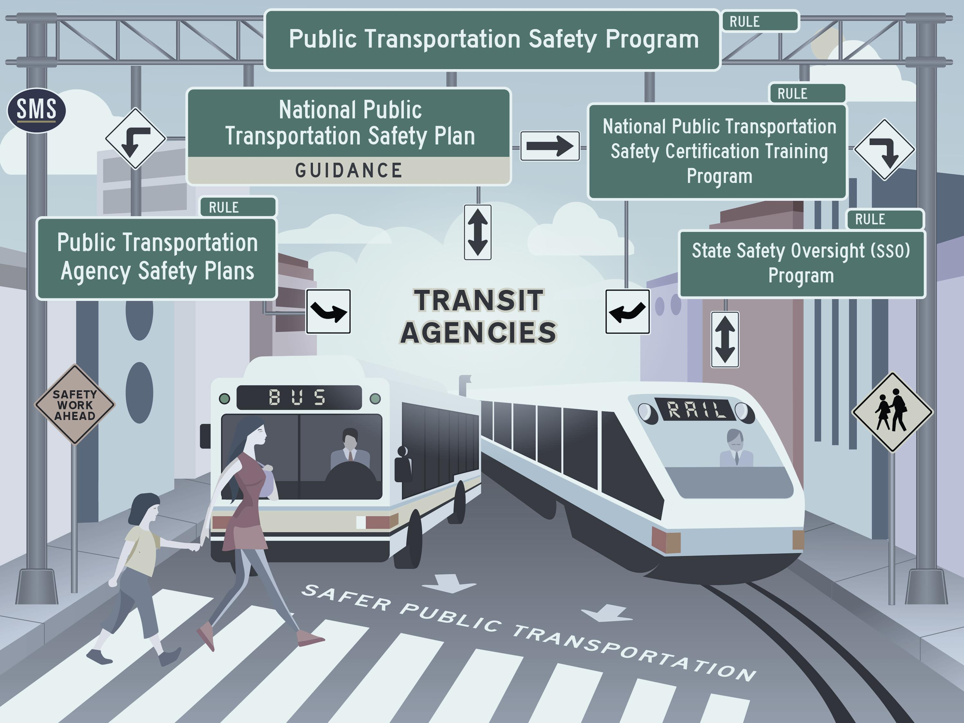
Notes:
Since 1964, FTA, which finances nearly half of the capital expenditures for transit systems nationwide, had been prohibited by law from issuing basic safety standards to protect transit passengers and workers. With MAP-21, FTA is entering brand new territory.
For rail transit specifically, previous weak authority contributed to insufficient and inconsistent State oversight
Several high profile accidents, coupled with weak or non-existent State oversight, sparked renewed focus on transit safety
In December 2009, the Administration transmitted to Congress the first piece of legislation ever submitted that was solely about public transportation
In July 2012, President Obama signs into law MAP-21, which authorized the Public Transportation Safety Program, codified at 49 U.S.C. Section 5329.
For the first time FTA is able to close the loophole in inadequate transit safety oversight and enforcement.
FTA is proposing a flexible and scalable approach to implementing its new safety authority. Each of the components of the program will become part of a comprehensive framework to improve safety of the Nation’s public transportation systems
This graphic depicts the transit safety rulemaking components as envisioned under MAP-21, With the Public Transportation Safety Program NPRM establishing the structure of FTA’s oversight, based on the guiding principles of Safety Management Systems or SMS, and guided by the National Public Transportation Safety Plan.

Slide 3
Public Transportation Safety Program NPRM
“Umbrella” document for all of the other Safety rulemakings and guidance
Formally establishes FTA’s safety policy - Safety Management Systems (SMS)
Sets rules of practice under FTA’s enforcement authority
Commits FTA to creating and implementing a National Public Transportation Safety Plan

Slide 4
National Public Transportation Safety Plan
Provides a tool for FTA to communicate information to the transit industry and provide updates about safety performance
Provides guidance on Safety Management Systems
Future plans will provide additional guidance, technical assistance, tools, and best practices

Slide 5
Public Transportation Agency Safety Plan (TASP)
Agencies will need to establish a safety plan, as set forth by the requirements in MAP-21
Defines how operators will implement SMS
Applies to all operators of Public Transportation Systems that receive Chapter 53 funds
States may draft and certify state-wide plans for small operators
Agencies set performance targets for safety and State of Good Repair, based on criteria in the National Public Transportation Safety Plan

Slide 6
State Safety Oversight (SSO) NPRM
Comment period closed on April 28, 2015
Received comments from 55 respondents
Reviewing, identifying issues to be addressed in final rule
Anticipate publication in Spring 2016
Within three years of the effective date of the final rule, SSOAs will need to meet the regulatory requirements

Slide 7
Safety Certification Training Program NPRM
Establishes a minimum training baseline for Federal and State personnel who conduct audits and examinations of public transportation systems and for employees of public transportation agencies who are directly responsible for safety oversight of their systems.
FTA published Interim Provisions for the Public Transportation Safety Certification Training Program in the Federal Register on February 27, 2015
The Interim Provisions became effective on May 27, 2015
Notes:
The Safety Certification Training Program competencies are based on SMS principles and the technical capabilities required for examining and overseeing implementation of safety program elements in the public transportation industry. The competencies and technical training are also designed to address gaps in safety oversight of public transportation systems identified in NTSB accident investigations, FTA’s SSO audits and program, triennial reviews and annual reports submitted by SSO agencies, and NTD assessments and special studies.

Slide 8
Safety Certification Training Program NPRM
Interim Provisions require participation of the following:
Federal and State personnel (and contractors) who conduct safety audits and examinations of public transportation systems; and
Employees of public transportation agencies directly responsible for safety oversight.
Continues the voluntary component for bus transit 5307/5311 (who are designated as safety oversight)
Continues the voluntary component for State DOTs (who conduct audits or examinations of public transportation systems)
Mandatory participants have 3 (three) years to complete the required curriculum
Notes:
This will establish Interim Provisions as a Reference Document in the NPRM – thereby they become the final provisions.
Once a final rule is in place, the Reference Document will be updated as needed in order to update TPSCTP training requirements, via notice and comment, and additional rulemaking will not be required. This allows FTA flexibility to respond to events, industry needs, national safety program requirements, etc.

Slide 9
What is SMS?
SMS is a formalized approach to identifying safety concerns, evaluating them for safety risk, and developing risk-reducing strategies.
SMS helps to answer these questions:
What will cause our next accident?
How do we know this?
What are we doing about it?
Is it working?
How do we know it is working?
Notes:
SMS means the formal, top-down, organization-wide data-driven approach to managing safety risk and assuring the effectiveness of safety risk mitigations. SMS includes policies, procedures, and practices for the management of safety risk.
At the transit agency level, SMS aids in:
Identifying hazards
Assessing consequences of those hazards
Assessing risk (severity and likelihood)
Determining mitigations
Assessing performance of the mitigations

Slide 10
Safety Management Systems
CAVEAT EMPTOR
CAVEANT ADMONITUS

Slide 11
Where to find more information on SMS?
FTA’s SMS Framework – SMS - Getting Ready – is posted on our website at:
http://www.fta.dot.gov/tso_15176.html
Notes:
FTA’s SMS Framework – SMS - Getting Ready – is posted on our website at http://www.fta.dot.gov/tso_15176.html

Slide 12
Outreach and Communications
Webinars
Industry Conference Presentations
Dear Colleague Letters
Blogs
Social Media Postings
Facts Sheets/FAQs

