Slide 1
TEAM Training: Program Management
Last Update: May 2011

Slide 2
Program Management
Grant Reporting Requirements
Federal Financial Reports
Milestone Progress Reports
Budget Revisions
Grant Closeouts

Slide 3
FTA Reporting Requirements
Reporting is required by FTA Circular 5010.1D “Grant Management Requirements” Chapter III, Section 3 – available on FTA’s website http://www.fta.dot.gov/laws/circulars/leg_reg_8640.html
Reporting is a Grantee’s primary way of communicating grant activities to FTA

Slide 4
Reporting in TEAM Web
Quarterly or Annual Reports - due 30 days after the end of the quarter in which they are due
Federal Financial Report
Milestone Progress Report

Slide 5
Reporting Annual vs. Quarterly
Over 200,000 UZA: Quarterly
Construction Grants: Quarterly
ARRA Grants: Quarterly
Non-construction
Grants in areas with
less than 200,000 UZA: Annual

Slide 6
Reporting Timeframes
Quarters follow Federal Fiscal Year
Quarter 1: October 1st – December 31st
Reports due by January 30
Quarter 2: January 1 – March 31st
Reports due by April 30
Quarter 3: April 1st – June 30th
Reports due by July 30
Quarter 4: July 1st – September 30th
Reports due by October 30

Slide 7
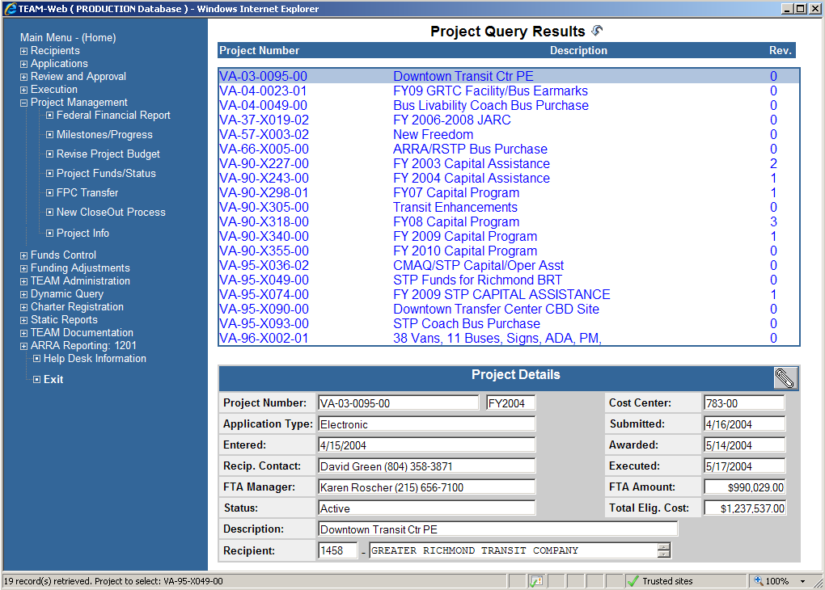
Program Management

Slide 8
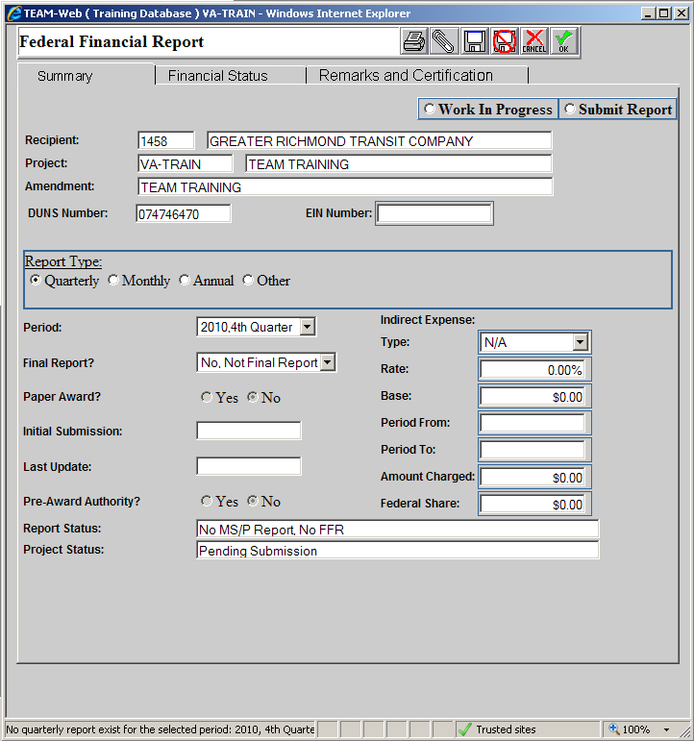
FFR: Summary Tab
1
2
3
Notes:
Report Type
Select this is a quarterly or annual report (most typical).
Grantee should know whether they report quarterly or annually.
If not sure contact FTA Program Manager
Period & Final Report?
Need to select both the appropriate reporting period and whether or not it is a final report or not.
Indirect Expense
Only applies of a Cost Allocation Plan has been submitted and approved by FTA as the cognizant agency.
The purpose of the FSR is to provide a current, complete, and accurate financial picture of the grant. This report is submitted electronically in TEAM and must be prepared on the accrual basis of accounting; that is, income is recorded when earned instead of when received, and expenses are recorded when incurred instead of when paid. FTA does not allow the FSR to be prepared in the cash method of accounting. A grantee may keep its books on the cash basis during its accounting year. If this is the case, at the submission of the FSR, the grantee must prepare the necessary accruals and submit the FSR on the accrual basis of accounting.
The FSR must contain the following elements:
All financial facts (e.g., expenditures and obligations) relating to the scope and purpose of each financial report and applicable reporting period should be completely and clearly displayed in the reports.
Reported financial data should be accurate and up to date. The requirement for accuracy does not rule out inclusion of reasonable estimates when precise measurement is impractical, uneconomical, unnecessary, or conducive to delay.
Financial reports should be based on the required supporting documentation maintained in the grantee’s official financial management system that produces information which objectively discloses financial aspects of events or transactions.
Financial data reported should be derived from accounts that are maintained on a consistent, periodic basis; material changes in accounting policies or methods and their effect must be clearly explained.
Reporting terminology used in financial reports to FTA should be consistent with receipt and expense classifications included in the latest approved project.
The FSR screen in TEAM consists of three tabs: Summary, Financial Status and Remarks, and Comments.
The Summary tab provides basic information, with entry fields for the Period of the FSR, Initial Submission, and Last Update dates. It also allows the grantee to select whether it is a Final Report, a Paper Award, or if the grantee used Pre- Award Authority. It is important to enter in this tab whether the grantee is charging indirect costs to the grant.

Slide 9
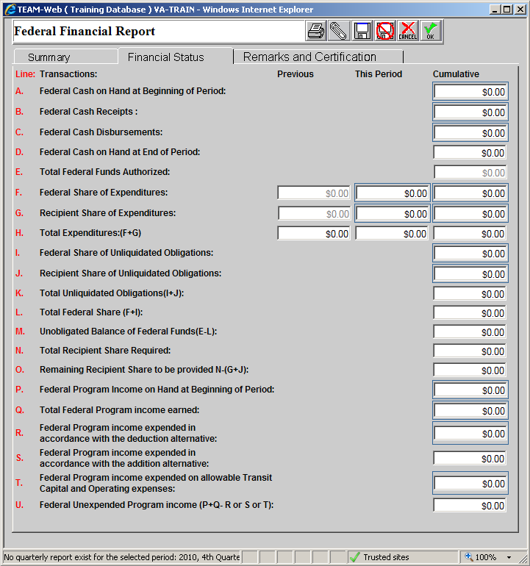
FFR: Financial Status Tab
Notes:
Federal Cash on Hand at beginning of period
Enter any cash on hand if any at the beginning of the grant.
In most instances, this line will be zero.
Federal Cash Receipts
Enter the cumulative amount of actual cash received from FTA for this grant as of the reporting period end date.
Report this amount on a cash basis
Federal Cash Disbursements
Cumulative amount of Federal funds disbursed as of the reporting period end date.
Disbursements = sum of actual cash disbursements for direct charges for goods and services, the amount of indirect expenses charged to the grant, and the amount of payments made to subrecipients and contractors.
Report this amount on a cash basis
Federal Cash on Hand at End of Period (Calculated by TEAM)
This is the sum of lines A + B – C.
If there is Cash on Hand, FTA requires an explanation in the Remarks and Certification Tab, explaining why the drawdown was made prematurely or other reasons for the excess cash.
Total Federal Funds Authorized (Calculated by TEAM)
This is the total amount of all federal funds in the grant including amendments.
Federal Share of Expenditures
Of the total project costs, enter the amount FTA will participate.
You can enter this information in either the “This Period” section or the “Cumulative section”; however do not enter in both sections.
Expenditures are the total project costs (less any rebates, refunds or other credits) incurred on the accrual basis of accounting.
Example of expenditures are:
the sum of cash disbursements for direct charges for property and services;
the amount of indirect expense incurred;
the amount of in-kind contributions, and
net increase or decrease in Accounts Payable or Accrued Expenses
Recipient Share of Expenditures
Of the total project costs, enter the amount the grantee will pay.
You can enter this information in either the “This Period” section or the “Cumulative section”; however do not enter in both sections.
Enter the recipient share of actual cash disbursements or outlays (less any rebates, refunds, or other credits) including payments to subrecipients and contractors.
This amount may include the value of allowable third party in-kind contributions.
Should equate to Line N (Total Recipient Share Required ) on the final report
Report this amount on an accrual basis
Total Expenditures (Calculated by TEAM)
Total of all expenditures (total project costs) as of the end of the reporting period.
Federal Share of Unliquidated Obligations
Enter the Federal portion of unliquidated obligations
binding commitments entered into for goods and services not yet received.
On the final report, this line should be zero.
Report this amount on an accrual basis
Recipient Share of Unliquidated Obligations
Enter the local share of unliquidated obligations.
Total Unliquidated Obligations (Calculated by TEAM)
Total of grantee binding commitments entered into for goods and services not yet received.
Total Federal Share (Calculated by TEAM)
The total FTA is expected to contribute to the Total Project Costs.
This is the sum of Federal Share of Expenditures (Line F) and Federal Share of Unliquidated Obligations (Line I).
Unobligated Balance of Federal Funds (Calculated by TEAM)
Federal share of the grant the grantee has not entered into a binding commitment.
Total Recipient Share Required (Calculated by TEAM)
This amount represents the total required recipient share for the grant including amendments.
The required recipient share should include all matching and cost sharing provided by recipients and third-party providers to meet the level required by FTA.
Remaining Recipient Share to be Provided (Calculated by TEAM)
The Total Recipient Share required (Line N) minus the sum of Recipient Share of Expenditures (Line G) and the Recipient Share of Unliquidated Obligations (Line J).
Federal Program Income on Hand at the Beginning of the Reporting Period
Enter any unspent Federal Program Income on hand at the beginning of the grant.
In most instances, this line will be zero.
Total Federal Program Income Earned
Enter the amount of Federal program income earned as of the end of the reporting period.
Program income is gross income received by the grantee or subgrantee directly generated by a grant supported activity, or earned only as a result of the grant agreement during the grant period.
Examples: income from
Fees for services performed,
From the use or rental of real or personal property acquired with grant funds,
From the sale of advertising and concessions, and
From the sale of commodities or items fabricated under a grant agreement.
Federal Program Income Expended in Accordance with the Deduction Alternative
Enter the amount of program income that was used to reduce the Federal share of the total project cost.
Only to be used if the grantee does not exercise the provisions of the Common Rule @ 49 CFR part 18.25(g)(5).
As a rule of thumb, this field is zero.
Federal Program Income Expended in Accordance with the Addition Alternative (Calculated by TEAM)
FTA does not allow this method – this field is zero.
Federal Program Income Expended on Allowable Transit Capital and Operating Expenses
Of the Federal program income earned, enter the amount the grantee is allowed to spent on allowable transit capital and operating expenses as provided in the Common Rule at 49 CFR part 18.25(g)(5)
Unexpended Federal Program Income (Calculated by TEAM)

Slide 10
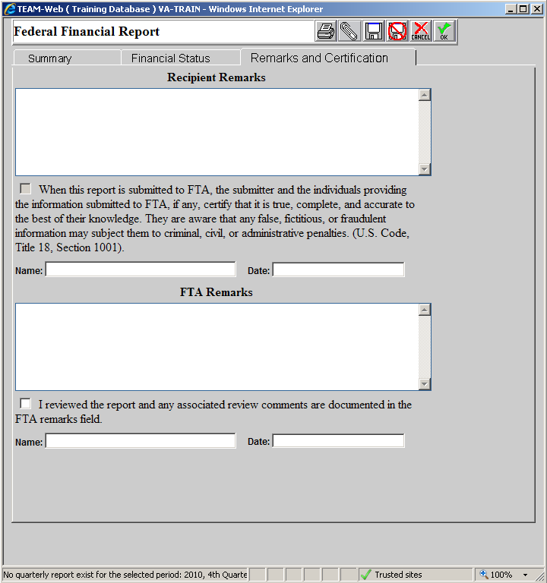
FFR: Remarks and Certifications Tab
1
2
3
4
Notes:
Recipient Remarks
This box should be used for explanations based on the numbers entered on the previous tab.
For example, if there is federal cash on hand at the beginning of the period, the explanation for that should be provided in this box.
Certification
Added language for compliance
Mandatory check box next to the above language for the user to show that they have agreed
Certified by Name and Date
These fields will be automatically populated by TEAM when the FFR screen is saved based on the logged-in user and the day they completed the certification.
FTA Remarks
The FTA Program Manager responsible for managing the particular grant will provide comments back to the grantees in this box.
Any comments should be corrected in the NEXT FFR/MPR submittal
Will also provide their own certification that the FFR/MPR was reviewed and all comments are provided in this box.

Slide 11
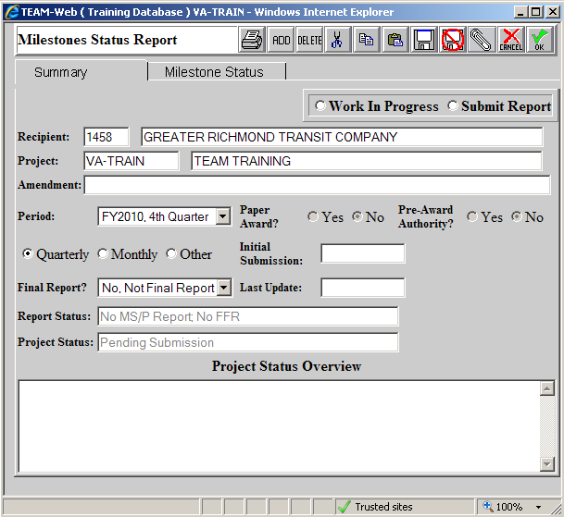
MPR: Summary Tab
1
2
3
Notes:
Work In Progress/Submit Report
These selections will allow the grantee to make changes to the MPR without actually submitting the report
Final Report?
This selection should be made when submitting the final report.
Project Status Overview
This box allows the grantee to provide a general update on the status of the projects contained in the grant.
An overview should be provided every time a report is submitted.
The overview should start with the reporting period followed by the general overview.
The overview provided should be similar to providing the project details during the grant development phase.
The MPR is the primary written communication between the grantee and FTA. This report should be submitted electronically in TEAM. If only operating assistance is included in the grant, the reporting requirements are limited to the estimated and actual dates when all funding has been expended. Each MPR must include the following data as appropriate:
Current status of each open ALI within the active/executed grant.
A narrative description of projects, status, any problems encountered in implementation, specification preparation, bid solicitation, resolution of protests, and contract awards.
Detailed discussion of all budget or schedule changes.
The dates of expected or actual requests for bid, delivery, etc.
Actual completion dates for completed milestones.
Revised estimated completion dates when original estimated completion dates are not met.
Explanation of why scheduled milestones or completion dates were not met. Identification of problem areas and narrative on how the problems will be solved. Discussion of the expected impacts and the efforts to recover from the delays.
Analysis of significant project cost variances. Completion and acceptance of equipment and construction or other work should be discussed, together with a breakout of the costs incurred and those costs required to complete the project. Use quantitative measures, such as hours worked, sections completed, or units delivered.
A list of all outstanding claims exceeding $100,000, and all claims settled during the reporting period. This list should be accompanied by a brief description, estimated costs, and the reasons for the claims.
A list of all potential and executed change orders and amounts exceeding $100,000, pending or settled, during the reporting period. This list should be accompanied by a brief description.
A list of claims or litigation involving third party contracts and potential third party contracts that:
Have a value exceeding $100,000,
Involve a controversial matter, irrespective of amount, or
Involve a highly publicized matter, irrespective of amount.
A list of all real property acquisition actions, including just compensation, property(s) under litigation, administrative settlements, and condemnation for each parcel during the reporting period.

Slide 12
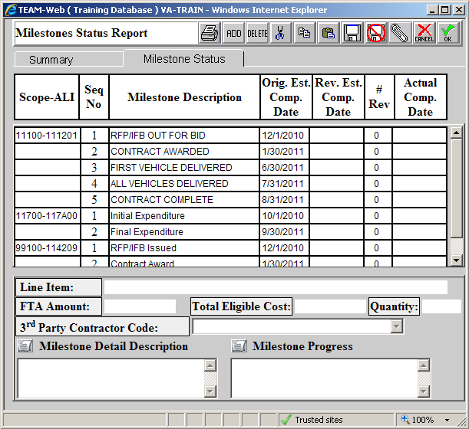
MPR: Milestone Status
1
2
3
4
5
6
Notes:
Orig. Est. Comp. Date
This is the date originally entered in the grant for each milestone.
Rev. Est. Comp. Date
As additional information is acquired for each project it might be necessary to update the estimated completion date.
That new date should be entered here.
If the original estimated completion date has passed during the course of the reporting period, a revised estimated completion date MUST BE PROVIDED.
In addition, a description of why the date was revised must be provided in the Milestone Progress Box
Start the update in this box with the reporting period followed by the explanation
Example: “4th Quarter 2010 – (Explanation of date revision)”
Also, old changes should not be deleted. The update should be provided above those old descriptions.
Rev #
The number of revisions made to that milestone.
Actual Comp. Date
When a milestone has been completed, the date it was complete should be entered in this box.
Milestone Detail Description
This is the description provided on the milestone in the original grant development
Milestone Progress
Any time a date is updated an explanation should be entered in this box, per the instructions above.

Slide 13
MPR
The MPR is the primary written communication between the grantee and FTA
Current status of each open ALI within the active/executed grant.
A narrative description of projects, status, any problems encountered in implementation, specification preparation, bid solicitation, resolution of protests, and contract awards.
Detailed discussion of all budget or schedule changes.
The dates of expected or actual requests for bid, delivery, etc.
Actual completion dates for completed milestones.
Revised estimated completion dates when original estimated completion dates are not met.
Explanation of why scheduled milestones or completion dates were not met. Identification of problem areas and narrative on how the problems will be solved. Discussion of the expected impacts and the efforts to recover from the delays.

Slide 14
MPR
Analysis of significant project cost variances. Completion and acceptance of equipment and construction or other work should be discussed, together with a breakout of the costs incurred and those costs required to complete the project. Use quantitative measures, such as hours worked, sections completed, or units delivered.
A list of all outstanding claims exceeding $100,000, and all claims settled during the reporting period. This list should be accompanied by a brief description, estimated costs, and the reasons for the claims.
A list of all potential and executed change orders and amounts exceeding $100,000, pending or settled, during the reporting period. This list should be accompanied by a brief description.
A list of claims or litigation involving third party contracts and potential third party contracts that:
Have a value exceeding $100,000,
Involve a controversial matter, irrespective of amount, or
Involve a highly publicized matter, irrespective of amount.
A list of all real property acquisition actions, including just compensation, property(s) under litigation, administrative settlements, and condemnation for each parcel during the reporting period.

Slide 15
Budget Revisions

Slide 16
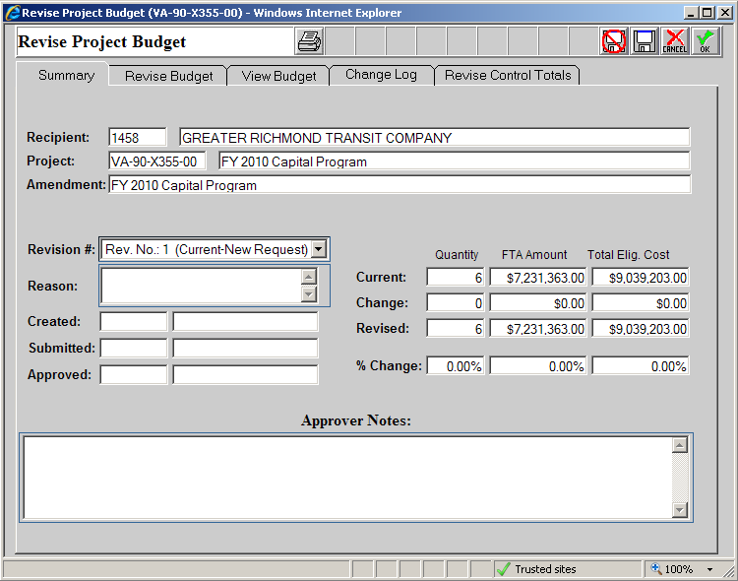
Budget Revision: Summary Tab
1
Notes:
The majority of the boxes on this screen are pre-populated by TEAM
Reason Box
When submitting a budget revision a reason must be provided in this box for FTA review. However, this box only has a 40 character limit, so a Word document should be attached with the justification. This box should simply reference that attachment.

Slide 17
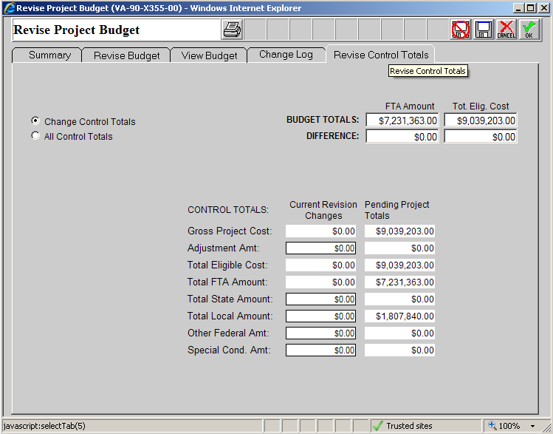
Budget Revision: Revise Control Totals
4
1
2
3
Notes:
If additional local, state, or other federal (non-DOT) money is being added to the grant via the budget revision this should be the next screen edited. Additional FTA funds cannot be added via budget revision, only by amendment. If not advance to the Revise Budget Screen.
Total State Amount
Additional State amount being added
Total Local Amount
Additional Local amount being added to the grant.
Other Federal Amt.
Additional federal funds being added from different agency
Updated Budget Totals and Difference
These boxes will be updated to reflect the additional budget amounts added in the budget revision.
Should make sure the difference boxes return to 0 before submitting the budget revision.

Slide 18
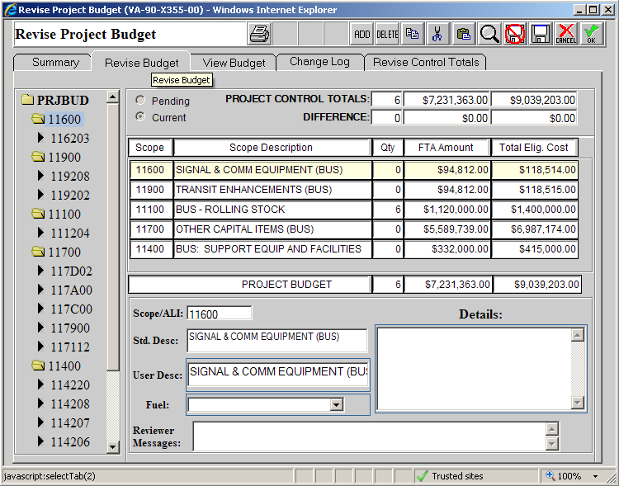
Budget Revision: Revise Budget Tab
1
2
3
Notes:
Add/Delete Activity Line Items
These buttons can be used to add or delete Activity Line Items in the budget.
Be sure to consult with FTA Program Manager when adding/deleting ALIs as the budget revision will require prior FTA approval.
FTA Amount and Total Elig. Cost
Shifting the dollars between ALIs in a budget revision is done in these two boxes by changing the FTA and Total Eligible Costs for each affected line item.
When shifting funds be sure to watch the Difference boxes as they must be equal to $0.00 to ensure the budget still matches the control totals.
Extended Budget Description
For EVERY affected ALI, an explanation and justification for the change must be provided in the Details Box.
Much like an amendment the text should start, “Budget Revision #X – XX/XX/XXX,” followed by the explanation and justification for the change.

Slide 19
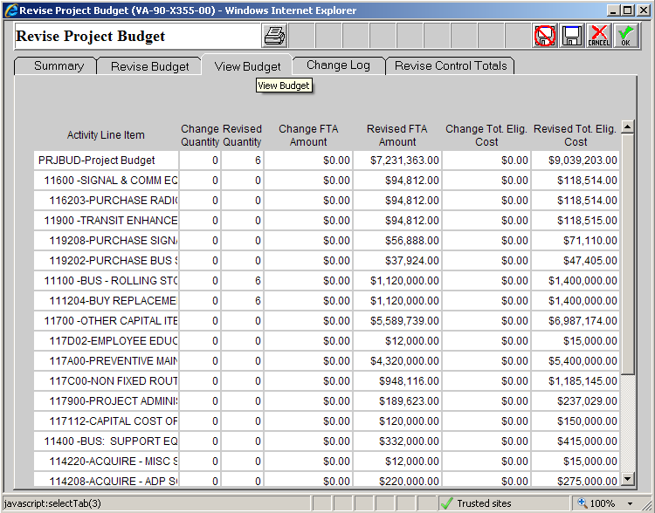
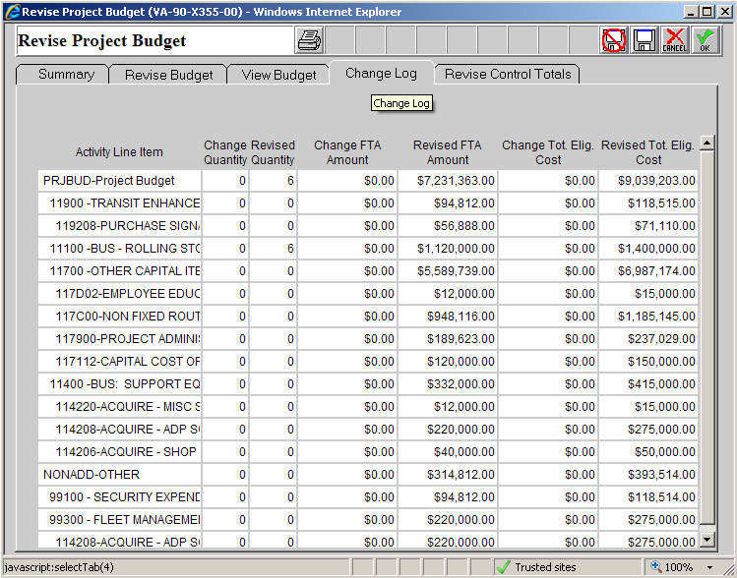
Budget Revision: View Budget & Change Log

Slide 20
Budget Revisions
BR’s Requiring Prior Approval
Federal share of the grant >$100,000 & Scope change >20%.
Transferred between ALIs with different Federal matching ratios
Changing the Federal share of an existing ALI
For revenue rolling stock, changes the #of vehicles by more than two units (for grants with fewer than 10 vehicles) or more than 20% from the quantity identified in the original grant.
Spare ratio requirement should continue to be met.
If change >20%, Rolling Stock Status Report included
Changes the size or physical characteristics of the items in the ALIs without changing the project scope.
The addition or deletion of an ALI to an existing scope
Should be consistent with the approved STIP and, if applicable, has satisfied NEPA requirements.

Slide 21
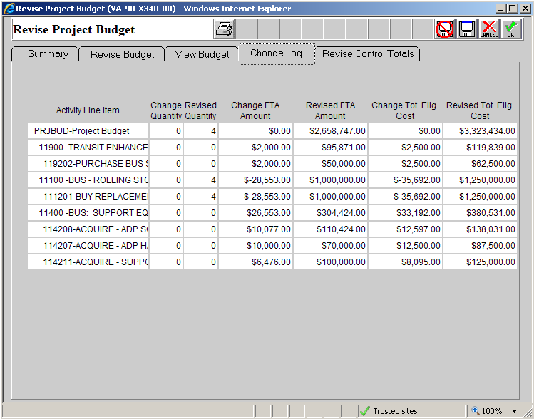
Budget Revision Example #1
Minor changes to the budget to account for the actual expenses – Changes below 20% of scope
Notes:
“Reason Box”: “See Attached Justification”
Extended Budget Descriptions
11.92.02
BUDGET REVISION #2 6/30/11: $2,000 was transferred to this line item from 11.12.01 to cover the actual cost of the bus shelters.
11.12.01
BUDGET REVISION #2 6/30/11: The replacement buses purchased in this line item came in under budget by $28,553. That amount was transferred to 11.92.02, 11.42.08, 11.42.07, and 11.42.11 to account for additional costs in those line items.
11.42.08
BUDGET REVISION #2 6/30/11: $10,077 was transferred to this line item from 11.12.01 to cover the actual cost of the software.
11.42.07
BUDGET REVISION #2 6/30/11: $10,000 was transferred to this line item from 11.12.01 to cover the actual cost of the ADP hardware.
11.42.11
BUDGET REVISION #2 6/30/11: $6,476 was transferred to this line item from 11.12.01 to cover the actual cost of the support vehicles.

Slide 22
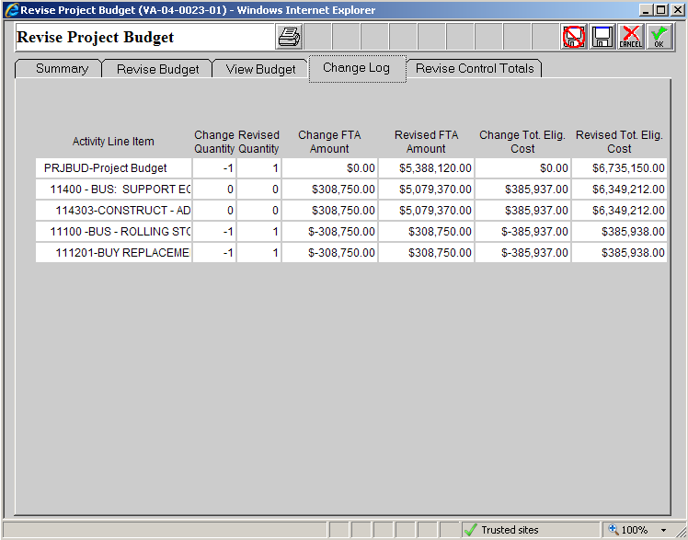
Budget Revision Example #2
Large change to budget (over 20% of scope) – Cost overrun causing one large shift from one project to another.
Notes:
“Reason Box”: “See Attached Justification”
Extended Budget Descriptions
11.43.03
BUDGET REVISION #1 6/30/11: In order to ensure the facility funded in this grant is fully funded, the decision was made to decrease the number of vehicles being purchased from 2 to 1 and shift that amount ($308,750) from 11.12.01 to this line item.
11.12.01
BUDGET REVISION #1 6/30/11: In order to ensure the facility funded in this grant is fully funded, the decision was made to decrease the number of vehicles being purchased from 2 to 1 and shift that amount ($308,750) from 11.12.01 to this line item.

Slide 23
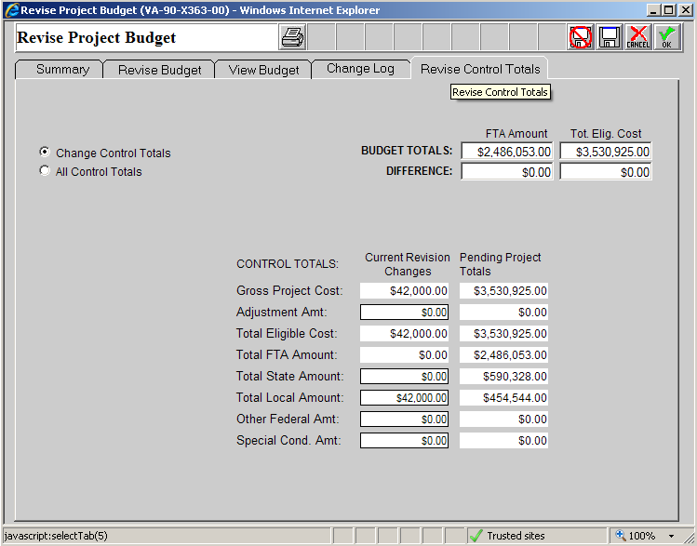
Budget Revision Example #3
Shifting funds between ALIs with different local match ratios
Notes:
“Reason Box”: “See Attached Justification”
Extended Budget Descriptions
30.09.01
BUDGET REVISION #1 6/30/11: $56,000 was transferred from 11.42.06 to cover additional operations needs. Local funds will make up the different in local match.
11.42.06
BUDGET REVISION #1 6/30/11: $56,000 was transferred from 11.42.06 to cover additional operations needs. Local funds will make up the different in local match. The project previously included in 11.42.06 will be completed in a future grant.

Slide 24
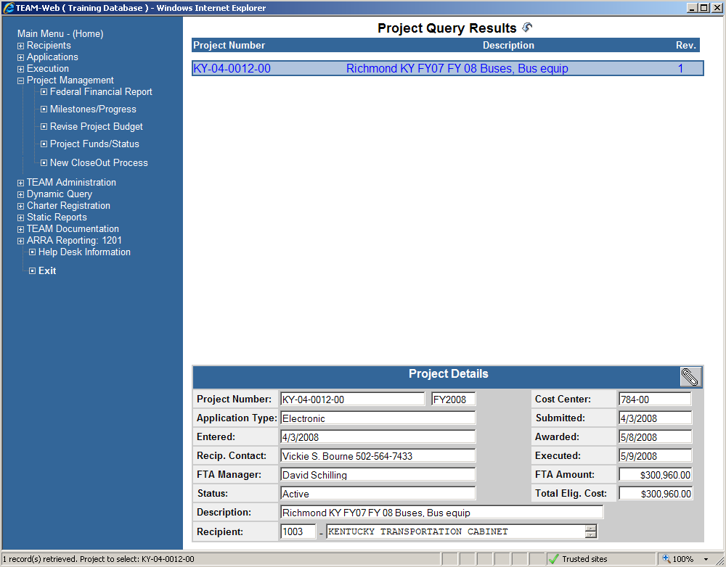
Closeout Process
Notes:
When grant is ready to be closed out – All milestones completed, all funds drawndown, etc. – you can proceed to the CloseOut Process.

Slide 25
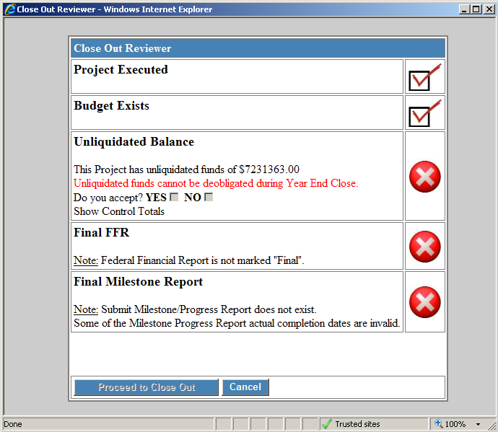
Closeout Process
1
2
3
Notes:
Cannot closeout the grant until all of these fields have a checkmark on the right side.
Unliquidated Balance
If the grant has unliquidated funds:
Click on “YES” to Accept deobligating remaining funds (usually a small amount left in the grant)
Final FFR
Will need to be completed and mark as final the Federal Financial Report.
Final Milestone Report
Will need to be completed and mark as final the Milestone Progress Report.

Slide 26
FTA Region IV TEAM Points of Contact
TEAM Training
Robert Buckley, 404-865-5618, robert.buckley@dot.gov
TEAM User Access
TEAM Help Desk
David Mucher, 404-865-5623, david.mucher@dot.gov

