Slide 1
TEAM Training: Grant Development
Last Update: May 2011

Slide 2
Grant Development
Creating a grant in TEAM
Project Information
Budget
Milestones
Environmental Findings
Fleet Status
Additional Miscellaneous
New Grants vs. Amendments
FTA Region IV Grant Review Process

Slide 3
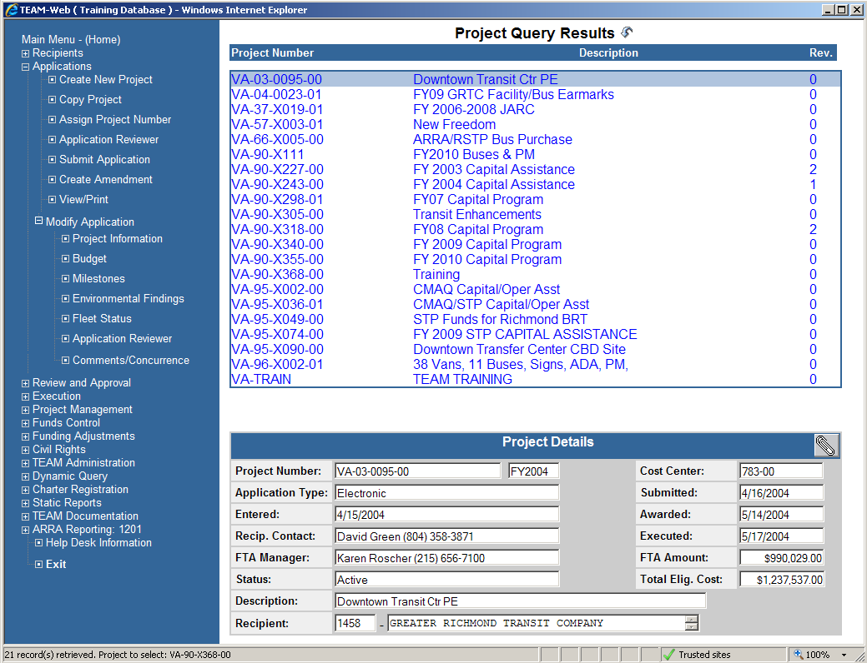
Grant Development
Notes:
Background information
Information/procedures that should be done prior to entering a grant
STIP/TIP/UPWP (Not required for TTP)***
Budget development
Independent Cost estimates
POP
NEPA
The grants should be the culmination of the background work that goes into developing the projects to be included.

Slide 4
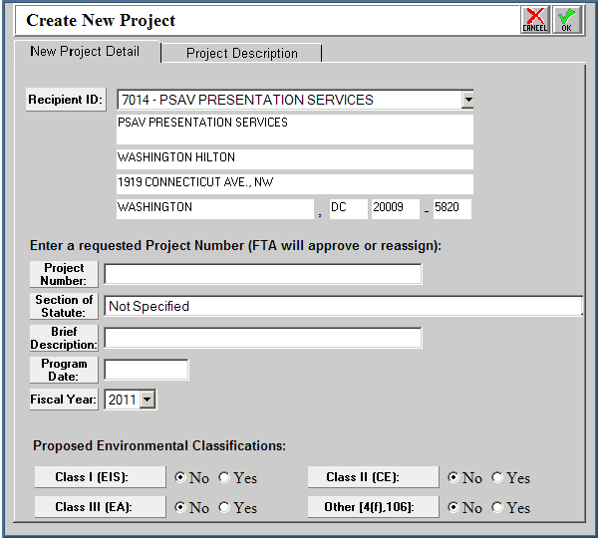
Create New Project
1
2
3
4
5
6
7
Notes:
Recipient ID Dropdown
Where the grantee is able to find their recipient information that is transferred from the Recipient screen into the grant.
Find and Select your organization’s User ID
Project Number:
Grantee generated Draft Project number
Really anything can be entered in this box prior to the grant being sent for FTA review. The first thing FTA reviewers do is request a unique Draft Project Number from Marie Lopez. Prior to sending for FTA review this is for the grantee to find and identify the grant they are working on developing.
Section of Statute:
The type of funding this grant will be applying for.
Ensure the correct section of statute (5307, 5309, 5316, etc) is selected. This information serves as the basis for our review of the grant and will prevent delays later if entered correctly on the front end.
Project Description:
Basically this is the title of the grant.
Ideally this title should provide a brief description into what is contained in the grant. The fiscal year of the funding and basic overview of the projects is probably the most helpful. For example, “FY2010 Bus Purchase & PM.”
Program Date:
This is the date that FTA approved the projects that will be contained in the grant into the TIP/STIP.
Need to be the FTA approval date that incorporated the projects, not necessarily the original approval date of the document. If the projects were added by amendment after the document was originally approved the amendment approval date is what should be entered here. Should be backed up by the STIP/TIP attachment.
Fiscal Year:
The fiscal year in which the grant is applied.
This is the fiscal year the actual grant application is made and not the year of the funds contained in the grant. For example, the grant might contain FY2009 funds, but if the grant is being entered this year the Fiscal Year should be FY2011.
Proposed Environmental Consequences:
Up front identification of potential environmental impacts stemming from the projects contained in the grant
Needs to be identified on the ALI level later in the grant development process, but here the grantee can identify any projects that might need anything further than the typical categorical exclusion.

Slide 5
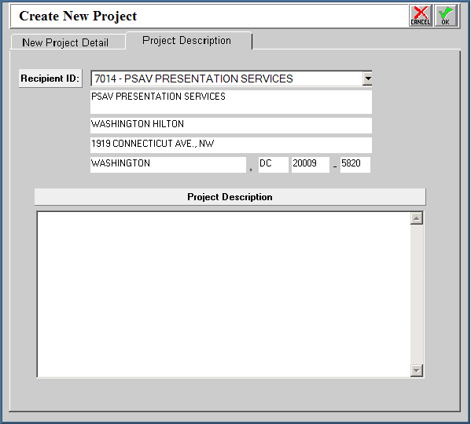
Create New Project
1
2
Notes:
Same as previous screen
Project Description:
Also known as the “Project Details” this is the section that provides FTA with the overview of what will be included in the grant.
Every Project Detail Section should start with the following sentence:
This grant is for FY20XX Section 53XX apportionment for (Name of Area the funds are apportioned to) in the amount of $XXXXX.
This should then be followed with a description of what is contained within the grant. This overview does not need to be as detailed as what will be contained in the Extended Budget Descriptions, but should have enough that the FTA reviewers will have a good idea of what is contained within the grant. Any background information pertaining to the grant as a whole can also be contained in this section.
Best way to create is to draft in Microsoft Word then copy/paste into the box above. Prevents spelling and grammatical errors that could confuse the description.

Slide 6
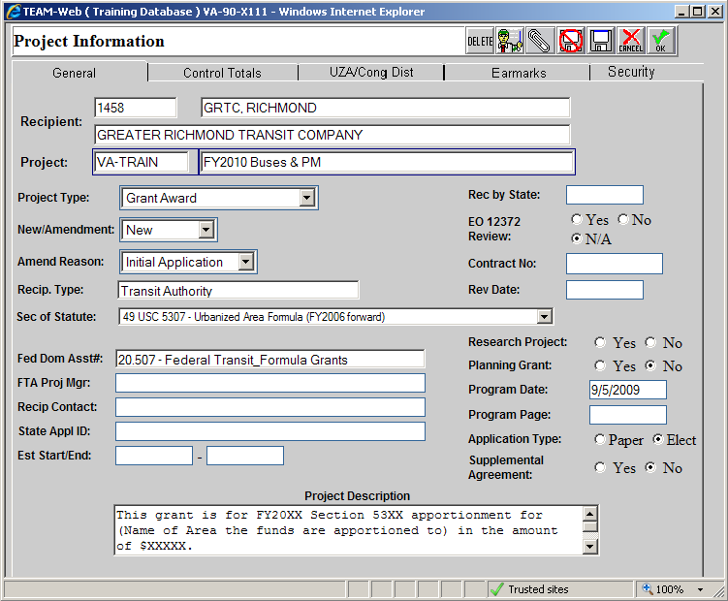
Project Information: General Tab
1
4
2
3
5
6
Notes:
FTA Proj Mgr & Recip Contact:
Two fields that identify the contacts for the management of this grant from both the grantee and FTA.
The FTA Proj. Mgr should be the program manager that will be in charge of managing the grant once it has been awarded.
The recipient contact will be that same contact person from the grantee’s perspective.
Both Contact names and Phone numbers should be included.
State Appl ID:
Only applicable for certain states.
Est Start/End:
The estimated start and end date for the implementation and completion of all of the projects contained in the grant.
The most important aspect of these two dates is that they are realistic and correspond to the milestone dates entered later in the development process. Any outlandish dates should have additional information provided in the project details, extended budget description.
Program Page:
Refers to the page number of the TIP, STIP or UPWP where the projects contained in the grant can be found.
This should be some identifier that allows FTA to easily find the projects contained in the grant. The Program Page should be drawn from whatever attachment is included in the grant to demonstrate the projects are included in the TIP/STIP/UPWP.
Supplemental Agreement:
Identifies if there is a Designated Recipient that needs to PIN the grant before it can be executed by the grantee creating the grant.
This will be need to be marked “Yes” if the organization applying for the funds is not the Designated Recipient for that area. One example is small urbanized area 5307 funds that are passed through the State DOTs. This box would need to be marked “Yes”
Project Description/Project Details
Suggest filling out this section of the grant in a companion Word Document for formatting and spelling purposes. This box cannot get any bigger, which makes typing long descriptions in this section problematic.
First sentence should state specifically the year of federal funding, section of funding, amount of funding, and geographic area funding allocated to.
Remainder of Project Details should describe, generally, all projects contained within the grant.
Reference Webinar Practice Grant for example Project Details

Slide 7
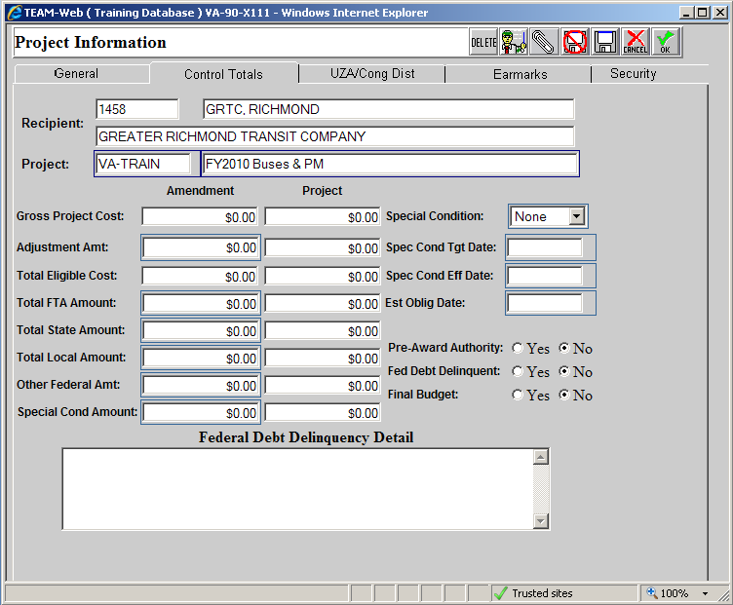
Project Info: Control Totals Tab
3
1
2
Notes:
Total FTA Amount:
This is the amount that should equate to the total FTA dollars included in the grant.
Total Local/State/Other Federal Amount
These boxes are provided to show the breakdown of how the local match for this project will be provided.
The grantee should breakdown the local match amount between any state, local, or other federal amounts that contribute to the local match for the grant.
Total Eligible Cost
TEAM calculates this amount based on the funds entered in the Total FTA and local match amounts

Slide 8
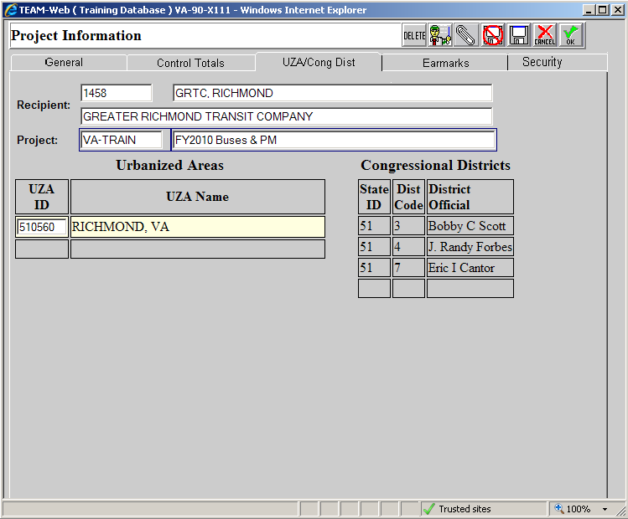
Project Info: UZA/Cong District Tab
1
2
Notes:
Urbanized Areas
The urbanized area associated with the grantee applying for the federal funds.
Even though it appears grayed out when you first open this tab, it is important to click on the UZA ID# and make sure it is correct when developing the grant. This ID # is needed for financial coding purposes later in the grant development process.
Congressional Districts
These district codes correspond to the district number of the congressional representatives in the grantees service area.
This section is especially important when the grant involves an earmark, as these are the offices that will be notified when the grant is sent for release. The release process can be expedited if these are correct from the beginning.

Slide 9
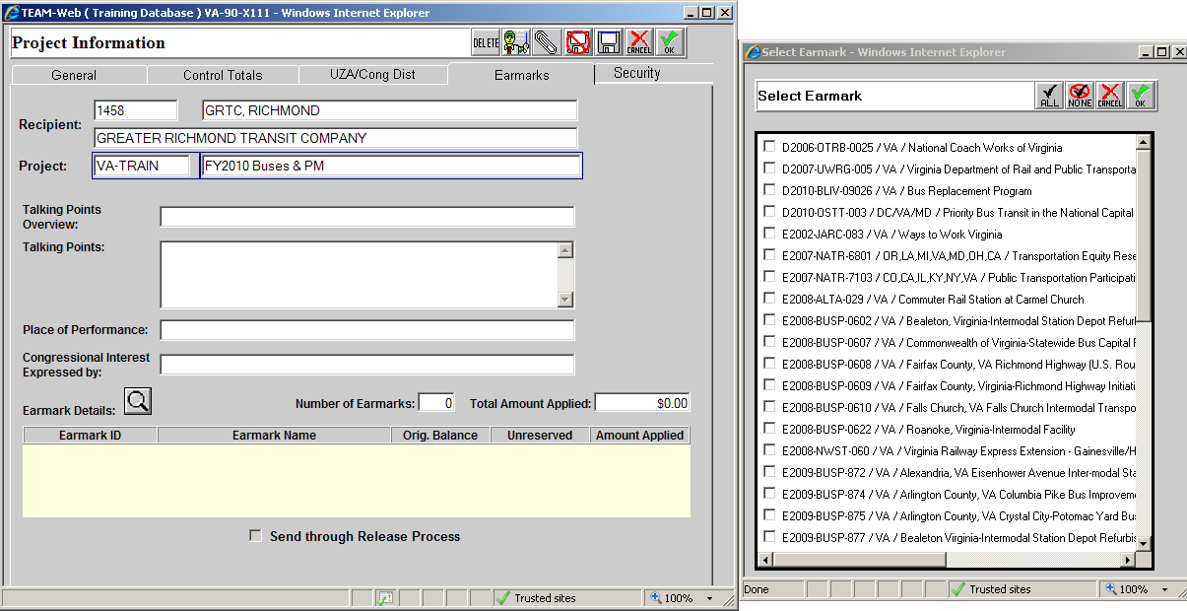
Project Information: Earmarks Tab
3
1
2
Notes:
It is very important know the earmark language before inputting a grant for that earmark. The EARMARK LANGUAGE MUST MATCH WHAT IS BEING APPLIED FOR IN THE GRANT. If an earmark contains language saying it is for the purchase of buses it CANNOT BE USED FOR ANYTHING OTHER THAN THE PURCHASE OF BUSES.
Talking Points Information
Talking Points Overview and Talking Points are similar to the Project Description and Project Details that are reviewed by FTA. The difference here is that this information is passed to Congressional representatives so information about the project should be tailored to them leaving out regulatory information requested by FTA. They should focus on the projects being conducted.
Congressional Interested Express by section should refer to the District number for the Congressional representative that acquired the earmark for the grantees agency. If unsure it is safest to include the district numbers for all representatives in the grantees service area.
Earmark Details
Select Earmark Window
The magnifying glass brings up a separate window that allows the grantee to select the earmark(s) they wish to use in the grant. Once the desired earmark is identified the box to the left can be check-marked and the Green “OK” check can be pressed to bring the information back onto the Earmarks Tab.

Slide 10
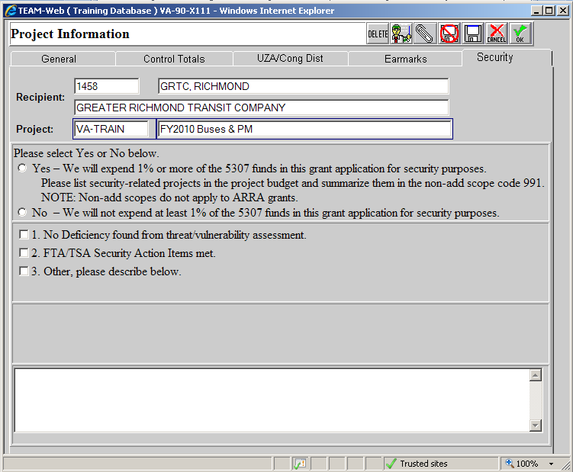
Project Information: Security Tab
1
2
Notes:
The FTA 5307 program requires at least 1% of each recipient’s annual apportionment to be spent on security expenditures, unless there is sufficient reason can be given that this is not necessary. Here the grantee should select whether or not they will spend the necessary 1% or if they have a sufficient explanation for not doing so.
The reason for not spending the 1% should be selected from options 1, 2, or 3. If # 3 is selected it is necessary to provide a further justification in the text box at the bottom of the tab.

Slide 11
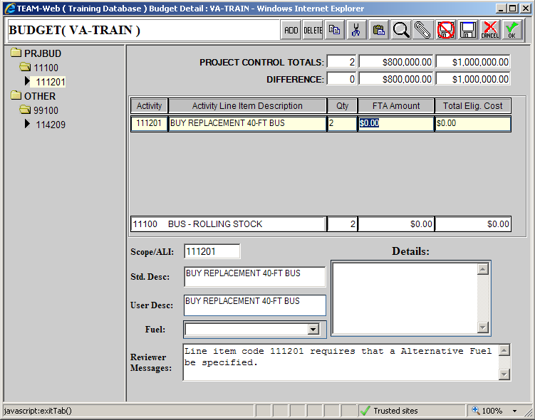
Budget
1
3
2
4
7
5
6
Notes:
Budget Toolbar
From left to right along this tool bar the tools include:
Add
Delete
Copy
Cut
Paste: If ALI’s already containing milestones or environmental findings are rearranged in the budget screen, the previously added milestones and environmental findings will be deleted.
Magnifying glass: Allows search for appropriate Scope/ALIs
Attachments
Save/Don’t Save
Cancel/OK
Project Control Totals & Difference
These amounts are drawn from the Control Totals Tab of the Project Information Screen.
These numbers are meant to keep you on track as the budget is developed. The Difference boxes should be $0.00 to ensure the budget matches the totals entered in the Project Information Screen.
List of Scope/ALI numbers
Folders = Scope
Black Arrows = ALIs
The entire list of scopes and ALIs will be shown here. The ALIs should be listed under the correct Scopes. Easy check – the first 3 digits of the ALIs should match the scope it is listed under. Example above ALI 11.12.01 should be listed under Scope 111-00
ALI/Scope Information entry
Scopes and ALIs are entered in the far left box without any dashes or period.
The description is then populated
The grantee must then enter the quantity of items being purchased in the ALI followed by the FTA Amount and Total Eligible Cost for each line item
Scope/ALI Descriptions
These two boxes show the standard scope/ALI descriptions and has a box available for grantees to edit the descriptions if needed.
Fuel
If buying vehicles, the vehicle purchase ALI must have a fuel type for the vehicle selected from this dropdown menu.
If purchasing vehicles with multiple fuel types there will have to be separate ALIs for the buses in order to specify how many of each fuel type will be purchased.
Details/Extended Budget Descriptions
This box is where the grantee needs to enter all the detailed information about the project(s) contained in each ALI. The more detail, the better to prevent numerous follow up questions from the FTA reviewer. Examples of information include:
Useful life of all capital items with individual value greater than $5,000
Associated plans (such as Force Account Plans for Preventive Maintenance ALIs)
PM only good for Current and Previous FY.
Background information for particular projects
Other grants that might fund the project.
The box DOES NOT need to be filled out for scope codes.
Reference Webinar Practice Grant for example Extended Budget Descriptions.

Slide 12
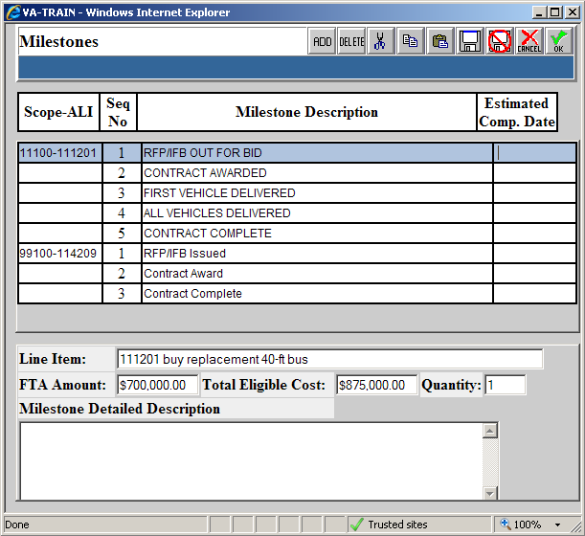
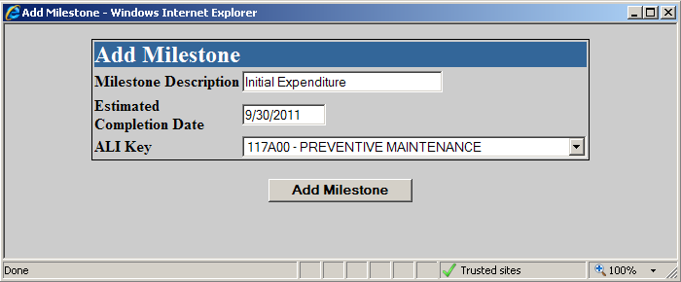
Milestones
2
1
4
3
Notes:
MUST HAVE AT LEAST 2 MILESTONE DATES FOR EVERY ACTIVITY LINE ITEM
Estimated Completion Dates
Enter the estimated completion date for each automatically created Milestone Date.
5 required for vehicle purchases
3 required for ALIs with contracts
2 minimum required for all others
Milestone Description
This can be edited to more accurately match the project milestone dates for each ALI, but should generally line up with any that are pre-populated
Milestone Detailed Description
This box, similar to the EBDs, provides a place for the grantee to give FTA more information about a particular date. For example, if one of the dates seems to be outlandish the grantee can use this box to justify the date they entered.
Every date does not need to be explained
Add Milestone screen
This is the pop-up screen that appears when a milestone date needs to be added.
TEAM DOES NOT PRE-LOAD ALL ALIs WITH AN APPROPRIATE NUMBER OF MILESTONE DATES, even though some do show up pre-populated.
Here enter the Milestone description, estimated completion date, then use the dropdown to find and select the appropriate ALI to list the information on.

Slide 13
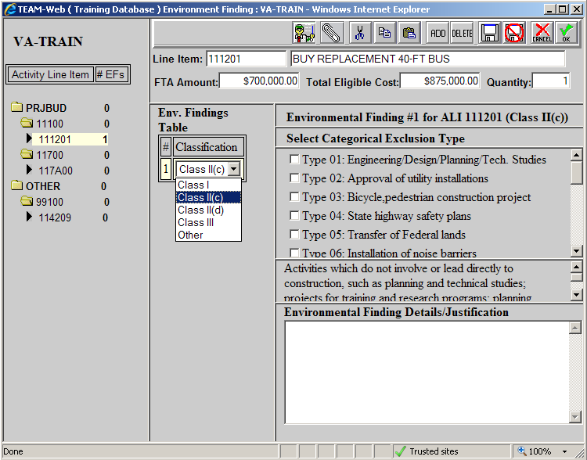
Environmental Findings
2
1
4
3
Notes:
Must have one Environmental Finding for every ALI (signified by the “1” next to the ALI code on the left side of the window).
Select ALI to add Environmental Finding.
First step is to highlight the ALI you would like to add an Environmental Finding to.
Add the Environmental Finding
Use the dropdown to select the correction environmental finding classification
This information should already be known before you start entering the grant into TEAM
If there are any project you are not sure of (rehabs, land acquisition, construction) you should consult with your FTA representative BEFORE entering the grant development process.
Additional Finding information
For Class II(c)
Select the type that best fits with the project contained in the ALI.
For Class II(d)
Ensure the CE document and approval letter from FTA is attached in TEAM.
Reference these documents in the Environmental Finding Details/Justification and state the date of their approval
Class I & III
Enter the appropriate dates – These projects are relatively rare and will require more information on a case by case basis.

Slide 14
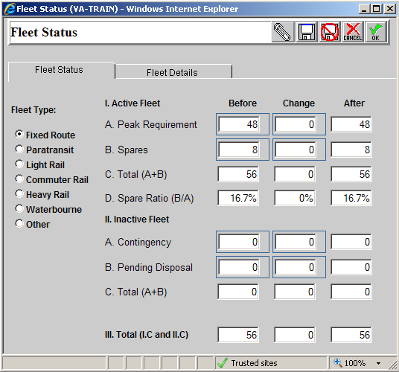
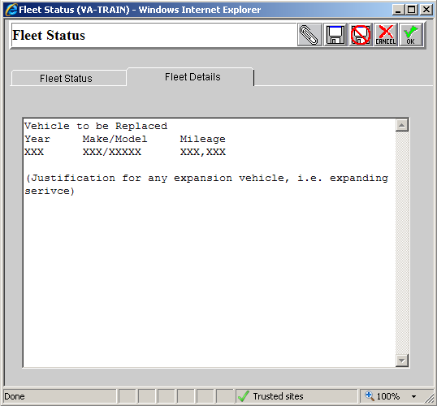
Fleet Status
5
1
2
3
4
Notes:
Fleet Status Type
Allows the grantee to enter the fleet status information on all of their different fleets of vehicles (if applicable).
Active Fleet Information
The only boxes that grantees can actually enter information into are the 4 to the top and left surrounded by small blue boxes.
This information should be provided to show the status of the fleet and how the purchases made in this grant affect that fleet.
Spare Ratio
If the grantee has over 50 vehicles this ratio (which is automatically calculated) should be less than 20%. If over 20% the grantee should provide some sort of justification or explain how they will be working to lower it below that percentage.
Inactive Fleet information
The grantee should also provide any information about their inactive fleet or vehicles that are being disposed of.
The Fleet Status Details tab
This area should be used to enter any additional information about the fleet
If the grant will be replacing any vehicles those vehicles should be listed out here (or use this box to reference an attachment that shows the vehicles to be replaced)
Must have age, make/model, and mileage of the vehicle(s) being replaced.
If expansion vehicles are contained in the grant, some justification for the expansion should be included in this box as well.

Slide 15
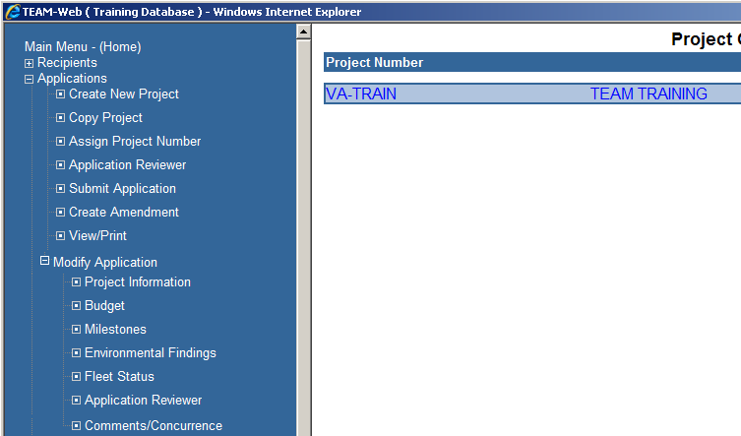
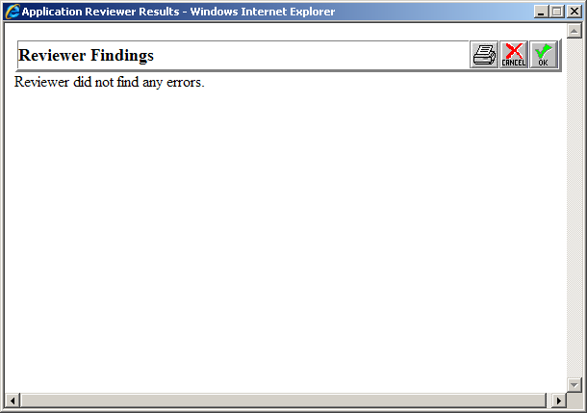
Application Reviewer
Notes:
The Application Reviewer can be used to find basic errors in the grant such as:
Budget not balancing with the control totals screen
Missing some environmental findings
Will catch SOME missing milestones, but not all.
Should be run BEFORE sending to FTA for review

Slide 16
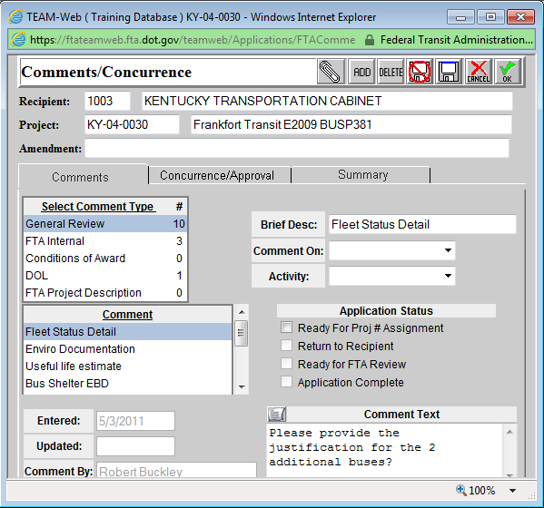
Comments/Concurrence
1
2
3
Notes:
Shows the comments entered by the FTA reviewer once they have finished reviewing the grant.
Once the FTA reviewer indicates they have entered comments these should be reviewed and any questions or requests for clarification should be directed to the FTA reviewer.
Need to ensure that ALL COMMENTS are addressed before sending the grant aback for a second review.
Once the comments have been cleared the FTA reviewer will go into the grant and enter “Comment cleared” on each individual comment has been satisfied.
Comment Type
All grant comments intended for the grantee are entered in the “General Review” Section. These are the comments that should be reviewed once notified that FTA has reviewed the grant.
Grantee will not be able to see the “FTA Internal Comment” section.
Comment Titles
Allows the grantees to see the types of comments.
Comment Text
Provides the description of what the particular issue with the grant is. Can be expanded by the paper button on the left side of this box.

Slide 17
Initial Grants vs. Amendments
Amendments are treated the same in the review process as initial grants, so all of the requirements from above are still applicable.
The difference is the information from the older version of the grant stays and the amendment information is added.
Extended Budget Descriptions | Project Details | Milestones and Environmental Findings
Any EBD’s affected by the amendment should include an explanation of the changes. This should be done on top of the original EBD. The explanation should start with the following: “Amendment #1 – (DATE OF CHANGES)”. Then, explain what you have done in the EBD for each affected ALI and why. | The project details should also describe what changes are occurring in this amendment. It should cite each ALI that is being altered in the amendment and by how much. This explanation should be made above the original project details and likewise begin with “Amendment #1 – (DATE OF CHANGES)”. | Ensure each new ALI has at least 2 milestone dates and an environmental finding entered in TEAM.

Slide 18
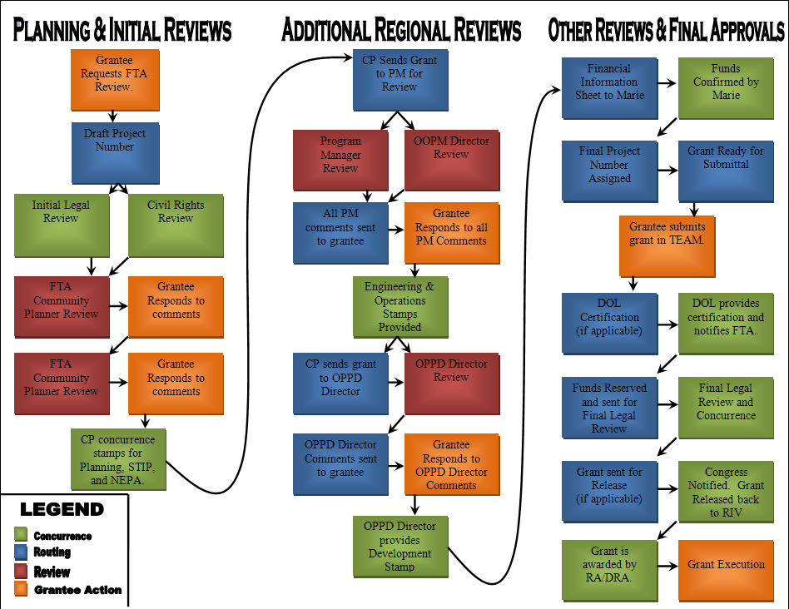
Notes:
For informational purposes only.
Graphic representation of the regional review process for FTA grants.

