Slide 1
Local System User Managers Kicking off the NTD
Keith Gates
NTD Program Manager
Office of Budget & Policy

Slide 2
Old Paradigm
Separate systems
FTA registers all users
FTA
Council on Being Old
Burbs Bus
user
NTD
TEAM
user
user
user
user
user
user
user
user
Village Transit
Streetcartowne
Bigcity Metro

Slide 3
New Paradigm
Integrated systems
FACS registers LSUMS
FTA
FACS
Council on Being Old
Burbs Bus
NTD 2
TRAMS
user
LSUM
user
LSUM
Streetcartowne
Village Transit
LSUM
LSUM
users
Bigcity Metro
users
LSUM
users

Slide 4
Local System User Manager (LSUM)
FTA requires each agency to nominate a LSUM
TEAM users upload designation letter in TEAM
Non-TEAM users send letter to FTA NTD program manager in Washington DC
FTA authenticates LSUM
LSUM at each reporting agency approves and registers new users of FTA systems
NTD 2
TRAMS (soon to replace TEAM)
Agency users may be contractors, consultants, or partners

Slide 5
LSUM Startup Tasks
After nomination has been accepted by FTA
Create LSUM password
Approve and enter local users into NTD 2

Slide 6
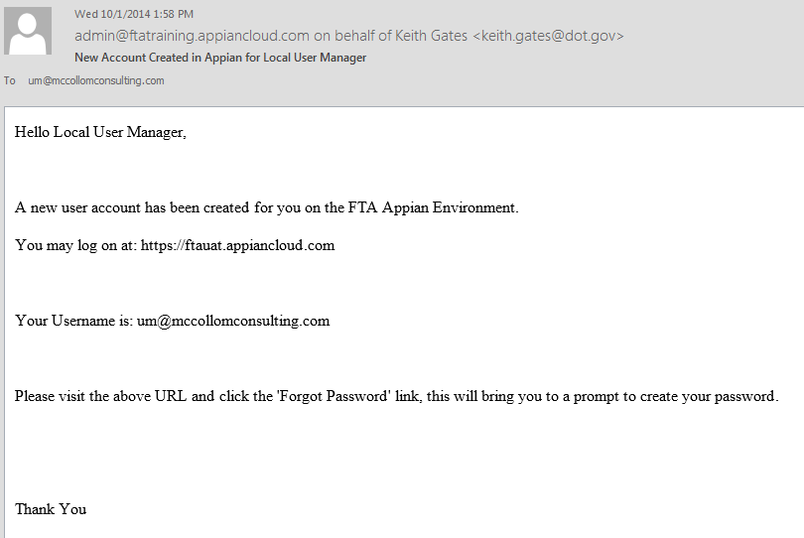
LSUM Receives Email Instructions
UM@test.com
Log on using LSUM email address as username
UM@test.com

Slide 7
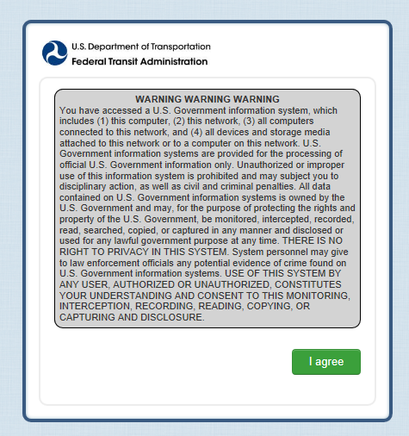
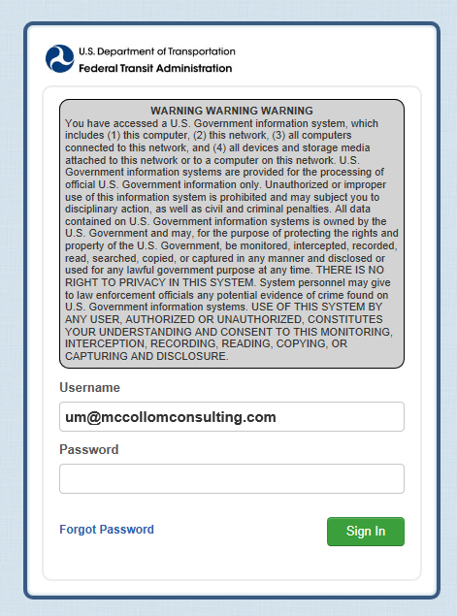
LSUM Starts Password Process
Enter Username (all lower case letters)
um@test.com
Click on I agree to accept government warning
Click on Forget Password to start process to set password

Slide 8
Request Password Reset
um@test.com
Click on Request Password Reset
Enter user name (email address)

Slide 9
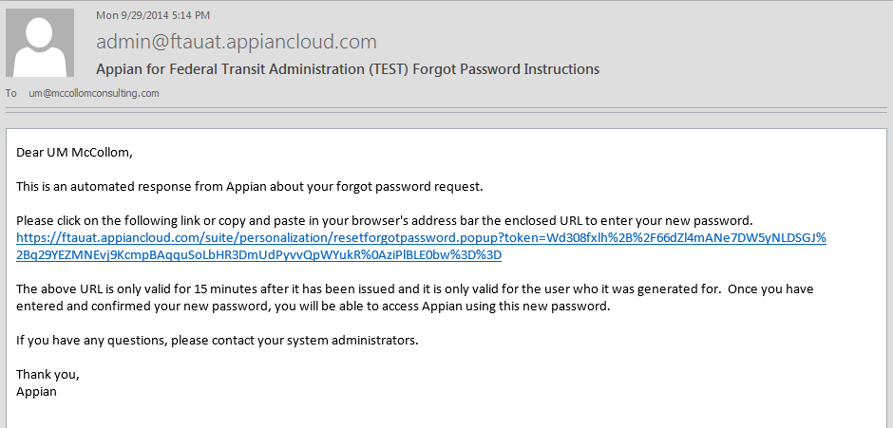
LSUM Receives Password Instructions
UM@test.com
Click to go to set password
User Manager

Slide 10
Set Password
Enter user name (email address)
um@test.com
Enter and reenter password
Click on Reset Password

Slide 11
Password Features (All Users)
Same as old NTD/TEAM reporting system
Federal requirements for length and complexity
Password length
Must be 12 characters and not more than 20 characters
Complexity
3 out of 4 – Lower case, Upper case, Numbers, Special Characters
Password History
Password must be different from 10 previous passwords and must be different from any password used in the last 6 months
Password expiration period is 60 days

Slide 12
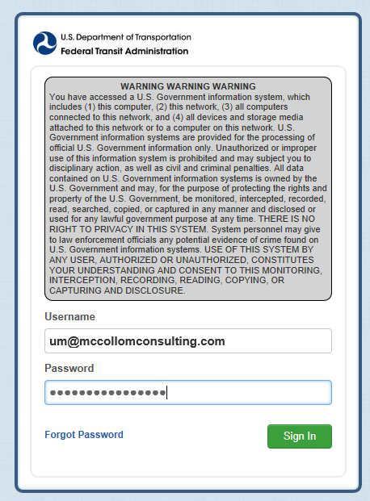
LSUM Logs In to Create Users
Enter Username and Password
um@test.com
Click on I agree to accept government warning
Click on Sign In

Slide 13
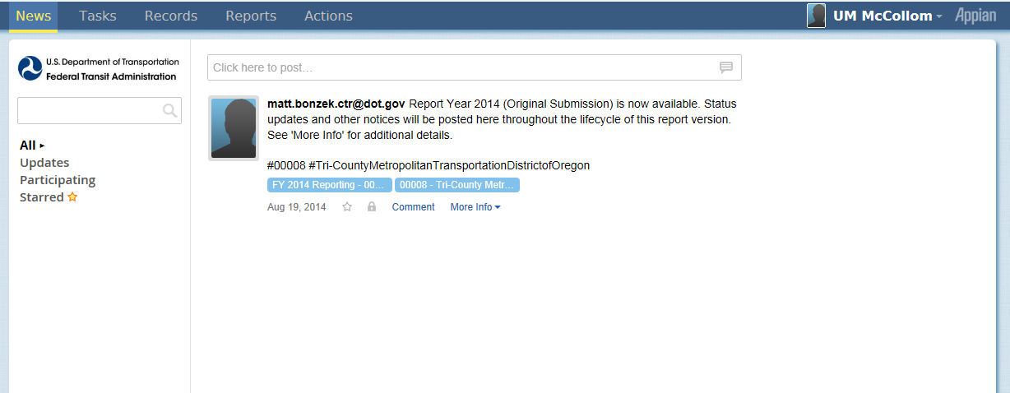
News Page is the Home Page
Click on Records to enter users

Slide 14
Records Page
Click on My NTD Reporter Profile(s)

Slide 15
My NTD Reporter Profile(s)
Click on reporting agency name

Slide 16
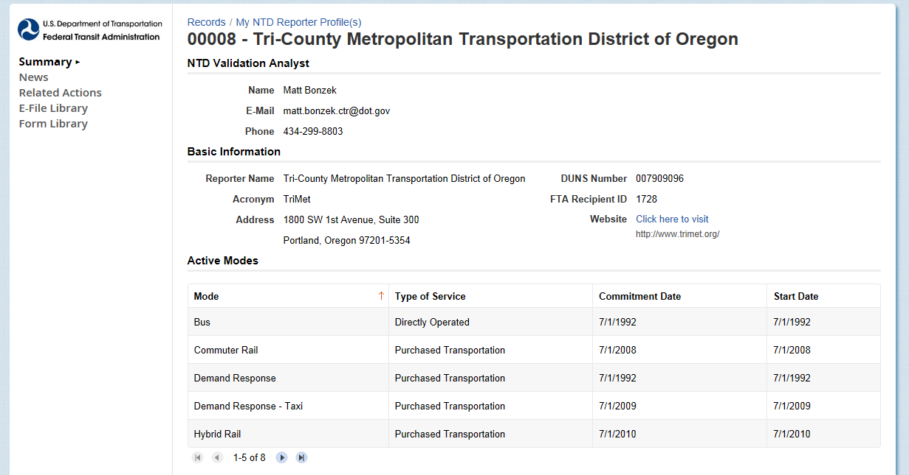
Reporter Profile
Click on Related Actions

Slide 17
Related Actions for Reporter Profile
Click on View & Manage Reporter Users (P-30)

Slide 18
View & Manage Users (P-30)
um@test.com
Click on Add User

Slide 19
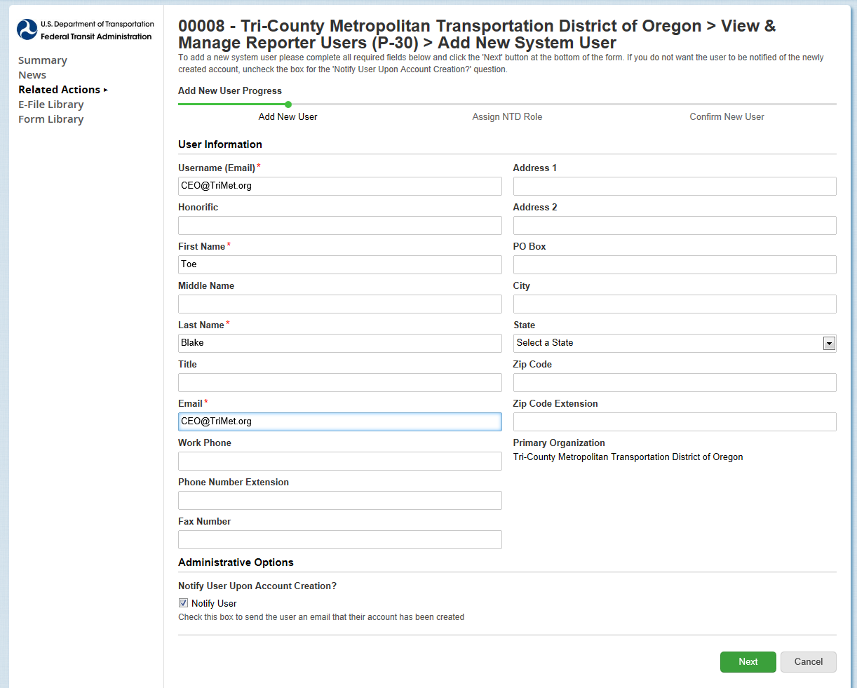
Add New System User
Add user information (name, email, address)
Click Next when completed

Slide 20
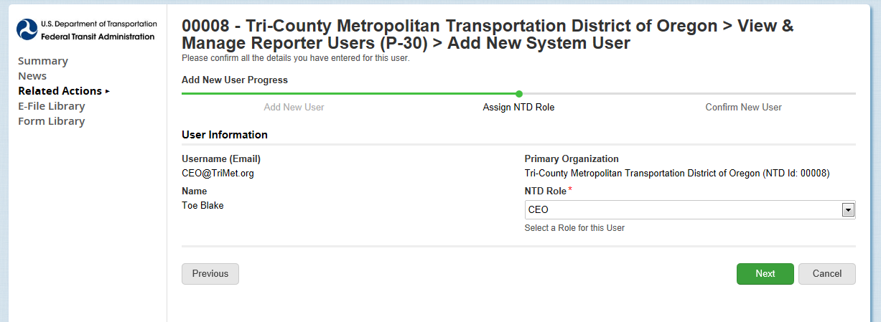
Select Reporter Role
Select Role
Click Next when completed

Slide 21
Roles
Role | Functions
CEO | Data entry, submit report, submit the CEO certification, all reporting areas
NTD Contact Person | Data entry, submit report, all reporting areas
Editor | Data entry, view forms
Viewer | View forms
Notes:
**Note: The instructor will review the 4 access levels on this slide, but two additional access levels relate to safety and security.

Slide 22
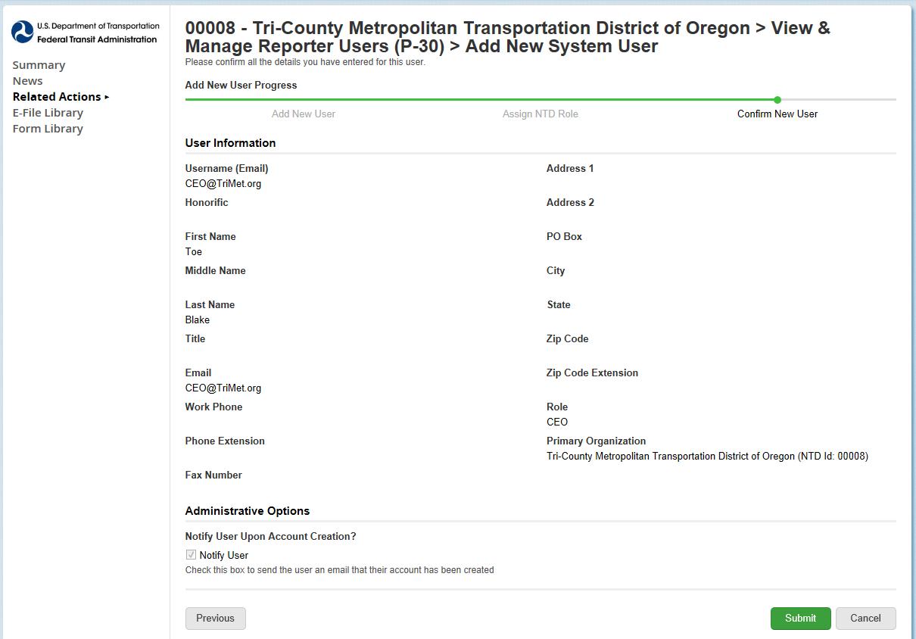
Review and Submit User
Click Submit
After submission, password instructions emailed to user
Same process as LSUM password

Slide 23
CEO and NTD Contact Required
LSUM should create CEO and NTD users
Required for annual NTD report “kick-off”

Slide 24
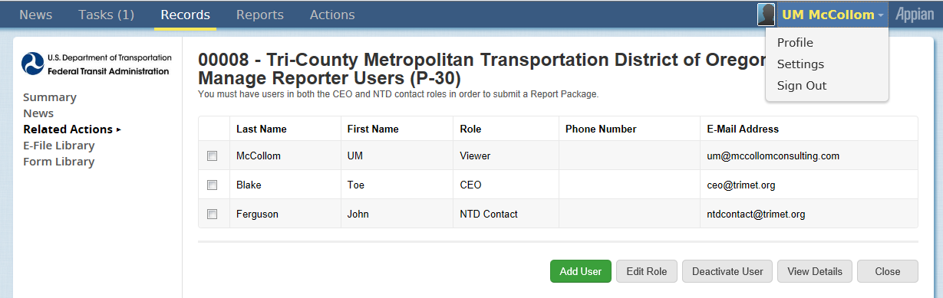
LSUM Sign Out
Click on username and click Sign Out

Slide 25
NTD Contact Startup Tasks
Perform “report kickoff”
Systems now in FY 2015 must do kickoff
No action needed from reporters now in FY 2014
Start monthly reporting
Enter September data
Enter August data if not done in September

Slide 26
What is a Kickoff?
Confirmation of current “profile” information at beginning of fiscal year
Actions
Confirm reporter contact information is accurate.
Confirm mode information is accurate.
Confirm declared reporter type for previous FY is still accurate (e.g., small systems waiver)
Declare reporter type for new fiscal year

Slide 27
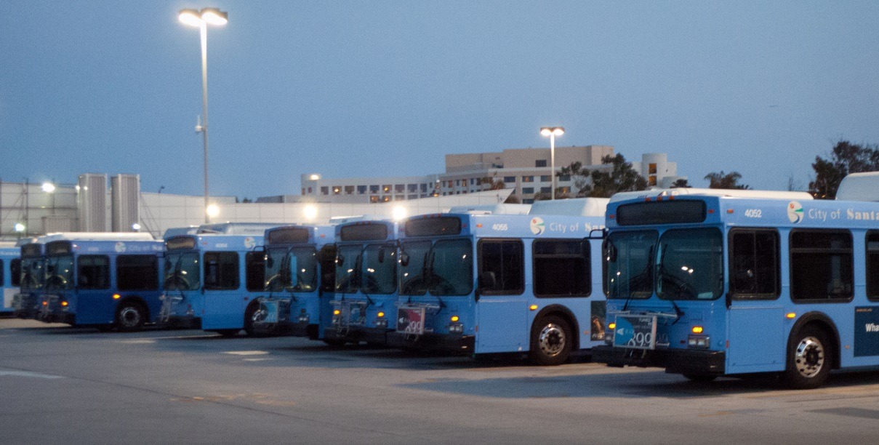
Why is Kickoff Done?
Create annual reporting forms for prior year (e.g., FY 2015)

Slide 28
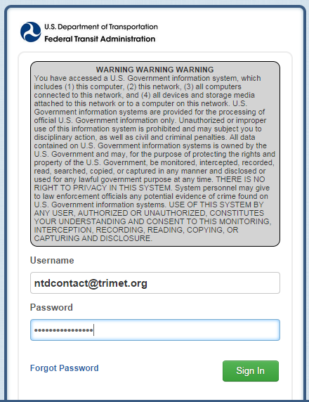
NTD Contact Logs in to NTD 2
Enter your User Name and Password
Click on Sign In

Slide 29
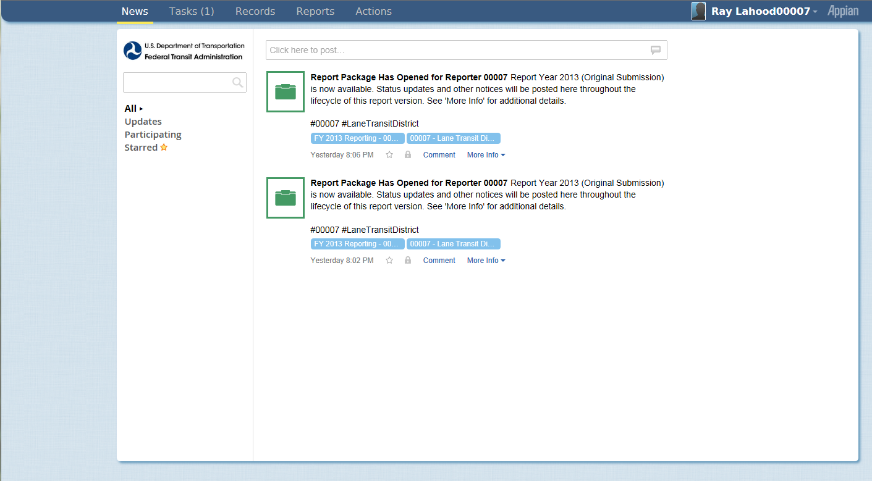
Kickoff Starts on News Page
Click on Tasks to start FY 2015
News

Slide 30
Start Report Kickoff
Applies to reporters for FY 2015
Click on Task

Slide 31
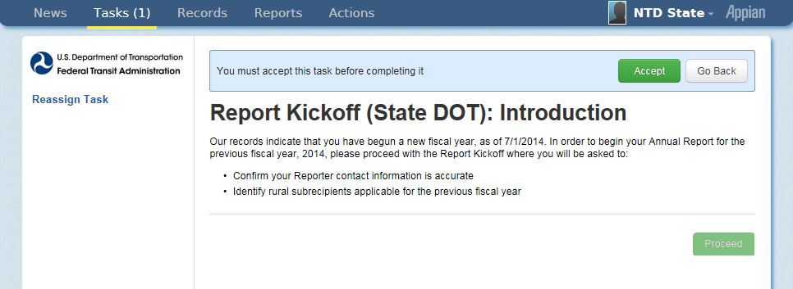
Accept Kickoff Task
1. Click Accept
2. Click Proceed

Slide 32
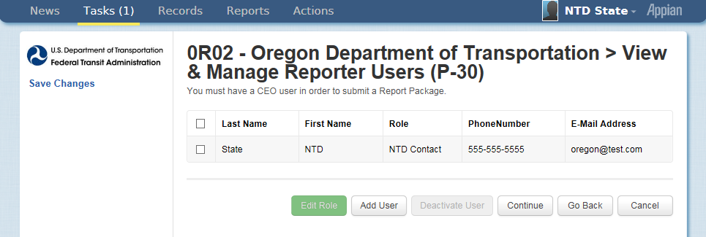
Manage Reporter Users
Click continue to go to next confirmation
Only user manager can add new users
Individual users can edit own profile

Slide 33
Review Subrecipients
Identify Subrecipients
Subrecipients from RY2013 are pre-loaded. Please verify this list
New subrecipients can be added from a list of existing agency profiles

Slide 34
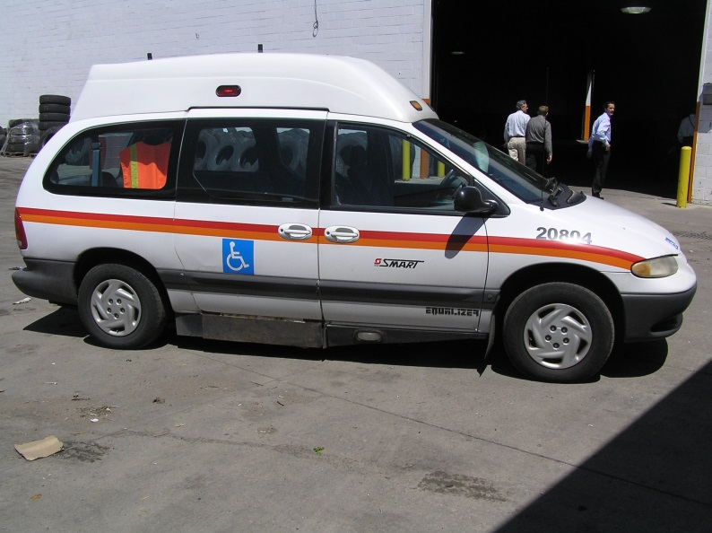
Review Subrecipients
If an agency does not have a profile, you can add them manually.
All manually created subrecipients must be approved by your Analyst before the subrecipient’s records are available to you.
The Analyst is notified automatically by the system.

Slide 35
Adding a Subrecipient
Notes:
These are the various options for adding subrecipients to your Report

Slide 36
Assign Subrecipient Type
The type is pre-loaded from RY2014
To change, select the subrecipient by checking the box to its left, click circle for type, and then click “Add Type”

Slide 37
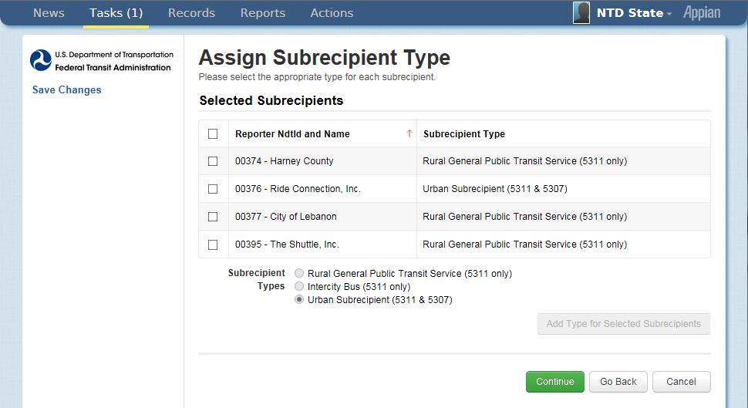
The new type will display in the grid

Slide 38
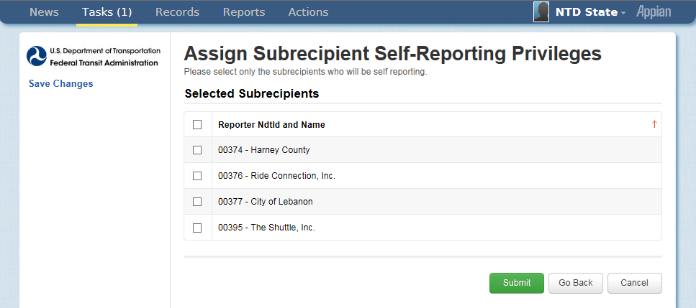
Assign Self-Reporting Privileges
We ask that States do not assign these privileges until NTD 2 system functionality is complete

Slide 39
Form Generation
Profiles and Report Packages (Annual Forms) take at least three minutes to generate
If new subrecipients were created, they will not display until your analyst approves the creation
Click “OK” to end the task

Slide 40
National Transit Database Offices
NTD Operations Center
Charlottesville, Virginia
Monday to Friday: 0800 –1900 Eastern
(888) 252-0936
NTDHelp@dot.gov
NTD Program Office
Washington, DC
Keith Gates, Program Manager
(202) 366-1794
keith.gates@dot.gov
NTD Help Desk
Me, email works best

Slide 41
Additional Training
NTD Website training page: http://www.ntdprogram.gov/ntdprogram/seminars.htm
National Transit Institute, NTD courses: http://www.ntionline.com/courses/courseinfo.php?id=7
NTD Website presentations page: http://www.ntdprogram.gov/ntdprogram/announcements.htm

