Slide 1
DBE Shortfall Analysis:
Common Errors and
Effective Practices
Office of Civil Rights
December 2013

Slide 2
Agenda
  DBE Shortfall Definition and Purpose
  49 CFR 26.47(c)—Shortfall Regulatory Requirements
  Conducting a Detailed Shortfall Analysis
  Shortfall Effective Practices and Common Errors
  Corrective Action Plan Effective Practices and Common Errors

Slide 3

DBE Shortfall
A recipient’s failure to meet its Triennial DBE Goal by the end of the fiscal year

Slide 4
DBE Shortfall Purpose
  Assist FTA recipients identify means to increase DBE participation and achieve DBE goal in the next fiscal year
  Ensure FTA recipients are complying with the spirit and the letter of the DBE rule
  Increase a recipient’s DBE accountability on FTA funded projects and activities

Slide 5
49 CFR 26.47(c):
DBE Goal Accountability
If the awards and commitments shown on your Uniform Report of Awards or Commitments and Payments at the end of any fiscal year are less than the overall goal applicable to that fiscal year, you must prepare a Shortfall Analysis and Corrective Action Plan
  Uniform Report of Awards and Commitments or End of FY Commitments and Payments less than Triennial DBE Goal Percentage = Shortfall

Slide 6
49 CFR 26.47(c):
DBE Shortfall Elements
Analyze in detail the reasons for the difference between the overall goal and your awards and commitments in that fiscal year
Establish specific steps and milestones to correct the problems identified in your analysis and to enable you to meet fully your goal for the new fiscal year

Slide 7
49 CFR 26.47(c):
DBE Shortfall Submission Dates
If you are […] one of the 50 largest transit authorities as determined by the FTA […], you must submit, within 90 days of the end of the fiscal year, the analysis and corrective actions developed under paragraphs (c)(1) and (2) of this section to the appropriate operating administration for approval.

Slide 8
DBE Shortfall Submission Dates
Top 50 FTA grantees submit the Shortfall Analysis and Corrective Action Plan in TEAM by December 29th of each applicable fiscal year
    Visit the website below for a list FTA’s Largest 50 Grantees
      http://www.fta.dot.gov/documents/Top_50_FTA_grantees.pdf
All other FTA grantees must perform a Shortfall Analysis, create a Corrective Action Plan, and maintain these documents in a file (e.g., TEAM, DBE Program file, etc.) for production upon FTA’s request or during an oversight review.

Slide 9
DBE Shortfall Submission Dates:
What If…
Your FY 2014-2016 is 10% Goal
    FY 2014: Achieved 15% DBE Participation = No Shortfall Submission Required
    FY 2015: Achieved 8.7% DBE Participation = Shortfall Submission Required and due on December 29, 2015
    FY 2016: Achieved 5.9% DBE Participation = Shortfall Submission Required and due on December 29, 2016

Slide 10
49 CFR 26.47(c):
Regulatory Recap
  FY DBE Participation is less than Overall Goal; you must have a Shortfall Analysis and Corrective Action Plan
  Shortfall Analysis must explain, in detail, the reason(s) for shortfall
  Corrective Action must identify specific steps and milestones to correct the shortfall

Slide 11

Important Note
Accurate Uniform DBE Reports
DBE Reports must:
  include on the FTA share of contracting funds
  must accurately reflect DBE participation during the fiscal year
  be entered in TEAM using the electronic reporting module (i.e., not as an attachment in the Civil Rights tab)
FTA uses the electronic reporting module to determine which recipients must submit the Shortfall Analysis and Corrective Action Plan

Slide 12
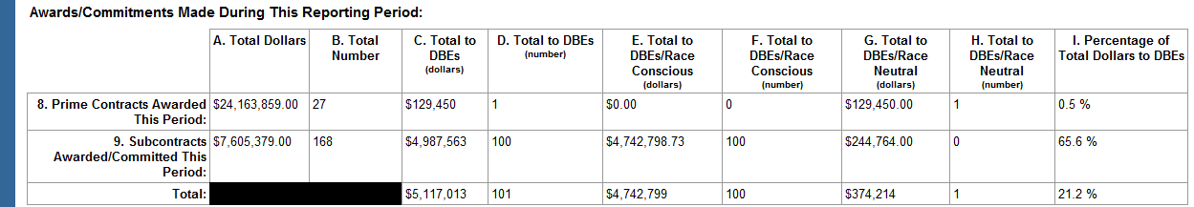
Did Your Agency Meet Its DBE Goal?
First, determine the total awards and commitments made during the respective fiscal year using Cell 8A from each Semi-Annual Report.
June 1st Prime Contract Total Dollars (8A) + December 1st Prime Contract Total Dollars (8A) = FY Total Awards and Commitments

Slide 13
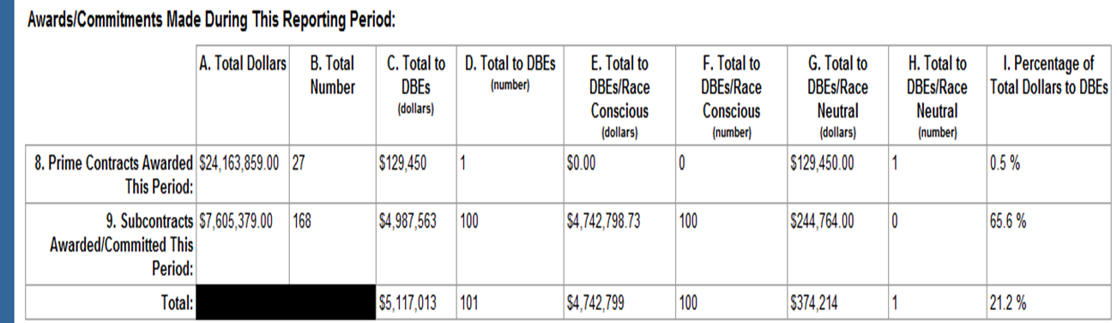

Did Your Agency Meet Its DBE Goal?
Next, determine the total DBE awards/commitments during the fiscal year by adding cells 8C and 9C from each Semi-Annual Report. (8C+9C= DBE Awards/ Commitments)
    June 1st DBE Awards/Commitments + December 1st DBE Awards and Commitment = FY Total DBE Awards/Commitments

Slide 14

Did Your Agency Meet Its DBE Goal?
Shortfall Formula
  FY Total DBE Awards/Commitments ÷ FY Total Awards and Commitments = FY DBE Participation

Slide 15
Did This Agency Meet Its Goal?
Example
June 1st (8A) + December 1st (8A) = Total Awards and Commitments
  Ex: June 1st ($1 million)+ December 1st ($1 million) = $2 million
June 1st (8C + 9C) + December 1st (8C + 9C) = DBE Total Awards and Commitments
  Ex: June 1st ($92,500) + December 1st ($92,500) = $185,000
DBE Total Awards and Commitments ÷ Total Awards and Commitments = DBE Participation
  Ex: $185,000 ÷ $2,000,000 = 0.925 or 9.25%
DBE Participation 〱 Triennial DBE Goal = Shortfall
  Ex: 9.25% less than 10% Triennial DBE Goal = Shortfall

Slide 16
Drafting a Shortfall Analysis:
  Shortfall Percentage
  Race-Conscious/Race-Neutral Breakdown
  Race-Neutral Measures
  Projects undertaken during the FY
  DBE participation on these projects
  Reasons for the Shortfall

Slide 17
Shortfall Percentage Defined
The difference between the overall goal and DBE Awards and Commitments within the FY
    Example: FY 2014-2016 – 10%
      FY 2015: 10% Triennial Goal – Achieved 9.25% DBE Participation = .75% Shortfall

Slide 18
FTA Funded Projects within the FY:
What Do You Need to Know
Recipients should evaluate projects used to establish the Triennial Goal and should not include all open/active projects in their analysis—even if these projects were completed within the respective FY
    Example:
    Recipient awarded a contract in FY2008 but completed the project in FY2013. Do not include this FY2008 project in the FY2013 shortfall analysis

Slide 19
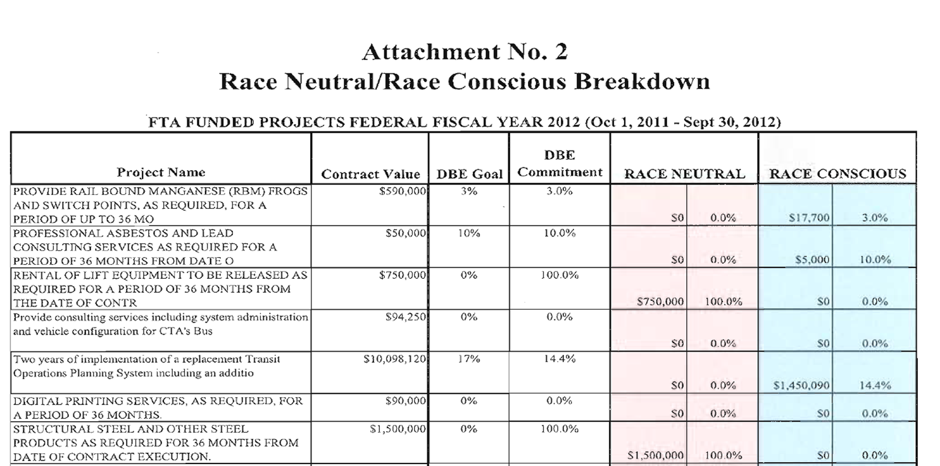
FTA Funded Projects within the FY:
Effective Practice
Displaying FTA funded projects in a table makes it easier to determine which projects attributed to the shortfall
*FTA Funds*

Slide 20
DBE Participation on each FTA Project:
What Do You Need to Know
List the DBE participation on each FTA funded project during the FY
    Remember: Evaluate only those projects used to establish the Triennial Goal.

Slide 21

DBE Participation on each FTA Project:
Effective Practice
Highlighting DBE commitment by project helps identify the levels of DBE participation per project
*FTA Funds*

Slide 22
FTA Funded Projects and DBE Participation:
Common Error
Failure to discuss the FTA projects undertaken during the FY and the level of DBE participation achieved during these projects.
Error:

Slide 23
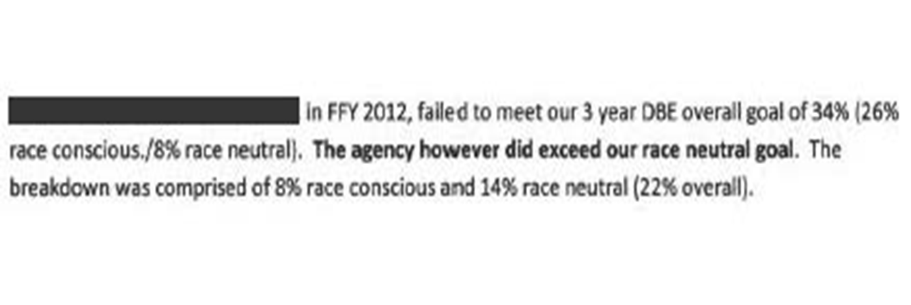
Race-Neutral/Race-Conscious Breakdown:
What Do You Need to Know
Explain what percentage of the goal was met using race-neutral measures and race-conscious measures
Example:

Slide 24



Race-Neutral/Race-Conscious Breakdown:
Effective Practice
  Highlighting the RN/RC levels of DBE participation helps identify additional areas for improvement
*FTA Funds*

Slide 25
Race-Neutral/Race-Conscious Breakdown:
Common Error
Failure to address measures taken to meet goal
    Did you use race-neutral measures?
    Did you use race-conscious measures?

Slide 26
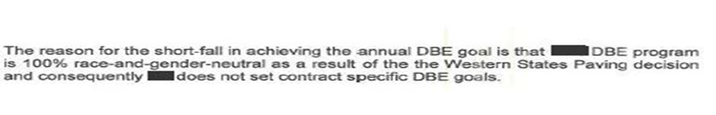
Race-Neutral/Race-Conscious Breakdown:
Common Error
Failure to consider disparity studies and other available evidence in jurisdiction
    Error:
    Ninth Circuit grantees may use race-conscious measures only when there is sufficient evidence of discrimination or its effects in the recipient’s contracting market area. Disparity studies are widely used to obtain this evidence. Grantees should consider disparity studies conducted by other recipients in its contracting market.

Slide 27
  Race-Neutral Measures:
  What Do You Need to Know
List all race-neutral measures used and explain whether these mechanisms were effective

Slide 28
Race-Neutral Measures:
Effective Practice
Answer these questions:
  Are trainings and other outreach efforts effective? If no, why not?
  Do training materials address issues relevant to the DBE and small business community?
  Has DBE participation improved since the implementation of the small business element?
  Are contracts unbundled?
  Does the contract solicitation process hinder DBE participation?
  Is the Office of Diversity present during the contract solicitation process?

Slide 29
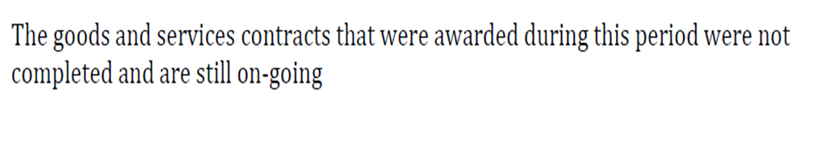
Race-Neutral Measures:
Common Error
Failure to specify which measures were (un)successful
Error:

Slide 30
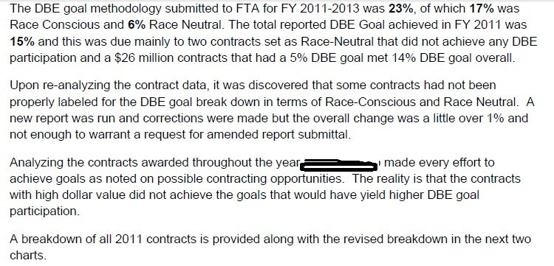
  Specific Reasons for Shortfall:
  What Do You Need to Know
Provide specific reasons for the shortfall
Example:

Slide 31
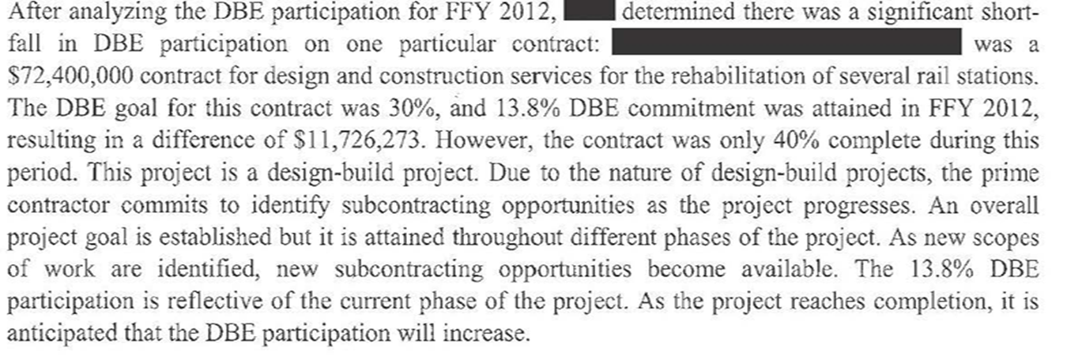
Specific Reasons for Shortfall:
Effective Practice
After collecting all relevant data, specifically state reasons for the shortfall
Example:

Slide 32
Specific Reasons for Shortfall:
Common Error
Lack of Specificity!
Explain why you did not meet your goal by evaluating:
      Projects with low level of DBE participation
      Whether these projects implemented RC or RN measures
      What went wrong generally

Slide 33
Shortfall Analysis Recap
Based on the chart below, the recipient has identified a lack of DBE participation on those projects where there is 0% DBE commitment. Is this the cause of the shortfall?
The recipient should begin here explaining why it did not meet its goal and determine the corrective action efforts needed to increase DBE participation in the upcoming FY.
3% Goal Achieved
0% DBE Participation
0% DBE Participation

Slide 34
Drafting a Corrective Action Plan:
Elements
  Specific Steps to Achieve Goal in Upcoming Fiscal Year
  Milestones for Implementing these Steps

Slide 35
Specific Steps to Achieve Goal:
How to Get Back on Track
  Increasing DBE participation
    How can this be achieved
  Strengthening race-neutral measures
    Identify key race-neutral measures for improvement
  Implementing a race-conscious component
    Use all available evidence when determining whether race-conscious measures should be implemented

Slide 36
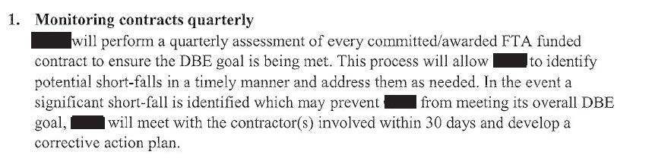
Specific Steps to Achieve Goal:
Effective Practice
  Enhanced Race-Neutral Measures
  Explain what race-neutral measures can be improved or added to increase DBE participation
    Example:

Slide 37
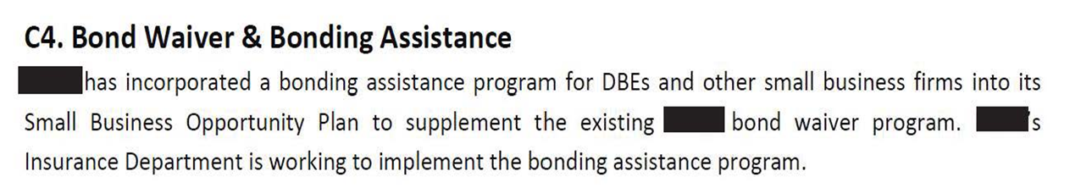
Specific Steps to Achieve Goal:
Effective Practice
  Enhanced Race-Neutral Measures
  Example:

Slide 38
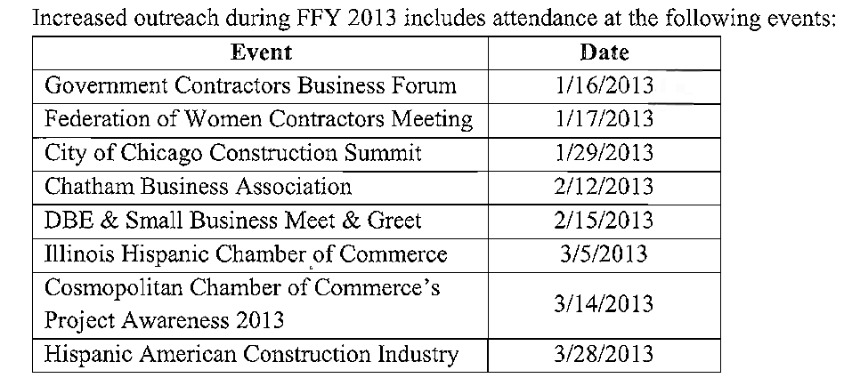
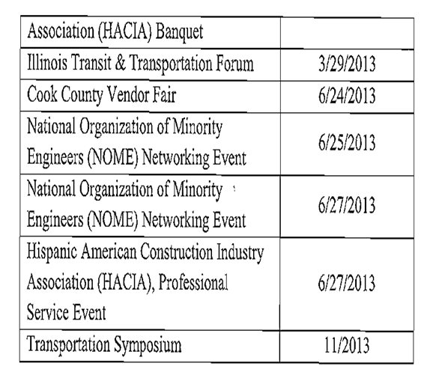
Specific Steps to Achieve Goal:
Effective Practice
Include dates and topics for outreach sessions that span throughout the FY
    Example:

Slide 39
Specific Steps to Achieve Goal:
Common Error
Failure to include specific methods to increase DBE participation
    Error:

Slide 40
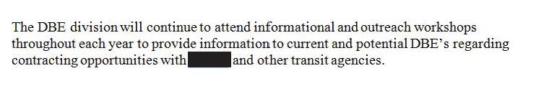
Specific Steps to Achieve Goal:
Common Error
Failure to provide specific dates for trainings, seminars, or other outreach
Failure to specify topics to be covered during upcoming trainings, seminars, or other outreach
    Error:

Slide 41
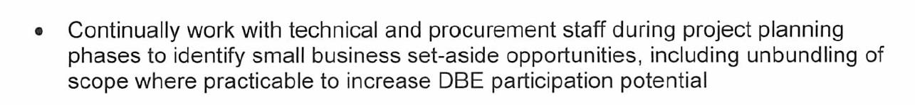
Specific Steps to Achieve Goal:
Common Error
Failure to include criteria for unbundling contracts when this method is identified in the corrective action plan
    Specify what factors will be considered when determining whether unbundling larger contracts is “practical” (e.g., geographic area, contract dollar threshold, etc.)
  Error:

Slide 42
Specific Steps to Achieve Goal:
Common Error
Relying on one project to meet the overall goal
    Error:

Slide 43
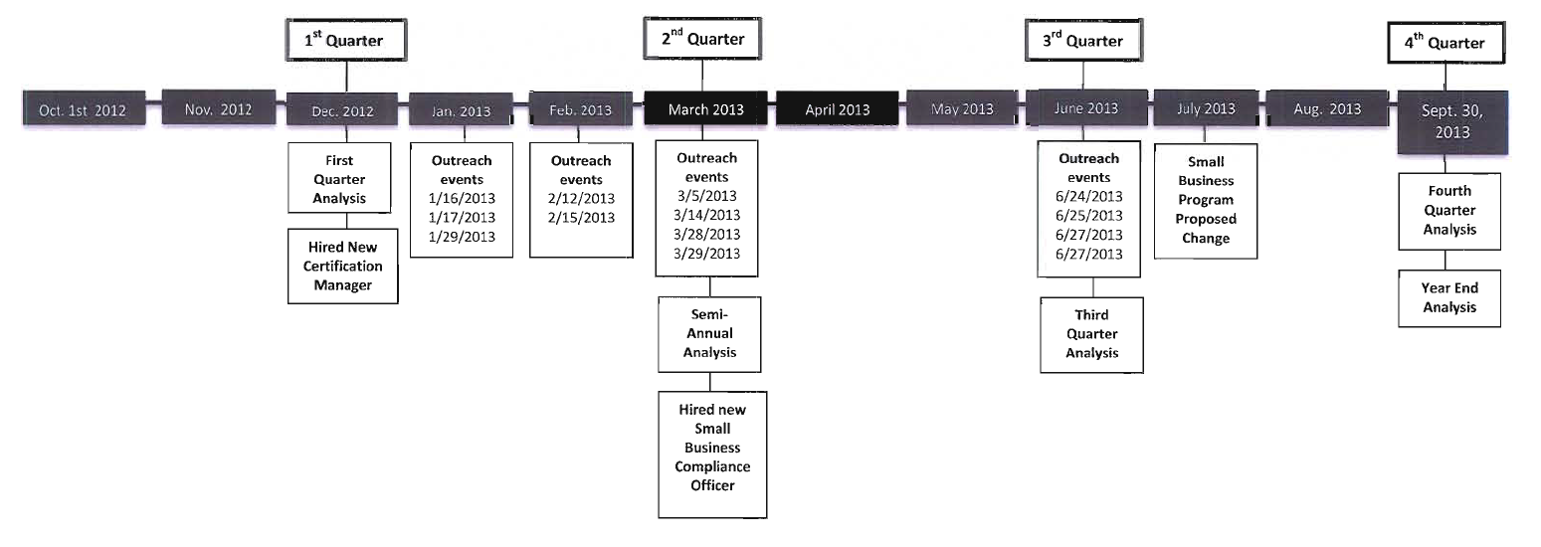
Milestones:
Effective Practice
Include a detailed timeline for implementing all corrective action
    Example:

Slide 44
Reminders and Notifications
FTA will continue to post DBE goals and attainment for Largest 50 Grantees
  http://www.fta.dot.gov/documents/Top_50_FTA_grantees_DBE_goals_9-30-13.pdf
View all FTA training materials and sign up for training notifications and alerts on the FTA web page
  http://www.fta.dot.gov/civilrights/12885.html
FTA training materials include: DBE Reporting (Beginner) and DBE Reporting (Intermediate); DBE Made Easy (video training); and DBE Goal Setting (video training).

Slide 45
FTA Headquarters and Regional Contacts
  Federal Transit Administration Headquarters:
    Email Inquiries: ftadbetraining@dot.gov
  FTA Regional Civil Rights Officers
    Region 1: Margret “Peggy” Griffin
      Email: margaret.griffin@dot.gov
    Region 2: Aaron Meyers
      Email: aaron.meyers@dot.gov
    Region 3: Michael Riess
      Email: michael.riess@dot.gov
    Region 4: Carlos Gonzalez
      Email: carlos.gonzalez3@dot.gov

Slide 46
FTA Regional Contact Information
  FTA Regional Civil Rights Officers
    Region 5: Marjorie Espina
      Email: marjorie.espina@dot.gov
    Region 6: Rebecca Tanrath (acting)
      Email: rebecca.tanrath@dot.gov
    Region 7: Rebecca Rand
      Email: rebecca.rand@dot.gov
    Region 8: Rebecca Tanrath
      Email: rebecca.tanrath@dot.gov
    Region 9: Derrin Jourdan
      Email: derrin.jourdan@dot.gov
    Region 10: Christopher Macneith
      Email: christopher.macneith@dot.gov

Slide 47


