Slide 1
Section 5310 Program Overview with FAST Act Changes March 2016

Slide 2
Section 5310 Program Purpose
“To improve mobility for seniors and individuals with disabilities throughout the country by removing barriers to transportation services and expanding the transportation mobility options available.”
By Supporting
Transportation services planned, designed, and carried out (emphasis added) to meet the special transportation needs of seniors and individuals with disabilities in all areas—large urbanized, small urbanized, and rural.

Slide 3
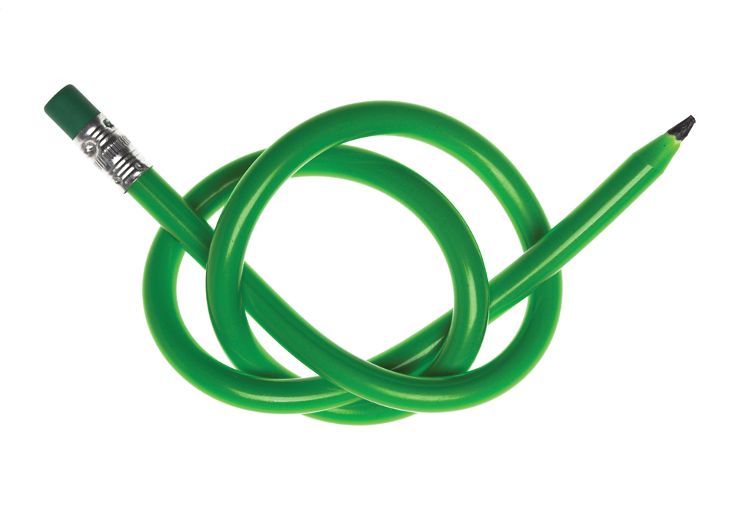
Section 5310 Program Is
A flexible State-managed program that connects seniors and individuals with disabilities to their communities.

Slide 4
At the Outset
5310 was established in 1975 with the following parameters:
Discretionary capital assistance program
Private nonprofits were eligible grantees
Seen as a transportation gap-filling program
Assets primarily used to transport human services agency clients

Slide 5
As It Evolved
Intermodal Surface Transportation Efficiency Act (ISTEA, 1991)
Encouraged coordination among human service transportation providers
Made acquisition of service an eligible expense
Added ability to flex* funds
*Refers to the ability to transfer Federal Highway Administration funding to FTA programs, including 5310.

Slide 6
As It Evolved (continued)
Safe, Accountable, Flexible, Efficient Transportation Equity Act: A Legacy for Users (SAFETEA-LU, 2005)
Established coordinated plan requirement
Required locally-developed coordinated planning process be used for 5310 programs
Required locally-developed coordinated planning process to be used for other FTA funding programs (i.e., New Freedom, Job Access Reverse Commute)

Slide 7
As It Evolved (continued)
Moving Ahead for Progress in the 21st Century (MAP-21, 2012)
Incorporated eligibilities of the former New Freedom Program
Provided specific apportionments to large urbanized areas (UZAs), small UZAs, and rural areas
Made operating expenses eligible
Expanded coordinated plan requirements to include specific requirements for stakeholder involvement in development and approval of the plan

Slide 8
Changes under MAP-21: Apportionments
Designated recipients added for large urbanized areas (UZAs)
Percentage of funding reapportioned between large and small UZAs, and rural areas
60% to large UZAs
20% to small UZAs
20% to rural areas
Apportionments for small UZAs and rural areas can be moved to all types of areas
Large UZA funding cannot be reallocated
FTA Apportionment table: http://www.fta.dot.gov/12853_14875.html

Slide 9
Changes in Map-21: Types of Projects, Traditional and Non-Traditional
A minimum of 55% MUST be spent on traditional 5310 projects
Remaining 45% may be spent on other projects, such as were eligible under the New Freedom (5317) program
Up to 10% may be spent on program administration

Slide 10
Recipients and Subrecipients: Definitions and Roles Following the Dollars

Slide 11
Recipients Defined
5310 Funds are Apportioned to Recipients
States are recipients for rural and small urban areas
Designated recipients for large urban areas are chosen by state governors

Slide 12
Recipients’ Role
Document their procedures in a state management plan (SMP) or program management plan (PMP)
Plan for future transportation needs, ensure integration and coordination among diverse transportation modes, and providers
Develop project selection criteria consistent with the coordinated planning process
Notify eligible local entities of funding availability

Slide 13
Recipients’ Role (continued)
Solicit applications from potential subrecipients
Allocate funds to subrecipients on a fair and equitable basis
Submit an annual program of projects (POP) and grant application to FTA
Ensure compliance with FTA requirements

Slide 14
Subrecipients
For Traditional 5310 projects *
Private nonprofit organizations
A state or local government, if
approved by a state to coordinate services for seniors and individuals with disabilities; or
certifies that there are no nonprofit organizations readily available in the area to provide the service.
*Under MAP-21, 55% of a recipient’s 5310 allocation must be spent on traditional 5310 projects. Chapter 3 will provide further detail on this.

Slide 15
Subrecipients (continued)
For Other eligible projects
State or local governmental authority
Private nonprofit organizations
Operators of public transportation
Such Other projects reflect the inclusion of eligible uses from the former New Freedom program.

Slide 16
Examples of Traditional Section 5310 Projects
Capital Purchases
Vehicles (i.e., buses, vans, or accessible taxis)
Approved Vehicle Rehabilitation or Overhaul
Related Vehicle Equipment (i.e., lifts, ramps, securement devices; etc.)
Other Capital Equipment Purchases (i.e., communications equipment such as Mobile Data Terminals or Computers; security equipment such as camera systems for vehicles; fare collection systems; etc.)
Mobility Management
Cost of Leased or Contracted Services

Slide 17
Examples of “Other” Section 5310 Projects
Mobility Management
Travel Training
Curb Cuts
Sidewalks
Pedestrian Signals or Other Accessible Features
Volunteer Driver Programs (Mileage Reimbursement)

Slide 18
Examples of “Other” Projects (continued)
Costs Directly Tied to Transit Operations
Administrative Expenses
Operation of Transportation Brokerages to Coordinate Providers, Funding Agencies, and Passengers
Development and Operation of One-Call/One-Click Call Centers
Voucher Programs

Slide 19
Case Studies of Section 5310 “Other” Project
Fairfax County Neighborhood and Community Services
Fairfax, VA
Section 5310 funding is used to implement the Northern Virginia Mobility Access Project, a multi-jurisdictional mobility management effort to coordinate services in Northern VA to increase transportation options and reduce barriers to access for older adults and people with disabilities.
Neighborhood groups will be trained on how to provide travel navigation support.

Slide 20
Case Studies of Section 5310 “Other” Project
Wyoming Independent Living Center
Wheatland, WY
Section 5310 funds are used for the Wyoming Transportation Check Program, a voucher program designed to assist people with a disabilities and barriers to mobility. Funding defrays the cost of a ride provided by a friend, co-worker, neighbor, volunteer or public transit provider. In addition, participants share strategies and resources through organized support groups. The program covers the Eastern half of Wyoming.

Slide 21
Case Studies of Section 5310 “Other” Funding
Ride Connection
Portland, OR
Section 5310 funds are used for the Ridewise Program that provides 1:1 travel training for older adults (60+) and people with disabilities; group travel training for people in transition programs; and practice for people new to using a mobility device on public transportation.

Slide 22
Case Studies of Section 5310 “Other” Funding
Door-Tran
Door County, WI
Section 5310 is used to provide a range of mobility management services, including:
Half-price taxi vouchers
Washington Island Community Van, or ferry rides
Shared-ride taxi program
Volunteer driver programs
Information and referral services
Mobility manager on staff

Slide 23
Local Match Requirements
Exceptions:
Vehicle acquisitions to support compliance with the Americans with Disabilities Act (ADA) or the Clean Air Act have an 85% and 90% Federal match, respectively, for vehicle-related equipment and facilities.
Notes:
For more information on Local Match Requirements, please review the circular.

Slide 24
Federal-to-Federal Match
FTA allows for local match to come from other federal programs supporting transportation
When funds are leveraged in this way, programs can be 100% federally-funded programs
This will be discussed further in Chapter 2

Slide 25
U.S. Department of Health and Human Services (HHS) Match Partnership
The Administration for Community Living (ACL), an Operating Division of HHS allows their Older Americans Act (OAA) Title III B (Supportive Services) federal funds to be used as match for 5310
View the FAQ:
http://www.aoa.gov/AOA_programs/OAA/resources/faqs.aspx#Transportation

Slide 26
HHS Partnership (continued)
Did you know that 5310 programs can partner with meal delivery programs? ACL oversees the OAA-funded meal programs. To find the meal program in your community, visit: www.Eldercare.gov
Transit service providers receiving 5310 funds may coordinate and assist in providing meal delivery services on a regular basis if the meal delivery services do not conflict with the provision of transit services or result in a reduction of service to transit passengers

Slide 27
Management Plans
State/Program Management Plans (SMP/PMP)
SMPs developed by states; PMPs by Designated Recipients
Describe the recipients’ processes for administering the 5310 and 5311 (rural-area formula) programs, including project selection
Should be consistent with state and metropolitan area planning efforts and have transparency with opportunities for public comment
Are reviewed by FTA on a regular basis to ensure compliance

Slide 28
The Project Selection Process Making Choices To Address Needs

Slide 29
Steps in Project Selection
Section 5310 Recipients are responsible for:
Developing project selection criteria consistent with the coordinated planning process
Notifying eligible local entities of funding availability
Soliciting applications from potential subrecipients
Allocating funds to subrecipients on a fair and equitable basis
Submitting an annual program of projects (POP) and grant application to FTA

Slide 30
Project Selection is Flexible
Recipients are afforded a great deal of flexibility in how they select projects.
The selection process may be:
Formula-based
Competitive
Discretionary

Slide 31
Selection Process Requirements
Whatever the selection process, it must ensure:
Equitable distribution among eligible groups
Projects selected are included in the Coordinated Plan
The Coordinated Plan was developed and approved in cooperation with stakeholders, including individuals with disabilities and seniors utilizing transportation services

Slide 32
Innovative Approaches To Project Selection Finding Creative Solutions To Challenges

Slide 33
Case Study for Section 5310 Project Selection: Texas Department of Transportation
Texas emphasizes local, public involvement in its project selection criteria. Considerations include:
Stakeholder involvement includes the early and extensive engagement of stakeholders in the process of planning, decision making, and implementation
TxDOT districts are required to establish a stakeholders group with no more than 15 members
Stakeholders are those who affect change and those who are affected by it

Slide 34
Case Study for Section 5310 Project Selection: Texas Department of Transportation (continued)
Stakeholders include:
Community or neighborhood leaders and groups
Traditionally under-represented groups
Transportation partners, passengers and advocates
Human service and workforce agencies
Others such as emergency management agencies
The aim of inclusiveness makes the identification of stakeholders important; excluding an important stakeholder can undermine the entire process

Slide 35
Case Study for Section 5310 Project Selection: Texas Department of Transportation (continued)
In recommending projects for funding, stakeholder groups are asked to consider the program goals and objectives and choose projects that:
Leverage existing resources and promote innovation
Are the only public transportation option for the proposed service area
Are sustainable over time
Demonstrate efficient use of resources
Involve partnerships that include for-profit transportation providers
Provide service continuity

Slide 36
Quiz
Test yourself by determining if the following statements are True/False.
The 5310 Program is a new creation of the Moving Ahead for Progress in the 21st Century (MAP-21) transportation bill.
5310 funds are meant to supplement FTA funding, such as the 5307 Urban Area Formula Program, and the 5311 Rural Area Formula Program to support services for people with disabilities or seniors, such as ADA-complementary paratransit.
States are the only recipients of 5310 funds.
Local transportation providers can be subrecipients of the 5310 program.
Stakeholders, including people with disabilities, older adults, and others, are required to be allowed to review the Coordinated Plan before it is approved by the local MPO, State, or other Recipient.

Slide 37
Quiz (continued)
1
2
3
4
5
Recipients must select sub-recipients to implement 5310 projects by a competitive process.
The Coordinated Plan must be prepared by the MPO, in a metropolitan area, or the State, for rural areas.
The Coordinated Plan should be prepared in a way that is complementary to, and benefiting from the larger planning efforts in a community, such as the Long Range Transportation Plan, State Transportation Improvement Plan, and others.
The majority of a 5310 allocation must be spent on traditional projects, for which nonprofit organizations are generally the subrecipients.
10% of a 5310 allocation must be used to cover the costs of program administration.

Slide 38
Quiz Answers
False
False
False
True
False
False
False
True
True
False

Slide 39
Questions to Ponder
The 5310 program acknowledges that traditional public transportation may not meet all the needs people with disabilities and seniors face in achieving mobility. What are some of the challenges in your community?
Consider how 5310 projects are selected in your community. How did that process come into being? How is that related to the development of the 5310 program?

Slide 40
Additional Resources
FTA Resources:
Section 5310 Fact Sheet - Provides a brief overview of the program’s allocation, purpose, and other provisions
Section 5310 Circular (June 6, 2014) – The authoritative document on the requirements of the 5310 program
NTD Glossary - Terms used in the National Transit Database, explained

Slide 41
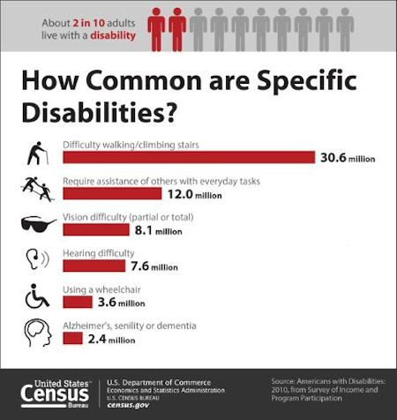
Trends
The Section 5310 Program serves an ever growing aging population and people with disabilities.

Slide 42
5310 Means
Independence
“The program is helping me stay independent for as long as possible. Since I do not drive, the program allows me to go to various functions, appointments and shopping.”
Inclusion
“I got to visit a friend I hadn’t seen in 20 years. What a fun day! The outlets in Kittery? I never thought I would get there again.”
Access/Health
“I had to keep cancelling doctor’s appointments, but I’m able to get there now. It’s easy to make arrangements with this program. I just check in with my driver’s schedule and work around that.”
*Quotes from riders of 5310-funded programs

Slide 43
FAST Act Authorized Funding for Section 5310
 | FY 2016 (in millions) | FY 2017 (in millions) | FY 2018 (in millions) | FY 2019 (in millions) | FY 2020 (in millions)
5310 Formula Grants | $262.95 | $268.21 | $273.84 | $279.65 | $285.58
Discretionary Pilot Program | $2.00 | $3.00 | $3.25 | $3.50 | $3.50
5310 Total | $264.95 | $271.21 | $277.09 | $283.15 | $289.08

Slide 44
FAST Act Changes to the Section 5310 Program
A State or local governmental entity that operates a public transportation service and that is eligible to receive direct grants under 5311 or 5307 is now an eligible direct recipient
There is now a requirement for the collection of best practices for dissemination to public transportation on innovation, program models, new services delivery options, performance measure findings, and transit cooperative research program reports

Slide 45
FAST Act Changes to the Section 5310 Program, Cont.
Section 3006(b): a discretionary pilot program for innovative coordinated access and mobility - open to 5310 recipients and subrecipients - to assist in financing innovative projects for the transportation disadvantaged that improve the coordination of transportation services and non-emergency medical transportation services; such as: the deployment of coordination technology, projects that create or increase access to community (i.e. One-Call/One-Click Centers, etc.)

Slide 46
FAST Act Changes to the Section 5310 Program, Cont.
Section 3006(c): Coordinated Mobility which requires following through on recommendations made by the Interagency Transportation Coordination Council on Access and Mobility (CCAM) 2005 Report to the President relating to the implementation of Executive Order No. 13330 (49 U.S.S. 101 note) including publicizing an updated strategic plan and developing a cost-sharing policy

Slide 47
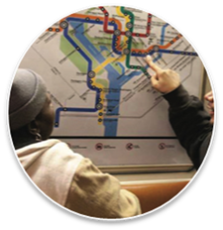
Rides to Wellness Demonstration and Innovative Coordinated Access and Mobility Grants program - 2016 NOFO
$5.3M R2W Demo Grants/5310 Pilot Program
Approximately $3 million in FY2015 National Research and Technology Program (Section 5312) discretionary funds authorized by the Moving Ahead for Progress in the 21st Century Act (MAP 21), Public Law 112-141, July 6, 2012
Approximately $2 million in FY2016 Enhanced Mobility of Seniors and Individuals Act, Public Law 114-94, December 4, 2015

Slide 48
R2W Demo Grants/5310 Pilot Program
Eligible applicants include: States, Tribes, Designated or Direct Recipients for 5307, 5310 and 5311
Program Goals:
Develop replicable, innovative, sustainable solutions to healthcare access challenges;
Foster local partnerships between the health, transportation, home and community-based services and other sectors to collaboratively develop and support solutions that increase healthcare access; and
Demonstrate the impacts of transportation solutions on improved access to healthcare and health outcomes and reduced costs to the healthcare and transportation sectors.

Slide 49
National Aging and Disability Transportation Center (NADTC)
Goals of the NADTC:
Promote the use of accessible public transportation for healthcare, employment, education, recreation, and to support independent living
Increase the effectiveness, efficiency, and quality of coordinated human service transportation
Ensure transportation planning is done in conjunction with broader planning activities at all levels
Highlight and assist in developing promising practices to solve transportation challenges maximizing the effectiveness of federal investments in specialized transportation
Notes:
Providing person-centered technical assistance: 800# information and referral; an information clearinghouse and publications
Training: webinars, online courses, and in-person events
Communication and outreach: website, blog, and use of social media; yearly trends reports; technology-focused information
Coordination and partnerships: stakeholder review committees; open dialogues; forums
Investing in Community solutions: community grant program
Developing a community accessibility scorecard and index
To find out more about the NADTC, request technical assistance, or to sign up for the Center’s e-News, send an email to contact@nadtc.org or call toll-free (866) 528-6278

Slide 50
Section 5310 Technical Assistance
To find out more about the NADTC, request technical assistance, webinars, online courses, in-person events,
or to sign up for the Center’s e-News, send an email to: contact@nadtc.org or call (866) 528-6278
Notes:
To find out more about the NADTC, request technical assistance, or to sign up for the Center’s e-News, send an email to contact@nadtc.org or call toll-free (866) 528-6278

