Slide 1
National Transit Database
NTD Reporting for State DOTs
Report Year 2016

Slide 2
Contact Information
National Transit Database
943 Glenwood Station Lane, Suite 102
Charlottesville, VA 22901
Help Desk
(888) 252-0936
NTDHelp@dot.gov
Monday- Friday
0800 – 1900 Eastern

Slide 3
Rural Reporting Webinar – 9/15
NTI will be holding this webinar again on September 15th.
Check https://www.ntionline.com/ for future webinar information or contact your analyst if you are interested in attending

Slide 4
Agenda
NTD Rural Module Overview
Report Year 2016 Changes and Clarifications
NTD 2.0 Overview
Starting the Report
Annual Form Navigation
Report Submission
Validation Process

Slide 5
NTD Rural Module Overview

Slide 6
Who Reports?
States complete a report on behalf of all 5311 subrecipients.
NTD recognizes three different types of subrecipients:
Public transit providers
Rural General Public Transit
Intercity bus carriers receiving 5311(f) funds
Intercity Bus
Public transit providers reporting directly
Urban/Tribal Subrecipient

Slide 7
Reporting Deadlines

Slide 8
What to Report?
All public transportation services either directly operated (DO) or operated through a contractor (PT)
All assets and expenditures associated with those services
NTD captures the total cost of service, regardless of funding source
Only report services for which you are responsible for the fully allocated cost of the service
Exclude from public transportation:
Charter Service
School Bus Service
Sightseeing Service

Slide 9
What to Report?
Data specific to each mode a subrecipient operates
Service data (miles, hours, ridership, etc. must be collected separately for each mode)
Actual Data
Not calculated or estimated data
Direct and Indirect Expenses related to the service
Regardless of funding source

Slide 10
NTD Process Overview

Slide 11
Report Year 2016 Changes and Clarifications

Slide 12
Reporting Spare Vehicles
In RY2016, Spare Vehicles will be included in the Active Vehicle count on the A-30.
Continue to report vehicles as active if they are purchased and delivered by the end of the fiscal year.
Inactive vehicles will be defined as:
In storage
Retained for emergency contingency purposes
Out of service for an extended period of time for major repairs
Awaiting sale or disposal

Slide 13
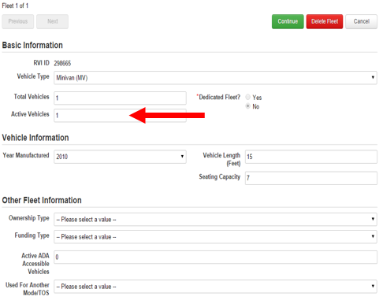
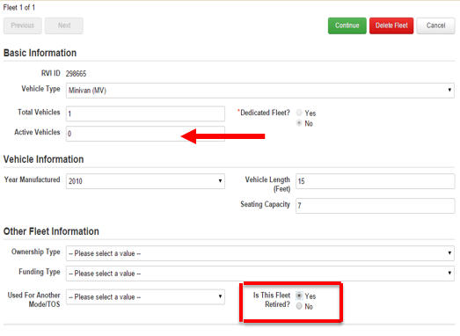
Clarification: Deleting vs. Retiring Fleets
When a fleet is no longer in use, do NOT click “Delete Fleet”
Instead, change “Active Vehicles” to 0 then
“Is This Fleet Retired?” field will be prompted
Select “Yes” and click “Continue” and save the form

Slide 14
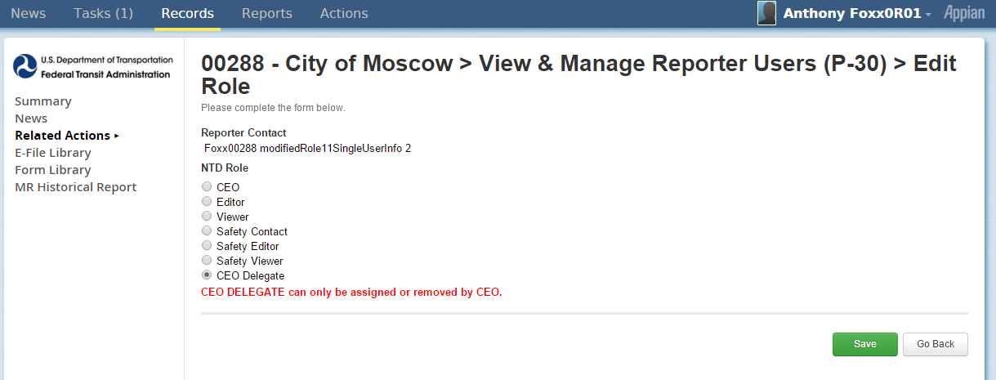
CEO Delegate
P-30:
NTD 2.0 requires at least two contacts,
One contact must be the head of the transit unit (CEO)
A CEO Delegate can be assigned by the CEO if the CEO does not work on or submit the NTD report. Completing the process delegates the NTD report to another user.

Slide 15
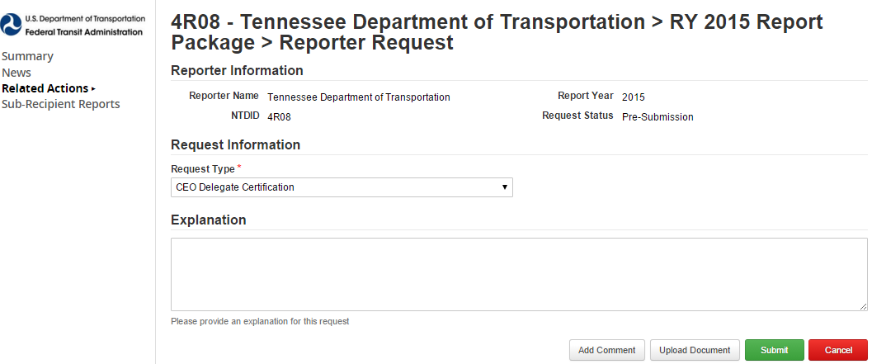
CEO Delegate Certification
Before updating the User Role on the P-30, the CEO must complete and upload a CEO Delegate Certification, through the State DOT Report Package > Reporter Requests

Slide 16
Transit Asset Management Program (TAM)

Slide 17
Annual NTD Reporting Requirements
Transit Asset Management Program
Requires agencies to report their performance targets to the NTD each year
First targets must be entered in January 2017 for FY2017
After, targets are reported with each annual NTD report for the next fiscal year
One target for each mode or vehicle type

Slide 18
Annual NTD Reporting Requirements
Transit Asset Management Plans
On-going Requirements (beginning Report Year 2018):
Data Reports
Projected performance targets for next fiscal year – entered with annual report
Facilities Condition and Performance Assessments (full implementation over 3 years – 1/3 due in RY 2018, 1/3 in RY 2019 and 1/3 in RY 2020)
Performance Restrictions (slow zones measure)

Slide 19
Transit Asset Management Plans
Annual NTD Reporting Requirements
On-going Requirements (beginning Report Year 2018):
Narrative Report
Change in condition
Progress toward targets

Slide 20
Annual NTD Reporting Requirements
Transit Asset Management Plans
Group Plan Sponsors submit consolidated reports on behalf of their participants
A TAM-NTD Crosswalk can be found on the TAM website https://www.transit.dot.gov/TAM/rulemaking/nprmntdcrosswalk

Slide 21
Transit Asset Management
Performance Measures
Age
Equipment | Percentage of vehicles that have met or exceeded their Useful Life Benchmark (ULB)
Rolling Stock | Percentage of revenue vehicles within a particular asset class that have met or exceeded their ULB
Infrastructure
Performance | Percentage of guideway directional route miles with performance restrictions by class
Facilities
Condition | Percentage of facilities with a condition rating below 3.0 on the FTA Transit Economic Requirements Model (TERM) scale (1=Poor to 5=Excellent)

Slide 22
Useful Life Benchmark (ULB)
ULB ≠ Useful life for FTA grant programs
Useful Life Benchmark – defined as the expected lifecycle of a capital asset for a particular Transit Provider’s operating environment, or the acceptable period of use in service for a particular Transit Provider’s operating environment
ULB takes into account a provider’s unique operating environment (i.e. geography, service frequency, etc.)
There are default ULB values, but agencies are welcome to develop their own
Notes:
Useful Life Benchmark is defined as the expected lifecycle of a capital asset for a particular Transit Provider’s operating environment, or the acceptable period of use in service for a particular Transit Provider’s operating environment.
We want to highlight this measure because it differs from the typical definition of useful life used for FTA grant programs, which typically defines the minimum age at which equipment can be retired. The useful life is the acceptable period of use in service. In contrast, ULB is a MAXIMUM. It reflects the age at which maintaining it in a state of good repair no longer makes sense.
FTA has calculated default ULBs based on TERM Lite, an analysis tool. ULB is based on a model’s extrapolation of when an asset would meet 2.5 on the TERM scale. ULB is the mathematical threshold of State of Good Repair, where anything beyond may be operational but is now part of the backlog. Agencies may use these default ULB values or develop their own.
A Transit Provider may either use the default ULB established by FTA or set its own, taking local conditions and usage into consideration. A ULB should take into consideration both the age of an asset and its operating environment.
As an example, a vehicle that operates 2 days per week in a low volume, rural setting may have a different ULB than a the same vehicle type operating in a high frequency, high volume, inner city environment. Similarly fleets with similar operating characteristics may have different ULB if they’re located in the Northeast as compared to one in the Southwest.
If an agency decides to set its own ULB, it will need to have that ULB approved by FTA.

Slide 23
Self-Reporting Subrecipients

Slide 24
Self-Reporting Subrecipients
In Report Year 2015, FTA launched new functionality to allow subrecipients to enter and edit their own data within the National Transit Database (NTD) online reporting system.
Completely optional
State DOT CEO/NTD Contact can grant self-reporting privileges to some, none, or all at their discretion
Grants subrecipients ability to save forms, not submit
Self-reporting subrecipient users are subject to FACES requirements

Slide 25
Standard Procedures: Self-Reporting
Subrecipients taking part in self-reporting will be required to submit a User Manager letter for accounts in the NTD Reporting System
DOTs should send User Manager letters to their assigned analyst
NTD will not be able to process or accept User Manager letters sent directly from subrecipients

Slide 26
Standard Procedures: Self-Reporting
State DOTs are responsible for the NTD Report
Subrecipients should contact the state for technical assistance with the reporting system
All correspondence with the NTD analyst, via email or phone, should go through the State Contact or include the State Contact

Slide 27
Reporting Contracts (B-30 forms)

Slide 28
Reporting Contracts to NTD
In RY2016 it will be optional to report the characteristics of service contracts (B-30)
The contractor and relationship type
Monetary nature of the contract
Type of Contract: competitively bid vs. fixed-rate cost
Assets provided by the buyer (vehicles, facilities, none)
Contract service and financial data
Vehicles Operated in Maximum service, number of months the provider operated, fare revenues, the cost of the contract, capital leasing expenses, and any additional costs the buyer incurs

Slide 29
Contractual Relationships
Transit service provided to an agency or governmental unit from a public or private transportation provider based on a written contract.
Buyer: transit agency that pays another entity to perform transit service
If the buyer of service only pays a portion of the costs to operate service, it should not report the service as a contract.
Seller: provides transit service on behalf of an agency, and may be a public or private entity.

Slide 30
Contract Criteria
A written agreement exists that
obligates the seller to provide the operations for a specific monetary consideration;
specifies a contractual relationship for a certain time period and service;
obligates the seller to provide to the buyer the operating statistics required by the NTD Annual Report;
Authorized representatives of both the buyer and seller sign the written agreement;
The buyer pays the seller the full costs of operating the service.
The purchased service must be branded under the transit agency buying the service.

Slide 31
Review of Important Principles

Slide 32
Review: Accounting Requirements
Generally Accepted Accounting Principles (GAAP)
If conflict exists, use NTD requirements
Accrual accounting
Revenue recorded when earned, regardless of when payment is received
Expenses recorded when liability occurs, regardless of when payment is made
Notes:
Accounting requirements – NTD reporting requirements for financial data follow generally accepted accounting principles (GAAP) and accrual accounting.
The NTD program is a system of accounts that complies with GAAP and Standards of Governmental Accounting and Financial Reporting. However, small differences exist between NTD and GAAP, relating to the accounting of costs for capital grant purchases. If there are conflicts between GAAP and NTD reporting instructions and requirements, NTD rules are to be followed.
Accrual accounting – Revenue is recorded when earned, regardless of when payment is received. Expenses are recorded when the liability occurs, regardless of when the payment is made.
Source: www.ntdprogram.gov

Slide 33
Review: Direct vs. Indirect Expenses
For agencies operating more than one mode, operating expenses must be reported as direct and indirect expenses
Determine which expenses are direct expenses and can be easily traced to a particular mode/TOS (i.e. bus passes)
Determine which expenses are indirect expenses. These costs are incurred for the benefit of more than one mode/TOS and cannot be easily traced to a specific mode/TOS (i.e. maintenance costs for vehicles that support both modes)

Slide 34
Review: Allocating Indirect Expenses
Once the indirect expenses have been identified, they can be allocated between modes based on a consistent and reliable variable, such as:
Vehicle Revenue Miles
Unlinked Passenger Trips
Vehicle Revenue Hours
Number of Employees

Slide 35
Review: Allocating Indirect Expenses
Subrecipient operates a Dial-a-Ride or Demand Response (DR) service and a fixed-route bus (MB) service
Collects Annual Vehicle Revenue Miles (VRM) for each mode separately.
DR: 200,000 VRM
MB: 300,000 VRM

Slide 36
Review: Allocating Indirect Expenses
Total Annual Operating Expenses: $1,500,000
Direct Expenses for DR = $400,000
Direct Expenses for MB = $500,000
Indirect Expenses not easily attributable to a specific mode = $600,000

Slide 37
Review: Allocating Indirect Expenses
Subrecipient uses vehicle revenue miles to allocate indirect costs.
$$\frac{200,000 DR miles}{500,000 total miles}=\frac{DR indirect operating cost}{\$600,000 indirect operating cost}$$
$$\frac{200,000 }{500,000 }×\$600,000=\$240,000 −DR Indirect Operating Cost$$
$$\frac{300,000 MB miles}{500,000 total miles}=\frac{MB indirect operating cost}{\$600,000 indirect operating cost}$$
$$\frac{300,000 }{500,000 }×\$600,000=\$360,000 −MB Indirect Operating Cost$$

Slide 38
Review: Direct and Indirect Expenses
Total Operating Expenses for DR = $640,000
Direct Expenses = $400,000
Indirect Expenses = $240,000
Total Operating Expenses for MB = $860,000
Direct Expenses = $500,000
Indirect Expenses = $360,000

Slide 39
NTD 2.0 Overview

Slide 40
NTD Home Page: www.transit.dot.gov/ntd

Slide 41
NTD Key Reference Documents
Policy Manual
Issued annually to provide detailed guidance on what data to report to NTD
Uniform System of Accounts (USOA)
Outlines the basic accounting structure all NTD reporters must follow
Notes:
RY15 Policy Manual has been published to NTD Program website.

Slide 42
User Manager
Each agency must submit an official letter designating an employee as the User Manager.
User Managers create accounts for the CEO and NTD Contact as well as accounts for editors and viewers.
The User Manager can also fill a NTD Role - for example, the CEO can also be the agency’s UM.

Slide 43
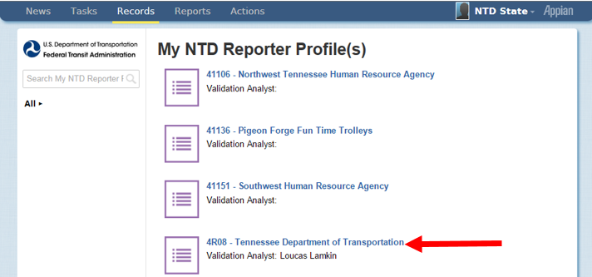
Defining Users
Select your State Profile
State users won’t see Profiles for Urban agencies unless they have system access to these specific profiles.

Slide 44
Defining Users
Select the P-30 (Reporter Users)

Slide 45
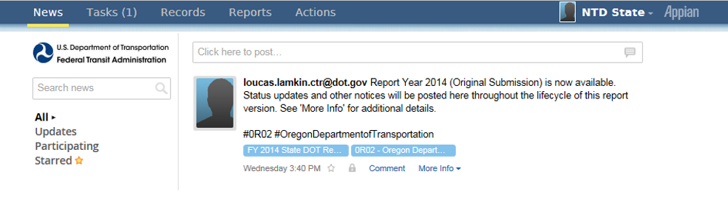
Interface overview
All users land on the News feed
Posts from NTD staff will display here

Slide 46
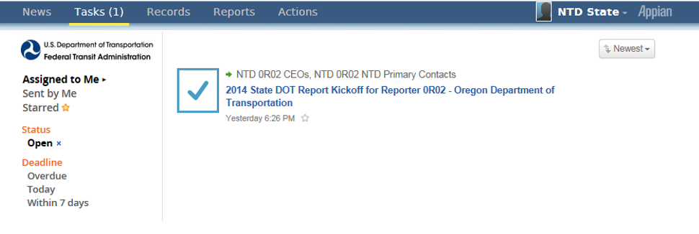
Tasks
Kickoff Tasks are assigned to CEOs and NTD Contacts
Kickoffs populate the packages for all the subrecipients in that Report Year

Slide 47
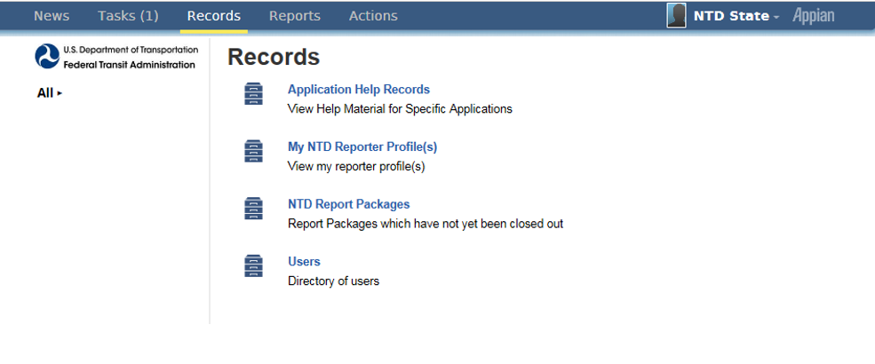
Records
Profiles and Package Forms are accessed through “Records”

Slide 48
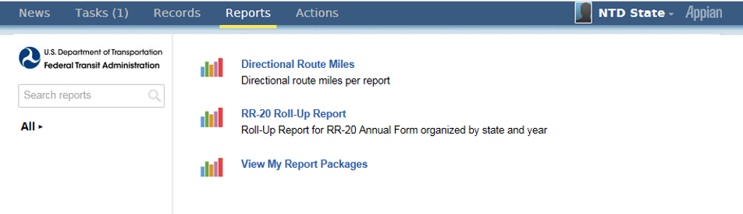
Reports
The RR-20 Roll-Up Report functions like the old system’s RU-30

Slide 49
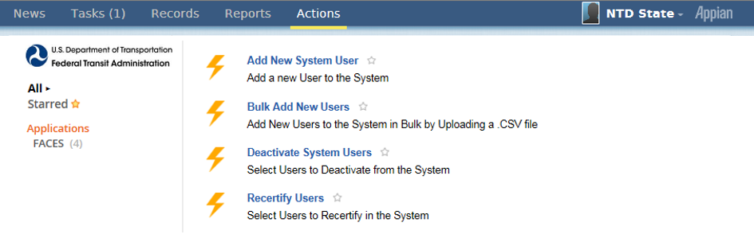
Actions
Options vary based on user privileges
Image below shows Actions tab for a User Manager

Slide 50
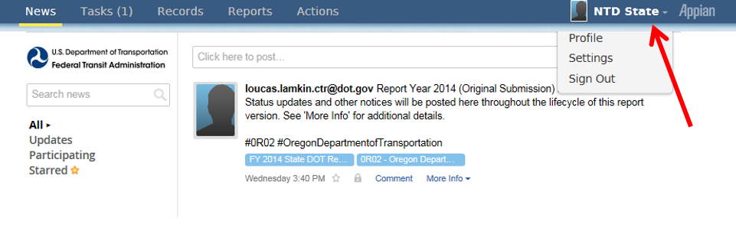
Account Settings
Click your name to update your profile or change account password

Slide 51
Report Package Forms
A Report Package contains all of the forms required for annual reporting
Identification (B-10)
Stations & Maintenance Facilities (A-10)
Revenue Vehicle Inventory (A-30)
Reduced Reporting (RR-20)

Slide 52
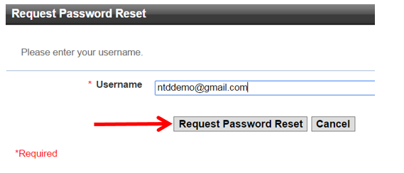
Resetting Passwords
Click “Forgot Password” from main login screen
Enter the email address used for your user name and click “Request Password Reset”

Slide 53
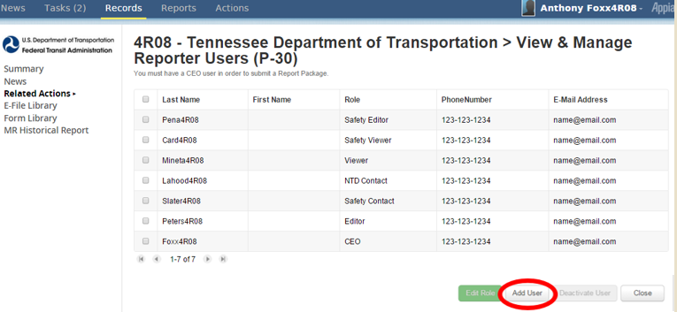
Defining Users
Click “Add User”
Once you click “Add”, you will be able to enter data for that user

Slide 54
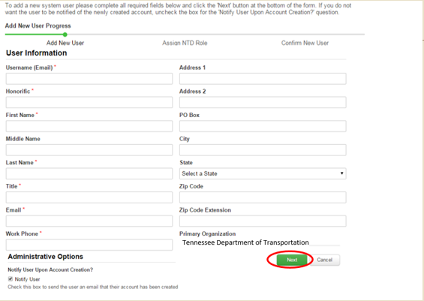
Enter Data
Fields with a red asterisk are required

Slide 55
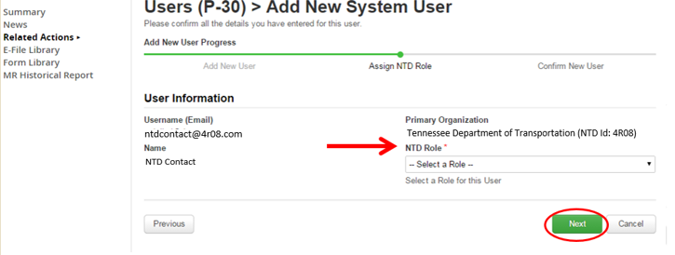
Assign Role
NTD Requires at least two users:
CEO
One additional user

Slide 56
NTD Roles
CEO or CEO Delegate must submit the Original Submission (first draft of NTD Report)
NTD Contact can submit all subsequent revisions
NTD 2.0
CEO
CEO Delegate
NTD Contact
Editor
Viewer

Slide 57
Permissions by Role
CEO & CEO Delegate:
Creating reporter requests (waivers, extension requests, etc.)
Submit annual report package
Can view and edit forms and issues
NTD Contact:
Can submit all annual report after the original submission by the CEO
Can view and edit forms and issues
Editor:
Can view and edit forms and issues
Viewer:
Can view forms and issues

Slide 58
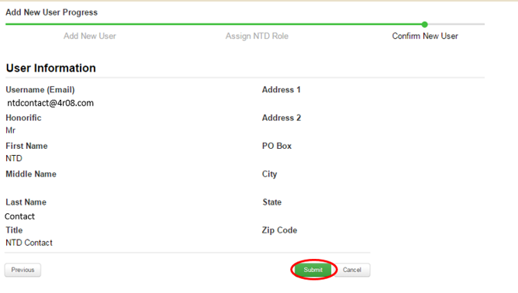
Defining Users
Submit
Finish by pressing submit

Slide 59
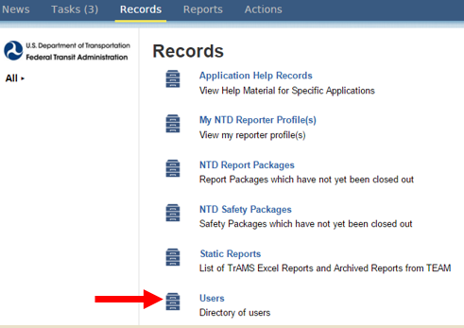
Editing User Information
Only the User Manager (UM) can edit other’s contact information
Click “Users” under the Records tab to complete the search and update.

Slide 60
Editing User Information
If the User is logged on, they may update their own account information under “Profile”

Slide 61
Starting the Report

Slide 62
Report Year Kickoff
Click on Tasks and select the Report Year Kickoff task

Slide 63
Report Year Kickoff
“Accept” the task and then select “Proceed”

Slide 64
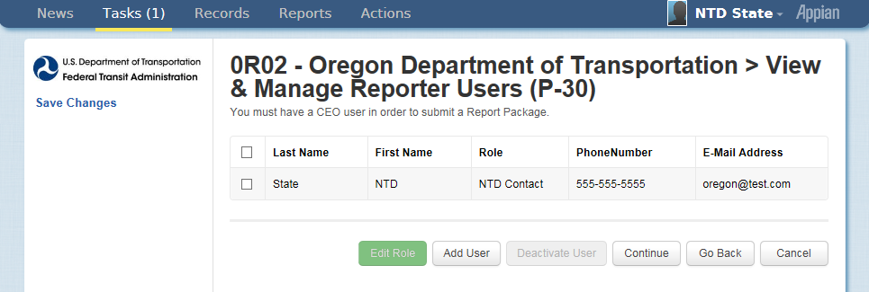
Verify DOT Information
Update Users
The CEO/NTD Contact can change user roles
Only the UM can add new users
Individual users can edit their own profile

Slide 65
Identifying Subrecipients
Identify Subrecipients
Subrecipients from RY2014 are pre-loaded. Please verify this list.
New subrecipients can be added from a list of existing agency profiles or created during kickoff.

Slide 66
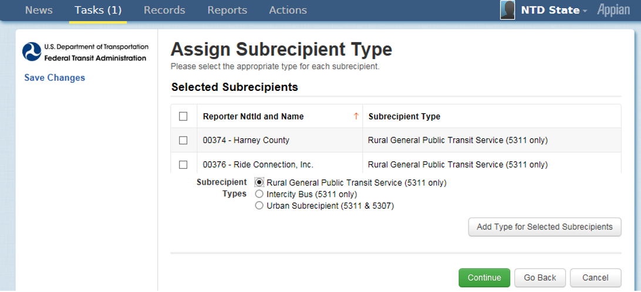
Assign Subrecipient Type
Assign Subrecipient Type
The type is pre-loaded from RY2014 Closed Report.
To change, select the subrecipient by checking the box to its left, bubble for type, and then click “Add Type”.
Before changing subrecipient type from Rural General Public Transit service to another type, please consult your analyst.

Slide 67
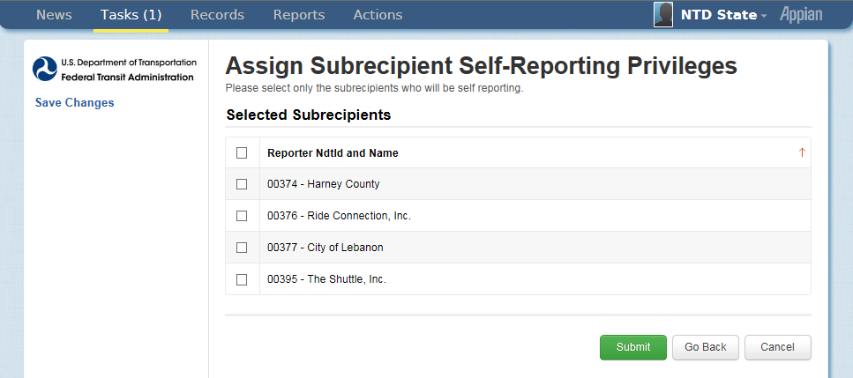
Assign Self-Reporting Privileges
Assign Self-Reporting Privileges
To select the subrecipient, check the box to its left.

Slide 68
Complete Report Year Kickoff
Form Generation
Profiles and Report Packages (Annual Forms) take at least three minutes to generate
Note: New subrecipients will require NTD approval before generating
Click “OK” to end the task
The process is not complete until you see this message.

Slide 69
Defining subrecipient modes

Slide 70
Common Modes in the Rural Module
Motor Bus (MB)
Demand Response (DR)
Motor Bus service is powered by a motor and fuel contained within a vehicle. Transit agencies must report any route deviation, point deviation, or deviated fixed route as MB service.
Shared-ride demand response service is scheduled in response to calls from passengers. A transit agency employee operates demand response (DR) vehicles. Many transit systems operate DR service to meet the requirements of the ADA.

Slide 71
How to Edit Subrecipient Modes
Click on “Records”

Slide 72
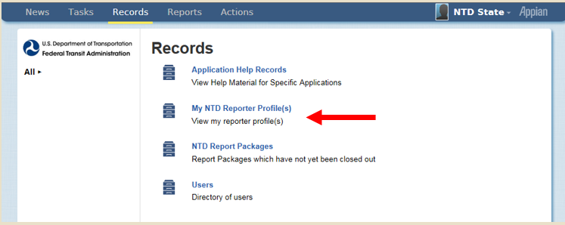
My NTD Reporter Profiles
Select “My NTD Reporter Profiles”

Slide 73
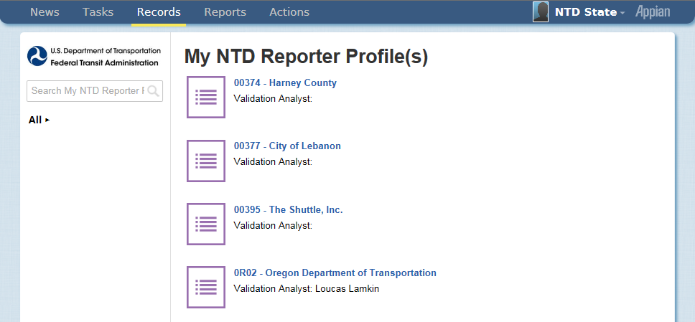
Select a Profile
Select a Profile
State users won’t see Profiles for Urban agencies

Slide 74
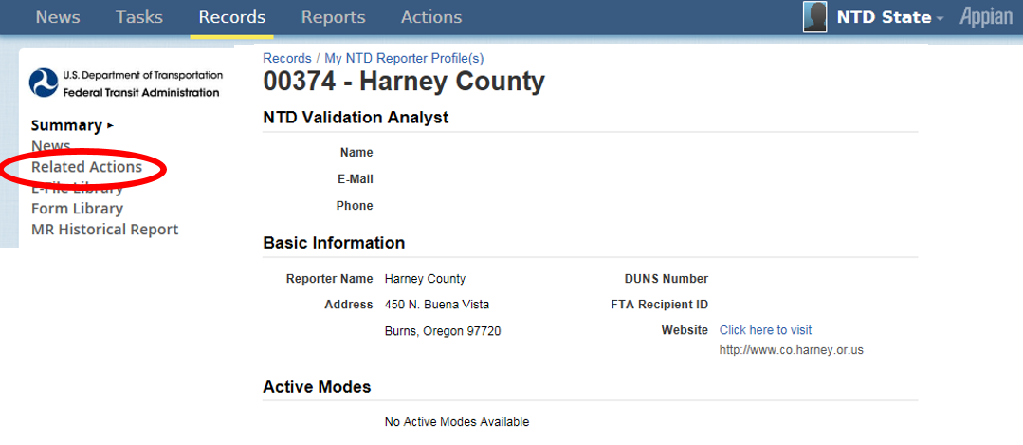
Select Related Actions
Select Related Actions
All forms have a non-editable “Summary” page
Data Entry & Edits require a “Related Action”

Slide 75
Select the P-20
Select the P-20 (View & Manage Reporter Modes)

Slide 76
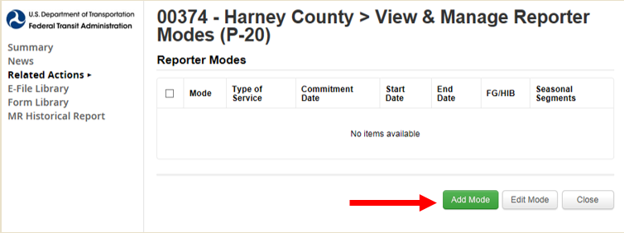
Click “Add Mode” Button
Click “Add Mode” Button
Once modes are entered into the new system, the data won’t need to be entered for future report years.

Slide 77
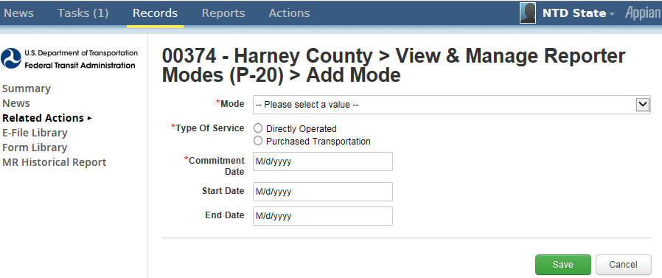
Defining Modes
Define the new mode and click “Save”
What is the mode? Bus (MB), Demand Response (DR), Vanpool (VP), etc.
Type of Service: DO (Directly Operated) or PT (Purchased Transportation)
Commitment Date: When capital funds were first expended
Start Date: First day of revenue service
End Date: Leave blank if service is still in operation

Slide 78
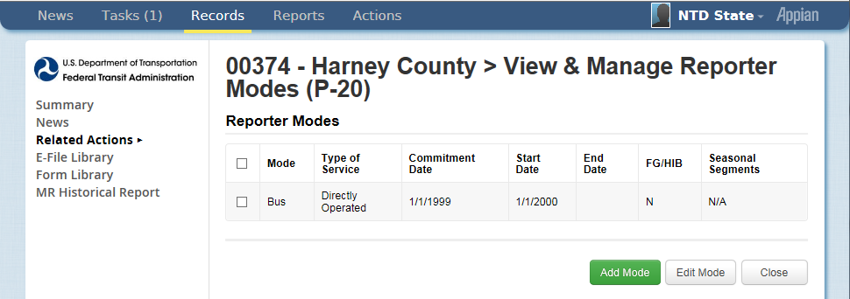
Edit Modes
Edit Modes
Repeat the process if the subrecipient has more than one mode
Select a mode and click “Edit Mode” to edit an existing mode

Slide 79
Annual Form navigation

Slide 80
Rural General Public Transit
Annual Forms

Slide 81
Rural General Public Transit (RGPT)
Definition: Agencies that provide rural service and receive or benefit from 5311 funding. (Does not include those receiving §5307 funding or Tribes)
Required Forms:
B-10: Organization Type and Fiscal Year Start and End Dates
A-10: Maintenance Facilities (one per mode)
A-30: Revenue Vehicle Inventory (one per mode)
RR-20: Financial Data
Service Data
Safety Data
Volunteer Data

Slide 82
Updating Subrecipient Report Packages
Step 1: Open “Records”

Slide 83
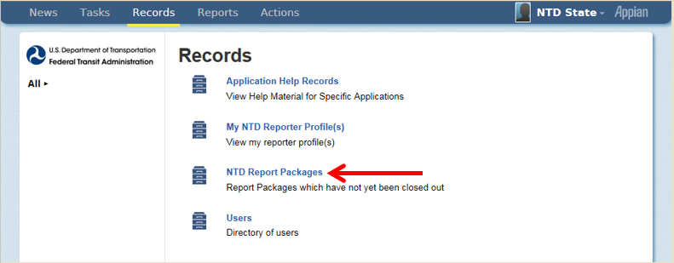
Open “NTD Report Packages”
Step 2: Open “NTD Report Packages”
These packages will contain the annual forms for all of your subrecipients

Slide 84
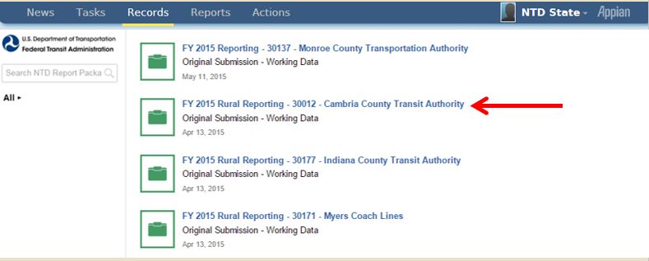
Package Selection
Step 3: Select the Package you want to edit

Slide 85
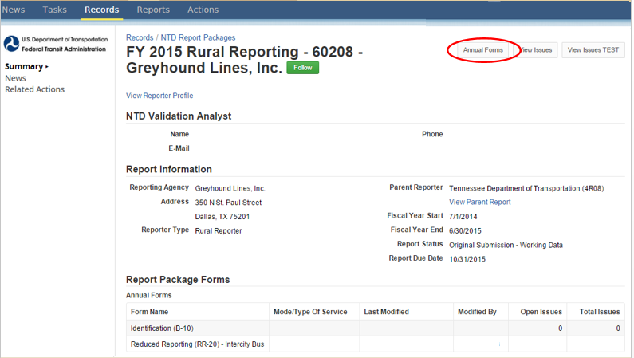
Select Annual Forms
Step 4: Select “Annual Forms”

Slide 86
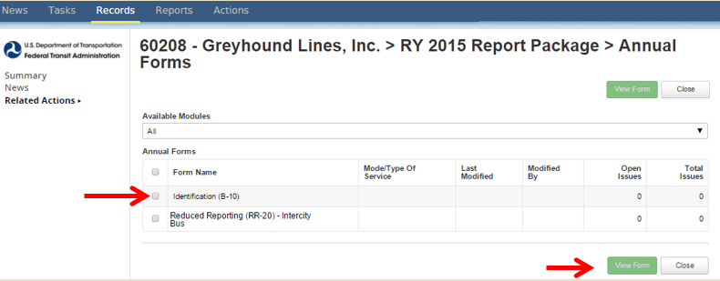
View Form
Step 5: Click on the Radio Button next to the form you would like to fill out and click on “View Form”
The form will then open

Slide 87
B-10 Form
Basic Information

Slide 88
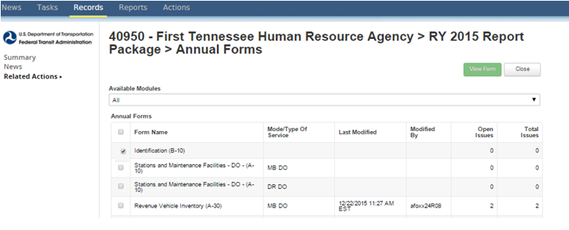
Open B-10 Form
Step 1: Open the B-10 form
Check the box
Click “View Form”

Slide 89
Update General Information
Step 2: Select “Update General Information”

Slide 90
General Information
Step 3: General Information
Organization types are in a drop-down menu
Fiscal Year State Date
Fiscal Year End Date

Slide 91
Save and Close
Step 3: “Save” and “Close”

Slide 92
A-10 form
Stations & Maintenance Facilities

Slide 93
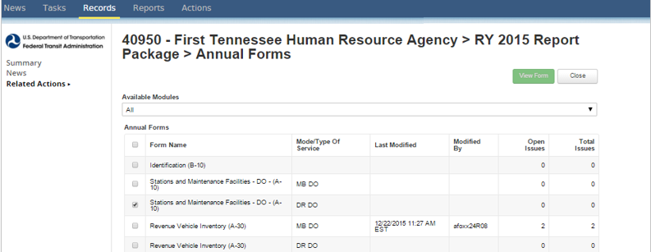
View Form
Step 1: Open the A-10 form
Check the box
Click “View Form”

Slide 94
Enter Data and Click Save
Step 2: Enter Data and Click “Save”
If facility is used by more than one mode, report a pro-rated share based on the amount of vehicles it services

Slide 95
Example: Allocation of Assets
Subrecipient operates a Dial-a-Ride or Demand Response (DR) service and a fixed-route bus (MB) service
Subrecipient owns 1 maintenance facility
Subrecipient owns 20 vehicles total – 15 used for DR and 5 used for MB
DR A-10 Form shows .75 for Owned Facility
(15 DR Vehicles/20 Total Vehicles) = .75
MB A-10 Form shows .25 for Owned Facility
(5 MB Vehicles/20 Total Vehicles) = .25

Slide 96
A-30 form
Revenue Vehicle Inventory

Slide 97
Historical A-30 Data
Starting Report Year 2014, agencies were required to report individual modal data, including assets by mode.
For RY16, the A-30 data will be pre-populated with the RY15 Closeout version of the form.

Slide 98
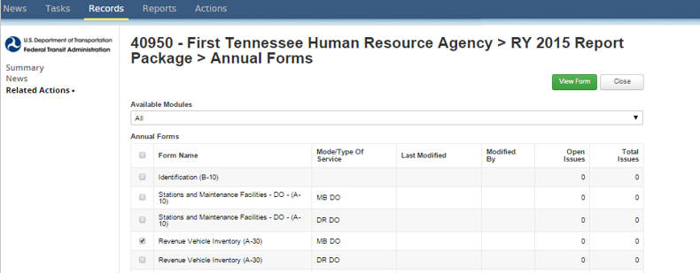
Open the A-30 Form
Step 1: Open the A-30 form
Check the box
Click “View Form”

Slide 99
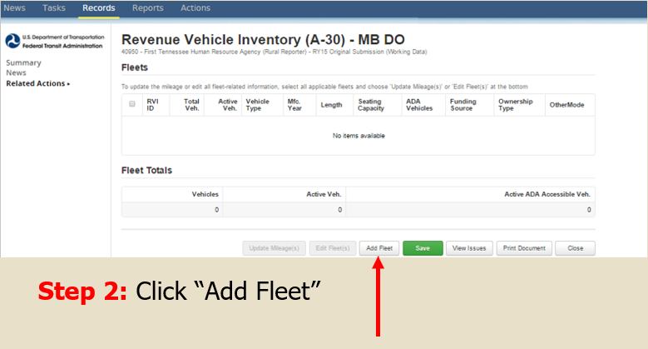
Add Fleet

Slide 100
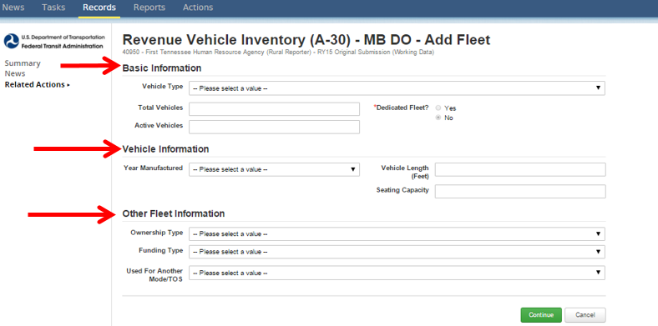
A-30 Required Information
Step 3: Fill out the form and click “Continue”.
If the Fleet is used by both modes, use the drop down menu to select the other mode.

Slide 101
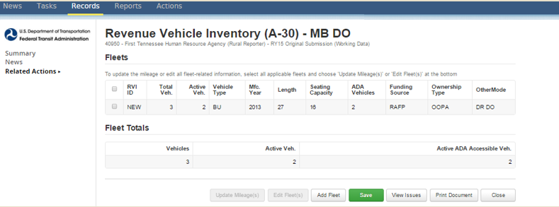
New RVI
Step 4: Click Save
Saving assigns a RVI ID
Click “Add Fleet” for more vehicles

Slide 102
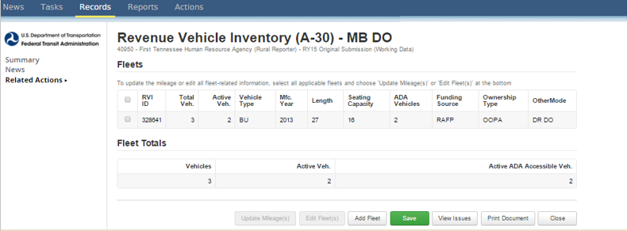
Saved new RVI
Step 5: Click “Close”

Slide 103
Common Validation Issues
Shared Fleets do not match across modes
If a fleet is shared between both modes, the fleet must be entered into all applicable A-30s, and all data fields must match
New Vehicles, no Capital Funding Reported
If new fleets are added to the report, the Capital Funding will be entered on that agency’s RR-20
Missing Data
All fleet data must be filled out prior to submission
Ownership Type is inconsistent with Subrecipient Organization Type
If a subrecipient is a public entity, the vehicle ownership type should be listed as Owned Outright by a Public Agency, True Lease by a Public Agency, Leased or Borrowed from Related Parties by Public Agency.

Slide 104
RR-20
Rural General Public Transit (RGPT)

Slide 105
Reduced Reporting (RR-20) – RGPT
Broken out as follows:
Financial Information
Non-Federal Funding Data
Federal Government Funds
Resource Data
Service Data
Safety Data

Slide 106
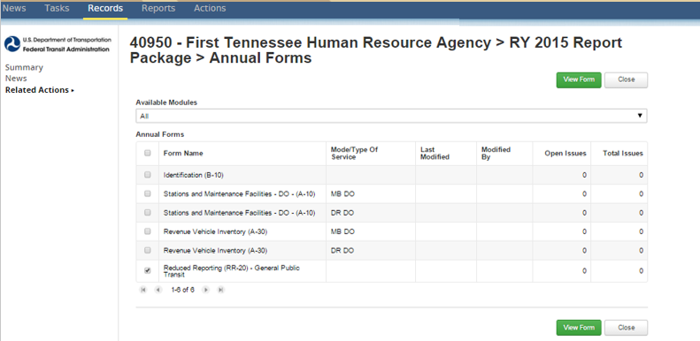
Open the RR-20
Step 1: Open the RR-20 form
Check the box
Click “View Form”

Slide 107
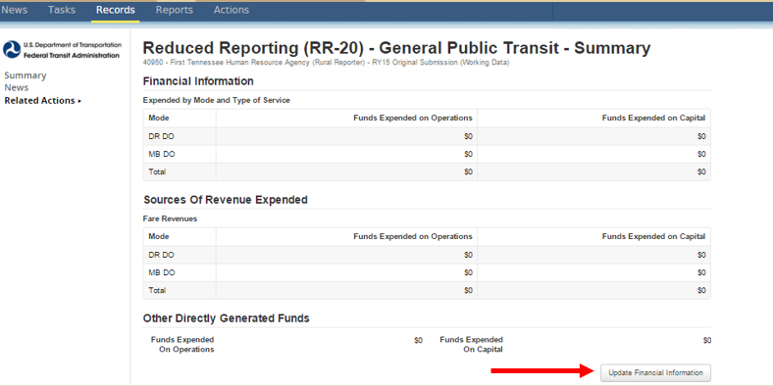
Update Financial Information
Step 2: Click “Update Financial Information”

Slide 108
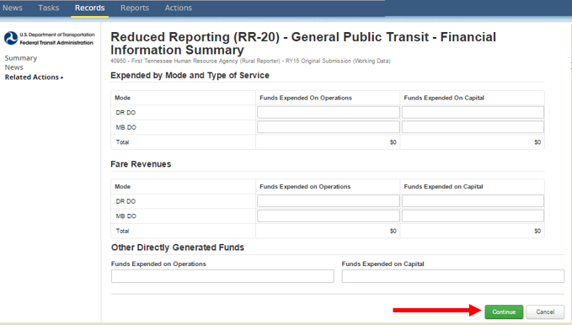
Data Entry
Step 3: Enter data and click “Continue” when finished.
Annual expenses by mode
Expended fare revenues by mode
Other Directly Generated funds expended

Slide 109
Fare Revenues
Fare revenues represent all income received directly from passengers. This includes:
Cash
Pre-paid tickets
Reduced or subsidized fares
Donations
Any donations received on board as payment for a ride, either suggested or unsolicited, should be recorded as fare revenues.

Slide 110
Other Directly Generated Funds
Advertising Revenues
Concession Revenues
Fundraisers
Park and Ride Revenues
Interest on Investments

Slide 111
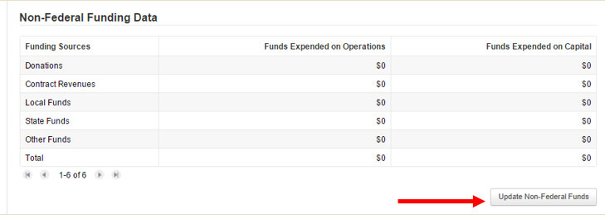
Update Non-Federal Funds
Step 4: Click “Update Non-Federal Funds”

Slide 112
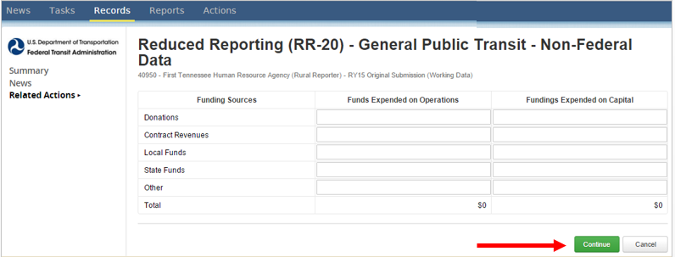
Enter Data
Step 5: Enter data and click “Continue” when finished

Slide 113
Contract Revenues
Reimbursement by any organization, government, agency, or company, such as a local human service agency, as a result of a formal contractual agreement with the transit service operator, for trips provided to a specific passenger or group of passengers.
The contract must cover the fully-allocated cost for the service.

Slide 114
Update Federal Funds
Step 6: Update Federal Funds
Select the Federal sources that apply
Only those data input fields will show
Can change sources at any time

Slide 115
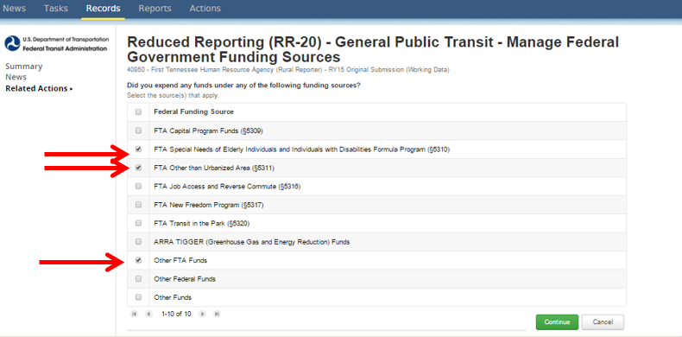
Update Federal Funding
Step 7: Select Federal Funding Sources and click “Continue”

Slide 116
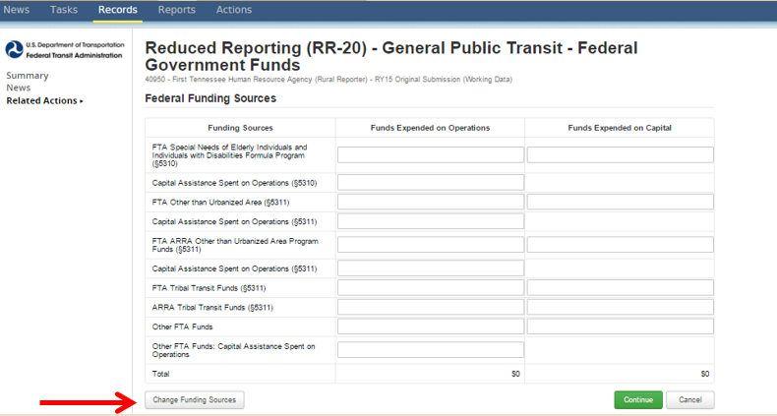
Change Funding Status
Step 8: Enter Data
Click “Change Funding Sources” to add more sources if needed

Slide 117
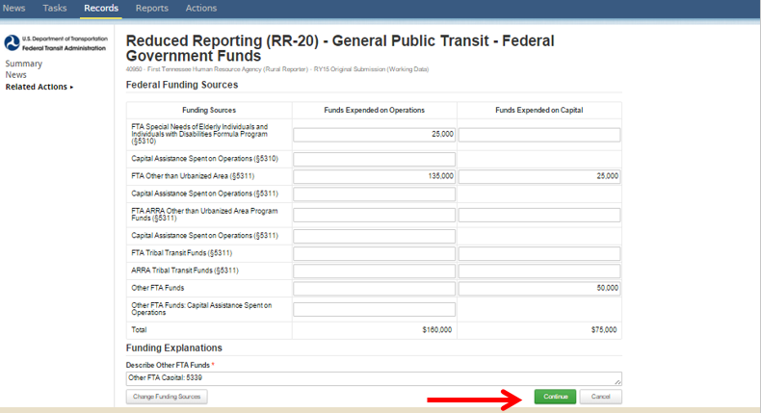
Click Continue
Step 9: Click “Continue”
“Other Federal Funds” and “Other FTA Funds” require a description

Slide 118
Federal Funding Section - Other Funds
Other FTA Funds
Map-21 Bus & Bus Facilities Formula (5339)
FTA Clean Fuels Program (5308)
Other USDOT **New for RY2016**
Funds from other USDOT agencies such as Federal Highway Administration, Federal Rail Administration
Other Federal Funds
Housing and Urban Development (HUD), Department of Health and Human Services (HHS)

Slide 119
Update Other Resources
Step 10: Update Other Resources
This is a required section

Slide 120
Volunteer Data
Step 11: Enter Data and Click “Continue”
Enter zeros if no volunteers are used as this is a required section.

Slide 121
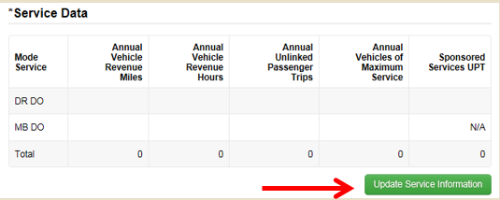
Update Service Information
Step 12: Update Service Information

Slide 122
Update Service Data
Step 13: Enter data, Click “Continue” when complete
Annual Unlinked Passenger Trips
For RY14 Annual UPT = Regular + Sponsored
Vehicles Operated in Maximum Service
Number of vehicles on road during peak service
Notes:
Vehicles operated in maximum service (VOMS) – Number of vehicles scheduled for the peak service on a typical day. It does not include:
Number of vehicles operated on atypical days such as holiday celebrations (e.g., Fourth of July), one-time special events (e.g., World Series celebrations, political conventions), or spare vehicles.
Vehicles in routine or extended maintenance, emergency contingency, and vehicles awaiting sale.
Source: www.ntdprogram.gov

Slide 123
Revenue Service
Vehicle Revenue Miles and Hours should include:
Miles and hours when the vehicle is in revenue service
Layover/Recovery time
It should not include:
Deadhead
Operator Training
School Bus or Charter Services
Vehicle Maintenance Testing

Slide 124
Revenue Service – Demand Response
Activity | Revenue Hours | Revenue Miles
Vehicle idles at the dispatching point. | No | N/A
Vehicle departs dispatching point to pick up a passenger. | No | No
Vehicle waits for a passenger at a pick up point. | Yes | N/A
After a passenger drop off, the vehicle departs to pick up another passenger with no passengers on board. | Yes | Yes
Driver travels to a restaurant for lunch after the last passenger drop-off. | No | No
Driver eats his lunch at a restaurant. | No | N/A
Vehicle transports passengers from a community center to a shopping mall. | Yes | Yes
Vehicle returns to the dispatching point with no passengers onboard. | No | No
Vehicle waits at the shopping mall until it is time to bring passengers back to the community center. | Yes | N/A
Driver fuels the vehicle at a gas station. | No | N/A

Slide 125
Revenue Service – Motor Bus
Activity | Revenue Hours | Revenue Miles
Bus travels its route in scheduled revenue operation. No passengers board the vehicle. | Yes | Yes
Bus arrives at the end of a route, incurs layover. Passengers can board during layover. | Yes | N/A
Bus arrives at the end of a route, incurs layover. Passengers cannot board during layover. | Yes | N/A
Bus arrives at the end of a route, travels (deadheads) to a storage lot, and parks. | No | No
Bus arrives at the end of a route, parks, and goes out of service. Resumes service in the PM peak. | No | No
Bus arrives at the end of a route, travels (deadheads) to another route to operate a scheduled trip. Passengers cannot board during deadhead. | No | No
Bus arrives at the end of a route, travels (deadheads) to the dispatching point. | No | No
Bus travels from the garage to another maintenance facility to perform routine maintenance. | No | No
Trip is terminated due to a collision with another vehicle, and the bus travels to a maintenance facility. | No | No
Bus travels from start to end of a route for training. Vehicle is not in service and does not board passengers. | No | No
Driver fuels the vehicle at a gas station. | No | No

Slide 126
Common Validation Issues
Reporting scheduled Hours or driver’s availability instead of actual vehicle revenue hours
Calculating vehicle revenue miles based on routes
Including deadhead in revenue service. Deadhead includes:
Leaving or returning to the garage or yard facility to or from the starting or ending point of revenue service
Changing routes
When the driver does not have the duty to carry passengers

Slide 127
Common Validation Questions
Funds Expended on Operations or Capital
Does not match Sources of Funds identified for Operations or Capital
VOMS reported is equal to or higher than Active Vehicles on the A-30 Form for corresponding mode
Reporting more Sponsored Unlinked Passenger Trips than Total Unlinked Passenger Trips
Total UPT now includes Sponsored UPT

Slide 128
Common Validation Questions
Reporting only Federal Funds
Agencies should report total operating expenses to show the true cost of transit service
How do I report data for a subrecipient that has a contract with a Tribe (NTD direct recipient) in which they are the seller of service?
The service data that the Tribe is buying under the terms of their fully allocated contract will be reported on the Tribe’s report.
The service that is not being paid for will be reported by the subrecipient.

Slide 129
Update Safety Information
Step 14: Update Safety Information
This is a required section

Slide 130
Click Continue
Step 15: Enter data and Click on “Continue” when complete
Incidents include fatalities, injuries, or property damage >$25,000
Fatalities are reported when deaths occur within 30 days of the event
Injuries are reported when passengers are transported away from the scene for medical attention

Slide 131
Click Save
Step 16: Click “Save”
This saves the ENTIRE form
“Save” after each “Update” to avoid loss of data

Slide 132
RR20 – Intercity bus

Slide 133
Intercity Bus Subrecipients
Definition: Regularly scheduled bus service for the general public that:
Operates with limited stops between two urbanized areas;
Connects rural areas to an urbanized area; or
Has the capacity for transporting luggage.
Required Information:
B-10
Fiscal Year Start and End Dates
Organization Type
RR-20 Intercity Bus Subrecipient
Section 5311 Funds
Vehicle Revenue Miles travelled during §5311 revenue service.
Unlinked Passenger Trips during §5311 revenue service.

Slide 134
Intercity Bus Clarifications
If the §5311(f) funds expended are for only planning activities or capital projects and are not expended for operations, do not complete the VRM and UPT data fields.
If a route is only partially subsidized by the §5311 funds, report all the VRM and UPT for that route—it is not necessary to track or allocate service for a partial subsidy of the route.

Slide 135
RR-20 - Urban/Tribal Subrecipient

Slide 136
Urban/Tribal Subrecipients
Definition: Transit agencies that commonly provide service to both Urban and Rural areas, may receive or benefit from §5307 funding.
Required Forms:
B-10
Fiscal Year Start and End Dates
Organization Type
RR-20- Urban/Tribal Subrecipients
Section 5311 Funds

Slide 137
Common Validation Questions
5311 Funding not matching between the State’s RR-20 form and the directly reporting subrecipient’s form (RR-20/F-10).
If the State and subrecipient operate on the same fiscal year, the amounts between the forms should match
Please note Tribes can receive State granted 5311 funding in addition to 5311 Tribal Transit Funds.

Slide 138
Report Submission

Slide 139
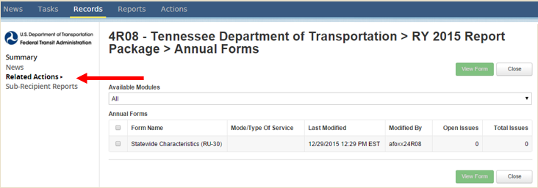
How to Submit
Step 1: Open the State Package and click on “Related Actions”
CEO and CEO Delegate can submit the Original Submission
NTD Contact is able to submit any revisions.

Slide 140
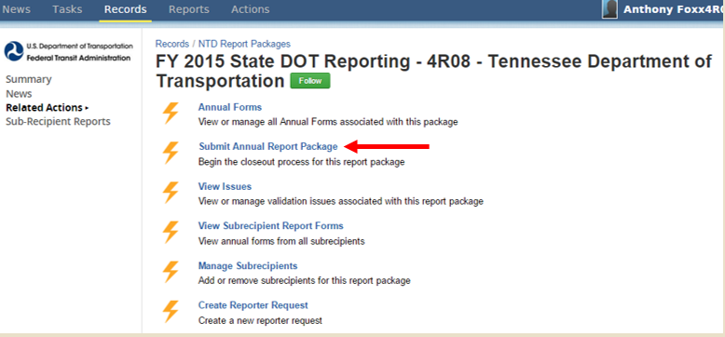
Submit Annual Report Package
Step 2: Click on “Submit Annual Report Package”

Slide 141
Confirm Package Submission
Step 3: If all data is filled out and no issues are firing, you will be able to Confirm Report Package Submission, and click “Continue”

Slide 142
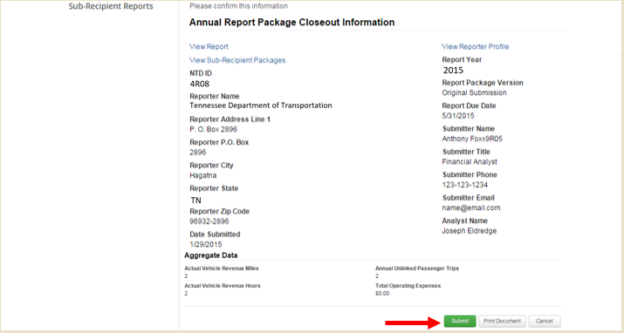
Aggregate Data Review
Step 4: Review the data presented
At the bottom of this page, it will have a snapshot of your aggregate data reported.
Click “Submit”

Slide 143
Action Completed
The top of the page will notate “Action Completed Successfully”
You may go to the State’s reporting package and verify that the package has been submitted, if the package’s status is “In Review” instead of “Working Data”

Slide 144
Closeout process

Slide 145
Validation Process
Analysts validate for deviation from reporting requirements, missing data and data irregularities
Significant data fluctuations from previous report year
Incomplete forms
Data reported to an incorrect field
Take advantage of resources
Pre-submission calls
Checklist
Notes:
This year’s validation process will work similarly to last year’s with the use of an Excel sheet containing a portion of your validation issues.
As with last year, please don’t forget to finish the submission of your report (under Related Actions) and email us your Excel sheet each time you complete a revision.
We’re here to help, we have large caseloads and see this stuff all the time!

Slide 146
Reviewing Reports
Data Entry and Revision
Data issues explained or corrected
NTD Review
Issues identified
Clean Closeout
All issues resolved
Closeout with Issues
Some issues not resolved, cited in closeout letter
Notes:
It is common for reporters to go back and forth with submission.
In rare cases, if a reporter is unresponsive to requests during the NTD review, a letter will be sent to the CEO.

Slide 147
Reporting Issues
Incomplete reports:
Non-conformance with definitions, accounting principles, accrual accounting
Failure to respond to validation issues – all identified issues must be fully addressed
When these issues occur, NTD cites them in the closeout letter
Notes:
Add Failure to Respond as a talking point.

Slide 148
Resolving Issues
Provide a solid and detailed explanation
Provide information to give your analyst a clear picture of a subrecipient’s service
Explain changes in service, even if they may seem insignificant
If last year’s data is wrong, show:
What it should have been
Why this year’s data is correct

Slide 149
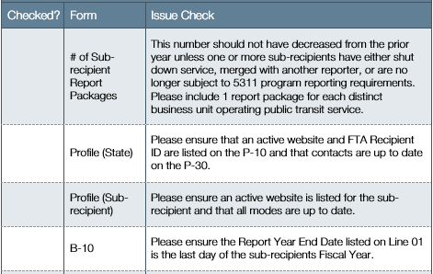
Agency Checklists
Resolve common reporting errors
Matching values
Newer requirements
Reduce validation time
Notes:
Complicated issues, namely with service forms and financial information, should be worked through with your analyst directly.
Retrieval of data, verification of accuracy, and compliance with NTD Reporting standards are the largest challenges when completing the NTD Report
A large number of reports are sent back to reporters because of typos or errors in oversight.
By using the checklist provided to review your report each time you submit, you can save time and reduce the number of revisions to your report

Slide 150
Looking Ahead
What to expect from your analyst:
Welcome Email
Improved Subrecipient Templates
Helpful Tips and Tools
Agency Checklist
Guidance throughout the submitting and validation process

Slide 151
Questions and Comments
NTD Operations Center
Monday – Friday
8:00 a.m. – 7:00 p.m. (ET)
NTDHelp@dot.gov or 1-888-252-0936
Joseph Eldredge
joseph.eldredge.ctr@dot.gov
434-993-8690
Melissa Lavey
melissa.lavey.ctr@dot.gov
434-207-8336
Bailey Bowen
bailey.bowen.ctr@dot.gov
434-218-3275
Courtney Springer
c.springer.ctr@dot.gov
434-260-6116
Rea Turner
434-218-1917

