Slide 1
NTD 2.0 Reporting for Tribes
Report Year 2014

Slide 2
Contact Information
National Transit Database
943 Glenwood Station LN STE 102
Charlottesville, VA 22901
Help Desk
(888) 252-0936
NTDHelp@dot.gov
Monday – Friday
0800 – 1900 Eastern

Slide 3
Program Officials
Keith Gates
NTD Program Manager
202-366-1794
Keith.Gates@dot.gov
Gary DeLorme
NTD Senior Advisor
202-366-1652
Gary.Delorme@dot.gov
Andy Lofton
Project Manager
434-260-1175
Andy.Lofton.CTR@dot.gov

Slide 4
Presenters
Loucas Lamkin
434-299-8796
Loucas.Lamkin.CTR@dot.gov
Joseph Eldredge
434-993-8690
Joseph.Eldredge.CTR@dot.gov

Slide 5
Agenda
Changes – Reporting Requirements
Interface Overview
User Manager
Reporting Process
Conclusion

Slide 6
Report Year 2014
Reporting Deadlines:
Fiscal Year End Date | January 1 – June 30 | July 1 – September 30 | October 1 – December 31
Report Due Date | January 31 | January 31 | April 30
Once the system is open for reporting, your analyst will contact you with instructions.

Slide 7
NTD Roles
The CEO must complete the Original Submission
NTD Roles are tied to an user’s email address
DIR and RUR prefixes are no longer used
“Old” System | “New” System
Director of the Transit Unit | CEO
Rural Contact | NTD Contact
Editor | Editor
Viewer | Viewer

Slide 8
Permissions by User Role
CEO:
View and edit all forms and issues
Create a Reporter Request (Waiver, Extension Request)
Submit Annual Report Package
NTD Contact:
View and edit all forms and issues
Able to submit reports after first submission
Editor:
View and edit all forms and issues
Viewer:
View all forms and issues

Slide 9
User Manager (UM)
Every agency must send FTA an official letter designating an employee as the agency’s User Manager.
The UM creates accounts for the CEO/Director and the NTD Contact. The UM can create accounts for others to enter/edit information or just view forms.
The UM can also fill a NTD Role. For example, the CEO can also be the agency’s UM.

Slide 10
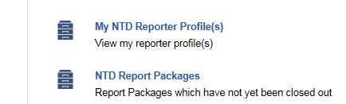
Records
The “Records” tab functions like the old system’s “Annual” tab
Information is separated into two categories
Profiles
Report Packages

Slide 11
Profiles
These forms contain data that normally doesn’t change from year to year:
Basic Information (P-10)
Reporter Modes (P-20)
Report Users (P-30)

Slide 12
Report Packages
A “Report Package” contains all the forms required for annual reporting
Identification (B-10)
Stations & Maintenance Facilities (A-10)
Revenue Vehicle Inventory (A-30)
Reduced Reporting (RR-20)
Federal Funding Allocation Statistics (FFA-10)
CEO-Transit Director Certification (D-10)

Slide 13
Changes to Report Structure
In the “old” system, tribes used the report structure developed for State DOTs.
The tribal reporting structure has been updated to mirror “Small Systems” Urban Reporters

Slide 14
New Forms – B-30
If your agency purchases or subsidizes another transit provider’s service, you will use the B-30 contractual relationship form.
If your report included the RU-22 form or RU-23 form for Report Year 2013, you will now use the B-30.

Slide 15
New Forms – FFA-10
FTA has added this form to allow providers to allocate vehicle revenue miles between multiple Rural Areas (non-UZA) or Urbanized Areas (UZA) as necessary for apportionment.
If you receive §5311 from two or more States, you can show how much of your service is operated in each state.

Slide 16
New Forms – D-10
FTA has added this form to require CEO/Transit Director certification of data accuracy.

Slide 17
New Fields – P-10
DUNS or D-U-N-S Number, is a unique nine-digit identification number your agency.
Please visit http://fedgov.dnb.com/webform to obtain the number

Slide 18
New Fields – P-20
For all modes:
Commitment Date | When capital funds were first expended for this mode
Start Date | The first day of revenue service
End Date | The last day of revenue service

Slide 19
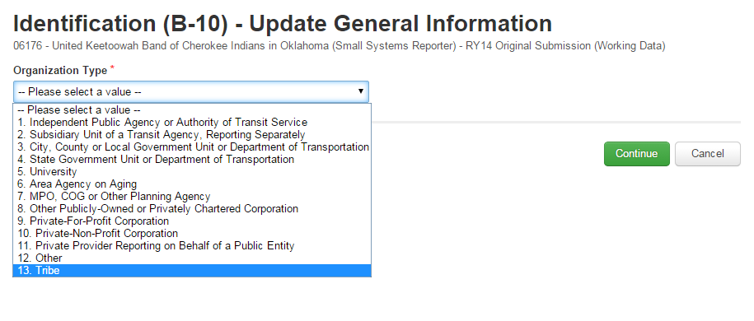
New Fields – B-10
Organization Type
All agencies should select “Tribe”

Slide 20
New Fields – A-10
If facility is used by more than one mode, prorated portions must be entered on each A-10
For example, if one garage services vehicles for both Motor Bus and Demand Response, then each A-10 would have 0.5 of a facility.

Slide 21
New Fields – A-30
Active Vehicles in a fleet
The old system collected “Number of Vehicles in Total Fleet”
FTA wants to identify the number of vehicles actively providing revenue service

Slide 22
New Fields – RR-20
Vehicles Operated in Maximum Service (VOMS)
This is the revenue vehicle count during the peak season of the year; on the week and day that maximum service is provided.
Excludes atypical days and one-time special events.
Operating Expenses by Mode
Cost Allocation Methods

Slide 23
RR-20 Cost Allocation Methods
Determine which expenses are direct expenses and can be easily traced to a particular mode/TOS.
Determine which expenses are joint expenses. These costs are incurred for the benefit of more than one mode/ TOS and cannot be easily traced to a specific mode/TOS.
Allocate joint expenses or shared costs to each mode/TOS.

Slide 24
RR-20 Cost Allocation Methods
Recognizing that some agencies may not allocate joint costs by mode/TOS, NTD suggests common allocation variables:
Revenue Hours
Revenue Miles
Number of Employees
Ridership
Notes:
While these options for allocating costs are common to the transit industry, in some instances others may be more appropriate.

Slide 25
Example—Allocating by VRM
Tribe operates a Dial-a-Ride or Demand Response (DR) service and a fixed-route bus (MB) service
Collects Annual Vehicle Revenue Miles (VRM) for each mode separately.
DR: 200,000 VRM
MB: 300,000 VRM
Does not allocate joint Operating Costs by mode.
Total Annual Operating Expenses: $100,000

Slide 26
Example—Allocating by VRM
Using vehicle revenue miles to allocate costs.
$$\frac{200,000 DR miles}{500,000 total miles}=\frac{DR operating cost}{\$100,000 joint operating cost}$$
$$\frac{200,000 }{500,000 }×\$100,000=DR operating cost$$
$$\$40,000=DR operating cost$$
$$\$60,000=MB operating cost$$

Slide 27
Interface overview
NTD Internet Reporting

Slide 28
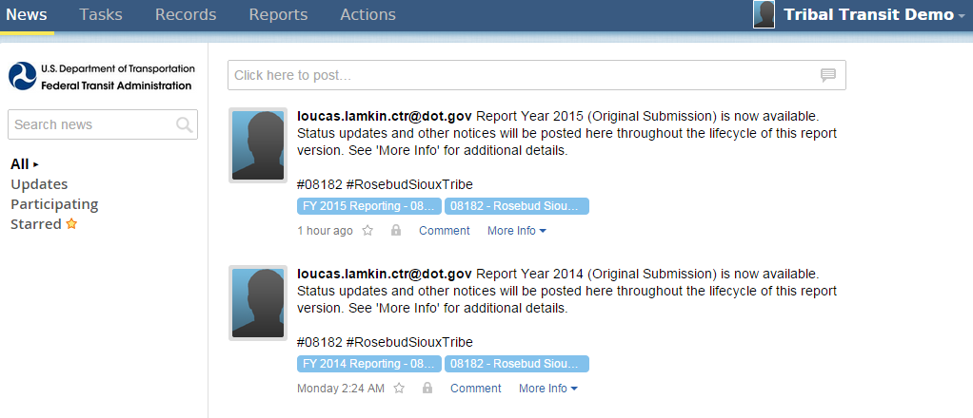
All users land on the News feed
Posts from NTD staff will display here

Slide 29
Tasks are assigned to CEOs and NTD Contacts

Slide 30
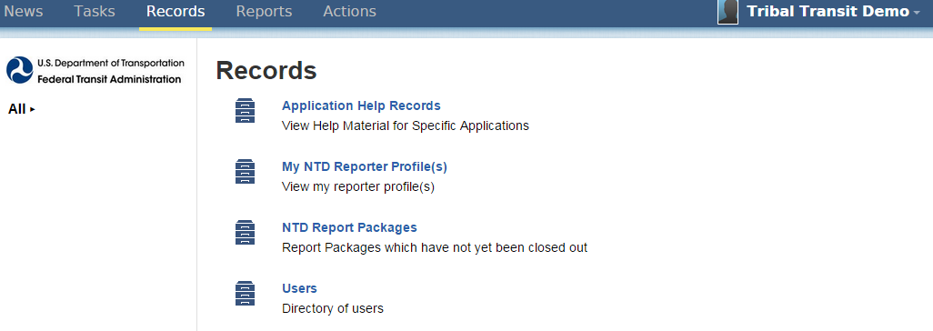
Reporting forms and profiles are accessed through “Records”

Slide 31
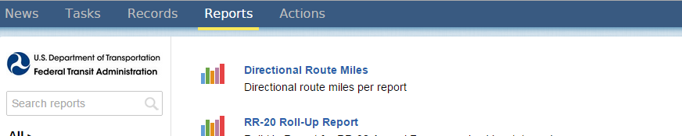
Various data reports are available here

Slide 32
Options vary based on user privileges

Slide 33
Click your name to update your user record or change account password

Slide 34
User managers
Getting Logged-In

Slide 35
User Managers
All Tribes are required to designate a User Manager
Contact your Analyst or the Help Desk to complete and submit your designation
FTA must create your agency’s User Manager first. Only then can the User Manager create accounts for the individuals responsible for NTD reporting.

Slide 36
Email to UM
User Managers will receive an email notification once the account has been created
Step 1: Click the link in the email to navigate to the online reporting interface
Hello User Manager,
A new user account has been created for you on the FTA Reporting Environment.
You may log on at www.ntdprogram.gov
Your Username is usermanager@test.org
Please visit the above URL and click the “Forgot Password” link, this will bring you to a prompt to create your password.
Thank you
Notes:
Registered User Managers receive email

Slide 37
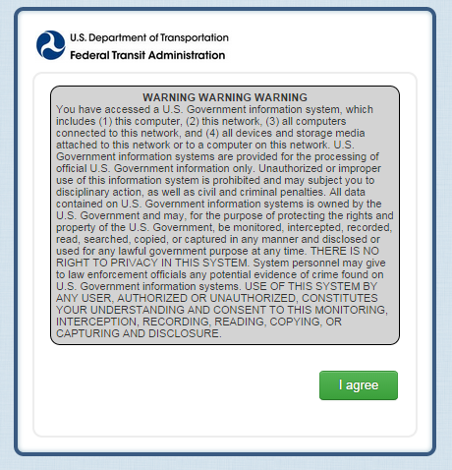
Step 2: Please read the warning message and agree to the statement

Slide 38
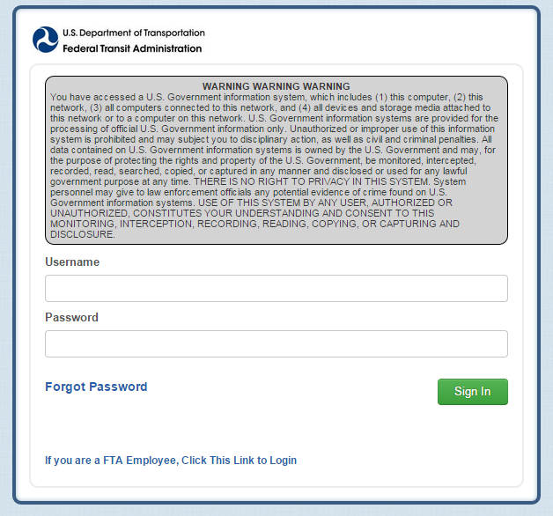
Forgot Password
Passwords are NOT sent via email
Step 3: Once at the log-in page, click the link for “Forgot Password”
These steps are necessary for creating your first system password

Slide 39
Request a Reset
Step 4: Enter the email address used for your user name and click “Request Password Reset”
This prompts the system to send a new link to your email account

Slide 40
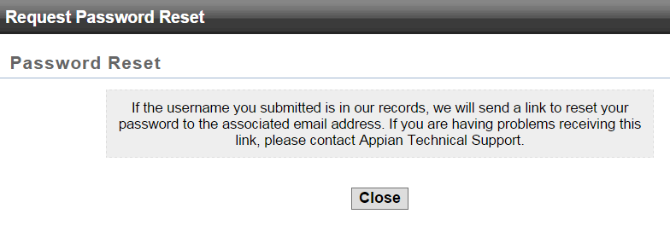
Request a Reset
Step 5: Click “Close” and check your email for the new link

Slide 41
Temporary Link for Password Reset
Step 6: Follow the new link in your email
The link expires after 15 minutes
Dear User Manager,

Slide 42
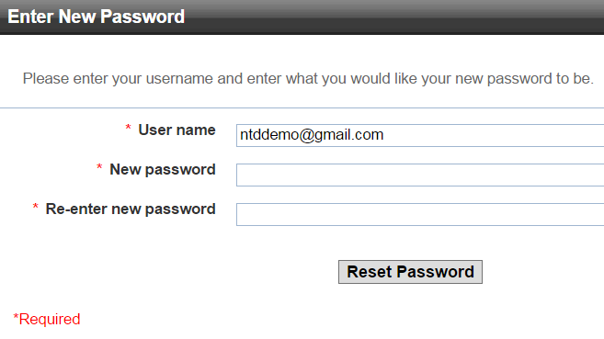
Create a Password
usermanager@test.org
• • • • • •
• • • • • •
Step 7: Enter your user name and create a password

Slide 43
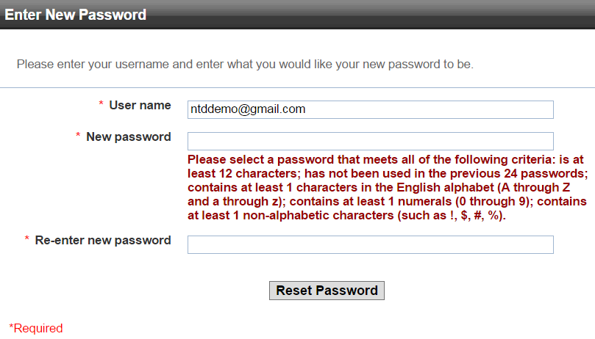
Password Security Requirements
usermanager@test.org
All passwords must meet basic security requirements

Slide 44
Password Security Requirements
Once password requirements are met, you will be able to use this password for all future logins
You can click the blue text to return to the login portal

Slide 45
Creating User accounts
Linking Individuals at the Agency to NTD Roles

Slide 46
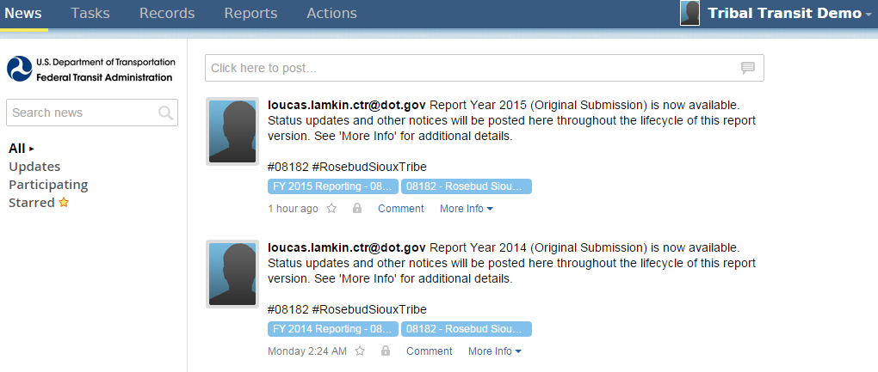
Step 1: Open the “Records” tab

Slide 47
The “Records” tab has replaced the legacy system’s “Annual” tab
Step 2: Open “My NTD Reporter Profiles”

Slide 48
Step 3: Open your agency’s Profile

Slide 49
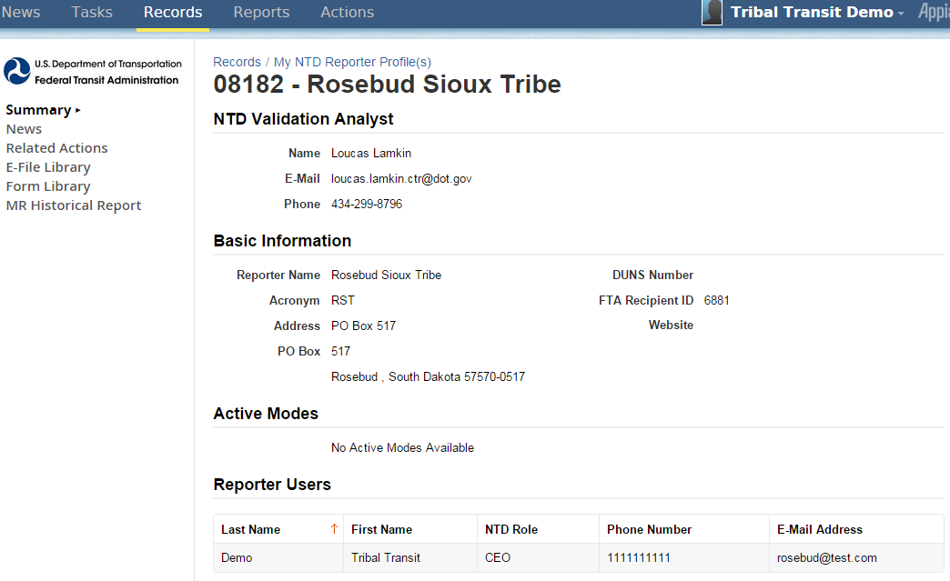
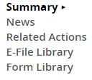
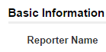
Step 4: Click “Related Actions”

Slide 50
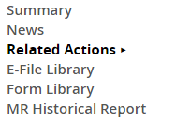
Step 5: Open “View & Manage Reporter Users (P-30)”

Slide 51
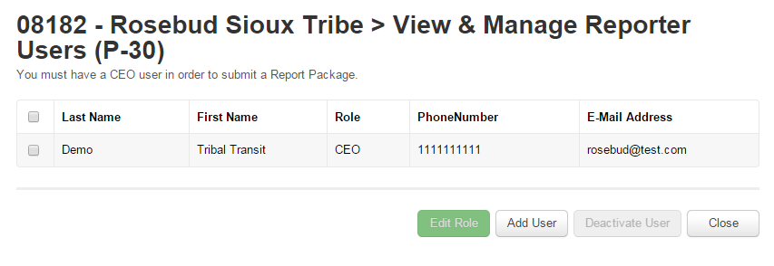
Step 6: Click “Add User”
The UM is defaulted as Viewer. If the UM will be the CEO or NTD Contact, click “Edit Role”

Slide 52
08182- Rosebud Sioux Tribe > View & Manage Reporter Users (P-30) > Add new System User
Step 7: Enter data
- Fields with a red asterisk are required fields
Notes:
The User Manager can have the email sent automatically, or new users can use the “Forgot Password” feature once their account has been created.
Please notice new navigation buttons.

Slide 53
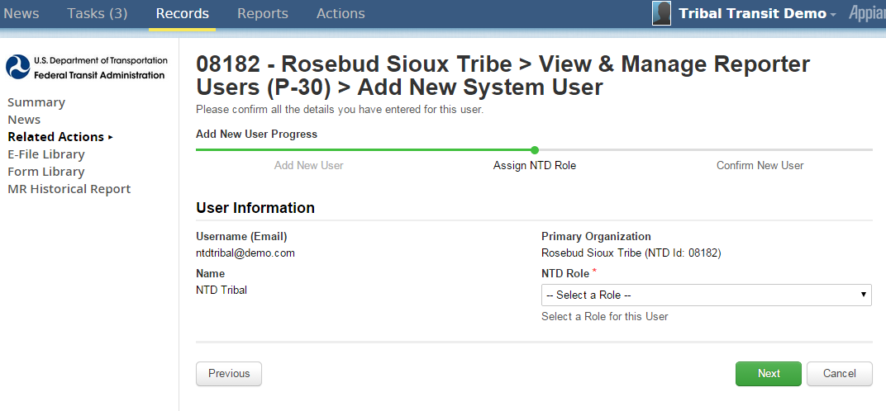
To add a new system user please complete all required fields below and click the “Next” button at the bottom of the form. If you do not want the user to be notified of the newly created account, uncheck the box.
Step 8: Assign NTD Role

Slide 54
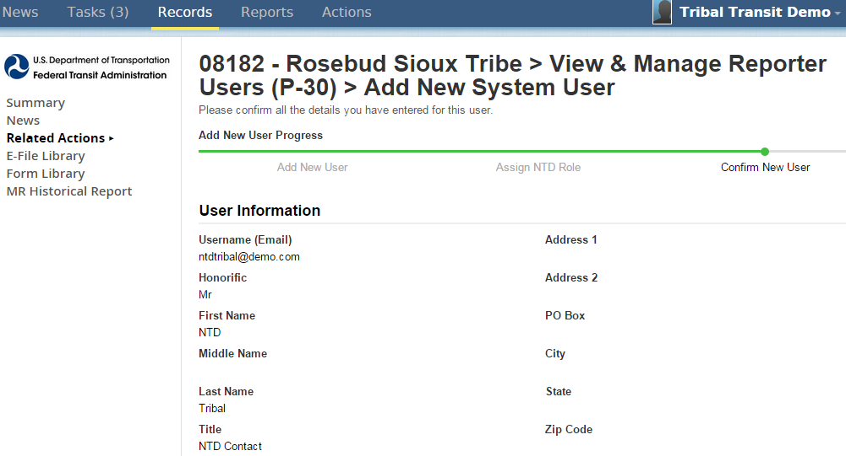
Step 9: Click “Submit”

Slide 55
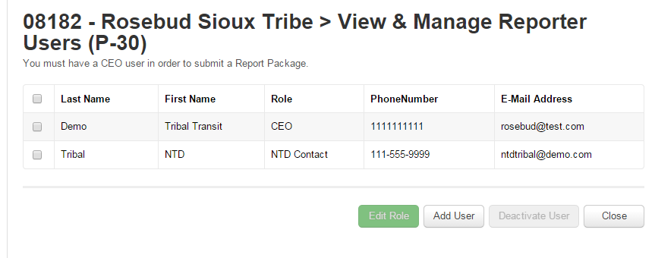
Newly created Users will need to follow the “Forgot Password” protocol
Repeat the process to assign remaining roles

Slide 56
Report Year Kick off
Update Contact Information and Modes

Slide 57
Report Year Kick Off
This process sets up your reporting forms for the year.
You will:
Update user roles
Add or edit modes
Confirm reporter type for 2014
Confirm reporter type for 2015

Slide 58
www.ntdprogram.gov
Click “NTD 2.0 Login”

Slide 59
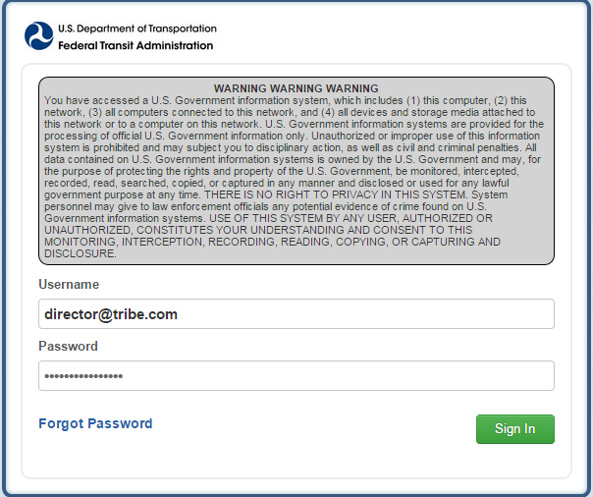
Logging in as the CEO/NTD Contact

Slide 60
Once in, open “Tasks”

Slide 61
Open the Report Year Kick Off (RYKO) task

Slide 62
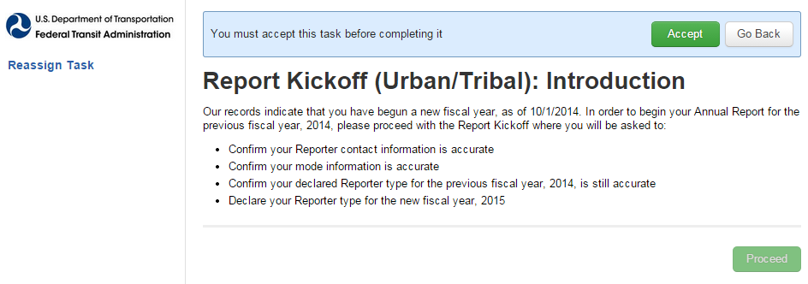
The CEO or NTD Contact must accept the task

Slide 63
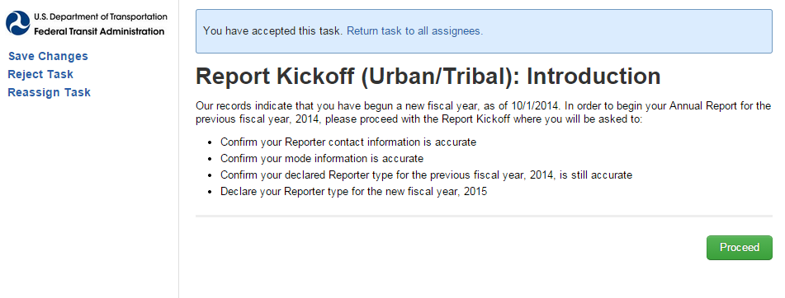
Users are given the opportunity to return the “task” to other users before proceeding

Slide 64
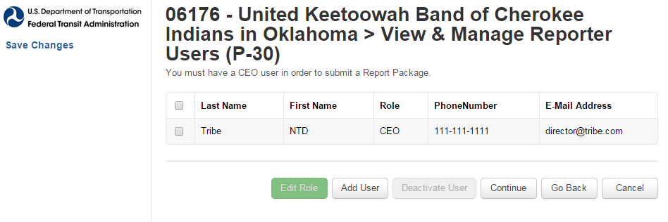
Step 1: Update Users
The CEO/NTD Contact can change user roles
Only the UM can add new users
Notes:
Step 1 RYKO – d
Reiterate that Tribes usually have at least two users here – Director of the Transit Unit as the CEO and NTD Contact.

Slide 65
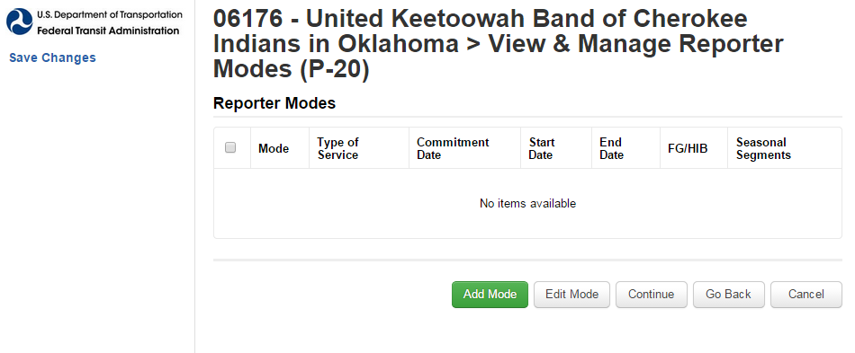
Step 2: Add Modes

Slide 66
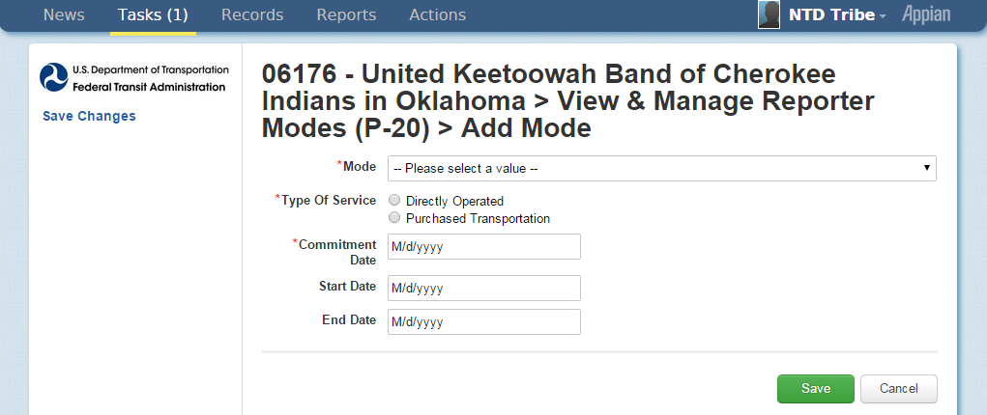
Step 3: Enter data
Commitment Date: When capital funds were first applied
Start Date: First day of Revenue Service
End Date: Last Day of Revenue Service
Notes:
If you operate both Bus and Demand Response, you will have two modes
If Directly Operate and Purchase Transportation, you will have at least two modes
If you purchase transportation of the same type from different providers (i.e. you contract with 4 different bus providers), only add that mode once

Slide 67
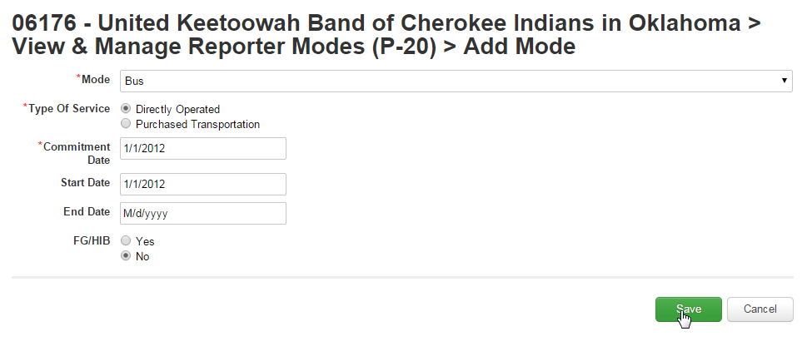
Step 4: Click “Save”

Slide 68
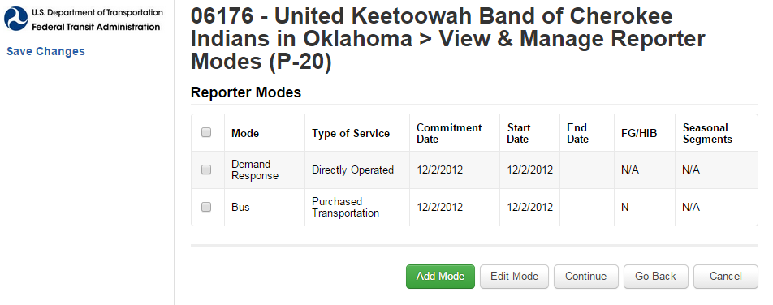
Step 5: Add additional modes OR click “Continue”

Slide 69
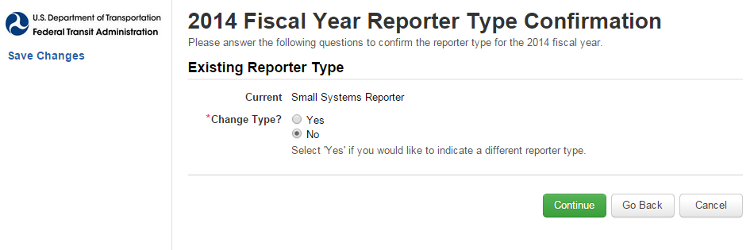
Step 6: Click “Continue”
As of RY 2014, all NTD Tribes are Small Systems reporters
Do not change Reporter Type without talking to NTD first
Notes:
Unless you directly receive FTA 5307 funds AND operate more than 31 vehicles in maximum service, your reporter type is Small Systems

Slide 70
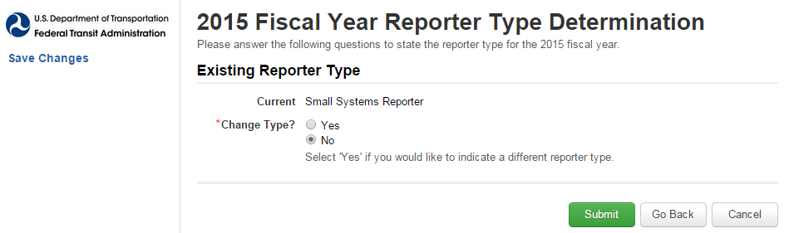
Step 7: Click “Submit”
This sets up forms for 2015
2015 forms are not yet available
No changes are necessary

Slide 71
Step 8: Form Generation
Reporting forms may take up to three minutes to generate
Click “OK” to end the task

Slide 72
Reporting Forms
Report Year 2014

Slide 73
Step 1: Open “Records”

Slide 74
Step 2: Open “NTD Report Packages”

Slide 75
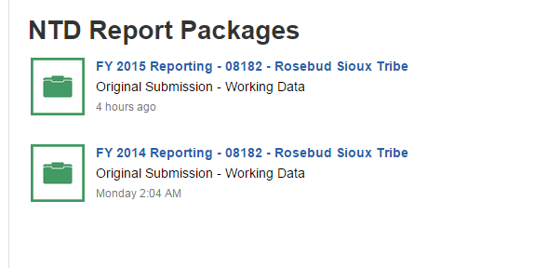
Step 3: Open FY 2014 Reporting
Only the FY 2014 Package will be populated with forms

Slide 76
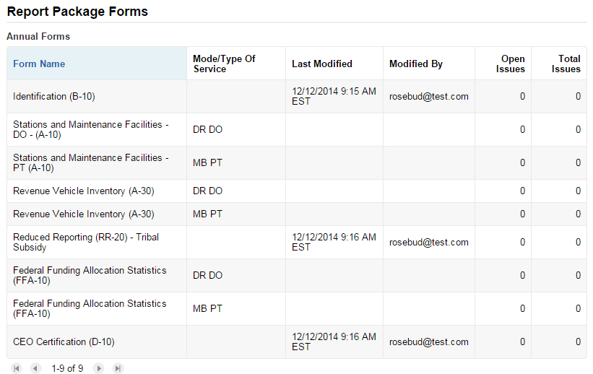
Step 4: Open “Related Actions”
Notes:
Can also click on “Annual Forms” to go straight to editable forms

Slide 77
Step 5: Open “Annual Forms”

Slide 78
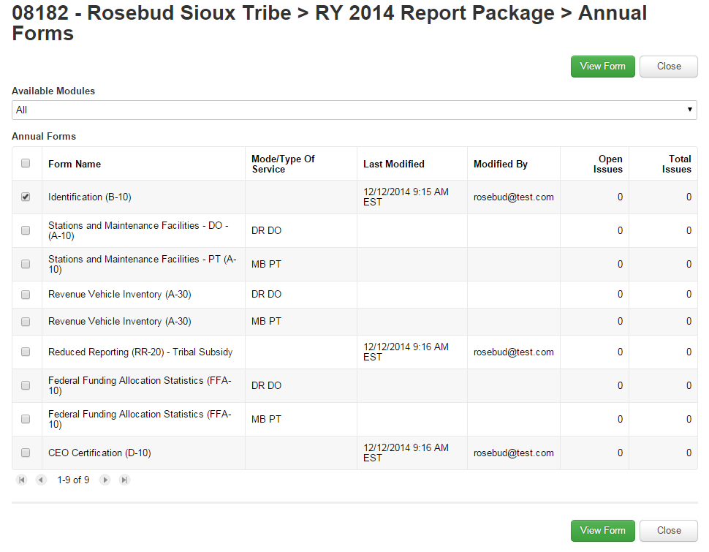

Slide 79
B-10
Agency Identification

Slide 80
06176- United Keetoowah Band of Cherokee Indians in Oklahoma > RY 2014 Report Package > Annual Forms
Step 1: Open the B-10 form
Check the box
Click : “View Form”

Slide 81
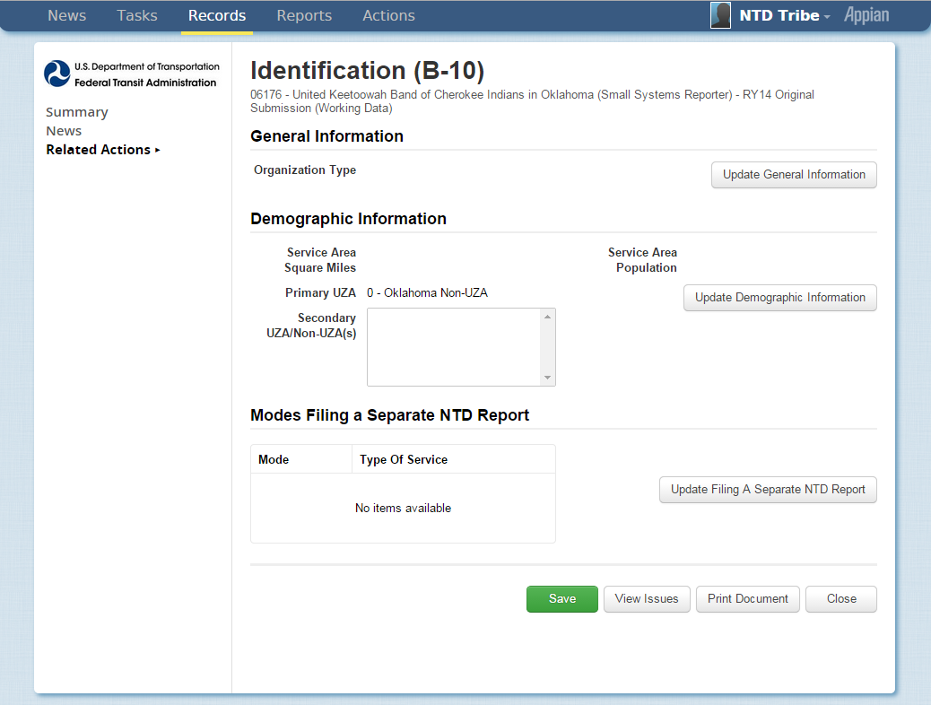
Step 2: Update General Information

Slide 82
Step 3: Select Organizational Type
Organization types are in a drop-down menu
Click “Continue”

Slide 83
Step 4: Click “Update Demographic Information”

Slide 84
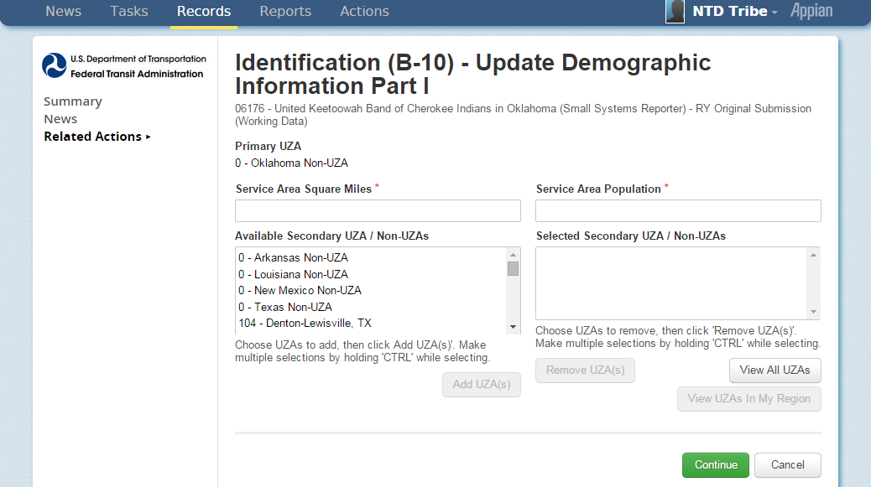
Step 5: Enter data
Service Area Square Miles and Service Area Population are NOT required
Notes:
Ignore? – being removed

Slide 85
Step 6: Update Non-UZA info
Ignore, unless instructed by Analyst
Notes:
Ignore? – being removed

Slide 86
Step 7: Click “Continue”
Notes:
Ignore? – being removed

Slide 87
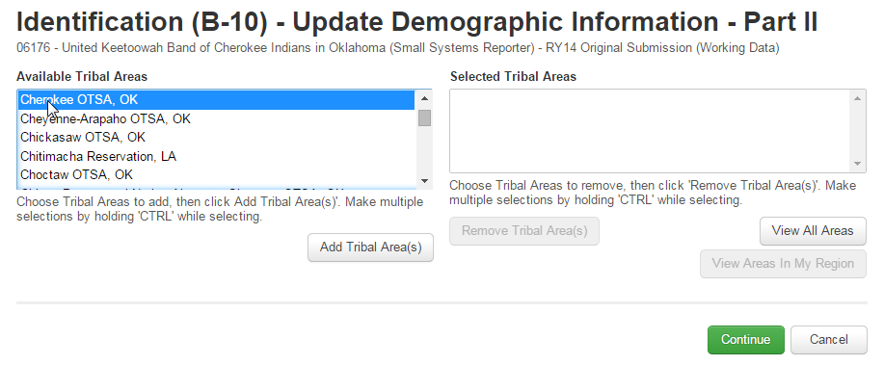
Step 8: Select Tribal Area(s)
Based on BIA/US Census data

Slide 88
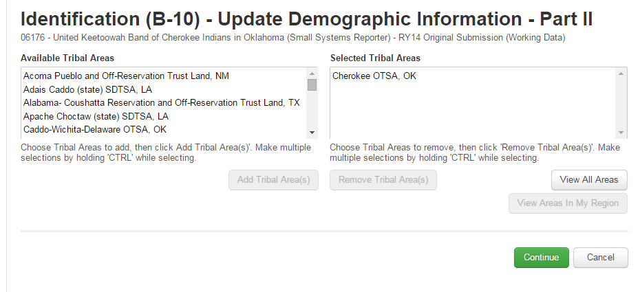
Step 9: Click “Continue”

Slide 89
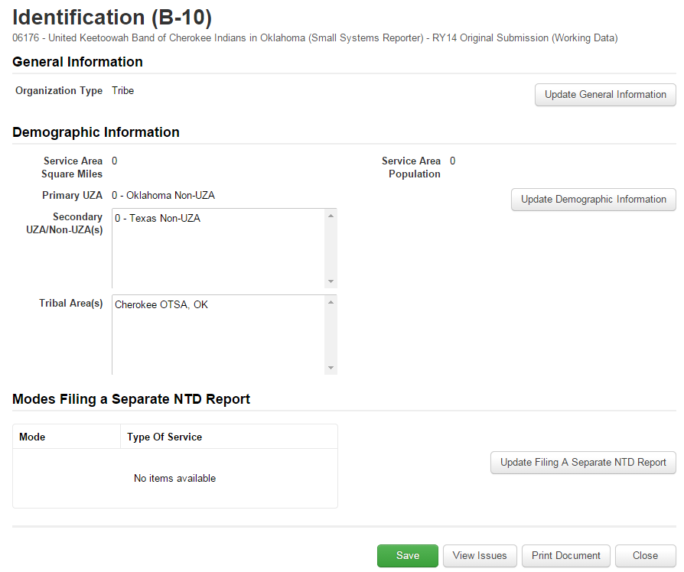
Step 10: Skip “Update Filing a Separate NTD Report”

Slide 90
Step 11: Click “Save”

Slide 91
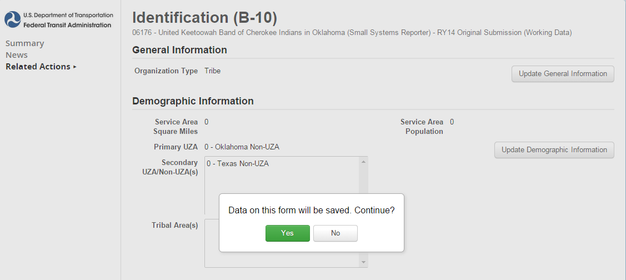
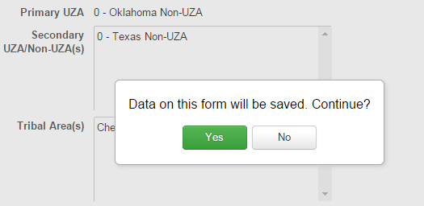
If you click on “Save” this message will appear
Click “Yes”
Notes:
Ignore? – being removed

Slide 92
Step 12: Click “Close”
Notes:
SAVE SAVE SAVE

Slide 93
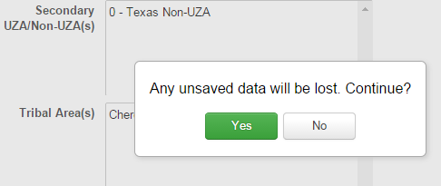
If you click on “Close” this warning will appear
Click “Yes”
Notes:
Ignore? – being removed

Slide 94
A-10
Stations & Maintenance Facilities

Slide 95
Step 1: Open the A-10 form
Check the box
Click “View Form”

Slide 96
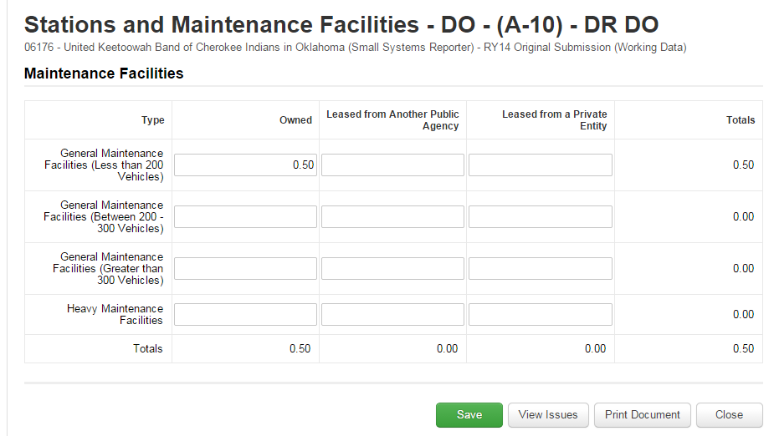
Step 2: Enter Data
If facility is used by more than one mode, report a pro-rated share

Slide 97
Step 3: Enter Data for remaining modes
If facility is used by more than one mode, report a pro-rated share

Slide 98
Step 4: Save & Close

Slide 99
A-30
Revenue Vehicle Inventory

Slide 100
Historical A-30 Data
For Report Year 2014, agencies are required to report data by mode.
Agencies reporting a single mode should have their A-30 pre-filled with “closed-out” data from 2013.

Slide 101
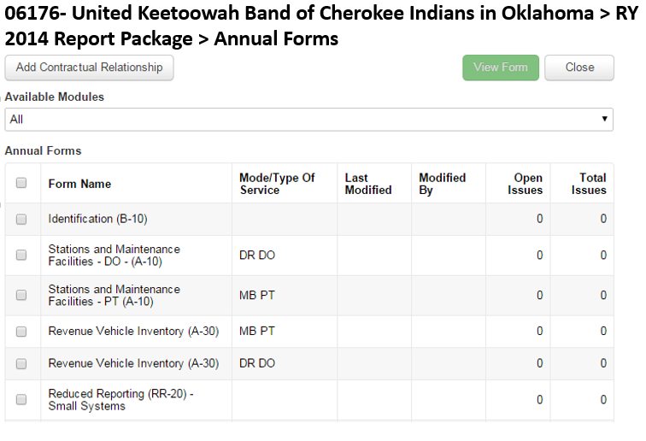
Step 1: Open the A-30 form
Check the box
Click “View Form”

Slide 102
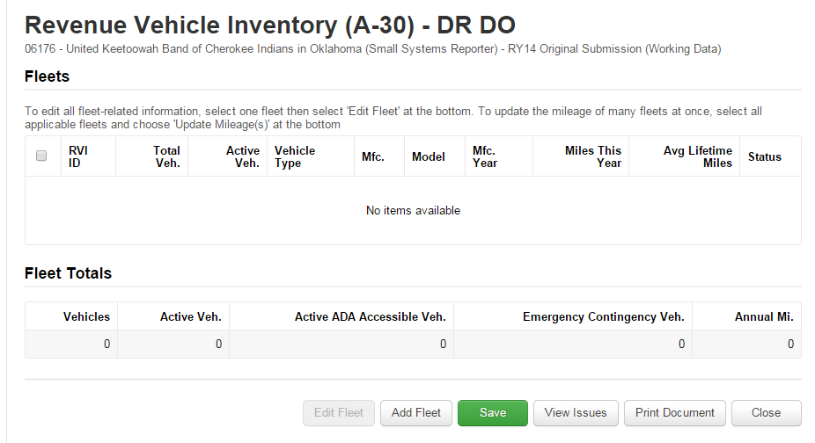
Step 2: Click “Add Fleet”

Slide 103
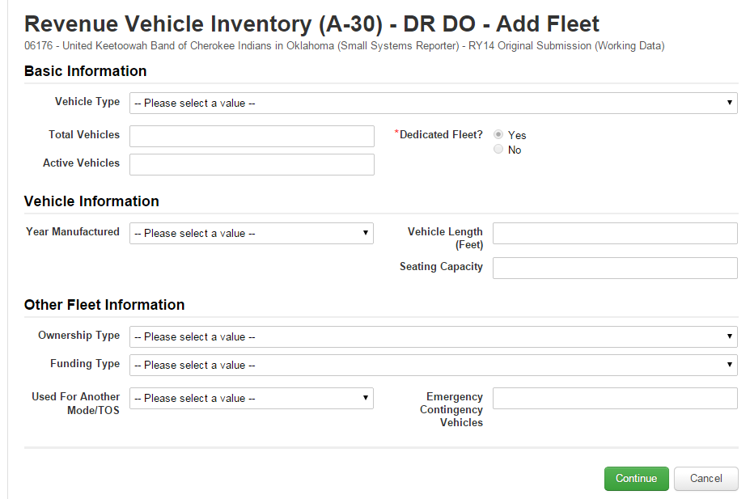
Step 3: Fill out the form

Slide 104
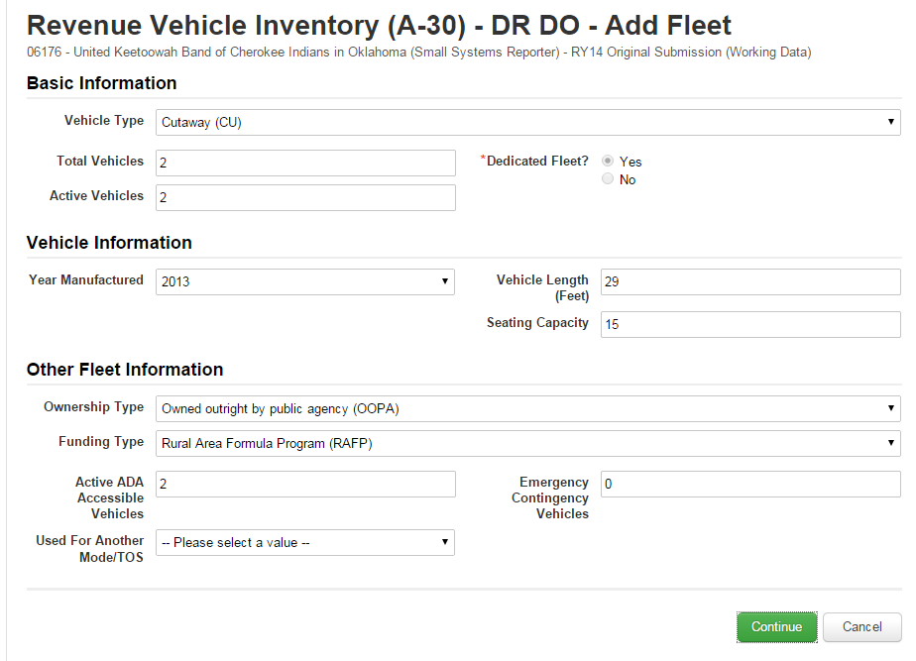
Step 4: Click “Continue”

Slide 105
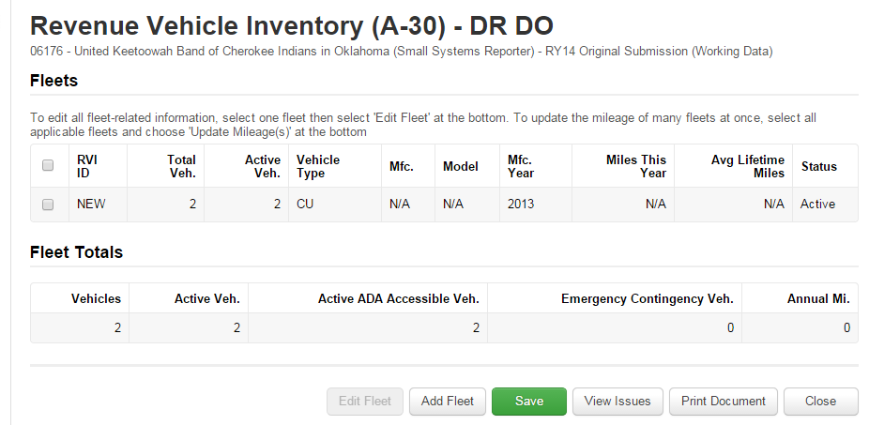
Step 5: Click “Save”
Saving assigns a RVI ID
Click “Add Fleet” for more vehicles
Notes:
Once saved, assigns ID #

Slide 106
Step 6: Click “Close”
Notes:
Once saved, assigns ID #

Slide 107
RR-20
Reduced Reporting Form

Slide 108
Full RR-20
Broken into Sections
Financial Information
Non-Federal Funding Data
Federal Government Funds
Service Data
Safety Data

Slide 109
Step 1: Open the RR-20 form
Check the box
Click “View Form”

Slide 110
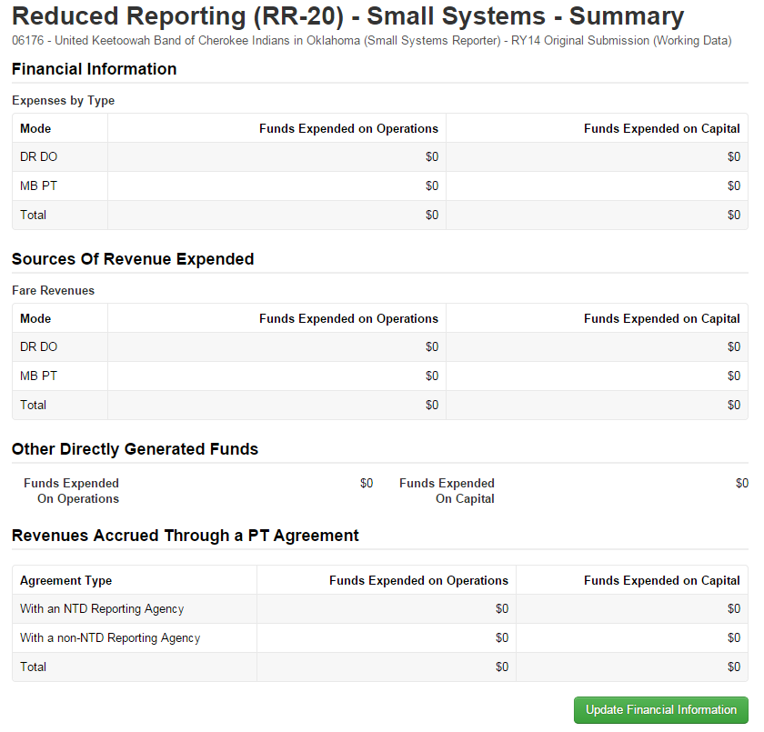
RR20.1
Step 2: Click “Update Financial Information”

Slide 111
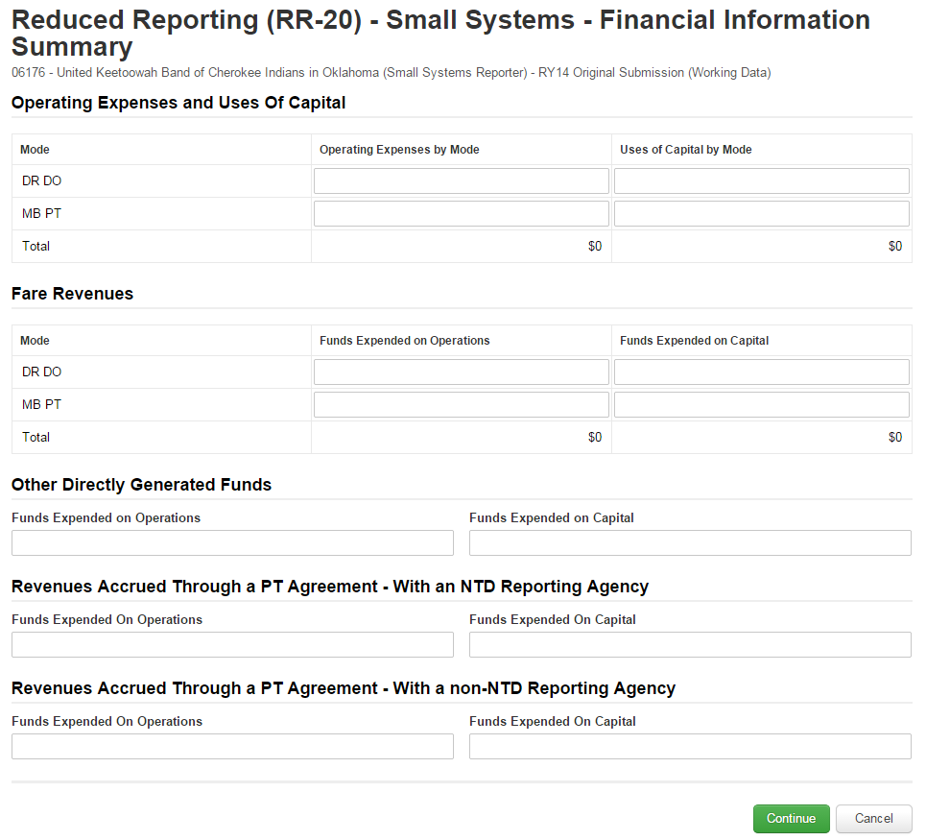
Step 3: Enter data
Annual expenses by mode
Revenue applied from Fare
Other Directly Generated Funds
Notes:
Talk about PT Agreement

Slide 112
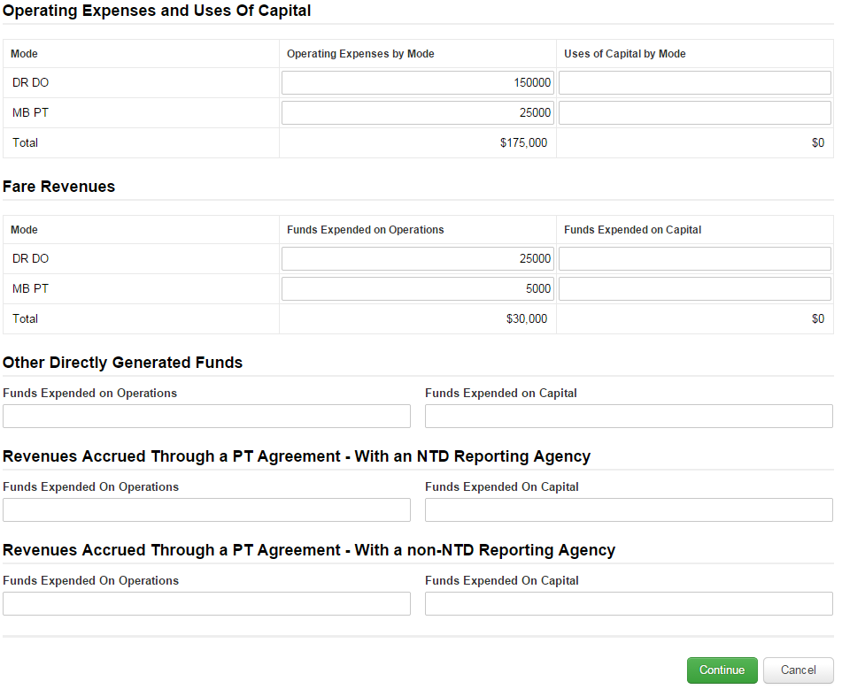
RR20.2
Step 4: Click “Continue”

Slide 113
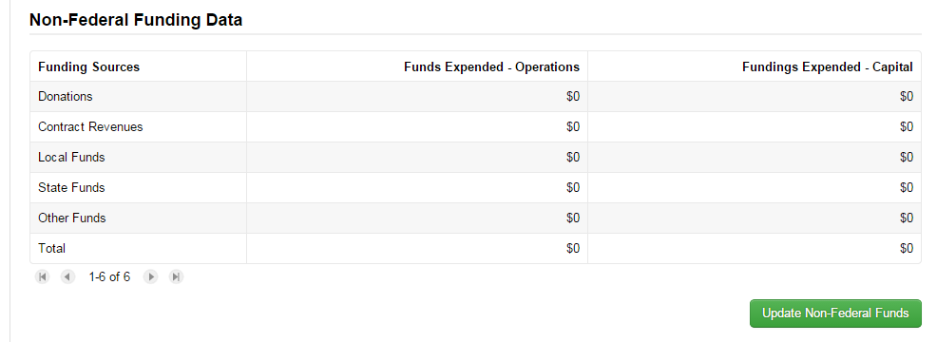
Step 5: Update Non-Federal Funds

Slide 114
Step 6: Enter data

Slide 115
Step 7: Click “Continue”

Slide 116
Step 8: Update Federal Funds
Select the Federal sources that apply
Only those data input fields will show
Can change sources at any time

Slide 117
Step 9: Select Federal Sources

Slide 118
Step 10: Click “Continue”

Slide 119
Step 11: Enter Data
Click “Change Funding Sources” to add more sources

Slide 120
Step 12: Click “Continue”

Slide 121
Total Funds Expended
Nothing is entered; comparable to line 12

Slide 122
Step 13: Update Service Information
This is a required section if you have active modes.

Slide 123
Step 14: Enter data
Annual Unlinked Passenger Trips
For RY14 Annual UPT = Regular + Sponsored
Vehicles Operated in Maximum Service
Number of vehicles on road during peak service

Slide 124
Step 15: Click “Continue”

Slide 125
Step 16: Update Safety Information
This is a required section

Slide 126
Step 17: Enter data
Incidents are: fatalities, injuries, or property damage >$25,000
Fatalities are deaths
Injuries are when passengers are transported away from the scene for medical attention

Slide 127
Step 18: Click “Continue”

Slide 128
Step 19: Click “Save”
This saves the ENTIRE form
“Save” after each “Update” to avoid loss of data

Slide 129
FFA-10
Federal Funding Allocation Form

Slide 130
Step 1: Open the FFA-10 form
Check the box (Note: one for each mode)
Click “View Form”

Slide 131
Step 2: Select Reporting Method
If only one UZA / Non-UZA, select Actual Vehicle Revenue Miles
If multiple, select Actual VRM, Actual Data, or Other

Slide 132
Step 3: Fill in box with vehicle revenue miles
Assuming you have filled in RR20, this number will be equal to the number in “Data from Other Forms” column

Slide 133
Step 4: Confirm that “Annual Total” column matches “Data From Other forms” column.
Allocated (%) column should read 100% for all data points.

Slide 134
Step 5 (if applicable): Allocate service between multiple areas
Use Actual Annual Vehicle Revenue Miles traveled in each area to allocate
OR use Actual Data for all data points (VRM, VRH, UPT, OE)

Slide 136
B-30
Contractual Relationship Form

Slide 137
Contractual Relationship (B-30)
If in RY2013, your report included a RU-22 or RU-23 form, you will now use the B-30 form.
The B-30 will capture the data necessary for annual apportionment.

Slide 138
06176- United Keetoowah Band of Cherokee Indians in Oklahoma > RY 2014 Report Package > Annual Forms
Step 1: Open the B-30 form
Click the “Add Contractual Relationship” button at top

Slide 139
Step 2: Select whether the provider of service is an NTD Reporter or another transit Company

Slide 140
Step 3: Search for agency in list of NTD Reporters
Select the checkbox If non-NTD Company, type in name of reporter

Slide 141
Step 4: Click “Continue”

Slide 142
Step 6: Select Contractual Position
Buyer or Seller of Service

Slide 143
Step 7: Select Type of Contract
Negotiated Contract
Fixed Contract
Subsidized Service

Slide 144
Step 8 (if applicable): Select Primary Feature
The Buyer Pays the Seller a Negotiated Fixed Rate Per Unit of Service
The Buyer Reimburses the Seller’s Net Operating Expenses, Based on Approved Budget

Slide 145
Step 9 (if applicable): Indicate Assets Provided
Usually vehicles or maintenance facilities; otherwise, select Other

Slide 146
Step 10: Indicate where Service is Captured
This NTD Report or contracting agency’s NTD report

Slide 147
Step 11 (if applicable): Add Modes of Purchased Transportation

Slide 148
Step 12 (if applicable): Mode Specific Statistics
Report Annual Contract Expenses, VOMS and Number Months Operated

Slide 149
Step 13 (if applicable): Click “Continue”

Slide 150
Step 14: Click “Save”

Slide 151
Step 15: Click “Close”

Slide 152
D-10
CEO Certification

Slide 153
Step 1: Open the D-10 form
Check the box
Click “View Form”

Slide 154
Step 2: Verify overall Accuracy of NTD Annual Report
Select “Yes” if financial and non-financial data are accurate and conform to NTD/USOA requirements

Slide 155
Step 3: Click “Save”

Slide 156
Step 4: Click “Yes”

Slide 157
Step 5: Click “Next”

Slide 158
Step 6: Select one of the following methods your agency used to collect unlinked passenger trips:
100% count of trips (actual data collection)
Statistician-approved sampling procedure
NTD Sampling Method
Sampling method from FTA Circular 2710

Slide 159
Step 7: Click “Save”

Slide 160
Step 8: Click “Yes”

Slide 161
Step 9: Click “Close”

Slide 162
Submitting Annual Report

Slide 163
Step 1: Open “Records”

Slide 164
Step 2: Click “NTD Report Packages”

Slide 165
Step 3: Click “FY 2014 Reporting”

Slide 166
Step 4: Click “Related Actions”

Slide 167
Step 5: Click “Submit Annual Report Package”

Slide 168
If all forms are complete, you will see box that says “Action completed Successfully”

Slide 169
FY 2014 Report is now “In Review” by analyst and cannot be edited.

Slide 170
Tribal Subsidy
Annual Forms

Slide 171
Tribal subsidy - shortened version of NTD Report
Applies if your agency provides an annual subsidy to local agency transit service(s) and does not operate or purchase other modes

Slide 172
Fill in the Subsidy, NOT the full cost of service

Slide 173
Questions?
Loucas Lamkin
434-299-8796
Loucas.Lamkin.CTR@dot.gov
Joseph Eldredge
434-993-8690
Joseph.Eldredge.CTR@dot.gov
Help Desk
(888) 252-0936
NTDHelp@dot.gov
Monday – Friday
0800 – 1900 Eastern

