Slide 1
NTD 2.0 Reporting for States
Report Year 2014

Slide 2
Contact Information
National Transit Database
943 Glenwood Station LN STE 102
Charlottesville, VA 22901
Help Desk
(888) 252-0936
NTDHelp@dot.gov
Monday – Friday
0800 – 1900 Eastern

Slide 3
Program Officials
Keith Gates
NTD Program Manager
202-366-1794
Keith.Gates@dot.gov
Gary DeLorme
NTD Senior Advisor
202-366-1652
Gary.Delorme@dot.gov
Andy Lofton
Project Manager
434-260-1175
Andy.Lofton.CTR@dot.gov

Slide 4
Presenters
Loucas Lamkin
434-299-8796
Loucas.Lamkin.CTR@dot.gov
Joseph Eldredge
434-993-8690
Joseph.Eldredge.CTR@dot.gov

Slide 5
Agenda
New System Changes
User Manager Process
Report Year Kick Off
Data Entry

Slide 6
Report Year 2014
Reporting Deadlines:
Fiscal Year End Date | January 1 – June 30 | July 1 – September 30 | October 1 – December 31
Report Due Date | January 31 | January 31 | April 30
Once the system is open for reporting, your analyst will contact you with instructions.

Slide 7
NTD Roles
The CEO must complete the Original Submission
NTD Roles are tied to an user’s email address
DIR2R10 or RUR3R15 are no longer used
“Old” System | “New” System
Director of the Transit Unit | CEO
Rural Contact | NTD Contact
Editor | Editor
Viewer | Viewer

Slide 8
Permissions by User Role
CEO:
View and edit all forms and issues
Create a Reporter Request (Waiver, Extension Request)
Submit Annual Report Package
NTD Contact:
View and edit all forms and issues
Able to submit reports after first submission
Editor:
View and edit all forms and issues
Viewer:
View all forms and issues

Slide 9
User Manager (UM)
Every agency must send FTA an official letter designating an employee as the agency’s User Manager.
The UM creates accounts for the CEO/Director and the NTD Contact. The UM can create accounts for others to enter/edit information or just view forms.
The UM can also fill a NTD Role. For example, the CEO can also be the agency’s UM.

Slide 10
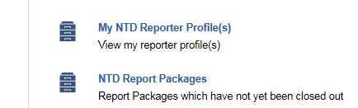
Records
The “Records” tab functions like the old system’s “Annual” tab
Information is separated into two categories
Profiles
Report Packages

Slide 11
Profiles
These forms contain data that normally doesn’t change from year to year:
Basic Information (P-10)
Reporter Modes (P-20)
Report Users (P-30)

Slide 12
Report Packages
A “Report Package” contains all the forms required for annual reporting
Identification (B-10)
Stations & Maintenance Facilities (A-10)
Revenue Vehicle Inventory (A-30)
Reduced Reporting (RR-20)
RR-20 – Rural General Public Tranist
RR-20 – Intercity Bus
RR-20 – Urban/Tribal Subrecipient

Slide 13
Report Packages
For Report Year 2014, Rural General Public Transit providers will break out Financials and Assets according to Mode.

Slide 14
New Fields – P-10
DUNS or D-U-N-S Number, is a unique nine-digit identification number for each physical location of your subrecipients.
Please visit http://fedgov.dnb.com/webform to obtain the number

Slide 15
New Fields – P-20
For all modes:
Commitment Date | When capital funds were first expended for this mode
Start Date | The first day of revenue service
End Date | The last day of revenue service

Slide 16
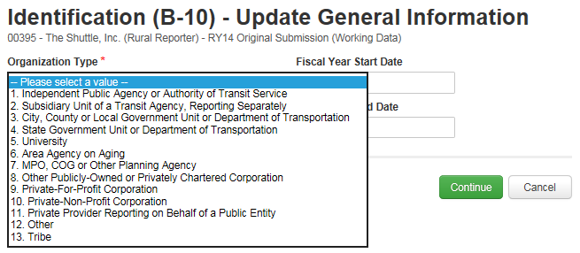
New Fields – B-10
Organization Type

Slide 17
New Fields – A-10
If facility is used by more than one mode, prorated portions must be entered on each A-10
For example, if one garage services vehicles for both Motor Bus and Demand Response, then each A-10 would have 0.5 of a facility.

Slide 18
New Fields – A-30
Active Vehicles in a fleet
The old system collected “Number of Vehicles in Total Fleet”
FTA wants to identify the number of vehicles actively providing revenue service

Slide 19
New Fields – RR-20
Vehicles Operated in Maximum Service (VOMS)
This is the revenue vehicle count during the peak season of the year; on the week and day that maximum service is provided.
Excludes atypical days and one-time special events.
Operating Expenses by Mode
Cost Allocation Methods

Slide 20
RR20 - Cost Allocation Methods
Determine which expenses are direct expenses and can be easily traced to a particular mode/TOS.
Determine which expenses are joint expenses. These costs are incurred for the benefit of more than one mode/ TOS and cannot be easily traced to a specific mode/TOS.
Allocate joint expenses or shared costs to each mode/TOS.

Slide 21
RR-20 Cost Allocation Methods
Recognizing that some agencies may not allocate joint costs by mode/TOS, NTD suggests common allocation variables:
Revenue Hours
Revenue Miles
Number of Employees
Ridership
Notes:
While these options for allocating costs are common to the transit industry, in some instances others may be more appropriate.

Slide 22
Example—Allocating by VRM
Subrecipient operates a Dial-a-Ride or Demand Response (DR) service and a fixed-route bus (MB) service
Collects Annual Vehicle Revenue Miles (VRM) for each mode separately.
DR: 200,000 VRM
MB: 300,000 VRM
Does not allocate joint Operating Costs by mode.
Total Annual Operating Expenses: $100,000

Slide 23
Example—Allocating by VRM (cont.)
Subrecipient uses vehicle revenue miles to allocate costs.
$$\frac{200,000 DR miles}{500,000 total miles}=\frac{DR operating cost}{\$100,000 joint operating cost}$$
$$\frac{200,000 }{500,000 }×\$100,000=DR operating cost$$
$$\$40,000=DR operating cost$$
$$\$60,000=MB operating cost$$

Slide 24
Interface overview
NTD Internet Reporting

Slide 25
All users land on the News feed
Posts from NTD staff will display here

Slide 26
Tasks are assigned to CEOs and NTD Contacts

Slide 27
Reporting forms and profiles are accessed through “Records”

Slide 28
The RR-20 Roll-Up Report functions like the old system’s RU-30

Slide 29
Options vary based on user privileges

Slide 30
Click your name to update your profile or change account password

Slide 31
User managers
Getting Logged-In

Slide 32
User Managers
All States are required to designate a User Manager
Contact your Analyst or the Help Desk to complete and submit your designation
FTA must create your agency’s User Manager first. Only then can the User Manager create accounts for the individuals responsible for NTD reporting.

Slide 33
Email to UM
User Managers will receive an email notification once their account has been created
Step 1: Click the link in the email to navigate to the online reporting interface
Hello User Manager,
A new user account has been created for you on the FTA Reporting Environment.
You may log on at www.ntdprogram.gov
Your Username is usermanager@test.org
Please visit the above URL and click the “Forgot Password” link, this will bring you to a prompt to create your password.
Thank you
Notes:
Registered User Managers receive email

Slide 34
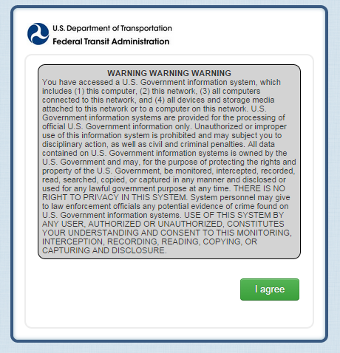
Security Agreement
Step 2: Please read the warning message and agree to the statement

Slide 35
Forgot Password
Passwords are NOT sent via email
Step 3: Once at the log-in page, click the link for “Forgot Password”
These steps are necessary for creating your first system password

Slide 36
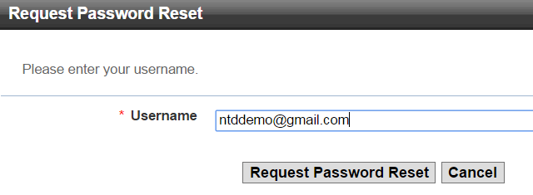
Request a Reset
usermanager@test.org
Step 4: Enter the email address used for your user name and click “Request Password Reset”
This prompts the system to send a new link to your email account

Slide 37
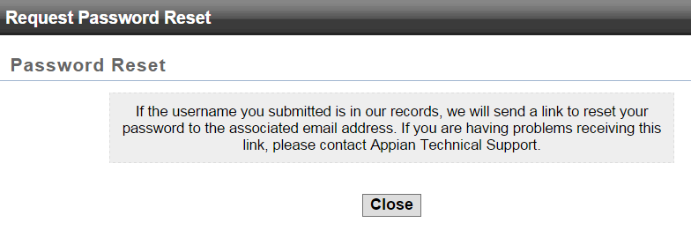
Request a Reset
Step 5: Click “Close” and then open your email inbox for the new link

Slide 38
Temporary Link for Password Reset
Step 6: Follow the new link in your email
The link expires after 15 minutes
Dear User Manager,

Slide 39
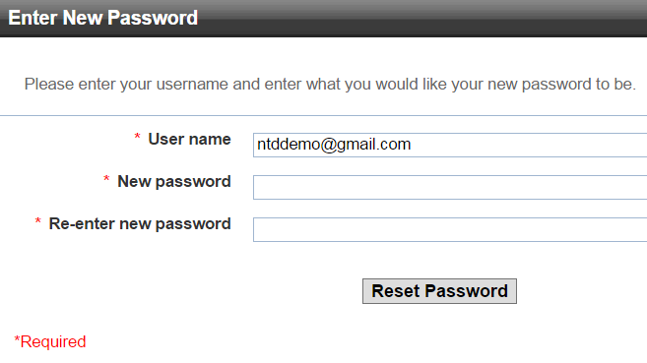
Create a Password
usermanager@test.org
• • • • • •
• • • • • •
Step 7: Enter your user name and create a password

Slide 40
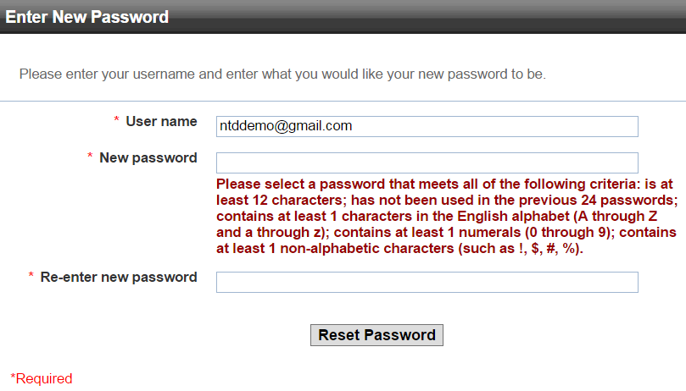
Password Security Requirements
usermanager@test.org
All passwords must meet basic security requirements

Slide 41
Password Security Requirements
Once password requirements are met, you will be able to use this password for all future logins
You can click the blue text to return to the login portal

Slide 42
Creating User accounts
Linking Individuals at the Agency to NTD Roles

Slide 43
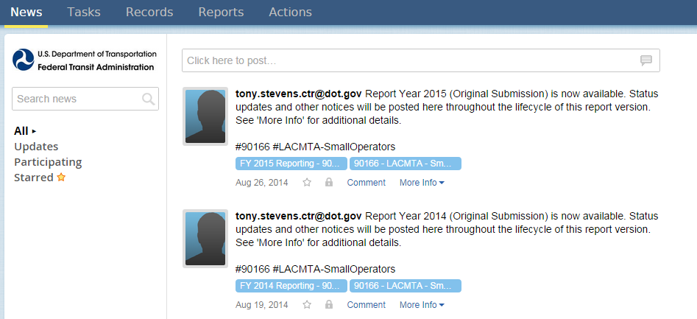
Step 1: Open the “Records” tab

Slide 44
Step 2: Open “My NTD Reporter Profiles”

Slide 45
Step 3: Open your agency’s Profile

Slide 46
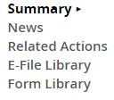
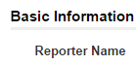
Step 4: Click “Related Actions” to fill out or edit forms.

Slide 47
Step 5: Open the P-30 form to add other users

Slide 48
Step 6: Click “Add User”
User Managers will show here and the default role is “Viewer”

Slide 49
90166 – LACMTA – Small Operators > View & Manager Users (P-30) > Add New System User
To add a new system user please complete all required fields below and click the “Next” button at the bottom of the form. If you do not want the user to be notified of the newly created account, uncheck the box.
Step 7: Enter data
- Fields with a red asterisk are required fields
Notes:
The User Manager can have the email sent automatically, or new users can use the “Forgot Password” feature once their account has been created.
Please notice new navigation buttons.

Slide 50
90166 – LACMTA – Small Operators > View & Manager Users (P-30) > Add New System User
To add a new system user please complete all required fields below and click the “Next” button at the bottom of the form. If you do not want the user to be notified of the newly created account, uncheck the box.
Step 8: Select NTD User Role from drop down and click “Next”

Slide 51
90166 – LACMTA – Small Operators > View & Manager Users (P-30) > Add New System User
To add a new system user please complete all required fields below and click the “Next” button at the bottom of the form. If you do not want the user to be notified of the newly created account, uncheck the box.
Step 9: Click “Submit”

Slide 52
User | NTD | NTD Contact | 434-555-5874 | user@test.com
Newly created Users will need to follow the “Forgot Password” protocol
Repeat the process to assign remaining roles

Slide 53
2014 Report Year Kick off
Update Contact Information and Subrecipients

Slide 54
www.ntdprogram.gov
Click “NTD 2.0 Login”

Slide 55
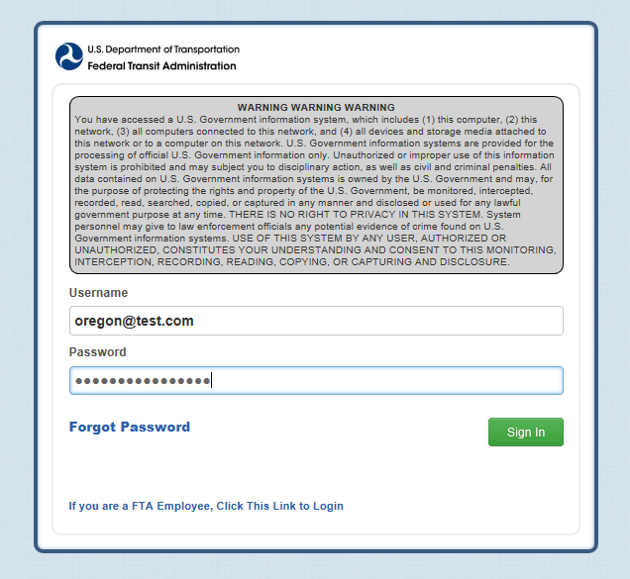
Logging in as the CEO/NTD Contact

Slide 56
Once in, open “Tasks”

Slide 57
Open the Report Year Kick Off (RYKO) task

Slide 58
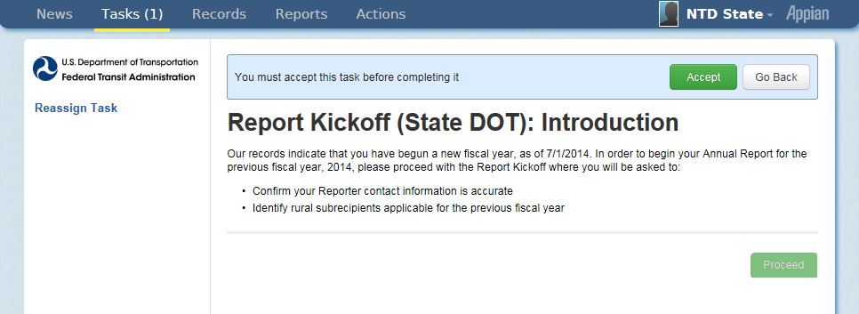
The CEO or NTD Contact must accept this task.

Slide 59
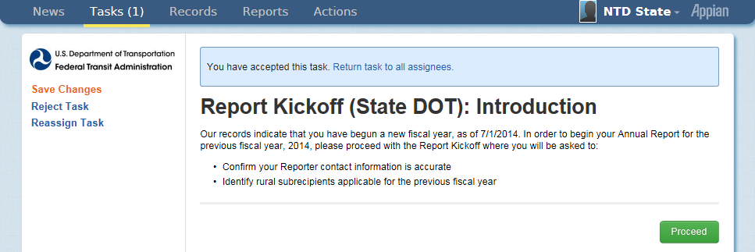
Users are given the opportunity to return the “task” to other users before proceeding

Slide 60
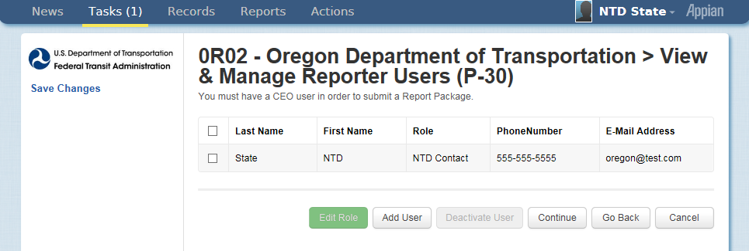
Step 1: Update Users
The CEO/NTD Contact can change user roles
Only the UM can add new users
Notes:
Step 1 RYKO - d

Slide 61
Step 2: Identify Subrecipients
Subrecipients from RY2013 are pre-loaded. Please verify this list
New subrecipients can be added from a list of existing agency profiles

Slide 62
Step 2: Identify Subrecipients
If an agency does not have a profile, you can add them manually.
All manually created subrecipients must be approved by your Analyst before the subrecipient’s records are available to you. The Analyst is notified automatically by the system.

Slide 63
Notes:
These are the various options for adding subrecipients to your Report

Slide 64
Step 3: Assign Subrecipient Type
The type is pre-loaded from RY2013 CLO
To change, select the subrecipient by checking the box to its left, fill in the circle for type, and then click “Add Type”

Slide 65
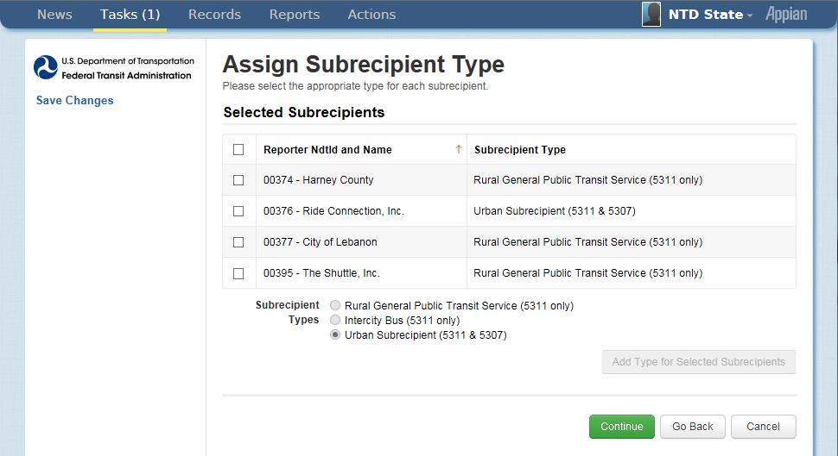
The new type will display in the grid

Slide 66
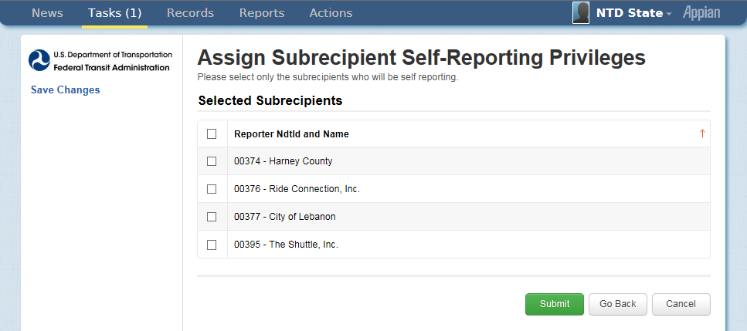
Step 4: Assign Self-Reporting Privileges
We strongly encourage that State do not assign privileges until year two of the new system

Slide 67
Step 5: Form Generation
Profiles and Report Packages (Annual Forms) take at least three minutes to generate
If new subrecipients were created, they will not display until your analyst approves the creation
Click “OK” to end the task

Slide 68
Defining Subrecipient modes

Slide 69
Step 1: Open “Records”

Slide 70
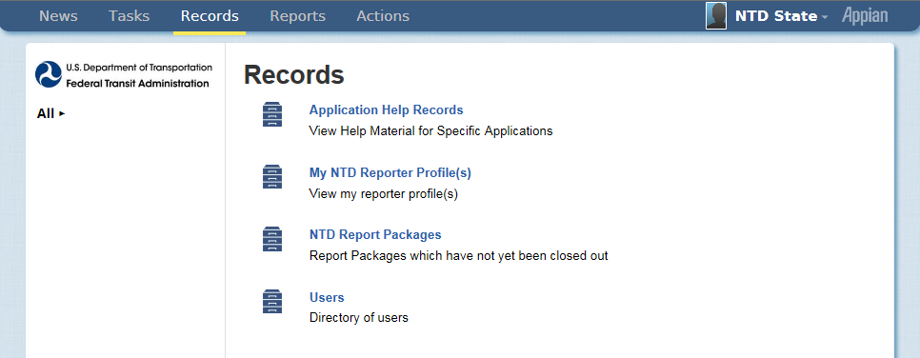
Step 2: Open “My NTD Reporter Profiles”

Slide 71
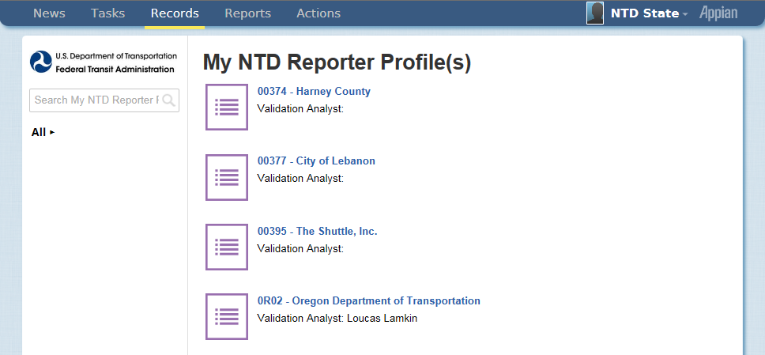
Step 3: Select the Profile you want to edit
State users won’t see Profiles for Urban agencies

Slide 72
Step 4: Open Related Actions
All forms have a non-editable “Summary” page
Data Entry & Edits require a “Related Action”

Slide 73
Step 5: Click “View & Manage Reporter Modes (P-20)”

Slide 74
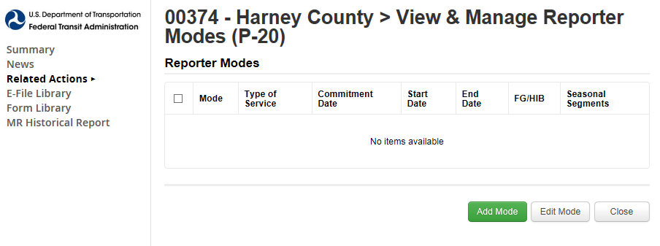
Step 6: Click “Add Mode”
Once modes are entered into the new system, the data won’t need to be entered for future report years.

Slide 75
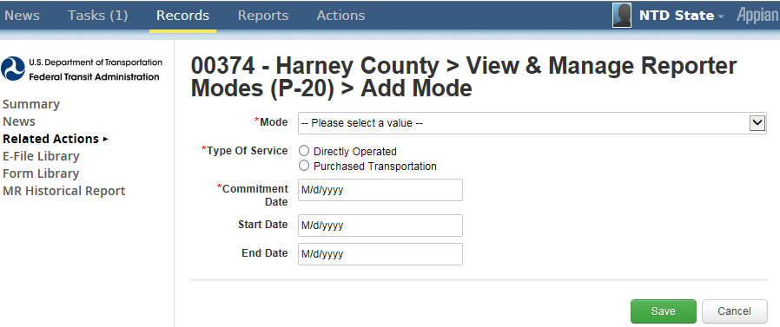
Step 7: Define the new mode
What is the mode? (MB, DR, VP, etc.)
Type of Service
Commitment Date: When capital funds were first applied
Start Date: First day of Revenue Service

Slide 76
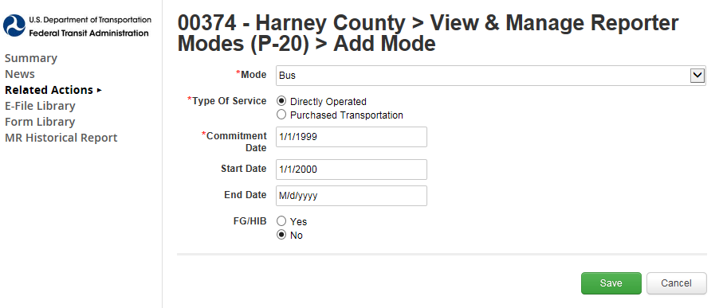
Step 7: Click “Save”

Slide 77
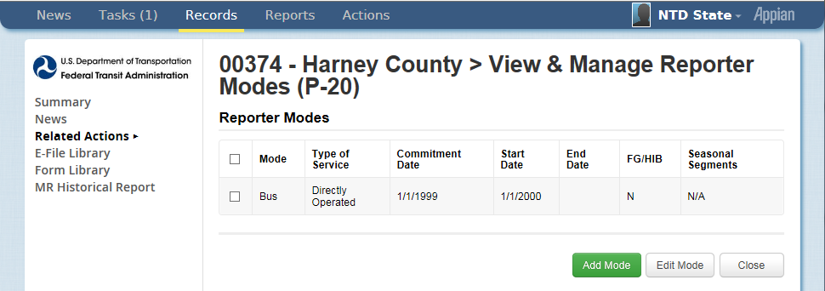
The new mode is displayed
Repeat the process if the subrecipient has more than one mode

Slide 78
RR-20: RGPT
Rural General Public Transit

Slide 79
Step 1: Open “Records”

Slide 80
Step 2: Open “NTD Report Packages”

Slide 81
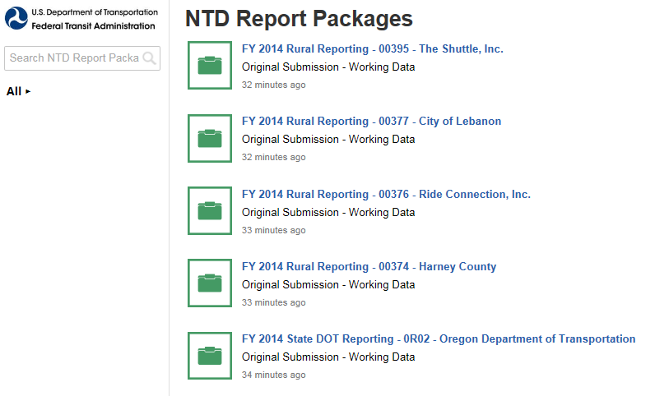
Step 3: Select the Package you want to edit

Slide 82
Step 4: Open “Related Actions”

Slide 83
Step 5: Open “Annual Forms”

Slide 84
Step 6: Select form to view
Check the box
Click “View Form”

Slide 85
B-10
Basic Information

Slide 86
Step 1: Open the B-10 form
Check the box
Click “View Form”

Slide 87
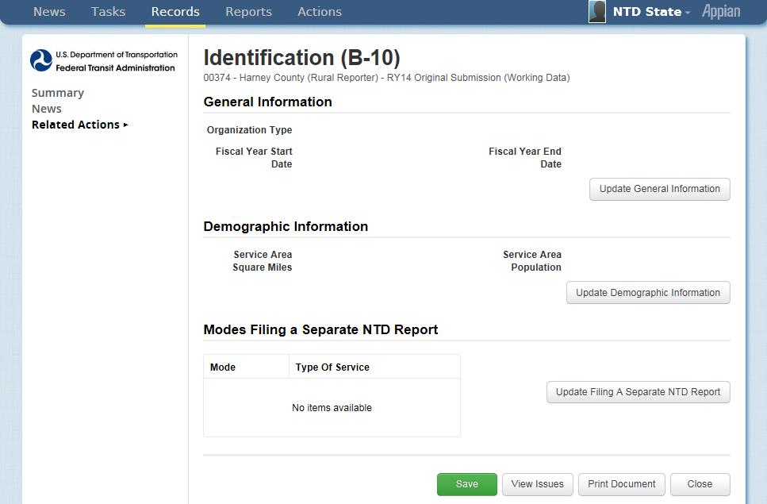
Step 2: Select a section to update

Slide 88
Step 3: General Information
Organization types are in a drop-down menu
Fiscal Year State Date
Fiscal Year End Date

Slide 89
Step 4: Demographic Information
These fields are NOT required
Please skip this section
Notes:
Ignore? – being removed

Slide 90
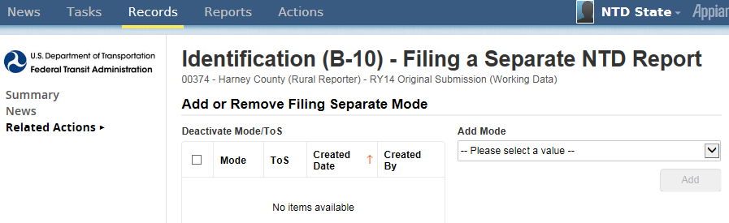
Step 5: Filing Separate
These fields are NOT required
Please skip this section
Notes:
ignore? – does not apply

Slide 91
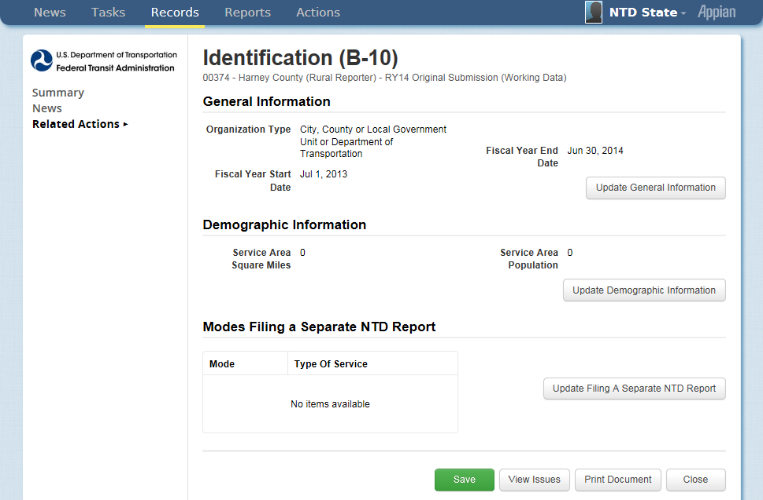
Step 6: Save & Close
Notes:
SAVE SAVE SAVE

Slide 92
A-10
Stations & Maintenance Facilities

Slide 93
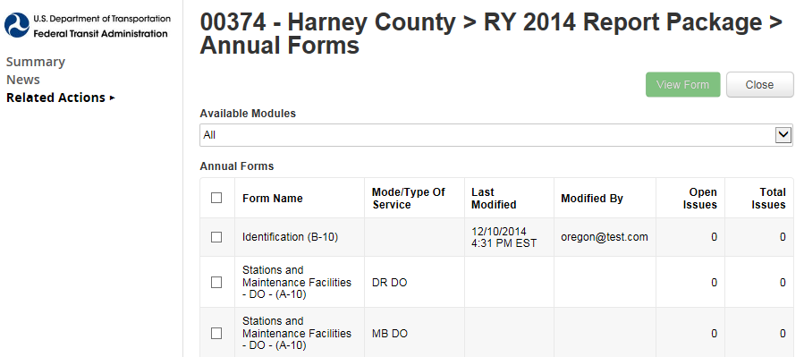
Step 1: Open the A-10 form
Check the box
Click “View Form”

Slide 94
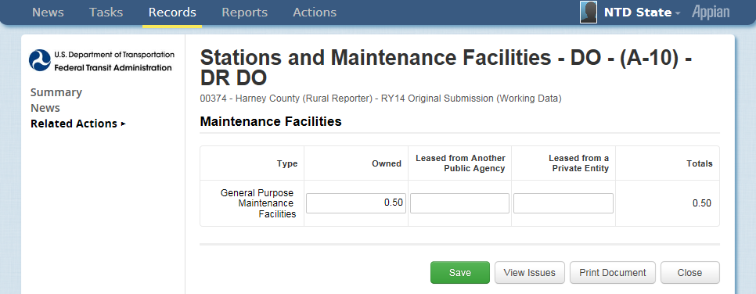
Step 2: Enter Data
If facility is used by more than one mode, report a pro-rated share

Slide 95
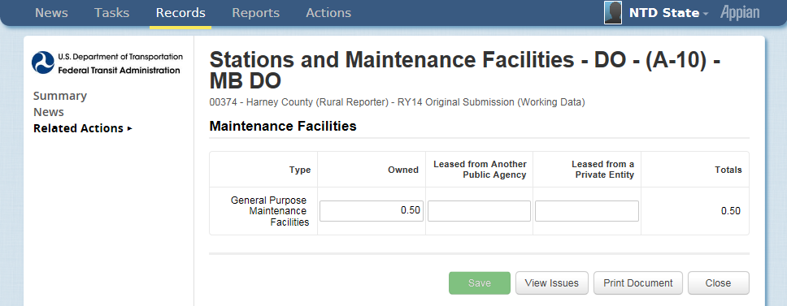
Step 3: Enter Data for remaining modes
If facility is used by more than one mode, report a pro-rated share

Slide 96
Step 4: Save & Close

Slide 97
A-30
Revenue Vehicle Inventory

Slide 98
Historical A-30 Data
For Report Year 2014, agencies are required to report data by mode.
Agencies reporting a single mode should have their A-30 pre-filled with “closed-out” data from 2013.

Slide 99
Step 1: Open the A-30 form
Check the box
Click “View Form”

Slide 100
Step 2: Click “Add Fleet”

Slide 101
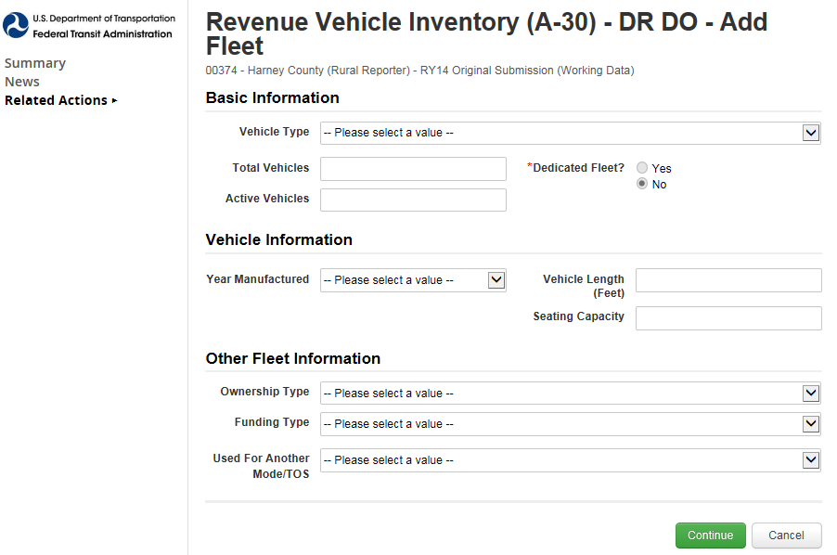
Step 3: Fill out the form

Slide 102
Step 4: Click “Continue”

Slide 103
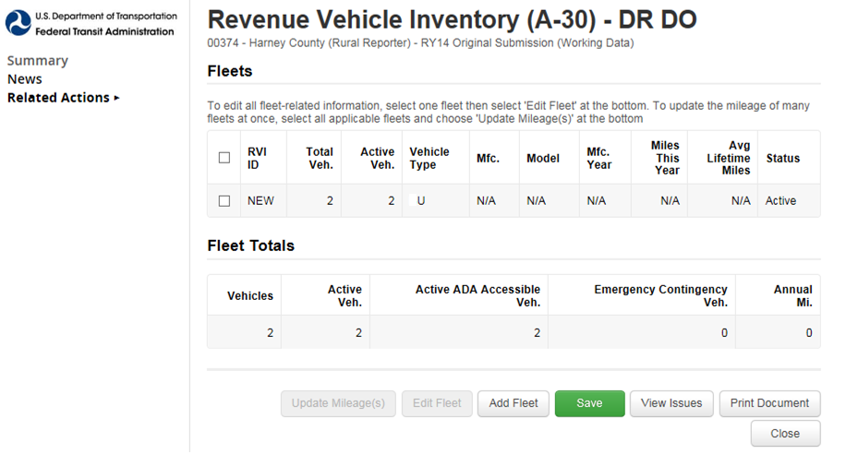
CU
Step 5: Click Save
Saving assigns a RVI ID
Click “Add Fleet” for more vehicles

Slide 104
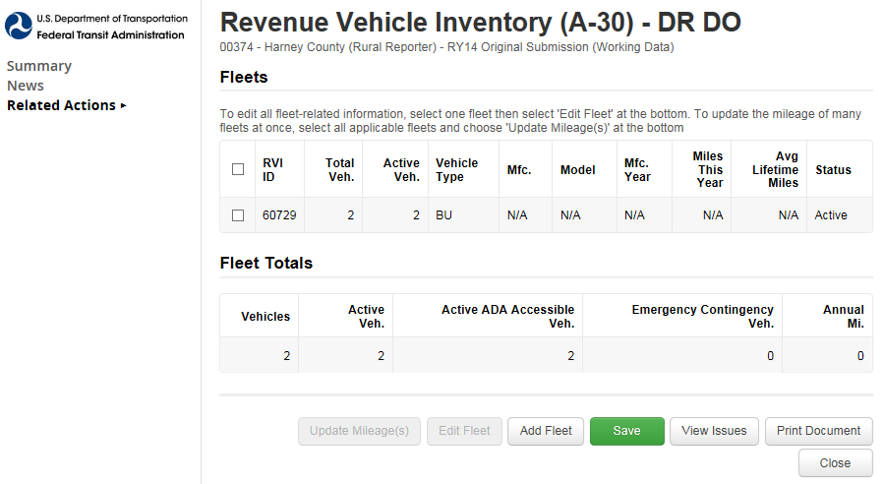
CU
Step 6: Click “Close”

Slide 105
RR-20

Slide 106
Reduced Reporting (RR-20)
Broken into sections
Financial Information
Non-Federal Funding Data
Federal Government Funds
Service Data
Safety Data

Slide 107
Step 1: Open the RR-20 form
Check the box
Click “View Form”

Slide 108
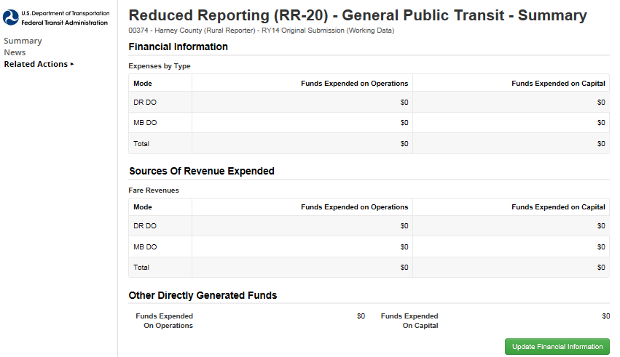
Step 2: Click “Update Financial Information”

Slide 109
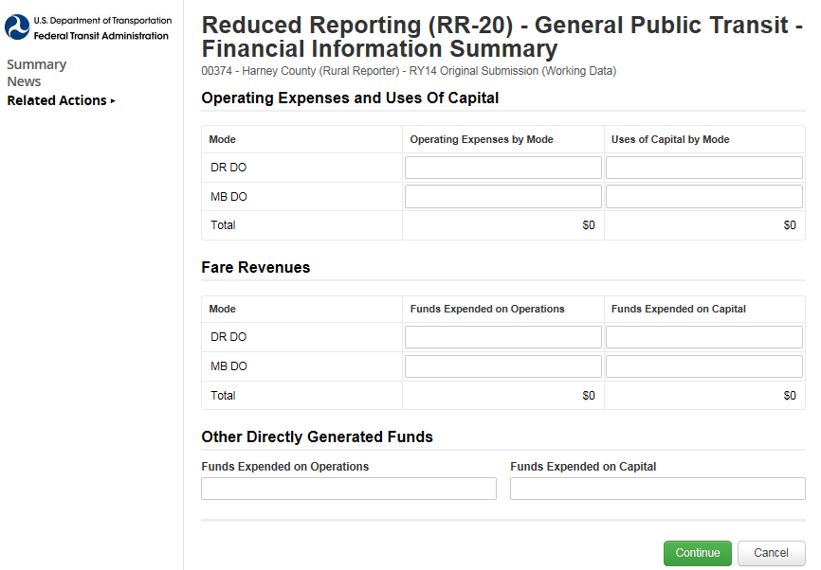
Step 3: Enter data
Annual expenses by mode
Revenue applied from Fares
Other Directly Generated Funds

Slide 110
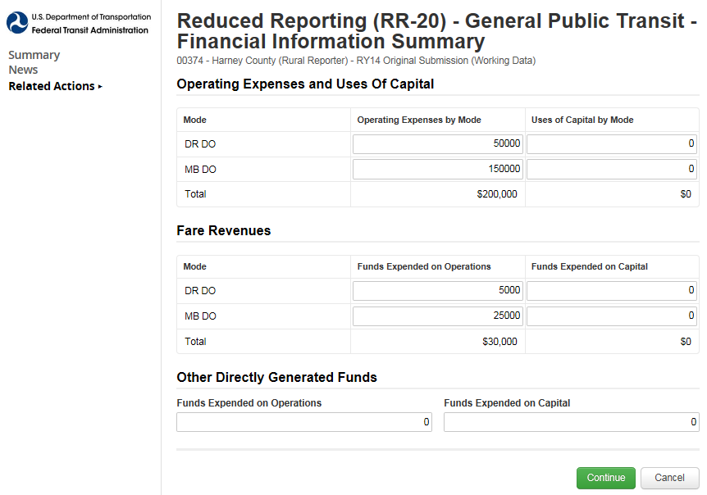
Step 4: Click Continue

Slide 111
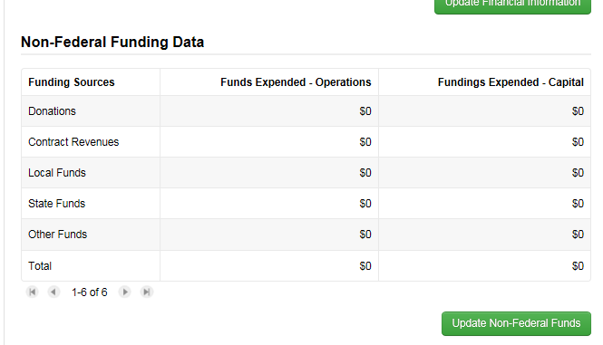
Step 5: Update Non-Federal Funds

Slide 112
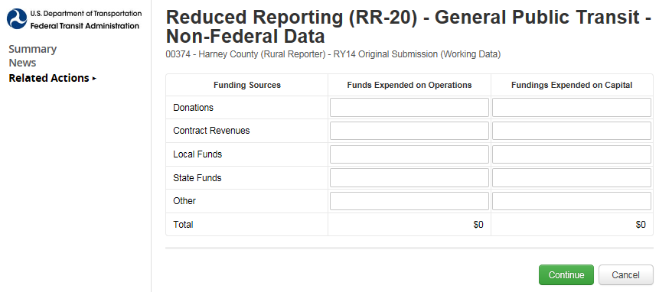
Step 6: Enter data

Slide 113
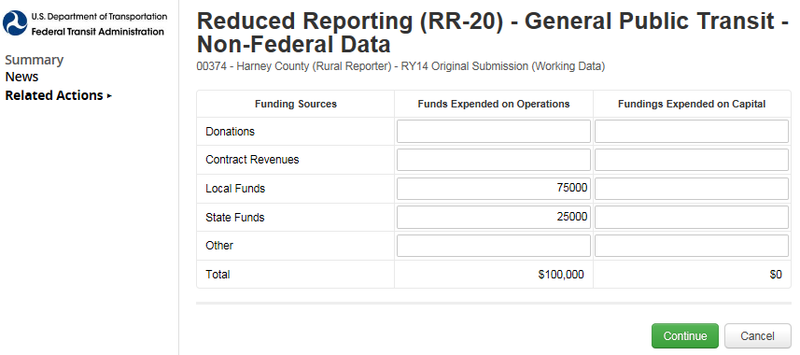
Step 7: Click Continue

Slide 114
Step 8: Update Federal Funds
Select the Federal sources that apply
Only those data input fields will show
Can change sources at any time

Slide 115
Step 9: Select Federal Sources

Slide 116
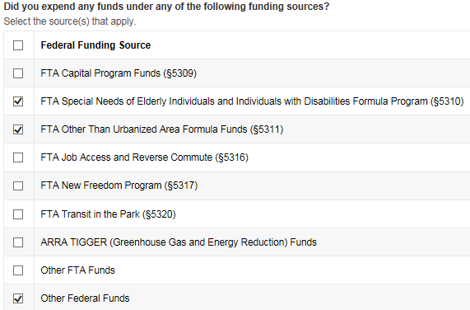
Step 10: Click “Continue”

Slide 117
Step 11: Enter Data
Click “Change Funding Sources” to add more sources

Slide 118
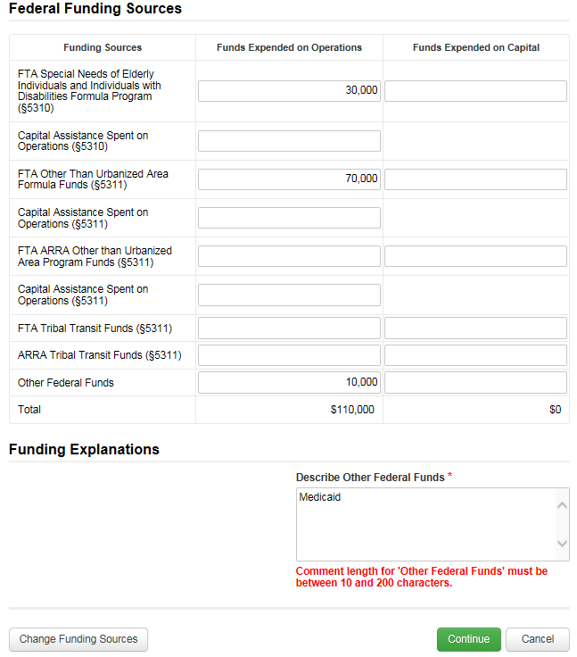
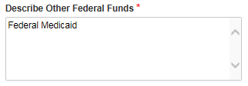
Step 12: Click “Continue”
“Other Federal Funds” requires a description

Slide 119
Step 13: Update Other Resources
This is a required section

Slide 120
Step 14: Enter Data
This is a required section

Slide 121
Step 15: Click “Continue”
If no data, just enter zeroes

Slide 122
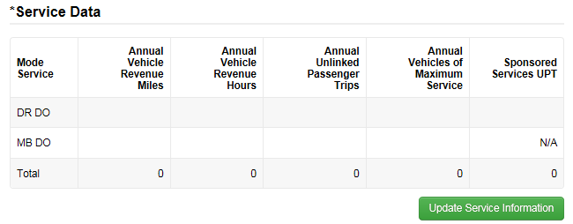
Step 16: Update Service Information

Slide 123
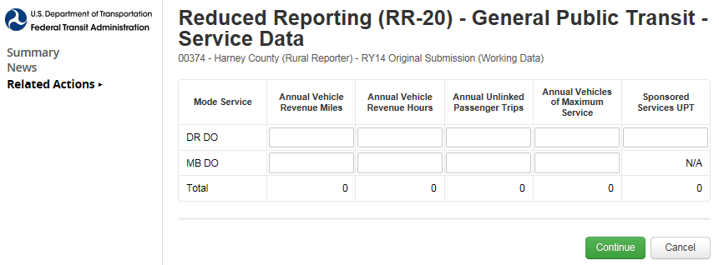
Step 17: Enter data
Annual Unlinked Passenger Trips
For RY14 Annual UPT = Regular + Sponsored
Vehicles Operated in Maximum Service
Number of vehicles on road during peak service

Slide 124
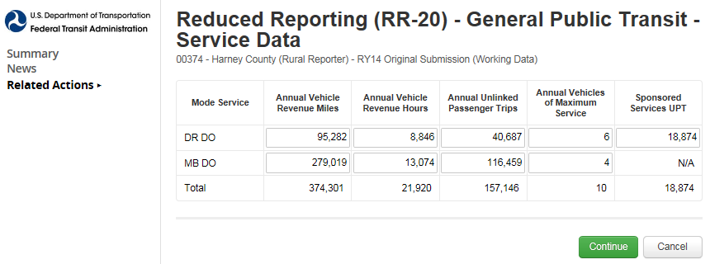
Step 18: Click “Continue”

Slide 125
Step 19: Update Safety Information
This is a required section

Slide 126
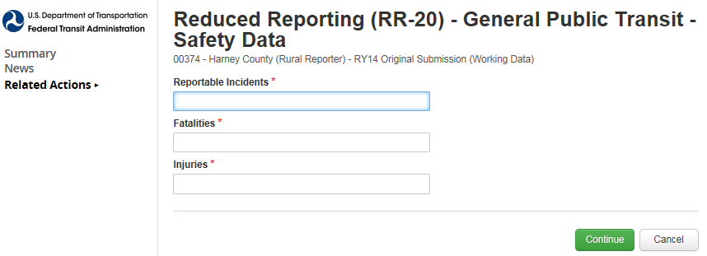
Step 20: Enter data
Incidents are: fatalities, injuries, or property damage >$25,000
Fatalities are deaths
Injuries are when passengers are transported away from the scene for medical attention

Slide 127
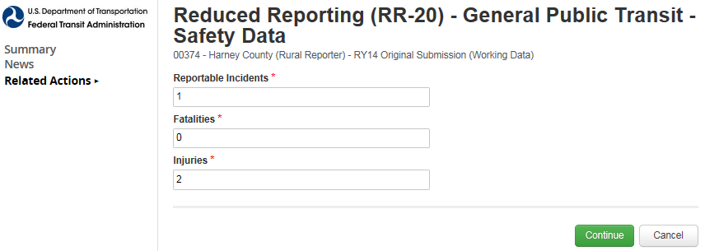
Step 21: Click “Continue”

Slide 128
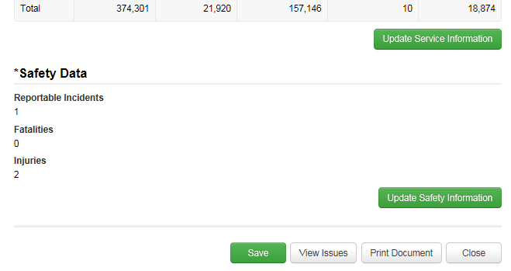
Step 22: Click “Save”
This saves the ENTIRE form
“Save” after each “Update” to avoid loss of data

Slide 129
RR-20: Intercity bus

Slide 130
Step 1: Open “Records”

Slide 131
Step 2: Open “NTD Report Packages”

Slide 132
Step 3: Select the Package you want to edit

Slide 133
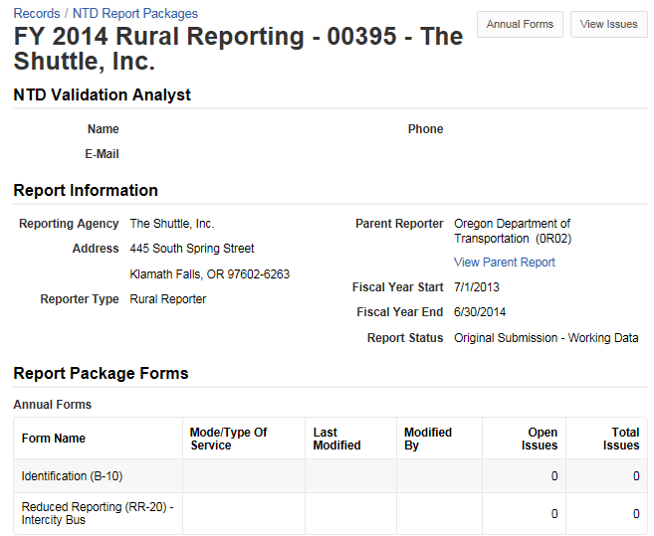
Step 4: Open “Related Actions”

Slide 134
Step 5: Click “Annual Forms”

Slide 135
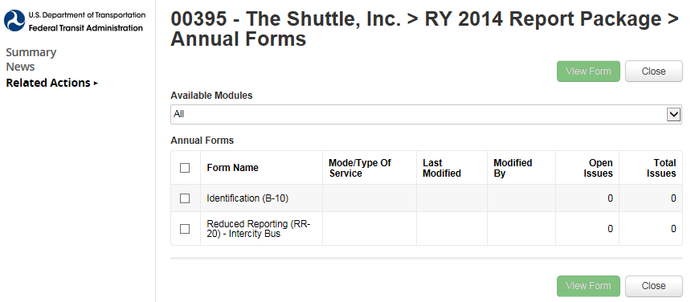
Step 6: Fill out B-10 data

Slide 136
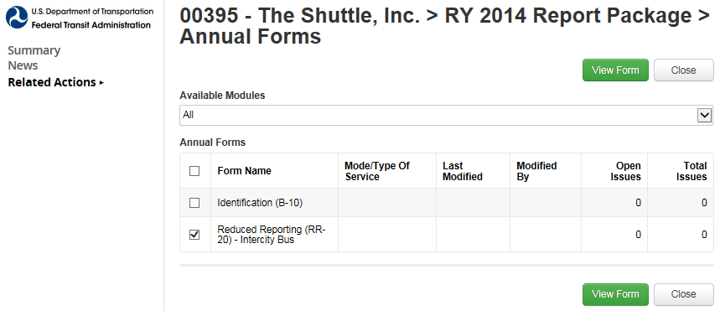
Step 7: Open RR-20: Intercity Bus
Check the box
Click “View Form”

Slide 137
Step 8: Update Federal funds

Slide 138
Step 9: Enter data

Slide 139
Step 10: Click “Continue”

Slide 140
Step 11: Update Service Information

Slide 141
Step 12: Enter data

Slide 142
Step 13: Click “Continue”

Slide 143
Step 14: Click “Save”
This saves the ENTIRE form
“Save” after each “Update” to avoid loss of data

Slide 144
RR-20: Urban/Tribal Subrecipient

Slide 145
Step 1: Open “Records”
This tab is similar to the old system’s “Annual” tab

Slide 146
Step 2: Open “NTD Report Packages”
These packages will contain the annual forms for all of your subrecipients

Slide 147
Step 3: Select the Package you want to edit

Slide 148
Step 4: Open “Related Actions”

Slide 149
Step 5: Open “Annual Forms”

Slide 150
Step 6: Fill out the B-10

Slide 151
Step 7: Select & View

Slide 152
Step 8: Update Federal Funds

Slide 153
Step 9: Enter data

Slide 154
Step 10: Click “Continue”

Slide 155
Step 11: Click “Save”

Slide 156
Questions?
Loucas Lamkin
434-299-8796
Loucas.Lamkin.CTR@dot.gov
Joseph Eldredge
434-993-8690
Joseph.Eldredge.CTR@dot.gov
Help Desk
(888) 252-0936
NTDHelp@dot.gov
Monday – Friday
0800 – 1900 Eastern

