Slide 1
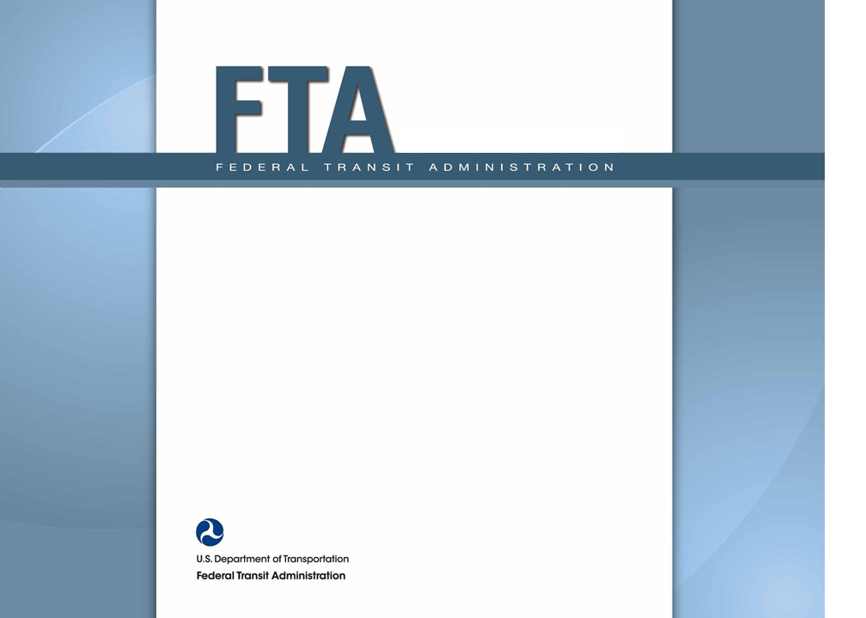
FY 2014 NTD Reporting Federal Register Notices Explanation of Proposed Changes 28 August 2014

Slide 2
NTD Modernization
Development of “NTD 2.0” System started in September, 2012
Pilot testing was May 19th thru June 6th, 2014
Motivation for new system:
Reduce maintenance costs
Improve data collection process
NTD 2.0 Go-Live Schedule:
Monthly reporting on October 8, 2014
Annual reporting in December, 2014
Safety & Security, mid-2015

Slide 3
NTD 2.0 Will Use Individual IDs
Individual IDs will have specific access rights
Replaces current CEO/Contact/Editor/Viewer IDs
1 unique ID for each individual
Every agency designates a “user manager” (UM)
UM then assigns user accounts for that agency
Designate UM in TEAM profile and attach appointment letter
No TEAM access? Then email appointment letter to NTD manager (keith.gates@dot.gov) with UM contact info
3

Slide 4
NTD Changes for FY 2014
The 8/18 Federal Register notice proposes revisions to National Transit Database (NTD) rules
FTA is seeking public comment before implementing these changes
Changes to the 2014 NTD Reporting Manual
Changes to urbanized area transit providers
Some revisions respond to MAP-21 provisions

Slide 5
General NTD Changes for FY 2014
A. ADA paratransit services clarification
B. Reporting of contractual relationships clarification
C. bus rapid transit (BRT) mode definition update
D. Guidance for reporting service on HOT lanes
E. Updates to the definition of commuter service and rules for allocation of service across multiple urbanized areas
F. Proposed elimination of consolidated reporting and expansion of small systems waiver eligibility
G. Requirement for consistent use of transit system names and types
H. New policy allowing delegation of CEO certification responsibility
I. Elimination of B-60/B-70 forms and rail peak period data collection
J. Updated guidance for sampling of passenger miles
K. Future expansion of capital asset reporting required by MAP-21

Slide 6
A. Reporting ADA Service
(1) Demand response services that are not intended to fulfill the ADA paratransit requirements of fixed route service should not be reported as attributable to ADA requirements.
(2) If you do operate demand response services to fulfill ADA paratransit requirements, report all trips for eligible passengers as ADA trips, except:
(i) Trips sponsored by a third party (Medicare);
(ii) Trips whose origin or destination are outside the ADA service area;
(iii) Trips taken during times when the fixed-route system is not operating.
(3) In general, if X% of your DR trips are ADA trips, then report X% of your DR operating expenses as ADA operating expenses.

Slide 7
B. Contractual Relationships
The buyer must be responsible for the fully-allocated cost of providing Purchased Transportation (PT) service
Allows for seller to retain fares as part of the payment
PT service must be operated in the name of the buyer
Customers see buyer’s name on vehicles
The seller must operate and manage PT service
3rd party management, PEO services are not “PT”

Slide 8
C. Bus Rapid Transit (BRT)
Restates Definition of BRT from SGR circular
Comments solicited in Federal Register on March 3, 2014
Comment on aligning NTD mode with the SGR Program Definition
Over 50% of the route operates in a separated right-of-way dedicated for transit use during peak periods
Short headways (“emulate the service provided by rail”)
Weekdays for either: (1) at least 14 hours a day with headways of <15 minutes; or, (2) headways <10 minutes or during peak periods and <20 minutes at all other times
Weekend service for at least 10 hours a day with headways that are < 30 minutes
Also:
Active signal priority
Substantial passenger stations
Separate brand identity

Slide 9
D. Service on HOT lanes
FTA will no longer consider transit service operated on any HOT lane to be the same as transit service operated on an HOV lane, for purposes of the formula apportionment for the High-Intensity Motorbus Tier
No longer any “grandfathering”

Slide 10
E. Definition of Commuter Service
Clarifies distinction between commuter and intercity transportation treatment in NTD
Commuter service is local passenger transportation, with more than half of passengers making a same-day return trip
For formula grant apportionments commuter service is allocated to the UZA that is primarily served
For formula grant apportionments 22.27% of rural Intercity non-bus miles are attributed to UZAs
Intercity bus service is not counted for formula grants
Service provided by Amtrak is defined as Intercity rail
Grandfathers existing systems in the NTD

Slide 11
F. Consolidated Reporting
There are 6 consolidated reporters in the NTD
Large systems reporting for smaller neighbors
Small systems waivers allow reduced reporting
They were not available before 2011
They also eliminate the requirement to report passenger miles
They also eliminate the monthly reporting requirement
Reports for each transit system will now have to be filed under a unique NTD ID number
Simplifies NTD data analysis
Less work for everyone

Slide 12
G. Consistent Use of Names/Types
Name and organization type on the B–10 form must now match the total revenues and total expenses reported on the F forms
Responsible certifying official designated on the B–20 form must be a direct employee of the reporting organization
Independent auditor statements must be done on the basis of the reporting organization.

Slide 13
H. Delegation of CEO Authority
Historically, the reporter’s CEO must submit the NTD report and certify its accuracy.
CEO may now delegate this certification to an employee who will act in the CEO’s name for this purpose
Delegation will remain valid as long as both the CEO and the designated official continue to hold their respective positions
Does not change the CEO’s overall responsibility for the accuracy of data submitted in the report

Slide 14
I. Eliminating Reporting Requirements
FTA has determined that this data is not needed
Eliminate the requirement for rail systems to report morning and evening peak period service data
Will align the service data reporting requirements for rail modes with other modes
eliminate B–60 and B–70 forms
Identify funds passed from one public entity to another public entity

Slide 15
J. Passenger Mile Sampling Guidance
Withdraw outdated circulars on sampling to collect passenger mile data
UMTA C2710.1A
UMTA C2710.2A
UMTA C2710.4A
Circulars have been replaced by the NTD Sampling Manual
Has been in use as optional guidance since 2011
OK to use old circulars for sampling underway
http://www.ntdprogram.gov/ntdprogram/sampling.htm

Slide 16
K. Asset Inventory Reporting
Solicits comments on plan to implement MAP-21 requirement to collect asset inventory data
High-level data on fixed assets to augment the current collection of vehicle data
Asset list filled out once and then updated annually
FY 2014 reporting (starts in October 2014) will not be affected
FY 2015 reporting will be an optional pilot year
FY 2016 reporting will be mandatory
http://www.ntdprogram.gov/ntdprogram/assetInventory.htm

Slide 17
Facilities Data
Administrative and Maintenance Facilities Inventory (A-10)
Passenger and Parking Facility Inventory (A-20)
Fill out fields to collect:
facility type
primary mode served
facility’s name, street address, square footage
year built or substantially reconstructed
estimated cost and year of estimated cost
number of parking spaces (parking facilities only)
Share (percent) of responsibility to fund replacement
Where a major facility’s age varies by section, report on separate line for each section
17

Slide 18
Guideway Data
Rail Fixed Guideway Inventory for each mode
Linear guideway assets
Power and signal equipment
Track Inventory for each mode
Length of linear track assets (tangent or curved track)
Total number of track special elements (crossovers, unions…)
For both, report:
Data as network totals by operating agreement (DO or PT)
Date of construction or major rehabilitation (in decade ranges)
Share (percent) of responsibility to fund replacement
Expected service life for each asset (default or based on agency experience)
18

Slide 19
NTD Safety Changes for FY 2014
The 8/21 Federal Register notice proposes revisions to National Transit Database (NTD) Safety & Security event reporting
FTA is seeking public comment before implementing these changes
Changes to the 2014 NTD Reporting Manual
Some revisions respond to MAP-21 provisions
Changes to urbanized area transit providers

Slide 20
NTD Safety Changes for FY 2014
Reportable Event (Clarification)
Change in Location Criteria
Evacuations
Derailments
Collisions at Grade Crossings
Collision with an Individual on a Rail Right-of-Way
Rail to Rail Collisions
Addition of “Tow-Away”
Revision to Non-Rail “Other Motor Vehicle” and “Collision Event”
Revision to Non-Rail “Type of Fire” Categories
Collect New Data on Geographic Location of Events

Slide 21
1. Reportable “Events”
Incidents reported to the NTD and the SSO will now be called ‘‘events.’’
Other uses of the term ‘‘incident’’ are defined as an occurrence that is less severe than an accident
‘‘Event’’ in this case is intended to include planned and unplanned events that are required to be reported
Better alignment with nomenclature used in other transportation modes
Clarity during data analysis conducted to identify safety trends
21

Slide 22
8. Addition of ‘‘Tow-Away’’
Adds a ‘‘tow-away’’ checkbox to the S&S–40 reporting form
Replaces property damage threshold for collisions
Makes vehicle event reporting compatible with the threshold used by the Federal Motor Carrier Safety Administration (FMCSA)
22

Slide 23
2. Change in Location Criteria
Current rule is to report events that are ‘‘related to or affect revenue service.’’
Change to ‘‘an event occurring on transit right-of-way, in a transit revenue facility, in a transit maintenance facility, or involving a transit revenue vehicle, excluding occupational safety events occurring in administrative buildings.’’
Consistent with data reported to the SSO program
NTD will no longer collect events at bus stops that are not on real property owned or controlled by the agency
Unless the event involves a transit revenue vehicle or riders getting on or off a transit revenue vehicle
23

Slide 24
11. Collect New Data on Geographic Location of Events
Adds fields for latitude and longitude of events
Improves analysis capability
24

Slide 25
3. Evacuations
Revise the definition of “evacuation” to include
patron/passenger self-evacuations and
evacuations for service or maintenance related issues when passengers are evacuated to potentially hazardous situations
Rail right-of-way
Highway shoulder lane
These events would require a major event report
Consistent with data reported to the SSO program
25

Slide 26
4. Derailments
Expand the mandatory reporting of derailments to include yard derailments
Yard derailments would be reportable regardless of injuries, fatalities, or property damage
26

Slide 27
7. Rail-Rail Collisions
A major event report will be required for all collisions between rail vehicles
Extends existing SSO threshold to the NTD
Agencies are already required to report and investigate these events to SSO program
Does not include normal connection of vehicles
27

Slide 28
Other Rail Collisions
5. Collisions at Grade Crossings
All collisions at grade crossings are reportable to the NTD
Already report and investigate these events for the SSO Program
6. Collision with an Individual on a Rail Right-of-Way
All rail collisions with individuals are reportable
Regardless of injuries or fatalities
Even if they do not result in an injury
As collected in the SSO program
28

Slide 29
9. Revision to Non-Rail ‘‘Other Motor Vehicle’’ and ‘‘Collision Event’’ Screens
Adds selections for ‘‘other motor vehicle type’’ to form for reporting collisions with a motor vehicle
Automobile, moped, scooter, motorcycle, charter bus, school bus
Collision with another agency’s transit vehicle
Collision with one of your own transit vehicles
Improves ability to support trend analysis of non-rail vehicle collisions
29

Slide 30
10. Revision to Non-Rail ‘‘Type of Fire’’ Categories on Fire Event Detail Screens
Adds selections for ‘‘type of fire’’ to the non-rail fire event detail screen
Provides better national level information for vehicle fire prevention and mitigation
30

Slide 31
Comment Submission
Must be received by 9/18 or 10/20 (Safety)
Include Docket Number FTA-2014-0006 or Docket Number FTA-2014-0009 (Safety)
Email: http://www.regulations.gov.
Fax: (202) 493-2251.
Mail/Courier (submit 2 copies): 1200 New Jersey Avenue SE, W12-140, Washington, DC 20590-0001

Slide 32
Also…
All comments received will be posted to http://www.regulations.gov
DOT’s complete Privacy Act Statement http://DocketsInfo.dot.gov.
Contact is: Keith Gates, (202) 366–1794, or keith.gates@dot.gov

