Slide 1
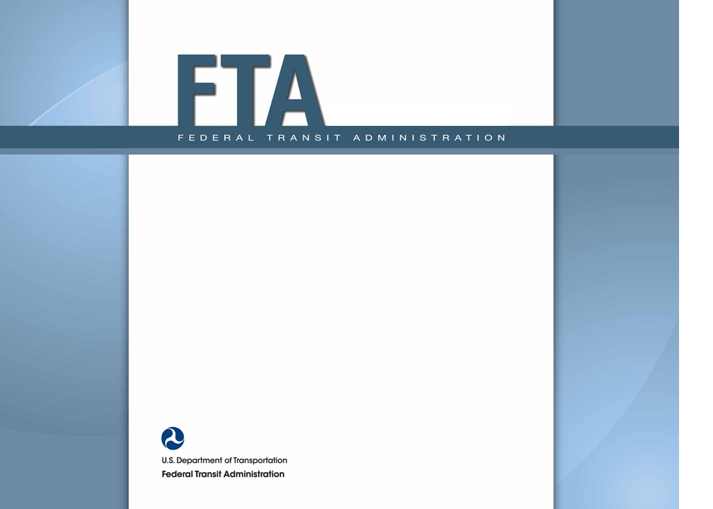
NTD Data Users Seminar 22 May, 2015 John D. Giorgis Director of Strategic Planning & Analysis Federal Transit Administration

Slide 2
Agenda
Overview of the NTD
NTD Data: the Basics
NTD Data Products and How to Use Them

Slide 3
Purpose of the NTD Program
SECTION 5335. NATIONAL TRANSIT DATABASE.
(a) National transit database.-- To help meet the needs of individual public transportation systems, the United States Government, State and local governments, and the public for information on which to base public transportation service planning, the Secretary of Transportation shall maintain a reporting system, using uniform categories to accumulate public transportation financial, and operating, and asset condition information and using a uniform system of accounts. The reporting and uniform systems shall contain appropriate information to help any level of government make a public sector investment decision. The
Secretary may request and receive appropriate information from any source.
(b) Reporting and uniform systems.--The Secretary may award a grant under section 5307 or 5311 only if the applicant, and any person that will receive benefits directly from the grant, are subject to the reporting and uniform systems.
(c) Data required to be reported.—The recipient of a grant under this chapter shall report to the Secretary, for inclusion in the National Transit Database, any information relating to a transit asset inventory or condition assessment conducted by the recipient.
Information for public transportation service planning
Other Uses: the apportionment, Conditions & Performance Report, Government Performance and Results Act reporting

Slide 4
The Four Data Groups of the NTD
Rural Module
Section 5311 Recipients with no 5307 Funding
Safety & Security Module
Urbanized Area Reporters with 30+ Vehicles
Monthly Module
Urbanized Area Reporters with 30+ Vehicles
Annual Module
ALL Urbanized Area Reporters

Slide 5
Who’s Required to Report?
Any Beneficiary of Section 5307 Grants Must Report to the Annual Module
Other Systems Servicing an Urbanized Area May Report Voluntarily
You Must Report All Transit Services
Both Federally-funded and non-Federally Funded
All Services: Urban, Rural, or Both
If You Have Fewer than 30 Vehicles, You Qualify for a Reduced Report
No Passenger Mile Sampling
No Monthly Module, No Safety & Security Module
A Recipient of Section 5311 Grants Must Report to the Rural Module
Report for All Subrecipients, Unless We Already Have the Data
Direct-Recipient Indian Tribes
A Full Report to the Annual Module
Report All Transit Services, Federally-funded and non-Federally Funded

Slide 6
What Does the NTD Collect Right Now?
Annual Module
826 Urbanized Area Systems
275 with Fewer than 30 Vehicles submit reduced reports
Remaining 551 submit full reports, (includes both FTA 5307 grant recipients and voluntary reporters)
Monthly Module (551 Reporters)
Safety & Security Module (551 Reporters)
Rural Module
54 States & 141 Indian Tribes
1300 Total Subrecipients

Slide 7
Rural Module – Financial Data
Contact Info for Each Subrecipient
Sources of Funds Separately for Operating & Capital
Total Local Funds
Total State Funds
Federal Funds by FTA Program
Other Funds (e.g. grants)
Types of expenditures are NOT collected

Slide 8
Rural Module – Asset Data
Revenue Vehicle Inventory
Type, Length, Seating, Ownership, Largest Funding Source, Model Year, & ADA Accessibility
Total Mileage is NOT collected
Number of Maintenance Facilities by Ownership
Volunteer Drivers and Volunteer Vehicles
Trips Supported Using Private Taxicabs

Slide 9
Rural Module - Service Data
Collected by Mode
Unlinked Passenger Trips (Sponsored and Unsponsored)
Vehicle Revenue Miles
Vehicle Revenue Hours
Passenger Miles are NOT collected (requires sampling)
Total Fatalities, Injuries, & Incidents

Slide 10
Safety & Security Module
Detailed Data on Major Incidents
Total Property Damage > $25,000
1 or More Fatalities
1 or More Injuries Requiring Immediate Medical Transport
Evacuation for Life-Safety Reasons
Excludes Non-Fatal Slips, Falls, & Electric Shocks
Summary Totals on Minor Incidents
Slips, Falls & Electric Shocks
Fires
Arrests & Citations

Slide 11
Monthly Module
Ridership:
Unlinked Passenger Trips (UPT)‏
Service Supplied:
Vehicle Revenue Miles (VRM)‏
Vehicle Revenue Hours (VRH)
Vehicles Operated in Maximum (Peak) Service (VOMS)‏
Regular (Weekday) Schedule Days Operated
Passenger Miles (PMT) Are not Reported

Slide 12
Annual Module – Fewer than 30 Vehicles
Contact Info for CEO & NTD Contact
Modes Operated (and under construction)
Vehicles Operated in Maximum Service (VOMS)
UZA(s) Served
Organization Type and Institutional Structure
Revenue Vehicle Inventory
Vehicle Type, Length, ADA Accessibility, Funding Source, Ownership, Seating, Standing, Fuel Source, Model Year, Manufacturer, Model, Annual Mileage, & Total Mileage
Passenger Miles Traveled (PMT) NOT Reported

Slide 13
Overview of Annual Module Full Report
Basic Information
What were your sources of funds?
What did you expend your funds on?
What service did you provide?
What resources did you consume?
What capital assets do you have?
Urbanized Area Allocation (for apportionment)
Certification

Slide 14
Annual Module – Basic Information
Contact Info for CEO & NTD Contact
Modes Operated and Under Construction
Vehicles Operated in Maximum Service (VOMS)
UZAs Served
Organization Type & Institutional Structure
e.g. unit of city government, independent corporation, private company, State DOT, etc.
Contractual Relationships with Service Providers
type of contract arrangement, total contract cost, etc.

Slide 15
Annual Module – Source of Funds
Reported by Source and by whether Applied to Operating Expenses or to Capital Expenses
Directly-Generated Funds
e.g. fares (by mode), advertising, parking, trip sponsors
Local Funds
reported by type of tax (e.g. gas, sales, property, income, etc.)
State Funds
reported by type of tax (e.g. gas, sales, property, income, etc.)
Federal Funds
reported by program (23 programs are listed)

Slide 16
Annual Module – Expenditures
Operating Expenses by Mode
15 categories of expenditures (e.g. salaries, benefits, fuel, tires, services, insurance, taxes, etc.)
Expenditures in each category are reported by function (4 Functions: Vehicle Operations, Vehicle Maintenance, Non-Vehicle Maintenance, & General Administration)
Capital Expenses by Mode
9 categories of capital expenditures
Expenditures in each category are reported as for either Service Expansion or Asset Rehabilitation & Replacement

Slide 17
Annual Module – Service Information
Hours of Operation: Total & Peak
Service Operations on Average Weekdays, Saturdays, & Sundays + an Annual Total
Vehicle Revenue Miles & Deadhead Miles
Vehicle Revenue Hours & Deadhead Hours
Unlinked Passenger Trips
Passenger Miles
Train Revenue & Deadhead Miles/Hours
Hours for Charter & School Service (not transit)
Directional Route Miles
Days Lost to Strikes or Emergencies

Slide 18
Annual Module - Fixed Guideways
Service Report:
Segments Reported by Service Operation
allows cross-checks when multiple agencies operate on the same segments
collects segment age and length
for HOV collects hours of enforcement, safe operation practices, and level of congestion
Asset Report:
Miles of Track Reported by Construction Type
Number of Grade Crossings for Rail Systems
Above two reports currently do NOT align – alignment of the reports would require a large initial investment by the big rail systems

Slide 19
Annual Module – Other Assets
Revenue Vehicle Inventory
Vehicle Type, Length, ADA Accessibility, Funding Source, Ownership, Seating, Standing, Fuel Source, Model Year, Manufacturer, Model, Annual Mileage, & Total Mileage
Number of Maintenance Facilities
Ownership
Capacity (Under 200, 200-300, & Over 300 Vehicles)
Number of Stations
Only Includes Enclosed Structures (i.e. excludes bus shelters)
Number of Stations that are Multimodal
ADA Accessibility
Number of Elevators and Escalators
Condition information is NOT collected (yet, Asset Inventory coming)

Slide 20
Annual Module - Resources
Employee Hours Worked by Full & Part-Time
Employee Counts by Full & Part-Time
Fuel Consumption by Mode and Type of Fuel
Number of Maintenance-Related Service Interruptions

Slide 21
Annual Module – Allocations & Certifications
Allocation of Service Data and Operating Expenses by Urbanized Area
Splits data among each UZA served, and to rural areas
We allow a simple allocation based on Vehicle Revenue Miles in each UZA and in rural areas
Bus data must also be allocated to fixed-guideway and to non-fixed-guideway
Certifications
CEO Certification of Overall Accuracy of Data
Certify that an Independent Audit has been Completed

Slide 22
Annual Module Summary
Based on Each Transit Provider’s Own Fiscal Year
Audited
Certified by the CEO
Fiscal Year | Number of Reporters
July to June | 458 (55%)
October to September | 130 (15%)
January to December | 252 (30%)

Slide 23
Monthly Module Summary
Based on Calendar Months
Due 30 days after end of month
Data is Validated, but not Audited or Certified
Currently Monthly Data Must be “in the ballpark” of the Annual Data
Timely vs. Accuracy/Certification

Slide 24
Agenda
1) Overview of the NTD
2) NTD Data: The Basics
3) NTD Data Products - And How to Use Them

Slide 25
NTD Data Is Organized in Three Ways
Agency
Mode
Type of Service (TOS)‏
Some Data Not Available for All Combinations of Agency, Mode & TOS
Agencies with Fewer than 30 Vehicles file Reduced Reports
Some Modes Don’t Have Fixed Routes
Some Data Is not Collected from Private Operators (e.g. number of employees)

Slide 26
What Is A Transit Agency?
Working Definition: A “NTD Transit Agency” Is a Record-Keeping Unit of a Transit Provider that has Operational Control Over Transit Services
Operational Control = Sets Schedules, Fares, and Makes Operational Decisions
Each Agency Has an NTD ID Number
The NTD ID Number is the Fundamental Organizational Unit of NTD Data
The NTD ID is 5 Digits, the first Digit is the FTA Region Number
The Term “Agency” Can be Confusing
MTA in New York City has 6 NTD IDs
ValleyMetro in Phoenix has 3 NTD IDs
Consolidated Reporters (being phased out in FY 2015 reports)

Slide 27
What Is a Mode?
Working Definition: A Technological and Operational Means of Providing Transit Service
Modes Are Divided Into “Rail” and “Non-Rail”
Each Mode Has a Two-Letter Code that Is Used in NTD Data Products

Slide 28
NTD Rail Modes (46%)
Code | Name | Reports | UPT (1000s) | % of Transit Ridership
HR | Heavy Rail | 15 | 3816789 | 36.7%
CR | Commuter Rail | 25 | 475515 | 4.6%
LR | Light Rail | 24 | 457701 | 4.4%
SR | Streetcar | 12 | 52336 | 0.5%
MG | Monorail/Automated Guideway | 6 | 21693 | 0.2%
CC | Cable Car | 1 | 6813 | 0.1%
YR | Hybrid Rail | 5 | 6647 | 0.1%
IP | Inclined Plain | 3 | 1187 | 0.0%
AR | Alaska Railroad | 1 | 156 | 0.0%

Slide 29
NTD Non-Rail Modes (54%)
Code | Name | Reports | UPT | % of Transit Ridership
MB | Bus | 701 | 5102798 | 49.0%
DR | Demand Response | 711 | 101685 | 1.0%
TB | Trolleybus | 5 | 95916 | 0.9%
CB | Commuter Bus | 116 | 90364 | 0.9%
FB | Ferryboat | 22 | 64186 | 0.6%
RB | Bus Rapid Transit | 7 | 43355 | 0.4%
VP | Vanpool | 83 | 36358 | 0.3%
PB | Publico | 1 | 27021 | 0.3%
DT | Demand Response Taxi | 83 | 6631 | 0.1%
TR | Aerial Tramway | 1 | 1645 | 0.0%
JT | Jitney | 0
OR | Other | 0

Slide 30
Types of Service (TOS)
DO = Directly Operated
Using Your Own Employees to Run Service
60% of Reports and 92% of Ridership
PT = Purchased Transportation
Hiring a Contractor Like First Transit or Veolia to Run Service with their Employees
40% of Reports and 8% of Ridership

Slide 31
Summary
Almost Any NTD Data Series Can Be Characterized by Some Combination of:
Agency, Mode, and Type of Service
Agency: Four/Five Digit NTD ID
Mode: Two Letter Code (MB, DR, HR, LR, CR, etc.)
Type of Service: DO or PT

Slide 32
Agenda
1) Overview of the NTD
2) NTD Data: The Basics
3) NTD Data Products - And How to Use Them

Slide 33
NTD Data Products

Slide 34
Overview of NTD Data Products
Transit Profile
One-Stop Shop for Key Data Items on Any One Transit Provider
National Transit Summaries and Trends
Stock Graphs of National Level Transit Data
Transit Data Tables
The Source for Data from the Annual Module Each Year
Monthly Data Tables
The Latest Ridership Data at Your Finger Tips – And More!
Historical Time Series
Key Data from the Annual Module Since 1991!

Slide 35
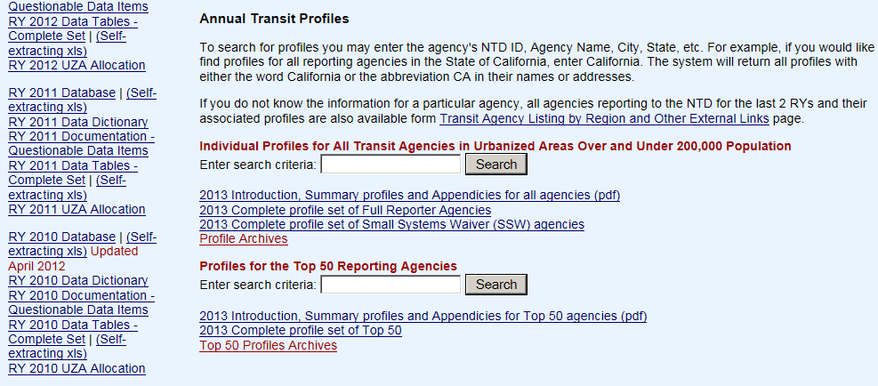
Find a Transit Profile
Scroll Mid-Way on “Access to NTD Data” Page
Search by NTD ID, Agency Name, or City Name

Slide 36
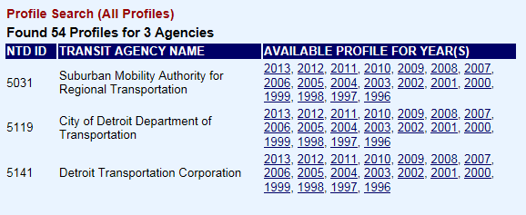
Search Profiles for “Detroit”
Three Hits
Detroit Department of Transportation
Detroit Transportation Corporation (The People Mover)‏
Suburban Mobility Authority for Regional Transportation
Profiles Available from 1996 to the Present

Slide 37
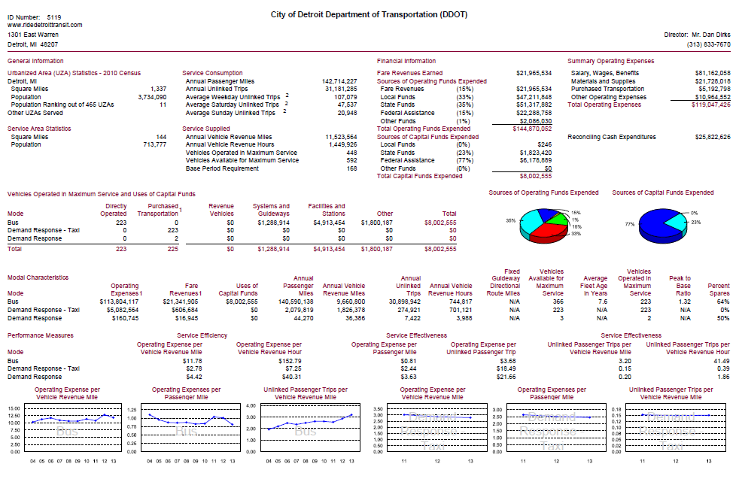
Inside a Profile
Contact Info
Operating Expenditures
Demographic Data
Total Sources of Funds
Vehicles and Capital Expenditures
Sources of Funds by Expenditure Type
Key Data by Mode
Performance Measures by Mode

Slide 38
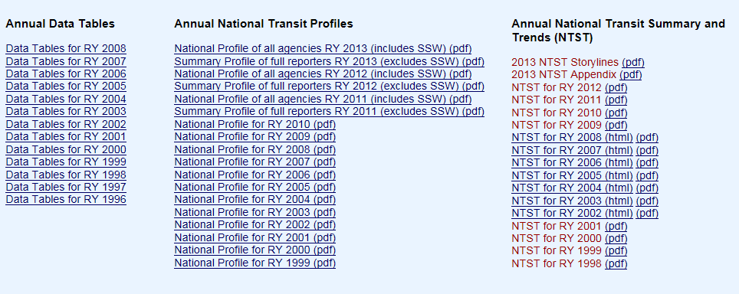
Find the NTST
Scroll to Bottom of “Access to NTD Data” Page

Slide 39
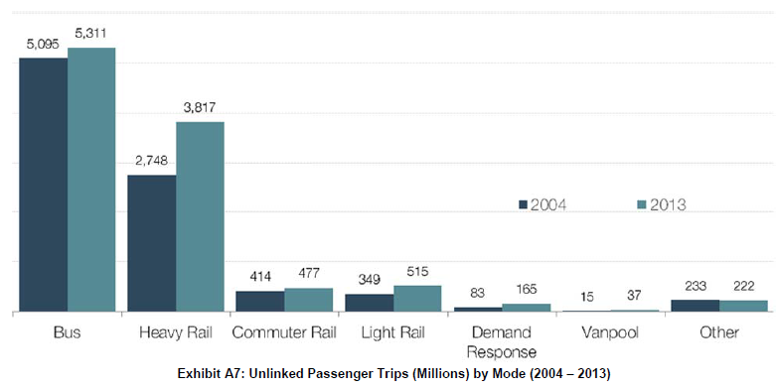
Sample of the NTST
Unlinked Passenger Trips by Mode‏

Slide 40
What Else Can You Find in the NTST?
Time Series Graphs of Operational and Financial Data by Mode
Time Series Graphs of Key Transit Performance Measures
Transit Funding Sources
Fleet Age and ADA Compliance
Aggregate Data by Urbanized Area

Slide 41
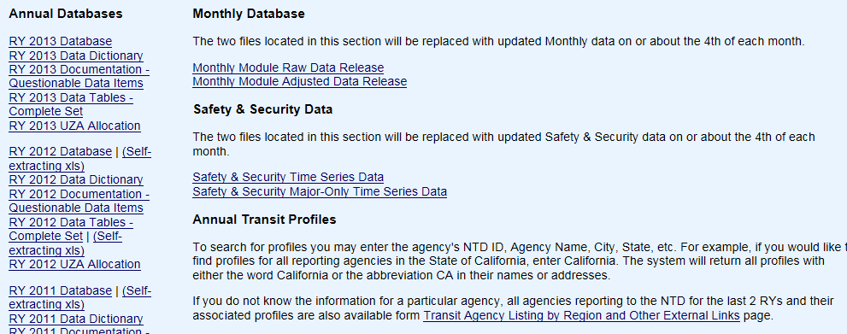
Find the Transit Data Tables
Scroll to Middle of “Access to NTD Data” Page

Slide 42
What Are the Data Tables?
27 Data Tables Produced Each Year from the Annual Module
Almost Everything that Goes Into the NTD Goes Into a Data Table
Open or Download as an Excel File
Create a New Folder Before Downloading
Be Sure to Unzip to the Folder you Created

Slide 43
Data Table Highlights
Table 1 – Source of Operating Funds
Table 7 – Sources of Capital Funds
Table 11 – Capital Expenditures by Type of Expenditure
Table 12 – Operating Expenditures by Function (Ops, Maint., Admin.)‏
Table 13 – Operating Expenditures by Type of Expenditure
Table 19 – Transit Operating Statistics (UPT, VRM, PMT, etc.)‏

Slide 44
Final Notes on the Data Tables
For Transit Providers with More than One Mode, System-Wide Totals are Provided
Totals by Urbanized Area Size Are at the Bottom of Each Table
Totals by Mode Are Also at the Bottom of Each Table

Slide 45
Find the Monthly Databases
Scroll to Middle of “Access to NTD Data” Page

Slide 46
What’s In the Monthly Database?
Two Tables – 7 Tabs in Each Table
The Basic Monthly Module Data Release has the Actual Data
The Adjusted Monthly Module Data Release Is Adjusted to Support Time-Series Study
Includes ALL Data from the Monthly Module in Separate Tabs
Unlinked Passenger Trips (UPT)‏
Vehicle Revenue Miles (VRM)‏
Vehicle Revenue Hours (VRH)‏
Vehicles Operated in Maximum (Peak) Service (VOMS)‏
Regular (Weekday) Service Days
Includes Key Data from the Most-Recent Annual Module Report
Operating Expenditures, Average Passenger Trip Length, Average Fare
Urbanized Area (UZA) Information: Size and Population

Slide 47
Cautions for the Monthly Database
Data from the Most-Recent Month May Be Incomplete Due to Late Reporters
Data Is Subject to Change for Up to 18 Months (or More in Rare Cases)
Try to Use the “Latest Release” Whenever Possible
Data from the Earliest Years Is Known to Be Less Accurate

Slide 48
Some Ways to Use the Monthly Data
Find National Ridership for any Calendar Year or Any Recent Month
Create a List of the “Top XX Transit Agencies”
Find Out if Your Transit Agency Has Increased Ridership
Find Out if Your Transit Agency Has Been Increasing Service (VRM or VOMS) or Cutting Back on Service
Suggestion: Become Familiar With “Sort” and “Sum” in Excel

Slide 49
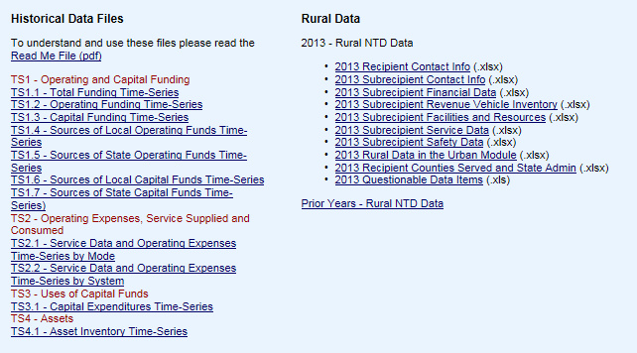
Find the Historical Time Series Tables
At the Top of the Page

Slide 50
What Are In the Historical Time Series?
11 Files – Over 50 Data Series – Data from 1991 to 2013
Sources of Total Funding, Operating Funding, and Capital Funding
Funding by Local and State Tax Type
Types of Operating and Capital Expenditure
Operations and Service Data
Fleet Size, Age, Capacity, and ADA Accessibility

Slide 51
Safety Data
Just Released in March 2010
Fatalities and Injuries by Agency, Mode, and Person Type for Each Year

Slide 52
Questions?
John D. Giorgis
Director of Strategic Planning & Analysis
john.giorgis@dot.gov
202-366-5430
Keith Gates
NTD Program Manager
keith.gates@dot.gov
202-366-1794

