Slide 1
National Transit Database
Reduced Reporting

Slide 2
New Reporting System (“NTD 2.0”)
Annual reporting planned to start December 15 for RY 2014 reporting

Slide 3
Our Agenda
Steps for Starting SSW Reporting
Local system “user manager” creates user accounts
Systems complete SSW forms

Slide 4
Local System User Manager (LSUM)
LSUM at each reporting agency approves (certifies) new users of FTA systems
NTD 2.0
TRAMS (updated TEAM)
FTA requires each agency to identify a LSUM to FTA for “authentication”
TEAM users upload designation letter in TEAM
Non-TEAM users send letter to FTA NTD project manager in Washington DC

Slide 5
LSUM NTD Startup Tasks
Create LSUM password
Approve and enter local users into NTD 2.0

Slide 6
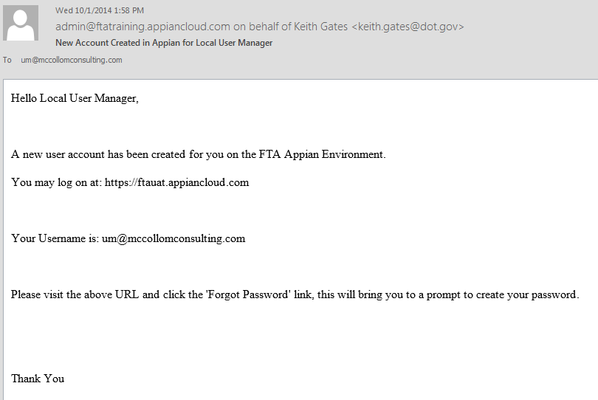
LSUM Receives Email Instructions
Mon 12/15/2014 7:40 AM
walter.mondale@mankato.org
Hello Walter Mondale,
Log on using LSUM email address as username
walter.mondale@mankato.org

Slide 7
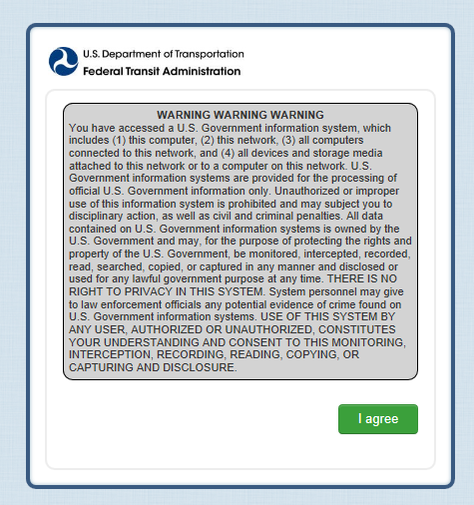
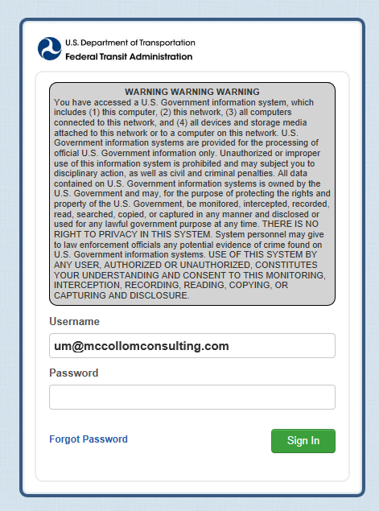
LSUM Starts Password Process
Enter Username (all lower case letters)
walter.mondale@mankato.org
Click on I agree to accept government warning
Click on Forget Password to start process to set password

Slide 8
Request Password Reset
walter.mondale@mankato.org
Click on Request Password Reset
Enter user name (email address)

Slide 9
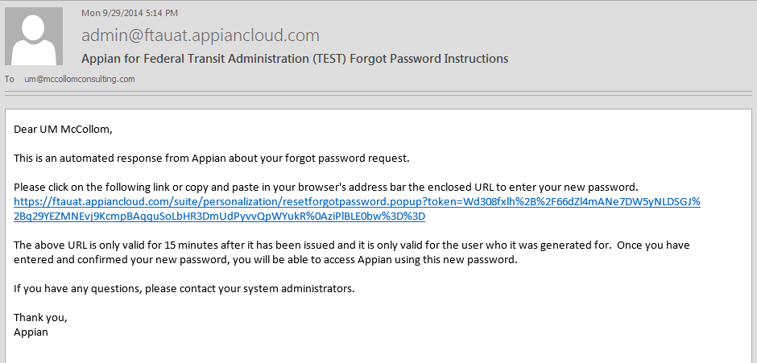
LSUM Receives Password Instructions
Mon 12/15/2014 8:00 AM
walter.mondale@Mankato.org
Click to go to set password
Dear Walter Mondale

Slide 10
Set Password
Enter user name (email address)
walter.mondale@mankato.org
Enter and reenter password
Click on Reset Password

Slide 11
Password Features (All Users)
Same as current NTD reporting system
Federal requirements for length and complexity
Password length
Must be 12 characters and not more than 20 characters
Complexity
3 out of 4 – Lower case, Upper case, Numbers, Special Characters
Password History
Password must be different from 10 previous passwords and must be different from any password used in the last 6 months
Password expiration period is 60 days

Slide 12
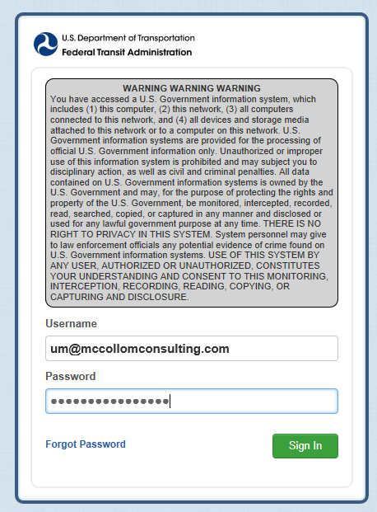
LSUM Logs In to Create Users
Enter Username and Password
walter.mondale@mankato.org
Click on I agree to accept government warning
Click on Sign In

Slide 13
News Page is the Home Page
Click on Records to enter users

Slide 14
Records Page
Click on My NTD Reporter Profile(s)

Slide 15
My NTD Reporter Profile(s)
Click on reporting agency name

Slide 16
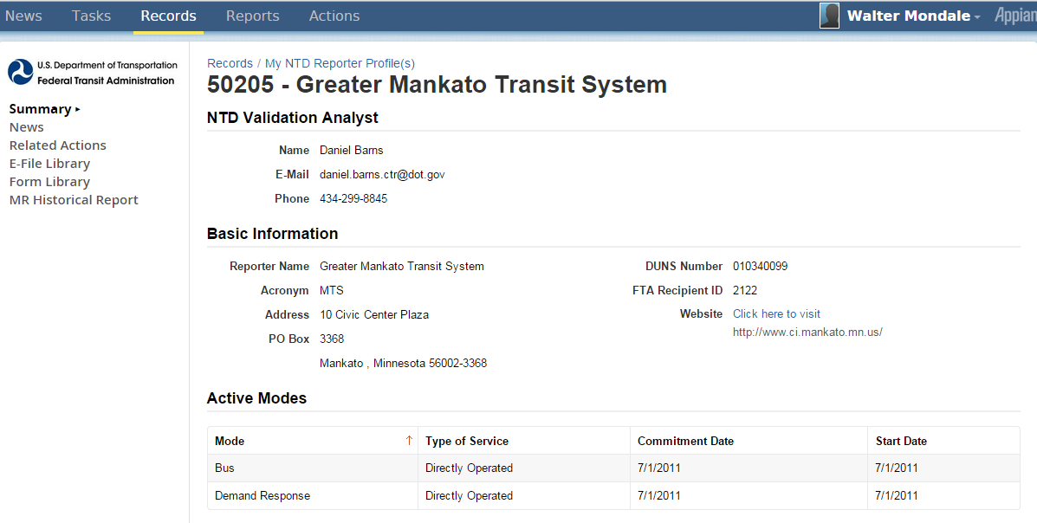
Reporter Profile
Click on Related Actions

Slide 17
Related Actions for Reporter Profile
Click on View & Manage Reporter Users (P-30)

Slide 18
View & Manage Users (P-30)
Click on Add User

Slide 19
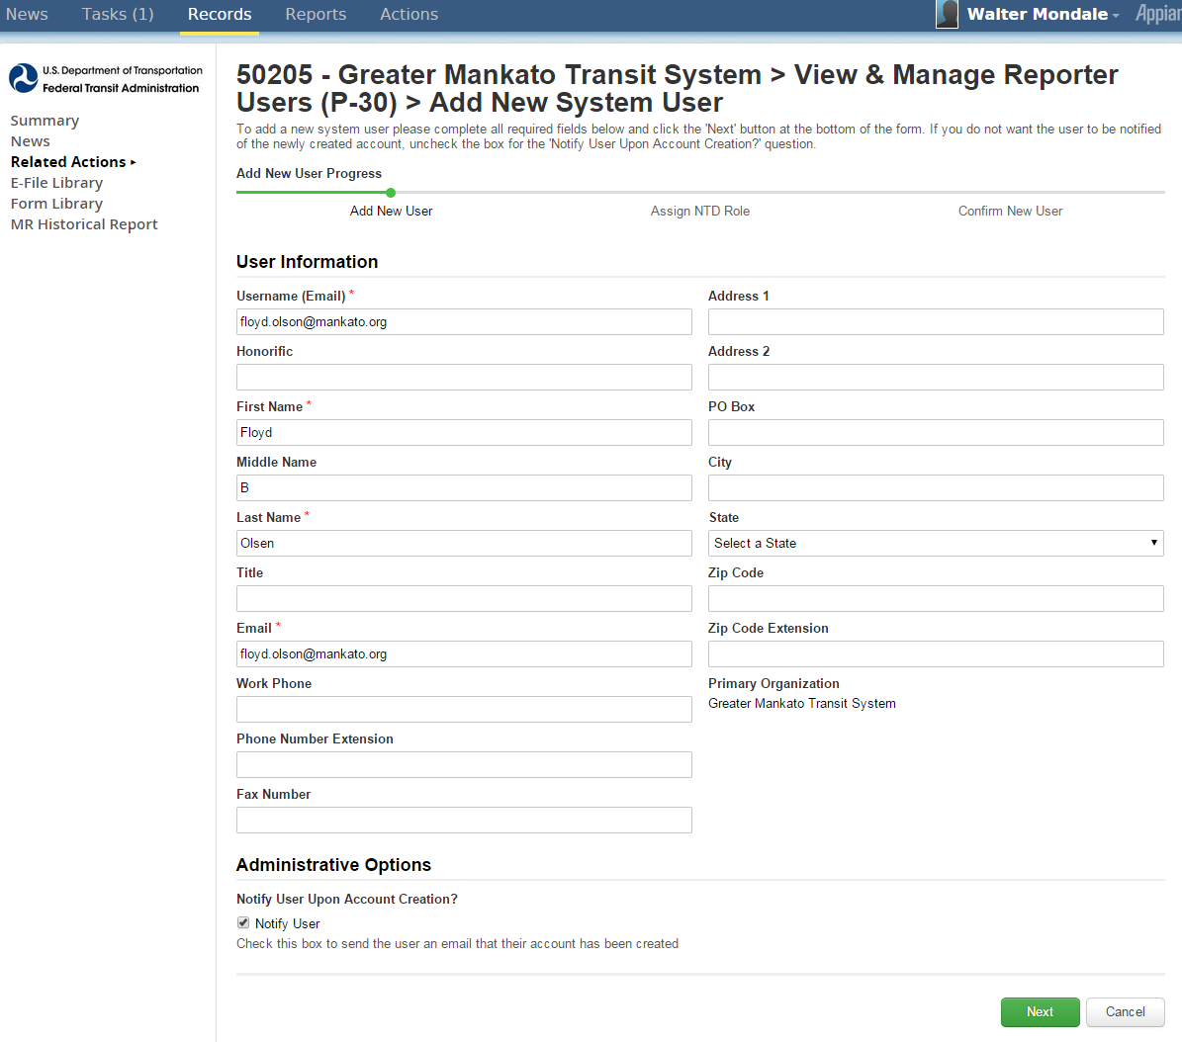
Add New System User
Add user information (name, email, address)
Click Next when completed

Slide 20
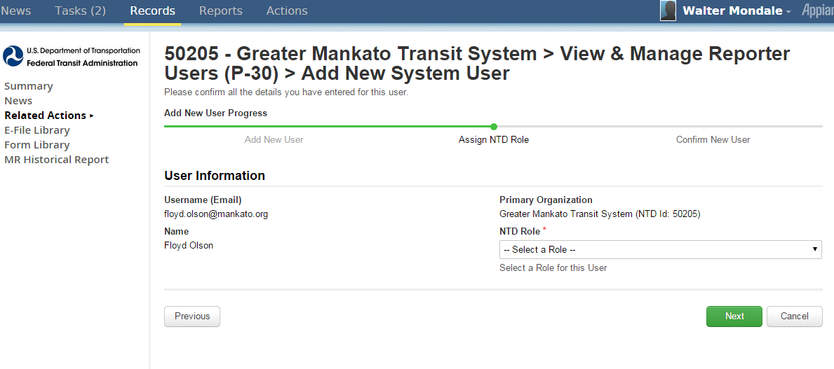
Select Reporter Role
Select Role
Click Next when completed

Slide 21
Roles
Role | Functions
CEO | Data entry, submit report, submit the CEO certification, all reporting areas
NTD Contact Person | Data entry, submit report, all reporting areas
Editor | Data entry, view forms
Viewer | View forms
Notes:
**Note: The instructor will review the 4 access levels on this slide, but two additional access levels relate to safety and security.

Slide 22
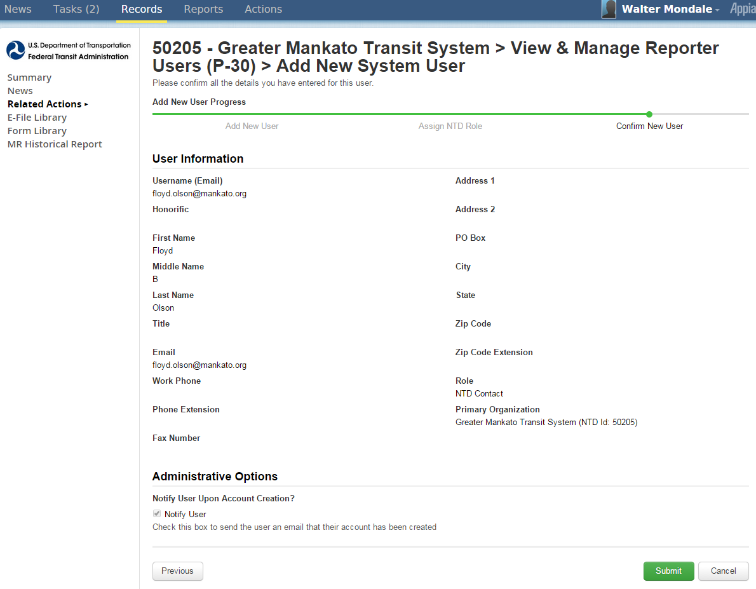
Review and Submit User
Click Submit
After submission, instructions are emailed to user to set up password
Identical process used for LSUM password

Slide 23
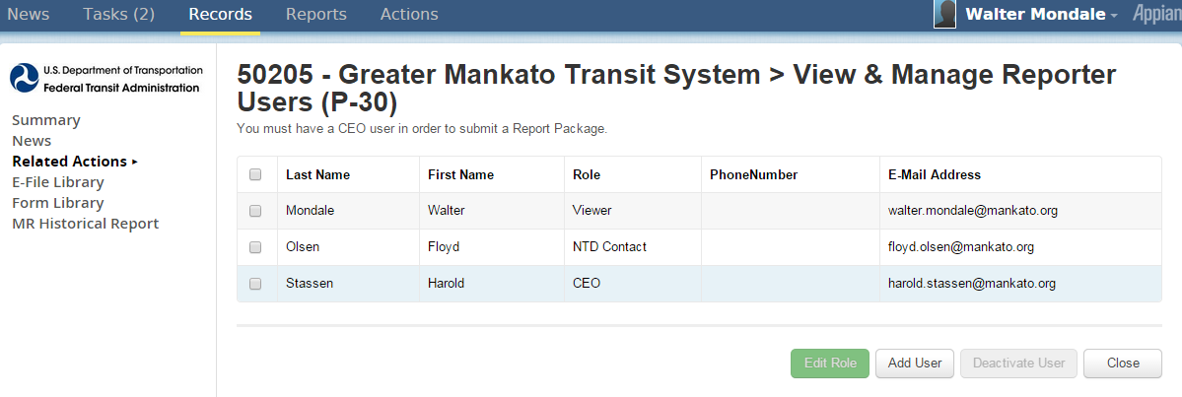
CEO and NTD Contact Required
LSUM should create CEO and NTD users
Required for report “kick-off”

Slide 24
LSUM Sign Out
Click on username and click Sign Out

Slide 25
NTD Contact Startup Tasks
Perform “report kickoff”
Enter annual data into NTD forms

Slide 26
What is a Kickoff?
Confirmation of current “profile” information at beginning of fiscal year
Actions
Confirm reporter contact information is accurate.
Confirm mode information is accurate.
Confirm declared reporter type for previous FY is still accurate (e.g., small systems waiver)
Declare reporter type for new fiscal year

Slide 27
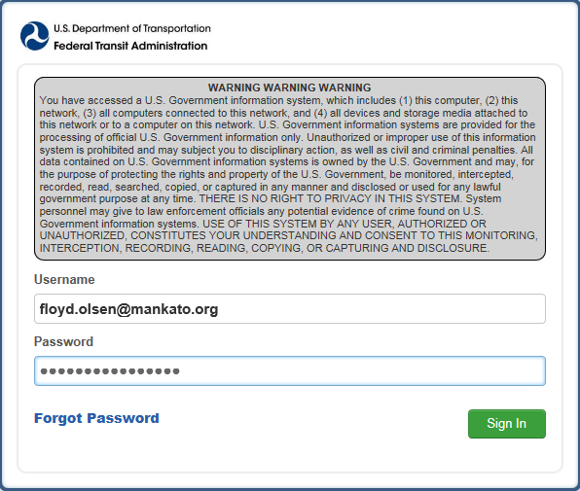
NTD Contact Logins to NTD 2.0
Enter your User Name and Password
Click on Sign In

Slide 28
Kickoff Starts on News Page
News
Click on Tasks to start FY 2015 and FY 2014 Annual Reporting

Slide 29
How to Start Report Kickoff
Click on 2015 Report Kickoff task

Slide 30
Accept Kickoff Task
1. Click Accept
2. Click Proceed

Slide 31
Manage Reporter Users
Click Continue to go to next confirmation
Only user manager can add new users

Slide 32
Manage Modes
Click to add mode
Click to edit/delete selected mode/TOS
Add, edit, or end mode/TOS as needed

Slide 33
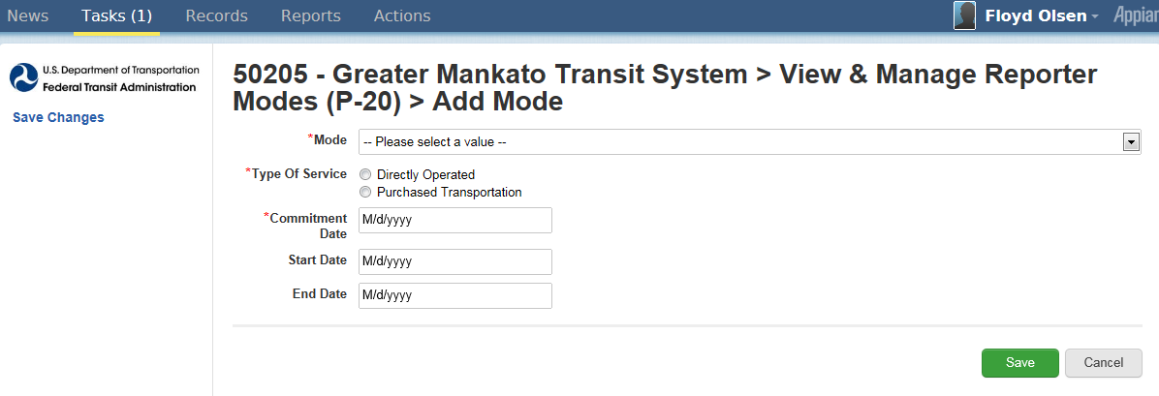
Add Mode Screen
Drop down menu
Click to save
Mode drop down menu
TOS selection = directly operated or P.T.
Commitment date = capital funds first expended
Start date = first day of revenue service

Slide 34
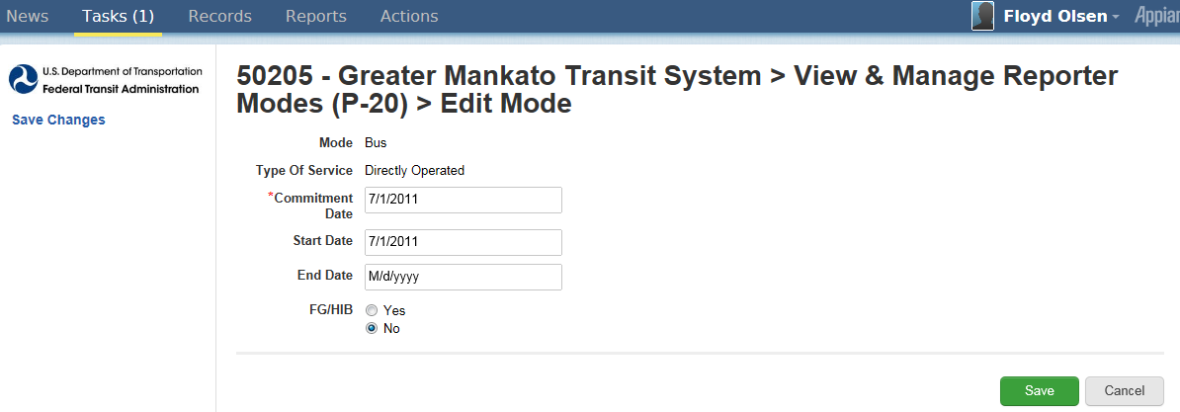
Edit Mode Screen
Click submit to save changes
End date = Last day of revenue service
Modes are ended, not deleted

Slide 35
Proceed to Reporter Type Confirmation
Click continue to go to next confirmation

Slide 36
Previous Reporter Type Confirmation
Click continue to complete kickoff
Click yes for questionnaire
Reporter type determines your required forms
Click yes to go through questionnaire
Questions appear
Strongly suggested for first-time NTD 2.0 users even if they are confident about their type

Slide 37
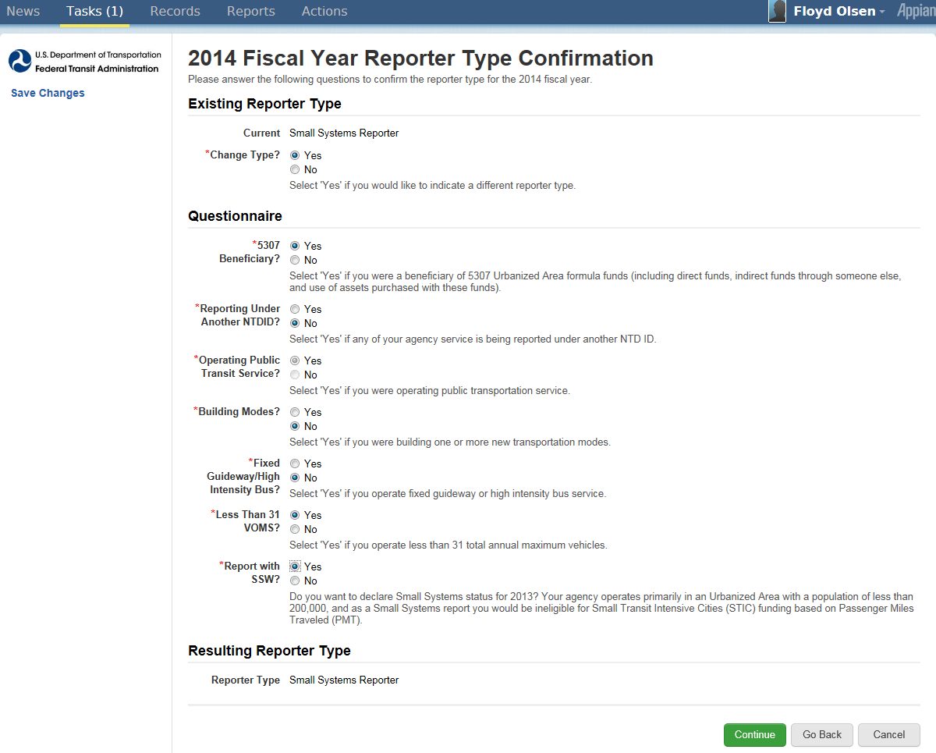
NTD 2.0 Reporter Type Questionnaire
Resulting Reporter Type based on answers to questions
Click Continue when all questions answered

Slide 38
Reporter Type Questionnaire
5307 beneficiary?
Reporting under another NTD ID?
Operating public transit service?
Building new modes?
Fixed guideway or high intensity bus?
Operating less than 31 VOMS?
Report with SSW?

Slide 39
Complete Kickoff
Click Submit to complete kickoff
Click OK

Slide 40
Getting to “Forms” Page
Click “Records”
Click “NTD Report Packages” to get to forms
Click to go to annual 2014 forms

Slide 41
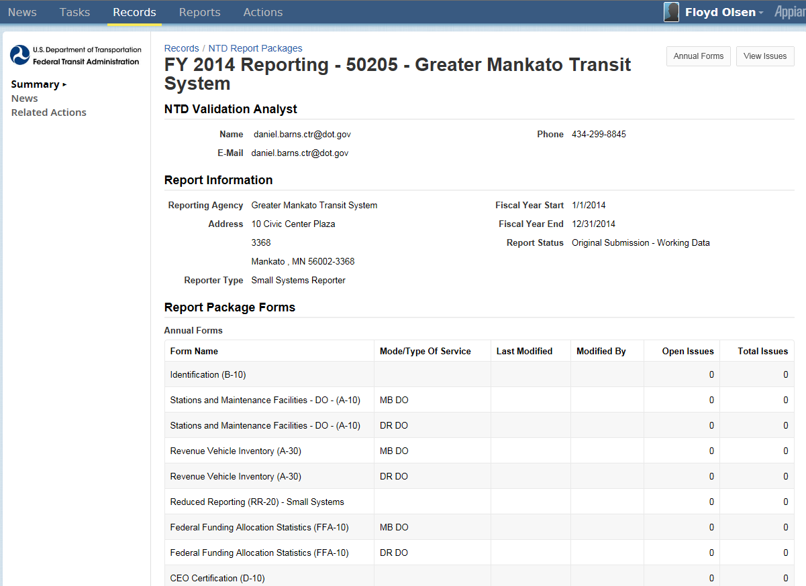
Report Package Summary Screen
Click Related Actions

Slide 42
Report Packages Screen
Click Annual Forms

Slide 43
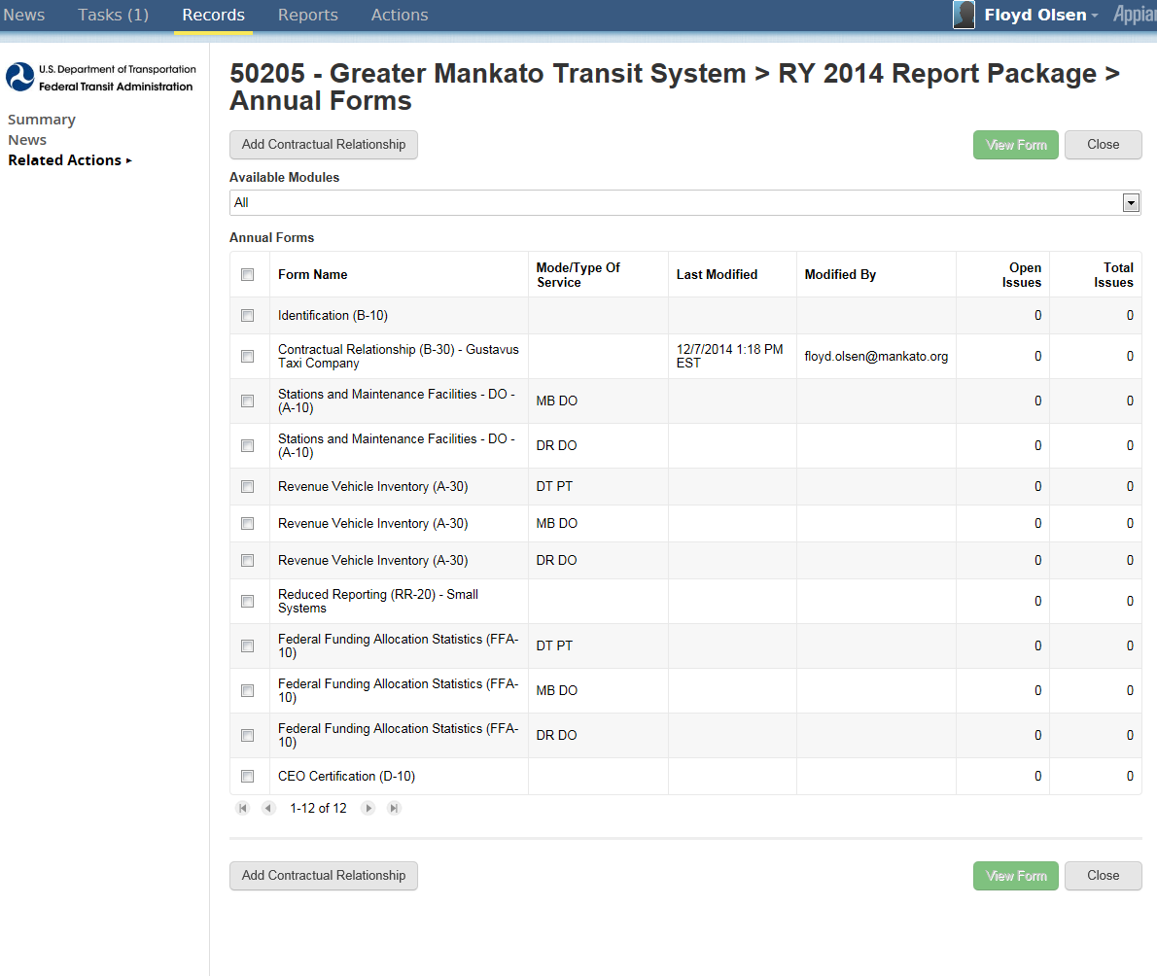
Individual Annual Forms by Mode/TOS
2. Click View Form
1. Check box for specific form and mode/TOS
2. Click View Form

Slide 44
Identification Form (B-10)
Broken into sections
Organizational type
Demographic information
Filing a separate NTD report (seller)

Slide 45
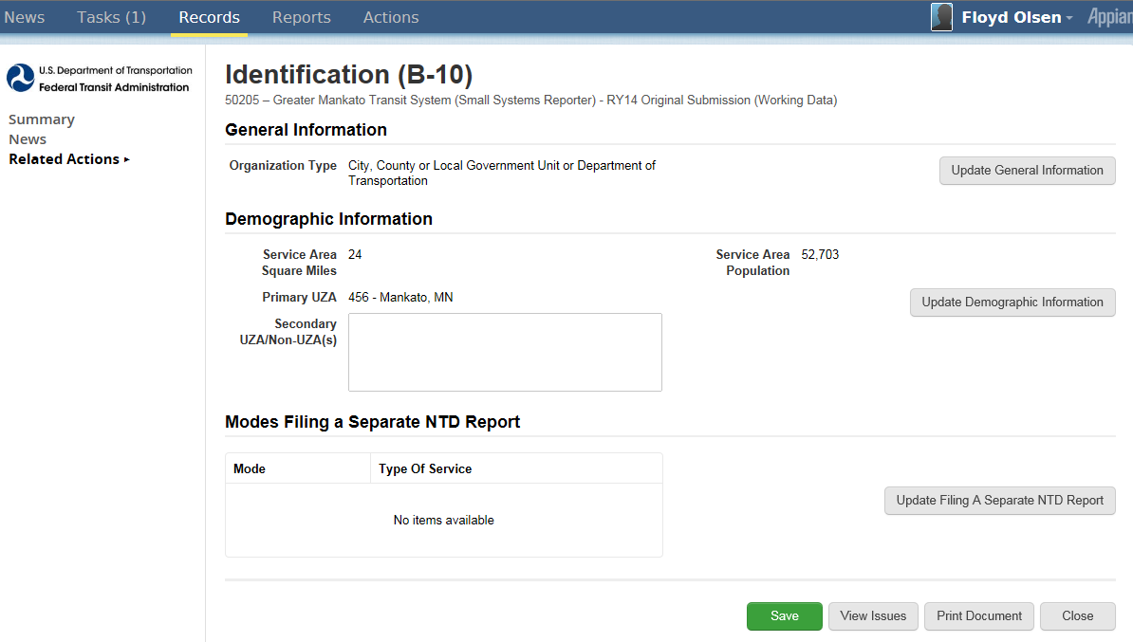
Identification Form (B-10)
Update
Update
Update
Click update icons to update sections
Update

Slide 46
Update Organization Type
Click pull-down menu to select organization type
Click Continue when completed

Slide 47
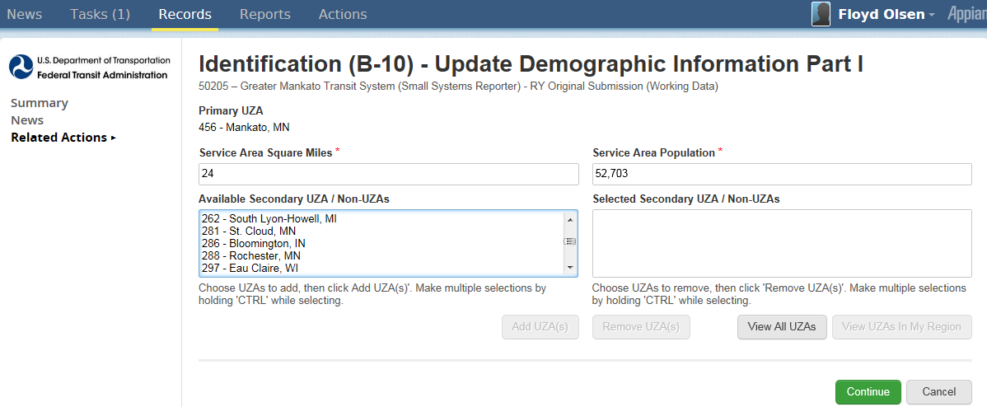
Update Demographic Information
Ctrl + Click to multiple select UZAs
Click to update sections

Slide 48
Update Filing a Separate Report

Slide 49
What Happened to Name, Address, Other B-10 Data?
It is on the new P-10. To go to form …
2. Click My NTD Report Packages
1. Click Records

Slide 50
Profile Page
Click Reporter Name
Click Reporter Name

Slide 51
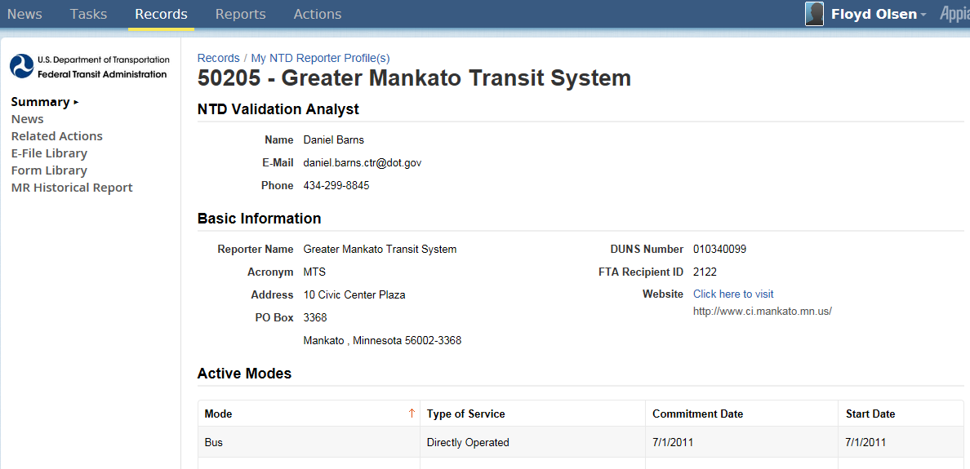
Profile Summary Page
Click Related Actions
Click Related Actions

Slide 52
Profile Forms Page
Click View & Manage Basic Information (P-10)
Click View & Manage Basic Information (P-10)

Slide 53
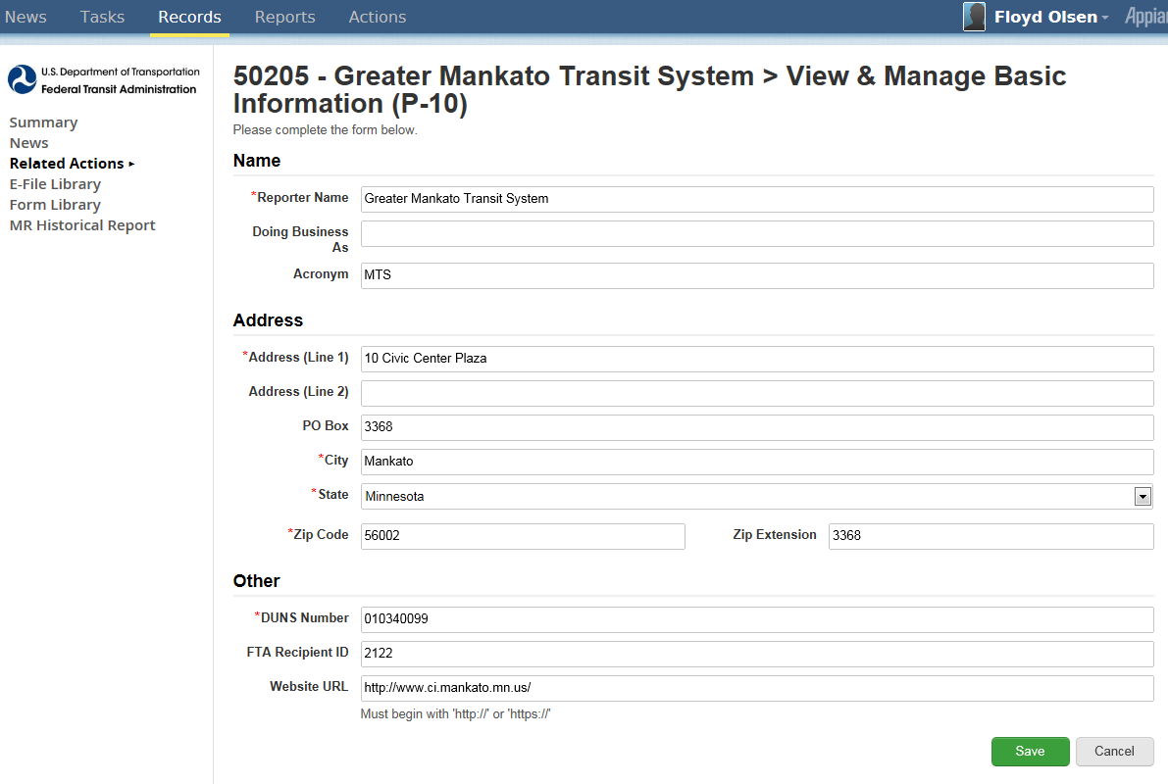
Basic Information (P-10)
Click to update sections

Slide 54
Profile Forms Page
Click View & Manage Basic Information (P-10)
Click View & Manage Basic Information (P-10)

Slide 55
Basic Information (P-10)
Click to update sections

Slide 56
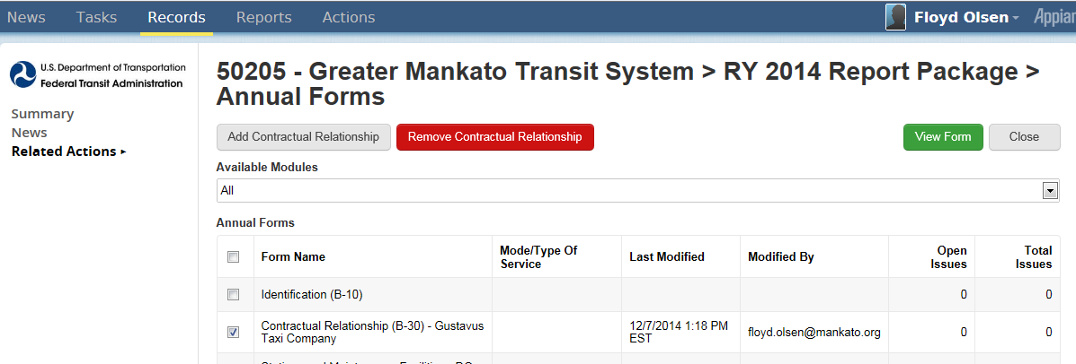
Add/Remove/View Contract
Click to add contract
Click to remove contract
Select prior RY contract and click View Form

Slide 57
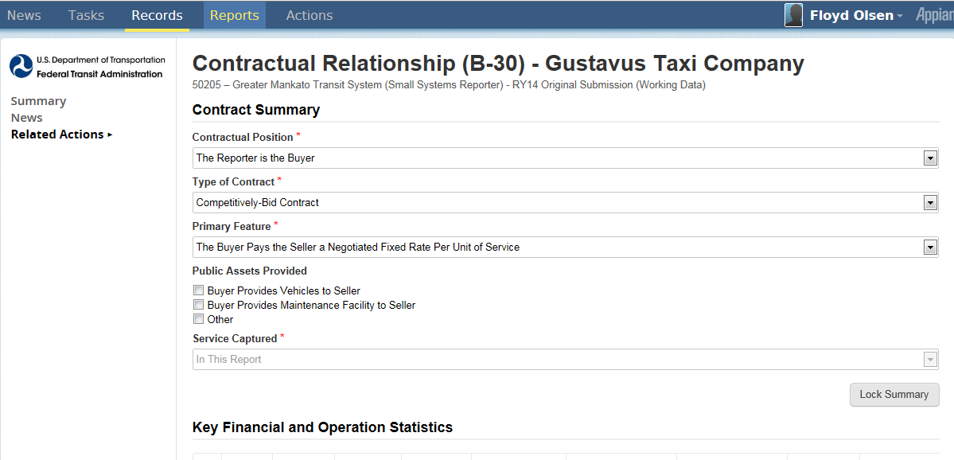
Contract Summary

Slide 58
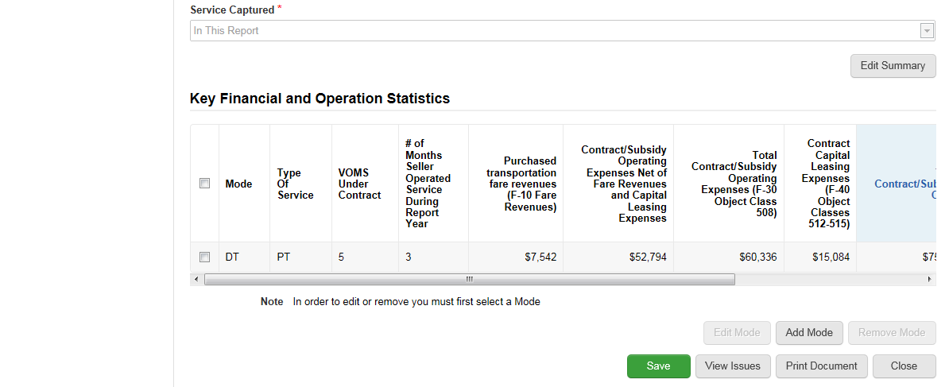
Key Financial and Operation Statistics
1. Select Mode
2. Click Edit Mode

Slide 59
Enter Operating and Financial Data

Slide 60
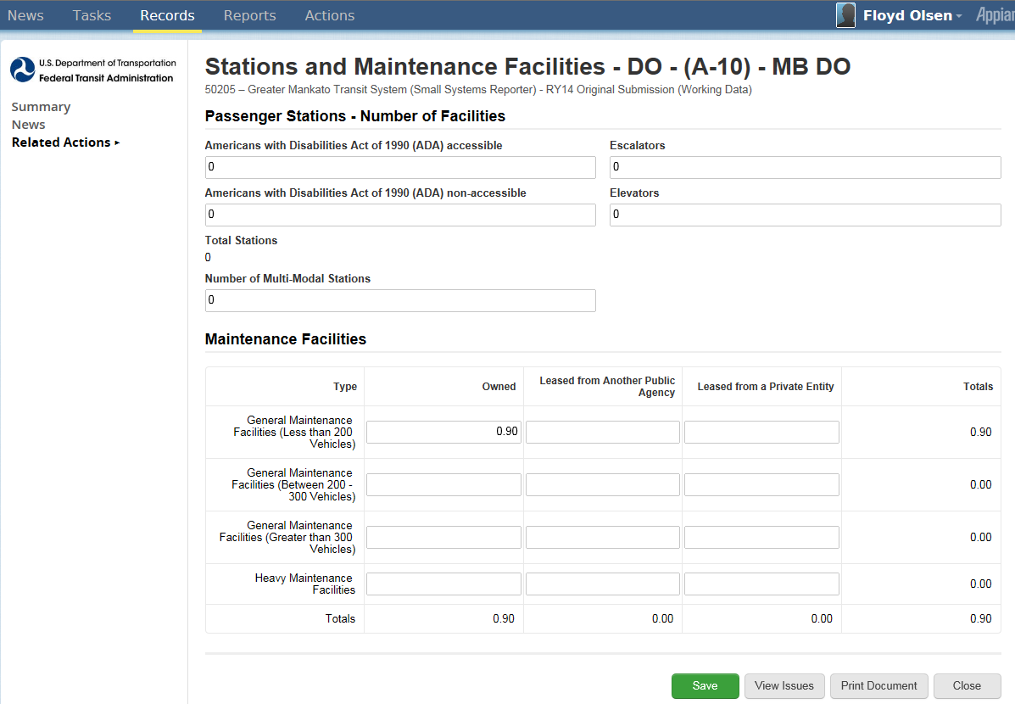
Stations Maintenance Facilities (A-10)
Click Save before closing

Slide 61
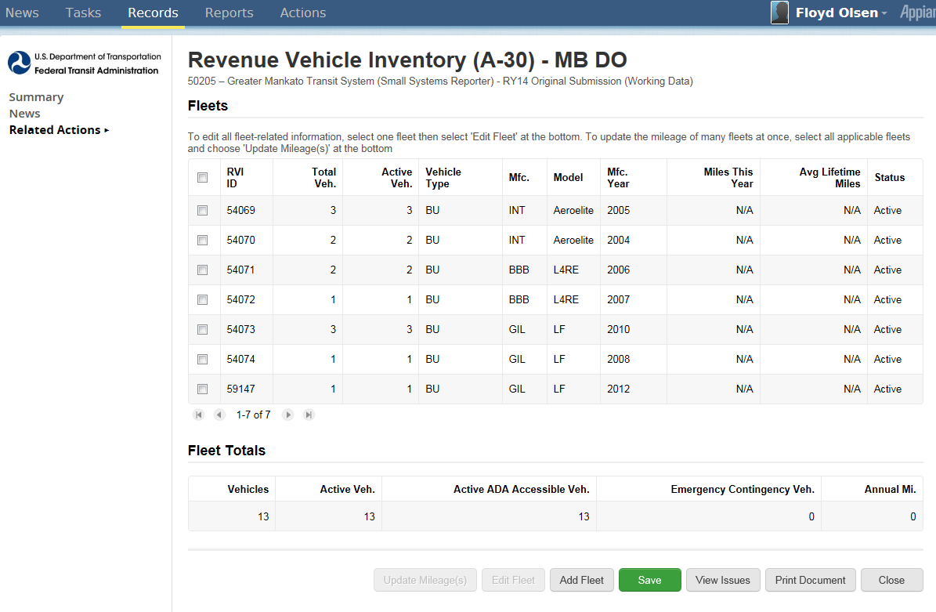
Revenue Vehicle Inventory (A-30)
1. Select existing fleet(s)
2. Click for Updates/Edit to selected existing fleet
Select to add new fleet

Slide 62
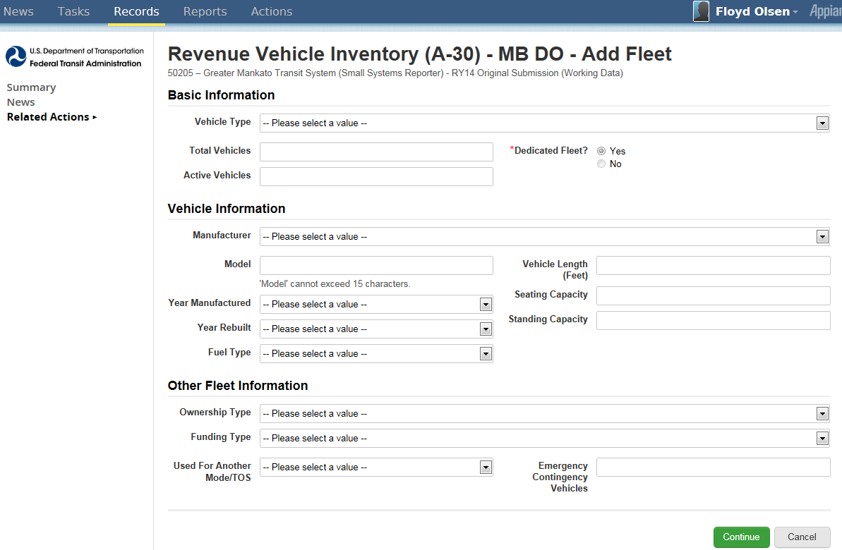
“Add Fleet” Data Entry Screen
Click Continue

Slide 63
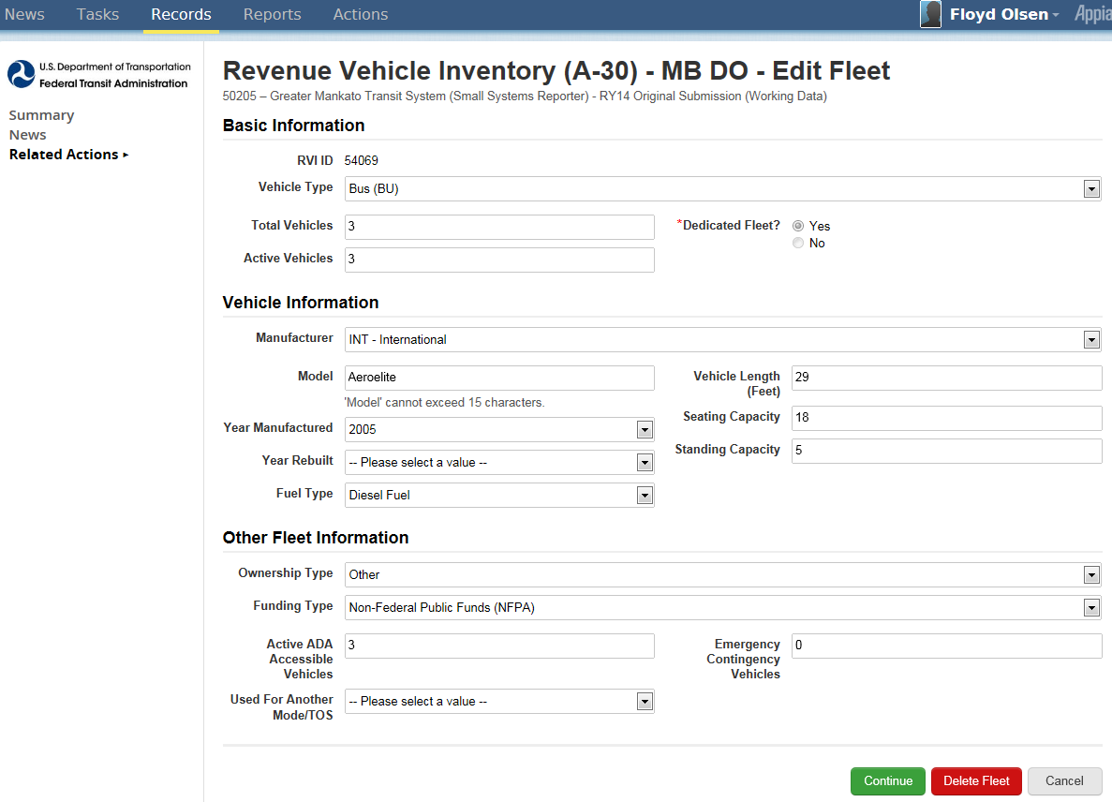
“Edit Fleet” Data Entry Screen
Click Continue

Slide 64
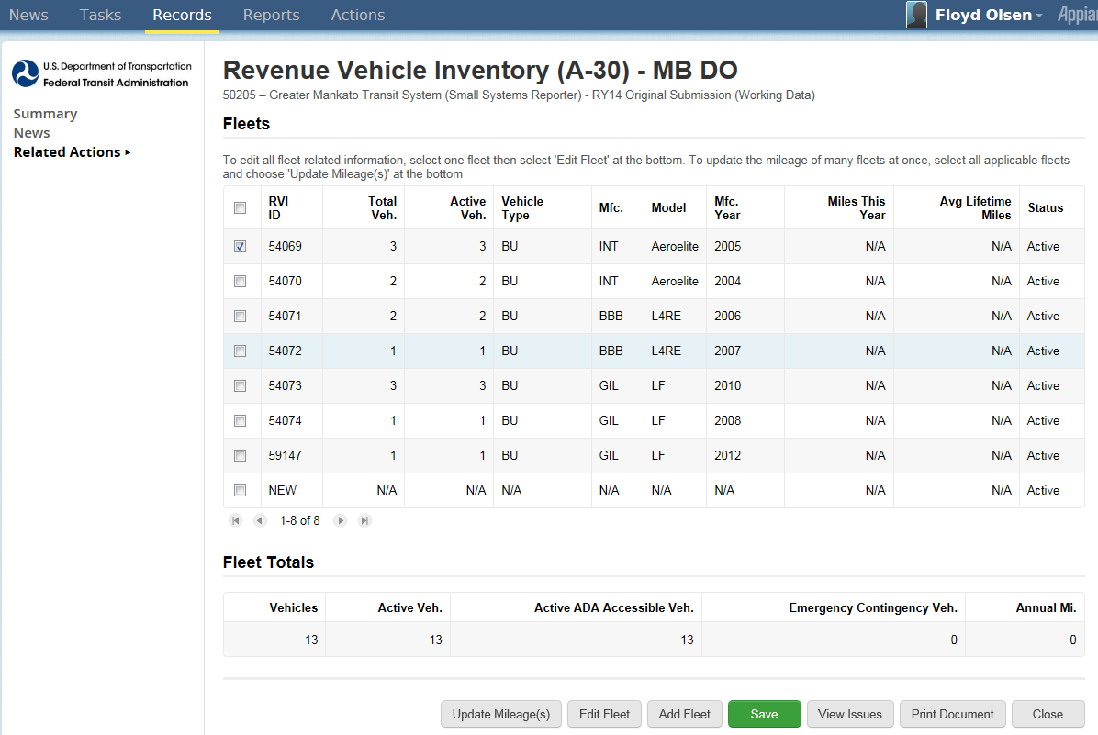
Reporting Mileage by Fleet
1. Click to select fleet(s)
2. Click Update Mileage(s)

Slide 65
Enter Updated Mileage
Click Continue

Slide 66
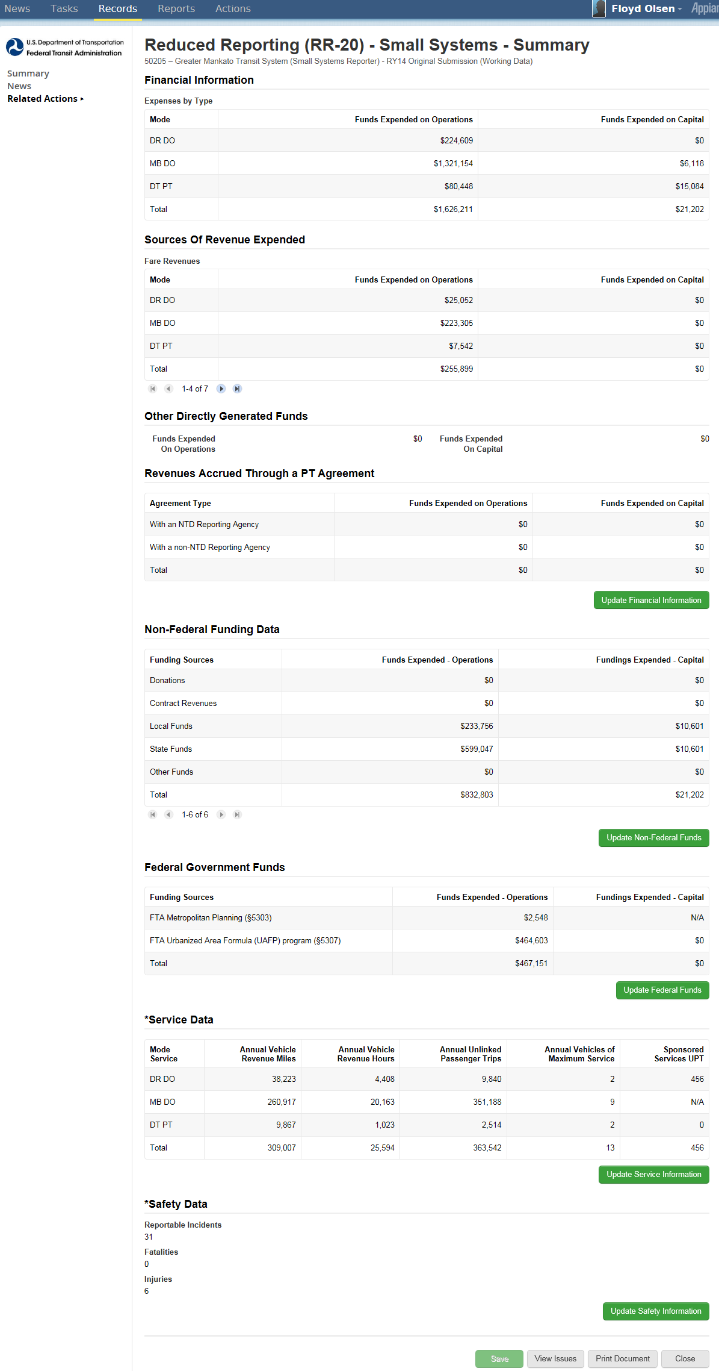
Reduced Reporting (RR-20)
Broken into sections
Financial Information
Non-Federal Funding Data
Federal Government Funds
Service Data
Safety Data
Click update icons to update sections
Update
Update
Update
Update
Update
Update

Slide 67
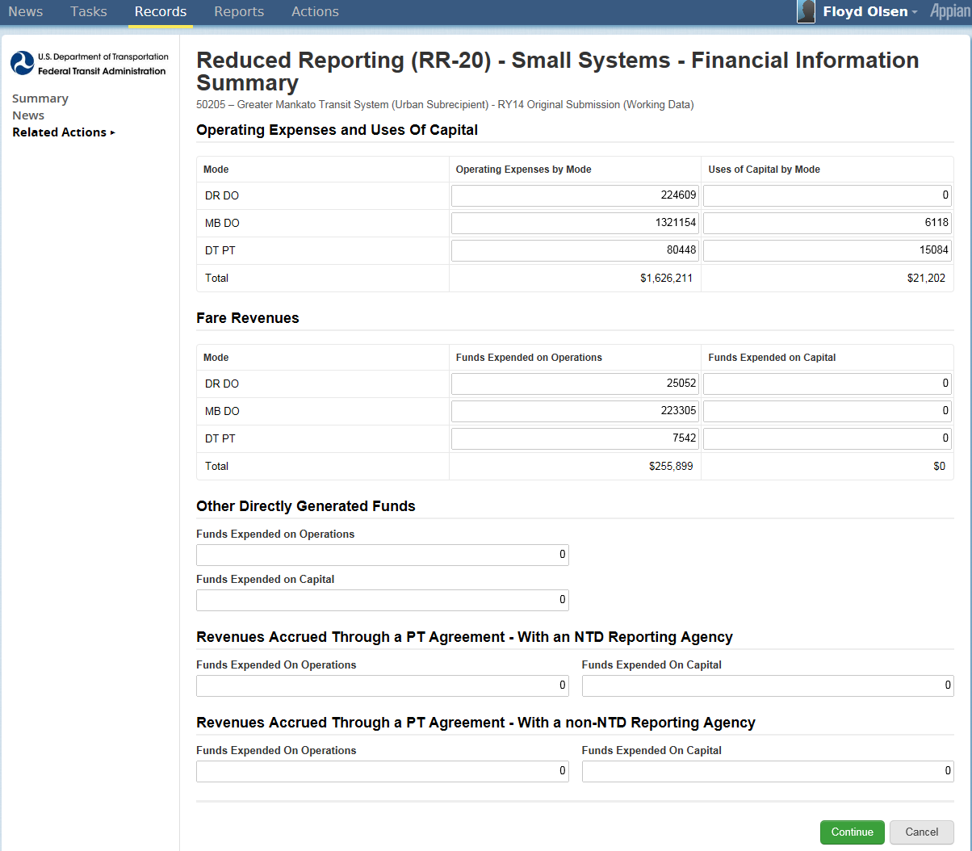
Update Financial Information
Click Continue

Slide 68
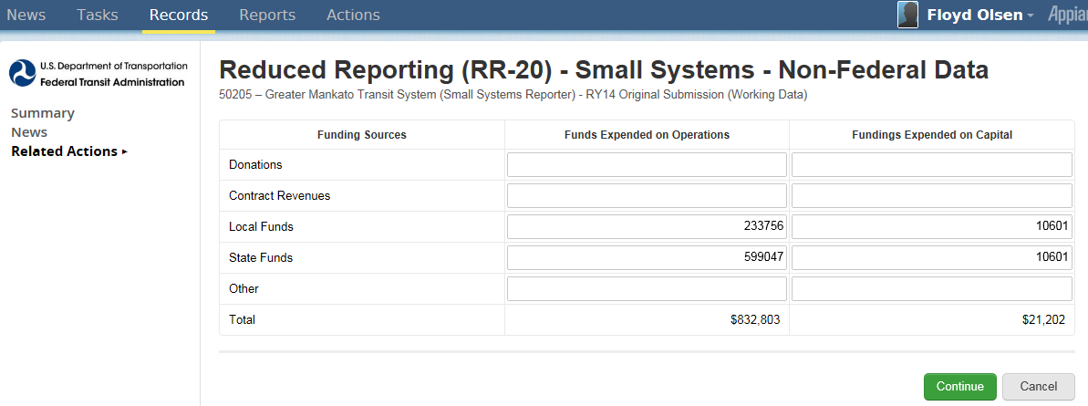
Update Non-Federal Funding
Click Continue

Slide 69
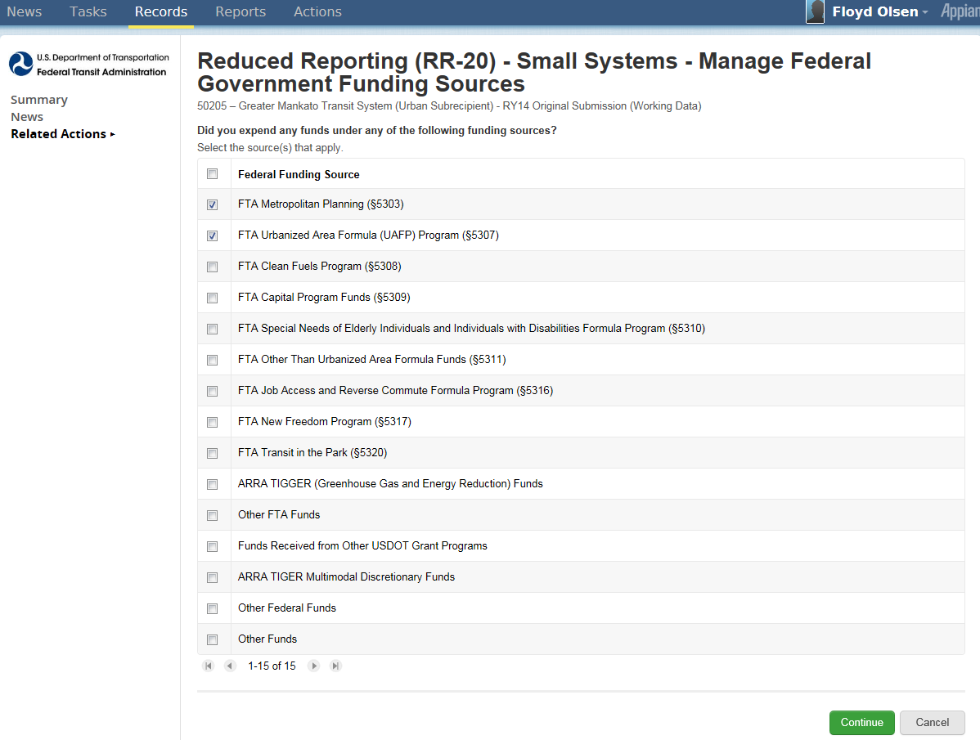
Customized Federal Funds Reporting
1. Click to select funding sources
2. Click when completed

Slide 70
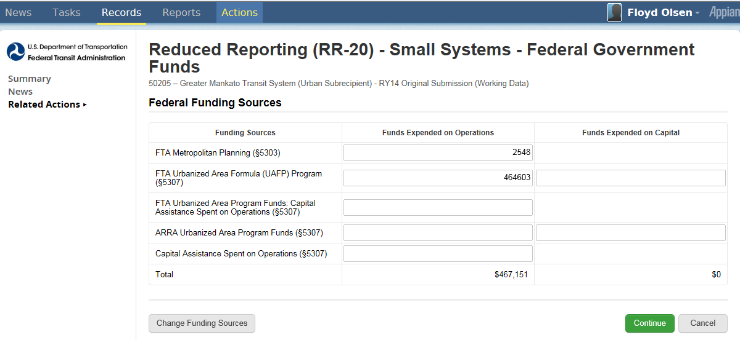
Customized Federal Data Entry
Click when completed
Click to change funding sources

Slide 71
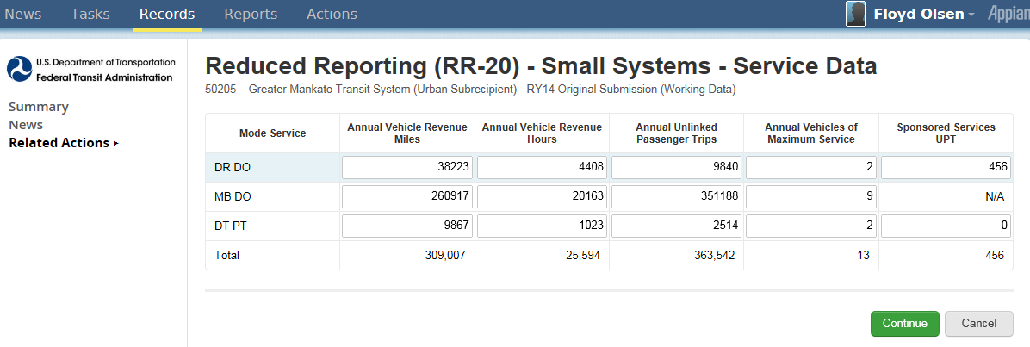
Update Service Data
Click when completed

Slide 72
Update Safety Data
Click when completed

Slide 73
Federal Funding Allocation Statistics (FFA-10)
Click to select UZA Reporting Method
Click to move from UZA to UZA
Click Save before closing

Slide 74
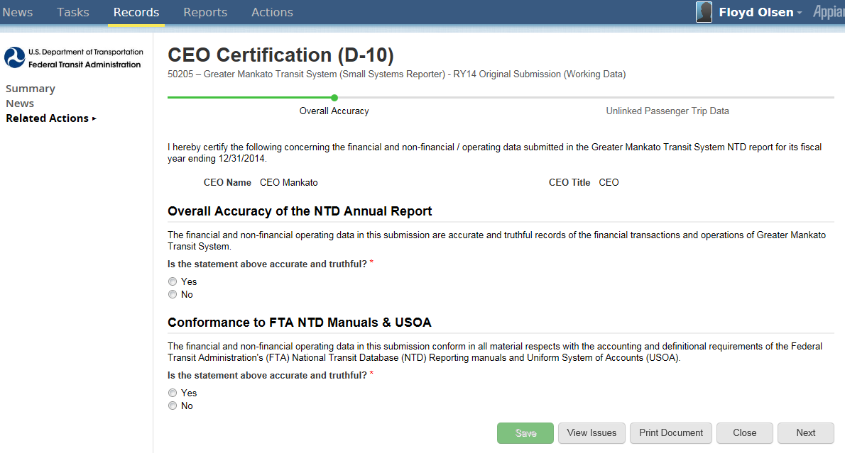
CEO Certification (D-10)
Completed in a sequence of 3 screens
Click Save before going to next screen
Click Next to go to next screen

Slide 75
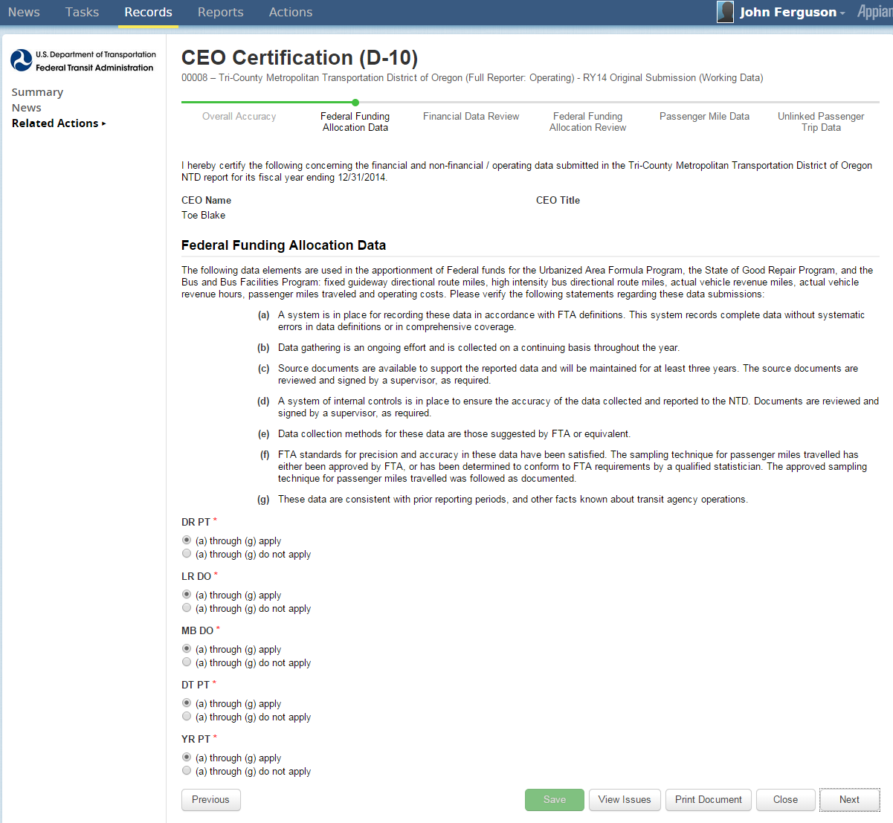
D-10 Federal Funding Allocation Data
Click Save before going to next screen
Click Next to go to next screen

Slide 76
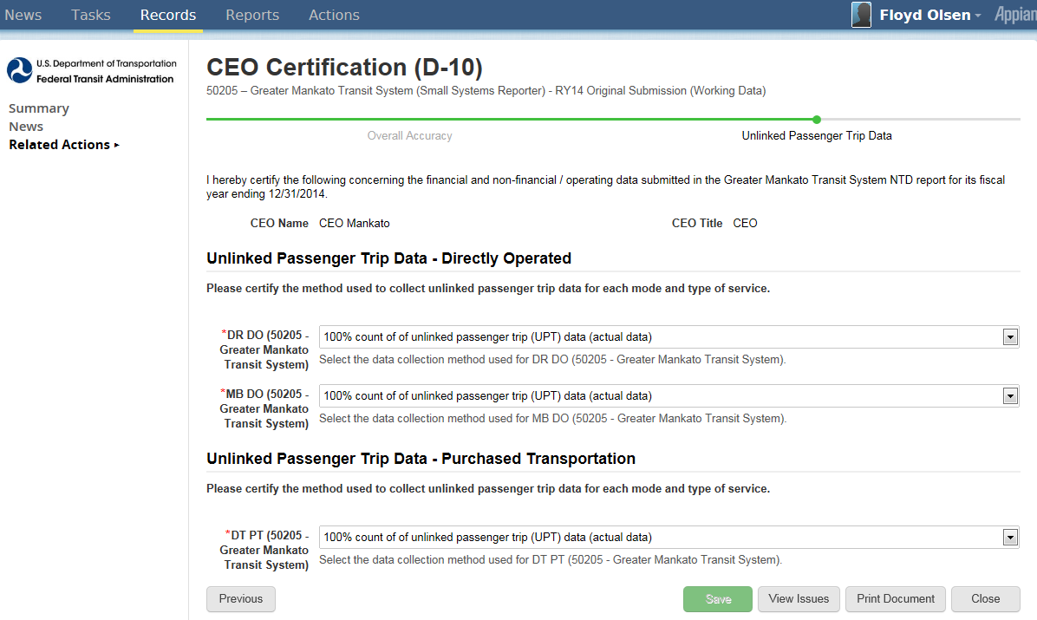
D-10 UPT Sampling
Click Save before closing

Slide 77
National Transit Database Offices
NTD Operations Center
Charlottesville, Virginia
Monday to Friday: 0800 –1900 Eastern
(888) 252-0936
NTDHelp@dot.gov
NTD Program Office
Washington, DC
Keith Gates, Program Manager
(202) 366-1794
keith.gates@dot.gov
NTD Help Desk
Me, email works best

Slide 78
Additional Training
NTD Website training page: http://www.ntdprogram.gov/ntdprogram/seminars.htm
National Transit Institute, NTD courses: http://www.ntionline.com/courses/courseinfo.php?id=7
NTD Website presentations page: http://www.ntdprogram.gov/ntdprogram/announcements.htm

