Slide 1
National Transit Database
Annual Reporting

Slide 2
New Reporting System (“NTD 2.0”)
Monthly ridership was first operational module
Reporting started October for reporting September data
Annual reporting will start December 15 for RY 2014 reporting
No change in data requirements
Same requirements in NTD 2.0 as current system

Slide 3
Our Agenda
Steps for Starting Annual Reporting
Perform “report kickoff”
Systems now in FY 2014 will do on first day of FY 2015
No action needed from reporters now in FY 2015 (kickoff already completed)
All systems perform reporting after end of FY 2014

Slide 4
What is a Kickoff?
Confirmation of current “profile” information at beginning of fiscal year
Profile information = Old B-10/B-20 data
Actions
Confirm reporter contact information is accurate.
Confirm mode information is accurate.
Confirm declared reporter type for previous FY is still accurate (e.g., small systems waiver)
Declare reporter type for new fiscal year

Slide 5
Why is Kickoff Done?
Create annual reporting forms for prior year (e.g., FY 2014)
Create monthly reporting forms for current year (e.g., FY 2015)

Slide 6
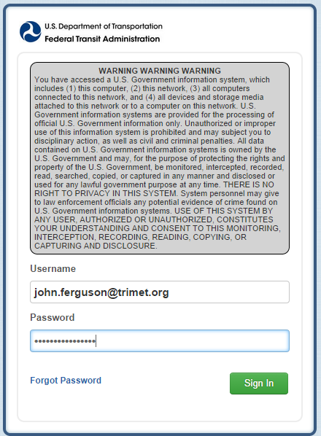
NTD Contact Logins to NTD 2.0
Enter your User Name and Password
Click on Sign In

Slide 7
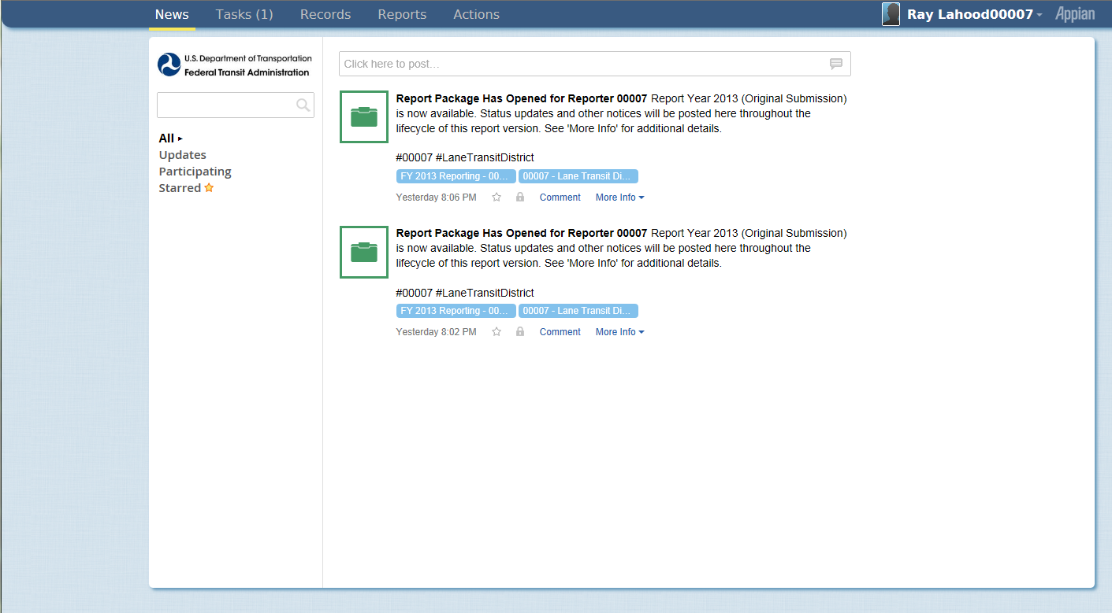
Kickoff Starts on News Page
Click on Tasks to start FY 2015
News

Slide 8
How to Start Report Kickoff
Applies to reporters for FY 2015
Click on Task

Slide 9
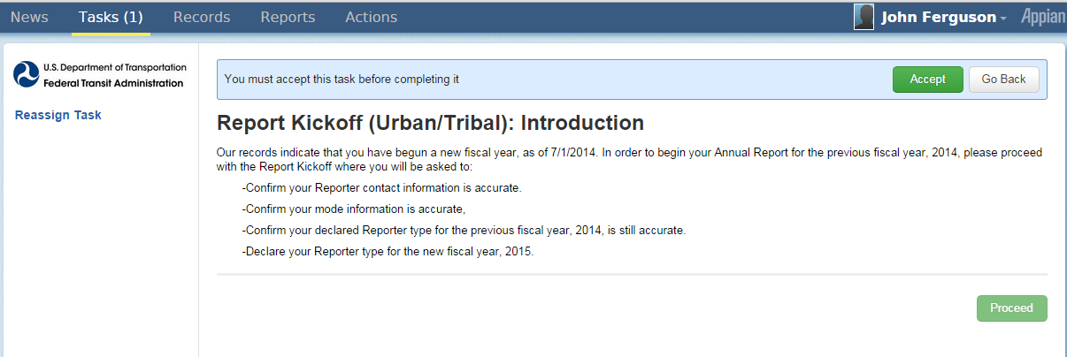
Accept Kickoff Task
1. Click Accept
2. Click Proceed

Slide 10
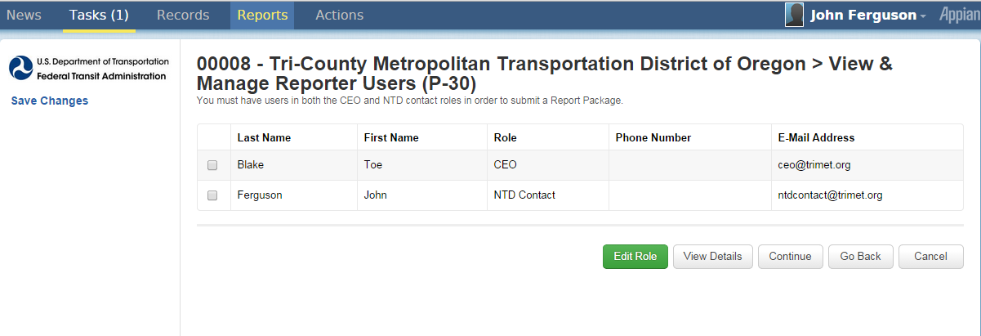
Manage Reporter Users
Click continue to go to next confirmation
Only user manager can add new users
Individual users can edit own profile

Slide 11
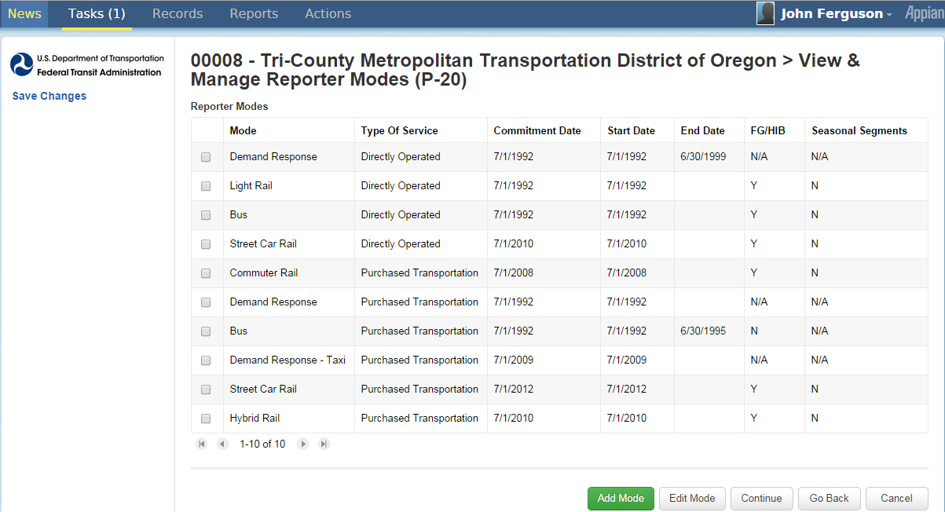
Manage Modes
Click continue to go to next confirmation
Click to add mode
Click to edit/delete selected mode/TOS
Add, edit, or end mode/TOS as needed

Slide 12
Previous Reporter Type Confirmation
Click continue to complete kickoff
Click yes for questionnaire
Reporter type determines your required forms
Click yes to go through questionnaire
Questions appear
Strongly suggested for first-time NTD 2.0 users

Slide 13
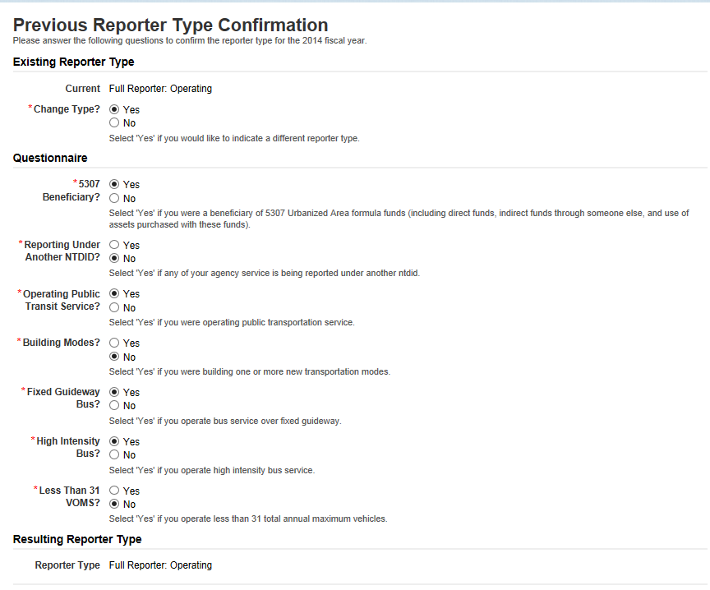
NTD 2.0 Reporter Type Questionnaire

Slide 14
Reporter Type Questionnaire
5307 beneficiary?
Reporting under another NTD ID?
Operating public transit service?
Building new modes?
Fixed guideway or high intensity bus or both?
Operating less than 31 VOMS?

Slide 15
Complete Kickoff
Click submit to complete kickoff

Slide 16
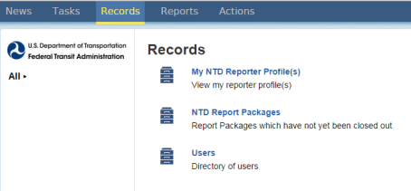
Getting to “Forms” Page
Click “Records”
Click “NTD Report Packages” to get to forms
Click to get to monthly 2015 forms
Click to get to annual 2014 forms

Slide 17
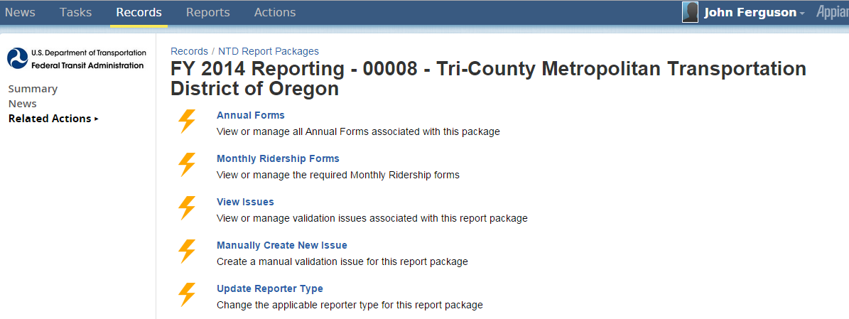
Report Packages Screen
Click Annual Forms
Click Annual Forms

Slide 18
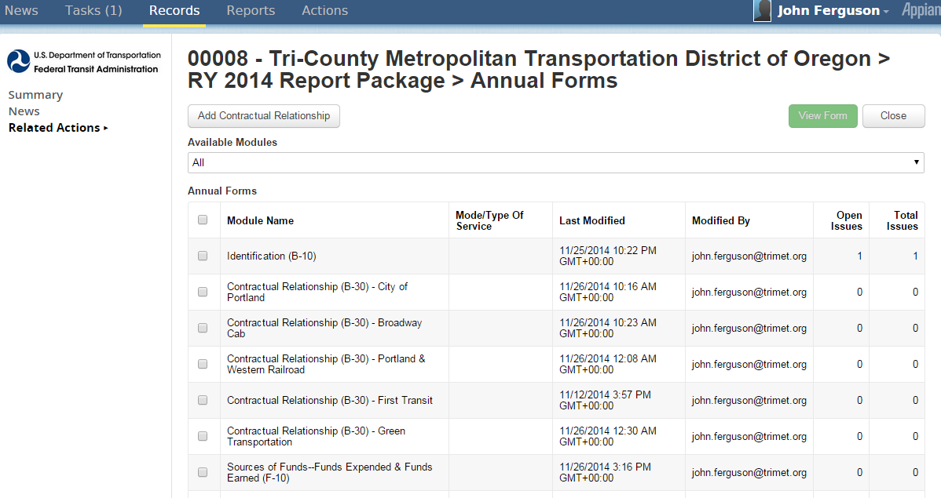
Individual Annual Forms by Mode/TOS
Check box for specific form and mode/TOS
Then click View Form
2. Click View Form
1. Check box for specific from and mode/TOS

Slide 19
Identification Form (B-10)
Broken into sections
Organizational type
Demographic information
Filing a separate NTD report (seller)

Slide 20
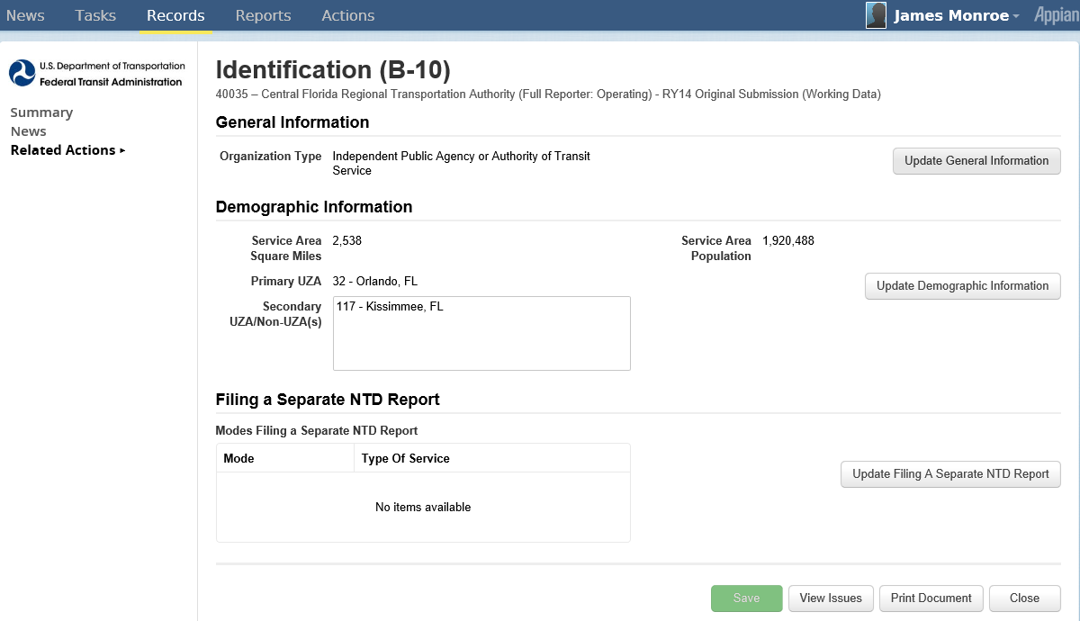
Identification Form (B-10)
Update
Update
Update
Click update icons to update sections
Update

Slide 21
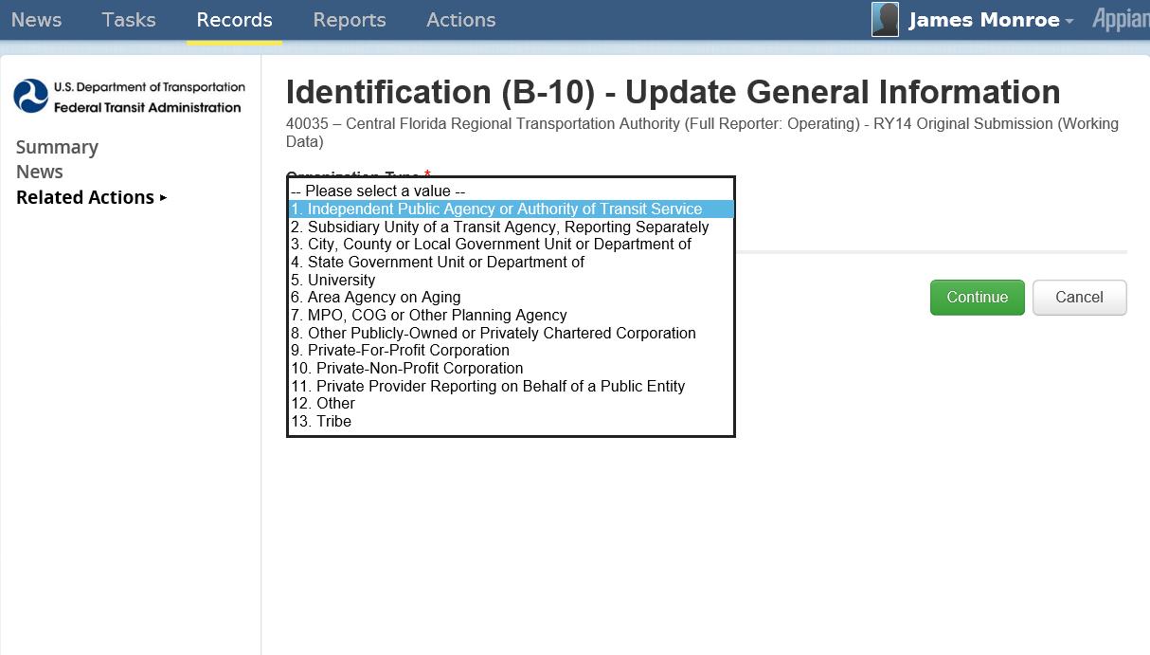
Update Organization Type
Click Continue when completed

Slide 22
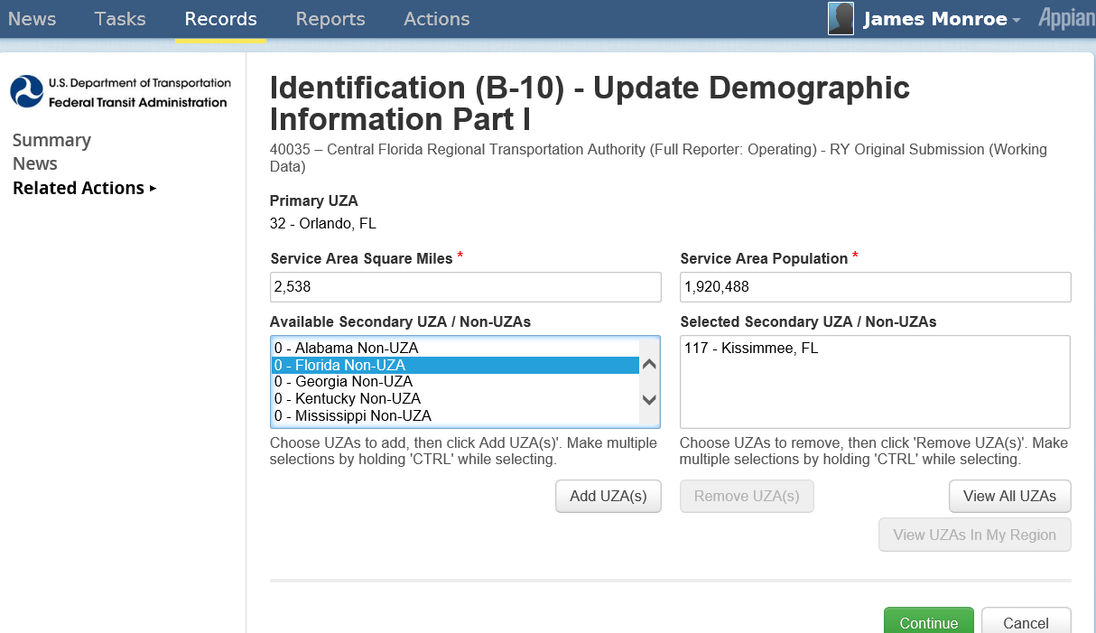
Update Demographic Information
Click to multiple select UZAs
Click to update sections

Slide 23
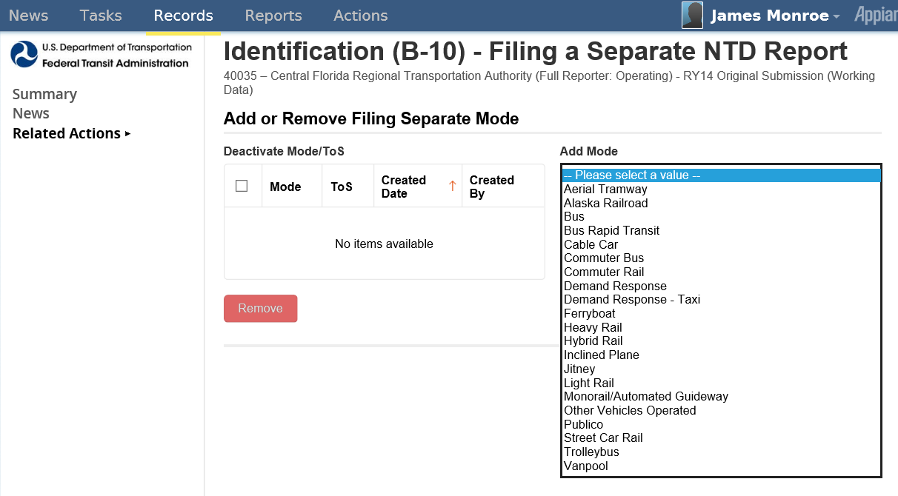
Update Filing a Separate Report

Slide 24
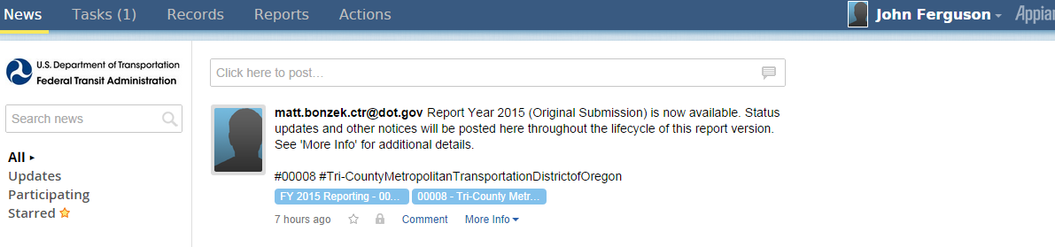
What Happened to Name, Address, Other B-10 Data?
It is on the new P-10!
Click Records
Click Records

Slide 25
Records Page
Click My NTD Reporter Profiles
Click My NTD Report Packages

Slide 26
Profile Page
Click Reporter Name
Click Reporter Name

Slide 27
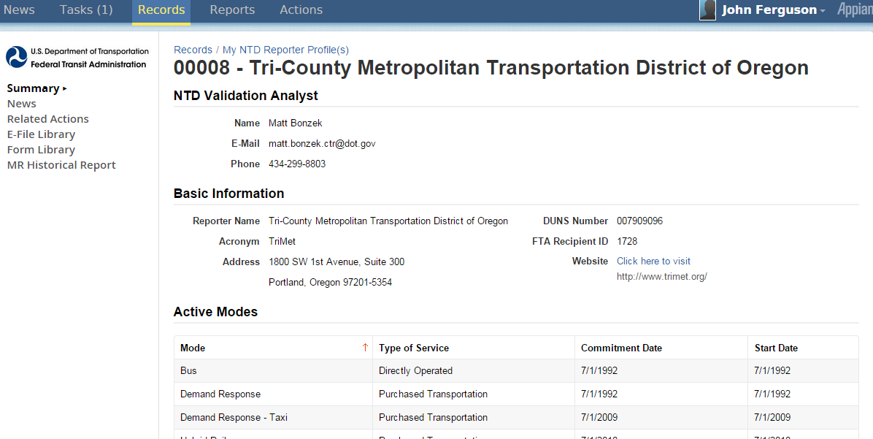
Profile Summary Page
Click Related Actions
Click Related Actions

Slide 28
Profile Forms Page
Click View & Manage Basic Information (P-10)
Click View & Manage Basic Information (P-10)

Slide 29
Basic Information (P-10)
Click to update sections

Slide 30
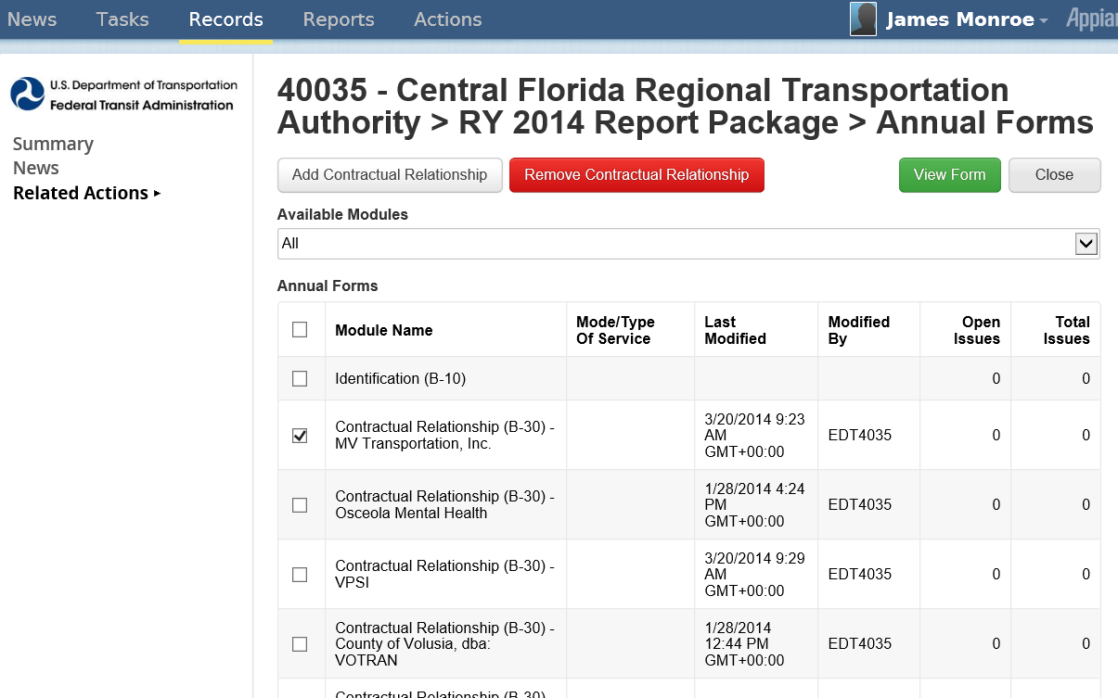
Add/Remove/View Contract
Click to remove contract
Click to add contract
Select prior RY contract and click “View Form”

Slide 31
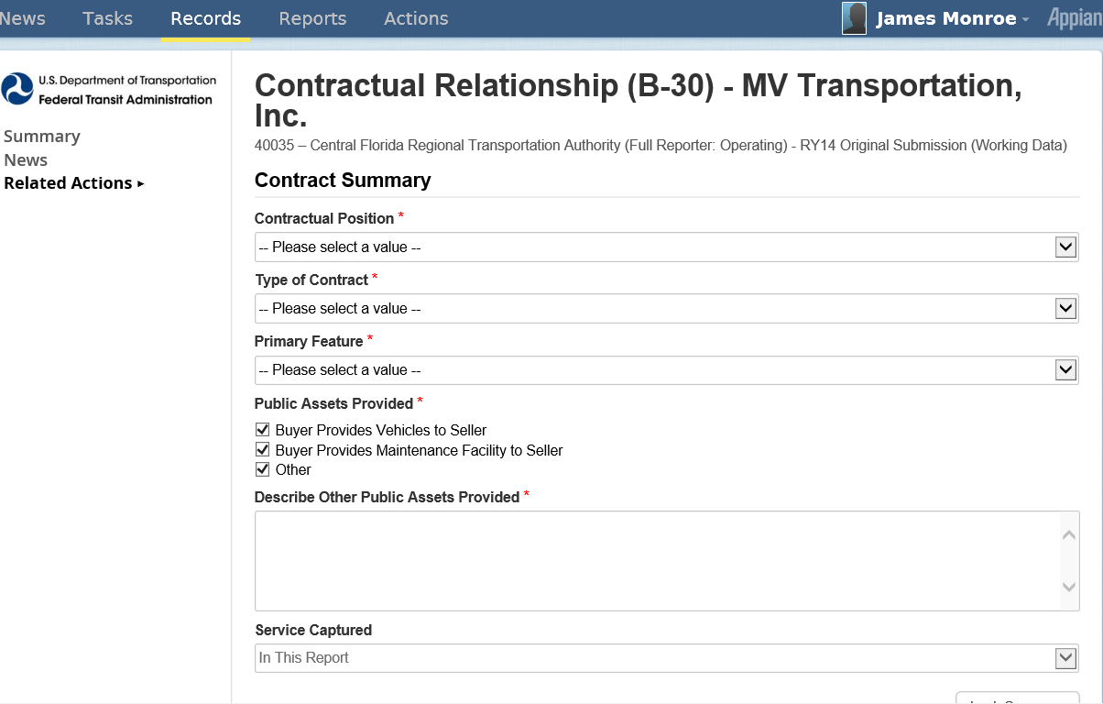
Contract Summary

Slide 32
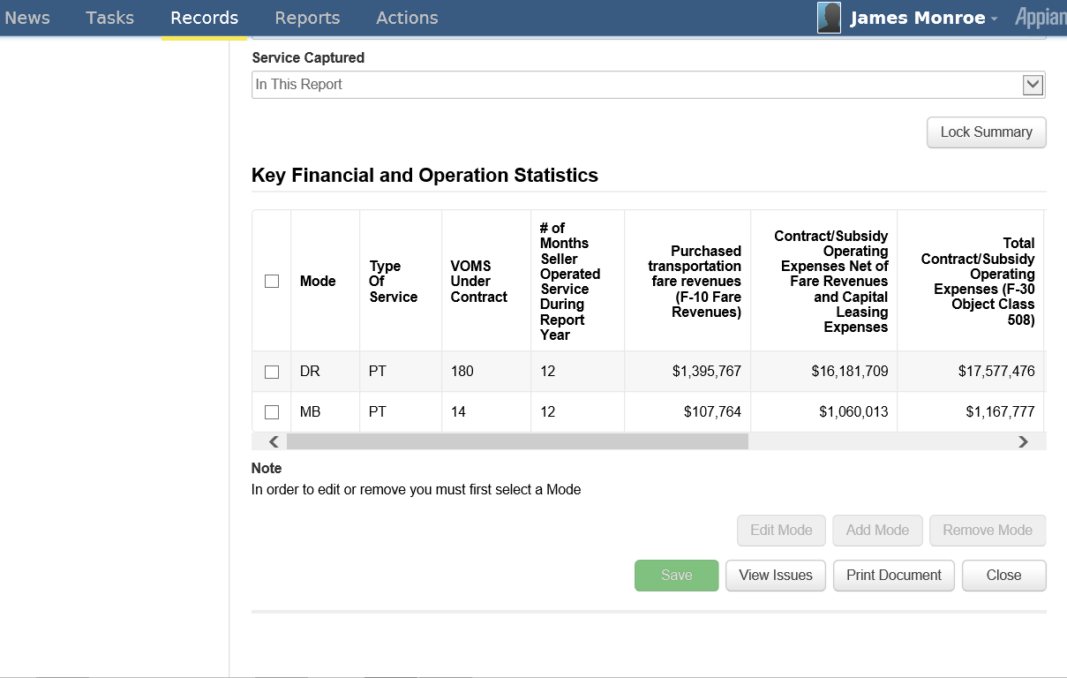
Key Financial and Operation Statistics
1. Select Mode
2. Click Edit Mode

Slide 33
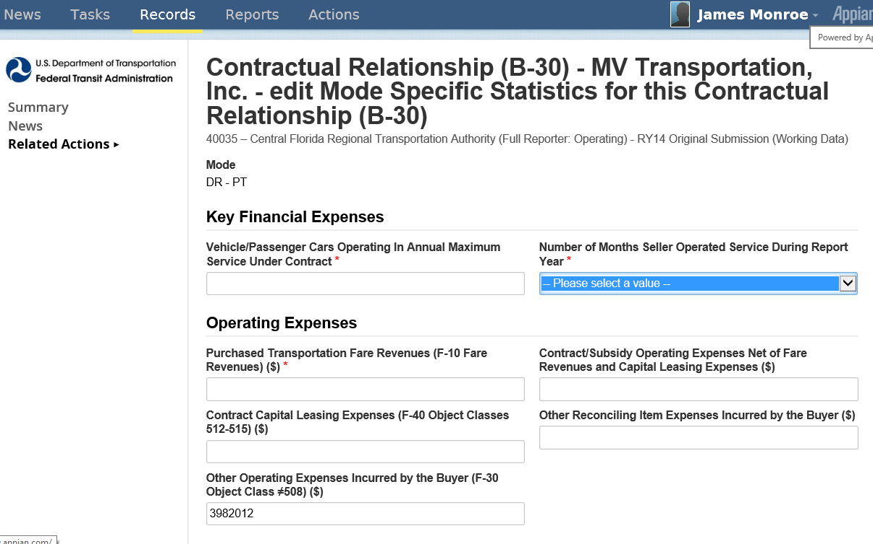
Enter Operating and Financial Data

Slide 34
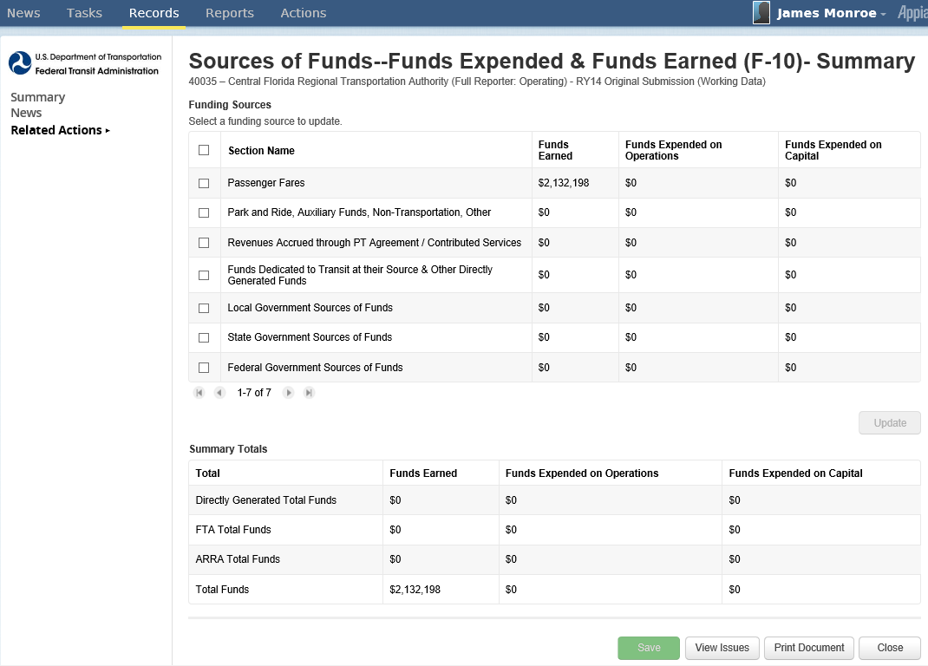
Sources of Funds (F-10)

Slide 35
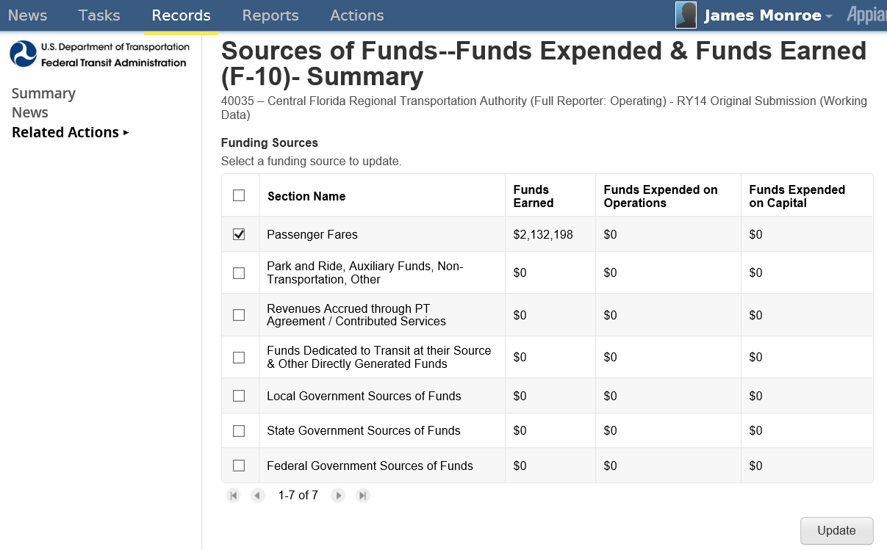
Funding Categories
1. Select Source
2. Click Update

Slide 36
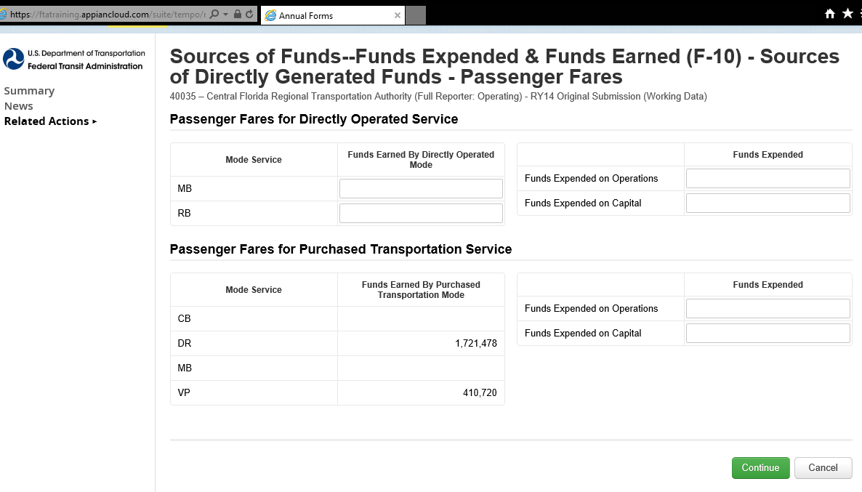
Passenger Fares DO and PT Services
Click when completed

Slide 37
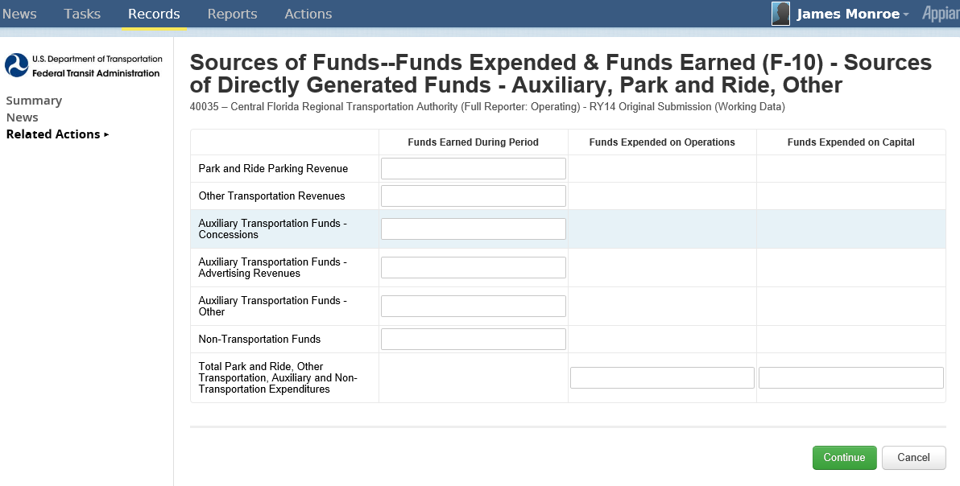
Park and Ride, Other, Auxiliary and Non-Transportation
Click when completed

Slide 38
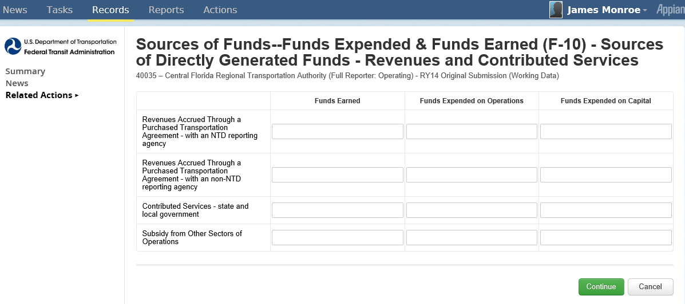
Revenues Accrued from PT, Contributed Services and Subsidy
Click when completed

Slide 39
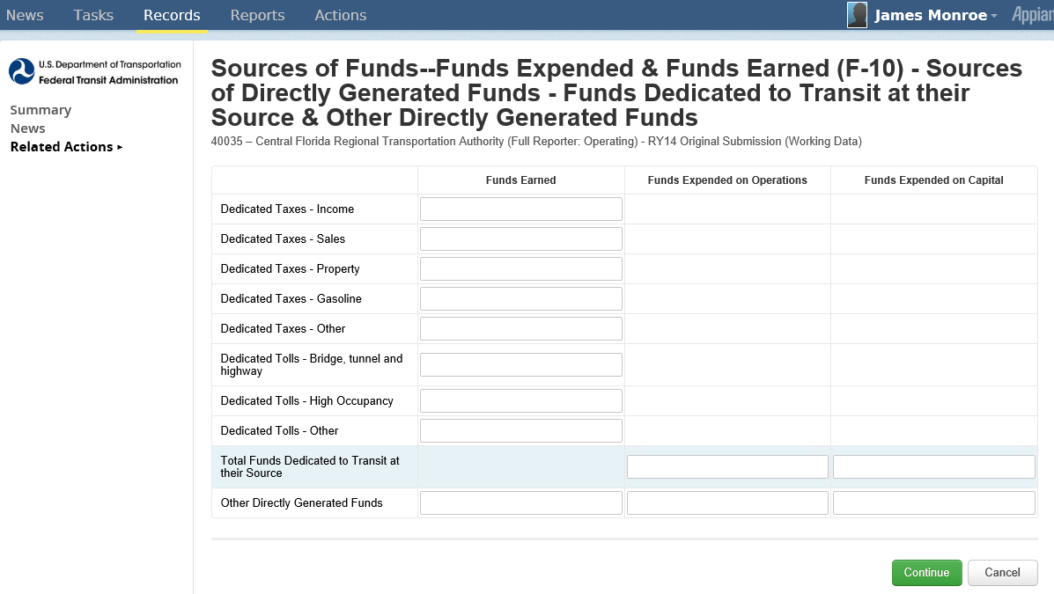
Revenue Sources of Independent Political Entities
Click when completed

Slide 40
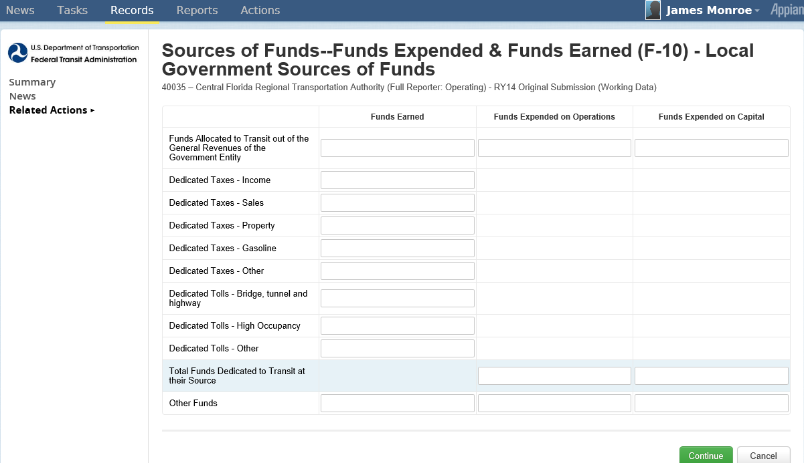
Local Government Funds
Click when completed

Slide 41
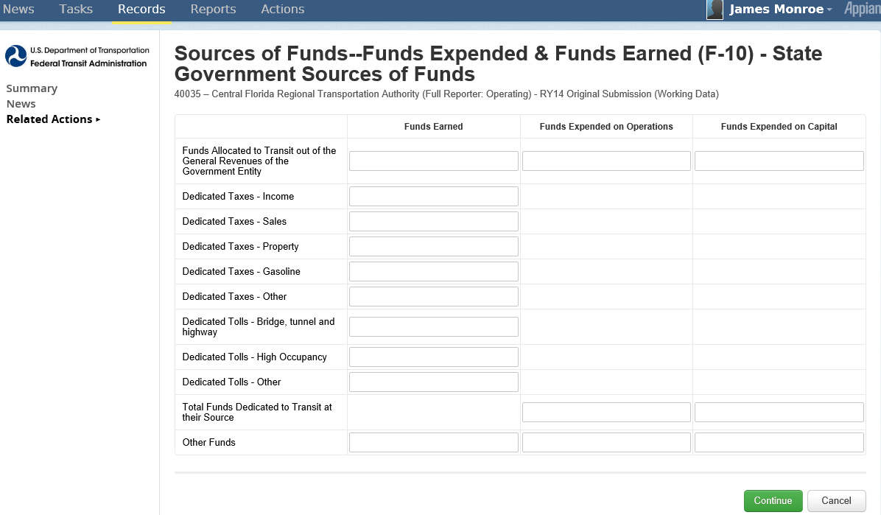
State Government Funds
Click when completed

Slide 42
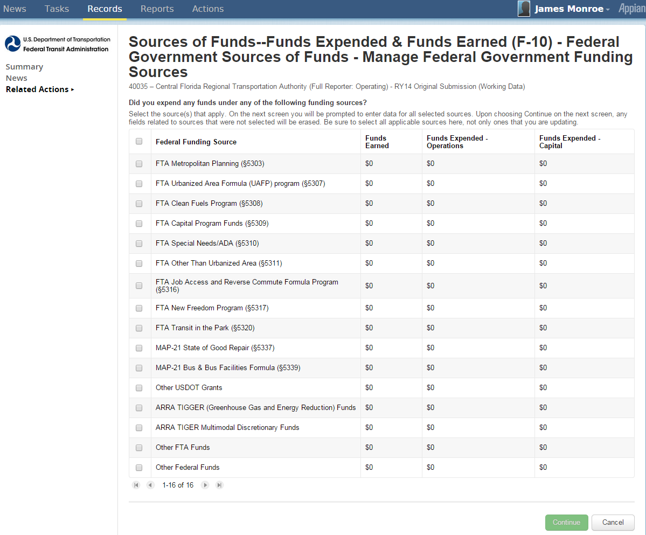
Customized Federal Funds Reporting
1. Click to select funding sources
2. Click when completed

Slide 43
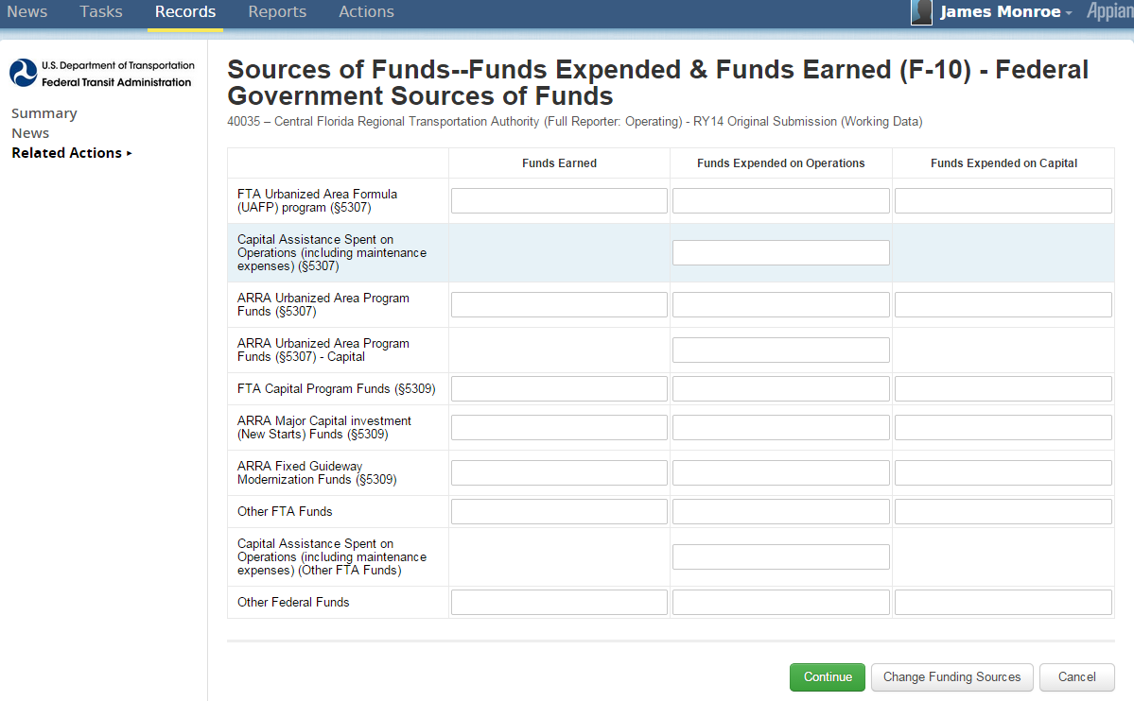
Customized Federal Data Entry
Click to edit funding sources
Click when completed

Slide 44
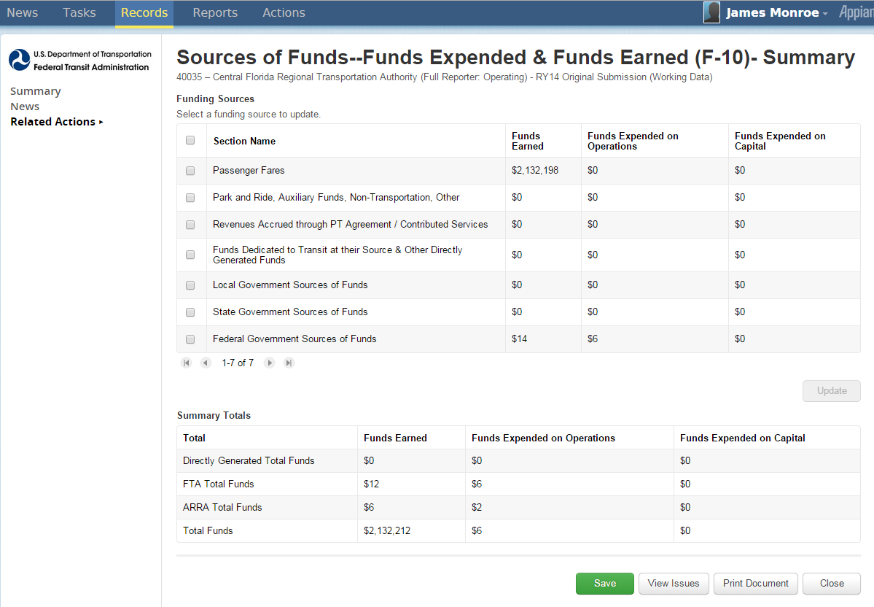
Federal Funding Summary Page
Total Summary
Click Save before exiting

Slide 45
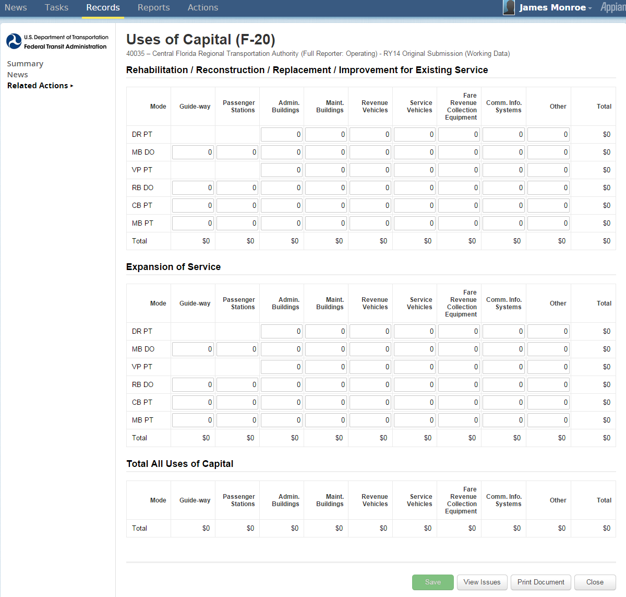
Uses of Capital (F-20)
Click Save before exiting

Slide 46
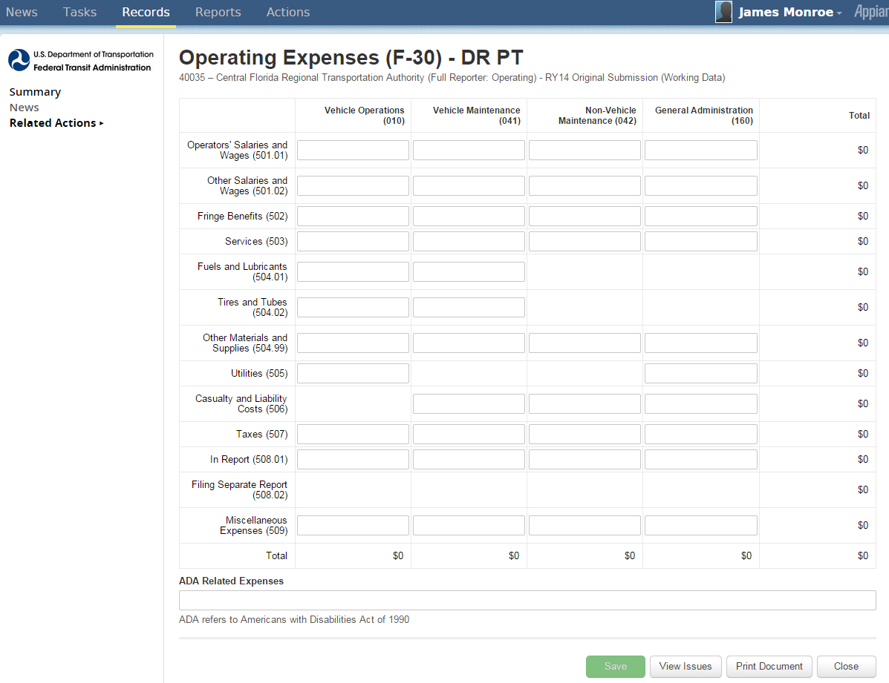
Operating Expenses (F-30)
Click Save before closing

Slide 47
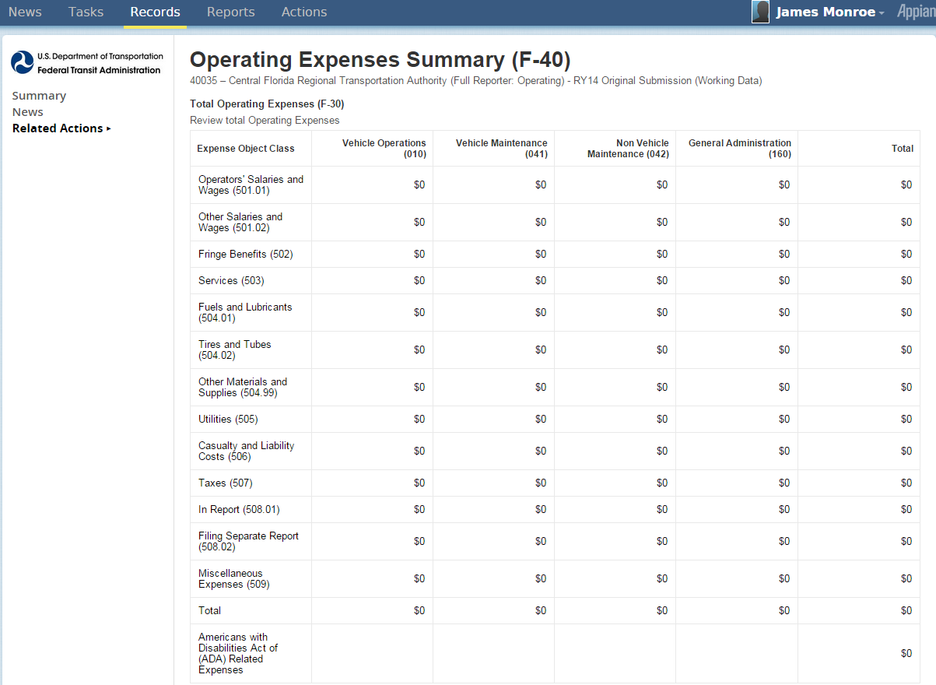
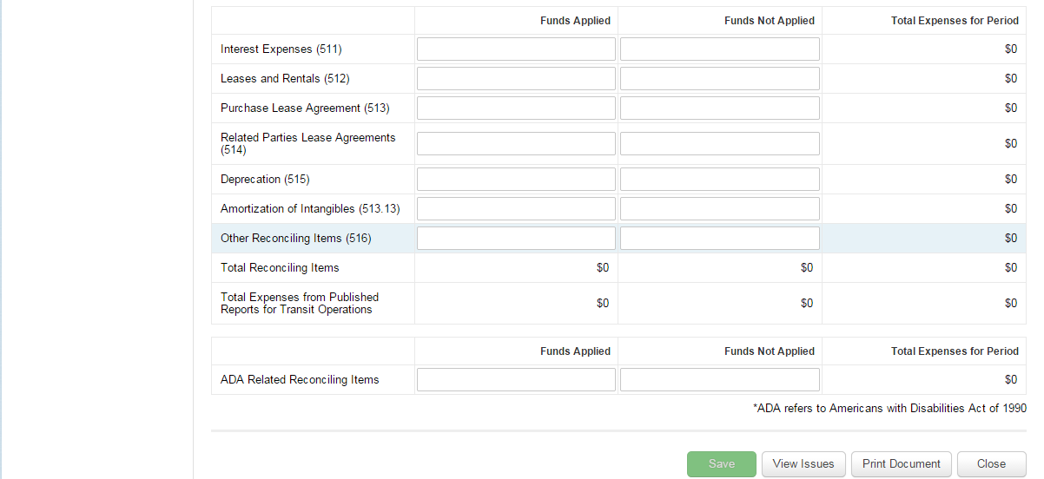
Operating Expense Summary (F-40)
Automatic Summary of expenses from individual F-30 forms
Data entry for Reconciling Items

Slide 48
Reconciling Items(F-40)
Click Save before closing

Slide 49
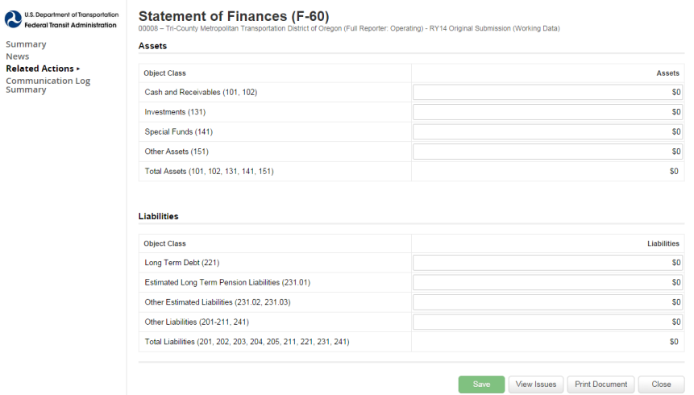
Statement of Finances Form(F-60)
Click Save before closing

Slide 50
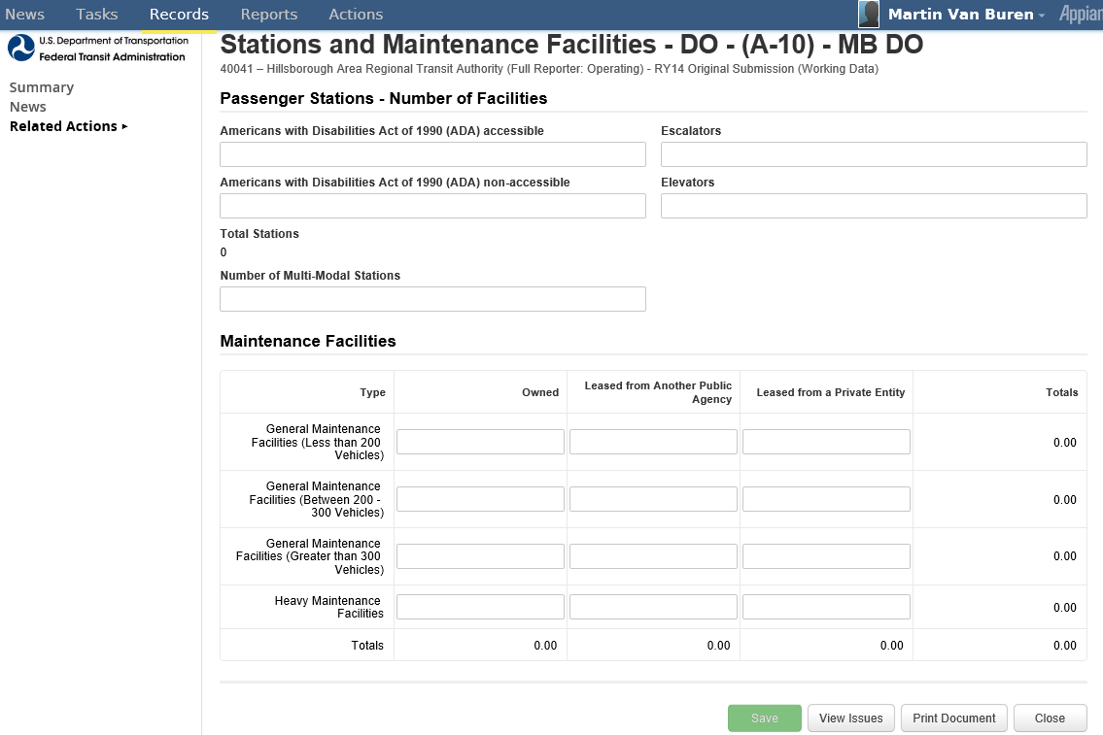
Stations Maintenance Facilities (A-10)
Click Save before closing

Slide 51
Transit Way Mileage (A-20)
Click Edit to enter data

Slide 52
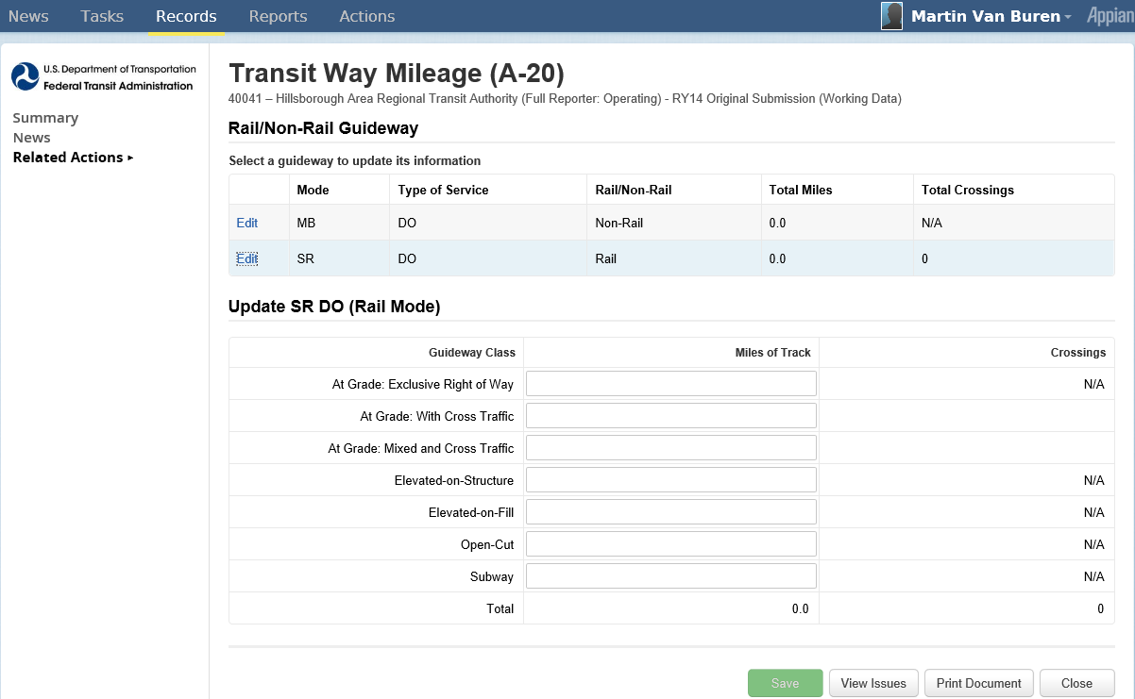
Entering Rail Transit Way Data
Click Save before closing

Slide 53
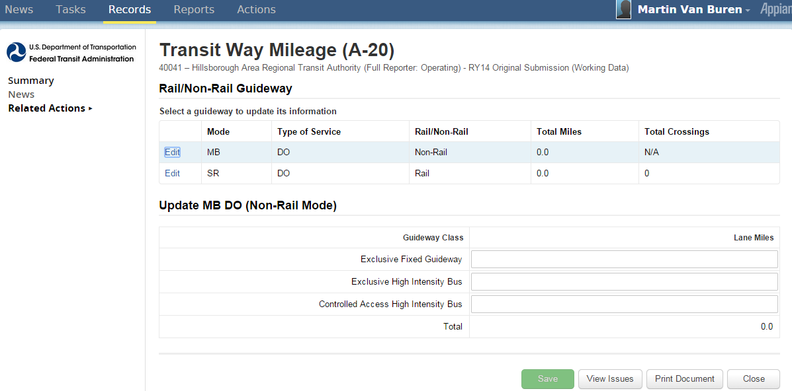
Entering Bus Transit Way Data
Click Save before closing

Slide 54
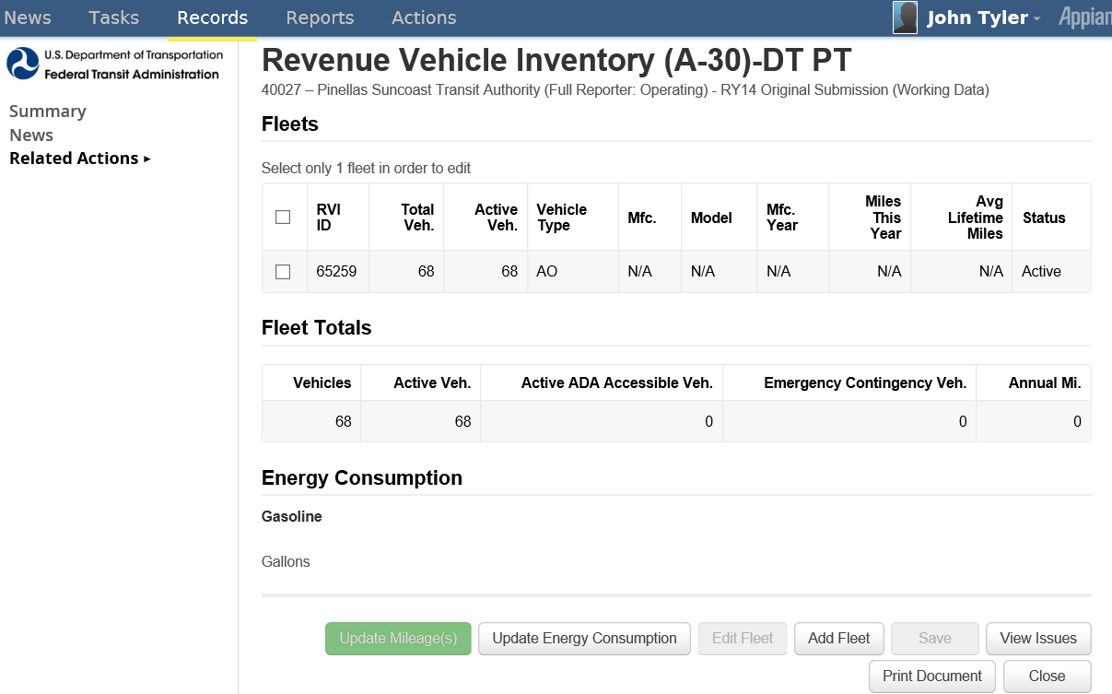
Revenue Vehicle Inventory (A-30)
1. Select existing fleet(s)
2. Click for Updates/Edit to selected existing fleet
Select to add new fleet

Slide 55
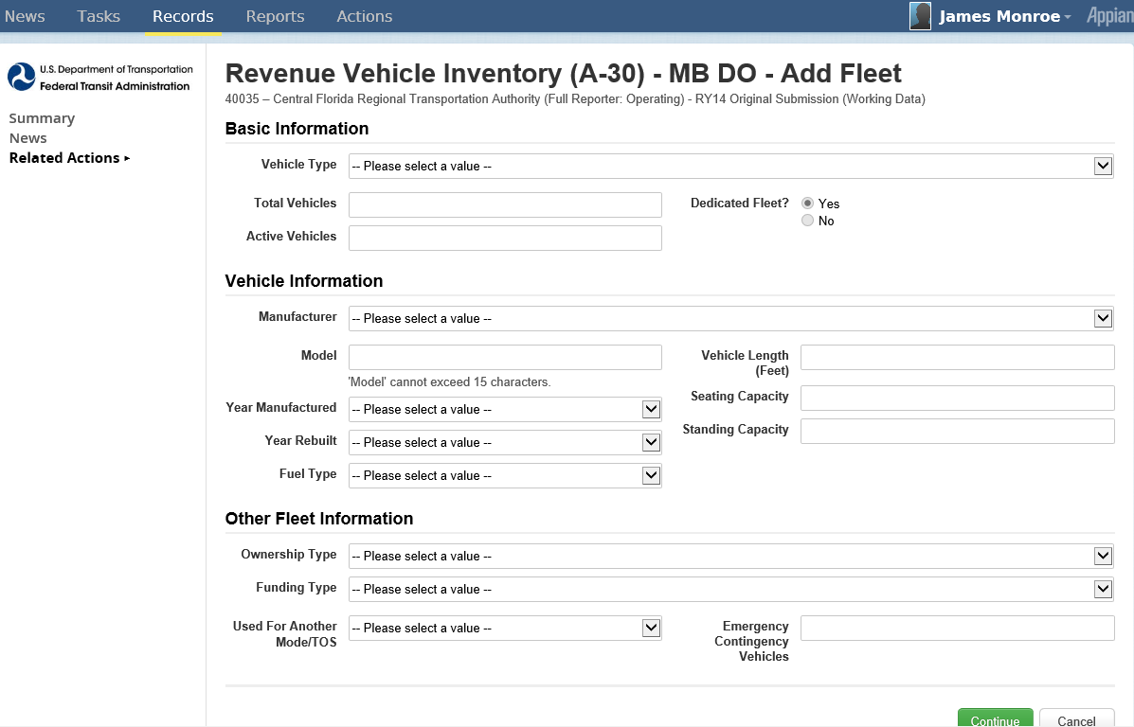
“Add Fleet” Data Entry Screen
Click Continue

Slide 56
“Edit Fleet” Data Entry Screen
Click Continue

Slide 57
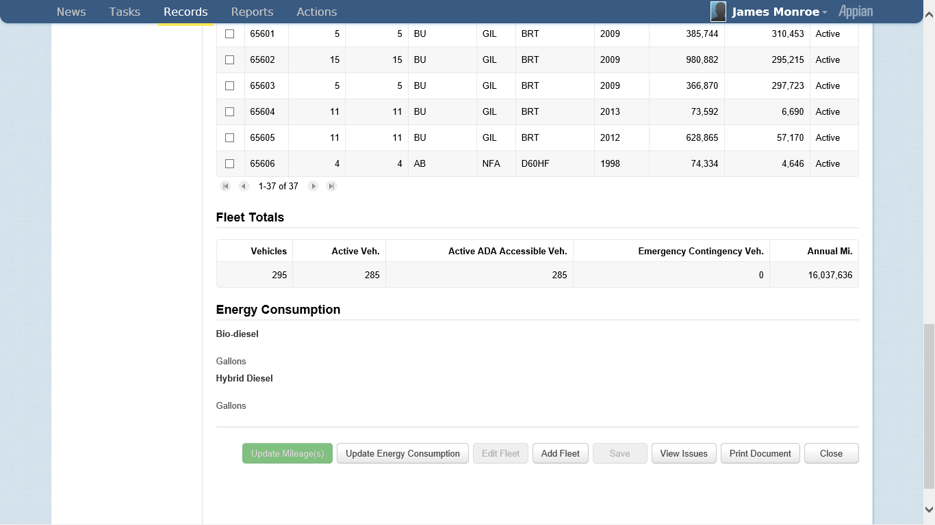
Reporting Mileage by Fleet
1. Click to select fleet(s)
2. Click Update Mileage(s)

Slide 58
Enter Updated Mileage
Click Continue

Slide 59
Reporting Energy Consumption
Data previously in R-30 now reported in A-30
Click Update Energy Consumption

Slide 60
Enter Energy Consumption
Click Continue

Slide 61
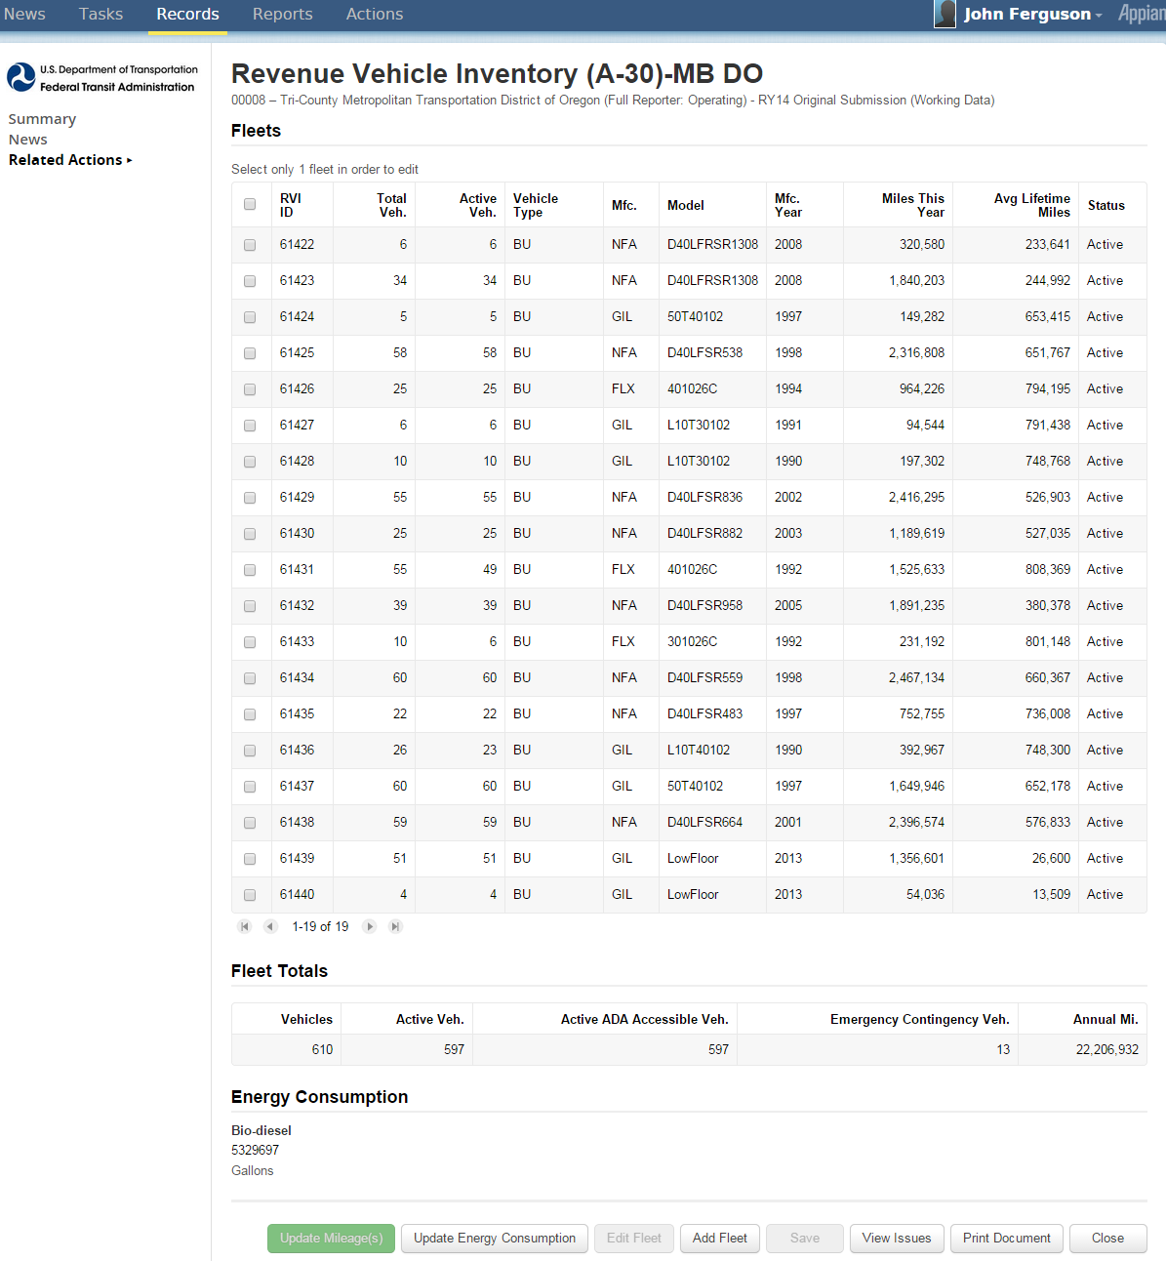
Key Data Summary Screen

Slide 62
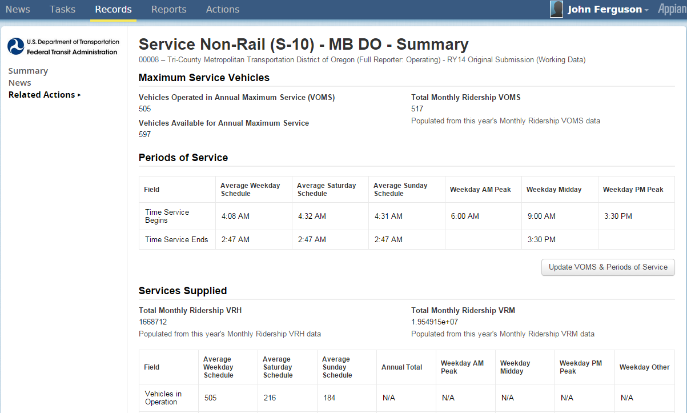
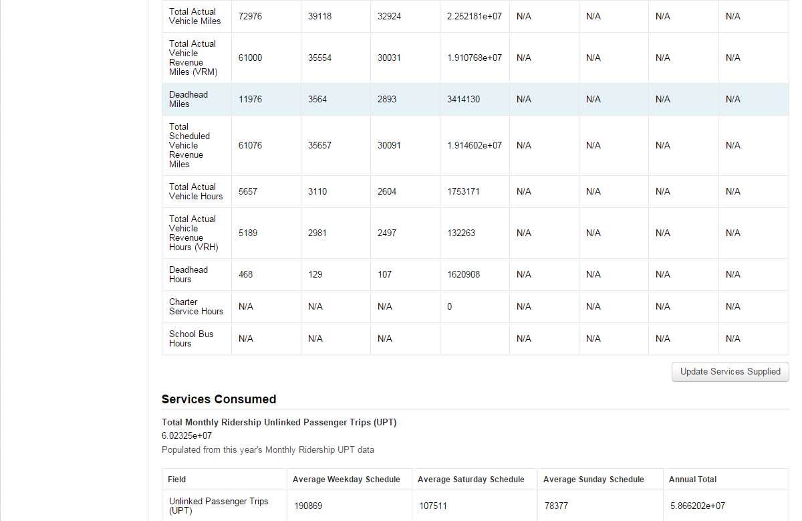
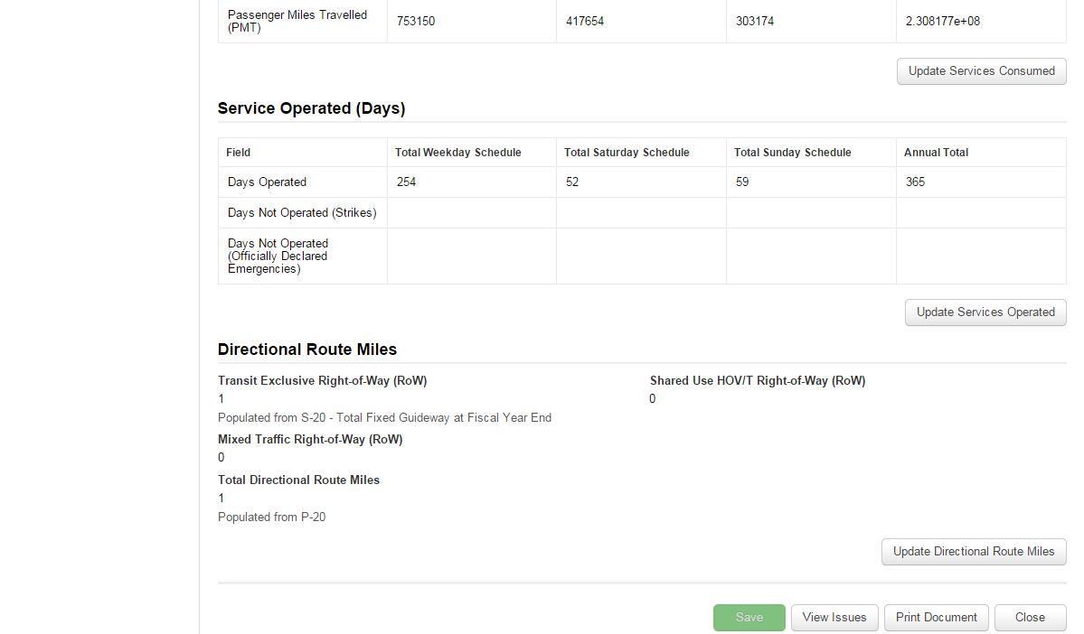
Service Supplied (S-10)
Form broken into sections
VOMS and Periods of Service
Service Supplied
Services Consumed
Service Operated (Days)
Directional Route Miles
Enter sections by clicking update icons
Update
Update
Update
Update
Update
Update

Slide 63
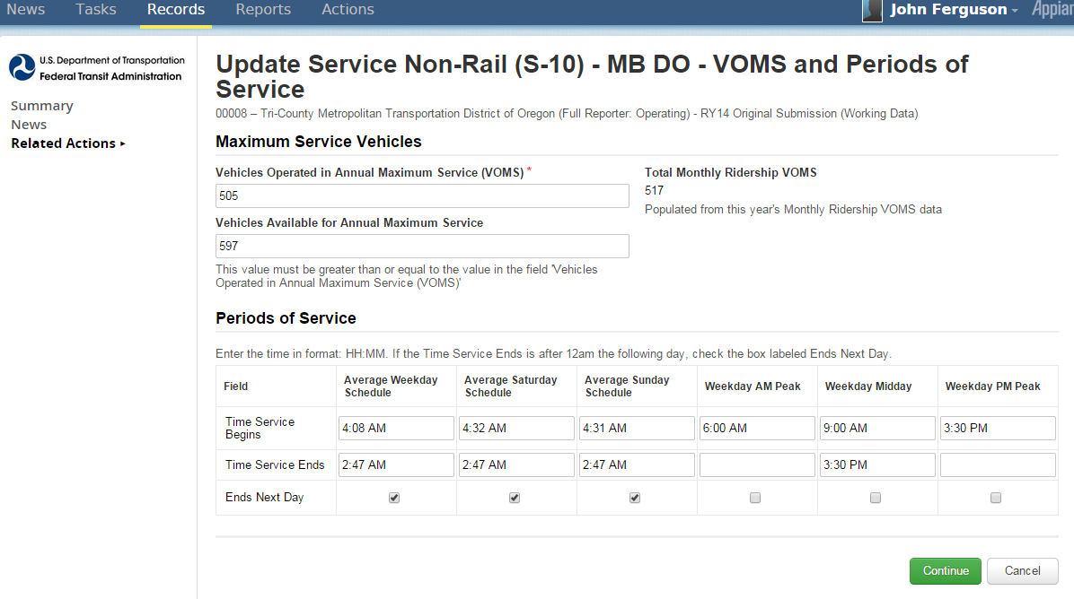
VOMS and Periods of Service
Click Continue

Slide 64
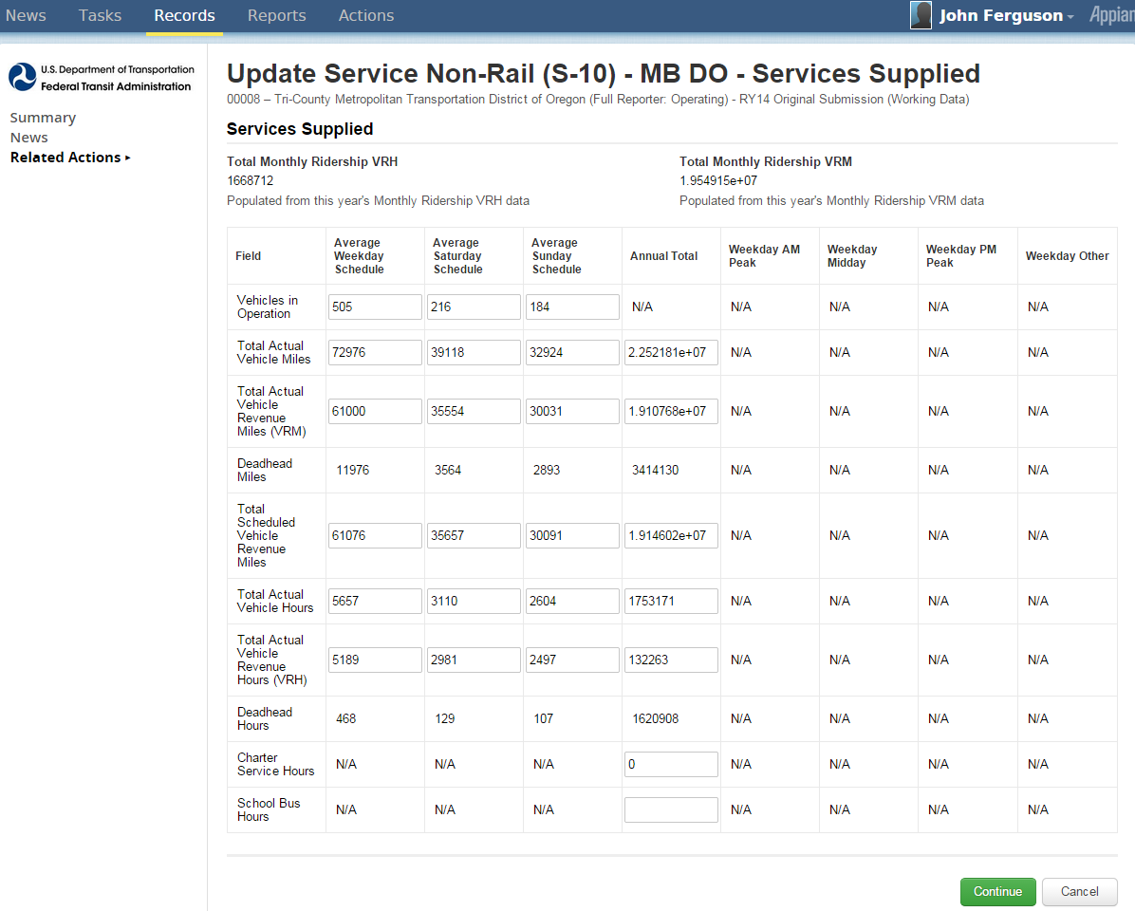
Services Supplied
Click Continue

Slide 65
Services Consumed
Click Continue

Slide 66
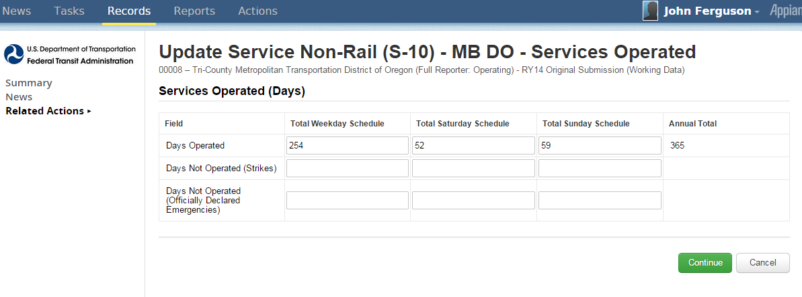
Services Operated (Days)
Click Continue

Slide 67
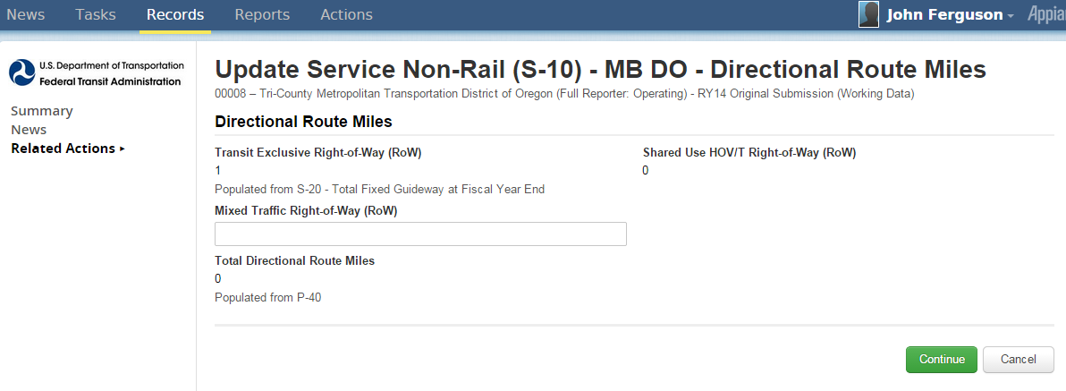
Directional Route Miles
Click Continue

Slide 68
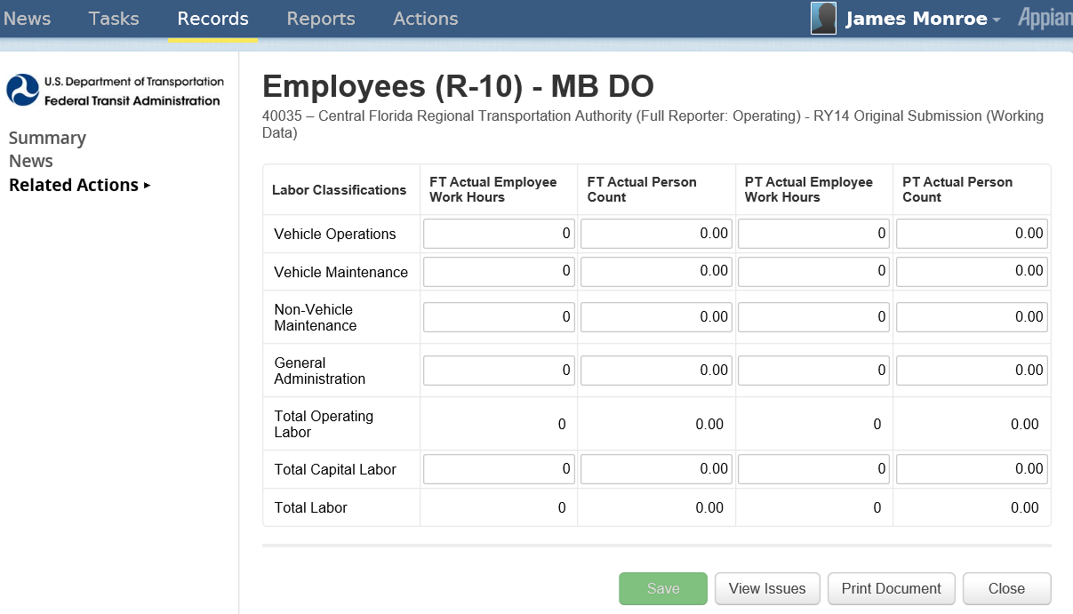
Employees (R-10)
Click Save before closing

Slide 69
Maintenance Performance (R-20)
Click Save before closing

Slide 70
Federal Funding Allocation Statistics (FFA-10): No FG or HIB
Click to select UZA Reporting Method
Click to move from UZA to UZA
Click Save before closing

Slide 71
CEO Certification (D-10)
Completed in a sequence of 6 screens
Click Save before going to next screen
Click Next to go to next screen

Slide 72
D-10 Federal Funding Allocation Data
Click Save before going to next screen
Click Next to go to next screen

Slide 73
D-10 Financial Data
Click Save before going to next screen
Click Next to go to next screen

Slide 74
D-10 Funding Allocation Review
Click to add findings, if any
Click Save before going to next screen
Click Next to go to next screen

Slide 75
D-10 PMT Sampling

Slide 76
D-10 UPT Sampling

Slide 77
National Transit Database Offices
NTD Operations Center
Charlottesville, Virginia
Monday to Friday: 0800 –1900 Eastern
(888) 252-0936
NTDHelp@dot.gov
NTD Program Office
Washington, DC
Keith Gates, Program Manager
(202) 366-1794
keith.gates@dot.gov
NTD Help Desk
Me, email works best

Slide 78
Additional Training
NTD Website training page: http://www.ntdprogram.gov/ntdprogram/seminars.htm
National Transit Institute, NTD courses: http://www.ntionline.com/courses/courseinfo.php?id=7
NTD Website presentations page: http://www.ntdprogram.gov/ntdprogram/announcements.htm

