Slide 1
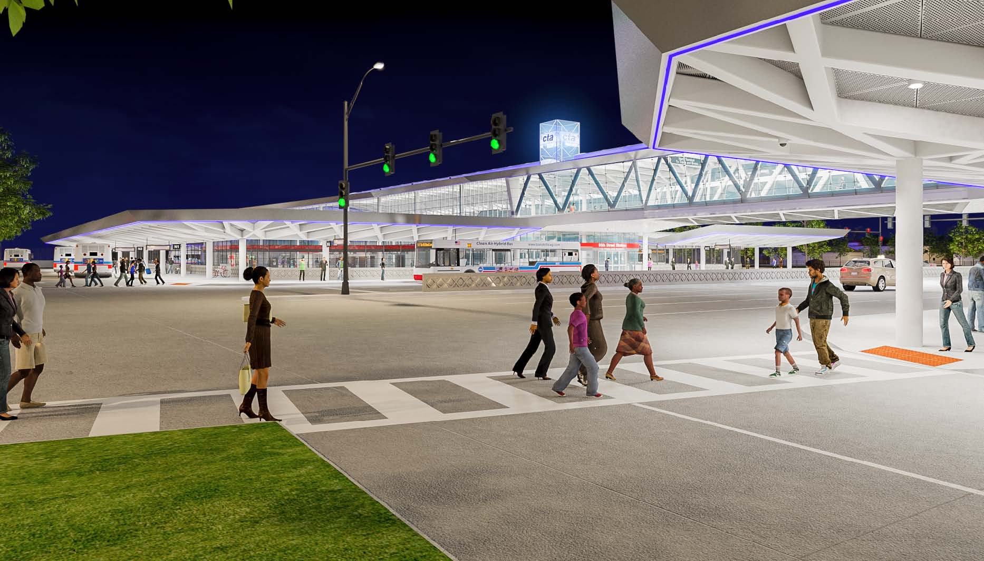

95th street / dan ryan terminal improvement project
2014 FTA Real Estate Workshop
National Highway Institute
Arlington, VA
May 19 – 21, 2014

Slide 2
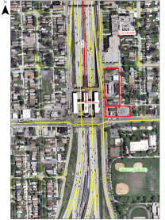
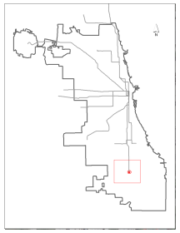
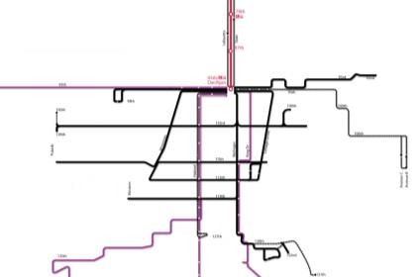

95th street / dan ryan terminal improvement project
  SERVED BY:
  CTA Red Line Train (40% of CTA Rail Ridership, 24 Hour Service)
  13 CTA Bus Routes
  5 Pace Suburban Bus Routes
  10 Greyhound & Indian Trail Intercity Buses
  Paratransit (ADA) Service
  The most number of bus routes serving any rail station on CTA system
  More than 1,000 CTA and Pace bus trips are made to/from the terminal daily
  USED BY:
  About 20,000 average weekday customers
  High minority (99%), below poverty line (17%), and transit dependent population (18%) live within one mile of the station
  About 300,000 people live within one-half mile of the CTA bus routes serving the station

Slide 3
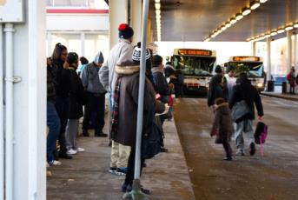
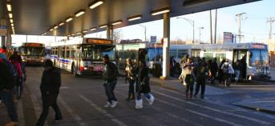
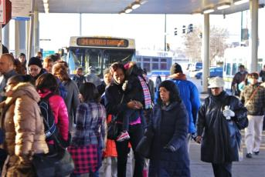

Existing Conditions
Bus Operations
  Insufficient number of bus bays for routes currently being served
  Absence of separate boarding and alighting areas creates congestion
  Spacing between bus bays is insufficient
Pedestrian Circulation
  No direct access from 95th Street
  Small pedestrian islands and narrow side walks restrict flow
  Limited space for high volume of riders and buses
Other Issues
  No paratransit pick-up/drop-off space
  No Kiss-n-Ride facility
  No Park-n-Ride facility
  Significantly constrained office and utility space

Slide 4
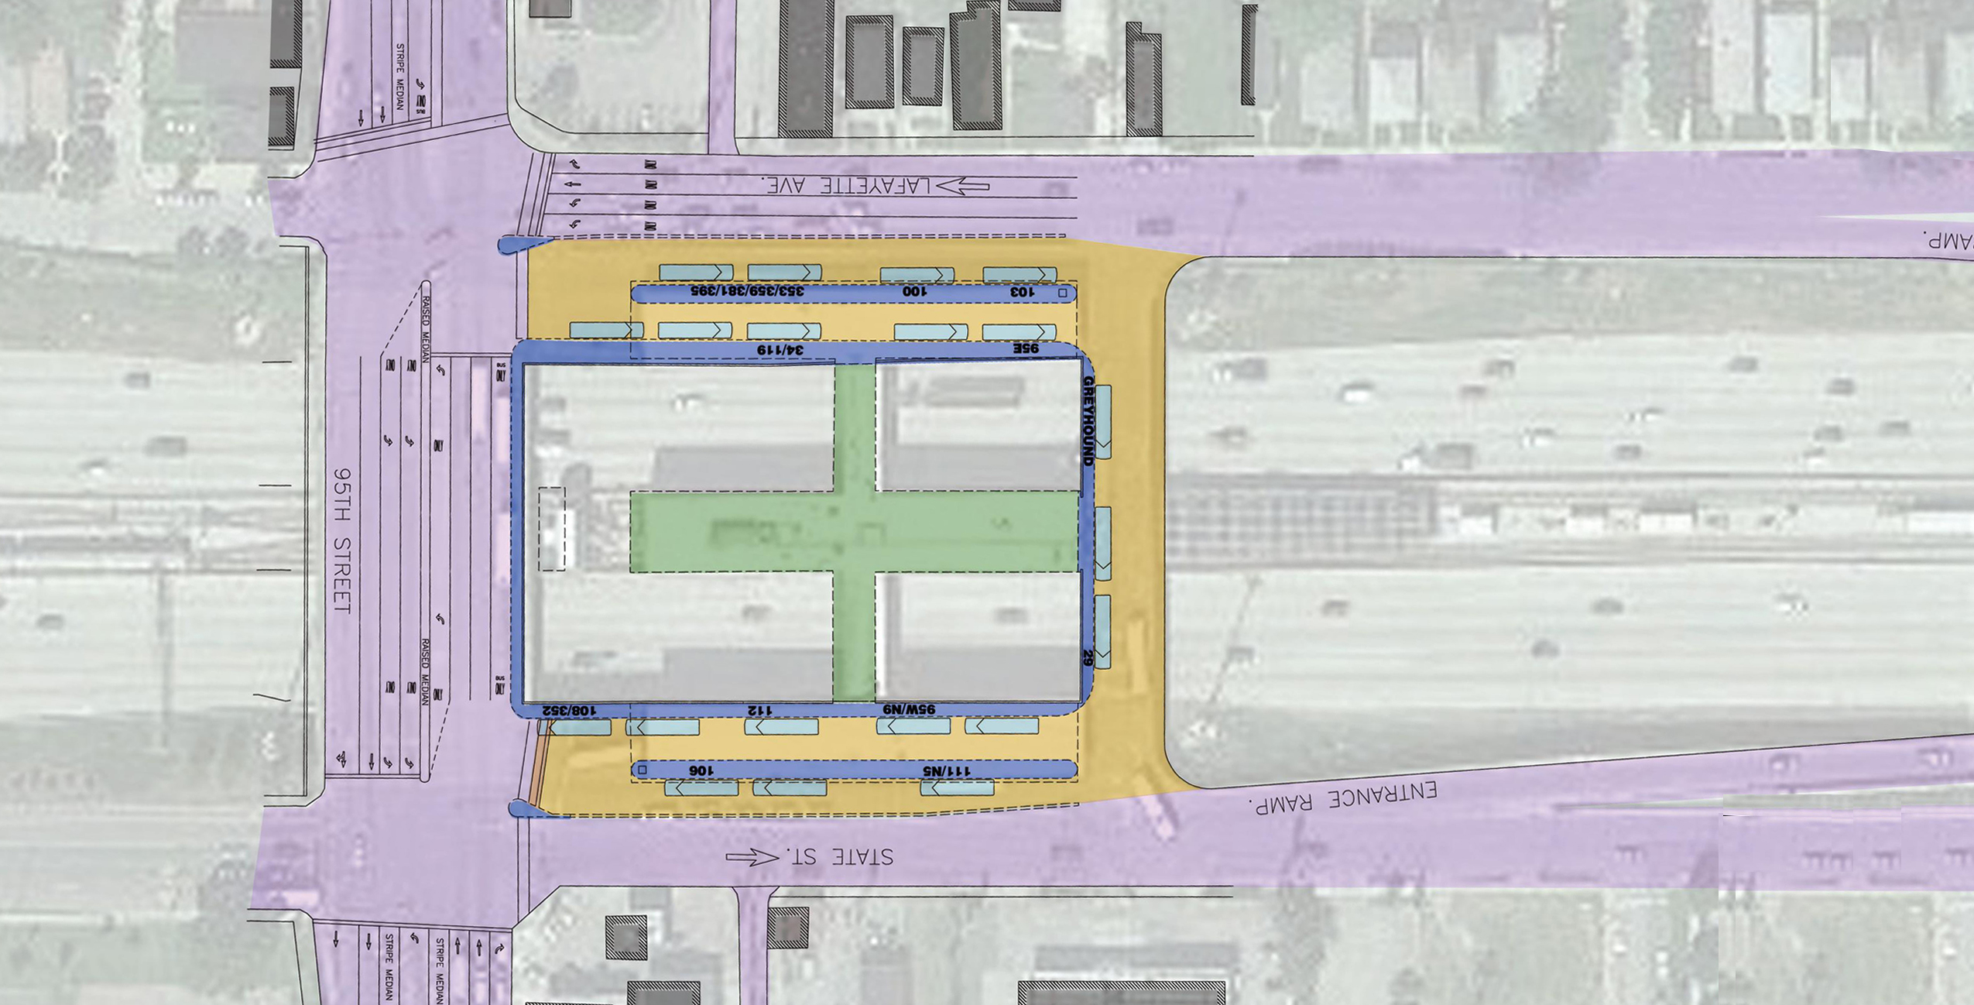
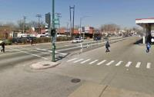
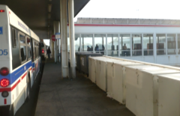
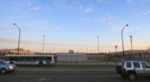
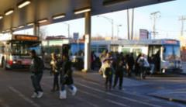
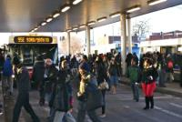
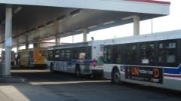

Existing Design
Lafayette Avenue
Narrow Pedestrian Islands
Narrow boarding and alighting areas with columns
No Terminal Entrance from 95th Street
Rail Station
20 bus bays for 19 routes with more than 1 bus per route in the terminal during peak periods
Pedestrian Congestion
State Street
Minimal spacing between buses

Slide 5
Long Term Vision
Bus Operations
  Improve safety and efficiency of bus operations
  Eliminate delays due to congestion
Pedestrian Circulation
  Improve pedestrian safety
    Separate pedestrian and vehicular flow
    Wider waiting and boarding areas
  Separate boarding and alighting
  Enhance visibility, connectivity, and accessibility
Other Goals
  Improve access to the terminal via different modes
  Improve internal station space and add amenities
  Enhance customer comfort

Slide 6
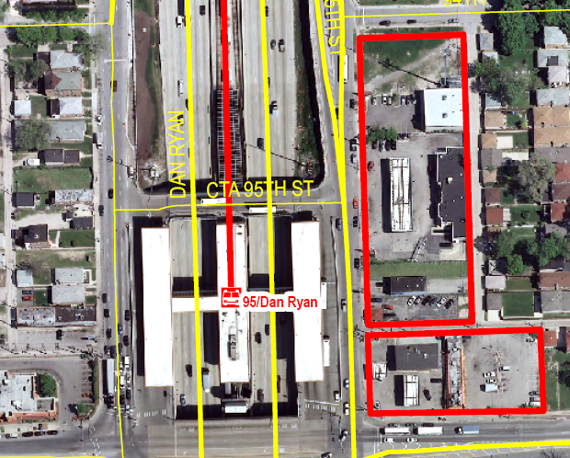
95th & State Acquisition Parcels

Slide 7
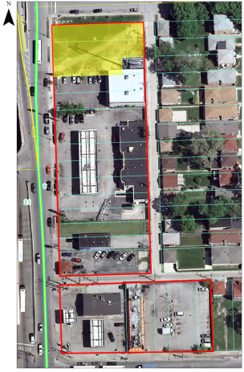
Looking East from State Street

Slide 8
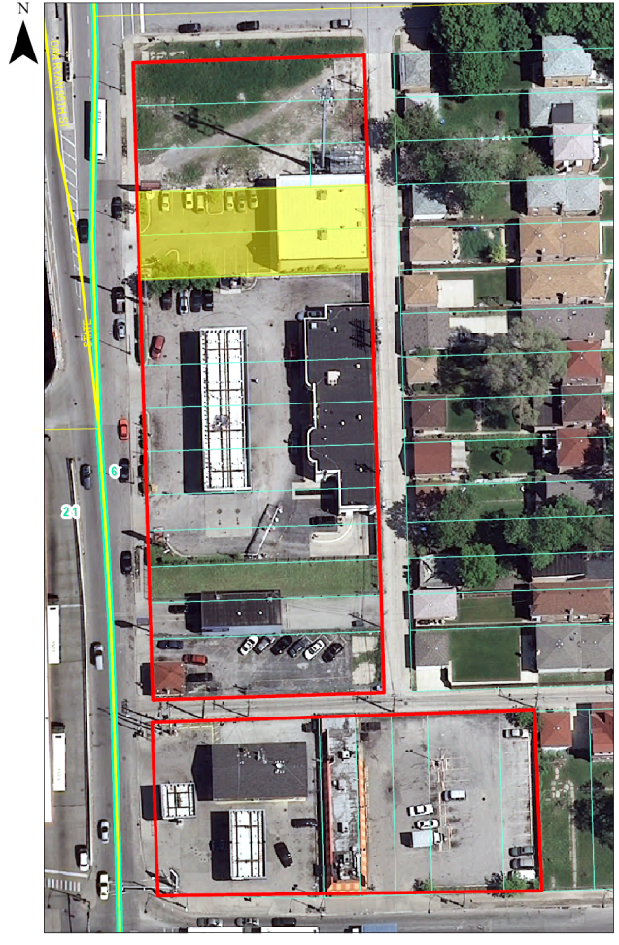
Looking East from State Street

Slide 9
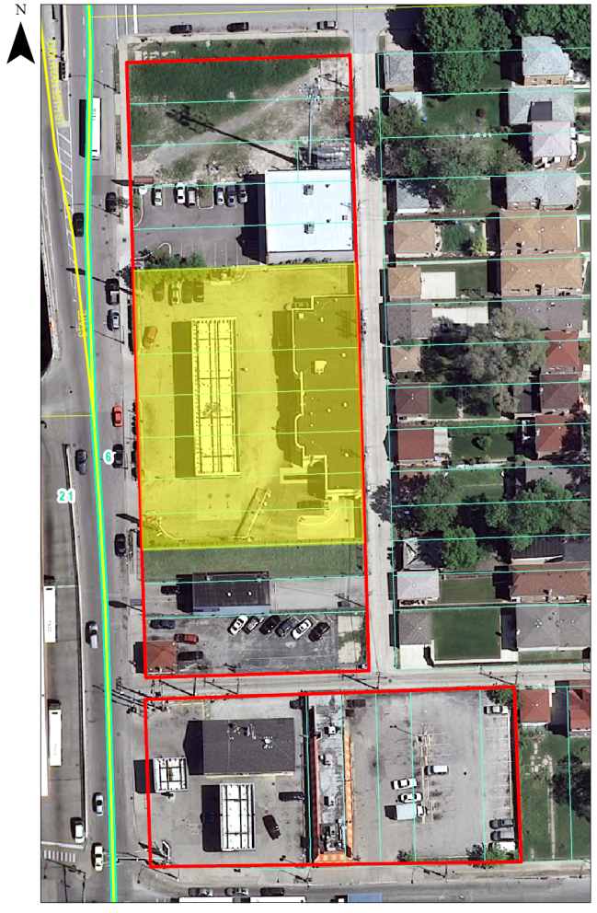

Slide 10
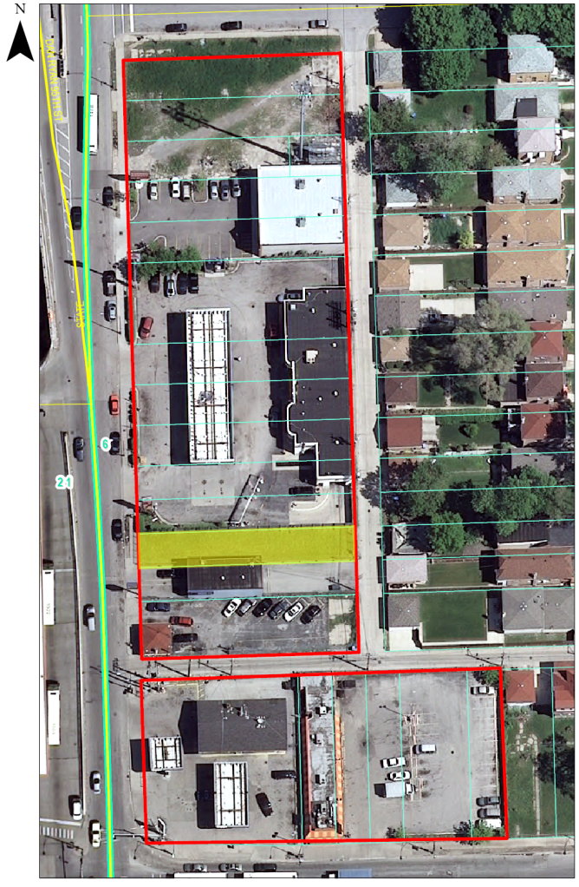
Looking East from State Street

Slide 11

Looking East from State Street

Slide 12
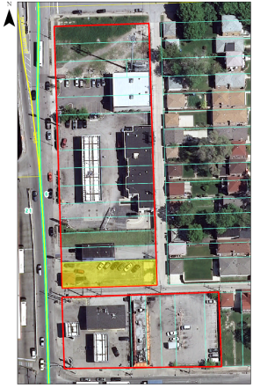
Looking Northeast from State Street

Slide 13
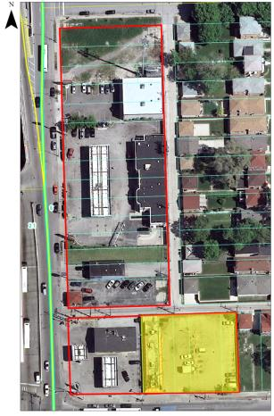
Looking Northwest from 95th Street

Slide 14
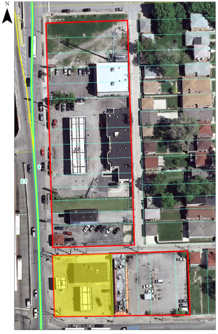
Looking Northwest from 95th Street

Slide 15
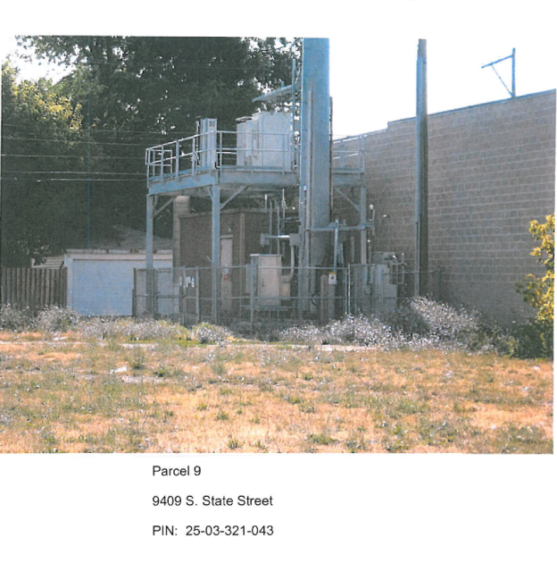
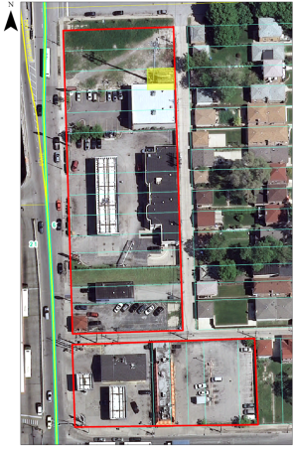
Looking East from State Street

Slide 16
ACQUISITION BUDGET

Slide 17
Eminent Domain and Outside Counsel

Slide 18
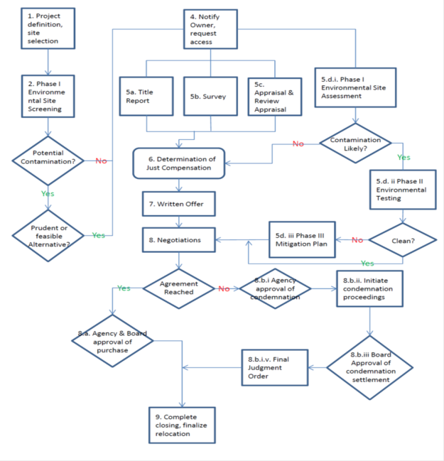
Acquisition Flow Chart

Slide 19
Real Estate Acquisition Management Plan (RAMP)
Project Description
Purpose of the Project
Organizational Structure / Key Staff
Parcels to be Acquired
Acquisition Schedule
Relocation
Real Estate Cost Estimates
Progress Reporting
Real Estate Acquisition Process
Property Management
Document Control

Slide 20

questions

