Slide 1
NEPA and Property Acquisition May 19, 2014 Elizabeth Patel Environmental Protection Specialist FTA Office of Planning and Environment

Slide 2
NEPA/Property Acquisition Topics
Categorical Exclusions
2013 Creation of FTA-specific CEs
Hardship and Protective Buys
New MAP-21 CEs
Corridor Preservation under MAP-21
Allowable ROW Activities during NEPA

Slide 3
Background
CEQ Definition
A categorical exclusion (or CE) is “…a category of actions which do not individually or cumulatively have a significant effect on the human environment and which have been found to have no such effect in procedures adopted by a Federal agency in implementation of these regulations (§ 1507.3) and for which, therefore, neither an environmental assessment nor an environmental impact statement is required.”
A CE is:
An action excluded from EA or EIS review
NOT an exemption from NEPA

Slide 4
Background
Just over a year ago, FTA issued two final rules on Categorical Exclusions (CE) that apply to FTA actions:
Addition of new section for FTA CE actions with ten all new CEs (23 CFR 771.118) on February 7, 2013
Designates Section 771.118 for FTA actions
Section 771.117 is no longer valid for FTA actions
Addition of Emergency Recovery Action CE (23 CFR 771.118(c)(11)) on February 19, 2013

Slide 5
Section 771.118(c)
(1) Acquisition, installation, operation, evaluation, replacement, and improvement of discrete utilities and similar appurtenances (existing and new) within or adjacent to existing transportation right-of-way, such as: utility poles, underground wiring, cables, and information systems; and power substations and utility transfer stations.

Slide 6
Section 771.118(c)
(2) Acquisition, construction, maintenance, rehabilitation, and improvement or limited expansion of stand-alone recreation, pedestrian, or bicycle facilities, such as: a multiuse pathway, lane, trail, or pedestrian bridge; and transit plaza amenities.

Slide 7
Section 771.118(c)
(6) Acquisition or transfer of an interest in real property that is not within or adjacent to recognized environmentally sensitive areas (e.g., wetlands, non-urban parks, wildlife management areas) and does not result in a substantial change in the functional use of the property or in substantial displacements, such as: acquisition for scenic easements or historic sites for the purpose of preserving the site. This CE extends only to acquisitions and transfers that will not limit the evaluation of alternatives for future FTA-assisted projects that make use of the acquired or transferred property.

Slide 8
Section 771.118(d)
The “d-list”
Implemented the same way as old list (Section 771.117(d)), including the possibility of “unusual circumstances”
Section 771.118(d) is generally FTA’s “Other” CE category: paragraphs listed under (d) are only examples of typically categorically excluded actions
Any action can be a CE under the d-list if documentation shows there is no potential for significant environmental impacts
Documentation can be as brief as a paragraph

Slide 9
Section 771.118(d)
(3) Acquisition of land for hardship or protective purposes. Hardship and protective buying will be permitted only for a particular parcel or a limited number of parcels.

Slide 10
Section 771.118(d)
(4) Acquisition of right-of-way. No project development on the acquired right-of-way may proceed until the NEPA process for such project development, including the consideration of alternatives, has been completed.

Slide 11
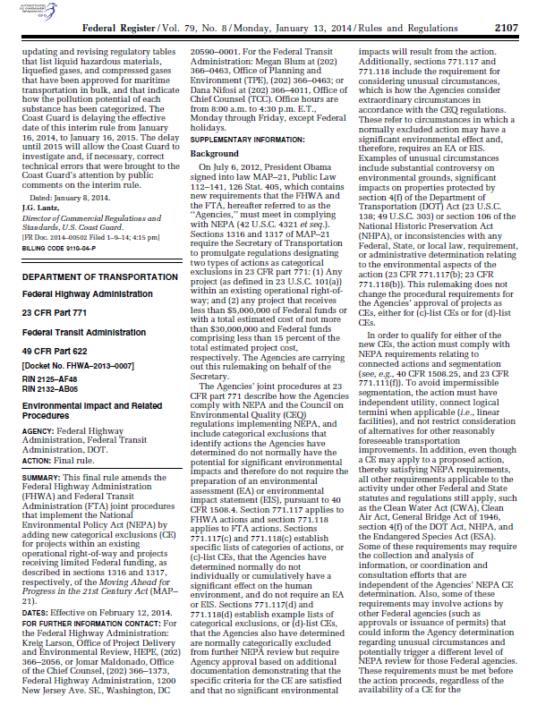
New 2014 Categorical Exclusions
FHWA/FTA recently issued a final rule on two
MAP-21 Categorical Exclusions (CE):
Actions within Existing Operational Right-of-Way CE (23 CFR 771.118(c)(12))
Actions with Limited Federal Financial Assistance CE (23 CFR 771.118(c)(13))
These CEs became effective on February 12, 2014

Slide 12
New 2014 Categorical Exclusions
(12) Projects, as defined in 23 U.S.C. 101, that would take place entirely within the existing operational right-of-way. Existing operational right-of-way refers to right-of-way that has been disturbed for an existing transportation facility or is maintained for a transportation purpose. This area includes the features associated with the physical footprint of the transportation facility (including the roadway, bridges, interchanges, culverts, drainage, fixed guideways, mitigation areas, etc.) and other areas maintained for transportation purposes…

Slide 13
New 2014 Categorical Exclusions
…such as clear zone, traffic control signage, landscaping, any rest areas with direct access to a controlled access highway, areas maintained for safety and security of a transportation facility, parking facilities with direct access to an existing transportation facility, transit power substations, transit venting structures, and transit maintenance facilities. Portions of the right-of-way that have not been disturbed or that are not maintained for transportation purposes are not in the existing operational right-of-way.

Slide 14
New 2014 Categorical Exclusions
(13) Federally-funded projects:
(i) That receive less than $5,000,000 of Federal funds; or
(ii) With a total estimated cost of not more than $30,000,000 and Federal funds comprising less than 15 percent of the total estimated project cost.

Slide 15
Corridor Preservation
MAP-21 modified a pre-existing provision that allowed acquisition of railroad right-of-way prior to completion of NEPA by deleting the modifier of “railroad”
FTA published draft guidance for this amended provision in December 2013
FTA is currently reviewing comments and plans to issue final guidance once ready

Slide 16
Allowable Activities during NEPA Process
Obtaining right-of-entry or other easement in order to conduct land surveys, site assessments for contamination, archaeological investigations, geological investigations, or testing of vibration propagation;
Performance of land surveys;
Subsurface investigations by non-ground-disturbing techniques;
Subsurface investigations by ground disturbing techniques, provided that right-of-entry or easement has been acquired and that the ground disturbance is limited to that necessary to determine the impacts or the presence of protected resources;
Performing title searches;
Preparation of a relocation plan including interviews with potential displacees to whom the exact project status and future process for finalizing project plans and decisions have been explained;
Preliminary appraisals and reviews of preliminary appraisals; and
A site assessment for potential contamination of the soil or buildings on the property (e.g., asbestos insulation or lead paint)

Slide 17
Activity not Allowed during NEPA Process
Actual offers to aquire the property
Actual relocations

Slide 18
Questions?
FTA has guidance on all of the CEs on its website at www.fta.dot.gov.
For questions, contact the regional office for the project in question. Contact information for all of FTA’s regional offices is also found on FTA’s website.

