Slide 1
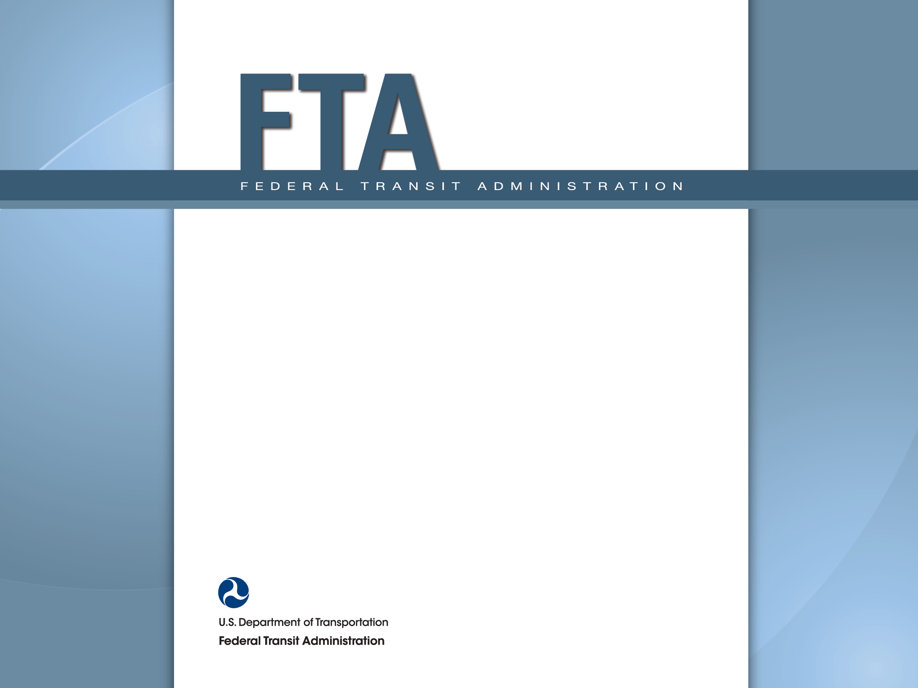
Legal Perspectives May 19, 2014 Jay Fox Regional Counsel FTA Region III

Slide 2
Initial Thoughts
1998 US DOT Policy Statement
Encourages use of brownfield sites
FTA Circular 5010.1D, Chapter IV, Section 2g(4) (Contaminated Property)
Use of broad, discretionary language
Due diligence
Interpreting “contamination” and “hazardous material”
FTA “generally” will not participate in remediation of contamination discovered during construction
Absence of language authorizing remediation costs
The RA usually makes the discretionary decisions

Slide 3
Due Diligence
Identify – NEPA Process
Evaluation of soil and geological resources
Hazardous materials and potential sites of concern
Impacts and mitigation measures documented
New information or circumstances
Valuation – Appraisal Process
Scope of work should include effect of contamination
Results of ESAs should be shared with appraiser
“Pre-Federalized” site assembly still subject to appraisal and review concurrence as in-kind/local match

Slide 4
Due Diligence
Responsibility – Title and PRP Searches
Chain of title
Sellers have a duty to disclose
Buyers have a duty to investigate
Commercial v. Residential properties
Other parties
Adjacent property owners
Dumpers (they don’t usually leave a card)
Grantees
Level of intent (practice, negligence, recklessness, knowingly)
Reimbursement

Slide 5
The Reimbursement Roadmap (fill in the blanks and find the money)
?

Slide 6
Due Diligence
Project Costs – Remediation and Liabilities
Remediation
Agency coordination is critical
Process – reduce, remove, and/or contain
Contingency
Liabilities
Short-term liabilities related to clean-up and construction
Long-term liabilities related to continued public safety, undiscovered conditions, etc.
Other Related Costs
Reasonable and necessary legal expenses
Notes:
\

Slide 7
Some Other Considerations
Technical Assistance
“The grantee should contact FTA for technical assistance regarding contaminated property”
Contamination Discovered During Construction
FTA generally will not participate in remediation
Ultimate answer turns on compliance with 5010.1D
Condemnation
Capital Leases
Terms should address the responsibilities and liabilities of the parties for existing and discovered contamination

