Slide 1


Section 1512 and 1201c Reporting:
Training Webinars for FTA Grant Recipients
January 5, 2012

Slide 2
Webinar Objectives
Provide information to individuals reporting on behalf of their agencies for the first time.
Provide refresher training on ARRA reporting (especially 1201c reporting) for FTA grantees.

Slide 3
This Webinar Will Cover:
What needs to be included in 1512 and 1201c reports.
When reports need to be submitted.
How reports should be submitted.
The key similarities and differences between ARRA 1512 and 1201c reports.

Slide 4

Thank You!
“The reports that you have submitted are of great interest to the Office of the Secretary of Transportation, the White House, Congressional Committees, and other stakeholders with the power to shape the future of public transportation.”
  June 8, 2010 “Dear Colleague” Letter from Administrator Rogoff to FTA Recipients.

Slide 5
1512 Technical Assistance Documents
FTA has posted the following technical assistance for its grantees:
  1512 Reporting Definitions and Examples
  Tips on Section 1512 Reporting
  Federalreporting.gov edit checks
  Instructions on Copying Forward Your report.
Available at http://www.fta.dot.gov/arra (then click on the “reports” link).
5

Slide 6
1201c Technical Assistance
1201(c) Reporting Instructions
1201(c) Reporting Questions and Answers
1201(c) Reporting Technical Instructions
Located in the 1201c guidance section of TEAM and at http://www.fta.dot.gov/arra (click on the “reports” link).

Slide 7
Comparing 1512 and 1201c reporting
1512
Applies to all ARRA recipients.
Report on activities as of 12/31/11.
January 14 reporting deadline.
Submit Report via www.federalreporting.gov
No reports accepted after 1/14.
All data should be reported on a cumulative basis, except for jobs, which should be reported quarterly.
All jobs reported in terms of Full Time Equivalents (FTEs).
Data quality checks conducted via www.federalreproting.gov
Data made available to the public on www.recovery.govon January 30.
1201c
Applies only to U.S. DOT ARRA recipients.
Report on activities as of 1/31/12.
February 17 reporting deadline.
Submit report in TEAM.
Limited grace period to submit report after 2/17.
All data, including jobs, should be reported on a cumulative basis.
Report job hours worked.
Data quality checks conducted via email/phone calls and reports re-submitted in TEAM.
Data provided to the Office of the Secretary of Transportation and Congress (will also be posted on the FTA website).

Slide 8

Section 1512 Reporting Timeframes
Report via www.federalreporting.gov (January 1-14)
Prime Recipient Review (January 15)
  You may review your report submitted between January 1-14, 2012. Direct recipients should review any data reported by subrecipients during this time. You may NOT submit a report during this timeframe. You can only review what was submitted during the first 14 days.
Agency Review (January 16-29)
  FTA will review your report during January 16-29, 2012.
Release (January 30)
  All data from the report will be released on January 30, 2012.
Continuous Correction (February 3-23)
  Starts three days after the end of the reporting period).

Slide 9
What Happens If I Do Not Report?
Recipients are required to submit timely, complete, and effective reporting under Section 1512 of ARRA.
President Barack Obama and OMB have directed all federal agencies to hold non-compliant recipients accountable “to the fullest extent permitted by law”.
All Federal Transit Administration (FTA) American Recovery and Reinvestment Act (ARRA) grants have a provision that allows FTA to withhold funds for failure to comply with ARRA requirements. FTA contracts also include ARRA reporting clauses.
Under FTA’s Penalty Policy, recipients who fail to submit a Section 1512 report are considered to be non-compliant, and are subject to federal action, up to and including the initiation of suspension and debarment proceedings and/or repayment of ARRA funds for the affected grant.

Slide 10
What Happens If I Do Not Report?
First Instance of Non-Compliance through Failure to Submit a Section 1512 Report
  The recipient’s General Manager (or similarly named chief executive) will receive a letter from the applicable regional administrator to:
    Document the instance of non-compliance;
    Remind the recipient of its ARRA Section 1512 reporting requirements;
    Advise the recipient that a second instance of non-compliance will result in suspension from the ECHO payment system for the grant not reported on.
Second Instance of Non-Compliance
  A second instance of non-compliance will result in suspension from the ECHO payment system for the grant not reported on.
  This suspension will continue until such time that a Section 1512 report is properly submitted for the affected grant (in a future reporting cycle).
Third Instance of Non-Compliance
  A third instance of non-compliance may result in severe penalties up to and including repayment of ARRA funds and the initiation of suspension and debarment procedures.

Slide 11
Tips For a Successful
1512 Report

Slide 12
Tip #1—Make Sure your CCR Registration is Current
All grantees need to update their CCR information once a year.
CCR sends a reminder email to your point of contact
Go to http://www.ccr.gov and search by your DUNS number to find out if your registration will expire soon.

Slide 13
Reporting Tip #2 – FRPIN
Make sure:
  You have the Federal Reporting Pin Number you will need to submit your report.
13

Slide 14
Tip #3—Report by January 14, 2012
Report as soon as you can in January.
Be mindful that January 14, 2012 falls on a Saturday.

Slide 15
Tip #4-Copy Forward the Information in Your October, 2011 Report
Use the copy forward function if you are a returning reporter. This will associate your new report with your previous reports. Even if you use the template method of reporting, use copy forward first if any key identifiers (e.g. award number or grant/contract) changed.
Follow the procedures in the copy forward quick reference guide to copy forward your previous report.

Slide 16
Reporting Tip #5 – Know When to Submit a Final Report
Submit a final report in January 2012 if, by December 31, 2011:
  The projects funded under the grant have been completed;
  All jobs have been reported;
  All funds from the grant that will be expended have been expended; and
  All funds that will be drawn down from the grant have been drawn down.
If these conditions have not yet been met, your January report should not be marked as final and you should report again in April.
16

Slide 17
Reporting Tip #6 – JOBS
Report jobs created or retained from October 1-December 31, 2011.
Report jobs in terms of full-time equivalents (FTEs).
Report jobs associated with vehicle manufacturing
  Report in the quarter when vehicles have been received.
  Contact manufacturer for a factor to use in calculating jobs.
17

Slide 18
Reporting Tip #7 – Dollar Amounts
Report financial data correctly
  Award amount = FTA amount in grant (this must match the amount in TEAM).
  Amount of ARRA funds received = ECHO draw-downs (these must match!).
  Amount of ARRA funds expended = accrued expenses you have incurred.
  Amount of infrastructure expenditures = amount of ARRA funds expended except expenses for operating and program administration.
18

Slide 19
Reporting Tip #8-Narratives
Make sure that your narrative descriptions provide clear and complete information on the award’s purpose, scope, location, cost, nature of activities, outcomes, and status of work.

Slide 20
Reporting Tip #8 – Narratives (cont).
Use plain English in the narrative sections. Avoid acronyms and jargon.
Imagine you are writing for your mother – and your mother will have to explain what you wrote to someone else.
The jobs narrative must:
  Describe the type of each job reported.
  Provide information on how the job number was calculated.
  Indicate whether jobs were reported in a previous quarter.
Think about the public, reporters, and auditors reading published reports.
20

Slide 21
Tip #9-Subrecipient and Vendor Data
Report subrecipient data if your grant passes through funds to subrecipients.
Report vendor data if you have disbursed over $25,000 to a vendor as of the end of the reporting period.
Subrecipient and vendor information should be cumulative.

Slide 22
Reporting Tip #10 – Quality Review
If FTA comments on your report during the agency review period, validate or correct the data.
Contact your regional 1512 reporting point of contact for assistance.
Use the help line and/or email technical assistance FTA provides.
22

Slide 23
Section 1201c Reporting

Slide 24
When to Submit 1201(c) Reports
Report period
April 31, 2009
July 31, 2009
January 31, 2010
January 31, 2011
January 31, 2012
Report deadline
May 18, 2009
August 16, 2009
February 17, 2010
February 17, 2011
February 17, 2012

Slide 25
What You Will Need to Report
Total Amount of funds in the grant that has been committed
  Enter amount of funding associated with commitments (i.e., a signed contract) that cannot be cancelled w/out penalty.
  Enter amount of funding that has been programmed for in-house projects.

Slide 26
What You Will Need to Report
The amount of funds in the grant that have been expended.
  Report total expenditures that have been incurred through 1/31/11.

Slide 27
What you will need to report
Number of contract solicitations issued.
  Report solicitations that have been advertised for bid.
  Report solicitations that were advertised between 10/1/08 and 2/17/09 under pre-award authority.
  Report solicitations issued prior to 2/17/09 but for which an option is being exercised.
Amount of funds from the grant associated with solicitations.

Slide 28
What you will need to report
The number of contracts awarded
  Report the number of signed contracts.
  Report the number of pre-existing contracts under which an option has been exercised.
The amount of funds in the grant that are in awarded contracts.

Slide 29
What you will need to report
The number of contracts for which work has begun.
  Report the number of contracts for which a notice to proceed has been issued.
The amount of funds from the grant in contracts for which work has begun.

Slide 30
What you will need to report
The number of contracts that have been completed.
The amount of funds from the grant in contracts that have been completed.

Slide 31
What you will need to report
Hours associated with direct jobs.
  Report cumulative hours worked through 1/31/12.
  Include hours worked on vehicle manufacturing, if you have purchased vehicles made to order and took delivery of the vehicles prior to 1/31/12. Contact vehicle manufacturer for the hours.
  Do not report hours associated with indirect or induced jobs.

Slide 32
What you will need to report
The total amount of capital funding from State resources that you planned to expend for the program that funds this grant as of February 17, 2009 during the period from 2/17/2009 through 9/30/2010.
Copy this information from your February, 2011 report.
The total amount of capital funding from State sources that you have expended for the program that funds this grant during the period from 2/17/2009 through 9/30/2010.
Copy this information from your February 2011 report.
For grantees reporting on multiple grants, do not double count this information--enter the state information in one of the grants.

Slide 33
The Comments Field
An opportunity to explain or provide context to the numeric information reported.
Not necessary to provide a narrative on the status of the project or types of jobs created.

Slide 34
What you will not need to report
Project number, Section of Statute, Recipient Name, DUNS number, award amount, award date.
This information will be pre-populated in TEAM.

Slide 35
What if you have closed an ARRA grant prior to February 1, 2012?
If you have submitted a final 1201c report in TEAM and your grant has been closed as of 1/31/12, you do not need to report for that grant in February 2012.
However, FTA may contact you if we have questions about the accuracy of the data you submitted in the final report.
If a change to the data submitted in the final report is needed, you can email the change to our regional staff and we can change the data in the report you had previously submitted (you do not need to go into TEAM to change your report).
If you are ready to close your grant during the February 2012 reporting period, you should submit a final 1201c report using the closeout module.

Slide 36
The next slides discuss:
Where to find the 1201(c) reporting feature in TEAM.
How to initiate a report.
How to populate the reporting fields.
How to reset and submit a report.
How to view and/or edit a report that has previously been initiated.
How to access 1201(c) report guidance.

Slide 37
Initiating a Report

Slide 38
Initiating a Report

Slide 39
Initiating a Report

Slide 40
Initiating a Report

Slide 41
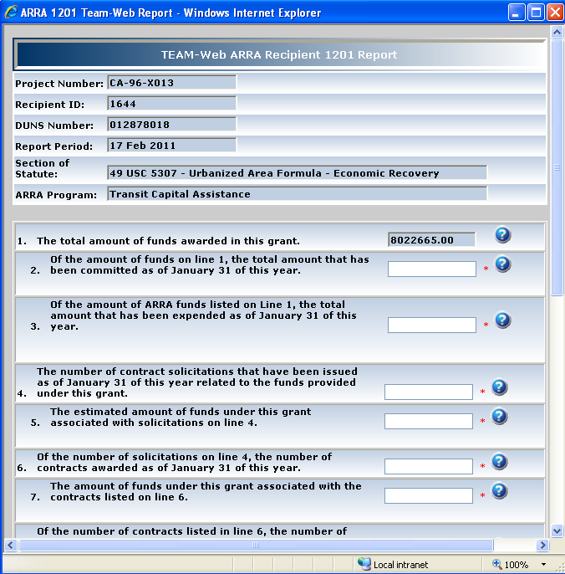
Initiating a Report

Slide 42
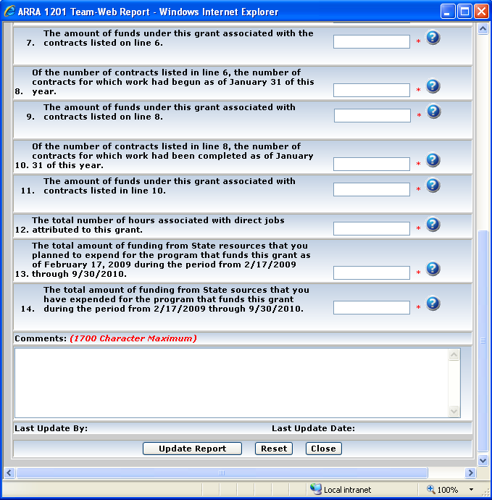
Initiating a Report

Slide 43
View/Edit Report

Slide 44
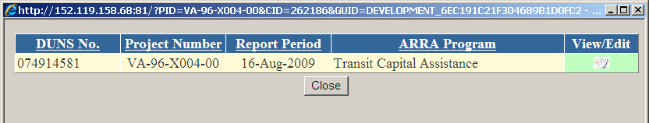
View/Edit Your Report

Slide 45
How to Access 1201(c) Guidance in TEAM

Slide 46
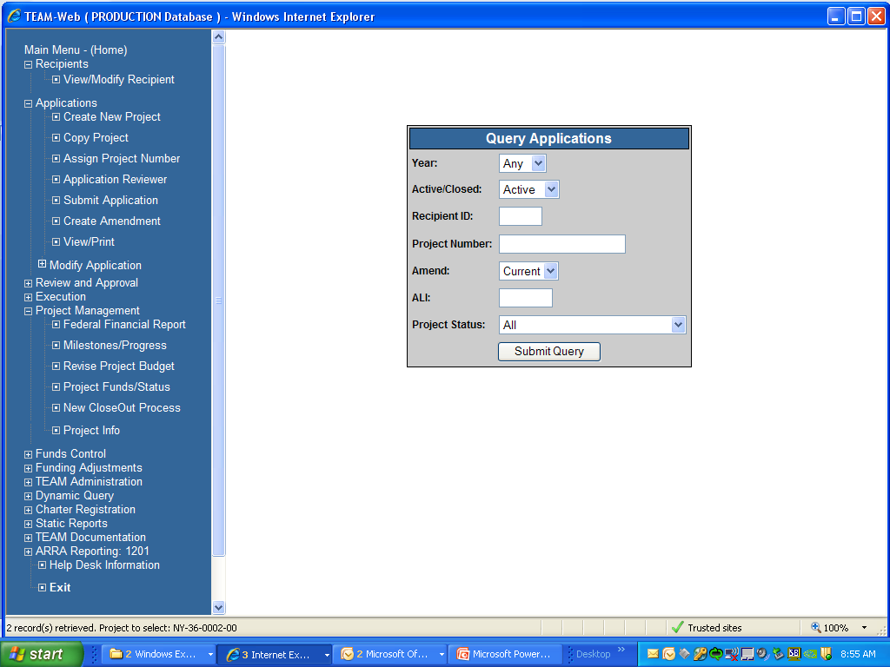
How to Submit a Final 1201c Report

Slide 47
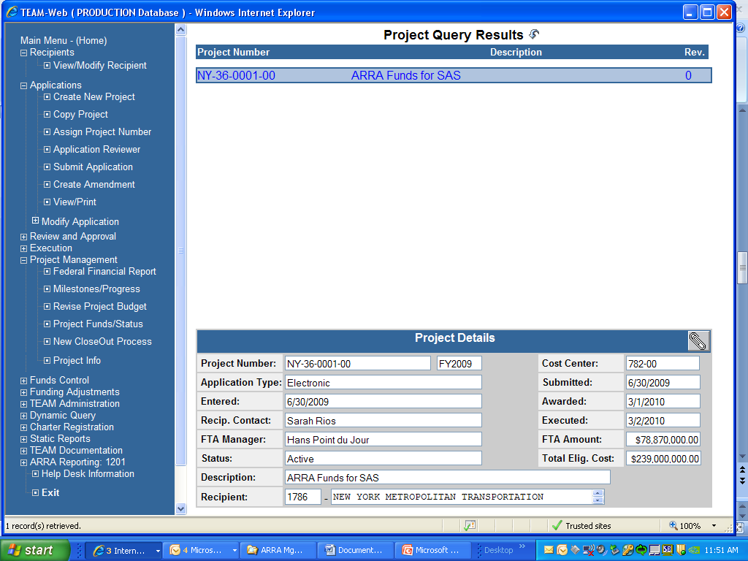
How to Submit a Final 1201(c) Report

Slide 48
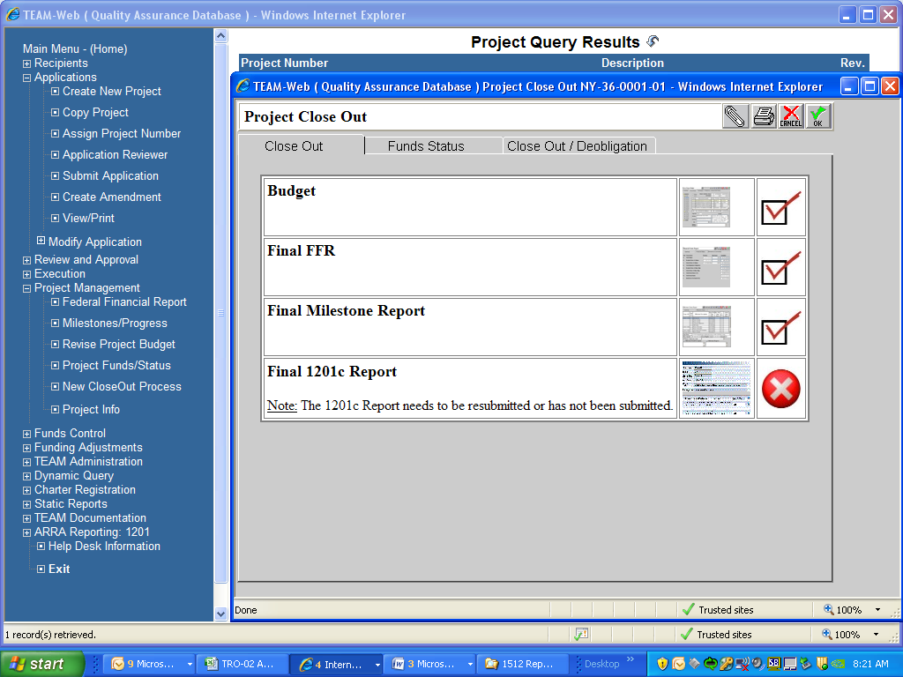
How to Submit a Final 1201(c) Report

Slide 49
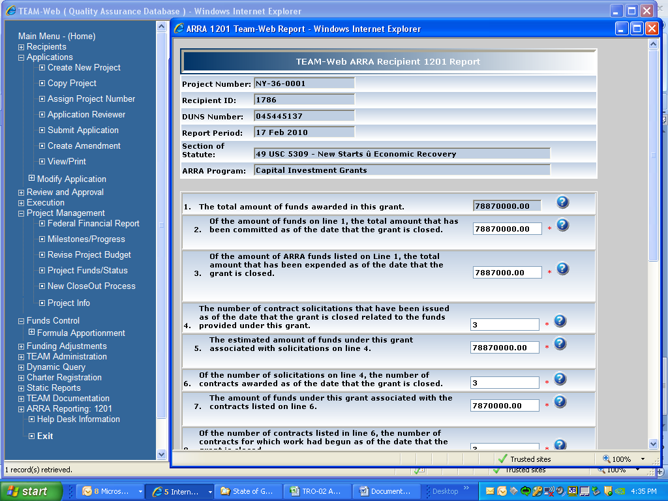
How to Submit a Final 1201(c) Report

Slide 50
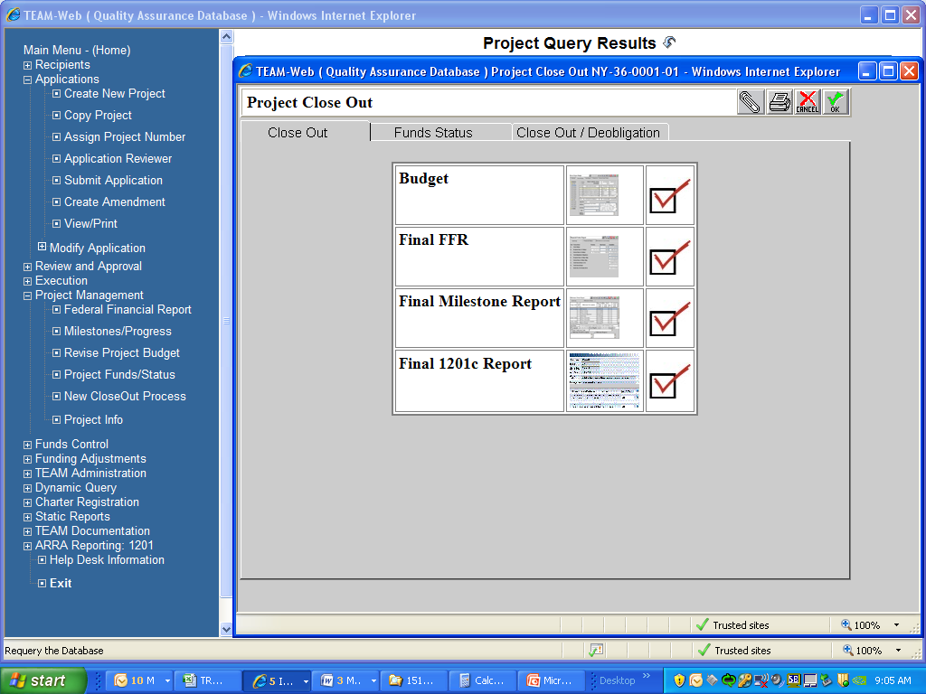
How to Submit a Final 1201(c) Report

Slide 51
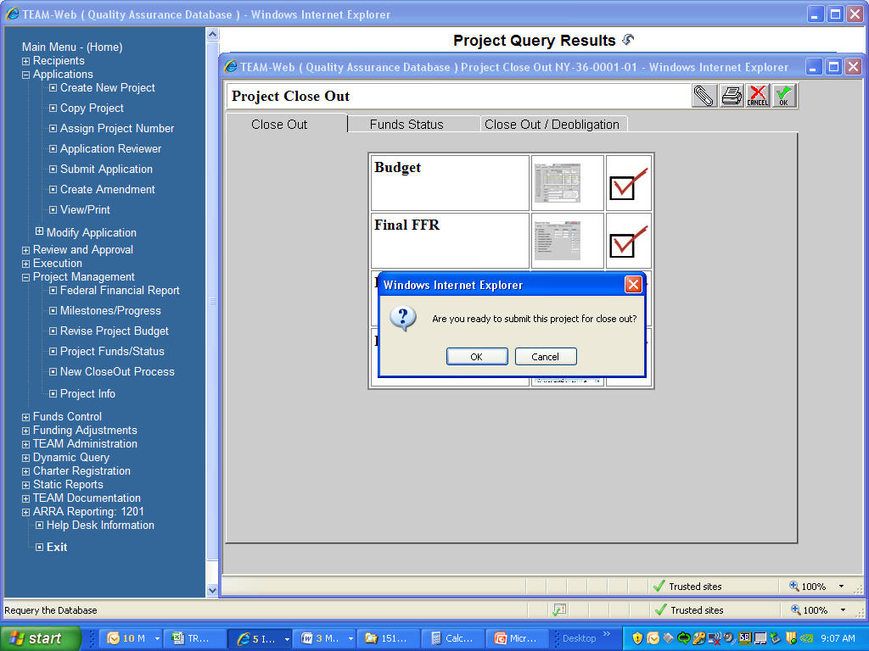
How to Submit a Final 1201(c) Report

Slide 52
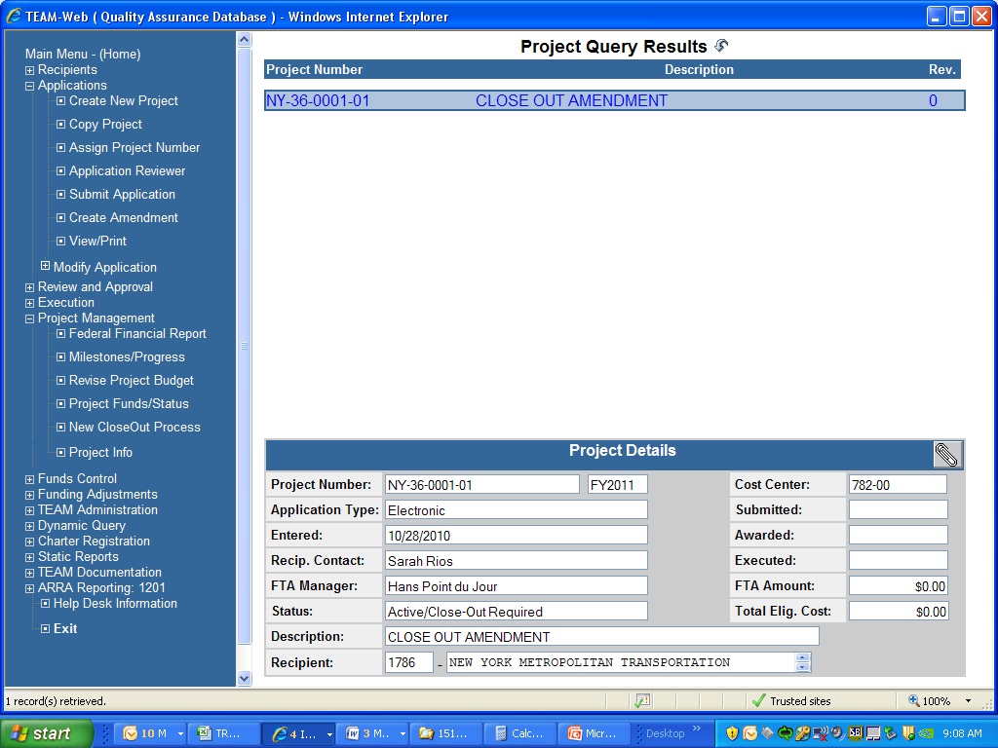
How to Submit a Final 1201(c) Report

Slide 53
How to Contact the TEAM Help Desk
1 - 888 - 443 - 5305
Team.HelpDesk@dot.gov

Slide 54
Additional 1201(c) Information
Q: What will FTA do with the information submitted?
Q: What will happen if information is not submitted on time?

Slide 55
Additional 1201(c) Information
Q: Will FTA review the report information for accuracy?
Q: Can 1201(c) Reports be combined with other reports?

Slide 56
Contact Information
  FTA Regional Points of Contact
    Region 1: Sean Sullivan 617-494-2484
    Region 2: Rosie Luperena (212) 668-2282
    Region 3: Elaine Burick (215) 656-7100 and Devendra Soni (215) 656-7257
    Region 4: Margarita Sandberg (404) 865-5612
    Region 5: Rotimi Ogunsuyi (312) 353-4070, Felisha Philips (312) 353-4025
    Region 6: Terry Showalter (202) 604-6875 & Esther Ssali (202) 400-1092
    Region 7: Daniel Nguyen (816) 329-3938 and William Kalt (816) 329-3927
    Region 8: Ryan Hammon (720) 963-3336
    Region 9: Pak Chu (415) 744-0141 and Karineh Gregorian (213) 202-3958.
    Region 10: Elaine Wine (206) 220-7536 and Ken Feldman (206) 220-7521
  FTA Headquarters Point of Contact
    Shapell Randolph (202) 366-1018
56

Slide 57
Questions?

