Slide 1

National Transit Datapalooza
17 June, 2015
Keith Gates
Senior Analyst
Federal Transit Administration

Slide 2
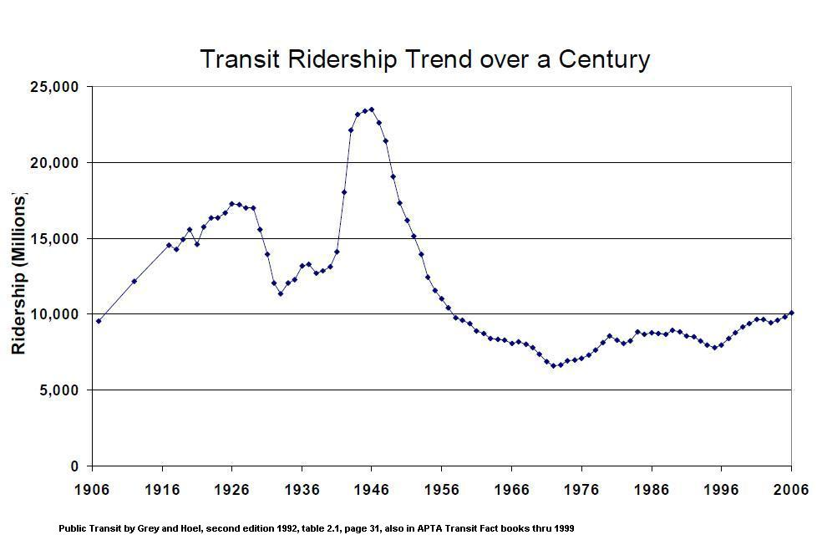
25
20
(Billions)
15
10
5

Slide 3
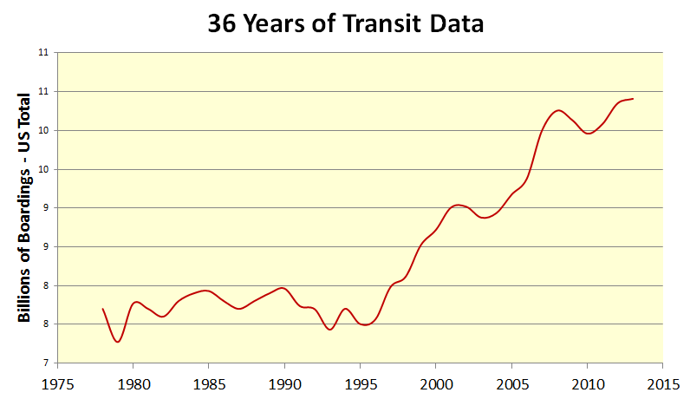

Slide 4
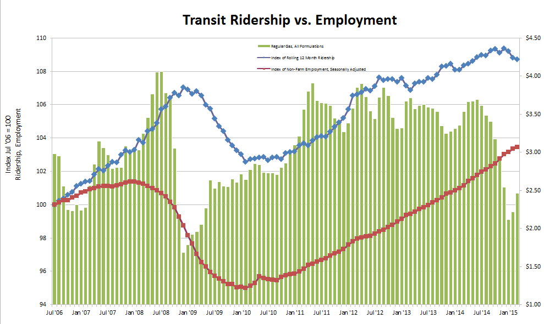
Riders
Employment
Gas Price
Monthly data from 7/06 to 3/15

Slide 5
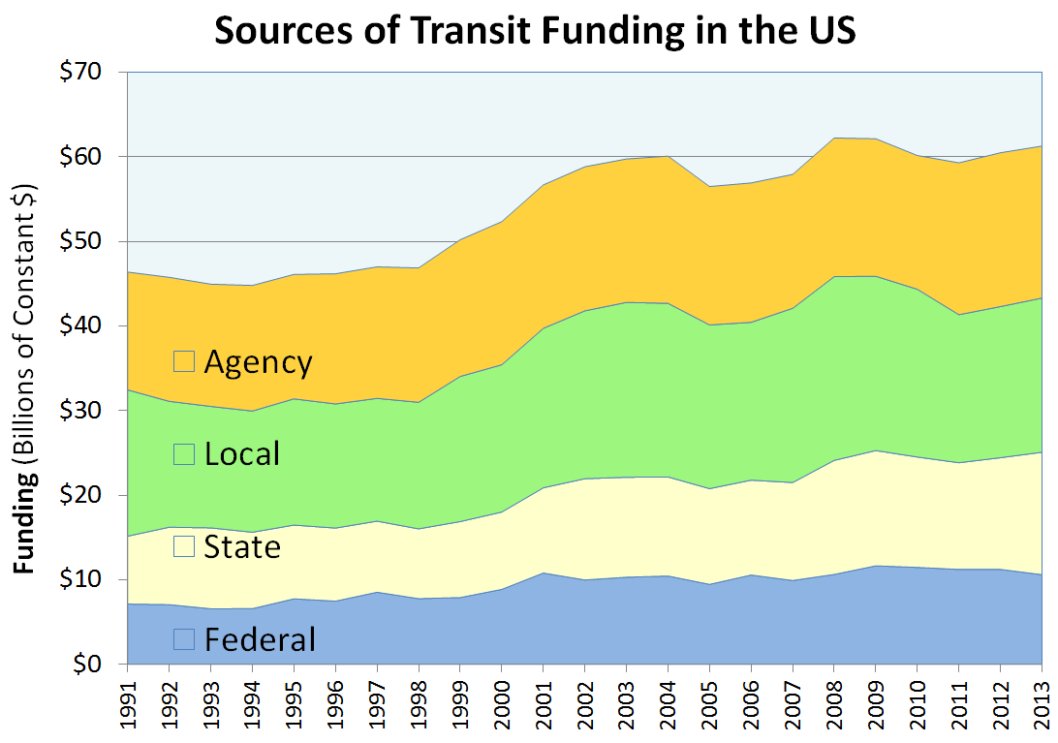
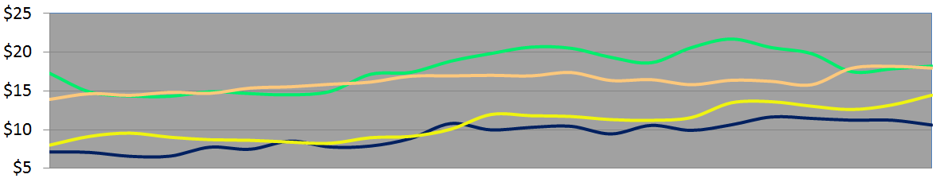

Slide 6
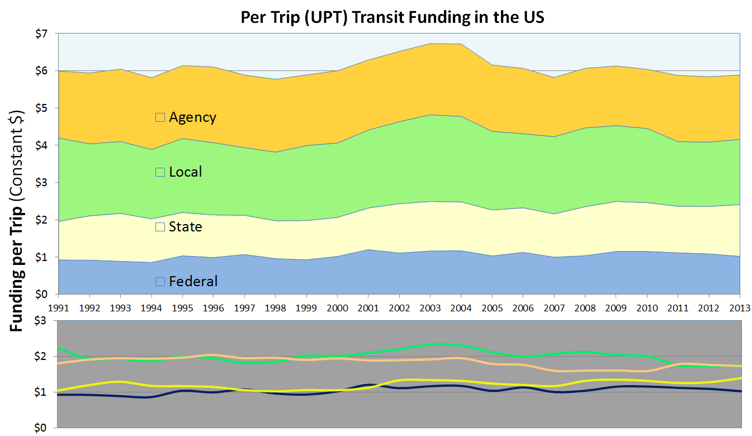

Slide 7
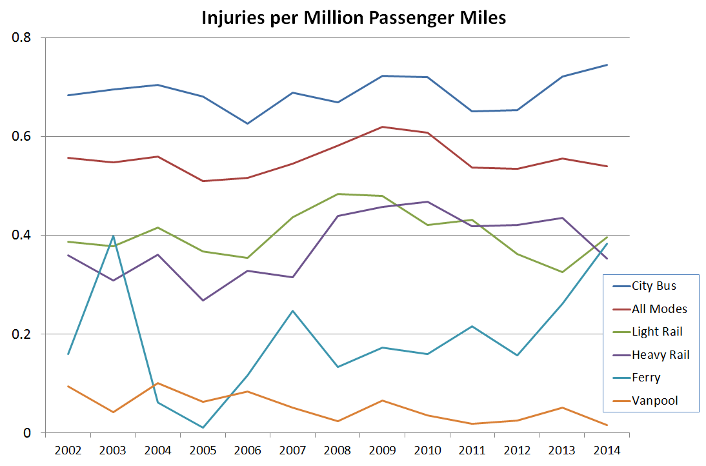

Slide 8
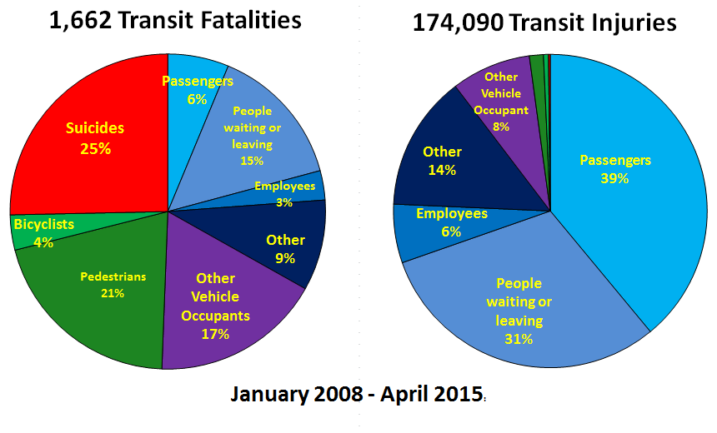

Slide 9
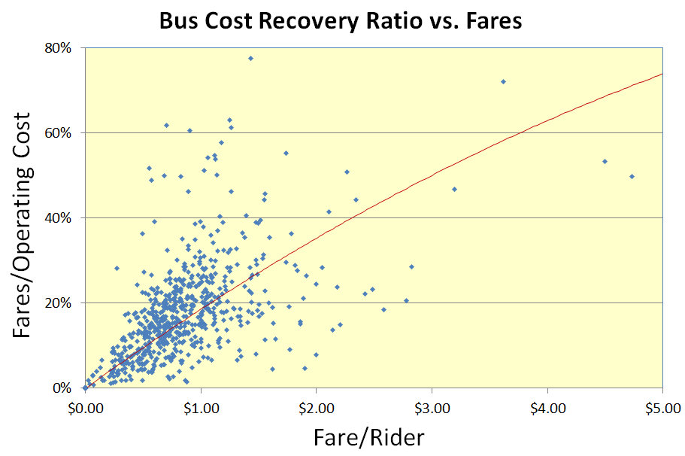

Slide 10
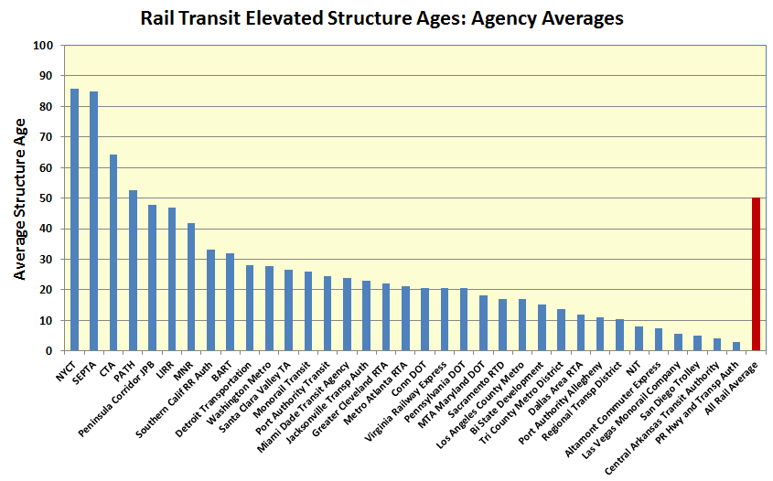

Slide 11
Capital Reinvestment Needs Forecast

Slide 12
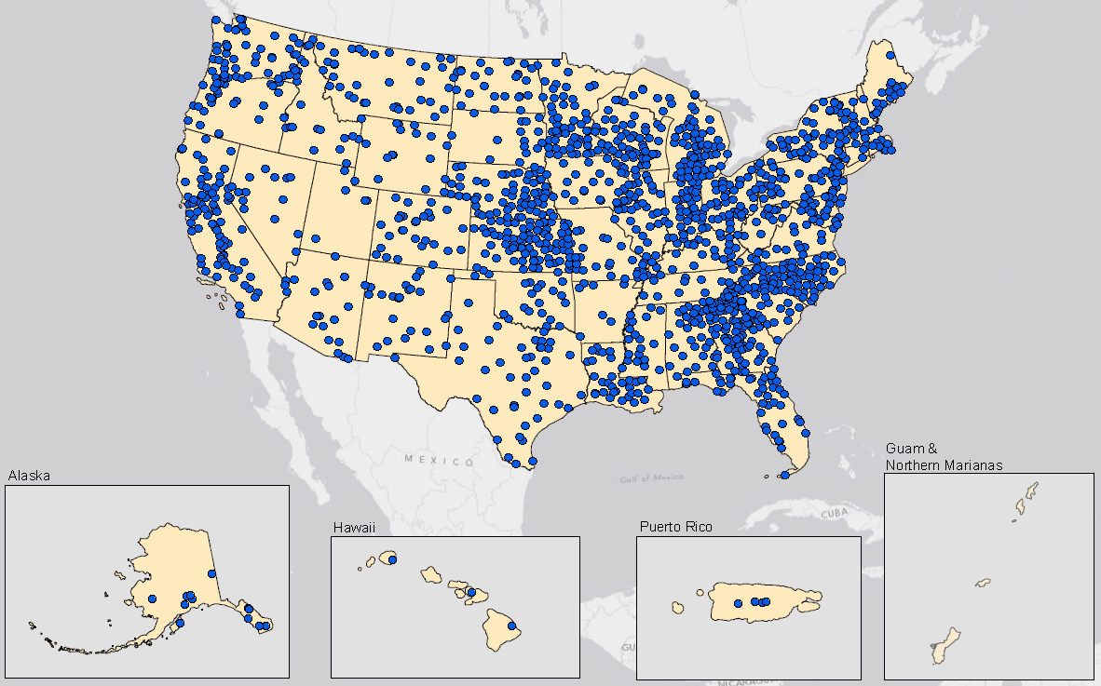
Rural
Transit Systems

Slide 13
Contact Info
Keith Gates
Manager, National Transit Database
DOT HQ, 1200 NJ Ave. SE, DC
202-366-1794
keith.gates@dot.gov
www.fta.dot.gov
www.ntdprogram.gov

