Slide 1
PROCUREMENT SYSTEM REIVEW
FY2015 WORKSHOP

Slide 2
WELCOME
Opening Remarks / Introductions
Housekeeping
Hotel Emergency Procedures
Workshop Format

Slide 3
Agenda
Day 1:
9:00am Welcome and Introductions
9:15am Presentation of FTA Requirements
Most Common Procurement Findings
System-Wide Procurement Elements
Contents of an Effective Policies and Procedures Manual
12:00pm Lunch
1:00pm Aspects of Micro Purchase, Small Purchase, Cost and Price Analysis
4:30pm Adjourn
Day 2:
9:00am Sealed Bids
12:00pm Lunch
1:00pm Request for Proposal Requirements, Sole Sources, A&E, and Construction Methods Requirements
Joint Procurement and Piggybacking Requirements
Clauses
Rolling Stock Requirements
2:00pm Review Documentation Requirements
3:00pm Adjourn

Slide 4
FTA Workshop Objectives
Explain the Procurement System Review Process
Clarify FTA procurement requirements
Provide guidance / technical assistance
Improve ability to access resources
Answer your questions (please ask them!)
Reduce the number of findings
Encourage interaction / networking with peers

Slide 5
Who is Here?
Have you had/or are you scheduled for a Procurement System Review?
What are your procurement responsibilities in your agency?
How can we best assist you in the workshop?

Slide 6
Purpose of the
Procurement System Review
The PSR is an assessment of recipient’s:
  Procurement system:
    policies & procedures
    implementation of the policies and procedures
  Management of grant funds in compliance with FTA regulations and recipient’s contractual agreement with the FTA
Notes:
Uniform Administrative Requirements Cost Principles, and Audit Requirements for Federal Awards (2 CFR Part 200)

Slide 7
Your Greatest Resources
FTA Circulars and legal opinions define the requirements
Other helpful resources:
FTA website www.fta.dot.gov
  Procurement Online Tools and Resources
  Third Party Procurement Frequently asked Questions,
  Civil Rights
FTA Regional Office Staff
Peer Grantees
Co-Workers
Notes:
FTA C 4220.1F Third Party Contracting Guidance

Slide 8
Key Regulations and Circulars
Regulations
Circulars
2 CFR Part 200
49 CFR Part 18
Master Agreement
Common Rule (48 CFR Part 18)
49 CFR Part 19
FTA C 4220.1F
FTA C 5100.1 (Bus & Bus Facilities)
FTA C 5300.1(State of Good Repair)
FTA C 6100.1E (Technology)
FTA C 9040.1G (Non-Urbanized))
FTA C 9070.1F (ADA Capital)
FTA C 9050.1 (JARC)
FTA C 9045.1 (New Freedom)
FTA C 9300.1B (Capital Investment)
FTA C 9030.1E (5307 Program)
FTA C 5010.1D (Grants Management Requirements)
Notes:
8
8
Regulations:
Common Rule (48 CFR Part 18 Uniform Administrative Requirements for Grants and Cooperative Agreements to State and Local Governments)
49 CFR Part 19 Uniform Administrative Requirements for Grants and Agreements with Institutions of Higher Education, Hospitals, and Other Non-Profit Organizations
Because of differences between Parts 18 and 19, requirements in Procurement are different for public entities and non-profits.
9040.1F Nonurbanized Area Formula Program Guidance and Grant Application Instructions
-Largely self-contained
-When silent on an issue, 5010 applies (VI.2)
5010.1C Grant Management Guidelines
-Administrative guidance for all non-state-managed programs

Slide 9
FTA Circular 4220.1F
FTA’s Third Party Contracting Requirements 4220.1F became effective Nov. 1, 2008
  Updates:
    Revision 1 – April 14, 2009
    Revision 2 – July 1, 2010
    Revision 3 – February 15, 2011
    Revision 4 (current version) – March 18, 2013

Slide 10
FTA Circular 4220.1F cont.
Applies to:
  Transit authorities
  FTA recipients and sub-recipients that contract with outside sources
Does not apply to States:
  States follow their own procedures, BUT must comply with FTA C. 4220.1F:
    Contract Term Limitations, Competition, Geographic Preference, A&E Services, and Awards to Responsible Contractors
    Inclusion of Federally-required clauses
Notes:
Taken from Alison’s email dated 4/24/15: Following is the direction we received regarding editing the PSR Guide to reflect changes in policy concerning the previous geographic preference prohibition. Our questions follow the guidance below.
“The item below must be included with edits as regulations pertaining to geographic preference has changed.
As part of the Appropriations Act for 2015, Congress enacted section 418 (Section 418 of the Consolidated and further Continuing Appropriations Act, 2015, Public Law No. 113-235), which prohibits FTA from using FY 2015 funds to implement, administer, or enforce 49 CFR 18.36(c)(2) for construction hiring. Section 18.36(c)(2) prohibits the use of statutorily or administratively imposed in-State or local geographical preferences in the evaluation of bids or proposals. Effective December 26, 2014, 49 CFR part 18 will apply only to grants obligated on or before December 25, 2014. Grants obligated on or after December 26, 2014 will be subject to 2 CFR part 200. This provision (18.36(c)(2)) is codified at 2 CFR 200.319(b) and is substantively the same as 18.36(c)(2). Although Congress did not address the change in codification in section 418, FTA intends to apply section 418 to grants obligated on or after December 26, 2014 and subject to 2 CFR 200.319(b). Accordingly, grantees may include in-State or local geographic preferences in construction contracts awarded or advertised in FY2015. FTA will provide additional guidance regarding the implementation and applicability of section 418 on its website at www.fta.dot.gov<http://www.fta.dot.gov>. Grantees may not use section 418 to alter or amend the requirements of the Disadvantaged Business Enterprise Program.
Please include this example:
“The following is the proposed question on Triennial Reviews and Procurement System Reviews.
Q. I have a Triennial Review or Procurement System Review scheduled in FY2015. Can FTA make a deficiency finding that construction contracts entered into before FY2015 contained a geographic preference?
A. No. Section 418 prohibits FTA from enforcing 49 CFR 18.36(c)(2). FTA, however, will ask recipients if they have any contracts with geographic preferences for information purposes only. ”

Slide 11
MAP-21 Changes to Procurement Requirements
Gives recipients the ability to request additional clarifying information before making an award
Excluded Parties List System (EPLS) is now located in System for Awards Management (SAM) at SAM.gov
Allows recipients to establish 7 year contracts (including options) for rail procurements
Requires recipients to ensure contractors working on a capital construction project give a hiring preference, to the extent practicable, to qualified veterans (except over equally qualified minorities or members of other protected classes)
Places restrictions on joint or piggyback procurements, and use of state or local government purchasing schedules

Slide 12
Use of the
Best Practice Procurement Manual (BPPM)
Provides “suggested” procedures, methods, and examples to “advise” a recipient on procurement tasks
Is not a source of federal requirements, is not binding on recipients
Should not be relied on “solely” to establish requirements.

Slide 13
FTA Oversight Activities
Annual Recipient Assessment
  Performed by the Regional Offices
  Assists in Determining Level of Oversight
    Low, medium or high
    Specialty Reviews

Slide 14
FTA Oversight Activities cont.
Assessment Areas
  Grant Administration
  Recipient Profile
  Property Management
  Financial Management
  Procurement Management
  Technology Deployment
  Safety and Security
  Planning
  Civil Rights

Slide 15
FTA Oversight Activities cont.
Comprehensive Reviews
  Triennial Review
    Conducted of recipients of 5307 funds
    Mandated by law
    2 of 17 areas reviewed relate to Procurement and DBE
  State Management Review
    Conducted of states and territories
    Focuses primarily on recipients of 5311, but also incorporates questions from other funding programs
    2 of 13 areas reviewed relate to Procurement and DBE
Notes:
*Note: 5316 Job Access and Reverse Commute and 5317 New Freedom Program, have been repealed but remain a part of the PSR review until all grants have been closed out.
5307 Urbanized Area Formula Grants
5309 Fixed Guideway and Capitol Investment Grants
5310 Enhanced Mobility of Seniors and Individuals with Disabilities
5311 Formula Grants for Rural Area
5312 Research, Development, Demonstration and Development Projects
5314 Technical Assistance and Standards Development
5325 Public Transportation Emergency Relief Program
5326 Transit Asset Management
5329 Transit Safety and Oversight Program
5337 State of Good Repair Grants

Slide 16
FTA Oversight Activities cont.
Program Specific Reviews
  Procurement System
  Financial Management
  Safety and Security
  Civil Rights
  Drug and Alcohol Audits
Project Level Reviews
  Project Management Oversight
  Financial Capacity Assessments
  Safety and Oversight Management Program

Slide 17
Review Process
Desk review
Notification letter
Regional Work Plan Meeting
Site visit
  Opening Conference
  On Site Review
  Exit Conference
Draft Report
Draft Final Report
Final Report
Resolution of findings / Technical Assistance
Follow-up reviews

Slide 18
Top 10 Deficiency Areas Across all
Oversight Review Programs for FY 10- FY14

Slide 19
Top Ten Triennial Deficiency Areas
Nationally FY10-FY14

Slide 20
Top 10 Procurement Deficiencies
Nationally for FY10 - FY14
Independent Cost Estimate (ICE)
Lack of Required Federal Clauses
Cost or Price Analysis
Award to Responsible Contractors
Procurement Policies and Procedures
Cost Analysis Required [Sole Source]
Written Record of Procurement History
Sound and Complete Agreement
Sole Source if Other Award is Infeasible
Contract Administration System

Slide 21
Procurement System Review Scope
Assess Recipients’ System-Wide Elements (6)
AND
Test Individual Procurement Elements
A sample of procurements is tested for 56 elements (as applicable) including Buy America Certifications
It is a review of the entire Procurement system, not just procurement files.

Slide 22
6 System-Wide Elements
Policies, procedures and organizational determinations necessary to guide the procurement function
  Written Standards of Conduct
  Contract Administration System
  Written Protest Procedures
  Prequalification System
  System for Ensuring Most Efficient and Economic Purchase
  Procurement Policies and Procedures
System-Wide Elements Checklist

Slide 23
Written Standards of Conduct
Basic Requirement
(FTA C 4220.1F Ch. III, 1. )
Requires each recipient to maintain written standards of conduct governing the performance of its employees engaged in the award and administration of contracts.
Element #1 of the PSR

Slide 24
Written Standard of Conduct cont.
Standards Applicable to:
Employees, officers, agents, board members, or immediate family member, partner or organization participating in the selection, award, or administration of a contract if a conflict of interest, real or apparent, would be involved.
What is a conflict?
If any of the following have a financial or other interest in the firm selected for award:
(1) Employee, officer, agent, board member; or their
- immediate family members,
- partners
(2) An organization that employs or is about to employ any of the above.

Slide 25
Written Standard of Conduct cont.
Standards must also address:
Prohibition of solicitation and acceptance of gifts, gratuities, favors, or anything of monetary value from contractors, potential contractors, or parties to sub-agreements.
Penalties, sanctions, or other disciplinary actions - for violation of standards by the recipient's officers, employees, agents, board members, contractors, or sub-recipients. (To the extent permitted by state or local law or regulations)
Notes:
PUT NOMINAL DEFINITION HERE
FAR 3-101-2

Slide 26
Contract Administration System
Basic Requirement
(FTA C 4220.1F Ch. III, 3)
Recipients shall maintain a contract administration system that ensures that contractors perform in accordance with the terms, conditions, and specifications of their contracts or purchase orders and applicable Federal, State and Local requirements.
Element #2 of the PSR
TOP TEN FINDING
Notes:
Questions #18-21 of TR Procurement Area

Slide 27
Contract Administration System cont.
How does recipient define “contract administration?”
a. Do you have written procedures describing the activities associated with contract administration?
b. How is contract administration provided within your organization? For example, once a contract is awarded (or purchase order issued), how do you ensure the terms and conditions of the contract are met; by the contractor and by your agency?
c. How does your agency inform staff of their contract administration responsibilities? What formal training is provided?
d. Which personnel are responsible for overseeing contract administration activities?
e. Do contract administration activities include evaluating contractor performance?
f. If yes, how is the evaluation completed and documented, what office or job position receives the evaluation, and how does your agency utilize the information?
g. How are contract changes managed and recorded? Are there written procedures?
Notes:
Question #44 of TR Procurement Area

Slide 28
Contract Administration System cont.
How does recipient demonstrate that it manages contract amendments and change orders, ensuring they are:
  Approved by the appropriate authorized official(s)?
  Determined to be fair and reasonable via use of independent cost estimate(s) and cost or price analyses?
  Consistent with the contracts base scope?
Notes:
Question #45 of TR Procurement Area

Slide 29
Elements of an Effective
Contract Administration System
Assign responsibility for assuring:
  the supplier performs the work the contract calls for
  satisfactory quality
  timeliness of performance
  performance within available funds
  receipt, inspection, acceptance, and certification for payment
  the history of contracting activities are documented
  information is retained for use in future responsibility determinations

Slide 30
Written Protest Procedures
Basic Requirement
(FTA C 4220.1F Ch. VII, 1.)
  Recipients are to have written protest procedures, as part of their requirement to maintain or acquire adequate technical capacity.
  Recipients must notify FTA when they receive a protest and keep FTA informed about its status.
  When a recipient denies a bid protest, they are to inform FTA.
Element #3 of the PSR
Notes:
Best Practices - BPPM § 11.1

Slide 31
Written Protest Procedures cont.
Limits on FTA’s protest review
FTA will only consider a protest if:
  a recipient fails to have protest procedures
  a recipient fails to follow its protest procedures
  there has been a violation of Federal law or regulation
Appeals to FTA must be received within 5 working days of the date when the protester received actual or constructive notice of the recipient’s final decision

Slide 32
Written Protest Procedures cont.
Items to consider:
Procedural differences for pre-bid, pre-award, and post-award protests
Deadlines for filing a protest
Specific contents of a protest
Location where protests are to be filed
Statement that recipient will respond
Identification of official responsible to make final determination
Statement that decision is final
Statement that FTA will only intervene when recipient fails to follow protest procedure
Allowance for request for reconsideration

Slide 33
Prequalification
Basic Requirement
(FTA C 4220.1F Ch. VI, 1.c. )
Recipients can prequalify people, firms, and property for procurement purposes if:
  All prequalification lists are current.
  All prequalification lists include enough qualified sources to ensure maximum full and open competition.
  The recipient permits potential bidders to qualify during the solicitation period (from the issuance of the solicitation to its closing date).
Element #4 of the PSR
Notes:
Define current and enough?

Slide 34
Prequalification cont.
Recipients are not required, or encouraged, to have a prequalification system.
They can be difficult and costly to maintain if they are to not inhibit competition.
Prospective contractors must be able to pre-qualify up to the due date of a specific solicitation.

Slide 35
System for Ensuring Most Efficient and Economic Purchase
Basic Requirement
(FTA C 4220.1F Ch. IV, 1. b., c., and e.)
Recipients are required to establish procedures to avoid the purchase of unnecessary property and services they do not need (including duplicative items and quantities or options they do not intend to use or whose use is unlikely).
Recipients should consider whether to consolidate or break out the procurement to obtain a more economical purchase.
Recipients should review lease versus purchase alternatives for acquiring property and, if necessary, should obtain an analysis to determine the more economical alternative.
Element #5 of the PSR

Slide 36
System for Ensuring Most Efficient and Economic Purchase cont.
Organizational questions to ask in relation to actual analysis performed by recipient:
Who has authority to initiate procurements within the agency?
Who has authority to approve procurements?
Does the agency have a requisitioning system?
Does the agency endeavor to combine and leverage volumes?

Slide 37
Procurement Policies and Procedures
Basic Requirement
(FTA C. 4220.1F Ch. III, 3.a.)
  Recipients must have written procurement procedures as a condition of self-certification.
Note: To insure implementation, training on the policies and procedures should be conducted. It also helps to conduct self assessments to ensure staff are in compliance.
Element #6 of the PSR
TOP TEN FINDING

Slide 38
Procurement Policies and Procedures cont.
When were the procurement procedures last updated?
How do the policies or procedures address full and open competition for all transactions under the following methods of procurement?
  Micro-Purchases ($3,000 or less)
  Small Purchases - over $3,000 but not more than $150,000 ($100,000 if executed prior to Super Circular, Dec. 26, 2014)
  Sealed Bids/Invitation for Bid (IFB)
  Competitive Proposals/Request for Proposals (RFP)
  Revenue Contracts
Notes:
Note: On December 19, 2014, a joint interim final rule was published, implementing for all Federal award-making agencies the final guidance “Uniform Administrative Requirements, Cost Principles, and Audit Requirements for Federal Awards” (commonly referred to as the “Super Circular”), which was published by the Office of Management and Budget (OMB) on December 26, 2013.
The Super Circular consolidates eight existing grant-related circulars into one set of uniform regulations located in Title 2 of the Code of Federal Regulations (CFR). 2 CFR Part contains certain notable changes to the Federal Transit Administration (FTA) grants management, including standardizing the simplified acquisition threshold from $100,000 to $150,000 (including for purposes of FTA Buy America regulations at 49 CFR part 661) and tying all future increases to the FAR (2 CFR § 200.318);
2 CFR Part 200 applies to the administration of all Federal grants and cooperative agreements as of December 26, 2014. Procurements under grants and cooperative agreements executed prior to December 26, 2014 continue to be subject to 49 CFR parts 18 and 19 as in effect on the date of such grants or agreements.

Slide 39
Procurement Policies and Procedures Cont.
Policies and Procedures are expected to Address:
Responsibility Determination
Written Record of Procurement History
“Time and Materials” Type Contracts
Contract Term Limitation for Rolling Stock
Tag-Ons
Full and Open Competition
Unreasonable Requirements and Excessive Bonding
Organizational Conflict of Interest
Prohibition on Arbitrary Action
Geographic Preference
Contractor Selection Procedures
Clear and Accurate Contract Specifications
“Brand Name or Equal” Requirements
Requirements Applicable to Micro-Purchases
Requirements Applicable to Small Purchases
Requirements Applicable to Sealed Bid
Requirements Applicable to Competitive Proposals
Notes:
Geographic Preference now permitted for construction hiring. It remains prohibited as an element of construction award.

Slide 40
Procurement Policies and Procedures Cont.
A&E, Brooks Act Procedures
Procurement of Design-Bid-Build
Procurement of Design-Build
Sole Source Documentation Requirements
Requirements for the use of Options
Cost and Price Analysis
Independent Cost Estimates
Cost and Profit Analysis for Sole Source
Cost Principles consistent with Federal Guidelines
Prohibition on Cost-plus-Percentage of Cost
Bonding Requirements
Prohibition on Advance Payments
Progress Payments
Liquidated Damages
Notification of FTA Participation
Remedies for Breach of Contract
Termination Clauses
Address Federal Statutory and Regulatory Requirements
Revenue Contracts
Exercise: Review this list and develop 4-5 areas for improvement to share with the group.

Slide 41
Procurement Methods
Five major methods (see threshold)
    Micro-Purchase ($3,000 or less)
    Small Purchase - Less than $150,000 ($100,000 if executed prior to Super Circular, Dec. 26, 2014)
    Invitation for Bids (IFB)
    Request for Proposals (RFP)
    Other than Full and Open (Sole Source)
Specific Methods
    A&E
    Construction
    Bus and Rail Purchases (Buy America)
Notes:
Note: On December 19, 2014, a joint interim final rule was published, implementing for all Federal award-making agencies the final guidance “Uniform Administrative Requirements, Cost Principles, and Audit Requirements for Federal Awards” (commonly referred to as the “Super Circular”), which was published by the Office of Management and Budget (OMB) on December 26, 2013.
The Super Circular consolidates eight existing grant-related circulars into one set of uniform regulations located in Title 2 of the Code of Federal Regulations (CFR). 2 CFR Part contains certain notable changes to the Federal Transit Administration (FTA) grants management, including standardizing the simplified acquisition threshold from $100,000 to $150,000 (including for purposes of FTA Buy America regulations at 49 CFR part 661) and tying all future increases to the FAR (2 CFR § 200.318);
2 CFR Part 200 applies to the administration of all Federal grants and cooperative agreements as of December 26, 2014. Procurements under grants and cooperative agreements executed prior to December 26, 2014 continue to be subject to 49 CFR parts 18 and 19 as in effect on the date of such grants or agreements.

Slide 42
Micro-Purchase Requirements
No splitting
Fair and Reasonable Price Determination
Micro-purchase Davis Bacon
  Construction contracts exceeding $2,000
Notes:
BPPM 4.1

Slide 43
Micro-Purchase: No Splitting
Basic Requirement
(FTA C 4220.1F Ch. VI, 3.a (2)(b))
Recipients may not divide or reduce the size of procurements merely to come within the micro-purchase limit.
Key Question: How much does the agency review micro-purchases at or near the threshold as a way to thwart splitting?
Examples of Splitting:
  A requisition each week for the same item in the same quantity.
  Multiple requisitions for the same service right at the micro-purchase threshold.
Element #20 of the PSR

Slide 44
Micro-Purchase: Fair and Reasonable Price Determination
Basic Requirement
(FTA C 4220.1F Ch. VI, 3.a (1) and (2)(a) and (c))
Micro-purchases may be made without obtaining competitive quotations.
Recipients should distribute micro-purchases equitably among qualified suppliers.
Only documentation requirement for micro-purchases is a determination that the price is fair and reasonable and a description of how determination was made.
Element #21 of the PSR

Slide 45
Micro-Purchase: Fair and Reasonable Price Sample Determination Form
I hereby determine the price to be fair and reasonable based on at least one of the following:
Check one or more:
_____ Found reasonable on recent purchase. _____ Similar in related industry.
_____ Obtained from current price list. _____ Personal knowledge of item procured.
_____ Obtained from current catalog. _____ Regulated rate (utility).
_____ Commercial market sales price from advertisements. _____ Other.
Comments:
______ Copy of purchase order, quotes, catalog page, price list, etc. is attached.
___________________________ _____________________________
Purchasing Agent Date

Slide 46
Micro-Purchase: Davis Bacon
Basic Requirement
(FTA C 4220.1F Ch. VI, 3.a (1))
Davis-Bacon prevailing wage requirements, apply to construction contracts exceeding $2,000, even though micro-purchase procurement procedures are used.
Prevailing Wage requirements apply to publicly funded construction contracts and require certified payrolls and audits.
Element #22 of the PSR

Slide 47
Davis-Bacon Prevailing Wages
Laborers and mechanics must be paid:
  not less than once a week, and
  not less than the minimum wage specified in the current DOL prevailing wage determination
Recipients must include a copy of the current DOL prevailing wage determination in each contract solicitation and must condition award upon acceptance of that wage determination

Slide 48
Small Purchase Elements
Independent Cost Estimate
Unreasonable Qualifications
Arbitrary Actions
Brand Name Restrictions
Geographic Preference
Contract Term Limitation
Price Quotation
Clear, Accurate, and Complete Specification
Cost or Price Analysis
Written Record of Procurement History

Slide 49
Independent Cost Estimate
Basic Requirement
(FTA C 4220.1F Ch. VI, 6. )
…in connection with every procurement action . . . grantees must make independent estimates before receiving bids or proposals.
Element #7 of the PSR
TOP TEN FINDING
Notes:
Question #16 of TR Procurement Area
Best Practices -BPPM § 2.3.2

Slide 50
Independent Cost Estimate cont.
How do you ensure that an independent cost estimate (ICE) is performed before receiving bids or proposals?
Independent doesn’t mean independent of your agency, it means independent of (and prior to) bids and proposals being received.
Document the ICE – date and source.
Notes:
Question #16 of TR Procurement Area

Slide 51
Sample Independent Cost Estimate Form
Contract Type: Date of Estimate:
Description of Goods / Service:
Method of Obtaining the Estimate:
I have obtained the following estimate from:
Published Price List / Past pricing (date)____________
Engineering or technical estimate
Independent Third Party estimate
Other (specify)_____________________________________________
Cost Estimate Details:

Slide 52
Sample Independent Cost Estimate Form cont.
Cost of Standard Items
Product | Cost $/ea. | Cost $/ea. | Notes / Data Source
 | Delivered | No Freight
US Dollars
Cost of Services, Repairs, or Non-Standard Items
Item / Tasks
Materials | Other Direct Costs | Labor (rate, hours) | Labor Class | Allocated Overhead | SG&A | Profit | Total
Signature of Preparer:

Slide 53
Exercise – Independent Cost Estimate
True or False: | T | F
1. The ICE is developed by the supplier.
2. The ICE is completed after bids or proposals are received.
3. It is okay to have an ICE prepared by the supplier who is not going to bid on the project.
4. A budget number is acceptable as an ICE.
5. The ICE is the foundation for later cost analysis.
6. The ICE can be prepared by either procurement or the end user.

Slide 54
Unreasonable Qualification Requirements
Basic Requirement
(FTA C 4220.1F Ch. VI, 2.a. (4)(a))
Imposing unreasonable business requirements on firms in order for them to qualify to do business is considered to be restrictive of competition.
Examples:
  Requiring a local office
  Requiring a certain number of staff with advanced degrees
  Element #9 of the PSR
Notes:
Best Practices - BPPM § 2.4.2.1

Slide 55
Arbitrary Actions
Basic Requirement
(FTA C 4220.1F Ch. VI, 2.a(4)(j))
Any arbitrary action in the procurement process is considered to be restrictive of competition.
Examples:
  Did not follow the procurement process
  Documentation shows one vendor should receive award but another vendor is awarded the business
Element #12 of the PSR
Notes:
Best Practices - BPPM § 2.4.2.1

Slide 56
Brand Name Restrictions
Basic Requirement
(FTA C 4220.1F Ch. III, 3.a. (1)(e))
When it is impractical or uneconomical to make a clear and accurate description of the technical requirements, a “brand name or equal” description may be used as a means to define the performance or other salient characteristics of a procurement. The specific features of the named brand which must be met by offerors shall be clearly stated.
Notes:
Best Practices - BPPM § 2.4.2.1, 2.4.2.2.1, 4.3.2, 4.4.1, 4.5.1, and 4.5.2

Slide 57
Brand Name Restrictions cont.
Basic Requirement
(FTA C 4220.1F Ch. VI, 2.a. (4)(f))
Specifying only a “brand name” product without allowing offers of “an equal” product or without listing item’s salient characteristics for the “equal” is considered to be restrictive of competition.
Element #13 of the PSR

Slide 58
Brand Name Restriction - Examples
The specification called for a specific model engine for a new bus procurement.
Brand name included in the specification without listing the salient features.

Slide 59
Geographic Preferences
Basic Requirement
(FTA C 4220.1F Ch. VI, 2.a. (4)(g))
Grantees shall conduct procurements in a manner that prohibits the use of statutorily or administratively imposed in-State or local geographical preferences in the evaluation of bids or proposals, except in those cases where applicable Federal statutes expressly mandate or encourage geographic preference.
Note: An FY15 DOT Pilot Program allows contractors to abide by State or local geographical preference mandates in construction hiring.
Element #14 of the PSR

Slide 60
Contract Term Limitation
Basic Requirement
(FTA C 4220.1F Ch. IV, 2.e(10))
A grantee may enter into a multi-year contract to buy rolling stock with an option not exceeding five (5) years to buy additional bus rolling stock or replacement parts. The grantee may not exercise that option later than five (5) years after the date of its original contract. The time frame for railcars or replacement parts has been extended to seven (7) years.
Note: The limitation applies to the ordering period.
Element #15 of the PSR

Slide 61
Contract Term Limitation cont.
Be judicious in establishing and extending contract terms on any contract.
Procurement file should contain evidence that the contract term is based upon sound business judgment.
Consider competition, pricing, fairness and public perception.
An extension of the contract term length that amounts to an “out of scope” change will require a sole source justification.

Slide 62
Price Quotation
Basic Requirement
(FTA C 4220.1F Ch. VI, 3.b. (2)(a))
Grantees must obtain price or rate quotations from an adequate number of qualified sources.
Element #23 of the PSR

Slide 63
Price Quotation Must Be Documented
Two or more qualified bidders must be obtained.
“No Bids” do not count as received bids
Bids must be “responsive” and be received from “responsible” bidders.
Verbal quotes can be received but must be documented.
Notes:
Define responsible and responsible

Slide 64
Clear, Accurate, and Complete Specification
Basic Requirement
(FTA C 4220.1F Ch. VI, 2.a.)
The solicitation and the contract awarded thereunder must include a clear and accurate description of the recipient’s technical requirements for the property or services to be acquired in a manner that provides for full and open competition.
Key Questions:
  How do you know specifications are complete?
  How many bids/proposals are being received?
  How do you establish specs that maximize competition?
Element #24 of the PSR

Slide 65
Cost or Price Analysis
Basic Requirement
(FTA C 4220.1F Ch. VI, 6)
  Grantees must perform a cost or price analysis in connection with every procurement action, including contract modifications.*
*except for micro-purchases, where a fair and reasonableness determination suffices
Element #41 of the PSR
TOP TEN FINDING
Notes:
65
65
Question #26 of TR Procurement Area

Slide 66
Cost or Price Analysis cont.
As part of its evaluation of bids and proposals prior to award, does the recipient perform a cost or price analysis?
What is the Difference?
Supplier Price |  | Supplier costs
$51,250 | One unit | Direct Labor $20,000 Direct Material 5,000 Overhead 22,500 + Profit $3,750 Total cost $51,250
Price Analysis looks at the supplier’s price in comparison to other market prices. |  | Cost Analysis breaks down the total price into its components, looking at the supplier’s costs to determine the profit margin contained in that price.
Notes:
Question #26 of TR Procurement Area

Slide 67
Questions and Answers
Question . . .
What if we can’t determine that the price per unit is fair and reasonable by analyzing the price?
Answer . . .
  Then we have to form an opinion as to the reasonableness of the per-unit price by reviewing and evaluating the individual cost elements and the profit that make up the price. In other words, we have to use cost analysis to analyze the per-unit price.

Slide 68
Questions and Answers cont.
How?
  By requiring the vendor (who may be reluctant) to supply specific dollar information concerning the elements of cost (e.g., direct, indirect, and profit) that comprise the overall per-unit price
  By independently analyzing the elements of cost in light of what we know are costs for like items, what industry standards may indicate, or what past experience has indicated
  By applying the standards or guidelines of reasonable accounting practices to determine that the supplier’s costing practices are representative of others in the field

Slide 69
Which One Should I Use?
Price Analysis is used if it is determined that competition was adequate and price was within the expected range established by the ICE.
Cost Analysis is used if it is determined that competition is inadequate or price is inconsistent with the expected range established by ICE.
Procurement Type | Analysis Type
Small Purchase | Price and/or Cost
IFB | Price and/or Cost
RFP | Price and/or Cost
Single Source | Cost
Sole Source | Cost
Contract Modifications | Cost

Slide 70
Price Analysis
Price Analysis is a direct comparison of a supplier’s price with benchmark prices for the same good or service:
Quotes/Bids Received from Competitors*
AND
Comparison with Independent Cost Estimate
Set guidelines as to when you will review submitted bids or proposals relative to the ICE. Will vary based on dollar value, market conditions. Some agencies confirm final prices on IFBs with selected suppliers.
Other sources are provided on the following slide.
*Catalog or market prices offered in substantial quantities to the public may be used for small purchases.
Price Analysis Form
Sample ICE and Price Analysis

Slide 71
Price Analysis Techniques
Purchaser must be familiar with market conditions
Compare bids
Yardsticks of measure
Compare price / quantity relationships
Comparing prices of similar products
Published information
  Supplier price lists
  Trade journals
  Government publications

Slide 72
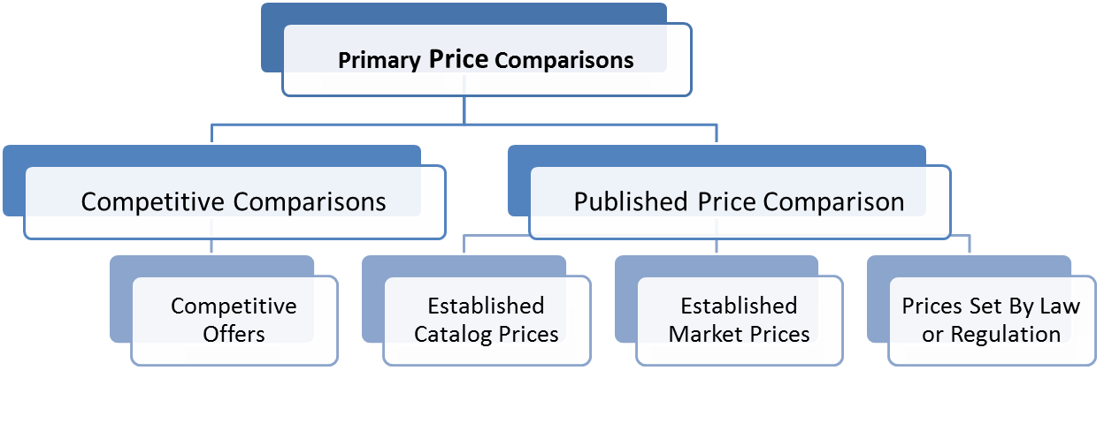
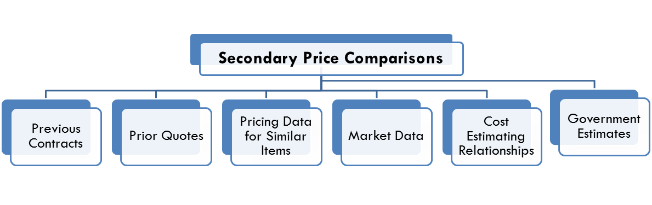
Price Analysis Comparisons

Slide 73
Checklist for Establishing Comparability

Slide 74
Case Study – Price Analysis
Scenario:
Three bids were received for project management consulting
The lowest bidder’s offer proposed a cost of $220 per hour based on the provider’s estimate that the work would take 260 hours
Total Offer = $57,200

Slide 75
Case Study – Price Analysis Cont.
Step 1: Compare low bid to other offers received
Step 2: Look up last purchase of project management consulting
    Last purchase in 2009.
    Adjust for inflation since 2009. (average 2%/ year.)
    Adjust for labor increases since 2009. (In this NAICS, 5%)
Step 3: Evaluate provider estimate of hours required to do the work
    Check against projects of similar size
    Ask in-house experts for estimate
Step 4: Draw conclusions from this analysis of their proposed cost.
Price Analysis Form

Slide 76
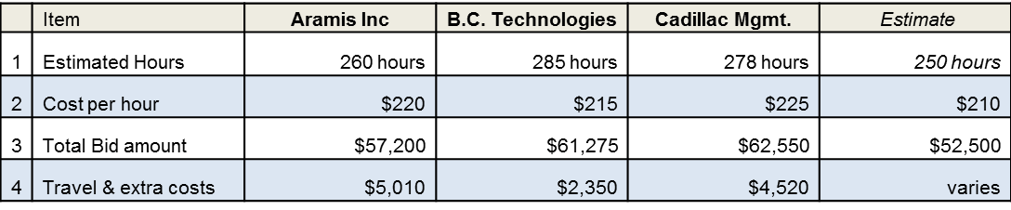
Case Study – Price Analysis
Steps 1 & 3: Compare to other bids, Evaluate hours
Step 2: Look up last purchase and adjust for time & inflation
Last Purchase: B.C. Technologies – Aug. 2009 400 hours at $180 / hour $72,000
Base rate / hour: $180
Wage rate adjustments- 5% per year for 3 years $208
Inflation adjustment @ 2% per year for 3 years $221
Conclusions?

Slide 77
Cost Analysis Required
Basic Requirement
(FTA C 4220.1F Ch. VI, 6.a.)
The recipient must obtain a cost analysis when price competition is inadequate, when only a sole source is available, or in the event of a change order.
Note: Cost analysis must include analysis of profit or fee
Element #39 of the PSR

Slide 78
Use of Cost Analysis
Cost Analysis is used when:
Price analysis will not provide sufficient information
Adequate price competition is lacking
Using sole source method, including contract modifications
The offeror is required to submit the elements (i.e. labor hours, overhead, materials) of the proposed cost

Slide 79
Preparation for Cost Analysis
Is the item same as or similar to items made by the supplier in the past?
The more “mature” the supplier’s product, the more the proposal should be based on actuals and the less on judgment factors / contingencies
Did supplier furnish same or similar item before?
If so, review previous cost/pricing data and analysis
Understand supplier’s competitive position
To what extent did supplier price the proposal competitively?
What is past experience with this supplier?

Slide 80
Analyzing Cost and Pricing Data
Perform a complete and detailed analysis of the supplier’s proposal. Understand the basis and logic for cost estimates.
In reviewing the supplier’s proposal, understand which elements of cost are based on judgment and which are based on fact.
Evaluate each element of cost.

Slide 81
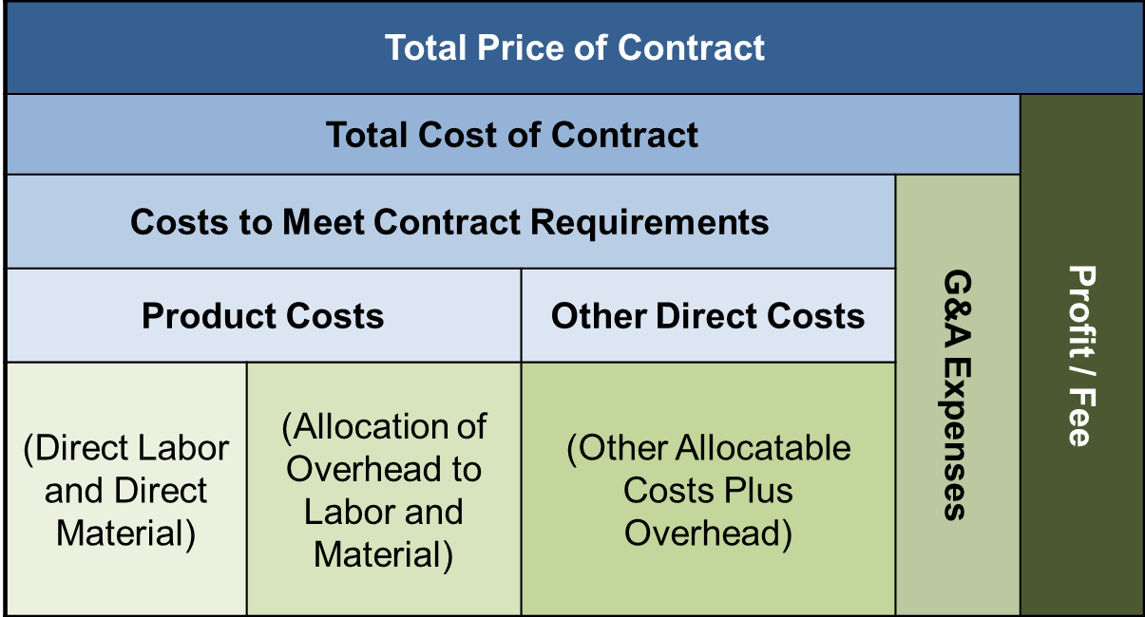
Cost Buildup

Slide 82
How Much Profit is Reasonable?
The amount of profit depends on:
Complexity
and
Risk
Example: In a Firm Fixed Price Contract, the supplier bears the risk, and therefore is entitled to more profit.
Form DD 1547
Notes:
??? “Average profit rate: 12% before taxes in the US” – statement on old slide – no idea where it came from or how to confirm it.

Slide 83
Resources for Determining Costs
Supplier Costs
Direct Labor $20,000 Direct Material 5,000 Overhead 22,500 Total Cost $47,500 + Profit $3,750 Price $51,250
Bureau of Labor Statistics – www.bls.gov
Federal Reserve Bank Salary Surveys
GSA Federal Supply Service Schedules
Commodity Prices for Key Materials
Prices of Component Parts
Survey of Manufactures
Price – Costs = Profit
Cost Analysis Form

Slide 84
Sample Cost Analysis
Costs: An Independent Cost Estimate in the amount of $40,543 was prepared on July 5, 2010. The Contractor submitted a cost proposal on October 27, 2010 in the amount of $72,925. The ICE and Cost Proposal (CP) forms the basis of this analysis.
Item | Description | ICE | Proposal | Variance
#1 | Labor | $3,894 | $42,240 | $38,346
#2 | Materials | $36,649 | $30,684 | ($5,965)
Total |  | $40,543 | $72,925 | $32,381

Slide 85
Sample Cost Analysis cont.
Analysis: Scope of the Change Order consists of a Change Notice with good quality sketches.
Labor: The CP of $42,240 is $38,346 or 985% higher than the ICE of $3,894. The CP appears excessive for the nature of the work. Costs for “PM,” “SW PM,” “Admin” and “Expenses” should all be denied. This would reduce the CP by $5,026 to $37,214.
The Contractor should:
Explain the position and duties of the Lead Engineer with respect to execution of the scope, as these costs appear to be an administrative cost paid for under the overhead mark-ups.
Justify the full labor-month of design time required. This work should be somewhat duplicated from one intersection to the next, such that execution of the design for the second intersection should take less time than the first.
Provide a detailed, step-by-step explanation of the process of updating drawings and software, so as to corroborate the full labor-month of work they have proposed for drafters and software engineers.
Explain why the six-hours of material Engineer procurement time could not cover both intersections, since the materials for each should be nearly identical.
There is significant room for negotiation in this price.

Slide 86
Sample Cost Analysis cont.
Materials: The $30,684 included in the CP is $5,965 or 16% less than the $36,649 included in the ICE. The Contractor’s price is fair and reasonable for the work.
Recommendations:
Low End: $3,894 (ICE) + $30,684 (CP) = $34,578
High End: $37,214 (Adjusted CP) + $30,684 (CP) = $67,898
Target Range for Negotiations: $34,578 to $67,898.

Slide 87
Cost Analysis – Special Circumstances
Equipment Purchase
  May be difficult to get cost breakdown
  Get profit margins at a minimum
Vendor may refuse to provide
  Find information on base price plus additional features

Slide 88
Case Study – Cost Analysis
Examine the offer on the following page.
Identify issues to question.
Are there benchmark data you can use?
Determine a plan for negotiating to better fulfill your needs.

Slide 89
Case Study – Cost Analysis
You have been asked to evaluate & negotiate the following proposal for Direct Labor pertaining to professional services associated with a network systems development project.
Assumptions:
  Benefits estimated based on average rate over last three years.
  All rates are fully burdened (include margin).
  Escalation based on CPI for next year and average salary increase of 7%.
    What information do you need to validate?
    What assumptions might be challenged?

Slide 90
Written Record of Procurement History
Basic Requirement
(FTA C 4220.1F Ch. III, 3.d(1))
Grantees are required to maintain and make available records detailing the history of each procurement.
Element #42 of the PSR
TOP TEN FINDING
Notes:
90
90

Slide 91
Written Record of Procurement History
Items Reviewed
At a minimum, records are to include:
Planning Document
Procurement Specific Information
The rationale for the method of procurement
The reason for the selection of the contract type
The reason for contractor selection or rejection
The basis for the contract price
Extent of documentation commensurate with size and complexity of procurement
Notes:
91
91

Slide 92
Method of Procurement Decision Matrix
Determine suitable procurement method by checking appropriate boxes. All elements must apply to use that method. The planned type of contract can be added to this checklist.
Micro Purchase
Amount <$3,000
Multiple Sources
Small Purchase Amount <$150,000 (<$100,00 if executed prior to Super Circular)
Complete and Adequate Specification or Description
Two or More Quotes Available
Sole Source
Approved by FTA
OEM, Custom Item OR
Only One Source OR
Competition Inadequate after Solicitation OR
Emergency / Public Exigency
Competitive Procurement
  Amount >$3,000
  Multiple Sources
  Not an Emergency
Sealed Bid (IFB) Amount >$150,000
(>$100,000 if executed prior to Super Circular)
Complete and Adequate Specification or Description
Two or More Responsible Bidders willing to Compete
Selection can be Made on Basis of Price Alone
Firm Fixed Price Contract is used
No Discussion with Bidders Required After Receipt of Bids
Competitive Proposals (RFP) >$150,000 (>$100,000 if executed prior to Super Circular)
Complete Specifications Not Feasible
Proposer input Needed
Two or More Responsible Proposers willing to Compete
Discussion Needed with Proposers After Proposals Received
Fixed Price can be Set After Discussions OR a Cost Reimbursement Contract is Determined
Notes:
Slides 93 and 94 replace 92: Is this an improvement?

Slide 93
Method of Procurement Decision Matrix cont.
Selection of Contract Type
Fixed Price
Firm Fixed Unit Prices
Cost Plus Fixed Fee
Time and Materials (T&M) – Must Provide Justification for T&M Contract if Selected.
Blanket Purchase Order
Indefinite Delivery Indefinite Quantity (IDIQ)

Slide 94
Exercise – Written Record
Read the statement of work on the following page.
Complete the method of procurement decision matrix on the previous slide.
Determine what type of contract you would award for this work.
What basis will you use for awarding this work?
What will be the basis for the contract price?

Slide 95
Exercise – Written Record
Facilities Maintenance and Utility Services: Grounds and Roads Maintenance
INTRODUCTION: The Supplier shall perform erosion control; clean up of debris, maintenance of drains, and ditches; landscaping operations; and other grounds services as required herein. The Supplier shall perform maintenance and repair of surfaced areas, including roadways, parking lots, trails, widened shoulders, gravel and earth surfaced areas, and associated structures and appurtenances.
SCHEDULED tasks
Grounds: Leaf Removal: Excepting where build-up of leaves on roads, sidewalks or in drainage structures poses a threat to system functionality or personnel safety, leaf raking and removal will be conducted a maximum of four times annually.
Fertilization: The Supplier shall fertilize to encourage erosion control.
Roads:
Road Grading: The Supplier shall provide grading to minimize potholes and wash boarding.
Maintenance and Repair of Pavements: The Supplier shall maintain and repair paved surfaces to include asphalt and concrete roadways, sidewalks, and surfaces of all types in a good state of repair. In order to provide smooth and safe surfaces, the Supplier shall keep surfaces free of potholes and depressions deeper than 3/4” that pond water. Work shall include, but not be limited to, repairing concrete, asphalt, and stone surfaces.
Maintenance of Waterway Channels, Gutters, Ditches, Storm Sewers, and Subsurface Drains: The Supplier shall ensure that waterway channels, gutters, ditches, storm sewers, and subsurface drains function at full capacity at all times. The Supplier shall schedule and perform storm drainage and sewer system maintenance and repair throughout the year as needed.
Other Snow and Ice Removal Services: Provide snow and ice removal services for designated areas and roads in order to maintain uninterrupted logistical and maintenance services. Provide, store, and load Salt & Sand into vehicles involved with snow removal operations.

Slide 96
Invitation For Bid (IFB) Elements
Independent Cost Estimate *
Unreasonable Qualifications *
Unnecessary Experience and Excessive Bonding
Organizational Conflict of Interest
Arbitrary Actions *
Brand Name Restrictions *
Geographic Preference *
Contract Term Limitation *
*previously discussed
Written Selection Procedures
Prequalification
Award to Responsible Bidders
Sound and Complete Agreement
Clear, Accurate, and Complete Specification *
Adequate Competition (2 or more)
Firm Fixed Price
Selection on Price
Discussions Unnecessary
Notes:
96
96

Slide 97
Invitation For Bid (IFB) Elements Cont.
Advertised/Publicized
Adequate Number of Sources Solicited
Sufficient Time
Bid Opening
Responsiveness
Lowest Price
Rejecting Bids
Evaluation of Options
Cost or Price Analysis *
Written Record of Procurement History*
*previously discussed
Exercise of Options
Out of Scope Changes
Advance Payments
Progress Payments
Time and Materials Contracts
Cost Plus Percentage of Cost
Liquidated Damages Provisions
Joint or Piggyback Procurement
Clauses
Notes:
97
97

Slide 98
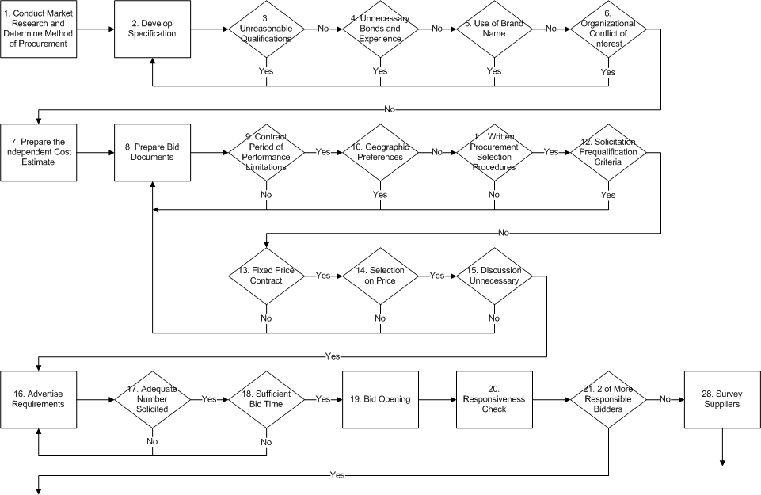
IFB Process
IFB Process

Slide 99
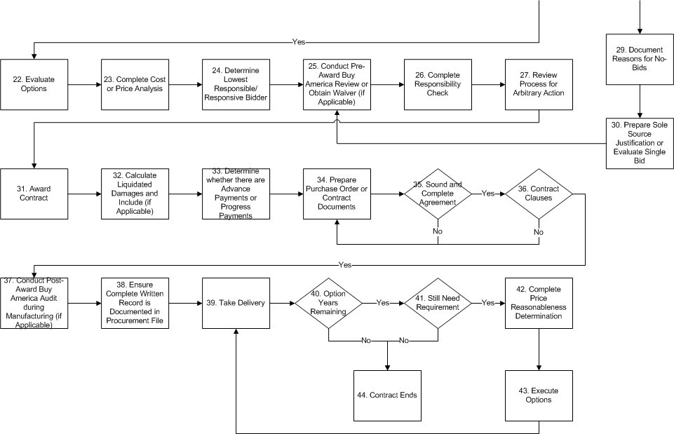
IFB Process cont.
IFB Process

Slide 100
IFB Process
1. Conduct market research and determine method of procurement.
2. Develop specification without:
      Unreasonable qualifications
      Unnecessary bonds and experience
      Use of Brand Names
      Organizational Conflict of Interest
  3. Prepare Independent Cost Estimate

Slide 101
IFB Process cont.
Prepare bid documents
  Include:
    Contract Period of Performance Limitations
    Written Procurement Selection Criteria
    Fixed Contract Price
    Selection on Price / No Negotiation Necessary
    Liquidated Damages (if applicable)
    Advance Payments or Progress Payments (if applicable)
  Do Not Include:
    Solicitation Prequalification Criteria for A & E
    Geographic Preference

Slide 102
IFB Process cont.
5. Advertise requirements
    Adequate Number Solicited
    Sufficient Bid Time
Bid opening
Responsiveness check
Receipt of 2 or more responsible bidders.
  If only1bidder:
    Survey suppliers to determine cause
    Document reasons for No-Bids
    Prepare Sole Source Justification or evaluate single bid

Slide 103
IFB Process cont.
9. Complete cost or price analysis
Determine lowest responsive bidder
Conduct pre-award Buy America Review or obtain waiver (if applicable)
Complete responsibility check
Review process for arbitrary action
Award contract
Prepare purchase order or contract documents
    Ensure a sound and complete agreement
    Containing all required contract clauses

Slide 104
IFB Process cont.
  Conduct post award Buy America Audit during manufacturing (if applicable)
  Ensure complete written record is documented in the procurement file
  Take delivery
  If Options remain
    Still need requirement
    Complete price reasonableness determination
    Execute Option
20. Contract ends

Slide 105
Unnecessary Experience and Excessive Bonding
Basic Requirement
(FTA C 4220.1F Ch. VI, 2.a. (4) (b) and (e))
Unnecessary business requirements and excessive bonding requirements are considered to be restrictive of competition
Note: FTA does have minimum bonding requirements for construction projects.
Considerations:
  Be careful with bonding for services and for requirements for capital and expenditures
  Ensure insurance and bonding requirements are reasonable for the delegated procurement
Element #10 of the PSR
Notes:
105
105

Slide 106
Organizational Conflict of Interest
Basic Requirement
(FTA C 4220.1F Ch. VI, 2.a. (4)(h))
An organizational conflict of interest is considered to be restrictive of competition
Note: Ensure that you have an OCI clause in the contract terms.
Element #11 of the PSR
Notes:
106
106
Best Practices 2.4.2.1 and 2.4.2.2.2

Slide 107
Organizational Conflict of Interest cont.
An organizational conflict of interest exists when:
A contractor is unable, or potentially unable, to provide impartial and objective assistance or advice due to other activities, relationships, contracts, or circumstances.
A contractor has an unfair competitive advantage through obtaining access to nonpublic information during the performance of an earlier contract; or
During the conduct of an earlier procurement, a contractor has established the ground rules for a future procurement by developing specifications, evaluation factors, or similar documents.
Notes:
107
107

Slide 108
Organizational Conflict of Interest
ORGANIZATIONAL CONFLICT OF INTEREST (SPECIFICATION PREPARATION)
(a) This contract, in whole or in part, provides for the Contractor to draft and/or furnish specifications in support of ____________ [Contracting officer identify system or program]. Further, this contract may task the Contractor to prepare or assist in preparing work statements that directly, predictably and without delay are used in future competitive acquisitions in support of __________ [Contracting officer identify program]. The parties recognize that by the Contractor providing this support a potential conflict of interest arises as defined by FAR 9.505-2.
(b) During the term of this contract and for a period of __________ [Contracting officer insert period of time after contract completion that contractor will not be allowed to supply time] after completion of this contract, the Contractor agrees that it will not supply as a prime contractor, subcontractor at any tier, or consultant to a supplier to the Department of Commerce, any product, item or major component of an item or product, which was the subject of the specifications and/or work statements furnished under this contract. The contractor shall, within 15 days after the effective date of this contract, provide, in writing, to the Contracting Officer, a representation that all employees, agents and subcontractors involved in the performance of this contract have been informed of the provisions of this clause. Any subcontractor that performs any work relative to this contract shall be subject to this clause. The Contractor agrees to place in each subcontract affected by these provisions the necessary language contained in this clause.
(c) For the purposes of this clause, the term “contractor” means the contractor, its subsidiaries and affiliates, joint ventures involving the contractor, any entity with which the contractor may hereafter merge or affiliate and any other successor or assignee of the contractor.
(d) The Contractor acknowledges the full force and effect of this clause. It agrees to be bound by its terms and conditions and understands that violation of this clause may, in the judgment of the Contracting Officer, be cause for Termination for Default under FAR 52.249-6. The Contractor also acknowledges that this does not represent the sole and exclusive remedy available to the Government in the event the Contractor breaches this or any other Organizational Conflict of Interest clause.

Slide 109
Written Procurement Selection Procedures
Basic Requirement
(FTA C 4220.1F. Ch. 3.d. (1)(c)
All recipients must state its reasons for contractor selection
  Government recipients must also state reasons for contractor rejection
  Non-government recipients need not state reasons for rejection.
All solicitations shall:
  Incorporate a clear and accurate description of the technical requirements for the material, product, or service to be procured.
  Identify all requirements that offerors must fulfill and all other factors to be used in evaluating bids or proposals.
Element #16 of the PSR
Notes:
109
109
Best Practices - BPPM § 4.3.2, 4.4.1, 4.5.1, and 4.5.2

Slide 110
Written Procurement Selection Procedures cont.
IFB
Typically lowest offer submitted by a responsive and responsible bidder.
RFP
Typically based on evaluation factors or best value.
Two-Step
Mix of IFB and RFP components
A&E
Qualifications Based
Your solicitation should “tell the story” of how bids/offers/proposals will be reviewed.
Notes:
110
110

Slide 111
Solicitation Prequalification Criteria
Basic Requirement
(FTA C 4220.1F Ch. VI, 1.c. )
Prequalification lists must be current
Lists must include enough qualified sources to ensure maximum full and open competition.
Process shall not preclude potential bidders from qualifying during the solicitation period (up to the due date of bid or proposal submission).
Element #17 of the PSR
Notes:
111
111
Not to be confused with technical qualifications that are an essential process in two-step procurement process

Slide 112
Award to Responsible Contractor
Basic Requirement
(FTA C 4220.1F Ch. VI, 8.(b))
Grantees shall make awards only to responsible contractors possessing the ability, willingness, and integrity to perform successfully under the terms and conditions of a proposed procurement.
Responsibility is a procurement issue that is determined after receiving bids or proposals and before making contract award.
Key Consideration:
  Check the Debarment and Suspension List;
  Be sure to document
Element #18 of the PSR
TOP TEN FINDING
https://www.sam.gov
Notes:
112
112
Questions # 27 - 29 of the TR Procurement Area

Slide 113
Award to Responsible Contractor cont.
As part of its evaluation of bids and proposals prior to award, how does the recipient ensure award to responsive and responsible contractors possessing the ability, willingness, and integrity to perform successfully under the terms and conditions of the contract?
As part of its evaluation of bids and proposals prior to award, does the recipient search the System for Award Management (SAM) to identify debarred or suspended bidders?
Subsequent to awarding a contract, has the recipient discovered that a contactor was listed in SAM as an excluded party? If yes, when did the recipient inform FTA in writing of this information?
https://www.sam.gov
Notes:
113
113
Question #27, 28 and 29 of TR

Slide 114
Award to Responsible Contractor
4220.1F lists areas for responsibility determinations:
Integrity and Ethics | Licensing and Taxes
Debarment and Suspension | Financial Resources
Affirmative Action and DBE | Production Capability
Administrative and Technical Capacity | Performance Record
Timeliness | Public Policy
Notes:
114
114

Slide 115
Responsibility Determination Checklist
Bid/RFP No:
Supplier:
Date:
For each of the areas described below, check that the appropriate research has been accomplished and provide a short description of the research and the results.
 |  | Acceptable | Comment
Appropriate financial, equipment, facility, and personnel |  | Yes No | ____________________________________________
Ability to meet the delivery schedule |  | Yes No | ______________________ ______________________
Satisfactory period of performance |  | Yes No | ______________________ ______________________
Satisfactory record of integrity, not on declined or suspended listings |  | Yes No | ______________________ ______________________
Receipt of all necessary data from supplier |  | Yes No | ______________________ ______________________

Slide 116
Exercise – Responsibility Determination
Read the following responsibility determination and indicate whether it is adequate:
ABC Company has been a reliable supplier of material to Transit in the past. There have been no reported complaints about the vendor. The latest Dun and Bradstreet has been reviewed to verify that they are responsible and are not debarred from performing public work.

Slide 117
Sound and Complete Agreement
Basic Requirement
(FTA C 4220.1F Ch. III, 3.(b))
All contracts must include provisions adequate to define a sound and complete agreement.
Compliance with Federal laws and regulations will necessarily result in the addition of many other provisions to ensure compliance with those laws and regulations.
Element #19 of the PSR
Notes:
117
117

Slide 118
Sound and Complete Agreement cont.
Must Include:
Termination for convenience and default clauses
Payment Provisions
Period of Performance
Disputes Clause
Ensure:
Purchase Orders have adequate information
Review standard terms and conditions
Contracts and POs are documented and in procurement files

Slide 119
Adequate Competition
(FTA C 4220.1F Ch. VI, 3.c(1)(b))
Procurement using sealed bids is appropriate if two or more responsible bidders are willing and able to compete effectively for the business.
Element #25 of the PSR
Notes:
119
119

Slide 120
Areas for Consideration
Special circumstances for single bids
Show due diligence on procurements with few or one bidder
  Conduct market research
In the final analysis, a procurement may be “sole sourced” due to investment, size of project, or unique capability requirements.

Slide 121
Exercise – Adequate Competition
True or False: | T | F
1. Adequate competition exists if I receive multiple bids even if only one is responsive.
2. I must exercise due diligence in the event I receive only one bid to find out why other suppliers did not bid.
3. It is possible that a specification requirement may unnecessarily limit competition.
4. It is acceptable to cancel a bid and re-solicit in the event only one bid is received.
5. If one bid is received, I should consider completing a sole source justification.

Slide 122
Firm Fixed Price/Selection on Price
Sealed Bids
(FTA C 4220.1F Ch. VI, 3.c)
The procurement lends itself to a firm fixed price contract and the selection of the successful bidder can be made principally on the basis of price
Areas to Consider:
  Check your evaluation criteria
  Can’t do major evaluation of technical capability
Elements #26 and 27 of the PSR
Notes:
122
122

Slide 123
Discussions Unnecessary
(FTA C 4220.1F Ch. VI, 3.c(1)(e))
No discussion with bidders is needed as award of the contract will be made based on price and price-related factors alone.
Except for clarifications
Element #28 of the PSR
Notes:
123
123

Slide 124
Advertised and Publicized/Adequate Number of Sources Solicited/Sufficient Bid Time
(FTA C 4220.1F Ch. VI, 3.c(2))
The invitation for bids will be publicly advertised and bids shall be solicited from an adequate number of known suppliers, providing them sufficient time and detail to prepare bids prior to the date set for opening the bids.
Key Questions:
What is an adequate number?
Does the solicitation result in submitted offers?
Have you provided sufficient bid time? (greater than 14 days)
Elements #29, 30, and 31 of the PSR
Notes:
124
124

Slide 125
Bid Opening
(FTA C 4220.1F Ch. VI, 3.c(2)(e))
All bids will be publicly opened at the time and place prescribed in the invitation for bids.
Best Practice: Include it in the solicitation, hold the meeting; have a sign-in form and sign it!
Element #32 of the PSR
Notes:
125
125

Slide 126
Public Bid Opening Summary Form
IFB #: ___________________________
BID OPENING DATE: _________________________
LOCATION OF OPENING: ___________________________________
BID OPENING ATTENDEES: __________________________________________________________________________________________________________________________________________________________
GENERAL DESCRIPTION OF PROCUREMENT: __________________________________________________________________________________________________________________________________________________________
NAME OF BIDDER TIME BID RECEIVED BID AMOUNT
Signature: ______________________________ Date: ______________________________
Title: ___________________________________

Slide 127
Responsiveness/Lowest Bid
(FTA C 4220.1F Ch. VI, 3.c(2)(f))
A firm fixed-price contract award will be made in writing to the lowest responsive and responsible bidder.
When specified in the bidding documents, factors such as transportation costs and life cycle costs affect the determination of the lowest bid; payment discounts are used to determine the low bid only when prior experience indicates that such discounts are typically taken.
Do a Responsiveness check and document it!
Element #33 and 34 of the PSR
Notes:
127
127

Slide 128
Responsiveness Checklist
SOLICITATION No. ____________________ Opening Date: ______________
DESCRIPTION: ___________________________________________________
CONTRACT ADMINISTRATOR: ______________________________________
CONTRACTOR / NAME OF BIDDER: ___________________________________
SOLICITATION REQUIREMENTS:
REQUIREMENT | YES | NO | COMMENTS
Bid received on time, in sealed envelope
All items (A to F) priced clearly in unit measures specified
Drawings submitted for products proposed as ‘equal to specified brand
Bid Security Received ($___)
Signature of Company Officer to the bid / offer
Lobbying Certification signed and attached
Financial information submitted per Section V:
DBE Documentation included and complete
Insurance documentation included
No exceptions to terms or other solicitation language
Other __________________________

Slide 129
Rejecting Bids
(FTA C 4220.1F Ch. VI, 3.c(2)(g))
Any or all bids may be rejected if there is a sound documented business reason.
Has to be documented:
  Late proposals/bids
  Non-responsive
  Doesn’t meet mandatory requirements
Be simple in the solicitation
Element #35 of the PSR
Notes:
129
129

Slide 130
Evaluation of Options
Basic Requirement
(FTA C 4220.1F Ch. VI, 7.b.)
Recipients must evaluate bids or offers for any option quantities or periods contained in a solicitation if it intends to exercise those options after the contract is awarded.
  Key word is intention
  Always evaluate if you think you might exercise
  If you don’t review/evaluate, exercise at a later point is a sole source procurement.
  Run numbers for the entire option period
  Does not matter if options are covered in contracts
Element #40 of the PSR
Notes:
130
130

Slide 131
Exercise of Options
Basic Requirement
(FTA C 4220.1F Ch. V, 7.a(1))
An option may not be exercised unless it has been determined that the option price is better than prices available in the market, or that when it intends to exercise the option, the option is more advantageous.
Element #43 of the PSR
Notes:
131
131

Slide 132
Options – Areas for Review
The PSR checks the following elements related to options:
  Were the option periods and quantities contained in the original bid or proposal?
  Were the option periods and quantities evaluated as part of the original contract award?
  When exercised, was a market analysis conducted to ensure that the option pricing is still in the best interest of the agency?

Slide 133
Exercise – Options
Tasks for Exercising Options | Order of Completion
Include options in the executed contract.
Determine whether or not the contract will contain options.
Exercise the option.
Evaluate the option pricing for each year.
Conduct market analysis to determine whether the option is still most advantageous.
Award the contract.

Slide 134
Out of Scope Changes
Basic Requirement
(FTA C 4220.1F Ch. VI, 3.i(1)(b))
When the recipient requires an existing contractor to make a change to its contract that is beyond the scope of that contract, the recipient has made a sole source award that must be justified.
Element #44 of the PSR
Notes:
134
134

Slide 135
Out of Scope Changes cont.
Added work not envisioned by the parties at the outset of the contract that is of a considerable size in relation to contract value
Work effort is not covered or mentioned in stage of work or specification
Funding added without basis (IDIQ contract) or adequate scope added

Slide 136
Advance Payments
Basic Requirement
(FTA C 4220.1F Ch. IV, 2.b(5)(b))
Recipients may not use FTA assistance to make payments to a third party contractor before the contractor has incurred the costs for which the payments would be attributable.
Require prior FTA approval.
Element #45 of the PSR
Notes:
136
136

Slide 137
Advance Payments cont.
Exceptions are permitted for sound business reasons including:
    Public utility connections and services
    Rent
    Tuition
    Insurance premiums
    Subscriptions to publications
    Software licenses
    Construction mobilization costs
    Transportation
    Hotel reservations
    Conference and convention registrations
Adequate security must be obtained when using advance payments
FTA must provide written concurrence before the advance payment is made

Slide 138
Progress Payments
Basic Requirement
(FTA C 4220.1F Ch. IV, 2.b(5)(c))
Recipients may use FTA assistance to support progress payments provided the recipient obtains adequate security for those payments and has sufficient written documentation to substantiate the work for which payment is requested.
Element #46 of the PSR
Notes:
138
138

Slide 139
Time and Materials Contracts
(FTA C 4220.1F Ch. VI, 2.c(2)(c))
Used only:
After a determination that no other type of contract is suitable
If the contract specifies a ceiling price that the contractor shall not exceed except at its own risk.
Ensure that you have an approval in file.
Include in the procurement plan
Element #47 of the PSR
Notes:
139
139

Slide 140
Cost Plus Percentage of Cost
(FTA C 4220.1F Ch. VI, 2.c(2)(a))
Cost plus a percentage of cost and cost plus percentage of construction cost methods of contracting are prohibited.
Areas to Watch For:
  Automatic add-ons above costs
  Fixed incentive rates
  No upper limit on costs
Element #48 of the PSR
Notes:
140
140

Slide 141
Liquidated Damages Provisions
Basic Requirement
(FTA C 4220.1F Ch. IV, 2.b(6)(b)1)
A recipient may use liquidated damages if it may reasonably expect to suffer damages due to:
Delayed contract completion, or
Weight requirements exceeded
AND
the extent or amount of such damages are uncertain and would be difficult or impossible to determine.
Element #49 of the PSR
Notes:
141
141

Slide 142
Liquidated Damages Provisions cont.
Basic Requirement
The assessment for damages is often a specific rate per day for each day of overrun in contract time.
The rate and measurement must be documented in procurement files and specified in solicitation and contract.
Any liquidated damages recovered shall be credited to the project account involved unless the FTA permits otherwise.
Notes:
142
142

Slide 143
Use of State and Local
Purchasing Schedules
Use of State or Local Government Purchasing Schedules are Acceptable
Prohibited: Use of intergovernmental purchasing schedules.
Permitted: Joint purchase agreements / contracts are only “intergovernmental” agreement approved for use.
Notes:
143
143

Slide 144
Piggybacking
Basic Requirement
(FTA C 4220.1F Ch. V, 7.a(2))
An assignment of existing contract rights to purchase supplies, equipment, or services.
Special Considerations
Assignability Clause
Minimum/Maximum Quantities
Identify any FTA funded equipment obtained since the past triennial review through a piggyback, state-led, or joint procurement method.
Element #50 of the PSR
Notes:
144
144
Question #36 of TR Procurement Area
Although most common in the purchase of vehicles, Piggybacking can also occur for purchases of services and property.

Slide 145
Joint & Piggyback Procurement cont.
Permissible when the solicitation contract contains an assignability clause that provides for the assignment of all or a portion of the specified deliverables as originally advertised, competed, evaluated, and awarded.
Solicitation and contract must contain a minimum and maximum quantity that represent the reasonably foreseeable needs of the parties
Before entering into a joint or piggyback arrangement:
  Determine that price remains fair and reasonable.
  Determine that contract complies with all Federal requirements (don’t forget Buy America).
  Be sure that the quantities already used by others, coupled with the quantities you will use do not exceed the amounts available under the original contract.
Notes:
145
145

Slide 146
Clauses
Basic Requirement
(FTA C 4220.1F Appendix D)
A current but not all inclusive and comprehensive list of statutory and regulatory requirements applicable to recipient procurements (such as Davis-Bacon Act, Disadvantaged Business Enterprise, Clean Air, and Buy America) is contained in the FTA Master Agreement.
Recipients are responsible for evaluating these requirements for relevance and applicability to each procurement.
Element #56 of the PSR
TOP TEN FINDING
Contract Clause Checklist
Notes:
146
146
Question #17 of TR Procurement Area

Slide 147
Clauses cont.
How does the recipient ensure that applicable clauses and certifications are included in FTA funded procurements exceeding the micro-purchase limit and construction contracts over $2,000? In intergovernmental agreements and subrecipient agreements, if applicable?
Contract Clause Checklist
Notes:
147
147
Question #17 of TR Procurement Area

Slide 148
Overall Guidelines
Check Purchase Threshold
  If Micro-Purchase (≤ $3,000), only Davis-Bacon clauses required for purchases above $2,000
  If Small Purchases (≤ $150,000*), some clauses apply
  If $150,000*, most clauses apply
  *Note: Threshold is $100,000 if execution was prior to Super Circular, Dec. 26, 2014
Type of Procurement informs which clauses are needed
See Circular 4220.1F (Matrices) for details
Do not incorporate clauses by reference
Do not simply list the clause title and Master Agreement or C 4220.1F reference
Notes:
148

Slide 149
Procurement Actions
Include clauses in standard boilerplate of contract in the solicitation
  This will allow the suppliers to bid based on complying with the requirements
  Some clauses implement the certifications provided by the contractor
Sign a contract with the supplier incorporating boilerplate contract included in solicitation
For construction work, the IFB/Sealed Bid is the contract, once accepted by the Agency
Don’t allow suppliers to take exceptions to required FTA clauses

Slide 150


Types of Clauses
Legal / FTA Required / Statute
Business-Related, such as:
  Payment
  Schedule
  Liquidated Damages
  Acceptance
  Warranty
You can NOT negotiate the legal/FTA clauses.
You can negotiate the business related clauses
The latest revision to the circular relates to access to records clauses. It relates to all records, documents, and papers, including contracts related to any FTA project financed with Federal assistance.

Slide 151
Information on Contract Language and Clauses
Include contract terms and conditions
State whether changes are allowed and how offerors should address in proposals
Ensure all FTA clauses are included, and protest process is covered

Slide 152
Other Aspects
You can provide the specific clauses on your website and reference them in your Purchase Order or contract.
You must have all the required clauses to be determined to be compliant.
Evidence of standard and compliant boilerplates is recommended.

Slide 153
Request for Proposals (RFP) Elements
Independent Cost Estimate *
Unreasonable Qualifications *
Unnecessary Experience and Excessive Bonding *
Organizational Conflict of Interest *
Arbitrary Actions *
Brand Name Restrictions *
Geographic Preference *
Contract Term Limitation *
Written Selection Procedures *
Prequalification *
Award to Responsible Bidders *
Sound and Complete Agreement *
Clear, Accurate, and Complete Specification *
Adequate Competition (2 or more) *
Advertised/Publicized *
Adequate Number of Sources Solicited *
Evaluation
Price and Other Factors
Evaluation of Options *
Cost or Price Analysis *
Written Record of Procurement History*
Exercise of Options *
Out of Scope Changes *
Advance Payments *
Progress Payments *
Time and Materials Contracts *
Cost Plus Percentage of Cost *
Liquidated Damages Provisions *
Joint and Piggyback Procurement *
Clauses *
*previously covered
Notes:
153
153

Slide 154
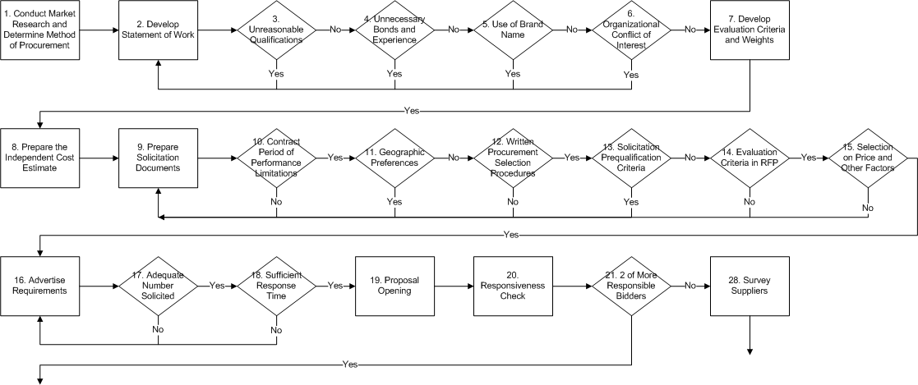
RFP Process
RFP Process

Slide 155
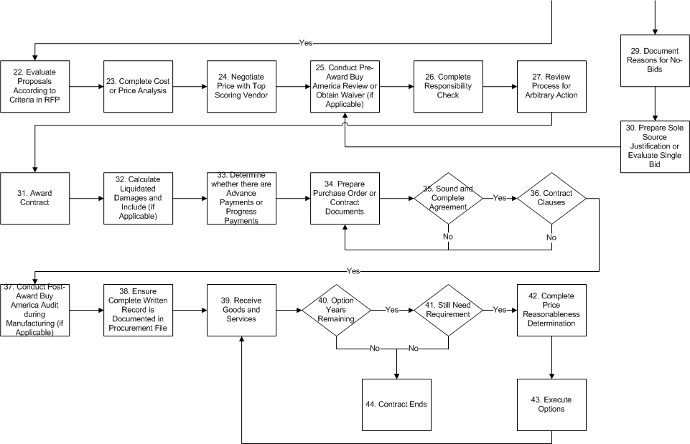
RFP Process cont.
RFP Process

Slide 156
RFP Process
1. Conduct market research and determine method of procurement
Develop Statement of Work without:
    Unreasonable qualifications
    Unnecessary bonds and experience
    Use of Brand Names
    Organizational Conflict of Interest
  Develop evaluation criteria and weights
  Prepare Independent Cost Estimate

Slide 157
RFP Process cont.
5. Prepare solicitation documents
  Include:
    Contract Period of Performance Limitations
    Written Procurement Selection Procedures
    Selection on Price and Other Factors
    Evaluation Criteria
    Liquidated Damages (if applicable)
    Advance or Progress Payments (if applicable)
  Do Not Include:
    Solicitation Prequalification Criteria for A & E
    Geographic Preference

Slide 158
RFP Process cont.
6. Advertise requirements
    Adequate Number Solicited
    Sufficient Bid Time
Proposal opening
Responsiveness check
Receipt of 2 or more responsible proposers
  If only1proposer:
    Survey suppliers to determine cause
    Document reasons for No-Proposals
    Prepare Sole Source Justification or evaluate single proposal

Slide 159
RFP Process cont.
10. Evaluate proposals according to criteria in RFP
Complete Cost or Price Analysis
Negotiate price with top scoring vendor
Conduct pre-award Buy America review or obtain waiver (if applicable)
Complete responsibility check
Review process for arbitrary action
Award contract
Prepare purchase order or contract documents
  Ensure a Sound and Complete Agreement
  Include Required Contract Clauses

Slide 160
RFP Process cont.
Conduct post award Buy America Audit during manufacturing (if applicable)
Ensure complete written record is documented in the procurement file
Receive goods and services
If Options Remain
  Still need requirement
  Complete price reasonableness determination
  Execute option
Contract ends

Slide 161
When to use the RFP Process
Proposer input needed to define work
Two or more responsible proposers willing to compete
Price is only one factor in source selection
Discussion needed with proposers after proposal submission
Fixed price can be set after discussions OR
Time and Materials Contract:
  Fixed price cannot be set
  Complete extent of work unknown

Slide 162
Elements of an Effective RFP
Clear instructions to offerors
Unambiguous scope of work
Defined deliverables and delivery dates
Evaluation criteria
Concise summary of award process including competitive range coverage
Information on contract language and clauses
  Allows for prospective contractor input and questions (pre-proposal conferences, Q&A)

Slide 163
Clear Instructions to Offerors
Explanation of how proposals should be submitted
  Timeline
  References
  Cost/Price Proposal
Note how many copies, in what format
Describes what is to be included in each volume, with page limitations as necessary
Includes references to forms to be completed
Includes “mandatory” submission requirements

Slide 164
Unambiguous Scope of Work
Describes design or performance requirements
Indicates desired tasks to be completed
Includes specific, tangible, and measurable work
Is defined to the overall goal of the procurements, with no chance of out-of scope modification

Slide 165
Defined Deliverables and Delivery Dates
Tie deliverables to key tasks
Indicate what is expected for end deliverables
Note number of copies, drafts, services, and location for delivery
Specify actual dates or dates from contract award

Slide 166
Identifying Reporting Requirements
What do you need to know?
Which task produces that information?
What should the contractor investigate, observe or record?
What analysis of data is required?
What information should be reported?
How often / when is the report required?
In what format is the information desired?
To whom is this report submitted?

Slide 167
Working with the User to Develop Evaluation Criteria
Evaluation criteria are used to assess:
  Contractor’s understanding of the requirements
    Each element of the WBS is addressed
  Approach to be taken
    Evaluate suitability of approach to results desired
  Resources to be committed
  Estimated cost of the work
  Experience / past performance

Slide 168
Examples of Evaluation Criteria
Technical approach
Personnel and company qualifications
Past performance
Installed systems performance
Price
Logistics

Slide 169
Concise Summary of Award Process
Discuss “Competitive Range”
Indicate how scoring will occur and when and how offerors will receive feedback
Note whether presentations will be required, and if proposals will be rescored; Include option for negotiations
Discuss whether “Best and Final” offers may be requested, and if the proposals will be rescored
Describe how final decisions will be reached

Slide 170
Best Value Determination (if used)
Best Value
Best value is a process used in competitive, negotiated contracting to select the most advantageous offer by evaluating and comparing factors in addition to cost or price. It allows offerors flexibility in selection of their best proposal strategy through tradeoffs which may be made between the cost and non-cost evaluation factors.

Slide 171
Evaluation
Basic Requirement
(FTA C 4220.1F Ch. VI, 3.d(2)(b) and (d))
All evaluation factors will be identified along with their relative importance.
Recipients will have a method in place for conducting technical evaluations of the proposals received and for selecting awardees.
Recipients may request additional information before making an award.
Note: The solicitation does not have to include the weighting factors; however, the evaluation criteria should be listed in order of importance.
Element #36 of the PSR
Notes:
171
171

Slide 172
Evaluation cont.
Determine Evaluation Team Members
Provide instructions on scoring the RFP
Assign responsibilities for reference checks
Oversee the scoring process
Summarize the results

Slide 173
Sample Evaluation Form
Evaluation Criteria | Definition | Weight | Score | Weighted Score
Technical Approach | Description of mechanisms to collect data Plan for responding to missing data Methods to analyze data Expertise in statistical analysis | 40%
Past Performance | Number of similar studies conducted in the past Reference checks | 25%
Staffing | Sufficient resources to conduct the study Qualifications of study team members Roles and responsibilities with respect to other studies | 20%
Price | Total price compared to other proposals. (4 points is given to lowest price and others receive points in ratio to lowest price) | 15%
Total |  | 100%

Slide 174
Scoring Methodology
Score | Definition Scoring Methodology
4 | Exceeds Standards - The proposal strengths demonstrate an excellent understanding of the requirements and the new or proven approach significantly exceeds performance or capability standards.
3 | Acceptable - The proposal demonstrates an acceptable understanding of the requirements and the approach meets performance or capability standards.
2 | Inconsistent - The proposal demonstrates a limited understanding of the requirements and the approach only marginally meets performance or capability standards necessary for minimal contract performance.
1 | Unacceptable - The proposal demonstrates a misunderstanding of the requirements and the approach fails to meet performance or capability standards.

Slide 175
Exercise: Evaluation Criteria
You have a solicitation to purchase new buses for your agency.
There is a local mandate that all new buses have some kind of alternative fuel propulsion system.
The total provider pool is limited due to the technical requirements of the buses.
1. Develop six criteria by which RFP responses will be judged
2. Assign a value range for all responses and weight each in relation to its importance
3. Present results using the format on the next slide.

Slide 176
Evaluation Format
Criteria | Definition | Weight | Score | Weighted Score
Technical Approach
Past Performance
Staffing
Price
Total | 100%

Slide 177
Price and Other Factors
Basic Requirement
(FTA C 4220.1F Ch. VI, 3.d(2)(e) and (f))
Awards made to firm whose proposal is most advantageous to the recipient's program with price and other factors considered
Recipients may award to the proposer that offers the greatest business value to the Agency based upon an analysis of a tradeoff of qualitative technical factors and price/cost to derive which proposal represents the “best value.” “Best value” language must be in the solicitation.
Take extra care when using the “Best Value” evaluation process.
Element #37 of the PSR
Notes:
177
177

Slide 178
Other Than Full and Open Competition Elements
Independent Cost Estimate *
Unnecessary Experience and Excessive Bonding *
Organizational Conflict of Interest *
Arbitrary Actions *
Brand Name Restrictions *
Geographic Preference *
Contract Term Limitation *
Award to Responsible Bidders *
Sound and Complete Agreement *
Clear, Accurate, and Complete Specification *
*previously covered
Other Award is Infeasible
Cost Analysis Required
Evaluation of Options *
Written Record of Procurement History *
Exercise of Options *
Out of Scope Changes *
Advance Payments *
Progress Payments *
Time and Materials Contracts *
Cost Plus Percentage of Cost *
Liquidated Damages Provisions *
Joint and Piggyback Procurement *
Clauses *
Notes:
178
178

Slide 179
Sole Source if Other Award is Infeasible
Basic Requirement
(FTA C 4220.1F Ch. VI, 3.i)
When supplies or services are available from only one responsible source, and no other supplies or services will satisfy its requirements, the recipient may make a sole source award.
When the recipient requires an existing contractor to make an out of scope change, the recipient has made a sole source award that must be justified.
Element #38 of PSR
Notes:
179
179
Question #13 of TR Procurement Area -TOP TEN FINDING

Slide 180
Sole Source if Other Award is Infeasible cont.
How does the recipient ensure that it conducts solicitations in a manner that ensures
a. proper use of vendor pre-qualification practices,
b. proper use of specifications and “brand names”, and
c. proper justification for sole source and single bid procurements?
Notes:
180
180
Question #13 of TR Procurement Area

Slide 181
Other Award is Infeasible
Property or services are available from one source if one of the following conditions is present:
Unique or Innovative Concept
Patents or Restricted Data Rights
Substantial Duplication Costs
Unacceptable Delay
Only one bid is received
FTA expects recipient to use competition, as feasible, to select teaming or consortium partners.
Notes:
181
181

Slide 182
Exercise – Sole Source Justification
Read the following sole source justification:
Due to the new buses that went into service in 2009 and 2010, our lubricant usage has dropped by more than fifty percent. We did not meet our terms of agreement with Company Q because of that drop.
Company Q has offered to extend the agreement for another five years with the same terms and conditions. I recommend we go with this agreement as it would be in the best interest of our Agency to stay with this product and equipment.
  What changes would you make to this justification?
  Would you approve this as a sole source?
  Does this justification meet the FTA requirements for other than full and open competition?

Slide 183
4220.1F Guidance on Single Bids
Upon receiving a single bid or proposal in response to a solicitation, the recipient should determine if competition was adequate. This should include a review of the specifications for undue restrictiveness and might include a survey of potential sources that chose not to submit a bid or proposal.
Adequate Competition. FTA recognizes competition to be adequate when the reasons for few responses were caused by conditions beyond the recipient’s control. Many unrelated factors beyond the recipient’s control might cause potential sources not to submit a bid or proposal. If the competition can be determined adequate, FTA’s competition requirements will be fulfilled, and the procurement will qualify as a valid sole source.
Inadequate Competition. FTA recognizes competition to be inadequate when, caused by conditions within the recipient’s control. For example, if the specifications used were within the recipient’s control and those specifications were unduly restrictive, competition will be inadequate.

Slide 184
Single Source Analysis
Solicitation: __________________
Product/ Services to be Procured: ___________________________
Bid or Proposal Due Date: _______
Number of Solicitations Requested: ____
Number of Bids Received: __________
Reasons for lack of Competition
(based on Supplier Contacts)
Lack competency
Lack available resources
Poor timing
Short response due date
Other: ___________________
Action to Plan
Award Contract Basis: ________________________________________________________
Extend Deadline (modify solicitation)
  New Due Date: _____________
Re-procure:
  New Solicitation Due to be Completed: _________________
  Projected Due Date: __________
  Signed: _____________________
  Title: ______________________
  Date: ______________________

Slide 185
Exercise – Single Bid Analysis
Bid No: 12345-11 Description: Material for Third Rail Heater Installation
Following this Invitation for Bid, awards are being recommended to Companies X, Y, and Z.
Bid Specifics: Advertised: January 22, 2011 in the County Sentinel
January 16, 2011 on the State procurement site
Bid Opened: February 13, 2001
The Bidder’s List of 21 Vendors, resulted in the following responses:
5 Bids
6 No Bids
0 Late Bids
*The items listed in Groups 1 and 2 are available only from Company X. The requestor is aware of this special situation. Several of the other vendors on the list of bidders were contacted regarding their no-quotes on these items. All of the contacted vendors said that they have never been able to supply these items and therefore would not quote on them.
Item | Quantity | Low Bidder | 2nd Low Bidder | % + or - | Awardee
Group 1 | 1 | $180,000 | n/a* | n/a* | Company X
Group 2 | 1 | $42,952 | n/a* | n/a* | Company X
Group 3 | 1 | $13,650 | $14,388 | 5% - | Company Y
Group 4 | 1 | $1,049 | $1,885 | 44% - | Company Z

Slide 186
Architectural and Engineering
Special Considerations
Geographic Preference
Qualifications Exclude Price
Serial Price Negotiations
Note: A&E services must be related to a
construction project
Notes:
186
186

Slide 187
A&E Geographic Preference
Basic Requirement
(FTA C 4220.1F Ch. VI, 2.a. (4)(g) 1.)
For A&E Procurements, geographic location may be a selection criterion if an appropriate number of qualified firms are eligible to compete for the contract in view of the nature and size of the project.
Element #8 of the PSR
Notes:
187
187

Slide 188
Qualifications Exclude Price
Basic Requirement
(FTA C 4220.1F Ch. VI, 3.f. (3))
Qualifications-based competitive proposal procedures require that:
(1) An offeror’s qualifications be evaluated for contract award
(2) Price be excluded as an evaluation factor
Element #51 of the PSR
Notes:
188
188

Slide 189
Serial Price Negotiations
Basic Requirement
(FTA C 4220.1F Ch. VI, 3.f(3)(d))
Negotiations are conducted with only the most qualified offeror
Failing agreement on price, negotiations with the next most qualified offeror may be conducted until a contract award can be made to the most qualified offeror whose price is fair and reasonable to the recipient.
Show results of the negotiation
Element #52 of the PSR
Notes:
189
189

Slide 190
Rolling Stock Procurement Process
The entire process for procuring rolling stock can be broken into three phases
  Select the method of procurement
  Manage the solicitation Process
  Make award and take delivery
Select the Method of Procurement
Manage the Solicitation Process
Make Award and Take Delivery

Slide 191
Difference Between
Joint Procurements & Piggybacking
Joint procurement is a method of contracting in which two or more purchasers agree from the outset to use a single solicitation and enter into a single contract with a vendor.
Piggybacking is the post-award use of a contractual document/process that allows someone who was not contemplated in the original procurement to purchase the same supply /equipment through that original document / process. The recipient may assign those contract rights to others if the original contract contains an assignability provision.
Notes:
FTA encourages Joint purchasers – they may be from different states.
The recipient may assign those contract rights to others if the original contract contains an assignability provision that permits the assignment of all or a portion of the specified deliverables under the terms originally advertised, competed, evaluated, and awarded, or contains other appropriate assignment provisions. Some refer to this process as “piggybacking.”

Slide 192
Phase 1.
Select the Method of Procurement
Select Method of Procurement
Manage the Solicitation Process
Make Award and Take Delivery
There are three methods of procurement that can be used when buying rolling stock
  Invitation for Bid (IFB)
  Request for Proposal (RFP)
  Joint Procurement or Piggybacking
The decision to piggyback or manage a new solicitation is made once funding has been received and the purchase request has been developed
Receive
Grant Funding
Solicit or Piggyback or Joint
Develop Purchase Request (number, type, timeframe
Joint or Piggyback
Develop Specification and Prepare Independent Cost Estimate
Solicit
Determine Method of Procurement
IFB
RFP

Slide 193
Phase 2:
Manage the Solicitation- Joint or Piggybacking
Select Method of Procurement
Manage the Solicitation Process
Make Award and Take Delivery
Solicit or Joint or Piggyback
Key steps to follow:
Verify assignability clause
Verify inclusion of FTA clauses and Buy America Certifications (or Buy America Waivers)
Conduct price analysis
Determine any desired changes to the specification and ensure they are in-scope changes
Solicit
Piggyback or Joint
Verify Assignability, FTA Clauses, Price Analysis
Determine Any Desired Specification Changes
Verify Buy America Certifications are included
Are Spec Changes within Scope?
Use Another Method of Procurement
No
Yes
Issue Contract Including Terms of Master Contract

Slide 194
Phase 2:
Manage the Solicitation- IFB
Select Method of Procurement
Manage the Solicitation Process
Make Award and Take Delivery
Key steps to follow:
Contract must be awarded to the lowest price responsive / responsible bidder
Bidders have the opportunity to submit requests for approved equals (RFA)
Buy America pre-award review must be conducted for procurements above threshold or a waiver must be obtained
Request Pre-Offer Change or Approved Equals
Develop Specification and Prepare Independent Cost Estimate
Yes
Issue Addenda
No
Prepare Bid Documents
Accept Bids (Include Certifications)
Advertise Requirements
Determine Lowest Responsible / Responsive Bidder
Conduct Pre-Award Buy America Review or Obtain Waiver
Conduct Pre-Bid Conference

Slide 195
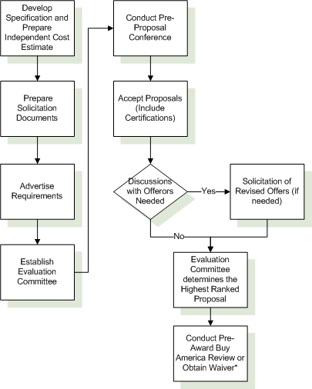
Phase 2:
Manage the Solicitation - RFP
Select the Method of Procurement
Manage the Solicitation Process
Make Award and Take Delivery
Key steps to follow:
Evaluation criteria must be developed and listed in order of importance
Award is made to the highest rated (best value) offeror
Buy America pre-award review must be conducted for procurements above $150K ($100K if executed prior to Super Circular) or a waiver must be obtained
* Buy America process is covered separately

Slide 196
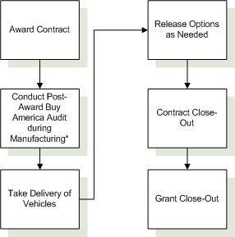
Phase 3:
Make the Award and Take Delivery
Select the Method of Procurement
Manage the Solicitation Process
Make Award and Take Delivery
Key steps to follow:
A Buy America post-award audit must be conducted for all procurements above $150K ($100K if executed prior to Super Circular) during manufacturing
After the initial order quantity has been fulfilled, options may be released as needed
* Buy America process is covered separately

Slide 197
Buy America Certification
Pre-Award and Post-Delivery audits must be conducted for all rolling stock procurements.
  Verify 60% domestic product
  Review and verify proposed final assembly
  Contractor may request a Buy America waiver
Pre-Award and
Post-Delivery Handbook
Pre-Award and
Post-Award Checklist
Notes:
Questions #39 and 40 of TR Procurement Area

Slide 198
Buy America Certification cont.
How does the recipient conduct pre-award and post-delivery audits to ensure the manufacturer(s) complied with contract specifications and Buy America?
How does the recipient verify domestic content, final assembly activities, and location of final assembly at the pre-award and post-delivery stages?
Notes:
Question #39 and 40 TR Procurement Area

Slide 199
Buy America Requirements
Pre-Award Requirements
Post-Award Requirements
Review and verify 60% domestic content AND U.S. final assembly location, operations and total cost
or
Request and receive a Buy America Waiver
Check bid specification compliance with solicitation specifications AND complete a manufacturer capability study
Review and verify 60% domestic content AND U.S. final assembly location, operations and total cost
or
Request and receive a Buy America Waiver
Complete resident inspector’s report AND complete visual inspections and performance tests
or
Complete visual inspection and road tests for procurements of 10 or more buses
Verified FMVSS sticker affixed to each bus
Notes:
Inspection needs to take place during the period of manufacture of the buses
For buses manufactured in multiple stages, the inspector is only required to visit the final-stage manufacturer’s final assembly location
The inspector can be an employee of the recipient or an appointed analyst
The inspector cannot be an employee or agent of the manufacturer

Slide 200
Documentation Requirements by Procurement Type
Standard Inclusions | Micropurchase | Small Purchase | IFB | RFP | Sole Source
Fair and Reasonable Price Determination | X
Method of Procurement Decision Matrix |  | X | X | X | X
Independent Cost Estimate |  | X | X | X | X
Clear, Accurate, Complete Specifications |  | X | X | X | X
Price Quotations |  | X
Cost/Price Analysis |  | X | X | X | X (Cost)
Written Selection Procedures (Included in Solicitation) |  |  | X | X
Emails to Potential Vendors, Proof of Publication |  |  | X | X
Bid Opening Sheet/Record of Proposals Submitted |  |  | X | X
Responsiveness Determination |  |  | X | X
Bid/Proposal Rejection Explanation (if any) |  |  | X | X
Responsibility Determination (Copy of EPLS search) |  |  | X | X | X
Bid Tabulation / Selection of Lowest Price |  |  | X
Evaluation Rating Sheets and Summary |  |  |  | X
Sole Source Justification |  |  |  |  | X
Sound and Complete Agreement (Signed Contract) |  |  | X | X | X
Clauses (In Solicitation and Contract) |  |  | X | X | X
Written Record of Procurement History |  | X (2 sections) | X | X | X
Awarded Supplier's Proposal |  | X | X | X | X

Slide 201
Documentation Requirements by Procurement Type cont.
Special Circumstances | Micropurchase | Small Purchase | IFB | RFP | Sole Source
Contract Mods (in scope) |  |  | X | X | X
Progress Payments |  |  | X | X | X
Approval for Advance Payments From FTA | X | X | X | X | X
Documentation of Board Approval |  |  | X | X | X
Notice of Protests and Resolution |  | X | X | X | X
Notice of Contract Claims and Resolutions |  | X | X | X | X
Piggybacking |  |  | X | X | X
Davis-Bacon (Construction) | X >$2000 | X | X | X
Copies of Bonds (Construction) |  |  | X | X | X
Buy America (Bus and Rolling Stock) |  |  | X | X | X
Evidence of Negotiations with Highest Ranked Suppliers and Ranking Based on Technical Capability Only (A&E) |  |  |  | X
CD
Sample Contract File

Slide 202
wrapping it up

Slide 203
After a PSR
Use the review as a tool for improvement in all procurements
Maintain proficiency with FTA resources/requirements
Work with your Regional Office and the reviewer to address deficiencies and get additional information
Focus first on resolving repeat findings
ARRA has heightened transparency and accountability for all procurements
Don’t just “paper over” a finding, make sure you can demonstrate implemented corrective actions
Technical Assistance Provided by FTA
Notes:
203
203

Slide 204

Points of Contacts
Hope Jensen
  202-366-2286
  hope.jensen@dot.gov
Jim Muir
  202-366-2507
  Jim.Muir@dot.gov
Notes:
204
204

Slide 205


