Slide 1
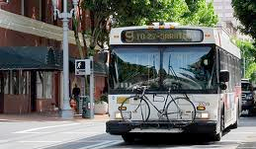
FTA SMS Update APTA Board Members Conference July 21, 2015

Slide 2
Background
Transit is the safest mode of surface transportation
On average, passengers on trains and buses are 40 to 70 times less likely to be in an accident than passengers in automobiles
Transit injuries and fatalities have reached a plateau and has ticked upward the last few years
Transit remains vulnerable to catastrophic accidents
19 major NTSB investigations since 2006

Slide 3
Recent Investigations have found:
Lack of management support for safety
Lack of information sharing and communication across departments to identify and fix safety concerns
Lack of resources and technical capabilities in safety and engineering functions to lead safety programs
Inappropriate procedures for operations and maintenance activities
Inadequate training for employees
Failure to conduct effective oversight
Notes:
Recent investigations have found that issues and accidents are more organizational in nature, including:
Lack of management support for safety (no higher up support)
Lack of info sharing & communication across divisions (bad communication across agency)
Lack of resources (i.e. budget and staff resources – big issue for many transit agencies, esp here at the CTAA Expo)
Inapprops operations & maintenance
Inadequate training and oversight

Slide 4
NTSB Most Wanted List 2014
Promote Operational Safety in Rail Mass Transit
“The NTSB has investigated many mass transit accidents and, much too frequently, has found that the accidents stem from human issues, ranging from lapses in train operator's judgment, through slow decision-making to inspect or repair track, to poor leadership by senior management to prioritize safety over operational timeliness. The NTSB describes these causal and contributing human factors in terms of organizational safety culture.”
Notes:
“This is one list that you do not want to make”

Slide 5
Change is Necessary
Our current approach has taken us as far as it can
“If you keep doing what you’re doing...
you’re going to keep getting what you got!”
–Yogi Berra

Slide 6
MAP-21 Safety Requirements
While FRA regulates safety for commuter railroads, MAP-21 Section 5329 is applicable for all rail fixed guide way transit (as well as bus and other transit modes)
To date, bus properties are not subject to the same safety oversight as rail, but MAP-21 is very informative on how the Board might address regulatory matters
In addition, under MAP-21, operators of all public transportation systems (including bus) will be subject to Agency Safety Plan requirements
New Safety Authority
Enacted in July 2012, MAP-21 provides new safety regulatory authority to strengthen how FTA regulates and enforces transit safety regulations
FTA now has authority to set national safety criteria and standards for all modes of transportation
New FTA Office
Safety is DOT’s Number One Priority
Established in July 2013, the FTA Office of Transit Safety and Oversight is committed to making transit safer through policy development, hazard investigation, data collection, risk analysis, effective oversight programs and information sharing

Slide 7
Recent FTA Safety Activities
Issued FTA Administrator Dear Colleague Letters Adopting Safety Management Systems (SMS) & MAP-21 Progress Update
Issued Interim Safety Certification Training Program
Published Notice of Proposed Rule Making (NPRM): State Safety Oversight (SSO) Program
Conducted First Safety Management Inspection and Released Findings and Required Actions in June 2015
Readying the release of upcoming guidance and rulemaking documents for later this year
New Safety Authority
Enacted in July 2012, MAP-21 provides new safety regulatory authority to strengthen how FTA regulates and enforces transit safety regulations
FTA now has authority to set national safety criteria and standards for all modes of transportation
New FTA Office
Safety is DOT’s Number One Priority
Established in July 2013, the FTA Office of Transit Safety and Oversight is committed to making transit safer through policy development, hazard investigation, data collection, risk analysis, effective oversight programs and information sharing
Notes:
How did we get here? MAP 21 provided FTA the authority to regulate safety for all modes of public transportation.

Slide 8
Safety Rulemaking Update
MAP-21 Requirements | Target Publication or Federal Register Notice for Public Comments
Safety & Transit Asset Management | ANPRM—Oct. 2013 (Completed)
State Safety Oversight NPRM (Open for Public Comment) | February 2015 (Completed)
Safety Certification Training Program Proposed Interim Provisions Final Interim Provisions | April 2014 (Completed) February 2015 (Completed)
Safety Certification Training Program NPRM | 2015
National Safety Plan Guidance | 2015
National Safety Program NPRM | 2015
Transit Agency Safety Plan NPRM | 2015
Transit Asset Management NPRM | 2015
ANPRM—Advanced Notice of Proposed Rulemaking
NPRM – Notice of Proposed Rulemaking
FRN – Federal Register Notice
Notes:
Every rule will have a 60 day comment period. Your comments are important to us. When these rules are published, please let us hear from you.
There are four options in which we can receive comments
Number one – go to http://www.regulations.gov and follow the instructions for submitting comments
Two - Send your comments by US Mail to USDOT Headquarters
Three - Hand Deliver or Courier to USDOT Headquarters
Finally - you can fax your comments to 202-493-2251

Slide 9
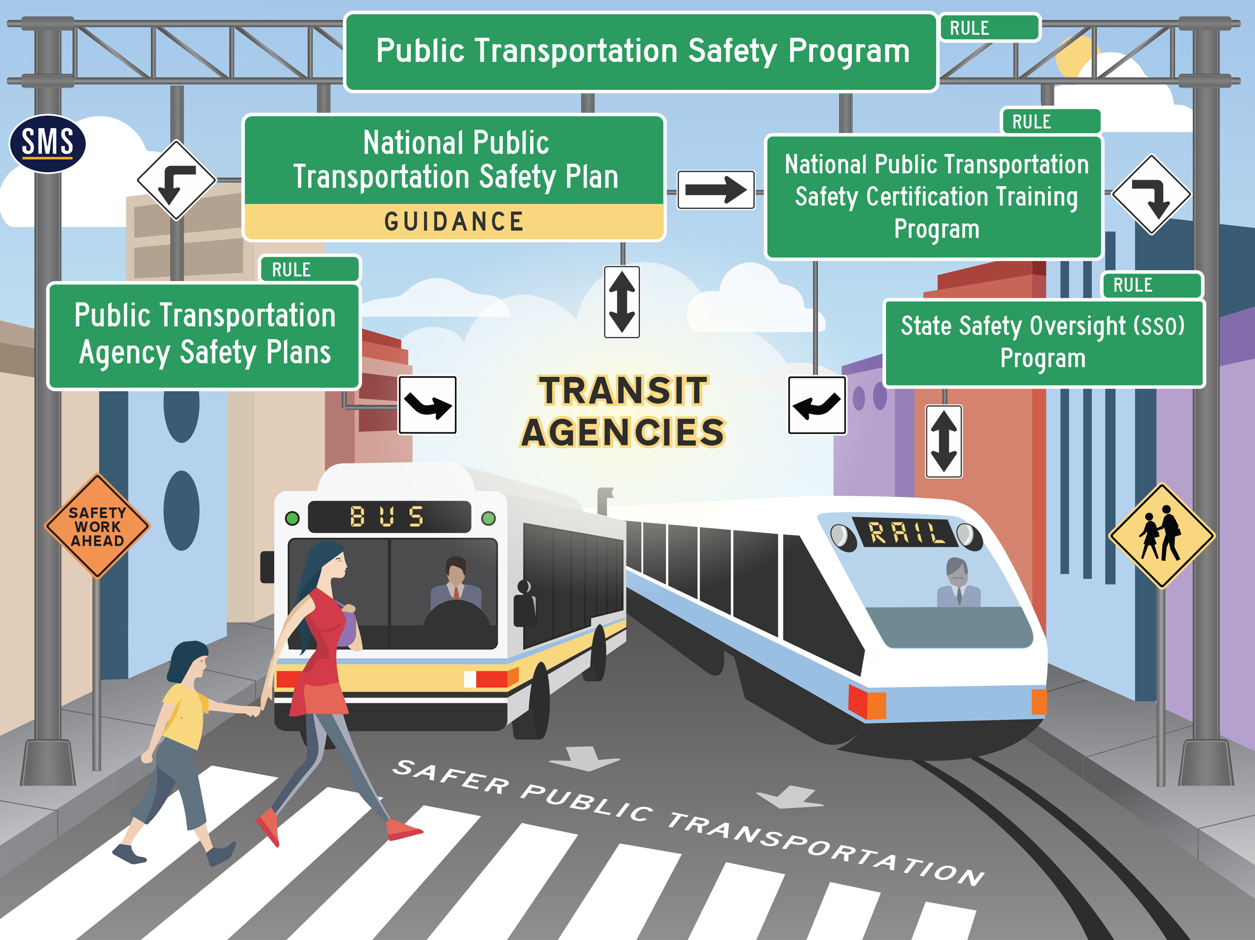
Notes:
This slide shows how the proposed guidance and rulemakings fit together for a flexible, SMS approach to safety for transit. Our rulemakings adhere to a minimalist, strategic approach that reflects the principles of SMS.

Slide 10
FTA Safety Expectations
Accountability is properly placed
Agency-wide reporting and communication of safety issues
Proactive investigation of hazards
Employing tools to monitor safety performance
Effective and efficient safety assurance activities
Balanced decision-making regarding safety risk within operations and planning
New Safety Authority
Enacted in July 2012, MAP-21 provides new safety regulatory authority to strengthen how FTA regulates and enforces transit safety regulations
FTA now has authority to set national safety criteria and standards for all modes of transportation
New FTA Office
Safety is DOT’s Number One Priority
Established in July 2013, the FTA Office of Transit Safety and Oversight is committed to making transit safer through policy development, hazard investigation, data collection, risk analysis, effective oversight programs and information sharing
Notes:
Accountability of TOP EXECUTIVE = Important
Employee Safety reporting Program = Important, if there’s not an agency-wide reporting program, then the agency won’t have a good risk picture
Need to be PROACTIVE instead of REACTIVE in investigating hazards
Need tools, such as data collection tools and other tools to look at safety performance of the agency
Need GOOD Safety Assurance (SA) activities – will discuss SA further momentarily
Need balanced decision making re: safety risk, and this needs to come into play & consideration including with operations and planning

Slide 11
What is Needed: A New Model
We need to understand our safety risk in order to effectively manage it
We need tools that support executive level decision-making to make informed decisions on safety risks
We need to align industry safety oversight with agency safety mission achievement
Notes:
Now that we’ve taken a snapshot of what SMS does, I’m going to talk about why we need this new SMS Framework.
Need to UNDERSTAND safety risk, and can do this through SMS
Need tools, such as data collection tools and other tools to support executive level decision making as to what poses the highest safety risk. Transit executives need tools to help prioritize risk and allocate resources. As with all management systems, a safety management system provides for goal setting, planning and measuring performance.
As FTA and the transit industry move forward, we all need to ensure that the safety mission is achieved and that federal and state oversight is aligned with individual transit agency management of safety. SMS will put us all on the same page.

Slide 12
What Is a Safety Management System?
SMS means the formal, top-down, organization-wide, data-driven approach to managing safety risk and assuring the effectiveness of safety mitigations. It includes systematic policies, procedures, and practices for the management of safety risk.
New Safety Authority
Enacted in July 2012, MAP-21 provides new safety regulatory authority to strengthen how FTA regulates and enforces transit safety regulations
FTA now has authority to set national safety criteria and standards for all modes of transportation
New FTA Office
Safety is DOT’s Number One Priority
Established in July 2013, the FTA Office of Transit Safety and Oversight is committed to making transit safer through policy development, hazard investigation, data collection, risk analysis, effective oversight programs and information sharing
Notes:
Formal definition: Let them read it. PAUSE for a moment.
SMS addresses many of the issues we have (in the public transit industry for safety)

Slide 13
Breaking Down SMS
Management system
Formal
Top-down
Organization-wide
Data-driven
Supports Executive risk-based decision making
Notes:
(Breaks down previous slide)
Management System – Like a financial management system
Formal: I.e. Written Down
Top-down: From CEO down, If senior execs don’t buy in, it won’t go anywhere
Organization-wide: i.e. DOES NOT stay in just the safety department, but is adopted by every one of you (point to audience)
Example of data-driven:
At a bus transit agency, initial data showed that buses were getting rear-ended
So, because of this the transit agency put Yellow X’s across the back of its buses
However, with data it was found that people were ramming into back of buses at an ever higher rate than previously, and these yellow X’s had the opposite effect than intended and were CAUSING rather than deterring accidents since people weren’t paying attention and so enthralled by the X’s, and therefore ramming into the back of buses at a greater rate
With data, said transit agency realized that these X’s were not working → Data can make you see if something is working or not.

Slide 14
SMS answers these critical questions
SMS will provide processes to assist a transit agency to answer the following five fundamental questions:
What will likely be the cause of the transit agency’s next accident?
How does the transit agency know the likely cause of the next accident?
What is the transit agency doing to mitigate the risk?
Is the strategy or action working?
How do you know it is working?
Notes:
SMS is designed to answer 5 critical questions.
Ultimately, these are the FIVE questions WE at FTA and agencies need to answer (for safety of Public Transit system)
It helps us determine what our most serious safety risks are.
It provides a documented methodology for identifying and prioritizing those safety risks.
It leads us down a path to decide what to do about mitigating our most serious risks.
It allows us to determine if our mitigation strategies are working.
And it allows us to empirically document our assurance that mitigations are effective, or if not effective, consider what other mitigations will work better.

Slide 15
4 Components (Pillars) of SMS
Safety
Management
Policy
Safety
Risk
Management
Safety
Assurance
Safety
Promotion

Slide 16
4 Components (Pillars) of SMS
Safety Management Policy – a written document that serves as the rules of the game
Safety Risk Management - a process to identify the bad things that could happen and develop strategies to reduce the likelihood of the event occurring, or the severity of the outcome should it occur.
Safety Assurance – activities to verify the effectiveness of safety risk mitigations, and the fashion in which safety functions or activities are being carried out.
Safety Promotion - emphasizes communication and training to support the SMS
Notes:
Safety Management Policy:
Establishes necessary organizational structures, roles, and responsibilities
Defines CEO/executive commitment & helps ensure sufficient resources are provided to meet safety objectives
Puts in place the employee reporting program (i.e. safety culture)
Safety Risk Management:
Vital to the success of SMS
Establishes system-wide, proactive activities to identify safety hazards (Including LIKELIHOOD and SEVERITY through risk matrices)
Develops strategies to mitigate safety risks
Provides management with safety priorities to be addressed
Safety Assurance:
Answers: Are the mitigations that have been put in place working?; Procedures being adhered to?
Looks at if Safety Risk Management (SRM) process is working
Is the organization planning on making a change – and management of that change
Safety Promotion:
Ensures organization-wide safety communication
Facilitates training to proficiency on safety skills and competence
Sets the quality of your agency’s safety culture

Slide 17
SMS formalizes organizational safety commitment
SMS ensures a structure is in place to promote an environment where safety issues can be:
Identified, discussed, reported and evaluated
Presented for action in the Board Room and on the Front-line
SMS fosters commitment by all parties to an effective employee safety reporting program (if it is not widely used, it cannot be effective)
SMS clarifies roles and responsibilities for employees regarding agency’s safety performance
Notes:
SMS ensures a structure is in place to promote an environment where safety issues can be:
Identified, discussed, reported and evaluated
Presented for action in the Board Room and on the Front-line
SMS fosters commitment by all parties to an effective employee safety reporting program (if it is not widely used, it cannot be effective)
SMS clarifies roles and responsibilities for employees regarding agency’s safety performance

Slide 18
The Board’s Role in SMS
Implement measures to mitigate the greatest safety risks to the highest extent possible
Utilize the results of internal and external reviews and audits
Monitor the safety performance of the agency
Approve budgets to fund and implement safety mitigation measures
Approve plans to manage assets and safety (Agency Safety Plans)
New Safety Authority
Enacted in July 2012, MAP-21 provides new safety regulatory authority to strengthen how FTA regulates and enforces transit safety regulations
FTA now has authority to set national safety criteria and standards for all modes of transportation
New FTA Office
Safety is DOT’s Number One Priority
Established in July 2013, the FTA Office of Transit Safety and Oversight is committed to making transit safer through policy development, hazard investigation, data collection, risk analysis, effective oversight programs and information sharing
Notes:
Implement measures to mitigate safety risks to the highest extent possible
Utilize the results of internal and external reviews and audits; SRM activities; etc.
Approve budgets to fund safety & safety mitigation – huge part of what Boards can do to mitigate & help with safety risk
Approve plans to manage assets and safety (TAM plans and Agency Safety Plans – approve these & really look them over to ensure meeting Congressional/MAP-21 & FTA requirements)

Slide 19
The Board’s Role in SMS
Foster employee safety awareness to encourage safer behavior
Ensure that a strong safety culture exists, wherein employees feel comfortable reporting safety concerns.
Include safety performance data as part of routine review of agency and CEO performance
Monitor the safety performance of the agency
Provide leadership in meeting safety challenges
Give priority to safety when making budget decisions
Ensure that equipment is kept in a state of good repair
Maintain staffing at appropriate levels
New Safety Authority
Enacted in July 2012, MAP-21 provides new safety regulatory authority to strengthen how FTA regulates and enforces transit safety regulations
FTA now has authority to set national safety criteria and standards for all modes of transportation
New FTA Office
Safety is DOT’s Number One Priority
Established in July 2013, the FTA Office of Transit Safety and Oversight is committed to making transit safer through policy development, hazard investigation, data collection, risk analysis, effective oversight programs and information sharing
Notes:
Foster employee safety awareness to encourage safer behavior – Creating a strong safety culture
Ensure that a strong safety culture exists, wherein employees feel comfortable reporting safety concerns.
EMPLOYEE SAFETY REPORTING Program – ensure that something of this nature is in place and effective and where employees feel comfortable reporting safety concerns (i.e. non-punitive culture)
Include safety performance data as part of routine review of: 1. Agency; and 2. CEO performance
Monitor the safety performance of the agency
Provide leadership in meeting safety challenges
Keep safety in mind as: 1. Budget decisions are made, 2. Keep equipment in a state of good repair, and 3. Try to maintain staffing at appropriate levels

Slide 20
How SMS Empowers a Board
The Board …
Has more accurate knowledge of the organization’s risk profile
Is involved in adopting & ratifying an agency’s safety policy and plans
Is empowered to make safety the top consideration in all Board actions
New Safety Authority
Enacted in July 2012, MAP-21 provides new safety regulatory authority to strengthen how FTA regulates and enforces transit safety regulations
FTA now has authority to set national safety criteria and standards for all modes of transportation
New FTA Office
Safety is DOT’s Number One Priority
Established in July 2013, the FTA Office of Transit Safety and Oversight is committed to making transit safer through policy development, hazard investigation, data collection, risk analysis, effective oversight programs and information sharing
Notes:
In Summary the Board should…
Adopt & ratify an agency’s safety policy and plans
The Board should not only sign, but take ownership of it's Agency System Safety Plan and understand what it calls for
Make safety the preeminent consideration in all Board actions

Slide 21
For more information: Mr. Brian Alberts Office of Transit Safety and Oversight Federal Transit Administration Office: (202) 366-3600 Email: brian.alberts@dot.gov www.fta.dot.gov

