Slide 1
FTA PROCUREMENT TECHNICAL
ASSISTANCE WORKSHOP
January 31- February 2, 2012
Region X
Seattle, Washington
JACKSON FEDERAL BUILDING 915 SECOND AVENUE, NORTH AUDITORIUM 4TH FLOOR SEATTLE, WA 98174 By:
James Harper, Jr.
Director, Office of Acquisition Management

Slide 2
Course Objectives
Buy America
COI’s (Organizational/Personal)
Contract Administration
Subrecipient Responsibilities
Modifications
Cardinal Changes
Bid Protest Responsibilities
Understand Sole Source Requirements
Perform Price/Cost Analysis

Slide 3
FTA Oversight Activities
Annual Grantee Assessment
Performed by the Regional Offices
Determines Level of Oversight
Assessment Areas
Grant Administration
Grantee Profile
Property Management
Financial Management
Procurement Management

Slide 4
FTA Oversight Activities
General Reviews
Triennial Review
Conducted of recipients of 5307 funds
Mandated by law
5 of 23 areas reviewed relate to procurement
State Management Review
Conducted of states and territories
Addresses 5309, 5310, 5311, 5316 and 5317 requirements
5 of 21 areas reviewed relate to procurement

Slide 5
FTA Oversight Activities
5
Assessment Areas (continued)
Technology Deployment
Safety and Security
Planning
Civil Rights
Level of Oversight
Low, medium or high
Specialty reviews
Notes:
5
5

Slide 6
FTA Oversight Activities
6
Program Specific Reviews
Procurement System
Financial Management
Safety and Security
Civil Rights
Notes:
6

Slide 7
FTA Oversight Activities
7
Project Level Reviews
Project Management Oversight
Financial Capacity Assessments
Notes:
7
7

Slide 8
Procurement System Review Scope
Assess Grantees’ System wide Elements
Policies and Procedures
Test Individual Procurement Elements
Sample of procurements tested for 50 elements (as applicable)

Slide 9
Review Process
Desk review
Notification letter
Site visit
Exit conference
Draft Report
Final report
Resolution of findings
Follow-up reviews
Notes:
9

Slide 10
Resources
FTA website
Best Practices Procurement Manual
Online procurement tools and resources
Frequently asked procurement questions
Other grantees
Notes:
10

Slide 11
Common Areas of Deficiencies
Independent Cost Estimates
Cost/Price Analysis
Arbitrary Action
Sound and Complete Agreements
Written Record of Procurement History
Notes:
11

Slide 12
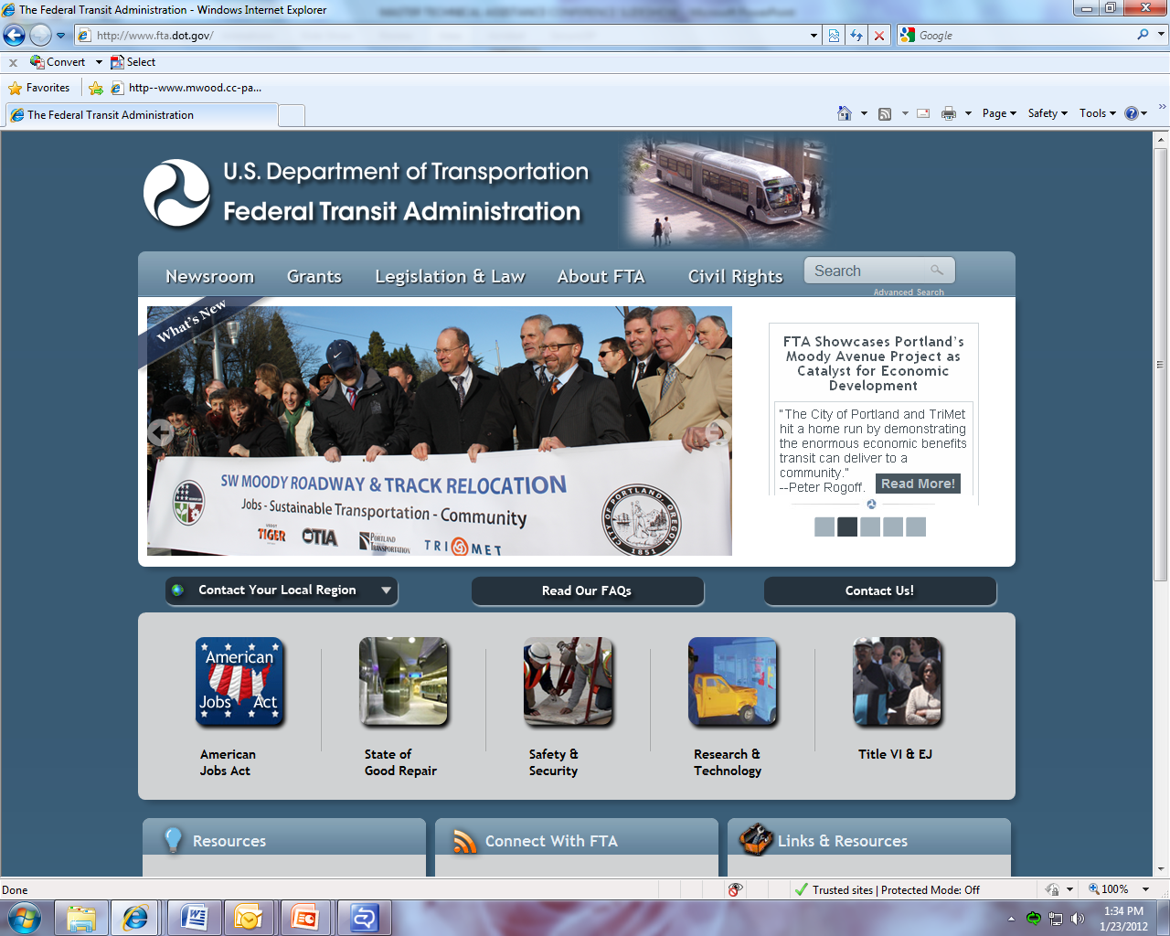
Notes:
12

Slide 13
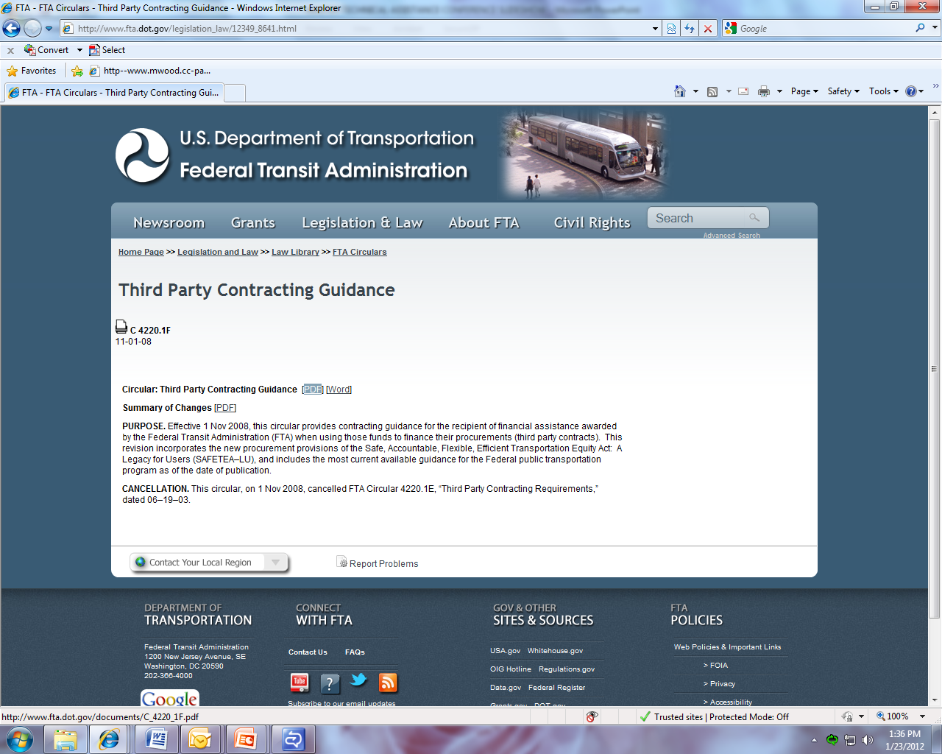
Notes:
13

Slide 14
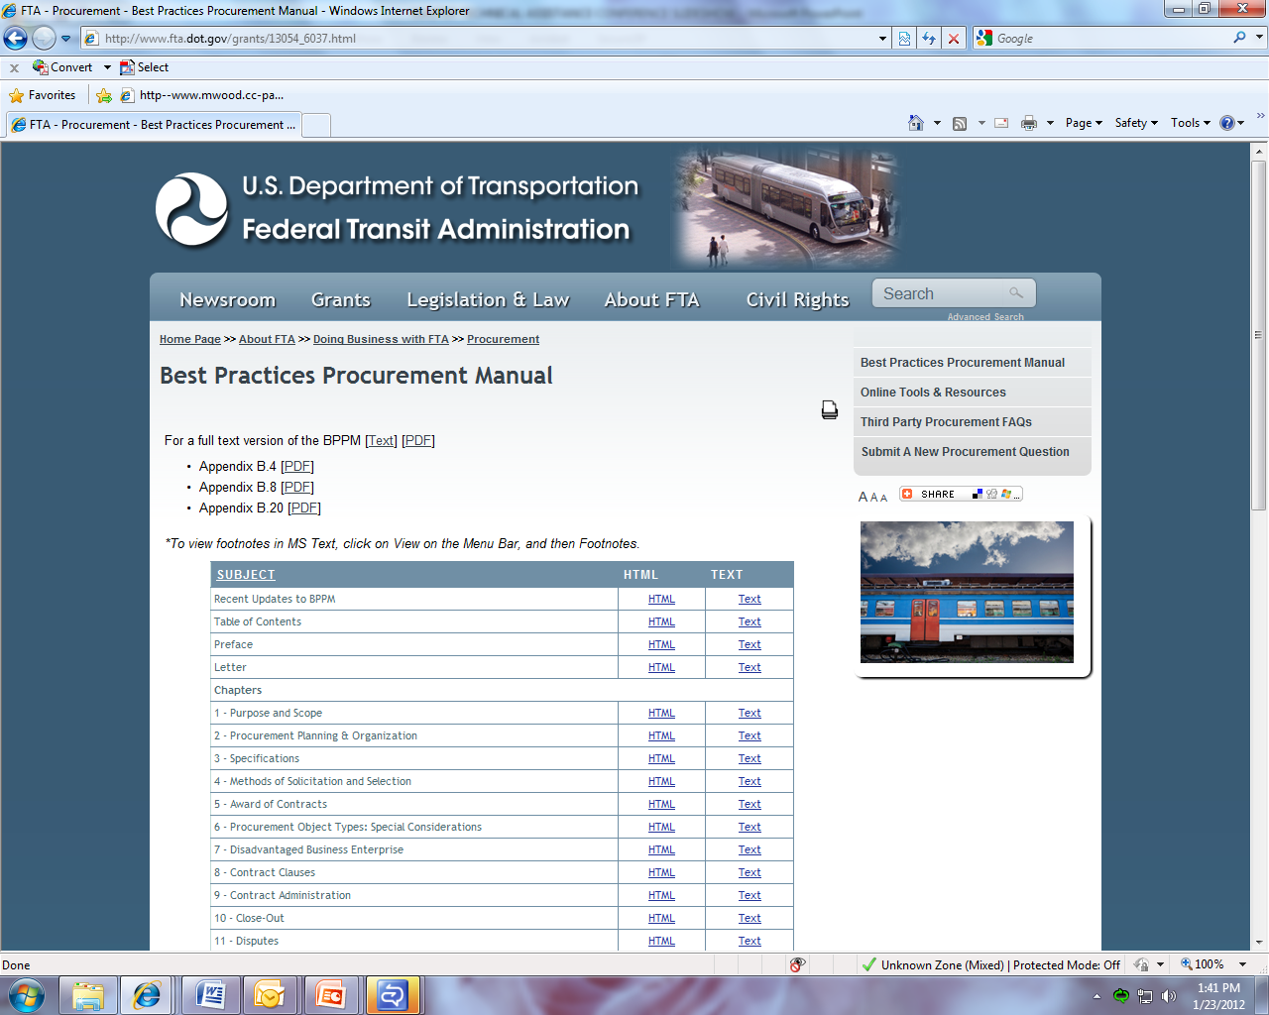
Notes:
14
14

Slide 15
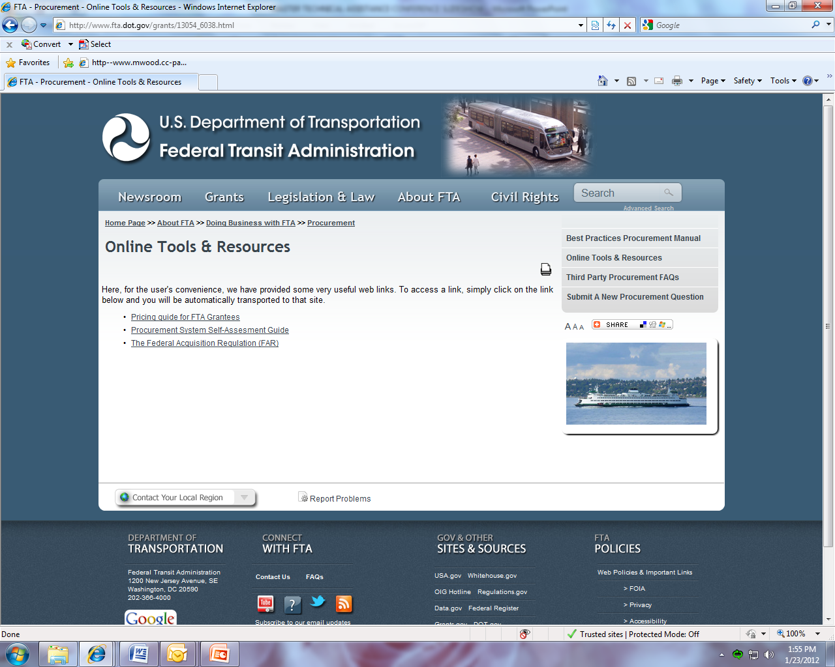
Notes:
15
15

Slide 16
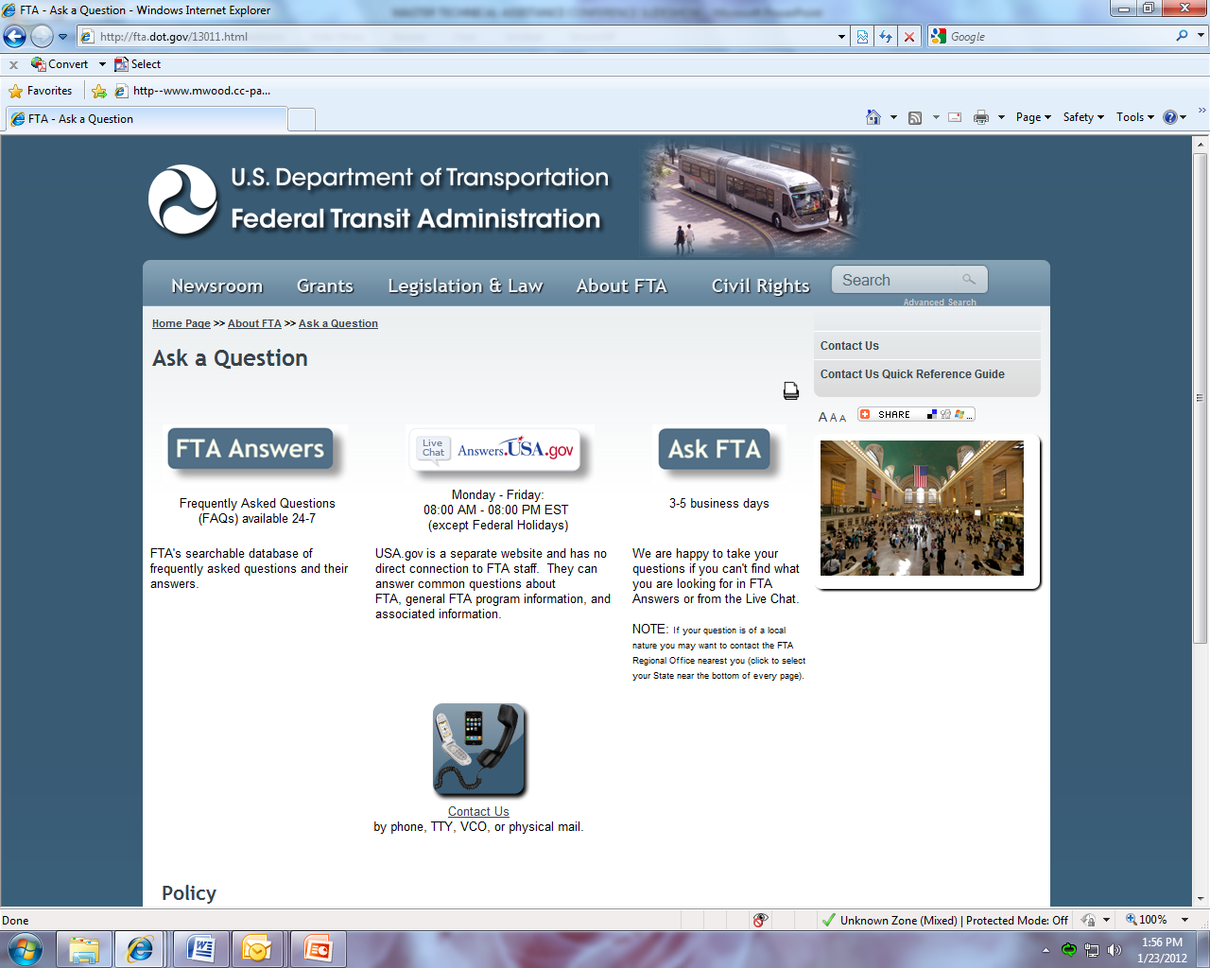
Notes:
16

Slide 17
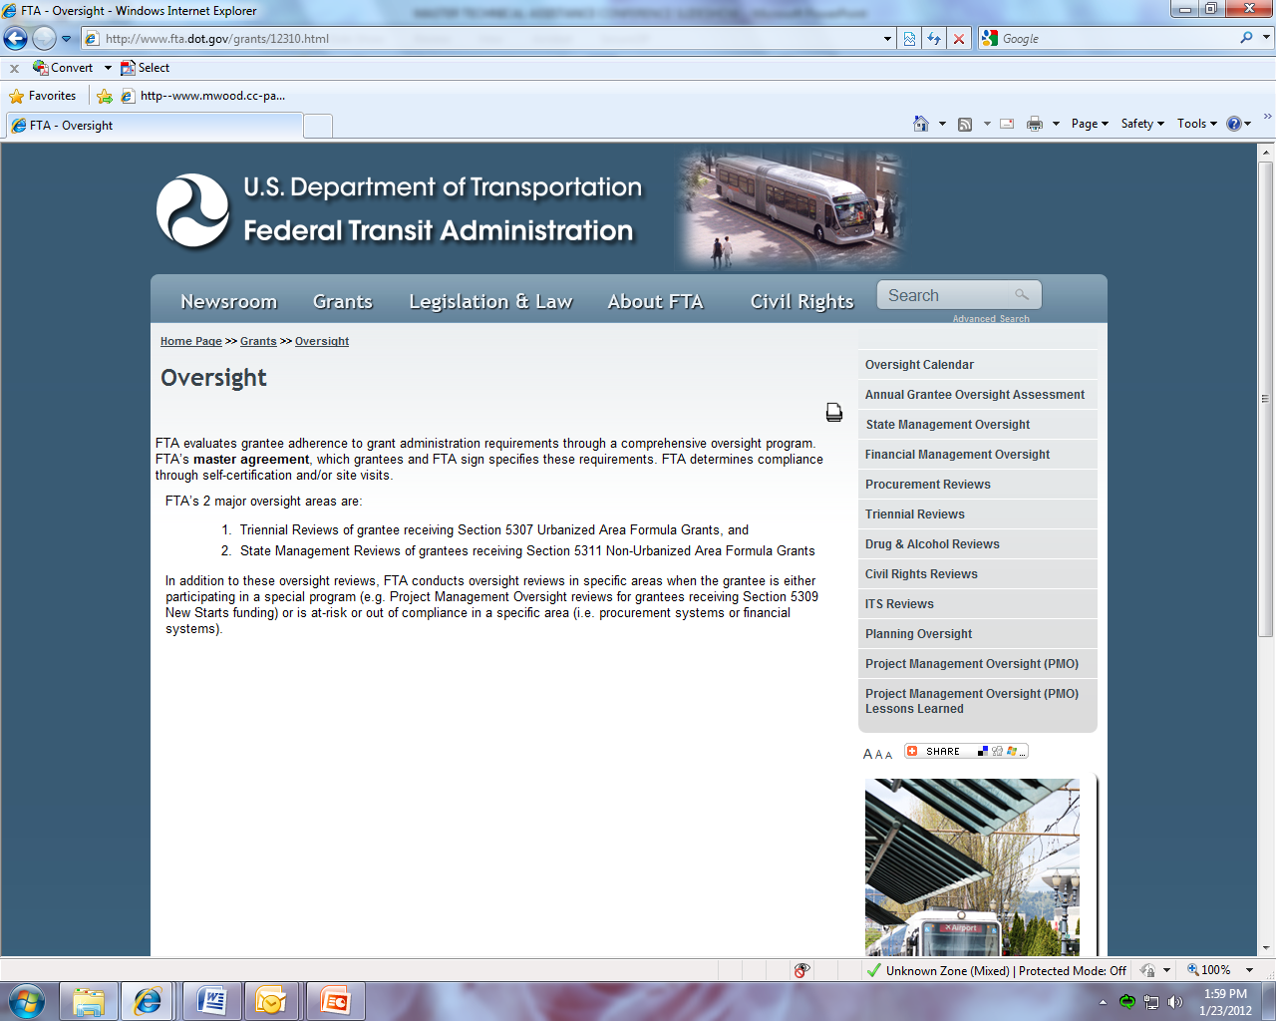
Notes:
17
17

Slide 18
Key Regulations and Circulars
Circulars
Regulations
49 CFR Part 18
Master Agreement
FTA C 4220.1E
FTA C 9040.1F
FTA C 9070.1F
FTA C 9050.1
FTA C 9045.1
FTA C 9300.1*
FTA C 9030.1C
FTA C 5010.1C *
Circular 4220.1F Became effective on 11/1/08
* Also updated as of 11/1/08
Notes:
18
18
Regulations:
Common Rule (48 CFR Part 18 Uniform Administrative Requirements for Grants and Cooperative Agreements to State and Local Governments)
49 CFR Part 19 Uniform Administrative Requirements for Grants and Agreements with Institutions of Higher Education, Hospitals, and Other Non-Profit Organizations
Because of differences between Parts 18 and 19, requirements in Procurement are different for public entities and non-profits.
9040.1F Nonurbanized Area Formula Program Guidance and Grant Application Instructions
-Largely self-contained
-When silent on an issue, 5010 applies (VI.2)
5010.1C Grant Management Guidelines
-Administrative guidance for all non-state-managed programs

Slide 19
FTA Circular 4220.1F
Applicability
To:
Transit authorities
FTA grantees and subgrantees that contract with outside sources
Not to:
States follow their own procedures, BUT must comply with FTA C 4220.1F:
Term limitations, Competition, Geographic Preference, A&E Services, and Awards to Responsible Contractors
Inclusion of Federally-required clauses
Notes:
19

Slide 20
FTA Circular 4220.1F
Applicability
For:
FTA-funded capital projects
All operating purchases if recipient of operating funds (primarily <200,000 in UZA population)
CMAQ and JARC funded contracts
However, operating purchases under these programs, do not trigger applicability to other agency operating contracts
Notes:
20

Slide 21
FTA Circular 4220.1F
Applicability
For (cont’d):
Preventative maintenance (PM) purchases
If formula funds are discrete, only to those projects,
If not, applies to all PM contracts
ADA complementary paratransit operating contracts if capitalizing ADA operating costs in a capital grant
Notes:
21

Slide 22
System-Wide Policies
Policies, procedures and organizational determinations necessary to guide the procurement function.
Notes:
22

Slide 23
System-Wide Policies
Written Standards of Conduct
Procurement Policies and Procedures
System for Ensuring Most Efficient and Economic Purchase
Written Protest Procedures
Prequalification System
Notes:
23
23

Slide 24
Written Standard of Conduct
Basic Requirement
(FTA C 4220.1F Ch. III, 1. )
Grantees shall maintain a written code of standards of conduct governing the performance of their employees engaged in the award and administration of contracts.
Element #1 of the PSR
Notes:
24

Slide 25
Written Standard of Conduct
Standards Applicable to:
Employees, officers, agents, immediate family members, or Board members participating in the selection, award, or administration of a contract if a conflict of interest, real or apparent, would be involved.
What is a conflict?
If following have a financial or other interest in the firm selected for award: (1) Employee, officer, agent, or Board member, (2) Any immediate family member, (3) His or her partner, or (4) An organization that employs, or is about to employ, any of the above.
Notes:
25
25

Slide 26
Written Standard of Conduct
Items standards should address:
The grantee's officers, employees, agents, or Board members will neither solicit nor accept gifts, gratuities, favors, or anything of monetary value from contractors, potential contractors, or parties to sub agreements.
To the extent permitted by state or local law or regulations, such standards of conduct will provide for penalties, sanctions, or other disciplinary action for violation of such standards by the grantee's officers, employees, or agents, or by contractors or their agents.
Notes:
26
26

Slide 27
Procurement Policies and Procedures
Basic Requirement
(FTA C 4220.1F Ch. III, 3.a. )
Grantees and sub grantees shall use their own procurement procedures that reflect applicable State and local laws and regulations, provided that the procurements conform to applicable Federal law, including the requirements and standards identified in 4220.1F.
Element #6 of the PSR
Notes:
27
27

Slide 28
Procurement Policies and Procedures
Policies and Procedures Should Address
Arbitrary action
Geographical preferences
Contractor selection procedures
Clear and accurate contract specifications
Brand name or equal
Micro-purchases
Small purchase
Sealed bid method of procurement
Notes:
28
28

Slide 29
Procurement Policies and Procedures
Policies and Procedures Should Address
Awards only to responsible contractors
Maintenance of records
Time and materials type contracts
Contract term limitation
Tag-ons
Full and open competition
Unreasonable requirements
Organizational conflicts of interest
Notes:
29
29

Slide 30
Procurement Policies and Procedures
Policies and Procedures Should Address
Competitive proposal (RFP) method of procurement
Brooks Act procedures
Procurement of design-bid-build
Sole source documentation
Options
Cost or price analysis
Independent cost or price estimates
Cost plus percentage of cost type contract
Notes:
30
30

Slide 31
Procurement Policies and Procedures
Policies and Procedures Should Address
Bonding requirements
Advance payments
Progress payments
Liquidated damages
Announcements of contract awards
Remedies for breach
Termination
Revenue contracts
Notes:
31
31

Slide 32
System for Ensuring Most Efficient and Economic Purchase
Basic Requirement
(FTA C 4220.1F Ch. IV, 1.b. )
Grantee procedures shall provide for a review of proposed procurements to avoid purchase of unnecessary or duplicative items.
Element #5 of the PSR
Notes:
32
32

Slide 33
Prequalification
Basic Requirement
(FTA C 4220.1F Ch. VI, 1.c. )
Grantees shall ensure that all lists of prequalified persons, firms, or products that are used in acquiring goods and services are current and include enough qualified sources to ensure maximum full and open competition. Also, grantees shall not preclude potential bidders from qualifying during the solicitation period, which is from the issuance of the solicitation to its closing date.
Element #4 of the PSR
Notes:
33
33

Slide 34
System for Ensuring Most Efficient and Economic Purchase
Organizational questions to ask:
Who has authority to initiate procurements within the agency?
Who has authority to approve procurements?
These questions should be asked in relation to how they are included in policies and how they actually occur.
Notes:
34
34

Slide 35
Prequalification
Grantees are not required, or encouraged, to have a prequalification system.
They can be difficult and costly to maintain if they are to not inhibit competition.
Notes:
35
35

Slide 36
Written Protest Procedures
Basic Requirement
(FTA C 4220.1F Ch. VII, 1.)
Grantees shall have written protest procedures to handle and resolve disputes relating to their procurements and shall in all instances disclose information regarding protests to FTA. All protest decisions must be in writing. A protester must exhaust all administrative remedies with the grantee before pursuing a protest with FTA.
Element #3 of the PSR
Notes:
36
36

Slide 37
Written Protest Procedures
Best Practices
BPPM § 11.1
Notes:
37
37

Slide 38
Written Protest Procedures
Limits on FTA’s protest review
a grantee fails to have or follow its protest procedures
there has been a violation of Federal law or regulation
Appeals to FTA must be received within 5 working days of the date the protester learned or should have learned of the grantee’s decision
Notes:
38
38

Slide 39
Preparing Solicitations
Independent Cost Estimate
Unreasonable Qualifications
Unnecessary Requirements/Excessive Bonding
Organizational Conflict of Interest
Brand Name Restrictions
Geographic Preferences
Solicitation Prequalification Requirements
Contract Term
Liquidated Damage Provision
Clauses
Clear, Accurate, and Complete Specification
Written Procurement Selection Procedures
Notes:
39
39

Slide 40
Independent Cost Estimate
Best Practices
BPPM § 2.3.2
Notes:
40
40

Slide 41
Independent Cost Estimate
Basic Requirement
(FTA C 4220.1F Ch. VI, 6. )
…in connection with every procurement action ….grantees must make independent estimates before receiving bids or proposals
Element #7 of the PSR
Notes:
41
41

Slide 42
Unreasonable Qualification Requirements
Basic Requirement
(FTA C 4220.1F Ch. VI, 2.a. (4)(a))
Unreasonable requirements placed on firms in order for them to qualify to do business are considered to be restrictive of competition
Element #9 of the PSR
Notes:
42
42

Slide 43
Unreasonable Qualification Requirements
Best Practices
BPPM § 2.4.2.1
Notes:
43
43

Slide 44
Unnecessary Experience and Excessive Bonding
Basic Requirement
(FTA C 4220.1F Ch. VI, 2.a. (4)(e))
Unnecessary experience and excessive bonding requirements are considered to be restrictive of competition
NOTE: FTA does have minimum bonding requirements for construction over $100,000.
Element #10 of the PSR
Notes:
44
44

Slide 45
Unnecessary Experience and Excessive Bonding
Best Practices
BPPM § 2.4.2.1
Notes:
45
45

Slide 46
Organizational Conflict of Interest
Basic Requirement
(FTA C 4220.1F Ch. VI, 2.a. (4)(h))
An organizational conflict of interest is considered to be restrictive of competition
Element #11 of the PSR
Notes:
46
46

Slide 47
Organizational Conflict of Interest
An organizational conflict of interest exists if:
because of other activities, relationships, or contracts, a contractor is unable, or potentially unable, to render impartial assistance or advice;
a contractor's objectivity in performing the contract work is or might be otherwise impaired; or
a contractor has an unfair competitive advantage Element #11 of the PSR
Notes:
47
47

Slide 48
Organizational Conflict of Interest
Best Practices
BPPM § 2.4.2.1 and 2.4.2.2.2
Notes:
48
48

Slide 49
Brand Name Restrictions
When it is impractical or uneconomical to make a clear and accurate description of the technical requirements, a “brand name or equal” description may be used as a means to define the performance or other salient characteristics of a procurement. The specific features of the named brand which must be met by offerors shall be clearly stated.
Notes:
49
49

Slide 50
Brand Name Restrictions
Basic Requirement
(FTA C 4220.1F Ch. VI, 2.a. (4)(f))
Specifying only a “brand name” product instead of allowing “an equal” product to be offered without listing its’ salient characteristics is considered to be restrictive of competition
Element #13 of the PSR
Notes:
50
50

Slide 51
Brand Name Restrictions
Best Practices
BPPM § 2.4.2.1, 2.4.2.2.1, 4.3.2, 4.4.1, 4.5.1, and 4.5.2
Notes:
51
51

Slide 52
Geographic Preferences
Basic Requirement
(FTA C 4220.1F Ch. VI, 2.a. (4)(g))
Grantees shall conduct procurements in a manner that prohibits the use of statutorily or administratively imposed in-State or local geographical preferences in the evaluation of bids or proposals, except in those cases where applicable Federal statutes expressly mandate or encourage geographic preference.
Element #14 of the PSR
Notes:
52
52

Slide 53
Geographic Preferences
This requirement does not preempt State licensing laws
Special considerations for A&E procurements
Notes:
53
53

Slide 54
Solicitation Prequalification Criteria
Basic Requirement
(FTA C 4220.1F Ch. VI, 1.c. )
Lists of prequalified persons, firms, or products that are used in acquiring goods and services must be current and include enough qualified sources to ensure maximum full and open competition.
Process shall not preclude potential bidders from qualifying during the solicitation period.
Element #17 of the PSR
Notes:
54
54

Slide 55
Contract Term Limitation
Be judicious in establishing and extending contract terms
Consider competition, pricing, fairness and public perception
An extension of the contract term length that amounts to an out of scope change will require a sole source justification
Notes:
55
55

Slide 56
Contract Term Limitation
Basic Requirement
(FTA C 4220.1F Ch. IV, 2.e(10))
Grantees shall not enter into any contract for rolling stock and replacement parts with a period of performance exceeding five (5) years inclusive of options
Element #15 of the PSR
Notes:
56
56

Slide 57
Liquidated Damages Provisions
Basic Requirement
(FTA C 4220.1F Ch. IV, 2.b(6)(b)1)
A grantee may use liquidated damages if it may reasonably expect to suffer damages and the extent or amount of such damages would be difficult or impossible to determine.
Element #49 of the PSR
Notes:
57
57

Slide 58
Liquidated Damages Provisions
Basic Requirement
The assessment for damages shall be at a specific rate per day for each day of overrun in contract time; and the rate must be specified in the third party contract. Any liquidated damages recovered shall be credited to the project account involved unless the FTA permits otherwise.
Notes:
58
58

Slide 59
Clauses
Basic Requirement
(FTA C 4220.1F Appendix D)
A current but not all inclusive and comprehensive list of statutory and regulatory requirements applicable to grantee procurements (such as Davis-Bacon Act, Disadvantaged Business Enterprise, Clean Air, and Buy America) is contained in the FTA Master Agreement.
Grantees are responsible for evaluating these requirements for relevance and applicability to each procurement.
Element #56 of the PSR
Notes:
59
59

Slide 60
Clauses
Best Practices
BPPM § 8
Notes:
60
60

Slide 61
Clear, Accurate, and Complete Specification
For sealed bidding, must have:
complete, adequate, and realistic specification or purchase description
Inclusion of any specifications and pertinent attachments
definition of the items or services sought in order for the bidder to properly respond
Notes:
61
61

Slide 62
Clear, Accurate, and Complete Specification
Basic Requirement
(FTA C 4220.1F Ch. III, 3.a.(1)(a))
Grantees shall have written selection procedures for procurement transactions.
Element #24 of the PSR
Notes:
62
62

Slide 63
Clear, Accurate, and Complete Specifications
Best Practices
BPPM § 3
Notes:
63
63

Slide 64
Written Procurement Selection Procedures
Basic Requirement
FTA C 4220.1F.
Grantees shall have written selection procedures for procurement transactions.
Element #16 of the PSR
Notes:
64
64

Slide 65
Written Procurement Selection Procedures
All solicitations shall:
Incorporate a clear and accurate description of the technical requirements for the material, product, or service to be procured.
Identify all requirements that offerors must fulfill and all other factors to be used in evaluating bids or proposals.
Notes:
65
65

Slide 66
Contract Award Considerations
Cost or Price Analysis
Evaluation of Options
Award to Responsible Contractors
Sound and Complete Agreement
Arbitrary Action
Notes:
66
66

Slide 67
Written Procurement Selection Procedures
All solicitations shall:
Incorporate a clear and accurate description of the technical requirements for the material, product, or service to be procured.
Identify all requirements that offerors must fulfill and all other factors to be used in evaluating bids or proposals.
Notes:
67
67

Slide 68
Written Procurement Selection Procedures
Best Practices
BPPM § 4.3.2, 4.4.1, 4.5.1, and 4.5.2
Notes:
68
68

Slide 69
Cost or Price Analysis
Basic Requirement
(FTA C 4220.1F Ch. VI, 6)
Grantees must perform a cost or price analysis in connection with every procurement action, including contract modifications.
Element #41 of the PSR
Notes:
69
69

Slide 70
Cost or Price Analysis
Cost analysis when:
the offeror is required to submit the elements (i.e., labor hours, overhead, materials, etc.) of the estimated cost,
adequate price competition is lacking and for sole source procurements, including contract modifications or change orders
Notes:
70
70

Slide 71
Cost or Price Analysis
Price analysis may be used in all other instances to determine price reasonableness
Notes:
71
71

Slide 72
Evaluation of Options
Basic Requirement
(FTA C 4220.1F Ch. VI, 7)
The option quantities or periods contained in the contractor's bid or offer must be evaluated in order to determine contract award. When options have not been evaluated as part of the award, the exercise of such options will be considered a sole source procurement.
Element #40 of the PSR
Notes:
72
72

Slide 73
Award to Responsible Contractor
Basic Requirement
(FTA C 4220.1F Ch. VI, 8.(b))
Grantees shall make awards only to responsible contractors possessing the ability to perform successfully under the terms and conditions of a proposed procurement. Consideration shall be given to such matters as contractor integrity, compliance with public policy, record of past performance, and financial and technical resources
Element #18 of the PSR
Notes:
73
73

Slide 74
Sound and Complete Agreement
Basic Requirement
(FTA C 4220.1F Ch. III, 3.(b))
All contracts shall include provisions to define a sound and complete agreement.
Element #19 of the PSR
Notes:
74
74

Slide 75
Sound and Complete Agreement
Contracts and subcontracts shall contain contractual provisions or conditions that allow for:
Administrative, contractual, or legal remedies (All contracts in excess of the small purchase threshold.)
Termination for cause and for convenience (All contracts in excess of $10,000.)
Notes:
75
75

Slide 76
Arbitrary Action
Basic Requirement
(FTA C 4220.1F Ch. VI, 2.a(4)(j))
Any arbitrary action in the procurement process is considered to be restrictive of competition.
Element #12 of the PSR
Notes:
76
76

Slide 77
Arbitrary Action
Best Practices
BPPM § 2.4.2.1
Notes:
77
77

Slide 78
Rules on Specific Types of Procurement
RFP
Sealed Bid
A&E
Construction
Vehicles
Notes:
78
78

Slide 79
Request for Proposals (RFP)
Basic Requirement
(FTA C 4220.1F Ch. VI, 3.(d))
The competitive proposal method of procurement is normally conducted with more than one source submitting an offer, i.e., proposal. Either a fixed price or cost reimbursement type contract is awarded. This method of procurement is generally used when conditions are not appropriate for the use of sealed bids
Special Considerations
Advertisement/Competition
Evaluation
Price and Other Factors
Notes:
79
79

Slide 80
Request for Proposals (RFP)
Advertisement
Basic Requirement
(FTA C 4220.1F Ch. VI, 3.d(2)(a))
Proposals will be solicited from an adequate number of qualified sources"
Requests for proposals will be publicized."
Element #29 and 30 of the PSR
Notes:
80
80

Slide 81
Request for Proposals (RFP)
Evaluation
Basic Requirement
(FTA C 4220.1F Ch. VI, 3.d(2)(b))
All evaluation factors will be identified along with their relative importance
Grantees will have a method in place for conducting technical evaluations of the proposals received and for selecting awardees;
Element #36 of the PSR
Notes:
81
81

Slide 82
Request for Proposals (RFP)
Price and Other Factors
Basic Requirement
(FTA C 4220.1F Ch. VI, 3.d(2)(e))
Awards made to firm whose proposal is most advantageous to the grantee's program with price and other factors considered
Grantees may award to the proposer whose proposals offer the greatest business value to the Agency based upon an analysis of a tradeoff of qualitative technical factors and price/cost to derive which proposal represents the “best value.” “Best value” language must be in the solicitation. Element #37 of the PSR
Notes:
82
82

Slide 83
Sealed Bids
Basic Requirement
(FTA C 4220.1F Ch. VI, 3.c)
Bids are publicly solicited and a firm-fixed-price contract (lump sum or unit price) is awarded to the responsible bidder whose bid, conforming to all the material terms and conditions of the invitation for bids, is the lowest in price.
Notes:
83
83

Slide 84
Sealed Bids
Special Rules
Advertised/Publicized
Adequate Number of Sources Solicited
Sufficient Bid Time
Adequate Competition
Firm Fixed Price/Selection on Price
Discussions Unnecessary
Bid Opening
Responsiveness
Lowest Price
Rejecting Bids
Notes:
84
84

Slide 85
Sealed Bids
Advertised/Publicized
Adequate Number of Sources Solicited
Sufficient Bid Time
(FTA C 4220.1F Ch. VI, 3.c(2))
The invitation for bids will be publicly advertised and bids shall be solicited from an adequate number of known suppliers, providing them sufficient time to prepare bids prior to the date set for opening the bids.
Elements #29, 30, and 31 of the PSR
Notes:
85
85

Slide 86
Sealed Bids
Adequate Competition
(FTA C 4220.1F Ch. VI, 3.c(2)(b))
Two or more responsible bidders are willing and able to compete effectively for the business
Element #25 of the PSR
Notes:
86
86

Slide 87
Sealed Bids
Firm Fixed Price/Selection on Price
(FTA C 4220.1F Ch. VI, 3.c)
The procurement lends itself to a firm fixed price contract and the selection of the successful bidder can be made principally on the basis of price
Elements #26 and 27 of the PSR
Notes:
87
87

Slide 88
Sealed Bids
Discussions Unnecessary
(FTA C 4220.1F Ch. VI, 3.c(1)(e))
No discussion with bidders is needed
Element #28 of the PSR
Notes:
88
88

Slide 89
Sealed Bids
Bid Opening
(FTA C 4220.1F Ch. VI, 3.c(2)(e))
All bids will be publicly opened at the time and place prescribed in the invitation for bids
Element #32 of the PSR
Notes:
89
89

Slide 90
Sealed Bids
Rejecting Bids
(FTA C 4220.1F Ch. VI, 3.c(2)(g))
Any or all bids may be rejected if there is a sound documented business reason.
Element #35 of the PSR
Notes:
90
90

Slide 91
Sealed Bids
Responsiveness/Lowest Bid
(FTA C 4220.1F Ch. VI, 3.c(2)(f))
A firm fixed-price contract award will be made in writing to the lowest responsive and responsible bidder.
Element #33 and 34 of the PSR
Notes:
91
91

Slide 92
Architectural and Engineering
Special Considerations
Qualifications Exclude Price
Serial Price Negotiations
Geographic Preference
Notes:
92
92

Slide 93
Architectural and Engineering
Qualifications Exclude Price
(FTA C 4220.1F Ch. VI, 3.f(3)(b))
Qualifications-based competitive proposal procedures require that: (1) An offeror’s qualifications be evaluated (2) Price be excluded as an evaluation factor
Element #51 of the PSR
Notes:
93
93

Slide 94
Architectural and Engineering
Serial Price Negotiations
(FTA C 4220.1F Ch. VI, 3.f(3)(d))
Negotiations be conducted with only the most qualified offeror
Failing agreement on price, negotiations with the next most qualified offeror be conducted until a contract award can be made to the most qualified offeror whose price is fair and reasonable to the grantee.
Element #52 of the PSR
Notes:
94
94

Slide 95
Architectural and Engineering
Special Considerations
Geographic Preference
Notes:
95
95

Slide 96
Architectural and Engineering
Best Practices
BPPM § 6.5
Notes:
96
96

Slide 97
Construction Over $2,000
Davis Bacon
(FTA C 4220.1F Ch. IV, 2.h(4))
The Davis-Bacon Act applies to construction contracts
Element #22 of the PSR
Notes:
97
97

Slide 98
Construction Over $100,000
Bid Security
(FTA C 4220.1F Ch. IV, 2.h(1)(a))
Equivalent to five (5) percent of the bid price.
Firm commitment such as a bid bond, certified check, or other negotiable instrument accompanying a bid as assurance that the bidder will execute contractual documents as may be required within the time specified
Element #53 of the PSR
Notes:
98
98

Slide 99
Construction Over $100,000
Special Considerations
Bid Security
Performance Security
Payment Security
Notes:
99
99

Slide 100
Construction Over $100,000
Performance Security
(FTA C 4220.1F Ch. IV, 2.h(1)(b))
Amount equal to 100 percent of the contract price
Executed in connection with a contract to secure fulfillment of all the contractor's obligations under such contract
Element #54 of the PSR
Notes:
100
100

Slide 101
Construction Over $100,000
Payment Security
(FTA C 4220.1F Ch. IV, 2.h(1)(c))
Assures payment of all persons supplying labor and material.
Required amounts : (1) Fifty percent of the contract price if the contract price is not more than $1 million; (2) Forty percent of the contract price if the contract price is more than $1 million but not more than $5 million; or (3) Two and a half million dollars if the contract price is more than $5 million.
Element #55 of the PSR
Notes:
101
101

Slide 102
Rules on Specific Methods of Procurement
Micro Purchase
Small Purchase
Piggybacking
Sole Source
Time and Materials
Cost Plus Percentage of Cost
Notes:
102
102

Slide 103
Micro Purchase
(FTA C 4220.1F Ch. VI, 3.a)
Micro-purchases are those purchases under $3,000.
Special Considerations
No Splitting
Fair and Reasonable Price Determination
Notes:
103
103

Slide 104
Micro Purchase
May be made without obtaining competitive quotations.
There should be equitable distribution among qualified suppliers and no splitting of procurements to avoid competition.
Document that the price is fair and reasonable and how this determination was derived.
Elements #20 and 21 of the PSR
Notes:
104
104

Slide 105
Micro Purchase
Best Practices
BPPM § 4.1
Notes:
105
105

Slide 106
Small Purchase
Price or rate quotations shall be obtained from an adequate number of qualified sources
Element #23 of the PSR
Notes:
106
106

Slide 107
Small Purchase
(FTA C 4220.1F Ch. VI, 3.b)
Small purchase procedures are those relatively simple and informal procurement methods for securing services, supplies, or other property that cost more than $3,000 but do not cost more than the simplified acquisition threshold fixed at 41 U.S.C. § 403(11) (currently set at $100,000).
Notes:
107
107

Slide 108
Small Purchase
Best Practices
BPPM § 4.2
Notes:
108
108

Slide 109
Piggybacking
(FTA C 4220.1F Ch. V, 7.a(2))
An assignment of existing contract rights to purchase supplies, equipment, or services.
Special Considerations
Assign ability Clause
Minimum/Maximum Quantities
Notes:
109
109

Slide 110
Piggybacking
Basic Requirement
Permissible when the solicitation contract contain an assign ability clause that provides for the assignment of all or a portion of the specified deliverables as originally advertised, competed, evaluated, and awarded.
Solicitation and contract must contain a minimum and maximum quantity that represent the reasonably foreseeable needs of the party(s)
Element #50 of the PSR
Notes:
110
110

Slide 111
Sole Source
(FTA C 4220.1F Ch. VI, 3.i(1)(b))
Solicitation of a proposal from only one source, or after solicitation of a number of sources, competition is determined inadequate. Contract changes not within a contract’s original scope is a sole source
Notes:
111
111

Slide 112
Sole Source
FTA C 4220.1E 9.h.(1)
Used only when other methods feasible, and at least one of the following applies:
The item is available only from a single source;
Delay not possible due to emergency or public exigency
FTA authorizes noncompetitive
After solicitation of a number of sources, competition is determined inadequate
Item is an associated capital maintenance item
Element #38 of the PSR
Notes:
112
112

Slide 113
Sole Source
FTA C 4220.1E 9.h.(2)
A cost analysis, i.e., verifying the proposed cost data, the projections of the data, and the evaluation of the specific elements of costs and profit, is required.
Element #39 of the PSR
Notes:
113
113

Slide 114
Cost Plus Percentage of Cost
(FTA C 4220.1F Ch. VI, 2.c(2)(a))
The cost plus a percentage of cost and percentage of construction cost methods of contracting shall not be used.
Element #48 of the PSR
Notes:
114
114

Slide 115
Time and Materials Contracts
(FTA C 4220.1F Ch. VI, 2.c(2)(b))
Used only:
After a determination that no other type of contract is suitable
If the contract specifies a ceiling price that the contractor shall not exceed except at its own risk.
Element #47 of the PSR
Notes:
115
115

Slide 116
Post Award Considerations
Six Elements:
Written Record of Procurement History
Contract Administration System
Advance Payments
Progress Payments
Out of Scope Changes
Exercise of Options
Notes:
116
116

Slide 117
Written Record of Procurement History
Basic Requirement
(FTA C 4220.1F Ch. III, 3.d(1))
Grantees shall maintain records detailing the history of each procurement.
Element #42 of the PSR
Notes:
117
117

Slide 118
Written Record of Procurement History
Items Reviewed
At a minimum, records shall include: (1) the rationale for the method of procurement, (2) selection of contract type, (3) reasons for contractor selection or rejection, and (4) the basis for the contract price.
Notes:
118
118

Slide 119
Contract Administration System
Basic Requirement
(FTA C 4220.1F Ch. III, 3)
Grantees shall maintain a contract administration system that ensures that contractors perform in accordance with the terms, conditions, and specifications of their contracts or purchase orders.
Element #2 of the PSR
Notes:
119
119

Slide 120
Advance Payments
Basic Requirement
(FTA C 4220.1F Ch. IV, 2.b(5)(b))
FTA does not authorize and will not participate in funding payments to a contractor prior to the incurrence of costs by the contractor unless prior written concurrence is obtained from FTA.
Element #45 of the PSR
Notes:
120
120

Slide 121
Progress Payments
Basic Requirement
(FTA C 4220.1F Ch. IV, 2.b(5)(c))
Progress payments are allowed if:
(1) They are only made to the contractor for costs incurred in the performance of the contract. (2) Adequate security is obtained (such as taking title, letter of credit or equivalent means)
Element #46 of the PSR
Notes:
121
121

Slide 122
Out of Scope Changes
Basic Requirement
(FTA C 4220.1F Ch. V, 7.b(2)(b))
A contract change that is not within the scope of the original contract is considered a sole source procurement .
Element #44 of the PSR
Notes:
122
122

Slide 123
Exercise of Options
Basic Requirement
(FTA C 4220.1F Ch. V, 7.a(1))
The exercise of an option must be in accordance with the terms and conditions of the option stated in the initial contract awarded.
An option may not be exercised unless it is determined that the option price is better than prices available at the time the option is exercised.
Element #43 of the PSR
Notes:
123
123

Slide 124
Common Areas of Deficiencies
Independent Cost Estimate
Cost/Price Analysis
Written Record of Procurement History
Sound and Complete Agreement
Notes:
124
124

Slide 125
Point of Contact
James Harper, Jr.
202-366-1127
james.harper@dot.gov
Notes:
125
125

