Slide 1
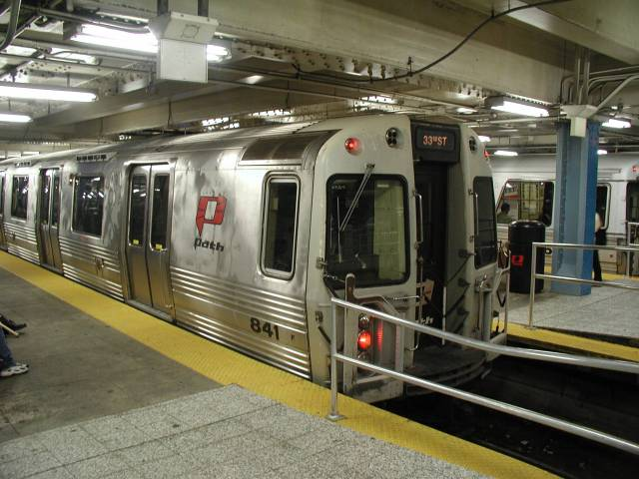
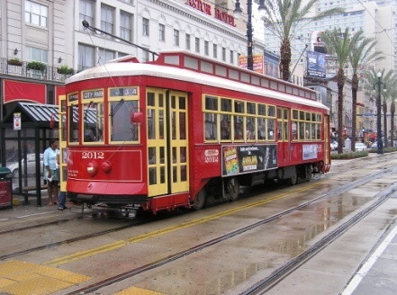

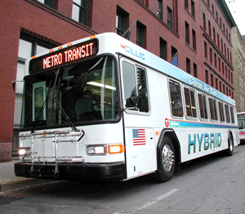
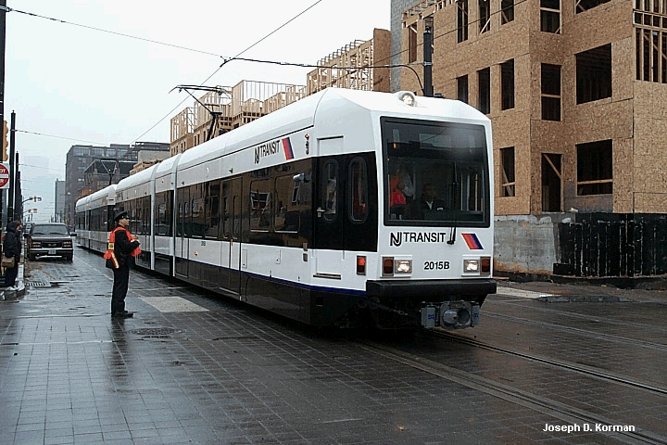
Financial Management Oversight
FY 2013

Slide 2
CONTENTS
Presentation Objective
Slide 3
Slide 4
Common Rules
Slide 28
Federal Cost Principles
Slide 47
Cost Allocation Plans
Slide 71
FTA Circulars
Slide 77
Financial Management Oversight Program

Slide 3
Presentation Objective
To review the criteria for establishing and maintaining financial management systems that meet the federal requirements, the common rules, and federal guidance.

Slide 4
The Common RuleS

Slide 5
Common Rules
Code of Federal Regulations (CFR)
The Common Rules are part of the CFR
The Code of Federal Regulations consists of regulations adopted by federal agencies and executive departments of the federal government.
Constitution
Code of Federal Regulations
FTA Circulars
Other Headquarters Guidance
Public Laws
OMB Circulars
U.S. Code
State and Local Directives
Regional Office Interpretations

Slide 6
Common Rules
Title 49, Code of Federal Regulations, Transportation
Constitution
Code of Federal Regulations
FTA Circulars
Other Headquarters Directives
Public Laws
OMB Circulars
U.S. Code
State and Local Directives
Regional Office Interpretations
Part | Title 49
18 | Uniform Administrative requirements for grants and cooperative agreements to State and local governments
19 | Uniform administrative requirements for grant and agreements with institutions of higher education, hospitals, and other non-profit organizations

Slide 7
Common Rules
18.20 Standards for Financial Management Systems
19.21 Standards for Financial Management Systems
Compliance with the Common Rules is not a choice or option.
The applicable Common Rules is required for all grant recipients and subrecipients.
Common Rules standards cannot be waived.
This presentation focuses on sections18.20 and 19.21 with greater emphasis on 49 CFR part 18 because most FTA recipients are governmental entities.

Slide 8
Common Rules
Standards Addressed by 49 CFR 18.20 and 19.21(b)
Financial Reporting
Accounting Records
Internal Control
Project Changes
(Part 18.30)
Budget Control
Allowable Cost
Source Documentation
Cash Management

Slide 9
Common Rules
Standards of 49 CFR 18.20 (Example) and 49 CFR19.21(b)
Financial Reporting
18.20(b)(1)
“Accurate, current, and complete disclosure of the financial results of financially-assisted activities must be made in accordance with the financial reporting requirements of the grant or subgrant.”

Slide 10
Common Rules
Financial Reporting Common Findings
Reported amounts of federal expenditures not in agreement with general ledger
Incorrect reporting of encumbrances
FFR’s are not reported on an accrual basis
NTD reports are not filed timely

Slide 11
Common Rules
Standards of 49 CFR 18.20 (Example) and 49 CFR 19.21
Accounting Records
18.20(b)(2)
“Grantees and subgrantees must maintain records, which adequately identify the source and application of funds provided for financially-assisted activities. These records must contain information pertaining to grant or subgrant awards and authorizations, obligations, unobligated balances, assets, liabilities, outlays or expenditures, and income”.
The grantee’s financial accounting system for the project must interface with the grantee’s overall financial management system.

Slide 12
Common Rules
Accounting Records Common Findings
Grantee does not have a formal record retention policy
Grant expenditures are not properly supported
Grantee does not maintain a fixed asset subsidiary ledger
Grantee does not reconcile amounts reported in the FFR to the general ledger

Slide 13
Common Rules
Standards of 49 CFR 18.20 (Example) and 19.41
Internal Controls
18.20(b)(3)
“Effective control and accountability must be maintained for all grant and subgrant cash, real and personal property, and other assets.”
Specifically with respect to fixed asset records, 49 CFR 18.32(d) requires that grantees and subgrantees maintain a fixed asset control system providing detailed property records for assets acquired under a grant or subgrant, and include procedures to provide reasonable assurance that safeguards are present to prevent or detect unauthorized acquisition, use, or disposition of the property, and that maintenance procedures are implemented for such assets.

Slide 14
Common Rules
Internal Controls Common Findings
Biennial physical inventory of property not performed
Lack of adequate and documented Policies and Procedures
Inadequate segregation of duties
The grantee lacks a comprehensive disaster recovery plan

Slide 15
Common Rules
Standards of 49 CFR 18.20 (Example) and 49 CFR 19.21
Budget Control
18.20(b)(4)
“Actual expenditures or outlays must be compared with budgeted amounts for each grant or subgrant. Financial information must be related to performance or productivity data, including the development of unit cost information whenever appropriate or specifically required in the grant or subgrant agreement.”

Slide 16
Common Rules
Budget Control Common Conditions
Budget to actual analysis not performed for capital budget
Explanations for budget variances not documented
Budget not approved before the beginning of fiscal year

Slide 17
Common Rules
Standards of 49 CFR 18.20 (Example) and 49 CFR 19.21
Allowable Cost
18.20(b)(5)
"Grantees must have procedures to provide reasonable assurance that 2 CFR Part 225 (incorporated within 49 CFR 18.22), agency program regulations, and the terms of grant and subgrant agreements will be followed in determining the reasonableness, allowability, and allocability of costs.” If indirect costs are being charged to the grant, Grantees must prepare a cost allocation plan that is approved by its cognizant agency.

Slide 18
Common Rules
Allowable Cost Common Findings
Unallowable costs charged to the federal program
Indirect Costs billed without FTA approved Cost Allocation Plan
Grantee reported amounts of federal funding obtained in excess of eligible expenditures

Slide 19
Common Rules
Standards of 49 CFR 18.20 (Example) and 49 CFR 19.21
Source Documentation
18.20(b)(6)
“Accounting records must be supported by such source documentation as canceled checks, paid bills, payrolls, time and attendance records, contract and subgrant award documents, etc.”

Slide 20
Common Rules
Source Documentation Common Findings
Justification for sole source procurement was not documented
Grantee does not maintain complete and organized procurement files
Monthly reconciliations of accounts receivable and accounts payable prepared, but documentation is not retained

Slide 21
Common Rules
Standards of 49 CFR 18.20 (Example) and 49 CFR 19.21
Cash Management
18.20(b)(7)
Procedures for minimizing the time elapsing between the transfer of funds from the U.S. Treasury and disbursement by grantees must be followed whenever advance payment procedures are used.
Grantees must monitor cash draw downs by their subgrantees to assure that they conform substantially to the same standards of timing and amount as apply to advances to the grantees.”

Slide 22
Common Rules
Standards of 49 CFR 18.20 (Example) and 49 CFR 19.21
Cash Management
Excessive Cash Rules
Cash received from FTA must be disbursed within three business days
If not disbursed within three days, cash becomes excess funds and must be returned to FTA
Exceptions:
If drawn early by mistake and funds will be disbursed within 7 calendar days; or
If <$10,000 and will be disbursed within 30 calendar days, then funds may be retained, but interest accrues beginning with day 4

Slide 23
Common Rules
Cash Management Common Findings
Grantee drew down federal funds in excess of need and did not remit overdraw to FTA
Preventive Maintenance funds drawn down in equal monthly increments throughout the year, rather than as the expenditures are incurred

Slide 24
Common Rules
Other Cash Management Topics
Farebox Collection Procedures
Controls Over ECHO Drawdown Process
Controls Over Cash in Banks

Slide 25
Common Rules
Other Cash Management Topics Findings
No reconciliation of ECHO drawdowns to bank records and TEAM
Bank reconciliations not performed in a timely manner
No reconciliation of farebox cash collected to GFI records

Slide 26
Common Rules
Standards of 49 CFR 18.20 (Example) and 49 CFR 19.21
Project Change
“Unless waived by the awarding agency, certain types of post-award changes in budgets and projects shall require the prior written approval of the awarding agency.”
18.30

Slide 27
Common Rules
Project Change Common Findings
Change orders on federally funded projects are not reviewed for federal funding eligibility
Required FTA approval is not being obtained for project scope changes

Slide 28
Federal Cost Principles

Slide 29
Federal Cost Principles
Office of Management and Budget Circulars
OMB Circulars established to convey uniform guidance through instructions and information to executive departments and establishments
Even though it is mandatory for the federal agencies to follow the Circulars, certain requirements can be waived at the discretion of the OMB
Constitution
Code of Federal Regulations
FTA Circulars
Other Headquarters Directives
Public Laws
OMB CIRCULARS
U.S. Code
State and Local Directives
Regional Office Interpretations

Slide 30
Federal Cost Principles
A-21 | OMB Cost Principles Cost Principles for Educational Institutions (2 CFR Part 220)
A-87 | Cost Principles for State, Local and Indian Tribal Governments (2 CFR Part 225)
A-122 | Cost Principles for Non-Profit Organizations (2 CFR Part 230)
Constitution
Code of Federal Regulations
FTA Circulars
Other Headquarters Directives
Public Laws
OMB CIRCULARS
U.S. Code
State and Local Directives
Regional Office Interpretations

Slide 31
Federal Cost Principles
A set of established accounting principles to be used in determining allowable costs for federal grants, subgrants, and cost type contracts awarded under federal grants.
Implemented through the Common Rules and FTA Circular 5010.1D, Chapter VI, Parts 5 and 6.

Slide 32
Federal Cost Principles
What They Do
Identify allowable and unallowable costs
Set basic policies/procedures for identifying program costs
Brings rationality to the cost determination and approval process
Mandate cognizant agency approval/appeal concept
Stipulate cost allocation plan requirements
Cite documentation requirements
Specify allocation criteria

Slide 33
Federal Cost Principles
What They Do Not Do
Dictate extent of federal funding or extent of matching required
Supersede limitations imposed by law or regulation
Relieve state and local governments of stewardship responsibilities for federal funds
Dictate organizational form or management techniques needed for program administration

Slide 34
Federal Cost Principles - Appendices
(Example - 2 CFR Part 225
Appendix A
General Principles for Determining Allowable Cost
Appendix B
Selected Items of Cost
Appendix C
State/Local Wide Central Service Cost Allocation Plans
Appendix D
Public Assistance Cost Allocation Plan
Appendix E
State and Local Indirect Cost Rate Proposal

Slide 35
Federal Cost Principles
Appendix A
Objectives
Cost determination, not level of funding
Policy Guides
Fundamental premise: state/local governments responsible for administration of federal awards
Application
All federal agencies
Definitions
Awarding agency, approval, contracts, cognizant agency, cost, state/local government, etc.
Federal awards bear fair share of costs
Sub-awards
Guide for cost based contracts

Slide 36
Federal Cost Principles
Appendix A: Basic Guidelines for Allowability of Cost
Allowable
Reasonable
Allocable
Necessary
Reasonable
Allocable
Not prohibited
Conform with limitations
Apply uniformly
Consistent treatment
Conform with GAAP
Documented
Not claimed on other awards
Ordinary and necessary
Sound business practices
Market prices
No significant deviations from established practices
Assessed to activities based on relative benefit
Assessed to all activities regardless of fund sources

Slide 37
Federal Cost Principles
Appendix A
Composition of Costs
Total Costs = direct costs + indirect costs – applicable credits
Direct Costs
Identifiable specifically with a particular cost objective (i.e., project or award or primary function)
Indirect Costs
Costs of general support activities that benefit more than one cost objective
Not readily assignable without disproportionate effort

Slide 38
Federal Cost Principles
Examples of Direct and Indirect Costs
Direct Costs
Bus/Rail Operations
Planning
Indirect Costs
Directors’ office and staff
Human Resources
Construction
Project Administration
Purchasing
Accounting

Slide 39

Federal Cost Principles
Unallowable Costs
Alcoholic Beverages
Bad Debts
Contingencies
Contributions and Donations
Entertainment
Fines and Penalties
Defense of civil or criminal fraud proceedings commenced by the US or state government
Fundraising
General Government
Lobbying

Slide 40
Federal Cost Principles
Advertising and Public Relations
Advertising unallowable unless incurred for:
  recruitment of personnel,
  procurement of goods,
  disposal of surplus materials and,
  meeting the requirements of the federal award

Slide 41
Federal Cost Principles
Advertising and Public Relations
Public Relations unallowable unless:
Required by the federal award, and then only as direct cost
Incurred to communicate to the public and press about specific activities or accomplishments that result from federal award
Communicating with the news media regarding matters of public concern

Slide 42
Federal Cost Principles
Depreciation/Use Allowance
May not be used in combination for a single class of assets
If use allowance used, should not exceed 2% of acquisition cost for buildings and improvements and 6 2/3% of acquisition cost for equipment
Depreciation method shall not change unless approved by cognizant agency
Must be supported by property records

Slide 43
Federal Cost Principles
Compensation
Documentation
Leave
Retirement Plans/Pensions, Post Retirement Health Benefits
Donated Services
Severance Pay

Slide 44
Federal Cost Principles
Maintenance
Unless prohibited by law, the cost of necessary maintenance, normal repairs and upkeep are allowable to the extent they:
  Keep property in efficient operating condition
  Do not add to the permanent value of property or appreciably prolong its life
  Are not otherwise included in rental or other charges for space

Slide 45
Federal Cost Principles
Memberships
Allowable:
Business, technical, and professional organizations
Subscriptions to business, technical and professional periodicals
Costs of meetings and conferences where technical information is disseminated
Memberships in civic and community, social organizations (direct cost with approval)

Slide 46
Federal Cost Principles
Other Allowable Costs
ADP Systems Development/Testing
Employee Morale/Health/Welfare
Gains/losses on disposition of property
Pre-award costs
Proposal preparation costs
Self-insurance
Taxes
Travel
Working capital reserves

Slide 47
Cost allocation plans

Slide 48
Cost Allocation Plans
Objectives for this Section
Discuss Cost Allocation Plan requirements per 2 CFR Part 225 (or other applicable cost principles) and FTA Circular 5010.1D
Cost allocation plan definitions, methods and applications
Identify some of the common problems found in cost allocation plans

Slide 49
Cost Allocation Plans
Who Needs One?
Transit agencies that wish to claim indirect cost reimbursement under federal grants and contracts
Exception:
Agencies that are capable of directly charging administrative costs to direct cost objectives

Slide 50
Cost Allocation Plans
Why Does My Organization Need One?
Compute Indirect Cost Rate(s)
Capture indirect costs used to benefit federal awards
More informed decision-making
More accurate cost information

Slide 51
Cost Allocation Plans
FTA Circular 5010.1D Requirements
Initial plans must be approved by FTA (or cognizant agency)
Proposal must be updated annually. FTA must review update if certain conditions are met.
CAP must reflect actual cost (or budget)
Must be retained and made available for Single Audit
Costs must be supported by formal accounting records

Slide 52
Cognizant Agency
Definition
The Federal agency that is responsible for reviewing, negotiating and approving cost allocation plans or indirect cost proposals developed under 2 CFR Part 225 (or other applicable cost principles) on behalf of all Federal agencies.

Slide 53
Cognizant Agency
Determination Process
Option One – OMB has published a list of Federal Agencies with cognizance over certain governmental units. The latest list is in the Federal Register, Volume 51, No. 3 Monday, January 6, 1986
Option Two - For agencies not on the OMB list, cognizance is determined by the agency that provided the largest amount of Federal funds.

Slide 54
Cost Allocation Plans
FTA Circular 5010.1D Requirements
Proposal must be approved by FTA if:
First project or proposal
Accounting system changes
Proposed rate exceeds the amounts and rate approved for previous year(s) by more than 20%
Changes in the CAP methodology

Slide 55
Cost Allocation Plans
Three Types of Plan
State/Local Central Services Cost Allocation Plans (not addressed in this presentation)
Public Assistance Cost Allocation Plans (not addressed in this presentation)
Indirect Cost Proposals (will be the focus of this presentation)

Slide 56
Cost Allocation Plans
Indirect Cost Rate Proposals
What is an Indirect Cost Rate?
The ratio expressed as a percentage of an indirect cost pool and some direct cost base
Allowable Indirect costs = Indirect rate %
Direct cost base
Direct bases may be:
    Direct salaries and wages or a modification thereof
    Modified total direct costs (MTDC)

Slide 57
Cost Allocation Plans
Methodologies
Simplified
Multiple allocation base
Easiest
Use this method when each of your major functions benefit from each indirect cost item approximately to the same degree
More complex
Generally most accurate
Requires more data
Use this method when indirect costs benefit major functions to varying degrees

Slide 58
Cost Allocation Plans
Simplified Method: Step1 - Identify Indirect Costs
Total Costs Per Financial Statements (or budget)
Less: Depreciation/Use Allowance
Less: Unallowable Administrative Costs per 2 CFR Part 225
Less: Distorting Administrative Costs
Less: Costs Directly Chargeable to Federal Programs

Slide 59
Cost Allocation Plans
Simplified Method: Step 2 - Calculate Direct Costs
Total Costs Per Financial Statements (or budget)
Less: Depreciation/Use Allowance
Less: Distorting Costs
Less: Indirect Costs (calculated in Step #1)

Slide 60
Cost Allocation Plans
Simplified Method: Step 3 - Calculate Rate
Indirect Costs
Direct Cost Base
Indirect Cost Rate

Slide 61
Cost Allocation Plans
Multiple Allocation Base Method Steps
Step 1
Classify indirect costs into cost pools
Step 2
Select bases for distribution of each pool of indirect cost
Step 3
Step 4
Distribute each pool to the benefiting division
Add departmental indirect costs
Step 5
Calculate an indirect cost rate for each division of the agency
Define the Direct Cost Base
Step 6

Slide 62
Cost Allocation Plans
Multiple Allocation Base Method: Steps 1 to 4

Slide 63
Cost Allocation Plans
Multiple Allocation Base Method: Step 5
Benefiting Divisions | Direct Cost Base = Direct Salaries
Grants Administration | $ 123,792
Scheduling and Planning | $ 288,709
Transit Operations | $ 246,462
Maintenance | $ 386,269
Engineering and Project Development | $ 270,472
Total | $ 1,315,704

Slide 64
Cost Allocation Plans
Multiple Allocation Base Method: Step 6
Indirect Cost Rate Including Central Service Cost
Departments | Indirect Cost | Direct Salaries & Wages | Indirect Cost Rate
 | (a) | (b) | ( c )
 |  |  | a÷b=c
Grants Administration | $112,567 | $123,792 | 90.94%
Scheduling & Planning | $111,133 | $288,709 | 38.50%
Transit Operations | $98,420 | $246,462 | 39.94%
Maintenance | $242,612 | $386,269 | 62.81%
Engineering & Project Development | $122,267 | $270,472 | 45.21%
Total | $ 686,998 | $ 1,315,704 | 53%

Slide 65



Cost Allocation Plans
Some Commonly Used Bases for Allocation of Cost
Accounting
Number of Transactions
Building Space
Square footage
Human Resources
Number of employees

Slide 66



Cost Allocation Plans
Cost Allocation Plan Documentation
Organization Chart
Financial Statements
Approved Budget
Audited financials
Subsidiary Worksheets
Description of each service and base
Identification of units
Summary allocation schedule

Slide 67
Cost Allocation Plans
Cost Allocation Plan Documentation
Proposal Reconciliation
Reclassifications
Unallowable Costs
Direct Cost Base
Modified total direct cost or direct salaries
Certification of Conformance
  Cost are allocable, allowable, and consistently treated

Slide 68
Cost Allocation Plans
Indirect Cost Rate Types
Provisional
Temporary Rate (FTA uses only for new/revised plans until approval secured)
Agreed to in Advance
Final
Determined after costs are known
Subject to Retroactive Adjustment

Slide 69
Cost Allocation Plans
Indirect Cost Rate Types
Predetermined
(not used by FTA)
Agreed to in Advance
Fixed with Carryforward
Agreed to in Advance
No adjustment
Based on Estimated Future Cost
Based on Estimated Future Cost
No Retroactive adjustment: difference carried forward to future years

Slide 70
Cost Allocation Plans
Common Problems Found in CAPs
Not reconciled to financials or budget
Unallowable costs not excluded
Distorting costs not removed
Incorrect calculation of carry forward variances
Arithmetic errors
Applicable rates not used

Slide 71
FTA Circulars

Slide 72
FTA Circulars
FTA circulars are issued in order to outline specific requirements and/or give grantees guidance on how to carry out the common rules, federal statutes, executive orders and other FTA policies.
Constitution
Code of Federal Regulations
FTA Circulars
Other Headquarters Guidance
Public Laws
OMB Circulars
U.S. Code
State and Local Directives
Regional Office Interpretations

Slide 73
FTA Circulars
FTA is currently updating FTA Circulars to reflect changes made by the implementation of MAP-21
Constitution
Code of Federal Regulations
FTA Circulars
Other Headquarters Directives
Public Laws
OMB Circulars
U.S. Code
State and Local Directives
Regional Office Interpretations
Grants Management
4200 | PROCUREMENT
4220.1F | Third Party Contracting Requirements
5000 | GRANTS MANAGEMENT - GENERAL
5010.1D | Grant Management Guidelines
5200.1A | Full-Funding Grant Agreements Guidance

Slide 74
FTA Circulars
FTA is currently updating FTA circulars to reflect changes required by implementation of MAP-21. Specifically, under MAP-21, JARC and New Freedom are no longer individual programs. New Freedom is consolidated under 5310; and JARC is consolidated under 5307 and 5311. Grants Management
9000 | FORMULA GRANT, CAPITAL AND OTHER PROGRAMS
9030.1D | Urbanized Area Formula Program (5307)
9040.1F | Non-urbanized Area Formula Program (5311)
9045.1 | New Freedom (5317)
9050.1 | Job Access and Reverse Commute (JARC) (5316)
9070.1F | Elderly and Disabled Grants (5310)
9300.1B | Capital Program
Constitution
Code of Federal Regulations
FTA Circulars
Other Headquarters Directives
Public Laws
OMB Circulars
U.S. Code
State and Local Directives
Regional Office Interpretations

Slide 75
Other FTA Headquarters Requirements
The FTA Master Agreement, Grant Agreements, Supplemental Agreements, Cooperative Agreements, Federal Transit Program Fiscal Year Requirements
  The FTA website: www.dot.fta.gov
Constitution
Code of Federal Regulations
FTA Circulars
Other Headquarters Requirements
Public Laws
OMB Circulars
U.S. Code
State and Local Directives
Regional Office Interpretations

Slide 76
State and Local Directives
In many instances Federal policy incorporates, by reference, state and local policy.
Constitution
Code of Federal Regulations
FTA Circulars
Other Headquarters Directives
Public Laws
OMB Circulars
U.S. Code
State and Local Directives
Regional Office Interpretations

Slide 77
FINANCIAL MANAGEMENT
OVERSIGHT PROGRAM

Slide 78
Financial Management Oversight (FMO) Program
Program for examining grantee financial performance and
adherence to current FTA requirements and policies.
Initiated in 1991
Contractor-Assisted Program
Follow Independent Professional Standards

Slide 79
Financial Management Oversight (FMO) Program
Types of FMO Reviews
  Full Scope Systems Review – Examination of controls to ensure compliance with common rules.
  Follow-up Review – When requested, review status of full scope findings.
  Cost Allocation Plan Review – Review of cost allocation plan.
  Agreed-Upon Procedures – Review of specific items of concern.
  Financial Condition and Capability Assessment – Review of financial ability to meet grant requirements.

Slide 80
Financial Management Oversight (FMO) Program
Remainder of the presentation will focus on the Full Scope Systems Review
Full Scope Review is the most common type of FMO review
The flow and timing of the review are presented on slides 81 and 82
The format of the report and discussion of report findings are presented on slides 83-87

Slide 81
Full Scope Systems Review Process
Phases of the Review
Regional Desk Review
Assessment Phase
Testing Phase
Reporting Phase
Draft Report
Grantee Response
Final Report
2-4 weeks
Ends with Exit Conference
1 week
Entrance Conference and Interviews
Obtain background information from the regional office
1 day

Slide 82
Full Scope Systems Review Process
Reporting Timeline
Draft Report to FTA
30 days after Exit Conference
Grantee Response
30 days after receipt of draft report
Final Report
21 days after receipt of grantee response

Slide 83
Full Scope Systems Review Process
Report Format
Accountants’ Report
Section I - Description of Grantee
Section II - Material Weaknesses
Section III - Significant Deficiencies
Section IV - Advisory Comments
Section V - Summary of Findings
Section VI - Common Rules Criteria
Section VII - Grantee’s Response

Slide 84
Full Scope Systems Review Process
Types of Findings
Material Weakness
Significant Deficiency
Advisory Comment

Slide 85
Material Weakness
A deficiency in internal control, such that there is a reasonable possibility that a material misstatement of the entity’s financial statements will not be prevented or detected and corrected on a timely basis.

Slide 86
Significant Deficiency
A deficiency, or combination of deficiencies, in internal control that is less severe than a material weakness, yet important enough to merit attention by those charged with governance.

Slide 87
Advisory Comment
Do not represent significant deficiencies in the financial management system
Do not represent significant

Slide 88
