Slide 1

DBE Uniform Reporting:
Understanding and Avoiding Common Errors
Office of Civil Rights
January 2014

Slide 2
Topics to be Covered
Background on the reporting requirement
Common errors identified during Uniform Report reviews
How to identify common errors
Note: For an overview of the DBE Program or basic DBE reporting, visit us on the web at www.fta.dot.gov/dbe
Notes:
FTA and DOT's goal is to ensure that the agency and its recipients accurately reflect goal attainment for the program. We must prove the program has benefits; DBE reporting is one way to show this.
The numbers are linked and are checked for anomalies, so that we may share information about the program wth interested parties, such as Congress as well as the public.

Slide 3
Who Reports and When?
If you were required to:
  create a DBE goal, and
  you have not expended all FTA financial assistance,
  then you must submit a DBE semiannual report twice yearly
    June 1st
    December 1st
Notes:
So, who is required to submit DBE reports?
[click] If you in a fiscal year, past or present, were required to establish a DBE goal because you met the $250,000 contracting threshold AND you still have FTA funds available for contracting.
[click] Then you must submit the Uniform Report of Awards, Commitments and Payments semiannually, or by June 1st and December 1st each year.
<advance slide>

Slide 4
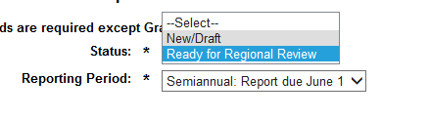
Reporting Window
Report due on June 1st covers:
  October 1st to March 31st
Report due on December 1st covers:
  April 1st to September 30th
Reminder: Reports must be submitted in TEAM and be in the status, “Ready for Regional Review”
Notes:
The federal fiscal year begins in October and ends in September. You will be reporting on the contracting activity that occurs between the halves of the fiscal year. The first half of the fiscal year runs from October 1 to March 31, you then have 60 days to compile the information and submit the reports by the June 1st due date. You can submit as early as April 1st , but after June 1st that report will be considered overdue.
The second half of the fiscal year runs from April 1st to September 30th. The first day you can submit your information to FTA is October 1st. On December 1st, that report is due. After December 1st your report will be considered overdue.
Your report is considered submitted once you submit the report in TEAM, marking it with the status “Ready for Regional Review”
<advance slide>
Have your information to enter ahead of time

Slide 5
Top Common Errors
Submitting the reports outside the TEAM module
Not considering all FTA funds in assisted opportunities
Not reporting on the timeline for the prime contract
Submitting incomplete information
Adding contract dollars but not the number of contracts (and vice versa)
Coding of ethnicity breakdown improperly
Using race-conscious fields improperly
Notes:
As we mentioned earlier, this presentation will focus on some of the most common errors that FTA recipients make while submitting DBE reports.
The errors we will focus on today include:
Not submitting the reports in TEAM
Not reporting on the appropriate timeline for the contracts awarded and completed
Incomplete submissions and not considering all FTA assisted opportunities
Oversights while completing the form, such as adding dollar values but not adding the associated number of contracts
Improper coding of the ethnicity and gender breakdown section
And Improper usage of the race-conscious fields on the form.
<advance slide>

Slide 6

Understanding and Avoiding
Common Errors
Notes:
This presentation will seek to help you understand these common errors and find ways to avoid them
<advance slide>

Slide 7
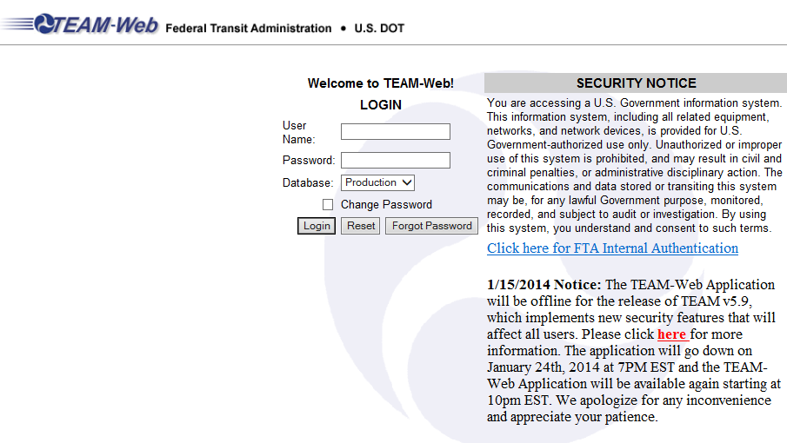
Submit Your Report Using the
TEAM Module
Notes:
TEAM is FTA’s system for managing grant applications.
Deputy Administrator Therese McMillan issued a letter in April 2011 announcing the DBE reporting module. This letter also required that submissions to FTA must be submitted within the reporting module, an electronic form that mimics the form from Appendix B of the DBE Regulations.

Slide 8
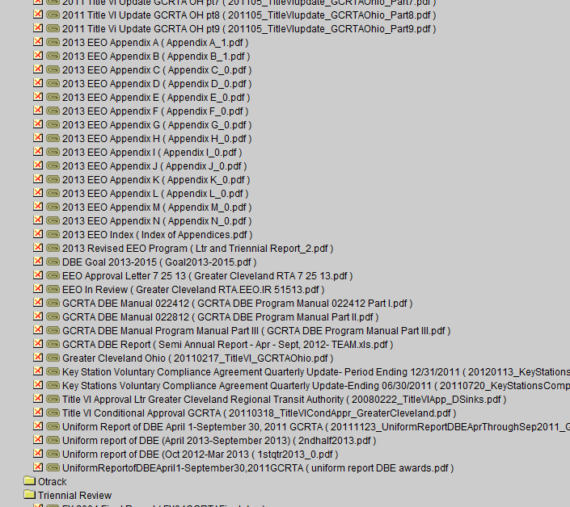
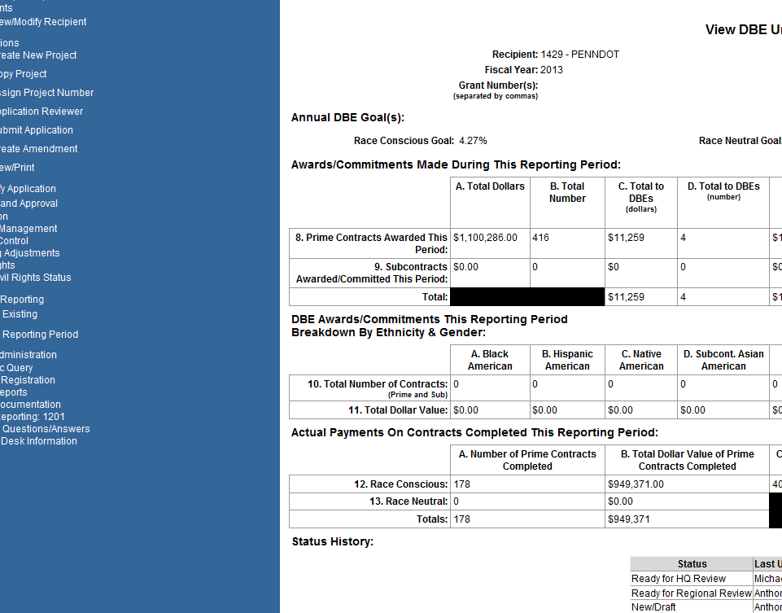
Submit Your Report Using the
TEAM Module
Correct
Incorrect
Notes:
If you are a frequent TEAM user for Civil Rights programs or other functions, you may know that many of the things you submit to FTA must be submitted as attachments in TEAM.
Program submissions such as your DBE Program Plan, your DBE Goal Methodology or your EEO Program should be submitted as Attachments in TEAM. [click]
You must submit your DBE reports to FTA using the electronic form. [click]
You may receive a finding of deficiency in your Triennial or State Management Review for not submitting your DBE reports using the electronic form in TEAM.
<advance slide>

Slide 9
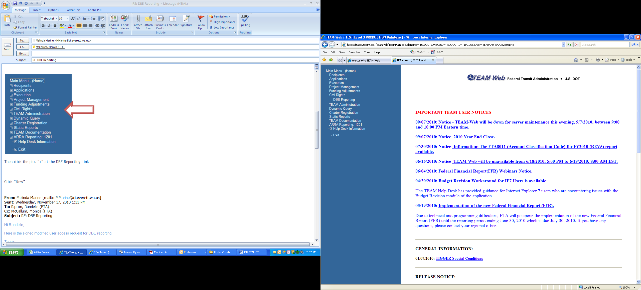
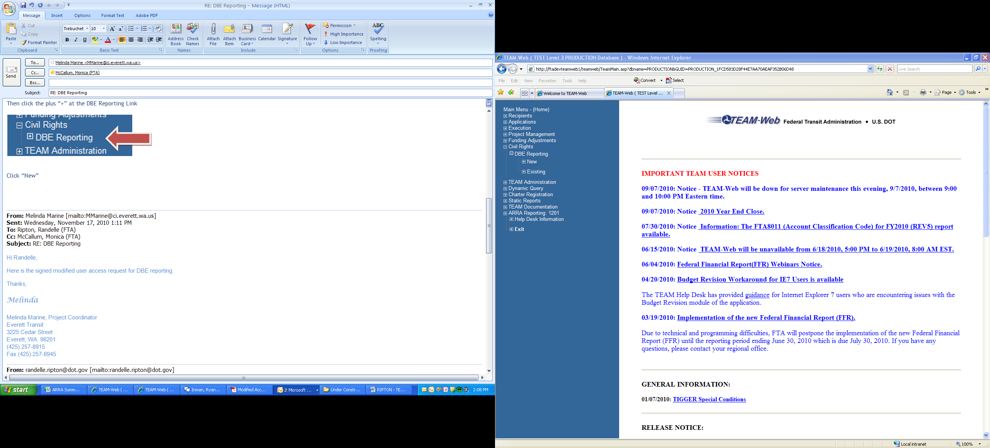
Submit Your Report Using the
TEAM Module
To submit DBE Reports in TEAM, you must have the “Civil Rights” option in the navigation window
  “New” allows you to create a brand new report
  “Existing” helps you search for previously submitted reports and edit them
Notes:
You must first have access to the DBE reporting module, which you can receive by applying for access from your regional office. You will know that you have DBE reporting access if you have the “Civil Rights” option visible in the left hand navigation window.
If you expand “Civil Rights” you will notice that there is an option for “DBE Reporting”
Expanding “DBE Reporting” reveals two other options. [click]
“New,” should be used every time that you wish to create a brand new report for a particular reporting period.
“Existing” will allow you to see and/or edit any report that you have previously worked on. This includes reports that you have saved to edit for later by selecting “New/Draft,” reports that have been previously submitted as “Ready for Regional Review,” or subsequently returned to you as “Incorrect/Incomplete” or which have been marked as “Ready for HQ Review” or as “Approved.” The module also holds DBE reports that FTA has “migrated” into the system, which were previously submitted on a paper or pdf version of the form.
You must contact your Regional Civil Rights Officer for assistance if you need to “Edit” any report that is currently in the system in a status other than “New/Draft.”
<advance slide>

Slide 10
Consider all FTA Funds
Your report must consider all FTA funds that would be affected by your DBE goal
  Your report would contain all zeroes if there were no FTA-assisted contracting activity during the period
  Your report should contain contract activity whether or not you have established contract goals
Notes:
FTA financial grant assistance may be used for a large variety of purposes, from purchasing supplies to designing transit projects to building transportation related structures. Direct recipients of FTA grant assistance must submit the DBE report to FTA. The report is designed to reveal the portion of all of the FTA assisted contracts that you have entered into with DBE firms.
Internal expenses such as salaries, and funds for new transit vehicles (which are reported on directly to FTA by the manufacturers) are not included in your DBE report. Likewise, you will not report on grants that you make with a subgrantee, such as an agreement between the state of Michigan and the city of Birmingham, however you would report on any FTA assisted contracts that the city of Birmingham entered into with private third party contractors.
Your DBE report will show no activity if you and your subgrantees have not awarded any contracts or closed any contracts in a reporting period.
We have learned through conversations, that some grantees believe that you must only report on contracts for which they have established a “DBE contract goal” or only on contracts with DBEs. Likewise, a grantee has stated that they have placed all zeroes on their DBE report because they have a zero percent goal. These are not reasons to show zero activity on your DBE report.
<advance slide>
Add slide with zero activity…that multiplies

Slide 11
Consider all FTA Funds
Your report must consider all FTA funds that would be affected by your DBE goal
  Planning, Capital, Operating
  You should report on FTA-assisted contracts even if you did not consider them in your overall goal methodology*
  * Note: Talk with your RCRO about Project-Specific Goals
Notes:
You must report on all FTA assisted contracts that are “DBE Program eligible” even if you did not consider them when you created your overall goal methodology.* Remember, when you establish your goal…you are considering the “reasonably anticipated contracting opportunities.” When you are submitting DBE reports, you are reporting on what has actually happened.
* (except in special circumstances such as when you establish a project specific DBE goal with FTA approval. In those instances, please contact your Regional Civil Rights Officer for additional guidance).

Slide 12
Report on the Contract Timeline
Your DBE Report will contain data from a wide variety of contracts:
  Micro Purchases, Small Purchases and Competitive Proposals
You will report activity when contracts are “awarded”
You will also report activity when the contracts are “completed”
Notes:
Your DBE Report will contain contract information from a wide variety of contracts including micro purchases under $3000, small purchases and competitive bids.
Your report will reflect the contract activity at the time of “Award” or the start of the contract, or when there is a “notice to proceed.” You will also report on a contract once it is Paid/Complete or when final payment is made or the project has been accepted.
Your DBE report follows the life of the prime contract or direct agreement for goods or services,
If someone is performing a service for you…it is likely that it will happen over a long period of time.
Comparatively, a purchase of goods can begin and end within a short period of time.
<advance slide>

Slide 13
Timeline: What Happens if You Don’t Follow the Prime Contract
The “Prime Contract” dollar fields represent the full FTA share of those contracts
Reporting off of the timeline may result in overstated DBE participation levels
Notes:
The prime contract dollar fields (8a, 12a & 13a are the fields you will complete) should include the total FTA share of all contracts. Every other dollar field in these sections are a subset of the prime contracting dollar fields.
An error FTA frequently sees is grantees mistakenly reporting on individual payments throughout the life of the contract OR reporting on subsequently issued subcontracts that belong to a prime contract from a prior period.
By not following the life of the prime contract, you have the potential to either overstate or understate your DBE participation.

Slide 14
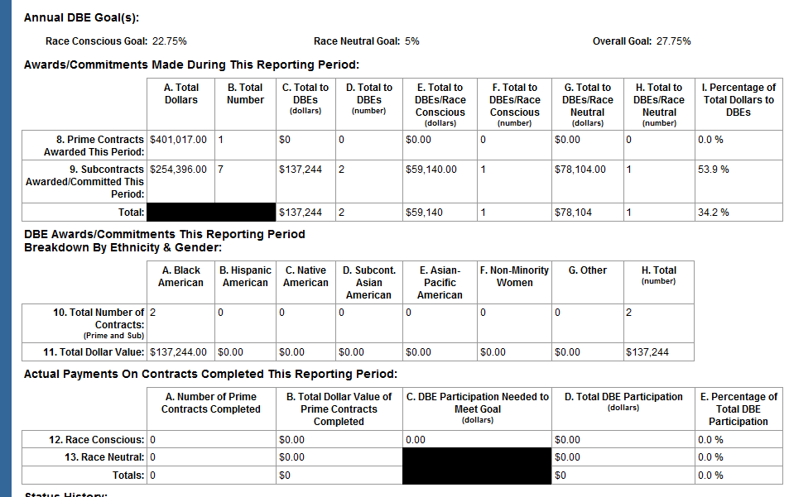
Timeline: Your Contract(s)’ Life on the DBE Report
200%
Notes:
[click] The most important comparison on the DBE report is total dollars to DBEs compared with the total dollars awarded. Dividing these two figures gives you the percentage of dollars awarded to DBE firms.
Reporting off of the timeline of the prime contract may be identifiable by an irregularly low percentage level of DBE participation, or an impossibly high level of participation [click].
<advance slide>

Slide 15
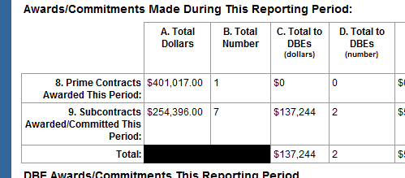
Timeline: Contracts Start with Awards this Period
Notes:
When you award a prime contract, you will enter information in the Awards section of the report [click]. You will populate the total FTA share of your prime contract on Line 8 [click]. All of the other contracting activity in the “Awards” section, such as subcontracts awarded or contracts awarded to DBEs, should relate to the prime contracts you have reported on in field 8a.
This is further evidenced by the “black mark” that appears on the total line, which reveals that you should not add 8a (total prime contract dollars) and 9a (total subcontract dollars) together to make “total dollars”
<advance slide>

Slide 16
Timeline: Follows the Prime Contract
Notes:
Your report will contain the full FTA share of all contracts awarded in 8a.
[click] The total value of subcontracts in dollars is a subset of 8a, and should be included in 9a [click].
8a will be larger than any other value within this section of the report. Notice in our example however that 9b is greater than 9a. In this case, our one prime contractor has awarded 7 contracts to subcontractors and/or sub-suppliers.
[click] The DBE dollar fields are a subset of total dollars, whether on the prime contracts line or the subcontracts line.
If we were to extend this view further, we will see that the breakdown between Race Conscious and Race Neutral DBE Awards are a subset of Total Dollars to DBEs, which once again are a subset of Total Dollars.
If you award contracts or subcontracts to DBEs you must complete the Ethnicity and Gender Breakdown section.
<advance slide>

Slide 17
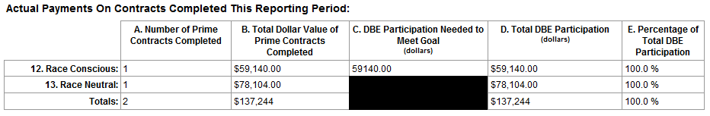
Timeline: Finish in Actual Payments Section
Notes:
When the prime contracts close in a future period, [click] it will appear in the section titled Actual Payments on Contracts Completed this Reporting Period, or on Lines 12 thru 14, [click]
We have seen reports, where the user will report only the dollars to DBEs in this section, or they will attempt to calculate the DBE participation needed to meet the goal, by multiplying their DBE goal with another value on this form.
The next slide will show you how to appropriately complete this section
<advance slide>

Slide 18
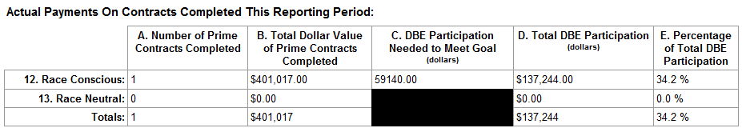
Timeline: Finish in Actual Payments Section
In the period that the contract completes, you will report the final values of that contract
Use Line 12 if you set a contract goal at the time of bid
Use Line 13 if you did not set a contract goal
Notes:
For our example, when the prime contract completes the number of prime contracts will refer to the 1 prime contract that we awarded in our previous example.
Notice here that we have chosen line 12, Race Conscious.
You will choose the line “Race Conscious” if you established contract goals with contract award.
You will choose the line “Race Neutral” if you did not establish contract goals.
The same rules apply as before [click]
The total dollars will reference the total dollars paid to all of those contractors who worked on that project…
DBE participation needed to meet the goal in dollars, field 12c represents the amount committed to meeting your contract goal
And the DBE dollars in column D are a subset of the total dollar values, the amount of which has actually been paid to DBE prime and subcontractors.
For small purchases, you might award and pay/complete a contract in the same period. For a simple example, if you were to purchase a “plotting machine” from a maker of fine printing and copying machines…the time of award could be considered “the time that you request your machine” and the completion time could be considered as “when the exchange for cash and supplies is made.”
<advance slide>

Slide 19

Questions?
Notes:
5 to 10 minutes for questions…

Slide 20
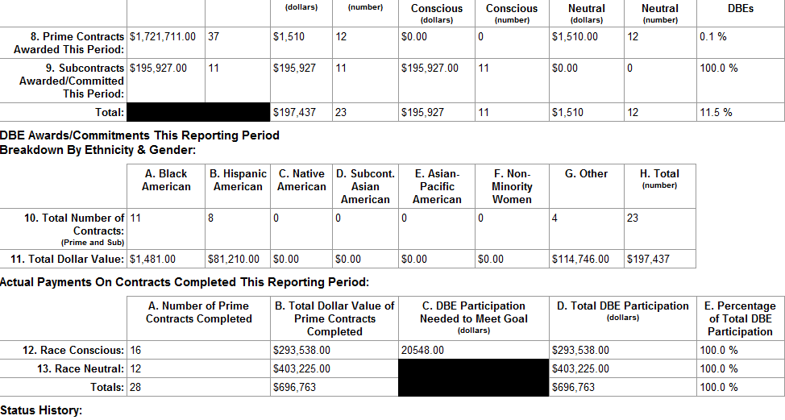
Submit Complete Information
Notes:
When looking at a DBE report, which shows that all of the payments on completed contracts were paid to DBE firms, yet only a portion were awarded to DBEs, it triggers questions for our review team.
We’ll talk more about the issue with the race-conscious dollar values, [click] total and total to DBEs being equal shortly.
Right now, I want to focus on the fact [click] that the submitter of this report has stated that they award 11.5% of their contracts to DBE prime and subcontractors, however, ALL of the contracts that closed have been paid to DBEs as evidenced by the 100% participation. <add click?>
While this may be true in some instances, sometimes only the contracts to DBEs will close in a given period, if this happens over several periods we believe that the reporter is only reporting on the total dollar value paid to DBE contractors, rather than reporting on payments made to all contractors as required. The FTA reviewer will contact you for clarification.
<advance slide>

Slide 21
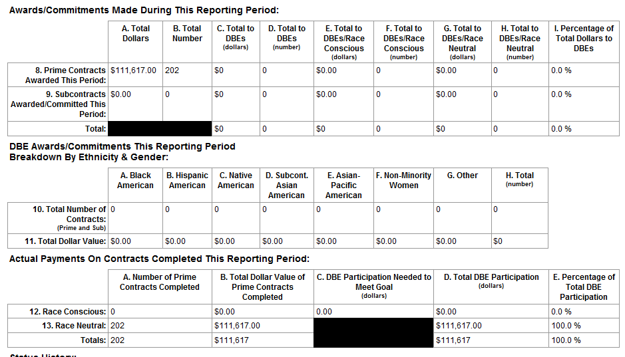
Submit Complete Information
Notes:
FTA reviewers are trained to notice when a large number of contracts are reported as either awarded or paid/complete in a period. They know that the submitter is most likely reporting that they have conducted mostly transactions for goods/supplies.
They will also notice when there appear to be discrepancies [click]. In this case, it is possible, that 202 contracts have both been awarded and paid/complete in the same period, it is also possible, but not highly probable, that the 202 contracts have the same dollar value unless they are the same contracts.
When an FTA reviewer sees this, and also sees [click] a difference between the amount awarded to DBEs and the amount paid to DBEs, they will ask questions to verify whether the correct information has been entered.
<advance slide>

Slide 22
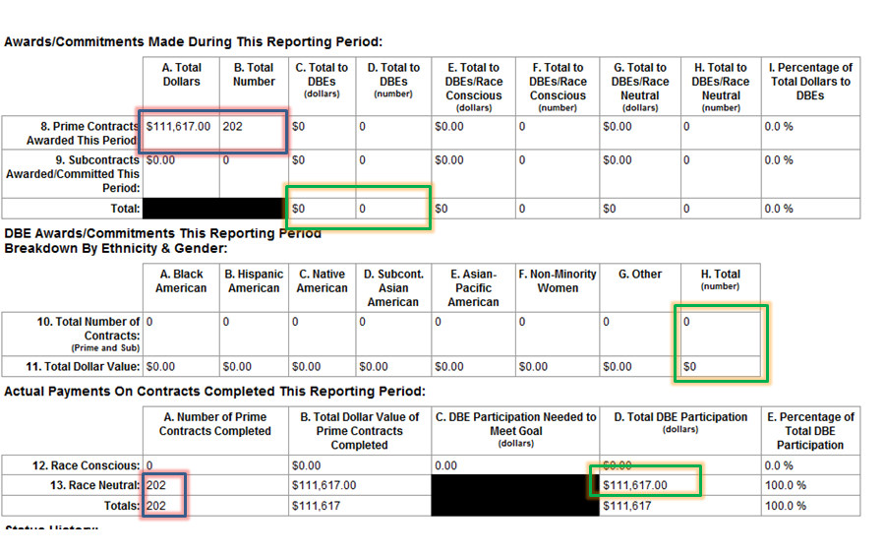
Submit Complete Information
If these are the same contracts awarded and paid in the same period:
  DBE Participation should be listed in both areas
  If contracts are awarded to DBEs, then the Ethnicity & Gender Breakdown section should be completed as well
Notes:
In this example, if these are the same 202 contracts then we should see DBE Participation listed in the Awards section as well. The contracts awarded to DBEs should also be separated by Ethnicity and Gender on lines 10 & 11 as well.

Slide 23
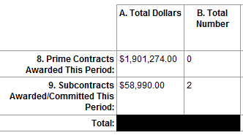
Ensure Dollars Have Associated Contracts
List the full FTA share of dollars awarded in field 8a
  Note: You must also list the number of prime contracts awarded
Notes:
Sometimes, reporters will make keying errors when submitting a report.
In this example, while the submitter has listed a total value for prime contracts awarded this period (8a) [click] they have not listed a value for the number of prime contracts that this represents in (8b). If values are included in column A then values are needed in column B, and vice versa.
<advance slide>

Slide 24
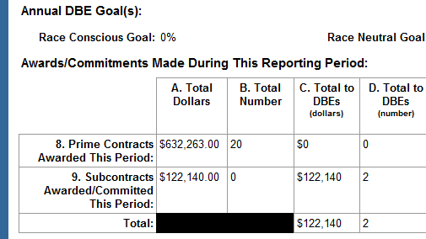
Ensure Dollars Have Associated Contracts
“Total Dollar” and “Total Number” columns include contracts to DBEs
  Note: Total Dollars and Total Numbers should be greater than or equal to Total Dollars and Total Number to DBEs
Notes:
The same holds true on the subcontracts line. [click]
However, this example helps us show another error. Total dollars and total number of contracts to DBEs are a subset of the total dollars and total number of contracts awarded. In our example here, if the total number of subcontracts to DBEs (field 9d) is greater than zero [click], then the total number of subcontracts awarded (field 9b) must also be greater than zero. The total number of subcontracts will be greater than or equal to the total number of subcontracts to DBEs.

Slide 25
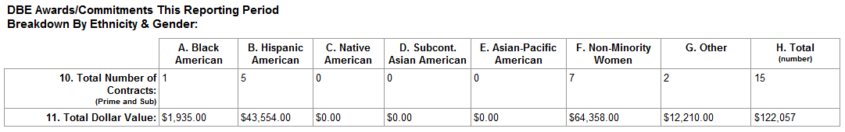
Code Ethnicity Breakdown Properly
Complete the “Breakdown by Ethnicity & Gender” when you award prime and/or subcontracts to DBEs
Ensure that the number of contracts correlates to the dollar value awarded to each group
“Other” is used for those certified DBE firms who are not in the groups that are listed
Notes:
Always be careful when you complete the ethnicity and gender breakdown section as well.
This section should be completed and correlate to those prime and subcontracts that are awarded to DBEs. Ensure that you place the correct number of contracts (not number of contractors) with the dollar values.
Remember that the DBE regulations identify the presumptively disadvantaged groups (those listed) in §26.5. Women are reported within their specific ethnicity. So for example, a Black American woman owned firm will be listed in Black American.
The field “Other” [click] should only be used for those firms that cannot be classified in these groups. This may include someone, who once certified has listed themselves as multiracial OR who has been deemed disadvantaged through an individual determination (see Appendix E for more information). “Other” should not be used when you do not know the ethnicity of the firm. If you do not have the data, check with your state UCP.
<advance slide>

Slide 26
Use Race-Conscious Fields Properly
Background on Using RC Measures
Race-conscious DBE participation is attributable to a contract goal that you establish
Having a contract with a firm whose owner is a particular “race” does not make your contract “race-conscious”
You may use contract goals only on those contracts that have subcontracting possibilities
  For example: A large construction contract may have a goal for 13% of the work to be performed by DBE firms who specialize in a variety of trades
Notes:
The Race Conscious and Race Neutral fields on the Uniform have confused a large number of reporters.
It is very important for you to use these fields properly.
Race-conscious DBE participation is attributable to those contracts for which you set DBE contract goals.
Having a contract with a firm whose owner is of a particular race does not make your contract “race conscious.” Though in some areas, like the 9th circuit, you may only be allowed to set DBE contract goals for certain racial/ethnic/gender groups. The important thing still, is that the “DBE contract goal” is what makes the contract race conscious.
Remember, that you may only use contract goals on those contracts that have subcontracting possibilities. This would imply that the contract is large enough to sustain a prime and subcontractor relationship. For example, if you have a large construction project, you might establish a goal for 13% of the work to be performed by DBE firms specializing in various trades. The bidders on your project will bring DBE subcontractors to help them fulfill your DBE contract goal.
<advance slide>

Slide 27
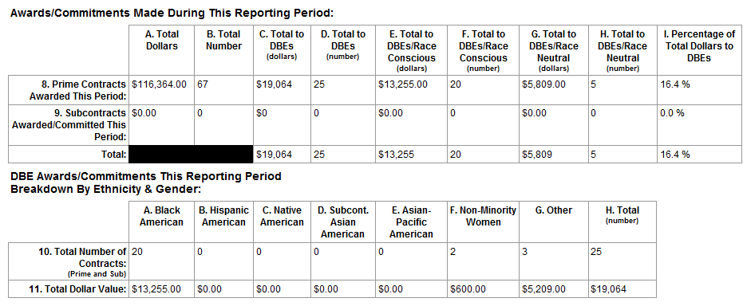
Use Race-Conscious Fields Properly
Prime Contracts Awarded to DBEs Race Conscious
Notes:
In this example, the submitter has reported that 20 contracts [click] were awarded directly to DBEs “race conscious.” In the ethnicity breakdown section, they have been listed as “Black American” firms [click].
The example here might cause the FTA reviewer to question whether the reporter has used the race conscious prime contracts fields (line 8, columns e & f) appropriately. FTA reviewers will question why the DBE prime contracts are listed as “race conscious.”
An appropriate response would be that the contracts contained DBE contract goals. An inappropriate response would be that they are listed there because the firms’ owners are Black American.
Even if there are contract goals on the associated contracts, the FTA reviewer may question whether or not a contract goal would be necessary on these types of procurements if a DBE firm “won” the award on their own merit. Please also note that even though you have listed the value in the “race conscious/prime contracts fields” FTA will still consider the participation “race neutral” as prime contracts are not awarded based on the participants DBE or non-DBE status.
Of course, through more conversation, it might be discovered that the DBE prime contracts perhaps should have been listed as subcontracts.
<advance slide>

Slide 28
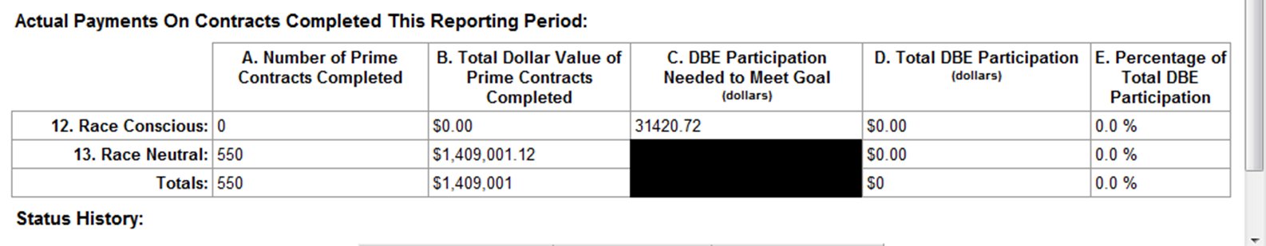
Use Race-Conscious Fields Properly
Goal Added with No Contracts Closed
Line 12 represents contracts that are paid, complete and contained contract goals
12c represents the DBE participation needed to meet the contract goals established previously
Do not use this line or these fields unless you use contract goals, and the prime contracts complete
Notes:
When reporting on contracts completed, remember that Line 12, race conscious represents those contracts where contract goals were established at the time of bid.
Field 12c represents the DBE participation needed to meet the contract goal(s) that were established previously [click].
Do not use field 12c, unless you have a prime contract that has been completed which contained a contract goal for DBE participation.
In this example, there should be zero in field 12c if there were no contracts completed containing a contract goal as shown by fields A & B on line 12.
<advance slide>

Slide 29
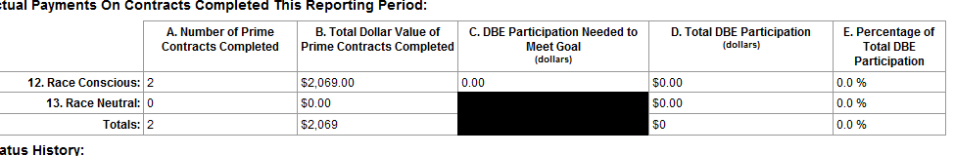
Use Race-Conscious Fields Properly
Dollars Added with No Goal Value
When a contract that contained a goal is completed, you must list the amount needed to meet that goal
  Note: Remember to only use contract goals on contracts with subcontracting possibilities [§26.51(e)(1) ]
Notes:
An FTA reviewer looking at this example, would question two things…
First, if a contract was completed that contained a contract goal and listed in fields 12a and 12b, why isn’t there a value listed in field 12c? [click]
They might also ask whether or not two contracts for which the FTA share combined equals just over $2,000 actually contained a contract goal, AND whether or not it should have contained a contract goal.
The FTA reviewer will likely contact you to discuss what you have actually tried to report.
There is a possibility here that the two contracts completed, should be listed as race neutral because they did not contain contract goals.
<advance slide>

Slide 30
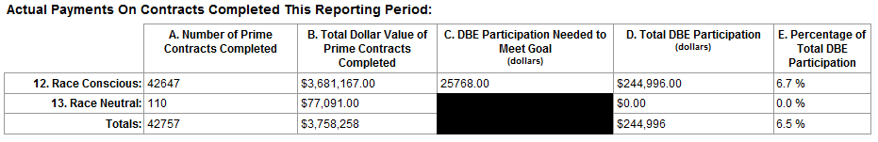
Use Race-Conscious Fields Properly
High Number of Contracts with Small Goal Value
It is unlikely that you will establish goals on every contract
Field 12c should contain the dollar amount needed to meet the contract goal agreed upon (“committed”) at the time of award
Notes:
Similarly, an FTA reviewer would look at this example and have questions immediately. In this example, the recipient has claimed that they have placed race conscious goals on 42, 647 contracts. Contract goal setting should be a deliberate action, it is highly unlikely that you would establish a contract goal on so many contracts.
Doing the math, those 42,000 contracts’ FTA share equates to $86 per contract. Contracts of that size, should not contain contract goals.
Also pay attention to field 12c. The DBE participation needed to meet the contract goals is listed as $25,768, or about .60 cent per contract. It is highly unlikely that someone established 42,000, 60 cent contract goals.
More than likely, the reporter has made a keying error on both the number of contracts and the participation needed to meet the goal.
Last example blurb
<advance slide>

Slide 31
Upcoming Webinars
EEO Workforce Analysis
ADA Path of Travel
View all FTA training materials and sign up for training notifications and alerts on the FTA Civil Rights Training Materials page:
  http://www.fta.dot.gov/civilrights/12885.html
Notes:
That concludes our presentation. We will take questions shortly.
Coming soon, you will have the opportunity to participate in these great webinars from my colleagues.
R

