Slide 1
Consideration of Brownfields and Contaminated Properties
During NEPA
2014
Real Estate Workshop

Slide 2

USDOT Policy Encourages Transportation-Related Redevelopment of Brownfields
encourages economic and infill development
aids community revitalization
use of brownfield for a transit purpose minimizes human exposure over other uses

Slide 3
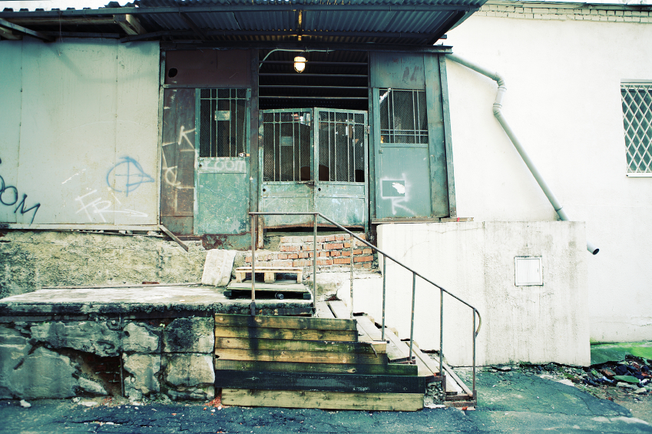
Brownfields Are
real property, the expansion, redevelopment, or reuse of which may be complicated by the presence or perception of a hazardous substance, pollutant, or contaminant.

Slide 4

Redevelopment Concerns
liability
prior uses are not often apparent
contamination from an off-site sources often not discovered unless digging/testing conducted
cleanup costs
’

Slide 5

Potential Brownfields Include
existing railroad corridors
former industrial areas
urban renewal/redevelopment areas
gas stations
dry cleaners
road right-of-way

Slide 6
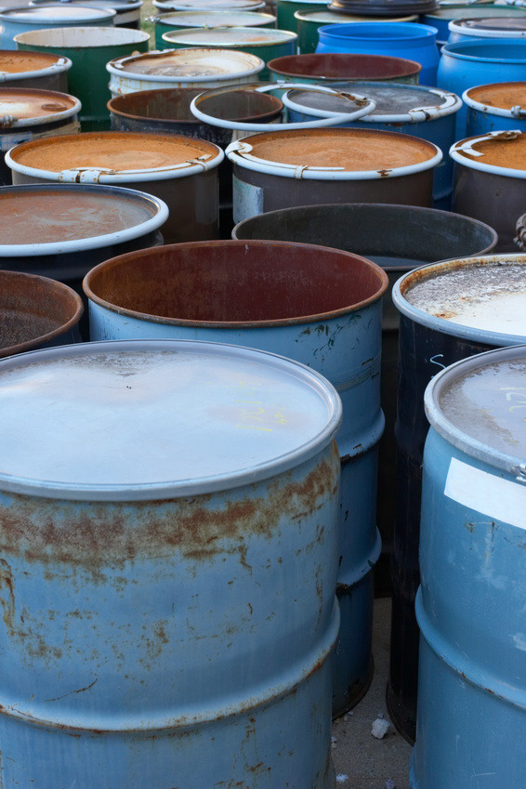
Sources of Contamination
Include
on-site deposits in soil (railyards, etc)
contaminated groundwater from
off-site source
leaking USTs and ASTs
buildings to be demolished (asbestos/lead paint)
naturally occurring
(acidic groundwater, asbestos rock)

Slide 7
Environmental Site Assessments (ESAs)
determine remediation needs and costs
assess liabilities and financial responsibilities
assess community impacts
assess environmental impacts
assess construction and operating impacts

Slide 8
Environmental Site
Assessments (ESAs)
Phase I ESA Identifies possible contamination
Phase II ESA determines extent of contamination
ASTM standards (www.astm.org)

Slide 9

Environmental Review
Process
required under NEPA
goal to balance the transit benefits, costs, and impacts in choosing an optimal project site
identify potential environmental and community impacts
inform the public

Slide 10

Environmental
Review Class of Action
Environmental Impact Statement (EIS)
Environmental Assessment (EA)
Categorical Exclusion (CE)

Slide 11
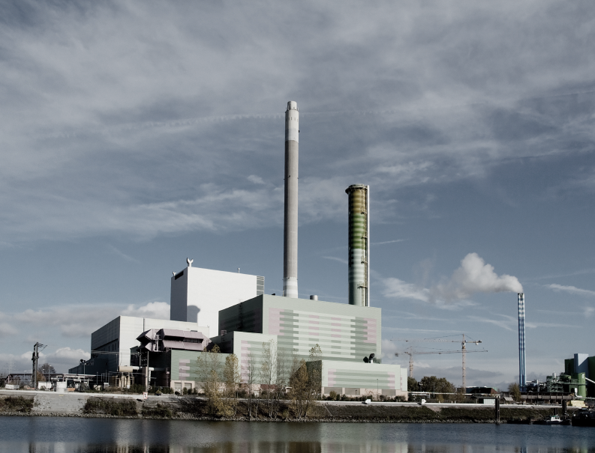
Identifying Contaminated Sites During NEPA
identify potentially contaminated properties, brownfields
identify known contaminated properties
identify potential property acquisitions

Slide 12
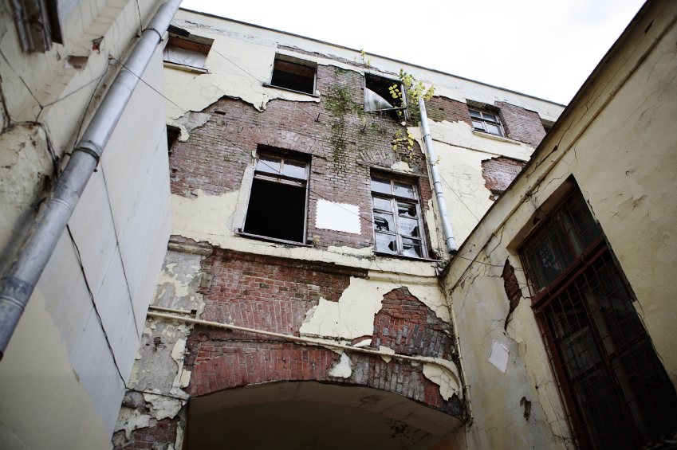
ESA During Environmental Review
Phase I ESA for properties to be acquired for all alternatives
Phase II ESA if Phase I ESA indicates its need
complete Phase I and II ESA for property to be acquired for the preferred alternative

Slide 13
ESA During Environmental Review
include mitigation for construction and operation activities:
remediation and clean-up plans
plans to control and contain contamination

Slide 14
ESA Timing During Environmental Review
Draft EIS: Phase I ESAs
Final EIS: Phase II ESAs; remediation commitments for preferred alternative
EA: Phase I and II ESAs
FONSI: remediation commitments
CE: Phase I and II ESA’s and remediation commitments

Slide 15
Thank You
Antoinette Quagliata
Environmental Protection Specialist antoinette.quagliata@dot.gov

