Slide 1
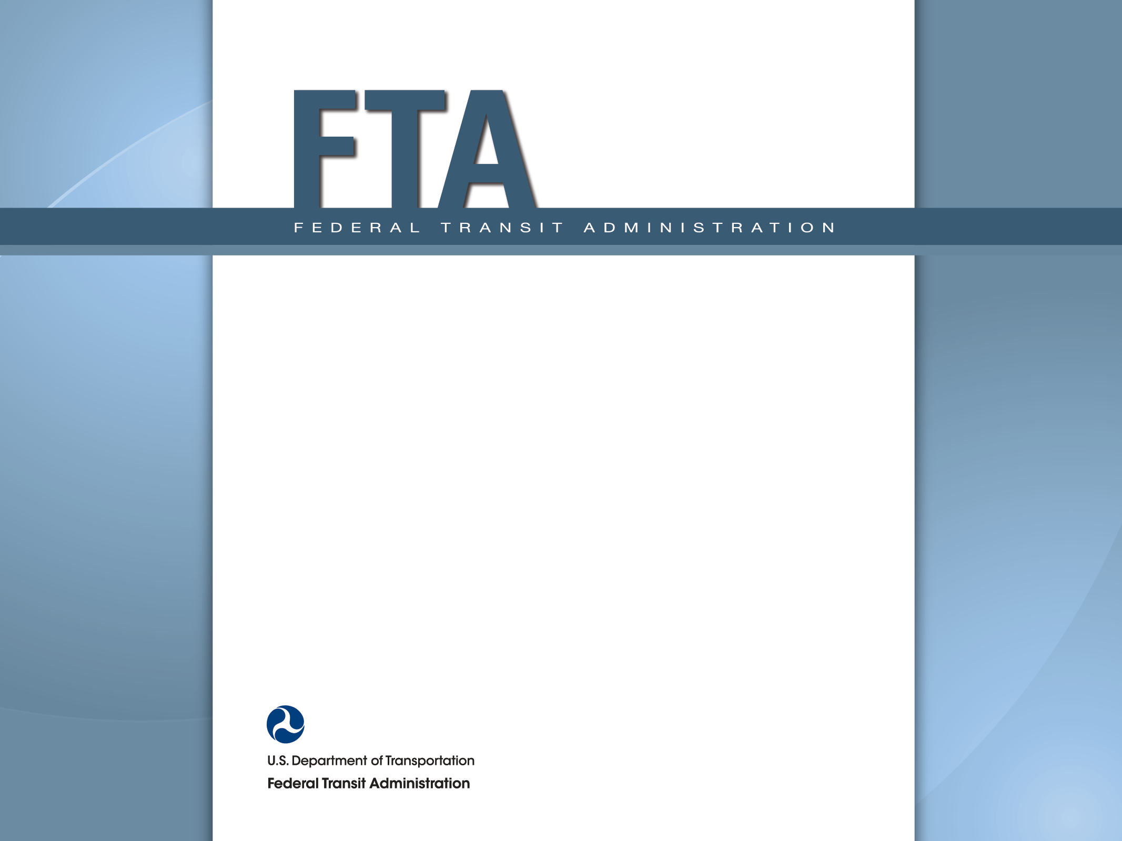
Accessible Route/ Path of Travel Under DOT ADA Regulations November 7, 2013 John Day ADA Team Leader

Slide 2
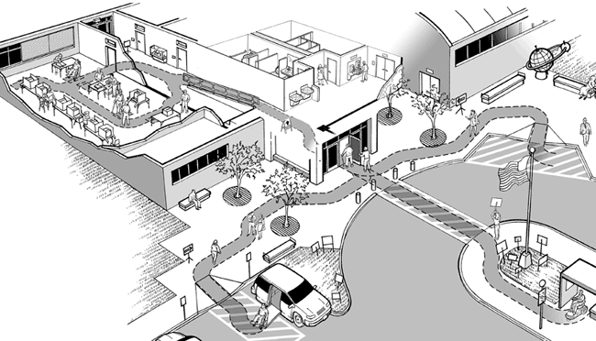
What is a Path of Travel?
A continuous, unobstructed way of pedestrian passage by means of which an area may be approached, entered, and exited
Related term: Accessible Route

Slide 3
Why Is This Important?
ADA compliance
Condition of eligibility for Federal funding
FTA is responsible for ensuring ADA compliance on the part of its grantees
Risk reduction
Reduced potential for delayed grants
Reduced exposure to litigation/enforcement action
Cheaper to do it right the first time!

Slide 4
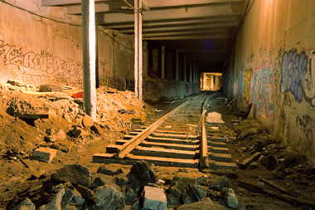
Why Is This Important?
Recurring issue among FTA projects
New Construction
Alterations to existing stations/facilities
State of Good Repair
Projects will likely contain activities regarded as “alterations” under DOT ADA regulations

Slide 5
What is the ADA?
Common misconceptions:
“It means you have to make reasonable accommodations for people with disabilities.”
“It’s all about paratransit.”
“It means you have to figure out how to get wheelchairs onto your bus/into your station.”

Slide 6
What is the ADA?
A comprehensive civil rights law that ensures that people with disabilities have the same rights and responsibilities as everyone else.

Slide 7
General Requirements for Facilities
All new construction must be accessible
Any alterations to any existing facility must be accessible
Standards are the same, but application may be different
Path-of-travel/accessible route is addressed in requirements for both

Slide 8
General Requirements for Facilities
“Accessible” means complying with DOT ADA standards.
Don’t try to figure it out on your own!
Use the right standard!
DOT ADA standards for buildings & facilities updated November 29, 2006
Different from Access Board’s 2004 standards
Different from DOJ’s “2010 Standards”

Slide 9
General Requirements for Facilities
ADA MYTHBUSTERS
Myth: “We’re using our own funds, so we don’t have to worry about ADA regulations.”
Facts: ADA requirements – and DOT ADA regulations – apply regardless of Federal funding
Compliance is a condition of eligibility for Federal funding
No FTA funding means no FTA oversight – but compliance is still required

Slide 10
General Requirements for Facilities
ADA MYTHBUSTERS
Myth: “We’re using our own funds, so we don’t have to worry about ADA regulations.”
Facts: ADA requirements – and DOT ADA regulations – apply regardless of Federal funding
Compliance is a condition of eligibility for Federal funding
No FTA funding means no FTA oversight – but compliance is still required

Slide 11
New Construction
Differences in DOT Standards
Minimize accessible route/path of travel
Detectable warnings at curb ramps
Different from 1991 Standards
60% of entrances must be accessible
Formerly 50%
One of two entrances is not 60%

Slide 12
New Construction
Minimize accessible route/path of travel
“Elements such as ramps, elevators, or other circulation devices, fare vending or other ticketing areas, and fare collection areas shall be placed to minimize the distance which wheelchair users and other persons who cannot negotiate steps may have to travel compared to the general public.” [DOT Standards, Section 206.3]
May affect how station is designed
May require elevators in lieu of ramps

Slide 13
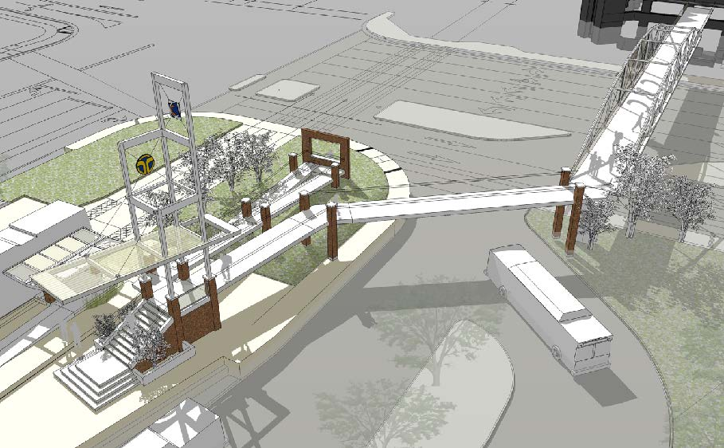
New Construction
Path of travel not minimized:

Slide 14
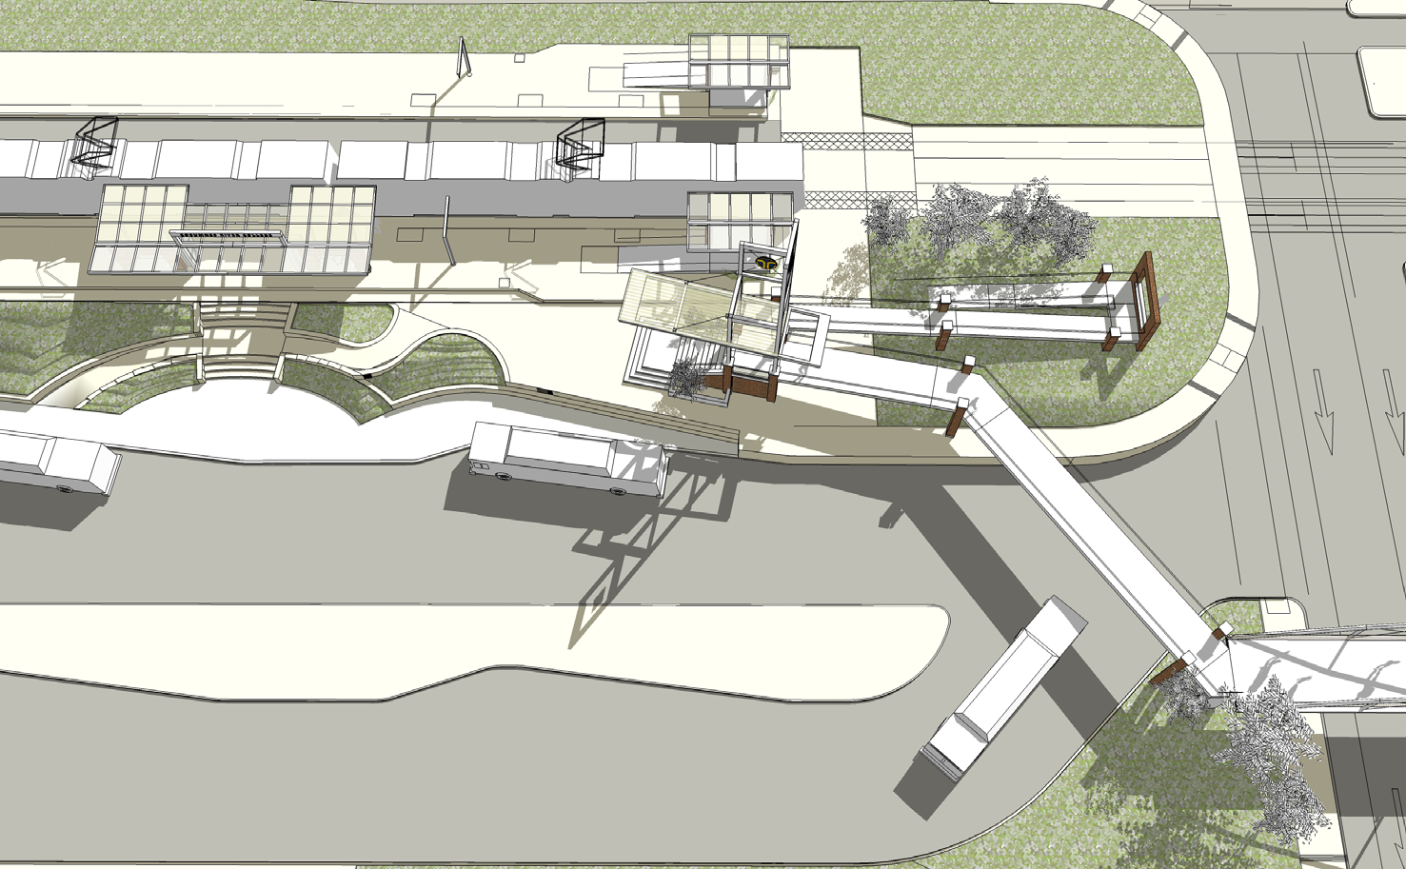
New Construction
Path of travel not minimized:

Slide 15
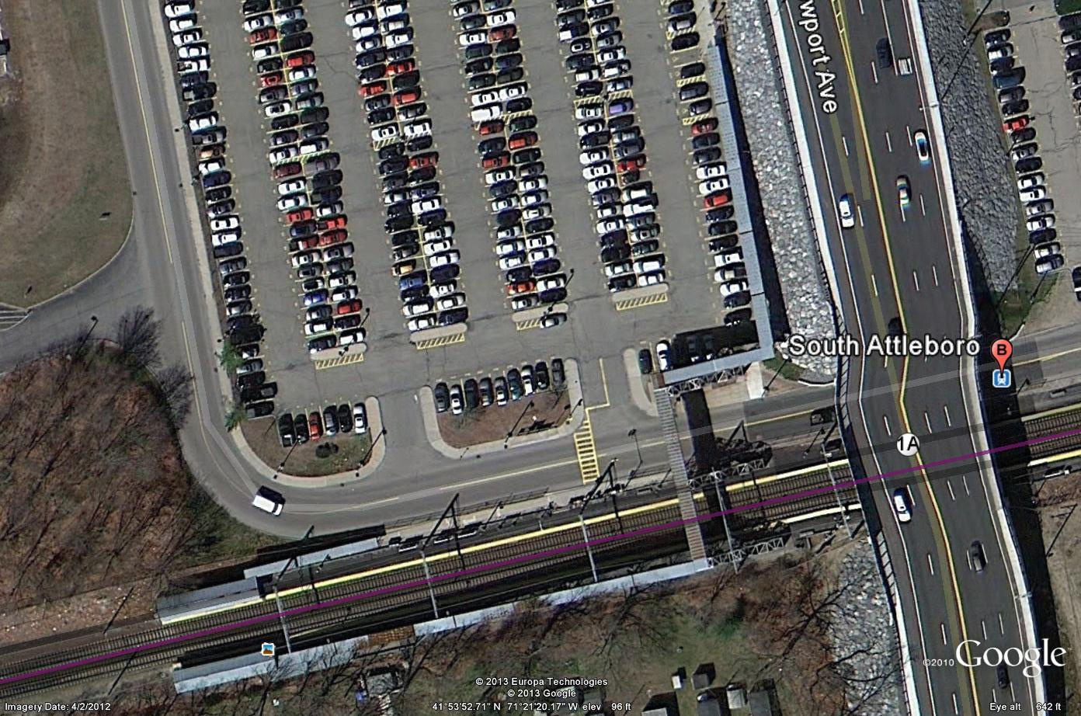
New Construction
Reaction to South Attleboro (MA) Station (c. 1989)

Slide 16
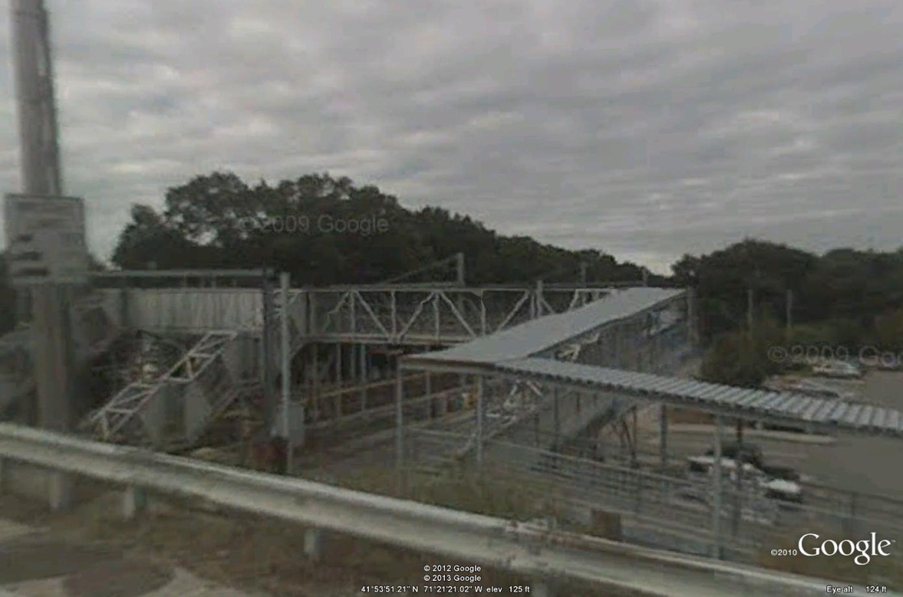
New Construction
Reaction to South Attleboro (MA) Station (c. 1989)

Slide 17
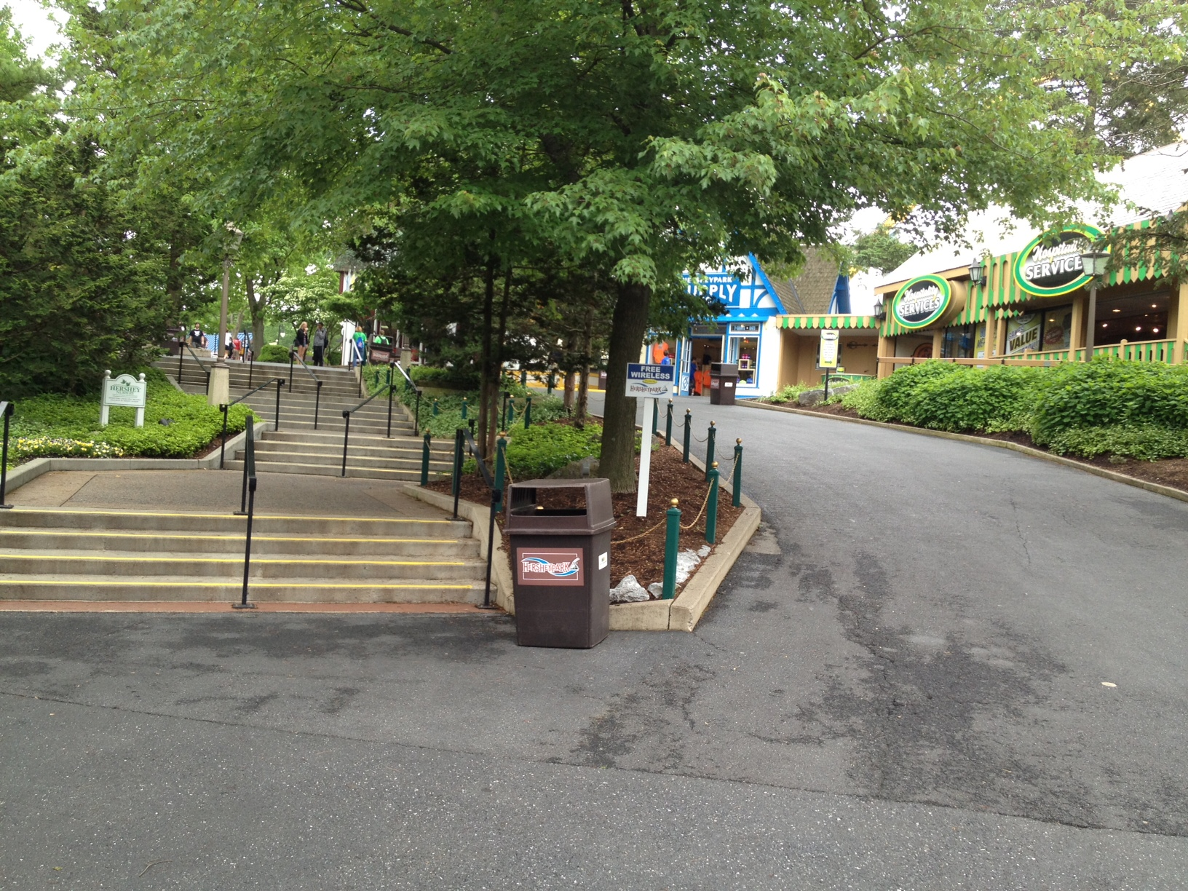
New Construction
Ramps and Stairs Coexisting Peacefully
Notes:
This slide added in response to questions concerning “break points” for ramps vs. elevators
There is none; the distance of the accessible route must be minimized with respect to the distance others must travel
This example is from a theme park, and is illustrative only; cannot confirm compliance re: slope, landings, etc.

Slide 18
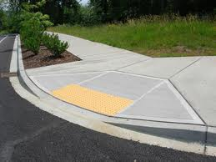
New Construction
Detectable warnings at curb ramps
Required under DOT ADA regulations
Continuation of original ADAAG requirement
Not included in DOJ “2010 Standards”
Not included in Access Board’s 2004 revisions

Slide 19
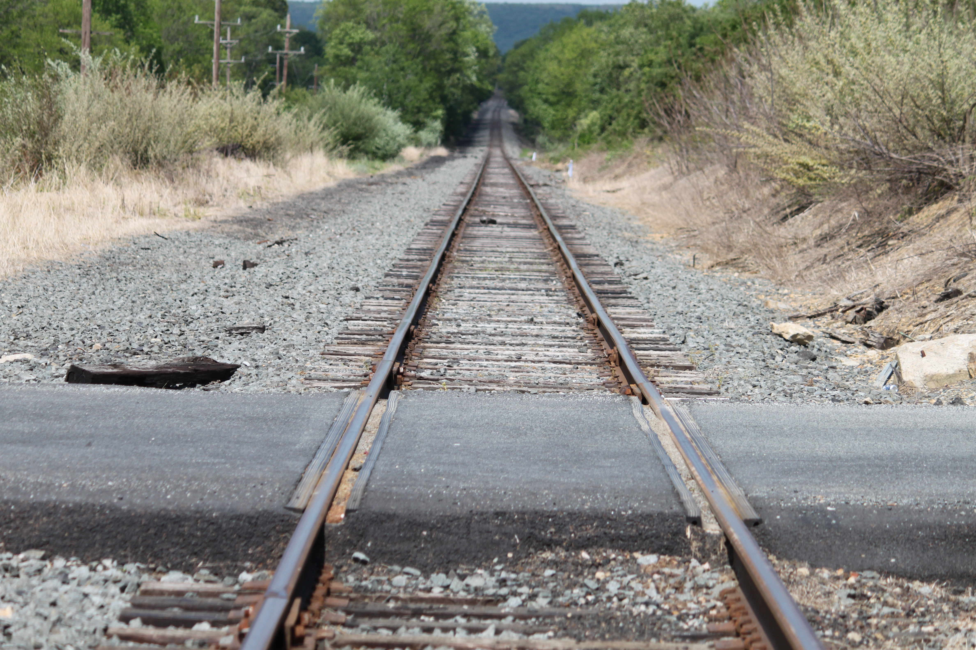
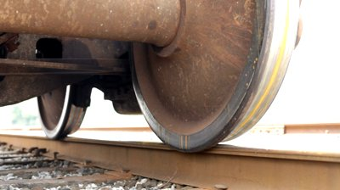
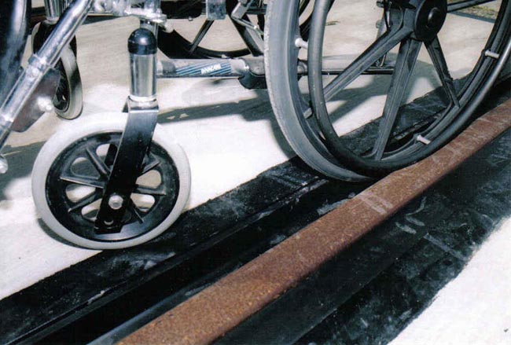
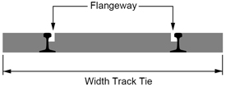
New Construction
Other important elements for rail facilities:
Flangeway gap must not exceed 2.5”
If cannot be achieved, overpass/underpass may be required
Overpass/underpass may require elevators

Slide 20
New Construction
Other important elements for transportation facilities:
Accessible routes must coincide with or be located in the same area as general circulation paths.
Where circulation paths are interior, accessible routes must also be interior.
Walks, unpaved paths and vehicular ways designed for pedestrian traffic must be accessible or have an accessible route nearby.
Elevators must be in the same area as stairs and escalators, not isolated in the back of the facility.

Slide 21
New Construction Do’s & Don'ts
If you are contemplating construction of a facility or part of a facility…
Do:
Use the right standards
Specify the right standards in contracts!
Plan and budget to ensure that the facility or part of the facility constructed will comply with ADA standards upon completion
Don’t:
Don’t rely solely on standards issued by county, municipality, state
Don’t rely on building inspectors, certificates of occupancy or other local “approvals”
Don’t rely on simple references to incorporate ADA requirements (e.g., “All facilities shall be ADA compliant.”)
Don’t attempt to “avoid” certain ADA requirements

Slide 22
Alterations to Existing Facilities
ADA MYTHBUSTERS
Myth: “It’s not a key station, so it doesn’t have to be accessible”
Facts: “Key stations” represented a deadline
Certain stations would have to be made accessible by a date-certain
Regardless of short- or long-term plans
To ensure a basic level of system accessibility within a reasonable timeframe

Slide 23
Alterations to Existing Facilities
ADA MYTHBUSTERS
Myth: “It’s not a key station, so it doesn’t have to be accessible”
Facts: “Key stations” represented a deadline
Certain stations would have to be made accessible by a date-certain
Regardless of short- or long-term plans
To ensure a basic level of system accessibility within a reasonable timeframe

Slide 24
Alterations to Existing Facilities
What is an alteration?
A change to an existing facility, including, but not limited to:
Remodeling
Renovation
Rehabilitation
Reconstruction
Historic restoration
Changes or rearrangement in structural parts or elements
Changes or rearrangement in the plan configuration of walls and full-height partitions
(49 CFR 37.3)

Slide 25
Alterations to Existing Facilities
What is not an alteration?
Normal maintenance activities, unless they affect the usability of the building or facility
Reroofing
Painting or wallpapering
Asbestos removal
Changes to mechanical or electrical systems
(49 CFR 37.3)

Slide 26
Alterations to Existing Facilities
What standards apply to alterations?
Same standards as for new construction
Application of those standards may be different
“To the maximum extent feasible” – The occasional case where the nature of the facility makes it impossible to fully comply [49 CFR 37.43(b)]
In some cases, slightly steeper ramp slopes are permitted.
Other examples: door thresholds, curb ramp landings, handrails, etc.

Slide 27
Alterations to Existing Facilities
When an alteration affects an area containing a “primary function,” an additional requirement is triggered to make the path of travel to the altered area accessible, unless the cost and scope would be “disproportionate” [49 CFR 37.43(a)(2)]
A “primary function” is a major activity for which the facility is intended [49 CFR 37.43(c)]
Ticket purchase and collection areas
Passenger waiting areas
Train or bus platforms
“Disproportionate” is defined as exceeding 20% of the cost of the alteration to the area of primary function, without regard to the costs of accessibility modifications [49 CFR 37.43(e) ]

Slide 28
Alterations to Existing Facilities
ADA MYTHBUSTERS
Myth: “Federal law requires that at least 20% of the cost of the alterations must be spent on making the altered facility accessible.”
Facts:
Alterations must be accessible
20% “disproportionality” only applies to additional alterations to the path of travel that are triggered when a primary function area is altered

Slide 29
Alterations to Existing Facilities
ADA MYTHBUSTERS
Myth: “Federal law requires that at least 20% of the cost of the alterations must be spent on making the altered facility accessible.”
Facts:
Alterations must be accessible
20% “disproportionality” only applies to additional alterations to the path of travel that are triggered when a primary function area is altered

Slide 30
Alterations to Existing Facilities
Example: Disproportionality
Sunnydale Station (Hill Valley Transit/HVT)
Platform resurfacing
Resurfacing = alteration (per ADA-ABA AG 106.5)
Platform = primary function
Alteration to platform triggers path of travel requirement
HVT documented that the cost of installing elevators to each platform would exceed 20% of the resurfacing cost.

Slide 31
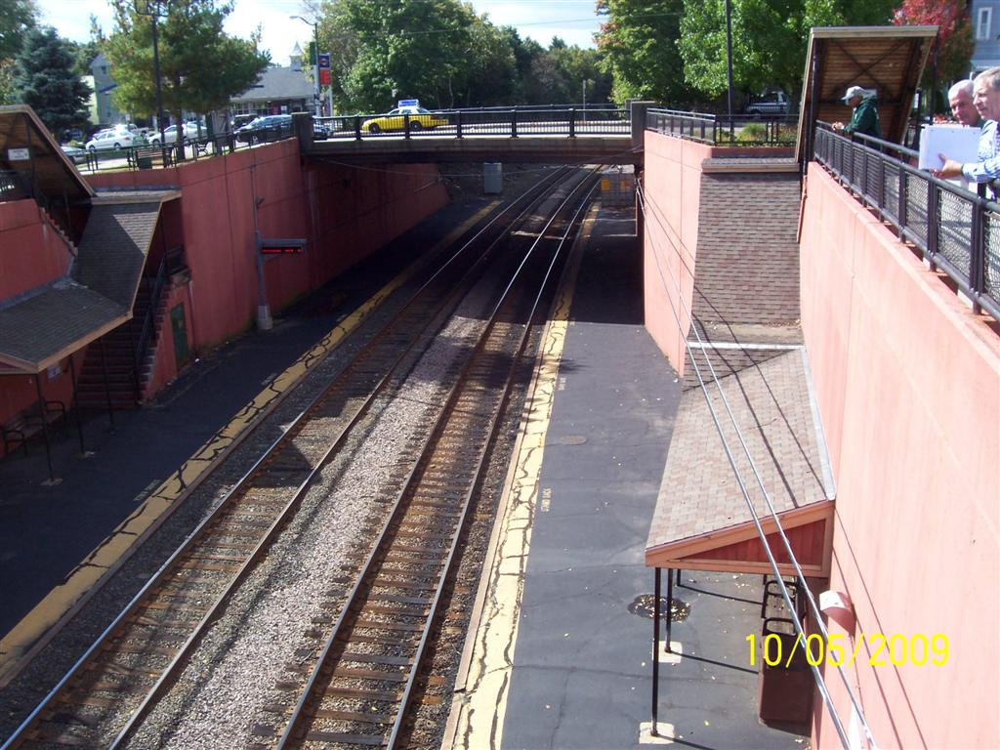
Alterations to Existing Facilities
HVT Sunnydale Station

Slide 32
Alterations to Existing Facilities
Example: “Maximum Extent Feasible”
Tremorton Transit (TTA) Red Line
Complete platform replacement at 7 elevated stations
Platform = primary function
Removal/replacement = alteration
Path of travel requirement triggered
TTA demonstrated insufficient clearances on narrow platforms to accommodate elevators (without exponential increase in cost/scope of alterations)

Slide 33
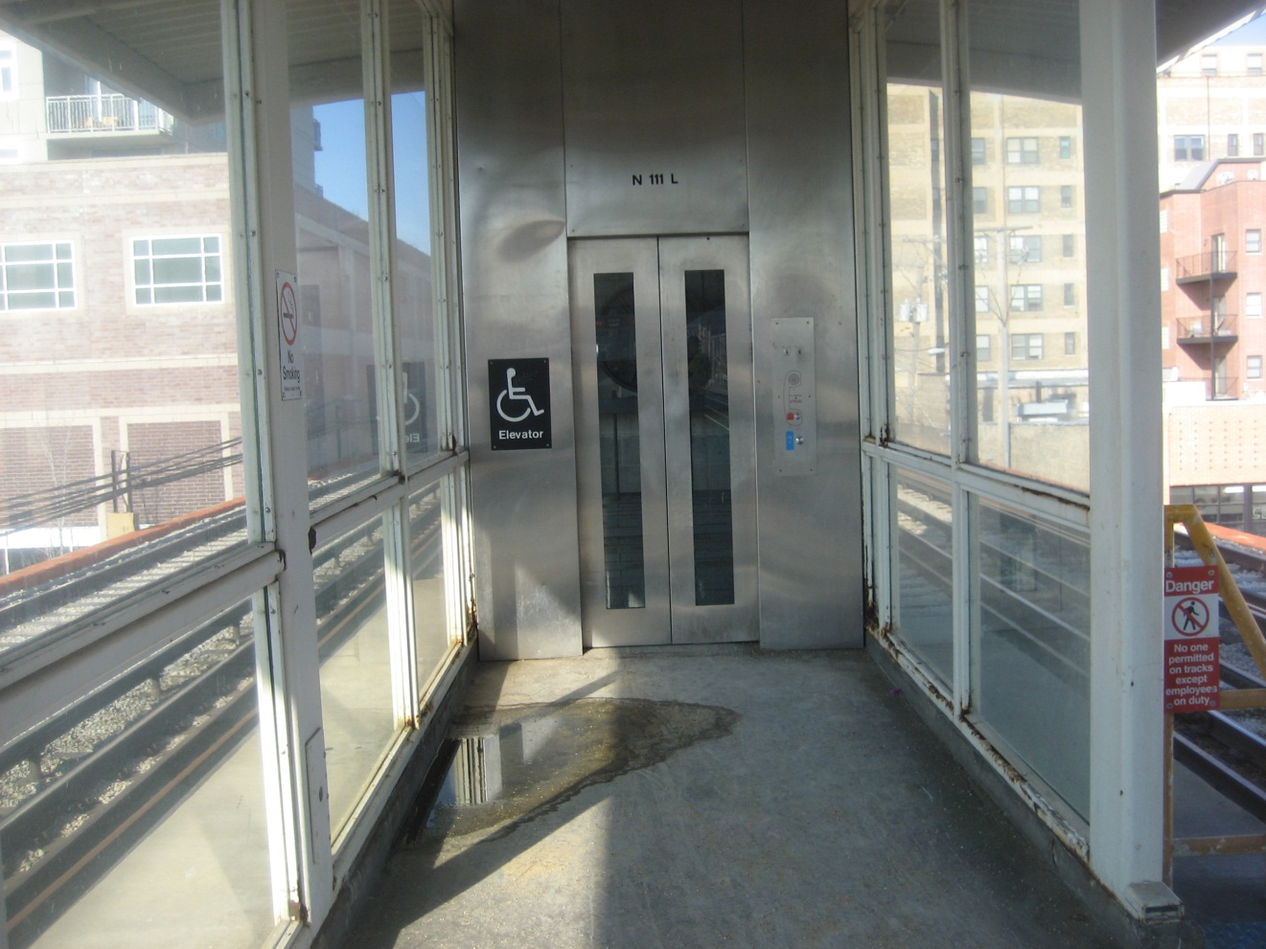
Alterations to Existing Facilities
TTA Danville Station

Slide 34
Alterations to Existing Facilities
When the altered area is the path of travel, the path of travel has to be accessible
Altered areas must be accessible
Disproportionality does not apply
Infeasibility may apply

Slide 35
Alterations to Existing Facilities
Example: Altered Area Is Path of Travel
Metroville Transit Authority (MTA)
Substantial rehabilitation at several stations
Platform, station house & staircases
All areas containing primary functions
Alteration to staircase = alteration to path of travel
MTA provided information for each station demonstrating specific site conditions that made elevators not feasible
Removal of travel lanes from streets under stations
Significantly reduced overhead clearance above streets beneath stations
Determined on basis of infeasibility (site-specific conditions); disproportionality not a factor

Slide 36
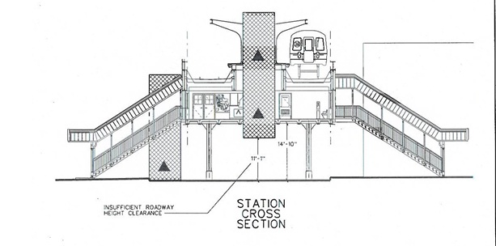
Alterations to Existing Facilities
MTA Traction Avenue

Slide 37
Alterations to Existing Facilities
Jurisdictional Issues
City owns facility
Transit system operates service
All entities involved must work together
All may not be FTA grantees
Grantee will have to demonstrate attempt to bring parties together
Can’t parse responsibilities when facilities are connected

Slide 38
Alterations to Existing Facilities
Example: Jurisdictional Issues
Lassiter Plaza (Metroville)
Bus transfer facility owned by City of Metroville, served by MTA, connected to OmniTrain commuter rail station below
City of Metroville undertaking alterations to bus transfer facility and surrounding pedestrian infrastructure
Existing stairwell connecting OmniTrain station directly to Plaza would be come primary entrance
Existing accessible entrance to OmniTrain station some distance away

Slide 39
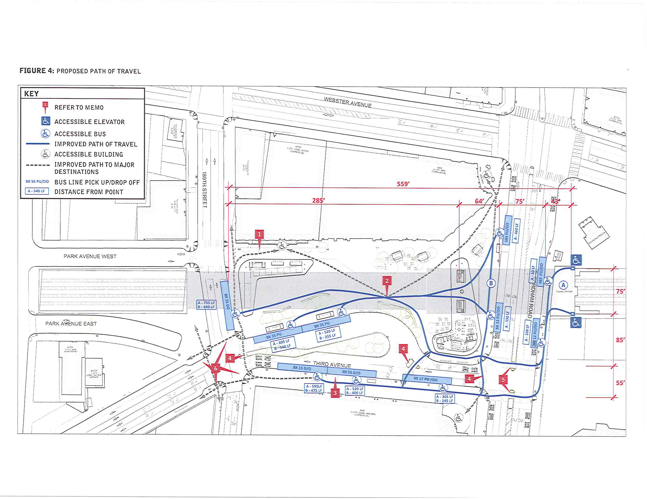
Alterations to Existing Facilities
Lassiter Plaza (Metroville)

Slide 40
Alteration Do’s & Don'ts
If you are contemplating alterations to a facility or part of a facility…
Do:
Use the right standards
Plan and budget to ensure that the altered areas will comply with ADA standards upon completion
Know whether the altered areas contain a primary function
If not, know why not
If so, plan and budget for additional alterations to the path of travel

Slide 41
Alteration Do’s & Don'ts
Do:
Show your work!
Document any site-specific conditions that make it infeasible to meet specific requirements
Demonstrate coordination with any other affected entities
Provide documented support for any claims that alterations to the path of travel would be disproportionate
FTA should be able to independently reach the same conclusions upon review of documentation
A picture is worth a thousand words; plans and architectural drawings are worth considerably more

Slide 42
Alteration Do’s & Don'ts
Don’t:
Don’t describe major renovations with terms like “maintenance” or “repairs”
Don‘t describe maintenance or repair activities with terms like “renovation” or “rehabilitation”
Don’t plan to “avoid” requirements

Slide 43
Alteration Do’s & Don'ts
Remember:
Infeasibility and disproportionality are not “waivers”
Does not require “FTA approval”
However, grants require FTA approval, and ADA compliance is a condition of all FTA grants
Absence of adequate documentation can delay grant approval
Any altered features that can be made accessible must be made accessible. [49 CFR 37.43(b) ]
alteration

Slide 44
Alteration Do’s & Don'ts
Remember:
There is no such thing as “replacement in kind”
Not contemplated in DOT ADA regulations
Cannot simply replace an element or feature with an identical element or feature
There is no such thing as “partial compliance”
Full compliance is required
What constitutes full compliance can vary according to specific circumstances

Slide 45
Federal Transit Administration
www.fta.dot.gov

