Slide 1

ADAPT
Advanced Drug & Alcohol Program Training

Slide 2
The Presentation
Phones
Breaks
Excusals
Questions
Handouts
Evaluations

Slide 3
Pre-Employment Testing

Slide 4
Pre-Employment Alcohol Testing
Testing is optional
If conducted, must follow DOT Part 40 Procedures

Slide 5
Pre-employment Sequence
Test Given
Negative result received
Safety-sensitive function performed
Additional Steps: Job Offer, Date of Hire, Training
Notes:
12

Slide 6
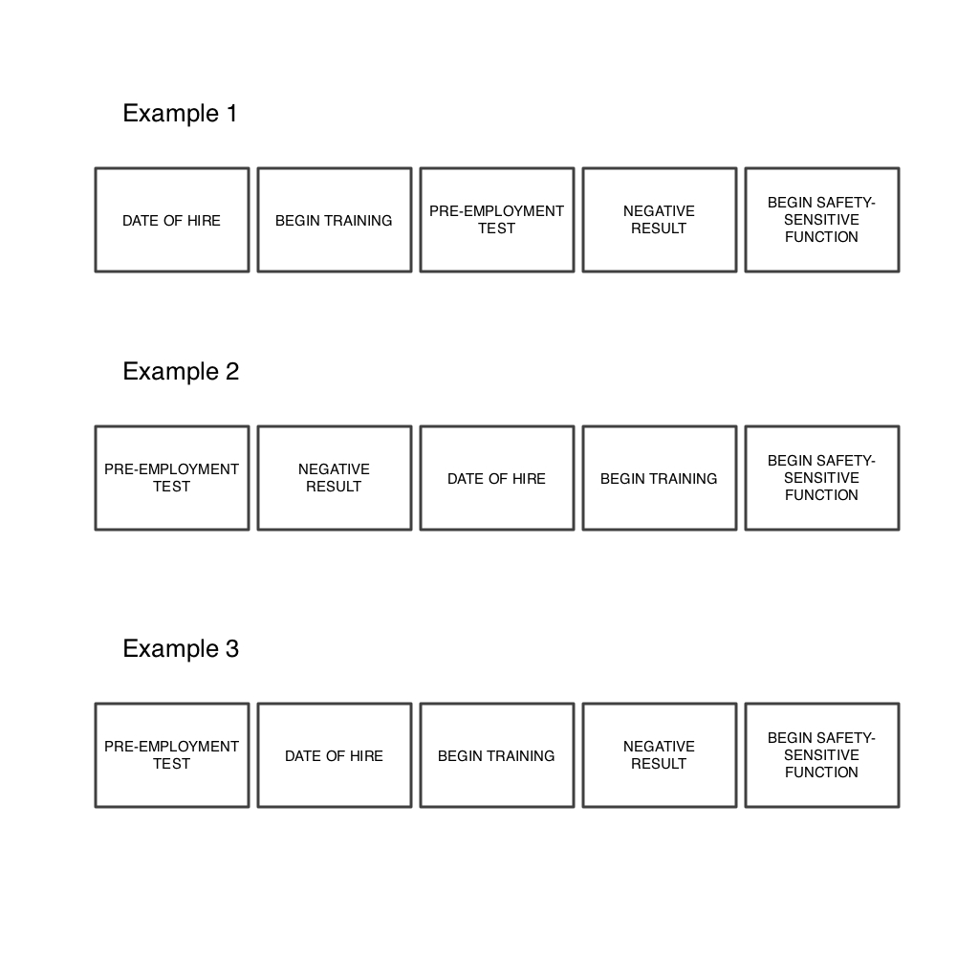

Slide 7
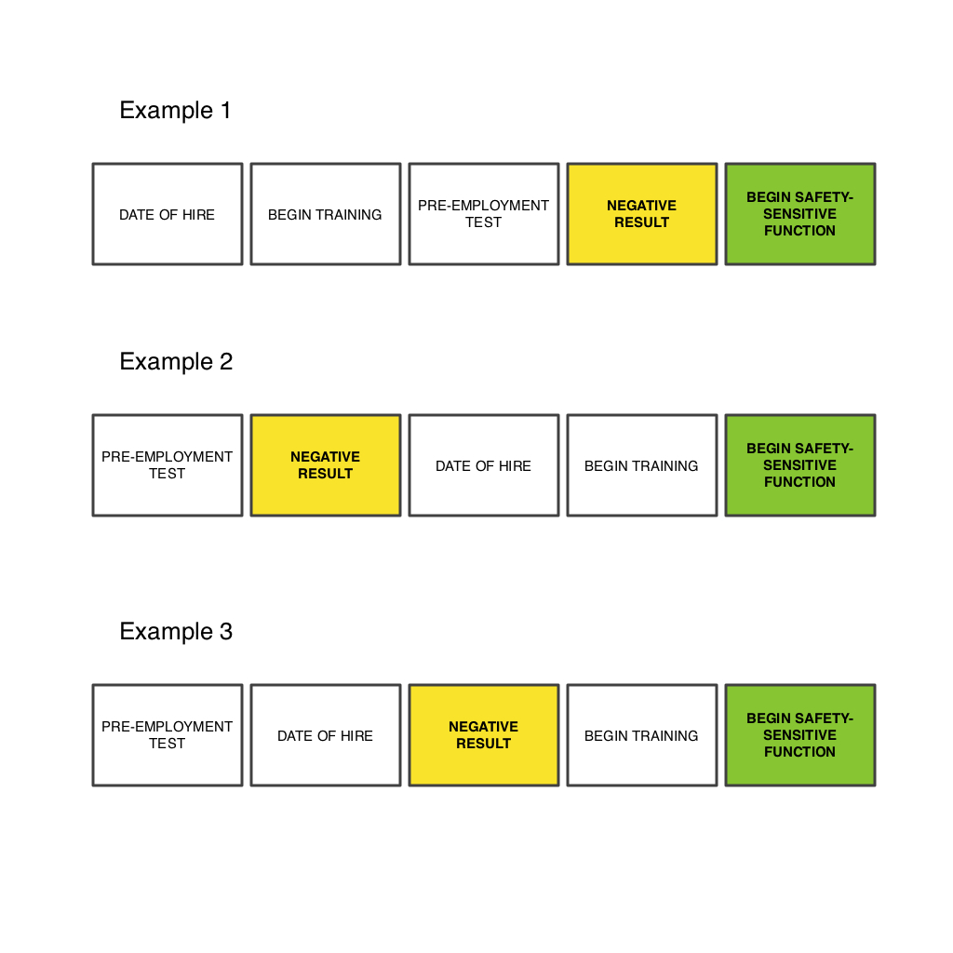

Slide 8
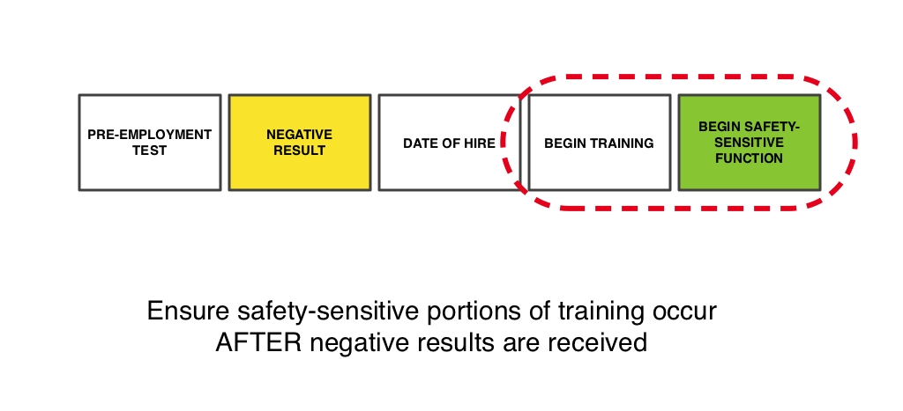

Slide 9
Pre-Employment Testing
Pre-Employment Testing is
Pre-Safety-Sensitive Duty Testing
The NEGATIVE test result is the
employee’s CLEARANCE to begin
safety-sensitive functions

Slide 10
Pre-Employment Test Timing
Before first safety-sensitive duty
  Includes training, in the yard, or any movement or control of the vehicle
Not more than 90 days prior to performance of a safety-sensitive duty (inclusion in random pool)
Must actually receive negative test report from MRO – don’t assume “no news is good news”

Slide 11
Pre-Employment Testing Refusals
Not same as Random, Post-Accident, etc.
NOT a refusal if applicant
  fails to appear for test
  delays a test
  leaves the collection site prior to commencement of the test
Refusal occurs: once the collection has commenced.
Notes:
12

Slide 12
Previous Employer Record Checks
As a potential employer, you must
  obtain signed consent from applicants to drug testing information from previous two years
  ask the applicant whether he/she has tested positive or refused to test within the last two years
  only allow employees who provide consent to perform safety-sensitive functions
  contact previous employers -- written consent for the release must accompany the request
  Q: Does this apply to other DOT agencies?
Notes:
12

Slide 13
Information to Request from Previous Employers
Alcohol test results higher than 0.04
Verified positive drug tests
Test refusals
Other violations of the DOT regulations
If appropriate, documentation of successful completion of return-to-duty process.
Notes:
12

Slide 14
Previous Employer Record Checks (Cont.)
Document good faith effort
  Q: What is a “good-faith effort”?
Review information received from previous employers
  30 day clock for results starts, but employee may begin safety-sensitive duties
Notes:
12

Slide 15
Pre-Employment Testing Following Leave:
Do not confuse Return-to-Duty testing with Pre-Employment Testing
Do NOT let collection site confuse these tests
  ALL return-to-duty tests are preceded by a positive/refusal result
Notes:
12

Slide 16
Pre-Employment Testing
No safety-sensitive duties for 90 or more days
+
Removal from the Random Testing Pool
=
Pre-Employment Test*
*NOT a Return to Duty Test (as assumed), but a “Pre-Duty”

Slide 17
What to look for in your records:
1. Date of 1st safety-sensitive duty
2. Date of test result from MRO
Was the Employee verified NEGATIVE before they performed their 1st safety-sensitive duty?

Slide 18
Pre-Employment Testing
P.E.T.E.R. may be available
(Pre-Employment Testing Exemption Request)
-Requires FTA approval

Slide 19
Policy
A Brief Review

Slide 20
Common Policy Flaws
Not formally adopted/dated
Not compliant with FTA regulations
Confuse FTA/FMCSA requirements
Notes:
12

Slide 21
Common Policy Flaws
Not current with regulatory changes (still refer to 653 & 654 instead of 655)
Consequences not clearly defined
Insufficient notification of employees
Use of boilerplate policy without modifying for local circumstances
Notes:
12

Slide 22
Common Policy Flaws
Does not differentiate between local pools and USDOT requirements
Tries to cover too many categories
Has been added to incrementally, but not fully revisited for editing, content, mission
Notes:
12

Slide 23
Compliance Tips (Cont.)
Make sure future revisions of a substantive nature also receive Board approval
Make sure all employees have the most current version of the policy
Clearly differentiate between FTA and company authority
Download the FTA Policy Review Form
Ask FTA to review your policy
Notes:
12

Slide 24
Random Testing

Slide 25
Current Rate of Random Testing
(minimums)
25% of safety-sensitive employees for drugs
10% of safety-sensitive employees for alcohol
  Consortium random rate can be applied to pool size of individual transit system or to total consortium.
Notes:
12

Slide 26
Scientifically Valid Method of Selection
Only USDOT safety-sensitive employees
in the pool
Human hand may not be directly involved
  Name pulled from hat, etc.
Notes:
12

Slide 27
Conduct of Random Testing
Notify, then immediately proceed to test
  Drugs: anytime on duty
  Alcohol: only before, during, or just after safety-sensitive duties
Legitimate excuses: sick, vacation, disability during entire draw period, not on shift
  operational difficulties are not legitimate excuses
Cease attempts to test once the next draw list received
Notes:
12

Slide 28
End of Shift Testing

Slide 29
End of Shift Interpretation
-Employers have “limited discretion regarding the scheduling of tests.”
-FTA wording … “Employees who provide advance, verifiable notice of scheduled medical or childcare (or eldercare) commitments, to be tested no later than 3 hours before the shift ends.”
-Alcohol tests no later than 30 minutes.
-Employer must routinely revisit each agreement.

Slide 30
Records Review: Random Tests
Your turn to be the auditor…

Slide 31
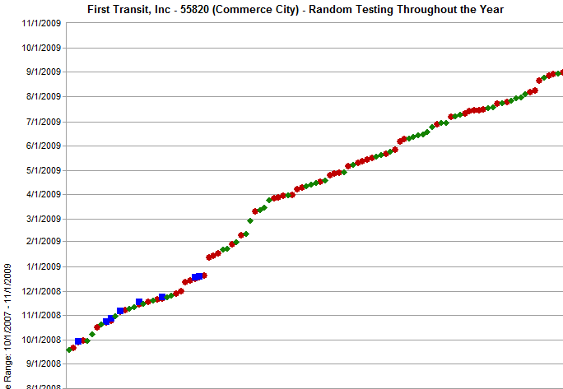

Slide 32
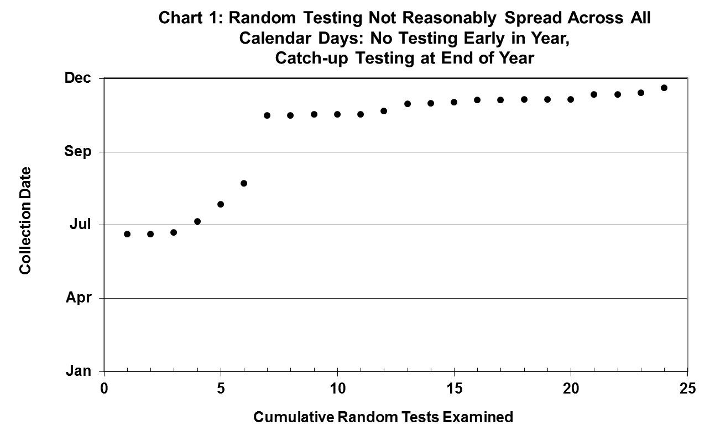

Slide 33
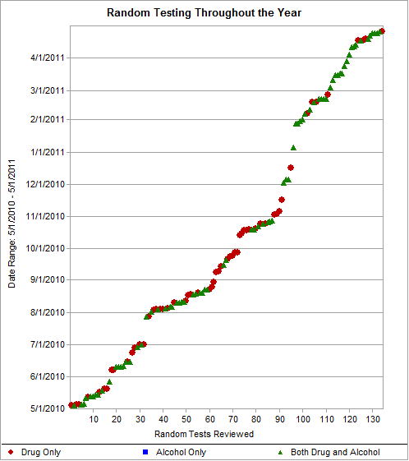
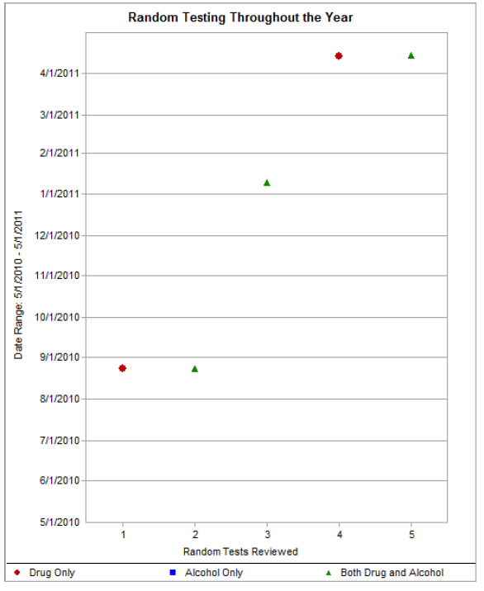

Slide 34
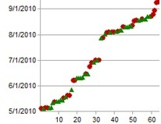

Slide 35
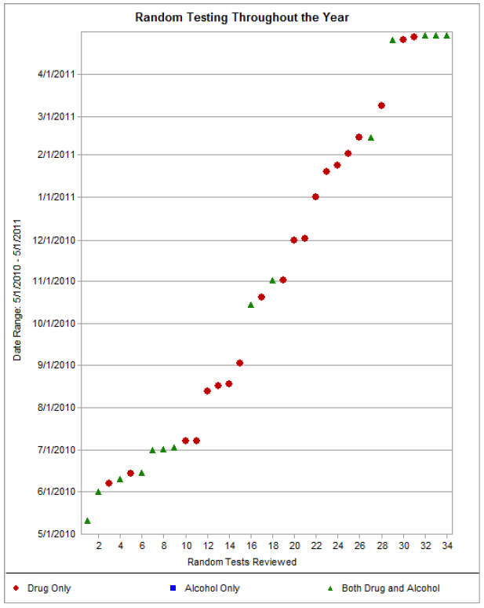

Slide 36
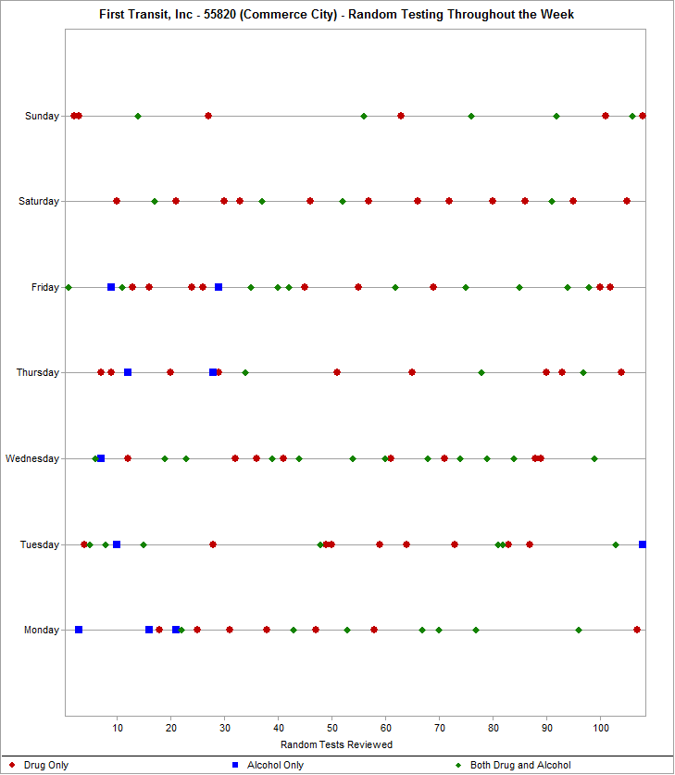

Slide 37
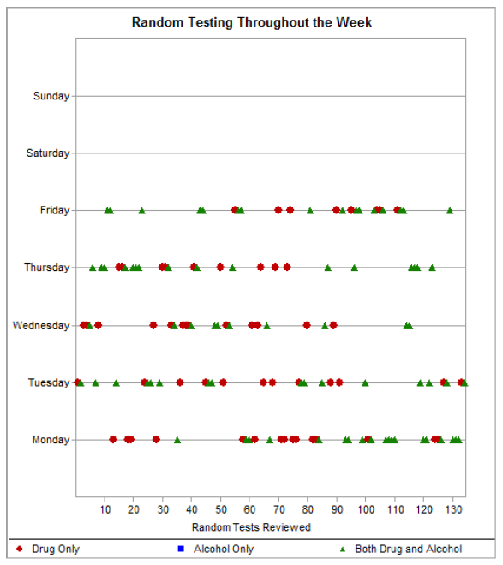
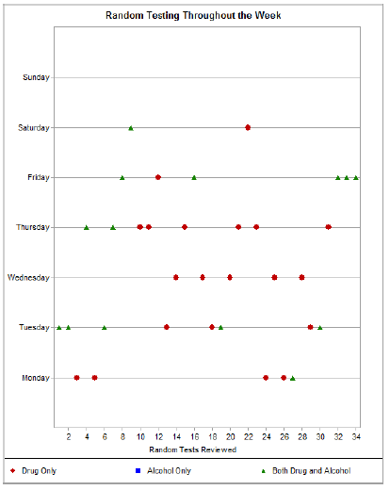
Recent Audit

Slide 38
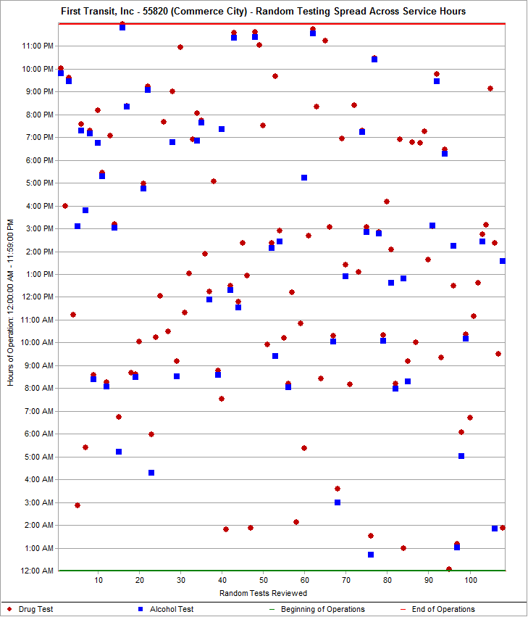

Slide 39
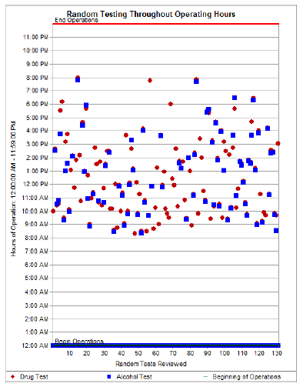
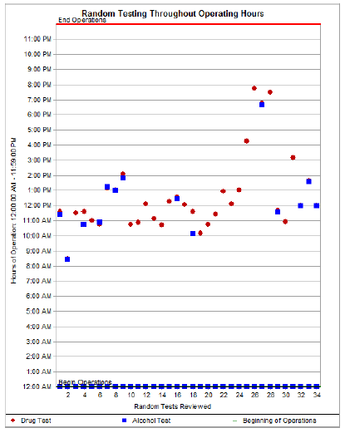
Recent Audit

Slide 40
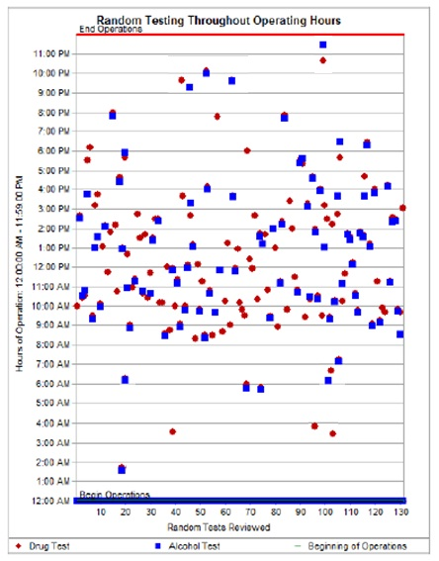
FTA Audit Results
Goals set by FTA & Grantee

Slide 41
Small Rural Transit Systems

Slide 42
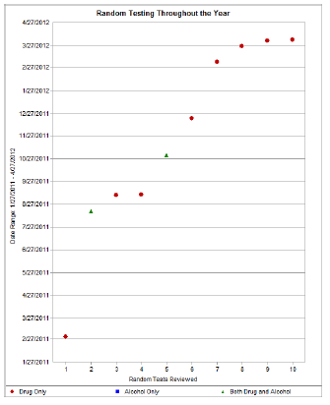
Location 1

Slide 43
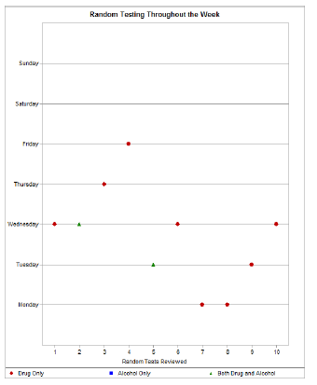
Location 1

Slide 44
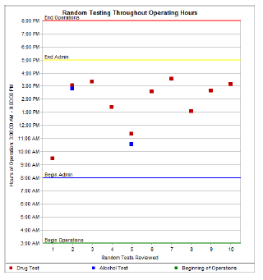
Location 1

Slide 45
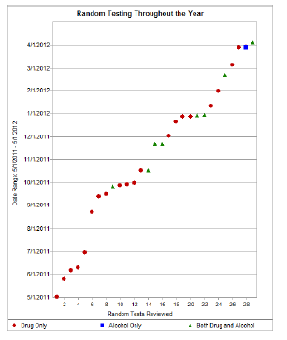
Location 2

Slide 46
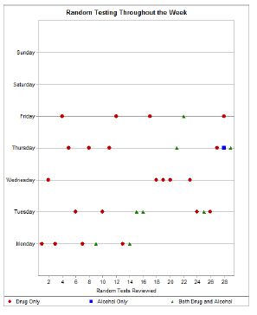

Slide 47
Auditor Requires Goal & Attempt in Audit Response
Majority of week adequate

Slide 48
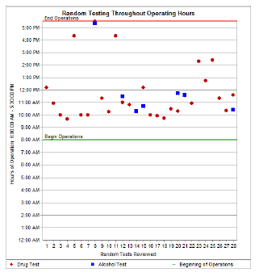
Location 2

Slide 49
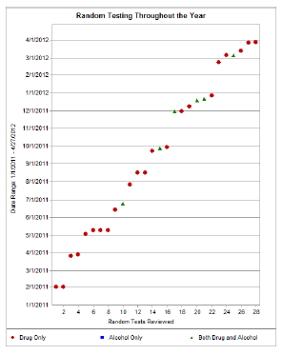
Location 3

Slide 50
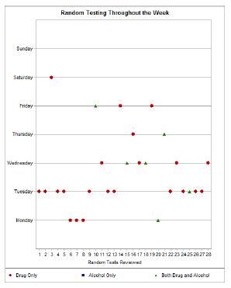
Location 3

Slide 51
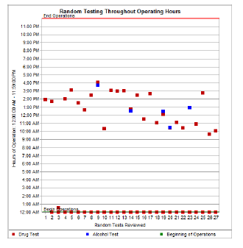
Location 3

Slide 53
Post-Accident Training
On-Site Investigation, Determinations, and Debriefing

Slide 54
What is an Accident?
Accident: associated with the operation of a revenue service vehicle, whether or not the vehicle is in revenue service (includes in the yard)

Slide 55
Actions On the Scene
What steps do you take?

Slide 56
What Happened?
How is this determined?

Slide 57
Drug & Alcohol Testing Priority
All medical and treatment considerations must be addressed
All safety considerations should be addressed
The site or scene must be secured
  No further requirements from Law Enforcement
  No further information immediately required from the operator

Slide 58
The Order of Investigation
Criteria
Contributors
Clearances

Slide 59
Criteria
Fatality
Disabling Damage to any vehicle
Injuries requiring immediate medical treatment away from the scene

Slide 60
Disabling Damage
A vehicle can not proceed under it’s own power without further damaging itself
Usually requires towing
Cannot be easily repaired at the scene: wipers, head/signal lights, tires, etc.

Slide 61
Injuries
An individual receives immediate medical attention away from the scene
Transported to medical facility by any means

Slide 62
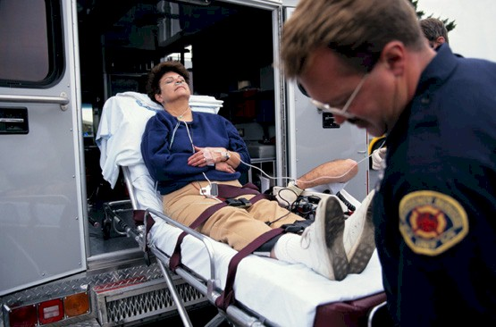
Slip & Fall?

Slide 63
Slip & Fall
The majority of slip and falls do not meet the thresholds of testing, because no collision occurs

Slide 64
Slip & Fall
Was there a collision?
-If no:
Was the fall related to a maneuver?
-If yes:
Was the maneuver appropriate?
-If no:
Post-accident test.

Slide 65
Factors that do not trigger P.A. tests
Dollar amount of damage
Driver citation
Insurance or Company requirement
“Just to be safe”
Reasonable Suspicion implications
At-fault/Preventable

Slide 66
Ordering a Test
Establish that at least one of the three criteria have been reached
Establish possible contributors (operator, mechanic, etc.)
Use event-specific facts to rule out all possible contributors
If the performance of one or more SSE can not be discounted, order the test

Slide 67
“Should I have ordered a DOT test?”
The requirement is to determine whether or not a safety-sensitive employee can be completely discounted as a contributing factor
Two company officials might not agree
The option to discount is based on an individual’s professional transit experience and expertise

Slide 68
Review
Criteria? Fatality, Disabling Damage, Injuries?
Contributors? Safety-sensitive employee involvement?
Clearances? Who can be reasonably ruled out?
Clock? How long has it been since the accident?

Slide 69
Clock
Alcohol
  Document after 2 hours
    Clock starts at time of accident
  Cannot test after 8 hours
Alcohol test first
Notes:
12

Slide 70
Time Limitations on Post-Accident Testing (Cont.)
Drugs
  Test should be performed as soon as possible, but no more than 32 hours following the accident
  After 32 hours, a USDOT test will no longer be valid
Notes:
12

Slide 71
Scenarios & Discussion/Analysis

Slide 72
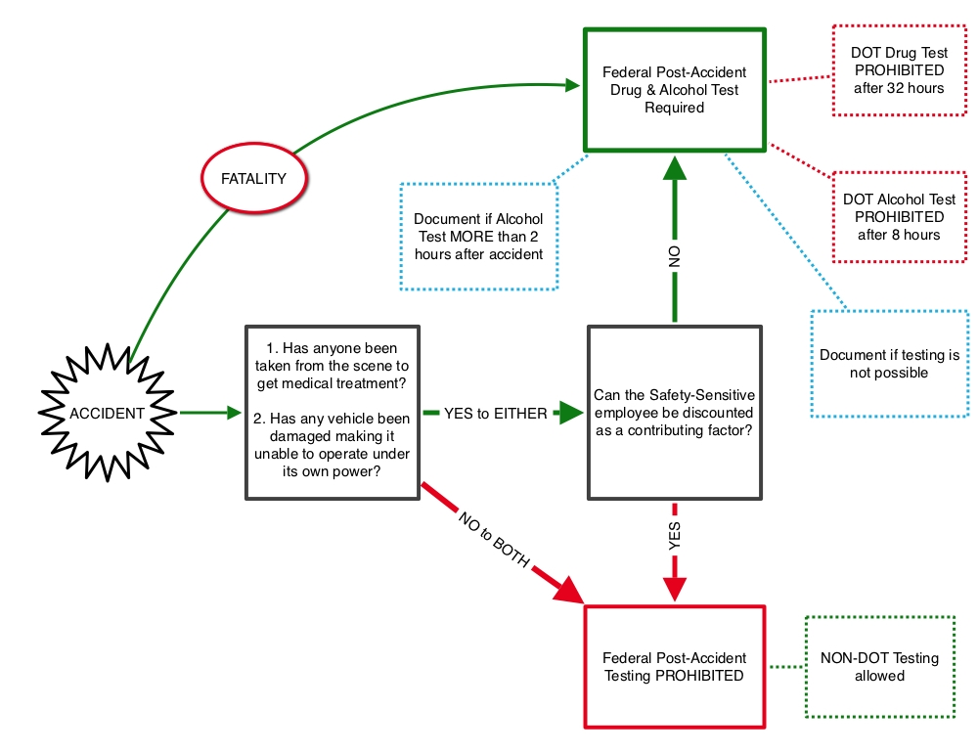

Slide 73
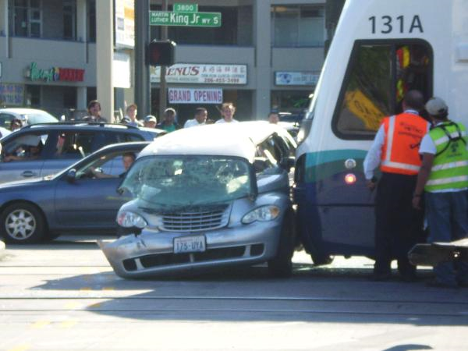
Analysis:

Slide 74
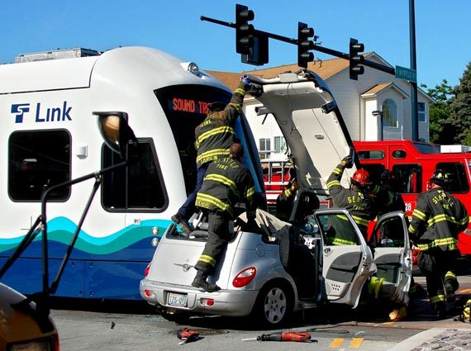
Later…

Slide 75
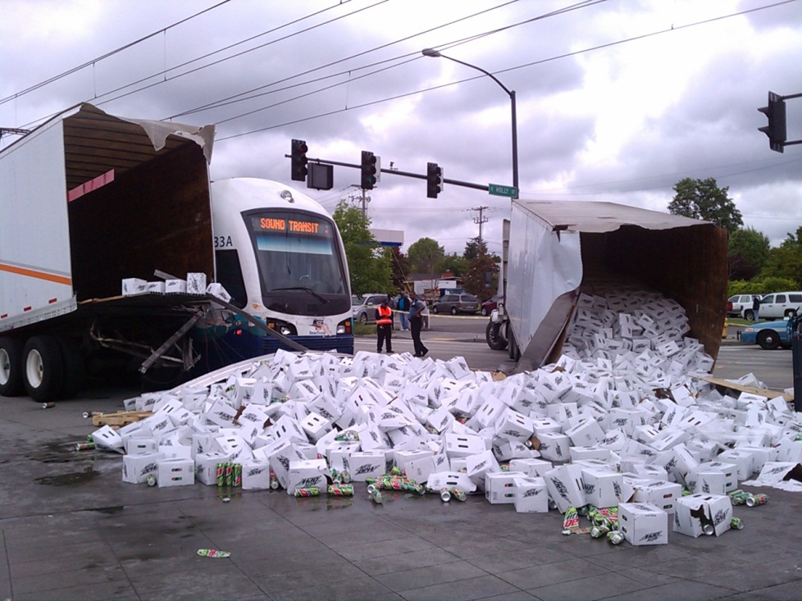
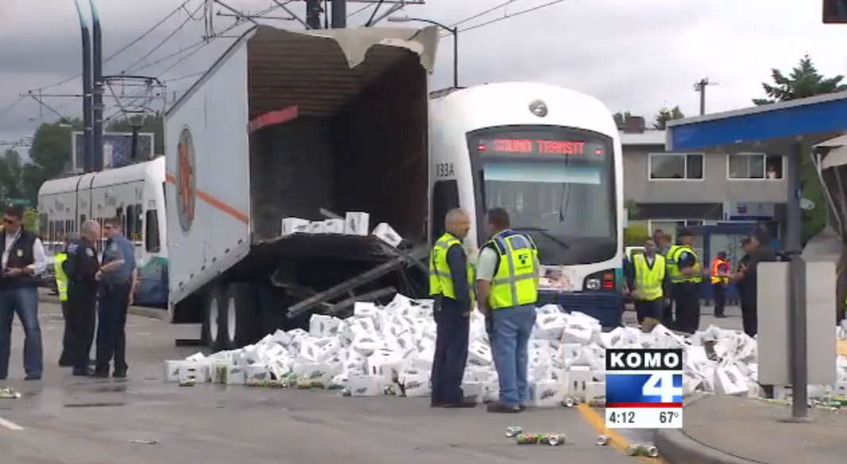
Disabling Damage to other vehicle

Slide 76
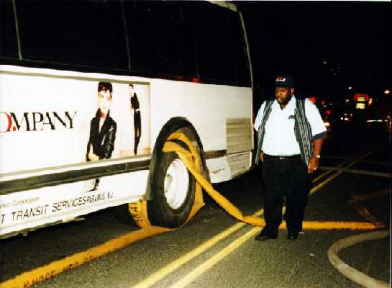
Analysis:

Slide 77
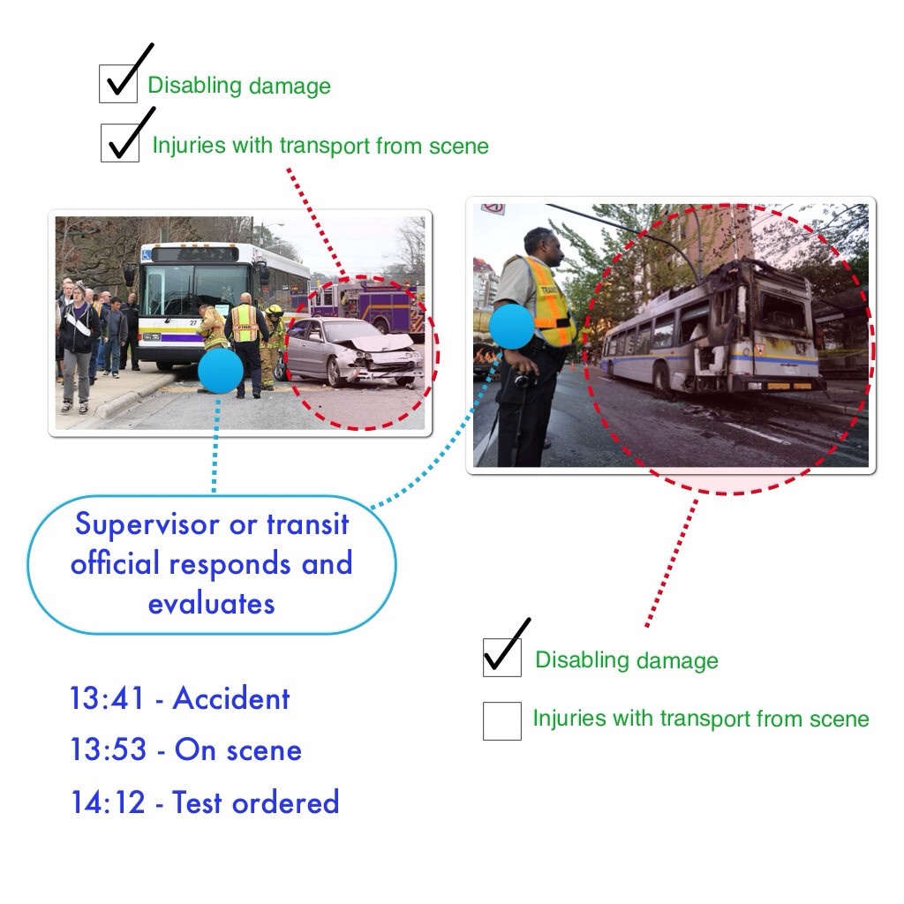

Slide 78
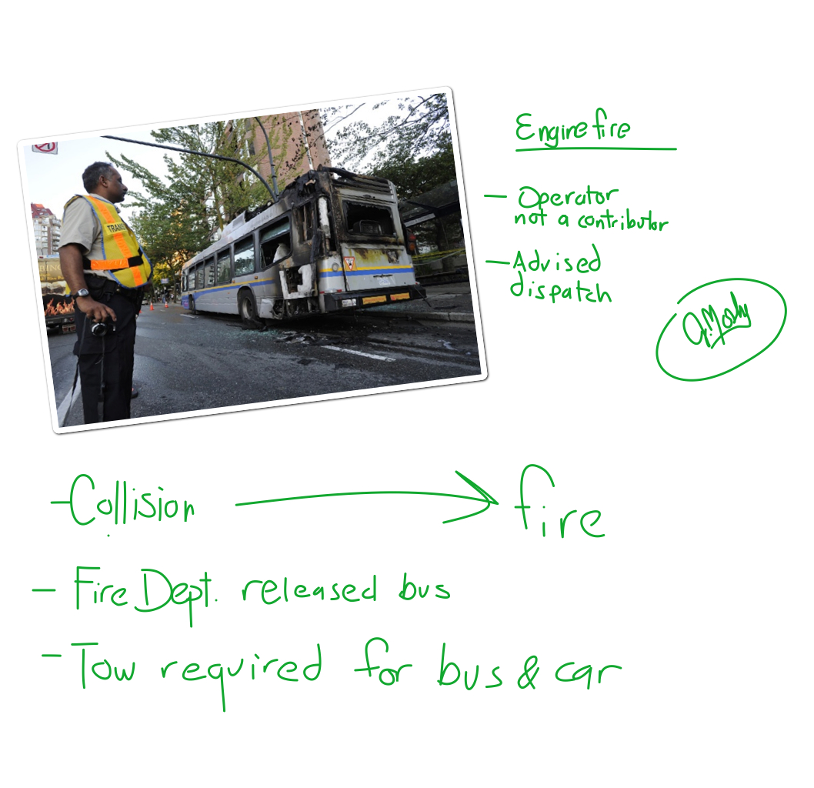

Slide 79
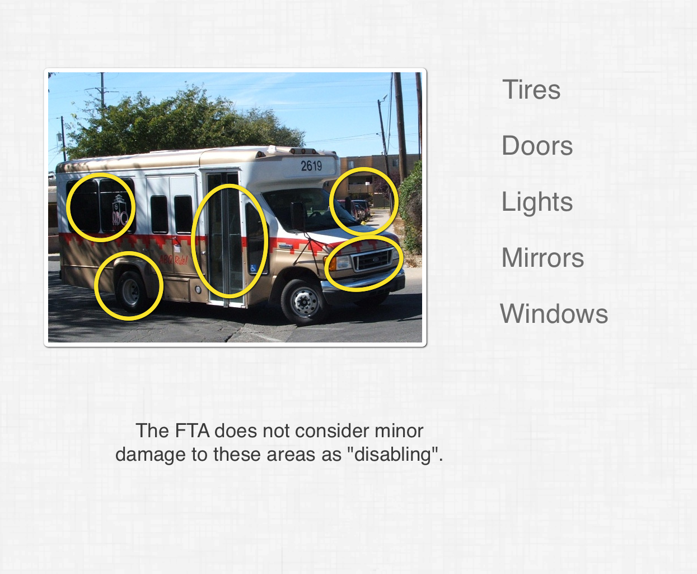

Slide 80
Make the Call
Use the best information available at the scene
Order an FTA test, a transit authority test, or no test
Examine and debrief with others afterwards
***As a supervisor, YOU are responsible for making the determination to test

Slide 81
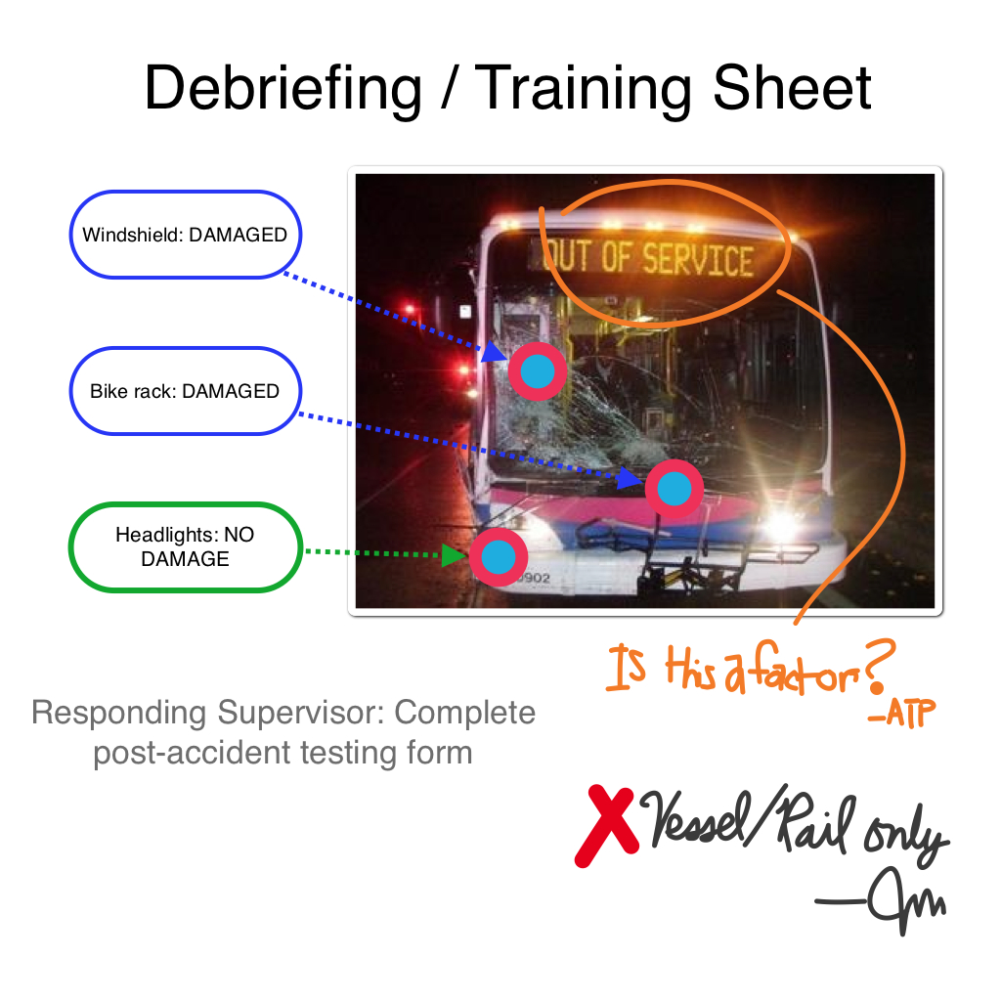

Slide 82
Acceptance of Other Test Results
In the rare event the employee cannot participate in the FTA collection process, following an accident, the employer may accept the results of a test performed by Federal, State, or local officials if results are released
Employer must document why DOT test was not performed within time period
Notes:
12

Slide 83
Employee MUST give consent
Dead or unconscious employees may NOT be tested
Every alcohol test must begin with the employee signing the ATF
The CCF must be completed by the employee
Refusals must be recognized by the regulations (as listed)

Slide 84
Common Problems: Post-Accident Testing
FTA thresholds not met
Delayed, or even no test
Ill-defined policies
No documented procedure
Poorly trained company official
Lack of company official empowerment
Testing “Just to be safe”
Notes:
12

Slide 85
Final Discussion

Slide 86
Reasonable Suspicion Testing
Notes:
12

Slide 87
Signs & Symptoms of Alcohol Use: Awareness and Training
Contemporaneous
Recent
Historical
Potential

Slide 88
Signs & Symptoms of Alcohol Use
  Odor
  Motor (physical/behavioral)
  Interactive (social/behavioral)
  Cognitive

Slide 89
Signs & Symptoms of Drug Use:
Awareness and Training
Contemporaneous
Recent
Historical
Potential

Slide 90
Reasonable Suspicion Testing Procedure
Reports, Tips, Fights, Signs or Symptoms, Etc.
Face-to-Face Evaluation
Test or Release

Slide 91
Reasonable Suspicion Testing
Detection of impairment is the goal
Accurately diagnosing particular substance use is less important

Slide 92
Beginning

Slide 93
Framing the Interaction
How you begin the conversation with the employee will determine:
Win / Lose Outcome
Win / Win Outcome

Slide 94
Win/Lose Outcome
“I think that you are under the influence of [a prohibited substance]. I am sending you for reasonable suspicion testing.”
Positive: Employee 0, Employer 1
Negative: Employee 1, Employer 0

Slide 95
Win/Win Outcome
“I am concerned about your readiness to perform safety-sensitive functions. I am required to refer you for a test to rule out chemical impairment.”
Positive: Employee 0, Employer 1
Negative: Employee 1, Employer 1

Slide 96
The Procedure
Approach the employee
Observe
Change the setting and re-evaluate
Evaluate fine/gross motor skills
Evaluate reaction to questions and awareness of actions
Refer employee to test or release

Slide 97
Approach the Employee
What can lead up to the approach?

Slide 98
Observe
Establish a “baseline”
Is the employee as you would normally expect them to be?
Is your interaction as you would normally expect it to be?
Make note of eyes, manner, posture, attitude

Slide 99
Change the Setting and
Re-evaluate
Move from dark to light/light to dark
Walk behind the employee
Observe their actions during the transition
Fine/gross motor skill observations

Slide 100
Make The Verbal Inquiry/Statement
Frame the interaction correctly

Slide 101
Evaluate their Reaction
Denial, Defensiveness, Aggression, Helplessness, Admission, etc.
Is their reaction appropriate?
Is it consistent with expectations?
Document the reaction

Slide 102
Ordering the Test
Do not set up a win/lose outcome
  Emphasize that you are required to refer employees for testing for observable fitness-for-duty concern
  Do not accuse the employee of substance use
  Release if you are satisfied with the interaction

Slide 103
Other Causes
Medical conditions (diabetes, stroke, head injuries) are causes of impairment, but immediate medical attention is more important than testing
What is your fatigue plan?
Allergy or sickness plan?

Slide 104
On the Job

Slide 105
Reasonable Suspicion Testing
Odor of alcohol?
Phone tip?
Employees fighting?
Conduct/safety violation?
Decreasing job performance?
Accident?
Covering for yourself or the company?

Slide 106


Reasonable Suspicion Testing
Only one company official is required

Slide 107
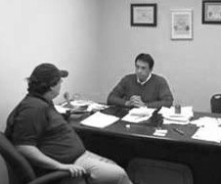
Reasonable Suspicion
Any symptom or sign must be actually observed, then documented

Slide 108
Reasonable Suspicion Testing
Required Steps:
Documented reasonable suspicion interview by trained official
Reasonable suspicion test, if needed
Notes:
12

Slide 109
Reasonable Suspicion Testing
Drugs - anytime on duty
Alcohol - Only if the observations are made during, just preceding, or immediately following the performance of safety-sensitive functions
Employees must proceed immediately to a collection site following a reasonable suspicion determination (employee should be transported)
Same time limits as Post-Accident tests
Notes:
12

Slide 110
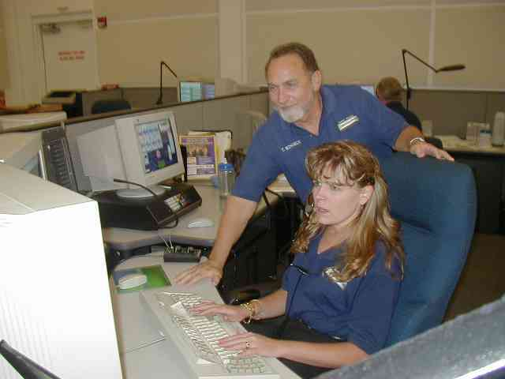
Dispatchers are often the “First Line of Defense” for Reasonable Suspicion Testing

Slide 111
Sensitized vs. Authorized
Authorized:
  Can conduct face-to-face evaluations
  Can make determination to send someone for reasonable suspicion testing
  Have received 2 hours of training

Slide 112
Sensitized vs. Authorized
Sensitized:
  Can observe symptoms and conduct informal evaluations
  Can NOT make determination to send someone for reasonable suspicion testing
  ***Enlist specific individuals

Slide 113
Sensitization and Priming
Who and where is the primary point of contact for each shift?
Are they able to be trained to make reasonable suspicion determinations?
Have these individuals been sensitized to the importance of reporting suspicion?
Do they know how and to whom they should report?

Slide 114
REVIEW:
Reasonable Suspicion Testing Procedure
Reports, Tips, Fights, Signs or Symptoms, Etc.
Face-to-Face Evaluation
Test or Release

Slide 115
The Collection Process

Slide 116
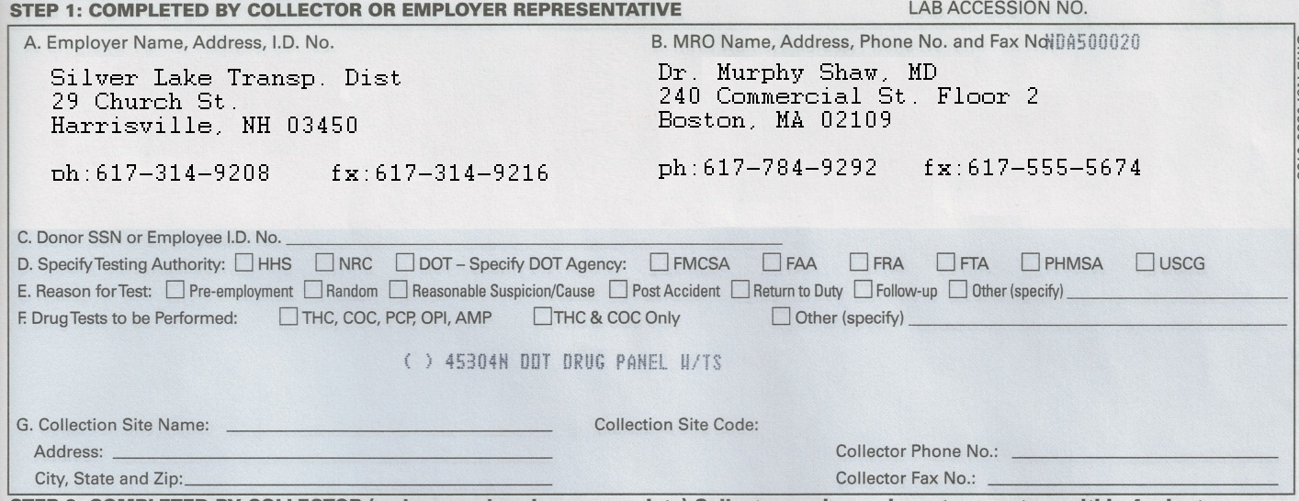
Step 1, Part D

Slide 117
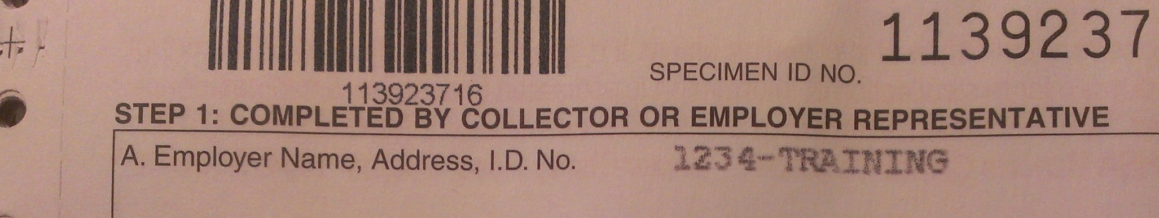
Step 1: Jurisdiction

Slide 118
Step 1, Part D
Requires mode authority for testing
  HHS
  NRC
  USDOT
    FMCSA
    FAA
    FRA
    FTA
    PHMSA
    USCG

Slide 119
Preparation
Collector verifies ID
Show back of form
Remove outer garments
Keep wallet/cash
Empty pockets

Slide 120
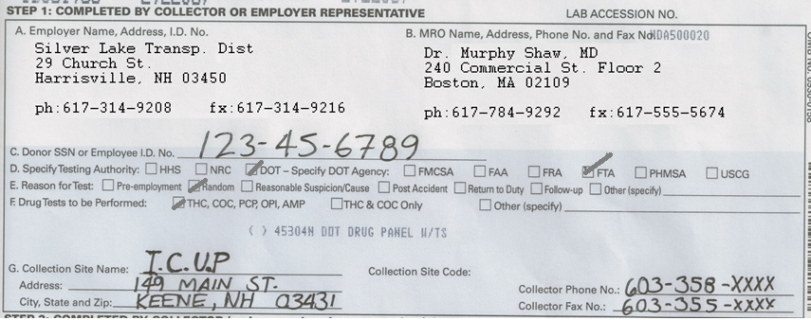
Step 1

Slide 121
Pre-specimen
Wash hands
Select container

Slide 122
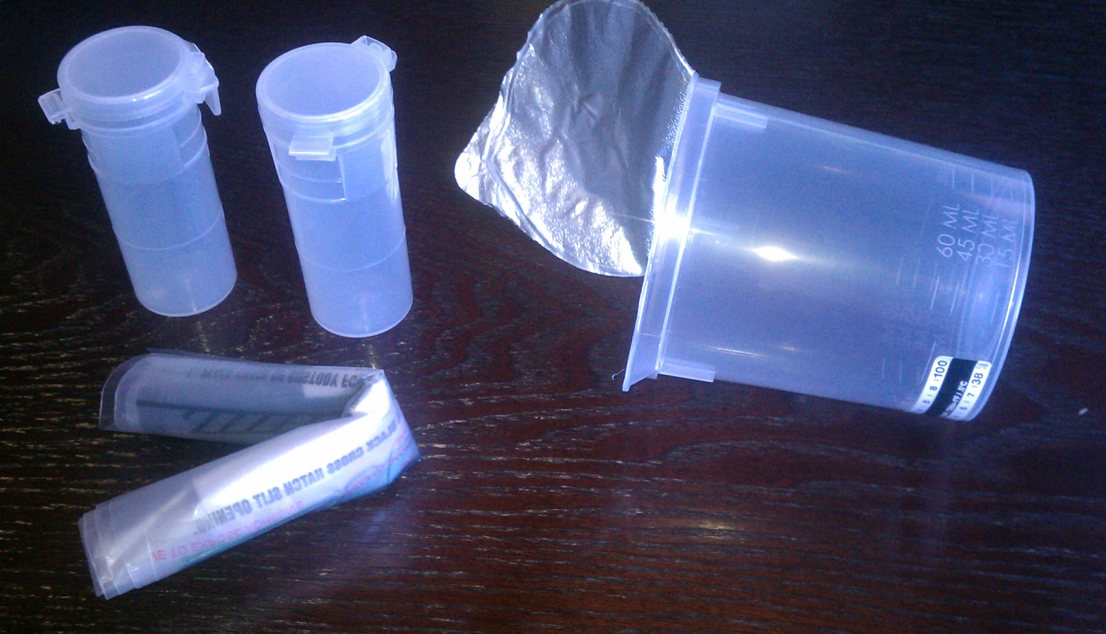
Collector Initiates Specimen Collection

Slide 123
The donor accepts the container, enters the enclosure
Reasonable time limit is given
Minimal auditory monitoring allowed

Slide 124
The Enclosure
The over-arching concern is a donor’s ability to dispose of or conceal paraphernalia brought into the enclosure
Hiding places for small objects are a concern

Slide 125
Common Areas Where Inspectors Find Paraphernalia
Under the sink
In ceiling tiles
In trashcan
On shelves
Cabinets and cupboards

Slide 126
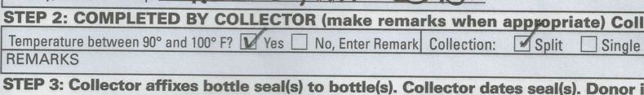
Step 2

Slide 127
Step 3
“STEP 3: Collector affixes bottle seal(s) to bottle(s). Collector dates seal(s). Donor initials seal(s). Donor completes Step 5 on Copy 2 (MRO Copy)”
*Step 3 REQUIRES that the collector proceed to Step 5 on Copy 2

Slide 128
Step 3: Four Parts
Collector affixes bottle seals
Collector dates bottle seals
Donor initials bottle seals (then folds Copy 1 over to reveal Copy 2)
Donor completes Step 5 on Copy 2 (MRO Copy)

Slide 129
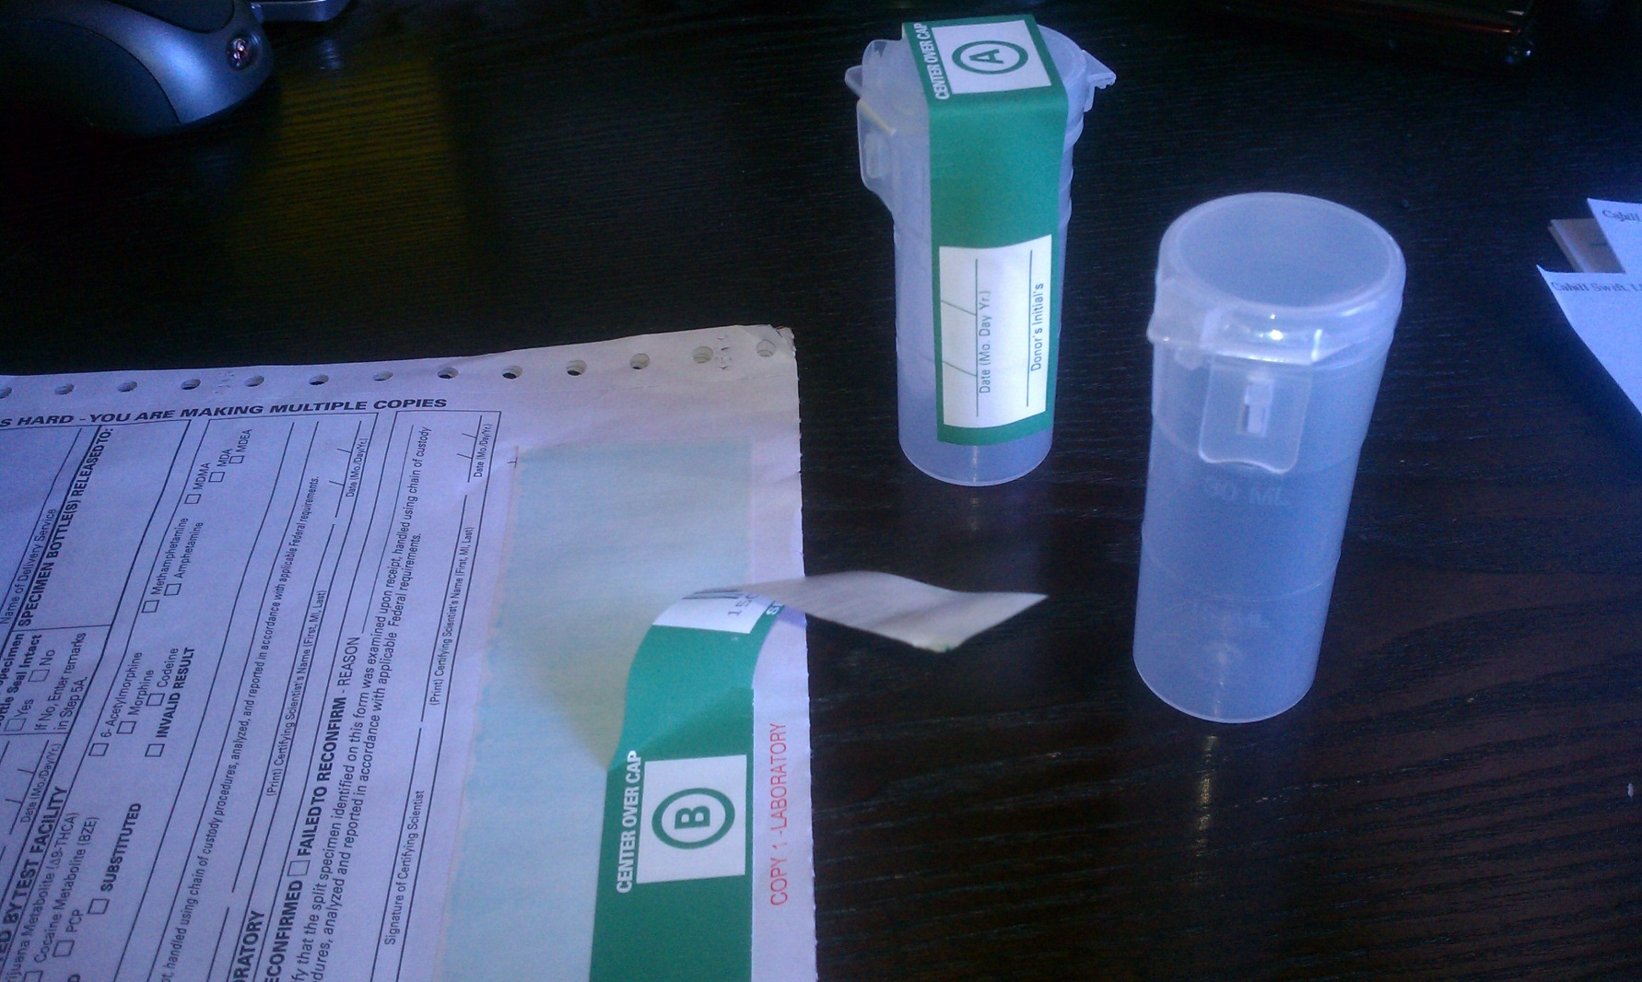
Step 3: Part 1
Bottles A and B

Slide 130
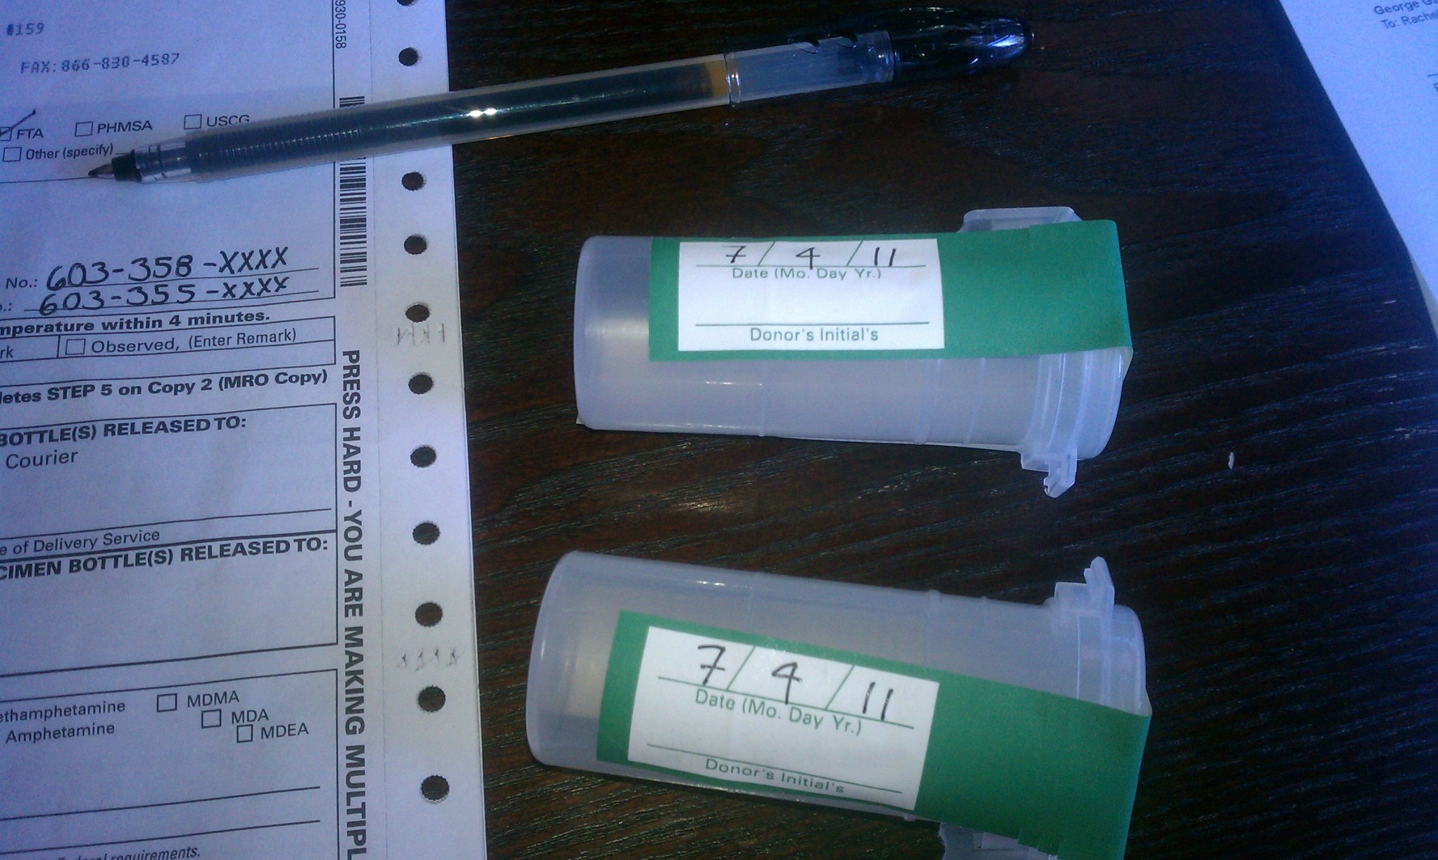
Step 3: Part 2
Collector Writes Date

Slide 131
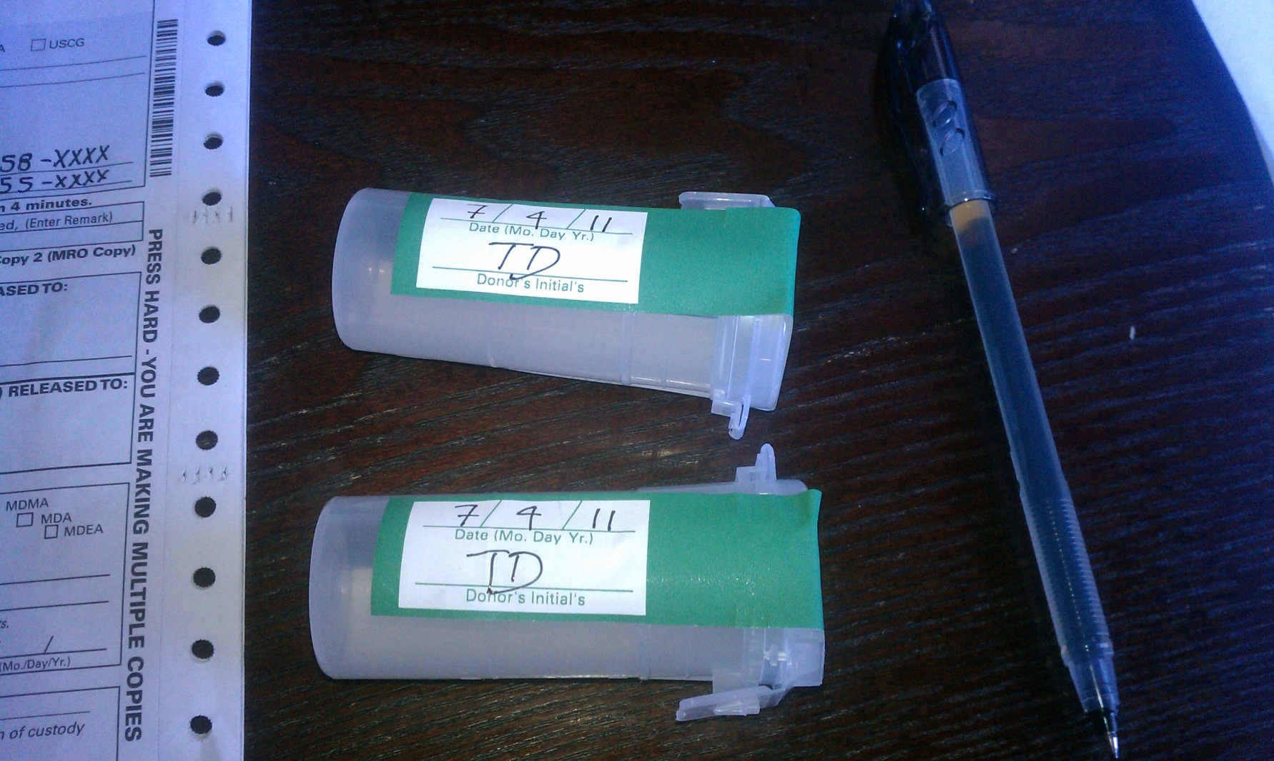
Step 3: Part 3
Donor Writes Initials

Slide 132
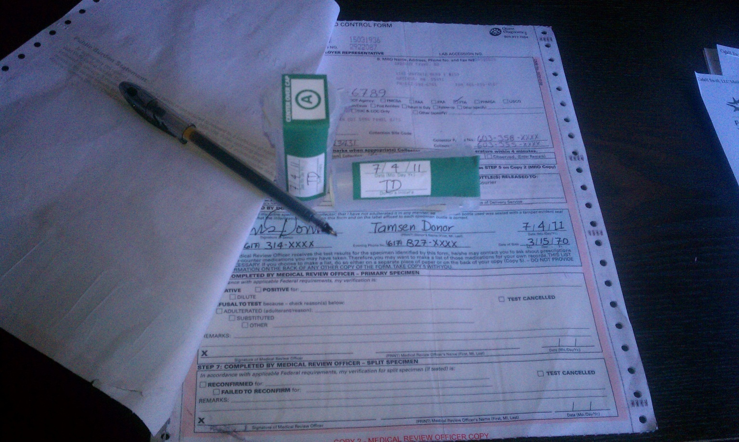
Step 3: Part 4
Collector Folds Top Copy Away, Donor Completes Step 5

Slide 133
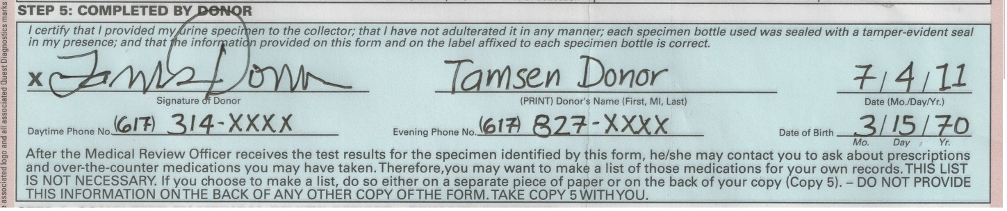
Step 5

Slide 134
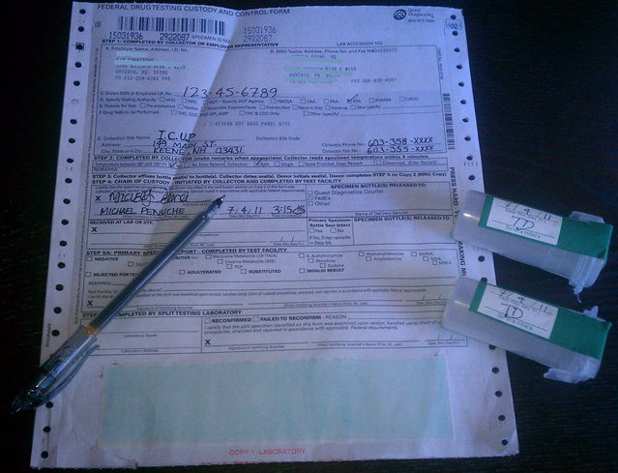
Step 4 (After Step 5)

Slide 135
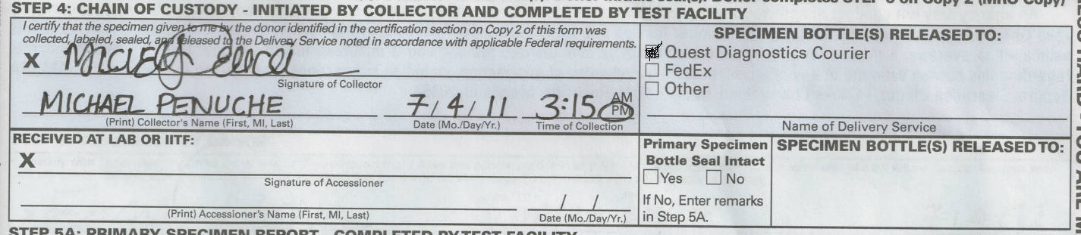
Step 4

Slide 136

Completion

Slide 137
Distribution of Forms
#1 - LAB Copy
#4 - DER Copy
#5 - Employee Copy
#3 - Collection Site Copy
#2 - MRO Copy

Slide 138
Typical Method of Distribution
LAB Copy – Shipped with Specimen
DER Copy – Scan, fax, or mailed
Employee Copy – Sent with employee
Collection Site Copy - Filed
MRO Copy – Fax or scan (usually)

Slide 139



Slide 140


Slide 141


Slide 142


Slide 143


Slide 144


Slide 145


Slide 146
MIS Reporting

Slide 147
MIS Questions?
We have a HOTLINE
Call: 617-494-6336
Or email:
FTA.DAMIS@DOT.GOV

Slide 148
MIS – FTA Reporting Requirements
Prepare and maintain summary of results
Submit results to FTA
  When requested (e.g., annual reporting, audit, triennial review, etc.)
Ensure accuracy and timeliness
  Grantees -> contractors, subrecipients, consortiums, TPA, etc.
Notes:
Prepare and maintain summary of results from anti-drug & alcohol misuse testing programs that fall under 49 Parts 40 and 655
Submit results to FTA
When requested (e.g., annual reporting, audit, etc.)
Annual reporting – March 15th for results from previous CY
Where: To Office of Safety and Security or designated agent (Volpe Center)
Ensure accuracy and timeliness
Grantees -> contractors, subrecipients, consortiums, TPA, etc.

Slide 149
Reporting Responsibilities
  State DOT’s
    Receive correspondence from FTA, distribute reporting materials to their subrecipients and contractors
    Pass through agencies such as MPO’s, county governments etc. need to report. They should “zero out” a report to indicate they are a pass-through.
  Direct Grantee (Non State Dot’s)
    Receive correspondence from FTA, distribute reporting materials to their contractors
    Need to “zero-out” a report if you are a pass through grantee that contracts out safety sensitive operations

Slide 150
MIS - Multi-Modal
When an employer is regulated by multiple DOT agencies – but employees perform duties regulated by a single DOT agency
  Submit separate agency specific MIS forms(s)
  Do not double-report

Slide 151
MIS - Multi-Modal
When an employer is regulated by multiple DOT agencies – and employees perform duties regulated by multiple DOT agencies
  Employees reported under DOT agency for which they are randomly tested
  or
  Employees reported under DOT agency for which majority of safety-sensitive duties are conducted
Notes:
Employers regulated by multiple DOT agencies – employees perform duties regulated by multiple DOT agencies
Employees in random pool of agency that tests at higher rate
Employees need be reported under the DOT agency for which they are randomly tested

Slide 152
MIS – Annual Reporting
How to Submit
Internet-based online reporting
  www.fta.dot.gov
  Select Safety and Security from the left column
  Select Drug and Alcohol tab
  Select Drug and Alcohol MIS Reporting from the right column
  Note: Grantee provides User Id and Password for contractors/subrecipients
New MIS Data Collection Form (paper)
  FTA Drug and Alcohol MIS Project Office, DTS-781 Volpe Center, Cambridge, MA, 02142

Slide 153
Vendors
Tips & Red Flags

Slide 154
How do you monitor vendors?
TPA
MRO
Collection Sites
SAP

Slide 155
TPA
TIPS:
Remember that they work for you
Do not tolerate poor performance
Do not tolerate uncooperativeness

Slide 156
TPA
TIPS:
YOU dictate when/how selection lists arrive
Don’t be a bad client: submit updated lists when requested by TPA

Slide 157
TPA
TIPS:
Make CERTAIN that they understand the difference between modes: FTA vs. FMCSA, etc.
Be clear about your expectations
  taking bids, drafting contracts, operating agreements

Slide 158
MRO
TIPS:
Ask the MRO if they personally contact donors to discuss test results
  Ask employees same if possible
Ensure that they are catching CCF mistakes
  Step 1D, Carbon shadows, incomplete sections

Slide 159
MRO
TIPS:
Ensure that their results forms are complete and accurate

Slide 160
What Can You Monitor Forensically?
Completeness of the CCF
  Steps 1-5
Step 3 (unless the form is a Quest form)
Accuracy of the CCF
  Time, date, test type, testing authority
Timeliness of the collection process
  Start-to-finish times and wait times

Slide 161
What Can’t You Monitor Forensically?
The order in which the collection was performed
The enclosure’s security
The participation requirements/allowances of the donor
  Remove outer garments
  Pockets
  Wallet

Slide 162
Corrections
Eliminating areas of concealment within the enclosure is the goal
Ensuring the supervision of the donor is crucial
Fatal flaws must be corrected by error correction training within 30 days

Slide 163
Collection Site
TIPS:
Ask that responses from collection site personnel be sent to you by email
  Time/date included
  Correspondence trail included
  Easier to distribute as needed
  You can ask for photos, etc.

Slide 164
Tips
After daylight savings time adjustments, monitor your collection site for a clock adjustment on the EBT
If faxes are unclear, require digital photos of the CCF itself which can be emailed directly from a phone (8 megapixel or higher) while you await the paper copy

Slide 165
Tips
If you like a particular collector, establish an on-call arrangement for late or early collections and pay them directly
Delay payment if needed for collection site unresponsiveness

Slide 166
Tips
Print bulletin cards for your collection site
  Multiple contact numbers
  Testing authority (you can pre-print these)
  Protocols

Slide 167
Tips
Provide your collection site with SASE’s in which to send your Employer Copies (Copy 4) from each CCF
  At the time of each collection
  Sent in batches at beginning of each testing period

Slide 168
Tips
Check your ATF and CCF to determine which test occurred first
Maintain a collaborative relationship (if possible) with your collectors
Make appointments if possible (or needed)
Monitor your employee’s wait time before the collection (after arrival)

Slide 169
The Required Order
Step 1
The collection of the specimen
Step 2
Step 3
Step 5
Step 4
The order is 1,2,3,5,4 and not 1,2,3,4,5

Slide 170
SAP
Make sure that you have a SAP
Make sure that they have heard of you
Ask if they have taken and passed the examination for qualification
Make sure your information about them is current

Slide 171
SAP
TIPS:
If you have someone in the RTD process, follow it CLOSELY
Ensure that you get complete documentation of eligibility from the SAP concerning the employee

Slide 172
SAP
TIPS:
Make sure that the RTD test is under direct observation
Wait for the result!

Slide 173
SAP
TIPS:
When you get the follow-up plan, set your internal deadlines
  Use calendar and reminders
  Double check everything

Slide 174
Thank You
Please complete your evaluations

