Slide 1
PROJECT FINANCING ALTENATIVES IN AFRICA
East African Community Arusha International Conference Centre 29th to 30th August 2009
Joseph O. Haule
Roads Fund Manager Tanzania

Slide 2
Structure of Presentation
The underlying problem
Alternative Financing Mechanisms
Experiences/ Lessons
Conclusion and Recommendations

Slide 3
Africa Infrastructure Needs
 | CAPITAL EXPENDITURE |  | OPERATING EXPENDITURE
 | US$ BN. PA OVER 10 YEARS | P’TAGE GDP | US$ bn. pa over 10 years | P’TAGE GDP
ICT | 0.8 | 0.1 | 1.1 | 0.2
IRRIGATION | 0.7 | 0.2 | - | -
POWER | 23.2 | 4.2 | 19.4 | 2.4
TRANSPORT | 10.7 | 1.7 | 9.6 | 1.5
WSS | 2.7 | 0.4 | 7.3 | 1.2
TOTAL | 38.1 | 6.6 | 37.4 | 5.3
Source: Africa Infrastructure Country Diagnostic Study Annual Report 2007

Slide 4
Financing requirement for transport infrastructure in Selected Countries
TITLE
US$ MILLION PER YEAR | REGIONAL CONNECTIVITY | NATIONAL CONNECTIVITY | RURAL CONNECTIVITY | URBAN CONNECTIVITY | AIRPORT, PORTS AND RAILWAYS | TOTAL
CONGO-DRC | 155.8 | 196.3 | 968.7 | 29.6 | 70.5 | 1 420.9
ETHIOPIA | 89.2 | 66.7 | 457.7 | 38.1 | 27.4 | 679.1
KENYA | 71.9 | 80.5 | 215.3 | 72.4 | 133 | 573.1
LESOTHO | 0.1 | 24.3 | 8.3 | 2.6 | 29.7 | 65
MALAWI | 30 | 38.8 | 70.2 | 10.2 | 21.6 | 170.8
MOZAMBIQUE | 97.1 | 49.8 | 383.6 | 22 | 67.2 | 619.7
NAMIBIA | 91.8 | 25.3 | 250.9 | 3.3 | 59.5 | 430.8
Source: Africa Infrastructure Country Diagnostic, 2007

Slide 5
Africa Infrastructure Needs
WB study recommends infrastructure investments in sub-Saharan Africa should exceed 5% of GDP to achieve the UN Millennium Development Goals (US $40 bn)
4% of GDP should be added for operation and maintenance to ensure sustainability of infrastructural investment (US$ 40bn)
Compared to Brazil and India launched US$ 75bn and US$100bn respectively

Slide 6
Tanzania Transport Needs Phase 1
SN | PROGRAMME COMPONENT | FY | FY | FY | FY | FY | TOTAL
 |  | 2007/08 | 2008/09 | 2009/10 | 2010/11 | 2011/12
1 | Roads | 646.3 | 695.88 | 814.60 | 965.62 | 1,106.95 | 4,274.87
2 | Air Transport | 39.09 | 48.09 | 57.23 | 78.44 | 79.44 | 303.29
3 | Railways | 63.32 | 139.46 | 163.22 | 294.55 | 285.91 | 946.46
4 | Maritime Transport | 52.21 | 114.55 | 114.43 | 88.52 | 87.44 | 456.83
5 | Institutional Support | 28.47 | 33.91 | 30.55 | 30.84 | 33.31 | 157.57
6 | Cross Cutting Issues | 10.70 | 10.70 | 10.70 | 10.70 | 10.70 | 53.50
GRAND TOTAL |  | 840.09 | 1,042.59 | 1,190.73 | 1,469.67 | 1,603.45 | 6,192.52

Slide 7
Tanzania Transport Needs
WB AICD study US$ 12,989 mill (US$ 1,298.9 Mill annually) required to meet basic scenario
US$6,192.52 meets about 46% only of investment required.
8.4 %of GDP equivalent to US$ 156 mill annually required to sustain the level of investment
US$ 2,475.17 already secured leaving a gap of UD$ 3,717.35 (60%) or 38% of WB est.

Slide 8
The Gap
Africa received a minimum $40 billion of external financial support to African infrastructure in 2007
Sectors benefited include telecommunication, water and energy
North Africa, South Africa and Nigeria
$40 bn for sustainability????

Slide 9
Alternative sources of Road Financing
Traditional Sources
Private Finance
Road Funds
Public Private Partnership
Rehabilitation
&
Maintenance
Construction,
Rehabilitation & Maintenance
Construction

Slide 10
Sources of Private Finance
Banking and Financial Institutions (lenders)
Share Holders & Investors
(sponsors)
Special Purpose Vehicle

Slide 11
Financial Institutions
Development Agencies- IDA, ADF, JICA etc
Multilateral Development Banks- WB, ADB,EIB
Bilateral Development Banks- JIBC, KFW
Development Finance Institutions- IFC, EADB
Funds or other Special Purpose Vehicles- EAIF, KFAED

Slide 12
Forms of private sector participation
Option* | Asset ownership | Operations & maintenance | Capital investment | Commercial risk | Typical duration
Service contract | Public | Public and private | Public | Public | 1-2 years
Management contract | Public | Private | Public | Public | 3-5 years
Lease | Public | Private | Public | Shared | 8-15 years

Slide 13
Option | Asset ownership | Operations & mtce | Capital invest’t | Commercial risk | Typical duration
Concession | Public | Private | Private | Private | 25-30 years
Build Operate Transfer | Public and private | Private | Private | Private | 20-30 years
Divestiture | Private or Public and private | Private | Private | Private | Indefinite (may be limited by licence)

Slide 14
Eligibility of Project financing products
Equity investments - acquisition of ordinary shares or common stock in a company- PPPs and private entities (Electricity, oil, gas, ICT)
Private sector loans- PPPs and private entities
Public sector loans- only govt, LGA and Public Institutions
Development credit- only government eligible

Slide 15
Commitments to Infrastructure Projects 2007 in Africa
ICA members increased by 61% to reach $12.4 billion in 2007
ODA increased by 59% to reach $8.17 billion
Transport sector received $3.6 billion from $3.2 billion committed in 2006. SSA got $ 3 billion

Slide 16
Commitments to Infrastructure Projects 2007 in Africa
Commitments to East Africa were $1.3 billion (36%) in 2007, whilst to West Africa fell by 40%
EU and World Bank commitments in transport of around $1 billion each.

Slide 17
Private Sector Investments in Africa
$20 billion from the private sector in 2007.
50% invested in North Africa and South Africa

Slide 18
International PPP by Sector in Developing Economies:

Slide 19
Investment commitments to transport projects with private participation in developing countries by region, 1990–2007
2007 US$ billions
Projects
Source: World Bank and PPIAF, PPI Project Database.

Slide 20
PPP Investments in East Africa in US $ Mill.
 | Kenya | Tanzania | Uganda | Rwanda | Burundi
Energy | 7 (355) | 8 (509) | 8 (937) | 2 (2) | 0
Telecom | 6 (3,123) | 8 (1,103) | 4 (1,012 | 3 (205) | 3 (54)
Transport | 4 (457) | 4 (178) | 1 (404) | 0 | 0
Water & Sa | - | 1 (9) | 2 | 0 | 0
Total | 16 (3,935) | 21 (1,799) | 15 (2,352) | 5 (206) | 3 (54)
Source: PPIAF Country data base

Slide 21
Sovereign bonds
South Africa
Ghana raised international bond in September 2007, raising $750 million.
Gabon’s first $1 billion bond sold in December 2007 and was priced to pay 8.2%
Nigeria, Zambia, Kenya and Uganda

Slide 22
Why PPPs
PPPs are attractive because:
Can increase infrastructure without govt borrowing
Can access user charges as additional revenue instead of higher taxes
Access innovativeness/technology and efficiency of provision

Slide 23
Impediments to Attracting Private Finance
Lack of Political Stability and predictability of policies
Lack of Legal framework and regulatory environment emphasising:
Transparent and competitive bidding
Bid evaluated on an NPV basis
Provision of international arbitration
Poor Healthy economic and financial environment

Slide 24
Investment climate
Country | Entry barrier | Property right protection | Quality of regulation | Index of political risk | Index of judicial efficiency | Index of corruption
Bulgaria | 10.0 | 3.0 | 4.0 | 26.0 | 0.3 | 4.8
Czech Republic | 10.0 | 2.0 | 3.0 | 22.5 | 1.3 | 3.8
Hungary | 8.0 | 2.0 | 3.0 | 19.5 | 0.3 | 3.0
Poland | 11.0 | 2.0 | 3.0 | 22.0 | 0.0 | 2.3
Romania | 16.0 | 4.0 | 4.0 | 31.5 | 0.3 | 4.5
Turkey | 13.0 | 3.0 | 4.0 | 40.5 | n.a. | n.a.
Source: World Bank working paper no.46

Slide 25
Investment climate
Country Credit worthiness indicators
Contract enforcement indicators
Degree of Government intervention

Slide 26
Ranking on ease of doing business
2009 | 2008 | Country | 2009 | 2008 | Country
1 | 1 | Singapore | 82 | 78 | Kenya
2 | 2 | New Zealand | 111 | 105 | Uganda
24 | 29 | Mauritius | 122 | 124 | Tanzania
32 | 35 | South Africa | 139 | 148 | Rwanda
38 | 52 | Botswana | 177 | 174 | Burundi
51 | 48 | Namibia | 181 | 181 | DRC
Source: Doing business 2009

Slide 27
What can go wrong
Uk Channel Tunnel Rail Link
Awarded to bidder with lowest subsidy
Euro 8mill equity and debt on Euro 8bill project
too optimistic forecast (actual 1/3 of forecast)
UK govt forced to provide more subsidy

Slide 28
What can go wrong
City Water in Tanzania
TRL in Tanzania
Rift Valley Railway in Kenya and Uganda
TICTS in Tanzania

Slide 29
Why PPPs Fail
World Bank’s PPI Database
1990-2001: 48 (1.9%) of 2,500 major PPI projects have been cancelled (3.2% of $754 billion)
One third of all cancellations were Mexico’s Tollroads
Water projects that were cancelled were primarily due to disputes regarding tariff increases

Slide 30
Why PPPs Fail
Inadequate due diligence
Risks not allocated to best suited partner
Inadequate capacity within government
Transaction advisers recruited too late or changed often
No provision for renegotiating, amendments and termination of concession agreement

Slide 31
Examples of good PPPs in Transport
Songas in Tanzania
N4 Toll Road South Africa to Mozambique
Maputo port
N4 PLATINUM HIGHWAY SA to Botswana

Slide 32
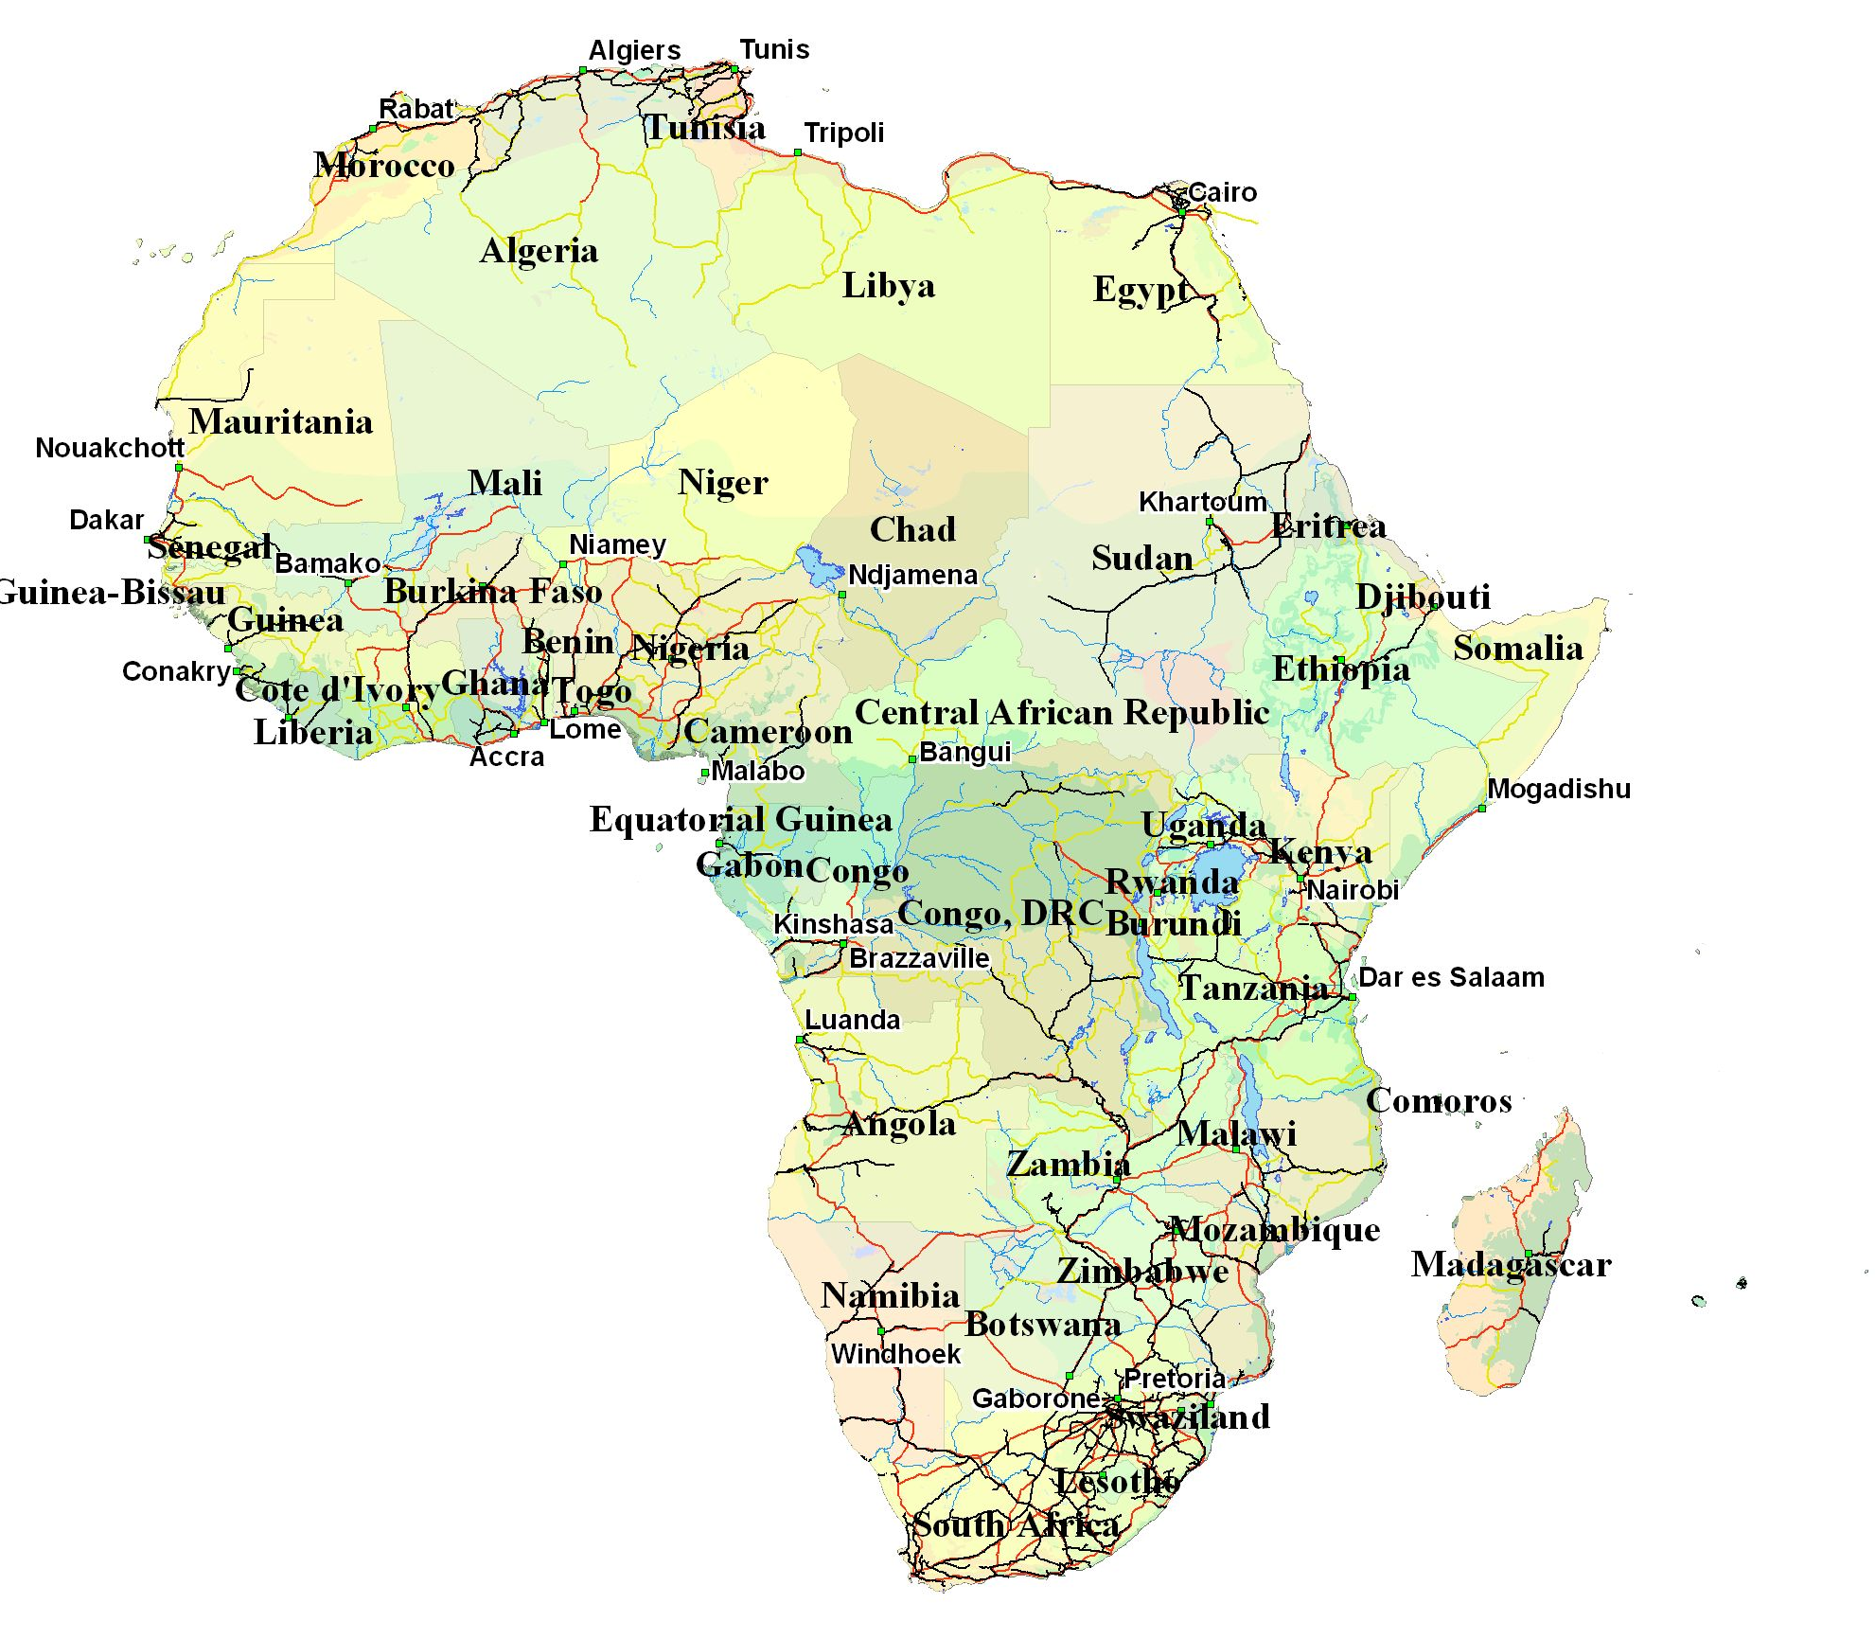
Maghreb Coastal
Niger: Dakar –
Port Harcourt
NEPAD indicative Spatial Development Program First Pass!
Red Sea - Nile
Djibouti
Conakry
Buchanan
Sekondi
Ougadougou
Douala
Mombasa
Gulf of Guinea
Coastal
Libreville Lomie
Madagascar
Bas Congo
Current SDIs
RSDIP
NEPAD SDP: 1st Pass

Slide 33
How to avoid failures
Establish and operate a PPP Unit with:
qualified and experienced in project management
well remunerated multidisciplinary staff
Professional and Politically independent to :
Prepare projects, bid documents and manage bid process
Negotiate contact and monitor implementation and operation

Slide 34
How to avoid failures C’tnued
Transaction advisers hired on long term basis
Must have contingency plan and rescue package
Guarantees and performance bond
Performance indicators and penalty for noncompliance
Mechanisms for sharing excessive profits

Slide 35
Future work
Development of local capital markets:
Pension funds
Insurance contracts
Stock exchanges

Slide 36
Conditions for Successful PPPs
Build effective, transparent & credible regulatory units to root out corruption
Peace and political stability
Clear policies and legal framework
Thorough feasibility studies of bankable projects with risks identified
PPP facilitation units with diverse skills eg. Negotiation skills

Slide 37
Thank you for your attention
jhaule@raha.com
www.roadsfundtz.org

