Slide 1
____________
Presenter(s)
Brian McCollom, NTD Validation Lead
Joseph Eldredge, NTD Validation Analyst
Loucas Lamkin, NTD Validation Analyst

Slide 2
State Reporting Requirements
Report Year 2015

Slide 3
Who Reports?
§5335 (b) – Reporting and Uniform Systems
The Secretary shall:
“award a grant under section…5311 only if the applicant, and any person that will receive benefits directly from the grant, are subject to the reporting and uniform systems.”
(Chapter 53 of title 49, as amended by MAP-21)
Notes:
By 1978, UMTA or FTA required those receiving the 5307 grant for transportation in urban areas to submit data, in accordance with the USOA, to the National Transit Data.
This requirement has since evolved to include those benefitting from the 5311 grant for transportation in Rural Areas.
http://www.dot.ca.gov/hq/MassTrans/Coord-Plan-Res.html

Slide 4
Who Benefits from §5311?
§5311(a) – Definitions
Recipient – a State or Indian tribe that receives a transit program grant directly from the Federal Transit Administration
Subrecipient – a State or local governmental authority, a nonprofit organization, or an operator of public transportation or intercity bus service that receives Federal transit program grants funds indirectly through a recipient.
(Chapter 53 of title 49, as amended by MAP-21)
Notes:
For the §5307 program, funds are apportioned to the Urbanized Area and the Metropolitan Planning Organization decides which agencies will benefit from §5307.
For the §5311 program, the State receives the apportionment, meets the definition for recipient, and becomes responsible for agencies (subrecipients) that receive grant dollars from the state’s apportionment.

Slide 5
Continuing Grant Requirements
Reporting begins the year after a transit agency applies for rural funding, and must continue if:
The transit agency intends to keep 5311 funding applications open;
Assets purchased with 5311 are still within their minimum useful life; and
If a transit agency intends to apply for 5311 in the future.

Slide 6
Types of Data Collected
§5311(b)(4) – Data Collection
“each recipient shall submit an annual report . . . on capital investment, operations, and service provided with funds received under this section, including – ”
(Chapter 53 of title 49, as amended by MAP-21)
Total annual operating costs | Vehicle revenue miles | Fleet size
Sources of revenue | Ridership | Fleet type
Total annual capital costs |  | Related facilities
Notes:
12 consecutive months with the last month ending in the current report year
Data should reflect the agency’s entire operation because FTA wants to collect the full cost of service.

Slide 7
Modes
The most common modes for transportation in rural areas include:
Bus (Fixed, Deviated-Fixed, Both)
Demand Response
Demand Taxi
Vanpool
Subrecipients must follow NTD modal definitions.

Slide 8
Modal Allocation
Data needs to be allocated between the Modes/TOS for:
Operating Costs, Capital Costs, Fare Revenues
Stations/Facilities and Revenue Vehicle Inventory
Allocation Methods
Actual Data
Allocate all data individually
Service Data Variable
Example Use VRM ratio to allocate data

Slide 9
Type of Service
Directly Operated (DO)
Service performed by the reporting transit agency
Purchased Transportation (PT)
Service performed on behalf of another transit agency
Must meet contract criteria to report PT service

Slide 10
Financial Information
Report the total amount of money your agency expends annually.
This information is separated into two categories:
Operating Expenses
Capital Expenses
Expenses are broken out by source of funding used to cover the expense.

Slide 11
How to Record Financial Data
§ 5335 (b) – Reporting and Uniform Systems
Accrual Accounting
Expenses are recorded when incurred, regardless of whether or not receipt of the revenue takes place in the same reporting period
Ex. A passenger buying $10 worth of fare, but only
expending $5.
(Chapter 53 of title 49, as amended by MAP-21)
Notes:
Financial data is based on Accrual Accounting – not a cash basis.
In this example, the passenger has $10 total for fare. However only $5 was expended in 2012. Recording this transaction would show $5 expended in 2012 and $5 expended in 2013.

Slide 12
How to Record Financial Data
§ 5335 (b) – Reporting and Uniform Systems
Accrual Accounting
Expenditures are recorded as soon as they result in liabilities for benefits received, regardless of whether or not payment of the expenditure is made in the same reporting period.
Ex. An employee receives a paycheck 10 days after it was issued. The receipt date is in a new fiscal year.
(Chapter 53 of title 49, as amended by MAP-21)
Notes:
If a calendar year:
The employer owes the employee for 40 hours worth of work for the pay period that includes December 16, 2013 through December 31, 2013 BUT the employee does not receive the paycheck until January 2014. The employer incurred the liability for payment in 2013 and should report that amount as an expense for that year.

Slide 13
Operating Expenses
Subrecipients must report:
The day-to-day expenses of operating and maintaining vehicles; maintaining other equipment, buildings, and grounds.
General administration costs including marketing and customer support; finance and procurement; planning and service development; legal costs.
Capital funds spent on operating activities detailed above, such as preventative maintenance

Slide 14
Operating Expenses
Examples:
Fuel
Salaries, wages, benefits
Utilities – Electric, water
Materials and Supplies
Equipment lease and rental
Cleaning services
Insurance
Taxes

Slide 15
Capital Expenses
Subrecipients must report:
The expenses related to the purchase of equipment where equipment means an article of non-expendable personal property having a useful life of more than one year
An acquisition cost which equals the lesser of
The capitalization level established by the government unit for financial statement purposes
$5,000 (Office of Management and Budget, Circular A87)

Slide 16
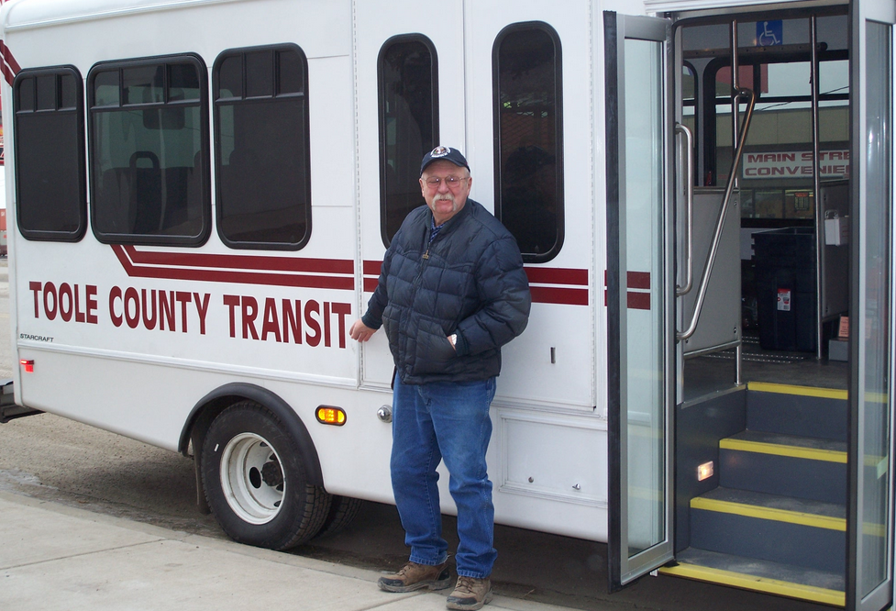
Capital Expenses
Examples:
Vehicles
Maintenance Facilities
Passenger Stations
Machinery
Equipment
Improvements to land

Slide 17
Paying for Expenses
Subrecipients receive funding from different grants and have access to multiple sources of revenue.
When reporting to the State, Subrecipients must:
Report the original source of funds
Report the total amount used for reimbursement NOT the total grant or award.

Slide 18
Revenue-Other Directly Generated
Sources in this category include:
Fares
Contracts
Bus Advertisements
Vending Machines
Donations
Notes:
Contracts – full cost of service

Slide 19
Fares
Most Common Directly Generated Fund
Do not include subsidies or passenger fare assistance
Include university paying for students to ride fare-free
Notes:
Fares – fare passes: what the passenger is obligated to pay
if passenger must pay, and someone else pays it, it is fare

Slide 20
Contracts
Purchased Transportation – provide service on behalf of another agency
Buyer: transit agency purchasing service
Seller: Operator of Service
Criteria
Written contract
Buyer pays full cost of service
Purchased service branded with buyer’s logo

Slide 21
Sources of Revenue
There are four major categories. Subrecipients must report revenues as:
Federal
State
Local
Other (Directly Generated)

Slide 22
State Funds
State programs that support public transportation vary.
This includes State awarded Medicaid Funds

Slide 23
Local
Financial assistance from local entities that support the operation of the transit system. They include, but are not limited to:
Tax levies
General funds
Specified contributions
Notes:
Tax levies: A specified amount from local levies that is dedicated to supporting public transit system operating costs;
General funds: Transfers from the general fund of local governments to cover the Local Share portion of the transit system budget;
Specified contributions: Contributions from city, county or other municipal government towards the Local Share portion of the transit system budget

Slide 24
Service Data
Subrecipients must report revenue miles, revenue hours, vehicles operated in annual maximum service, and unlinked passenger trips for each mode of public transportation operated by the agency.

Slide 25
Revenue Service
This is the time when a vehicle is available to the general public and there is an expectation of carrying passengers. These passengers:
Directly pay fares;
Are subsidized by public policy;
Provide payment through some contractual arrangement
Vehicles operated in fare free service are considered to be in revenue service.

Slide 26
Revenue Service
Layover and recovery time is included. These are the hours scheduled at the end of the route before the departure time of the next trip.
This time is scheduled for two reasons:
To provide time for the vehicle operator to take a break (layover)
To provide time to get back on schedule before the next trip departs if the trip arrives late at the end of the route (recovery).

Slide 27
Revenue Service
The following examples are excluded from revenue service:
Deadhead;
Vehicle maintenance testing;
School bus service; and
Charter service.

Slide 28
Deadhead
The miles and hours that a vehicle travels when out of revenue service. Deadhead includes:
Leaving or returning to the garage or yard facility
Changing routes
When there is no expectation of carrying revenue passengers.

Slide 29
Revenue Miles & Hours
For Miles (VRM), include the miles that vehicles are scheduled to, or actually travel while in revenue service.
For Hours (VRH), include the hours that vehicles are scheduled to or actually travel while in revenue service.

Slide 30
Unlinked Passenger Trips
These are the number of passengers who board public transportation vehicles.
Passengers are counted each time they board vehicles no matter how many vehicles they use to travel from their origin to their destination.

Slide 31
Sponsored Trips
Sponsored service is paid, in whole or in part, directly to the transit provider by a third party.
These services may be offered by transit providers as part of a Coordinated Human Services Transportation Plan.
Common sponsors include the Veterans Administration, Medicare, sheltered workshops, The Arc, Assisted Living Centers, and Head Start programs.

Slide 32
Vehicles Operated in Maximum Service
The number of revenue vehicles operated to meet the annual maximum service requirement. This is the revenue vehicle count during the peak season of the year; on the week and day that maximum service is provided.
Vehicles operated in maximum service (VOMS) exclude:
Atypical days
One-time special events

Slide 33
Safety Data
Reportable Events:
Event occurring on transit property or otherwise affecting revenue service that results in one or more of the following conditions:
Fatality
Injury
Property Damage equal to or exceeding $25,000
Fatalities
A fatality confirmed within 30 days of the incident
Injuries
An incident that requires immediate medical attention away from the scene

Slide 34
Asset Data
Revenue Vehicle Inventory Data
Number of vehicles in total fleet
Vehicle type
Vehicle length
Seating capacity
Year of manufacture
ADA-accessible vehicles
Ownership
Maintenance Facilities
Number of facilities
Ownership

Slide 35
NTD 2.0
NTD Online Reporting

Slide 36
NTD Legacy (“Old System”)
Now only Safety & Security reporting
Annual/Monthly data for prior report years can still be accessed
Will eventually only be accessible in new reporting system (Forms Library and e-file Library)

Slide 37
NTD Legacy

Slide 38
NTD 2.0
New online reporting system
First of FTA reporting application to move to FACES environment
Launched for Report Year 2014
Monthly Ridership launched Oct. 2014
Annual Reporting launched Dec. 2014
Notes:
TEAM will remain in operation during FY 2015
Grant-making with TrAMS will begin in FY 2016

Slide 39
NTD 2.0

Slide 40
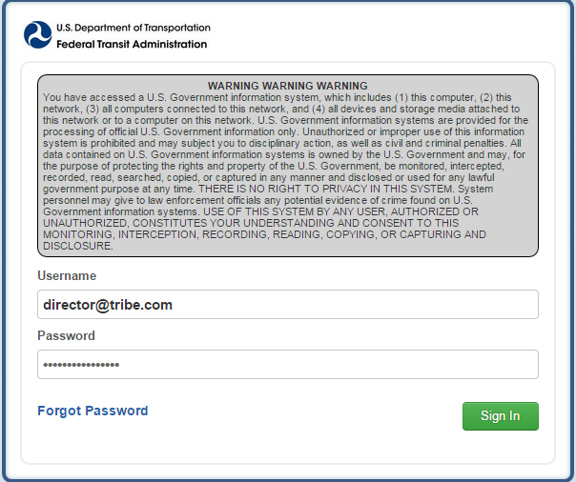
Logging in
Notes:
NTD 2.0: Can request password reset online

Slide 41
Local System User Manager
Create/manage accounts for new users of FTA systems at respective agencies
NTD 2.0
TRAMS (in development)
FTA requires each agency to identify a LSUM for authentication
Templates available online
Mail/email/fax signed letter to NTD Ops center or Help-Desk

Slide 42
User Manager Account
User Managers will receive an email notification once the account has been created
Hello User Manager,
A new user account has been created for you on the FTA Reporting Environment.
You may log on at www.ntdprogram.gov
Your Username is usermanager@test.org
Please visit the above URL and click the “Forgot Password” link, this will bring you to a prompt to create your password.
Thank you
Notes:
Registered User Managers receive email

Slide 43
Interface overview
NTD Online Reporting

Slide 44
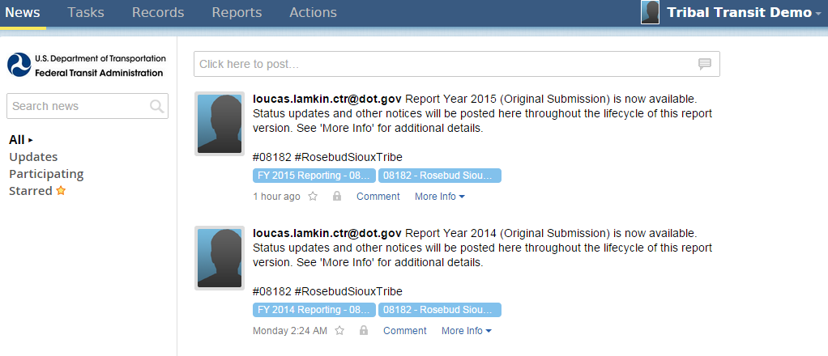
All users land on the News feed
Posts from NTD staff will display here

Slide 45
Tasks are assigned to CEOs and NTD Contacts

Slide 46
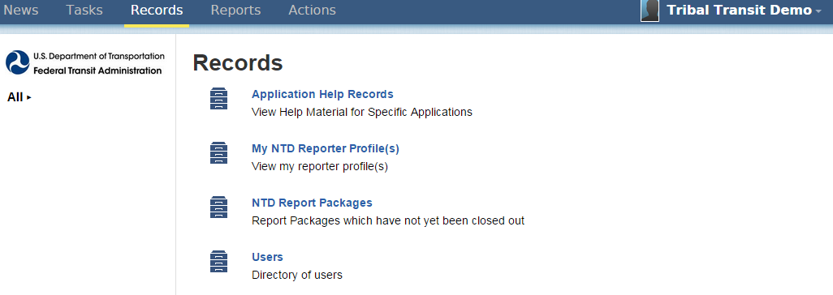
Reporting forms and profiles are accessed through “Records”

Slide 47
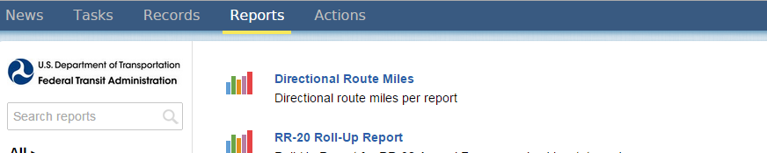
Various data reports are available here depending on reporter type, user group

Slide 48
System Actions will appear here based on privileges

Slide 49
Click your name to update your user record or change account password

Slide 50
Navigating NTD 2.0
NTD Online Reporting

Slide 51
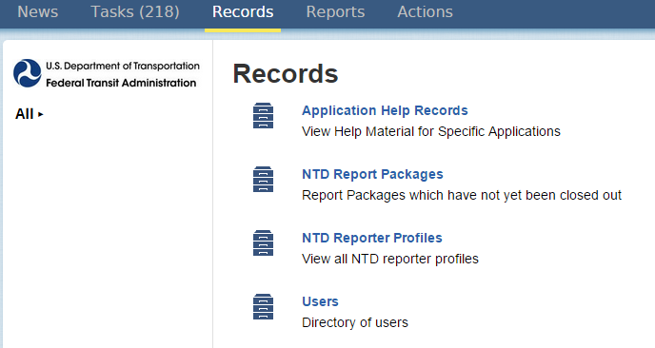
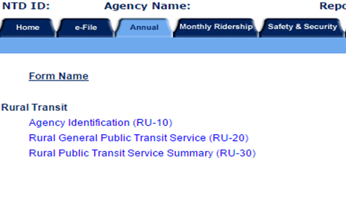
Accessing the NTD Report
The “Records” tab functions like the Legacy system’s “Annual” tab
Notes:
Profile houses basic agency information that doesn’t regularly change
Report package is report submitted annually

Slide 52
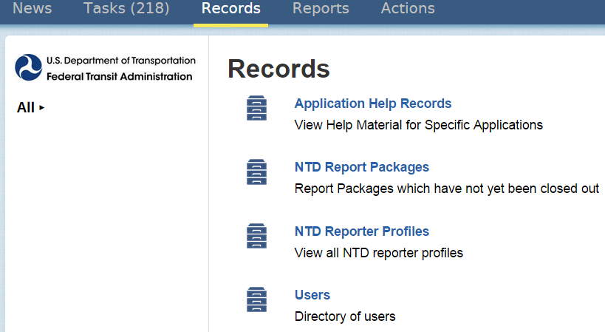
Information is now separated into two categories
Profiles
Report Packages

Slide 53
Profile is accessed through “My NTD Reporter Profile(s)”

Slide 54
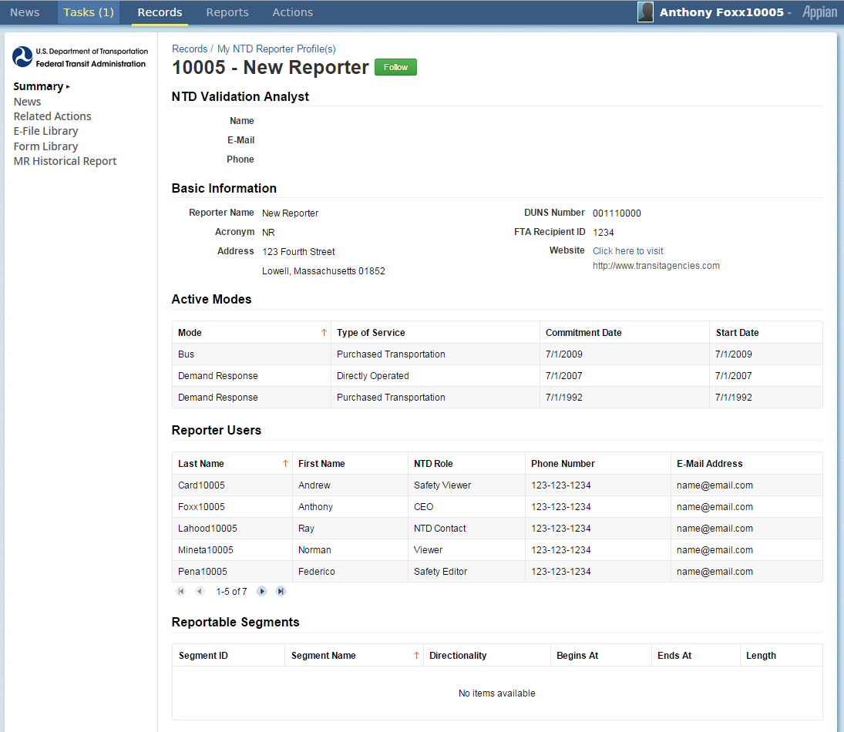
My NTD Reporter Profile(s)
All NTD Reporters now have a unique profile
Main page of profile is a “Summary”
Links to editable profile info on left hand side
Notes:
Every NTD Reporter, be it a Full Urban, Small Urban, Subrecipient, State 5311 Recipient, now has a unique profile

Slide 55
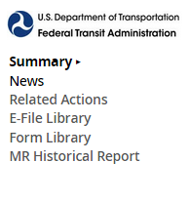
Profile Links
Information accessed via profile
Profile forms
Form Library (printable version of previous reports)
E-File Library (previous closeout letters and reporter requests)
Notes:
Every NTD Reporter, be it a Full Urban, Small Urban, Subrecipient, State 5311 Recipient, now has a unique profile

Slide 56
Profile Forms
Make sure all profile forms are up to date before beginning annual report
…click a form to edit
From Related Actions…

Slide 57
Annual and monthly reporting forms are accessed through “NTD Report Packages”

Slide 58
Report Package
A “Report Package” contains all the forms required for annual reporting
The Report Year will be indicated before the name of the agency
Once you complete report year kickoff, the report for the given report year will be available

Slide 59
Report Year “Kickoff”
Generates the report package and all necessary forms for the current report year.
Confirm info at the beginning of each report year:
Agency contacts or “Users”
Modes operated during given report year
Note: adding an end date indicates that service has been terminated and will not be included in the follow year’s report
Reporter type (e.g., small systems waiver)
Note: all information edited at kickoff can be edited again later through the Profile, with the exception of Reporter Type.

Slide 60
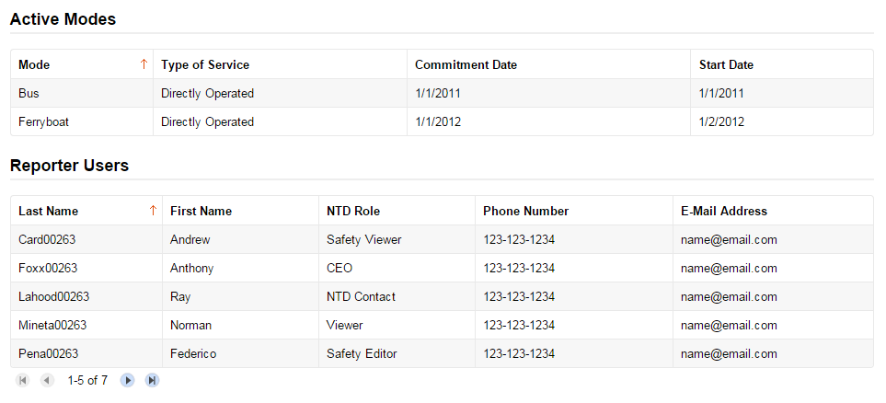
How to Complete Report Kickoff
All new user accounts begin as Viewers
Note: User Managers also fulfill an NTD role.
Like the Legacy system, users are designated roles with varying permissions

Slide 61
How to Complete Report Kickoff
Click to Edit Role to CEO or NTD Contact accordingly

Slide 62
How to Complete Report Kickoff
Click on 2015 Report Kickoff task

Slide 63
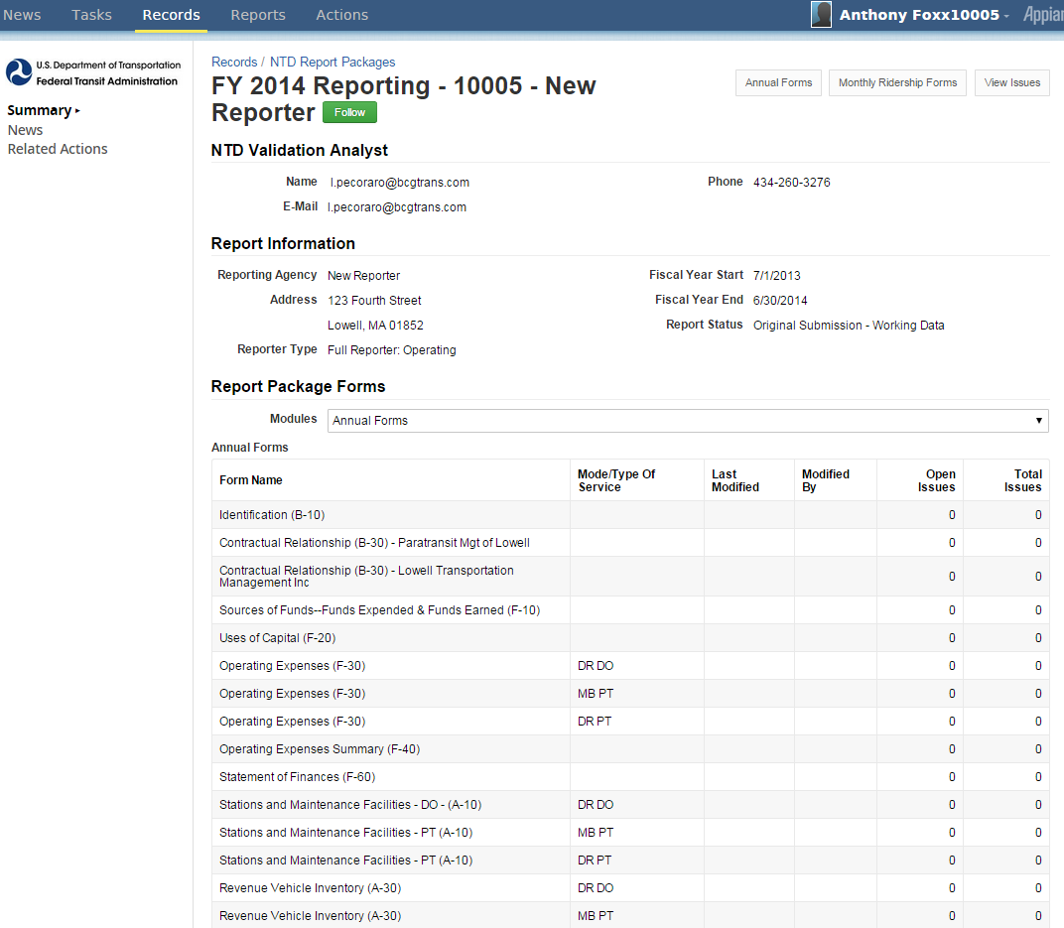
Report Package
Main page of package is a “Summary”
Links to editable profile info on left hand side
Notes:
Every NTD Reporter, be it a Full Urban, Small Urban, Subrecipient, State 5311 Recipient, now has a unique profile

Slide 64
Reporting Outline
NTD Online Reporting

Slide 65
Urban Full Reporter
Identification (B-10)
Contractual Relationship⁺ (B-30)
Uses of Capital* (F-20)
Operating Expenses* (F-30)
Operating Expenses Summary (F-40)
Statement of Finances (F-60)
Stations and Maintenance Facilities* (A-10)
Revenue Vehicle Inventory* (A-30)
Service* (S-10)
Employees* (R-10)
Maintenance Performance (R-20)
Federal Funding Allocation and Statistics* (FFA-10)
CEO Certification (D-10)
*one per mode and type of service
⁺per contractual relationship, if applicable

Slide 66
Urban Small Systems Reporter
Identification (B-10)
Stations & Maintenance Facilities* (A-10)
Revenue Vehicle Inventory* (A-30)
Reduced Reporting (RR-20)
Federal Funding Allocation Statistics* (FFA-10)
CEO Certification (D-10)
*one per mode and type of service

Slide 67
Rural General Public Subrecipient
5311 or future 5311 subrecipients (no 5307)
Identification (B-10)
Stations & Maintenance Facilities* (A-10)
Revenue Vehicle Inventory* (A-30)
Reduced Reporting (RR-20)
*one per mode and type of service
*not required for Intercity or separately reporting subrecipients

Slide 68
Rural General Public Transit
2013
2014
RU-20
Basic Information – Moved to Profile Modes – Moved to Profile Financial Information – Total Annual Expenses & Sources of Revenue Expended Asset and Resource Information – Number of Active Vehicles in Fleet, Vehicle Length, Seating Capacity, Year of Manufacture, Largest Funding Source for Purchase, ADA accessible Vehicles, Ownership Facilities Information – Number of General Purpose Maintenance Facilities Other Resources – Volunteer Drivers & Personal Vehicles Service Data – Vehicle Revenue Miles, Vehicle Revenue Hours, Regular Unlinked Passenger Trips, Sponsored Unlinked Passenger Trips Safety Data – Reportable Incidents, Fatalities, Injuries
B-10 – Identification Form
Organization Type, Fiscal Year Start and End
A-10 – Stations and Maintenance Facilities
Number of facilities, allocated by usage Owned, Leased by Public, or Leased by Private
A-30 – Revenue Vehicle Inventory
Total Vehicles in Fleet, Active Vehicles in Fleet, Used by Another Mode Updated Funding Sources and Ownership Type
RR-20 – Reduced Reporting
Financial Information Total Funds Expended, Sources of Revenue Expended Other Resources – Volunteer Drivers & Personal Vehicles Service Data – Broken out by Mode VRM, VRH, UPT, Sponsored UPT, Vehicles Operated in Maximum Service Safety Data – Reportable Events, Fatalities, Injuries

Slide 69
Intercity Bus
2013
2014
RU-21
Basic Information – Moved to Profile Modes – Intercity Bus “mode” Financial Information – Total Expenses from 5311 Service Data – Vehicle Revenue Miles & Unlinked Passenger Trips if applicable
B-10 – Identification
Organization Type, Fiscal Year Start and End
RR-20 – Intercity Bus
Financial Information – Total Expenses from 5311 Funding Service Data – Vehicle Revenue Miles & Unlinked Passenger Trips if applicable

Slide 70
Directly Reporting Subrecipients
2013
2014
RU-22 (Rural) or RU-23 (Urban)
Basic Information – Moved to Profile Financial Information – Total Expenses from 5311
B-10 – Identification
Organization Type, Fiscal Year Start and End Non-editable data imported from agency B-10
RR-20 – Urban/Tribal Subrecipient
Financial Information – Total Expenses from 5311

Slide 71
Multi-State Subrecipients
2013
One State Reports RU-22, One Reports RU-20
2014
Both States Report General Public Transit Report Package
State #21- RU-20 Form
Reports complete RU-20 for entire agency
State #1 – B-10, A-10, A-30, & RR-20
Financial, Service Data, and Safety Data – Specific to State #1 Reports Assets and Facilities for the entire agency
State #2 - RU-22 Form
Reports State #2 financial contribution towards Total Operating Expenses by source of revenue
State #2 – B-10, A-10, A-30, & RR-20
Financial, Service Data, and Safety Data – Specific to State #2 Does not report any assets or facilities in the A-10 or A-30

Slide 72
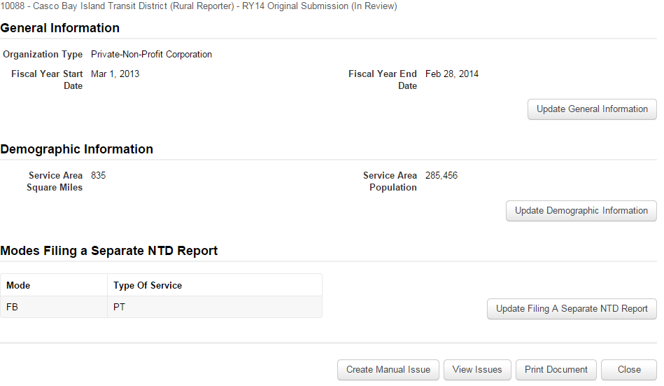
Identification (B-10)

Slide 73
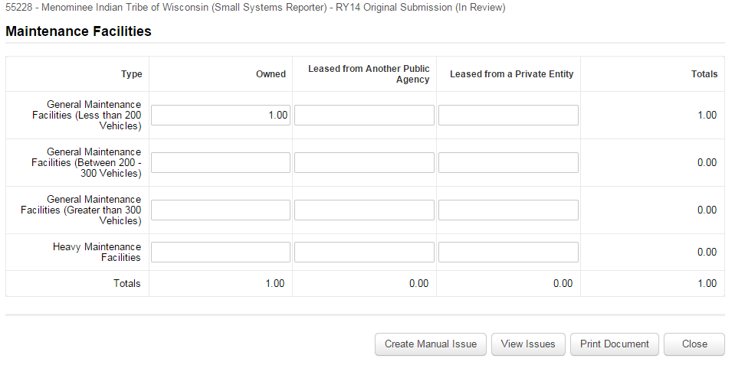
Stations and Maintenance Facilities (A-10)
Notes:
If facility is used by more than one mode, prorated portions must be entered on each A-10. Use vehicles per mode as allocation variable
For example, if one garage services vehicles for both Motor Bus and Demand Response, then each A-10 would have 0.5 of a facility.

Slide 74
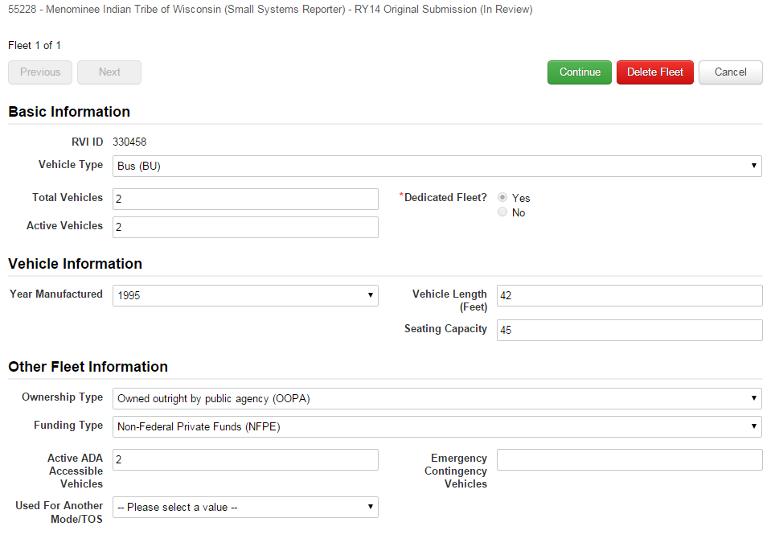
Revenue Vehicle Inventory (A-30)

Slide 75
Reduced Reporting (RR-20)
Total annual expenses

Slide 76
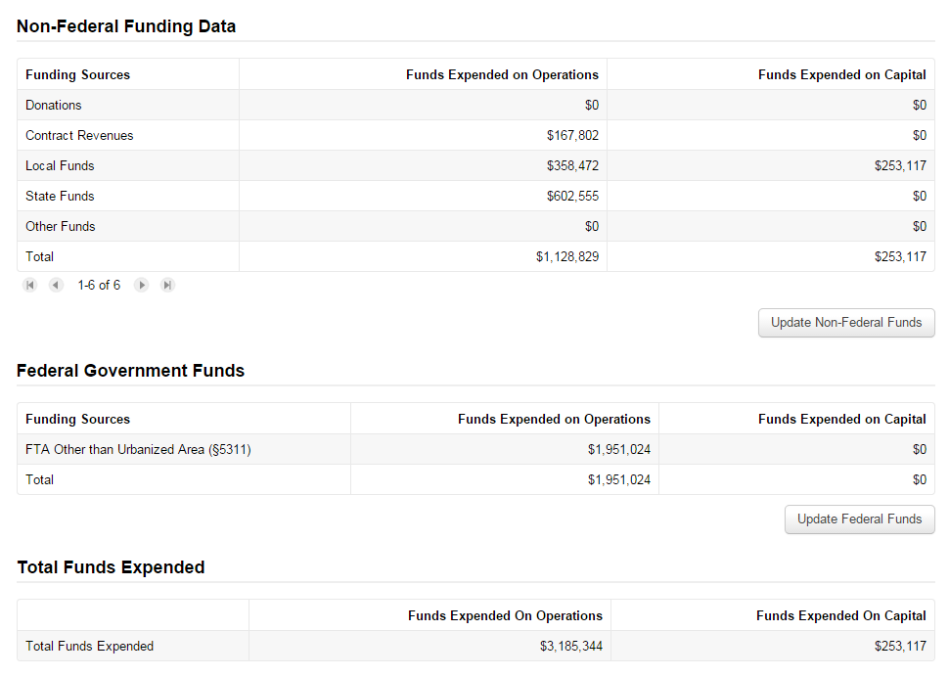
Reduced Reporting (RR-20)
Total Funds Expended must match Total annual expenses

Slide 77
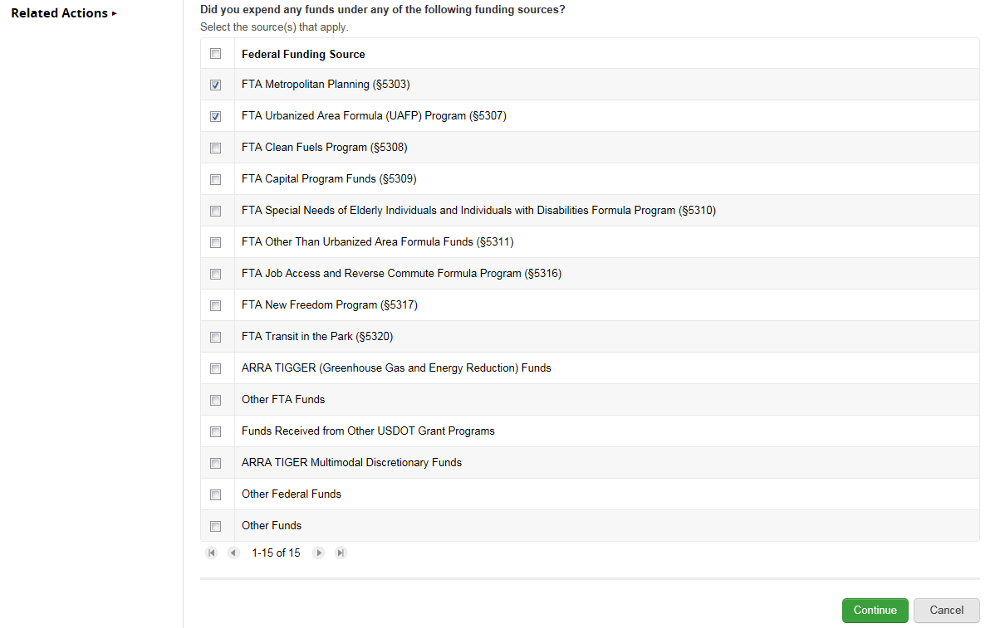
Customized Federal Funds

Slide 78
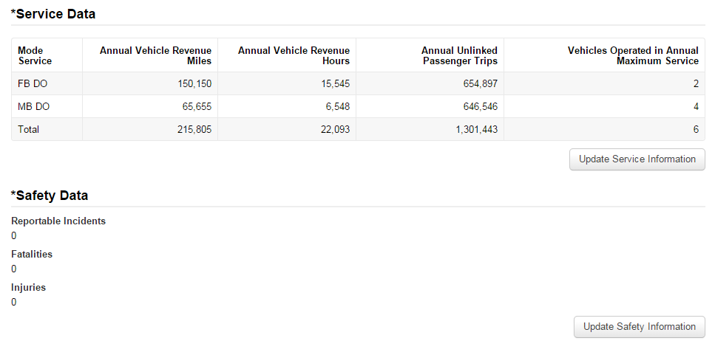
Reduced Reporting (RR-20)
Vehicles Operated in Annual Maximum Service (VOMS) = total number of revenue vehicles on the road during peak service

Slide 79
System Actions
NTD Online Reporting

Slide 80
Logging in for the First Time
Use same process as “Forgot Password”
Forgot Password
Make sure to verify with User Manager that your account has been created
If you don’t know who your agency’s User Manager is, contact NTD HelpDesk
Notes:
All new users are required to create their first password. The Appian system provides notice that a new account was created and provides a link for logging in. If that email is unavailable, all users can navigate to

Slide 81
Editing Roles
When Users are added to the system, the default NTD Role is “Viewer”.
Only the User Manager can assign NTD Roles until a CEO or NTD Contact is defined.
Edit Role

Slide 82
Reassigning Roles
Only one User at a time can fill the CEO or NTD Contact Roles.
If NTD Roles need to be reassigned, the user currently filling the NTD Contact Role will need to be changed to Editor first.
Only UMs, CEOs and NTD Contacts can change NTD Roles.
Reassigning NTD Roles

Slide 83
Adding New Users to your Report
Open Records and go to Profiles. Click Related Actions and then open the link for View and Manager Reporter Users (P-30).
Only User Managers (UM) can add new users to your agency.
Add New Users

Slide 84
Managing Subrecipients
Navigate to State Report Package > Related Actions > Manage Subrecipients
Add/Remove Subrecipients
Only CEO/NTD Contact can add/remove subrecipients.
Subrecipients not previously reporting to NTD require approval by analyst before creation

Slide 85
Managing Modes
All modal information is maintained the agency’s profile (P-20 form)
Add a New Mode
Edit a Mode

Slide 86
Creating Reporter Requests
Requests include Extension Requests, FY End Date Change Request
The CEO for your agency must create requests.
Enter an explanation for your request and you can also upload a document as well. When finished, click submit.
http://screencast.com/t/K7fTf2CK

Slide 87
Submitting Annual Report
On State Report Package summary page, click “Related Actions” to find submission link
Ensure all required fields on all forms are complete, forms have been properly saved & closed.
Report Submission

Slide 88
Questions?

