Slide 1

Rural National Transit Database (NTD)
2012 Report
Lauren Tuzikow
Program Analyst

Slide 2
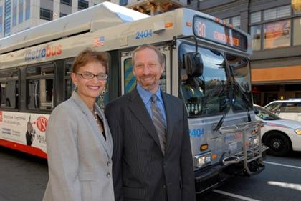
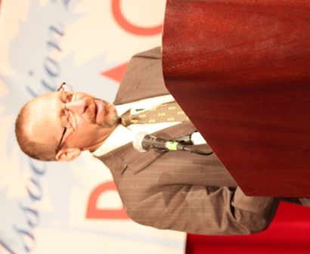
Agenda
Rural Reporting Basics
  Introduction
NTD System Overview
  Internet Reporting
Forms
  State / Tribe
    RU-10, 30
  Subrecipient
    RU-20, 21, 22, 23

Slide 3
Introduction
Rural Reporting Basics

Slide 4

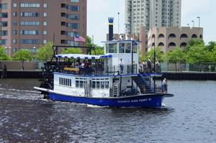
2012 Changes: Introduction
Changes
  MAP-21
  Apportionment
    Rural
    Tribal
Clarifications
  Shared ride
  Sources of funds applied
Introduction

Slide 5
SAFETEA-LU Law
5335 (a) National Transit Database
  Amended by MAP-21
5335 (b) Reporting and Uniform Systems
  The Secretary may award a grant under Section 5307 or 5311 only if the applicant, and any person that will receive benefits directly from the grant, are subject to the reporting and uniform systems.
Introduction
Notes:
Amended to include additional Capital Asset Inventory and Conditions Report
Not implemented ASAP but there will be a Notice and comment period for all changes

Slide 6
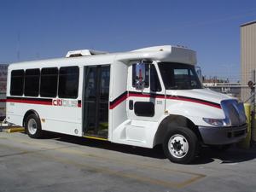
Requirements
Data Collection
  Each recipient under this section shall submit an annual report to the Secretary containing information on capital investment, operations, and service provided with funds received under this section, including:
    Total annual revenue
    Sources of revenue
    Total annual operating costs
    Total annual capital costs
    Fleet size and type, and related facilities
    Revenue vehicle miles
    Ridership
Introduction

Slide 7
Who Reports: Full Report
A State/Tribe completes a full report on behalf of all subrecipients each year
  Receives 5311 funds from the State/Tribe in the current year
  Benefits from Capital Assets purchased with 5311 funds
    Vehicles: up until the FTA minimum useful life
    Facilities: until replaced
“No Yo-Yo” Rule
Introduction

Slide 8
Who Reports: Limited Report
A State/Tribe completes a limited report on behalf of
  Intercity Bus providers – 5311(f) set aside
    Private for profit providers
  Subrecipients providing NTD with a full report
    A directly reporting Indian Tribe
    A subrecipient submitting an urban NTD report
      including those receiving a Small Systems Waiver
Introduction

Slide 9
What to Report: Full Report
For each subrecipient not reporting directly to the NTD
  A complete report of all transit operations
  Data including
    Basic identification information
    Financial information
    Non-financial information
Introduction

Slide 10
What to Report: Limited Report
For each subrecipient reporting directly to the NTD
  A reduced report
  Data including
    Basic identification information
    Financial information (5311 funds)
Introduction

Slide 11
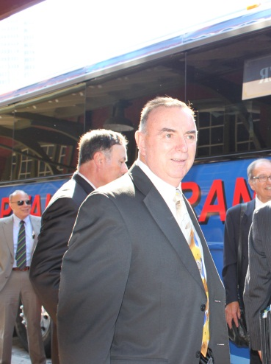
State/Tribal Forms
These forms are completed by the
State or Tribe administering the
5311 funds
  RU-10: Agency Identification
    Agency information
    Contact information
  RU-30: Rural Public Transit Service Summary
    Counties
    Admin expenses
Introduction

Slide 12
Subrecipient Forms
RU-20: General Public Transit Service
  Used to report a full subrecipient report
RU-21: Intercity Bus
  Subrecipients of 5311(f) funding
RU-22: Rural Recipient Reporting Separately
  Subrecipients reporting elsewhere in the rural NTD
    Examples: Tribes, subrecipients of 2 States
RU-23: Urban Recipient
  Subrecipients reporting directly to the urban NTD
Introduction

Slide 13
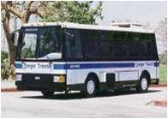
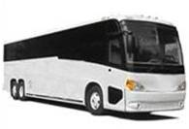
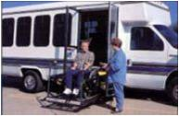
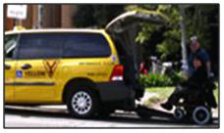

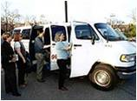
Modes
Bus
(MB)
Commuter
Bus (CB)
Intercity Bus
(IB)
Demand
Response
(DR)
Taxi
(DT)
Ferryboat
(FB)
Vanpool
(VP)
Introduction

Slide 14
Bus
Most prevalent mode in the country
Powered by a motor and fuel contained within vehicle
Includes:
  Fixed-route
  Deviated-fixed-route
  Both
Introduction

Slide 15
Commuter Bus
Bus service that operates:
  At least five miles of continuous closed-door service
  Typically using motor coaches (aka over-the-road buses)
  Usually connects outlying areas to a central city
Use this mode for publicly-operated 5311(f) services that do not qualify for the IB Mode and RU-21 reporting
Introduction

Slide 16
Intercity Bus
Uses over-the-road bus
Operates limited stops between
  2 urbanized areas or
  Connecting rural areas to an urbanized area
Private for-profit provider
Subrecipients of intercity bus set-aside funds
  49 USC 5311(f)
Introduction

Slide 17
Demand Response
Scheduled in response to passenger calls
Passengers with similar origins/destinations scheduled to ride the same vehicle
Includes door-to-door and curb-to-curb services provided in response to specific requests
Characterized by being a shared ride service
Introduction

Slide 18
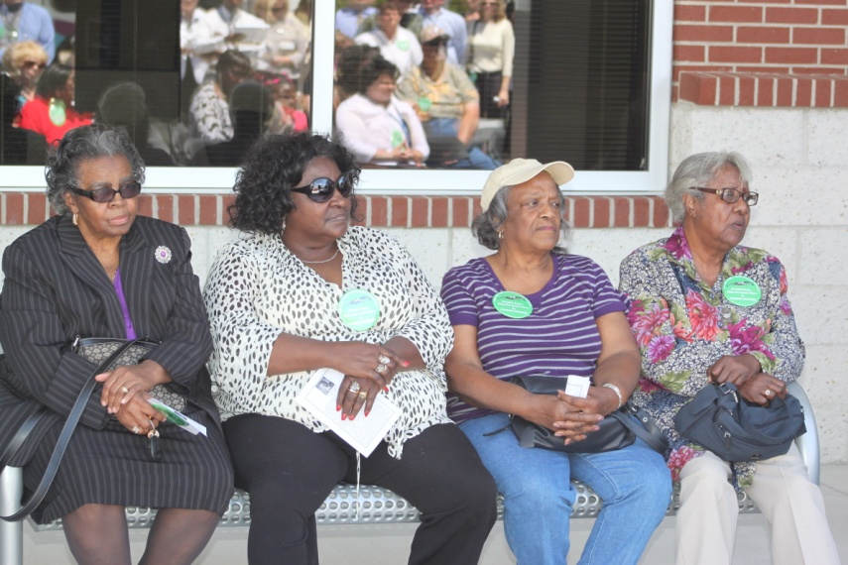
Demand Response Taxi
A special form of demand response mode operated through taxicab providers
  Uses commercial taxi companies with non-dedicated fleets for regular service
  No deadhead
Introduction

Slide 19
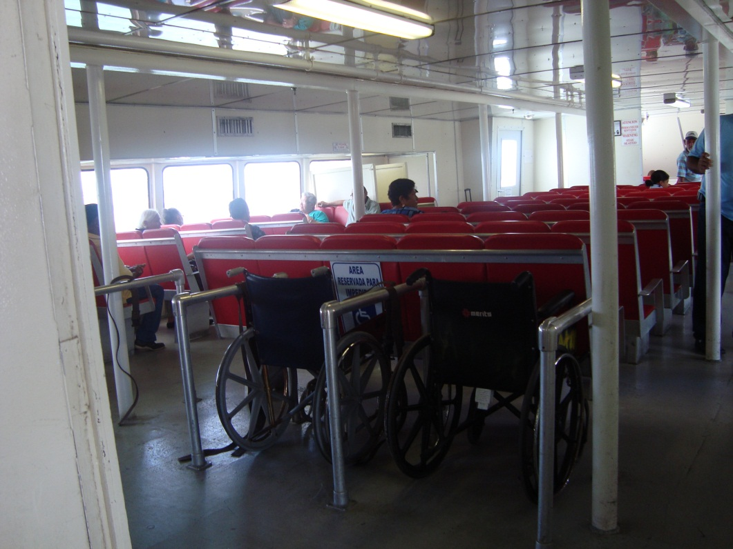
Ferryboat
Vessels carrying passengers over water
Excludes intercity ferryboat (FB) service
Introduction

Slide 20
Vanpool
Commuting service operating under prearranged schedules for previously formed groups of riders
Uses vans
One rider serves as a driver
Use bus mode if paid driver
Introduction

Slide 21
State/Tribe Reporting Deadlines
If the State/Tribe fiscal year ends between:
State’s/Tribe’s report is due:
Jan. 1 – June 30, 2012
*November 30, 2012
Oct. 1 – Dec. 31, 2012
April 30, 2013
January 31, 2013
July 1 – Sept. 30, 2012
Introduction

Slide 22

Fiscal Years
First preference is use data collected
for existing State/Tribal Reports
May request to report according to
their own schedule/reporting periods
  Must meet the following conditions:
    For current NTD Report Year (RY)
    Data for consecutive 12 month period ending in RY
    Meet overall program deadlines
      Example: If all subrecipients report by calendar year while the State’s fiscal year ends June 30
Introduction

Slide 23
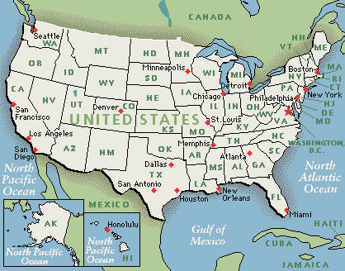
Recipient NTD ID
Automatically assigned
Remains the same for each
Report Year (RY)
4 digit Rural NTD ID
  State (54): #R##
  Tribe (81*): #T##
    1st character: Region
    2nd character: State (R) or Tribe (T)
    3rd and 4th character: ID’s State/Tribe in Region
* Estimate
Introduction

Slide 24
Subrecipient NTD ID
Unique Rural NTD ID for each subrecipient
Automatically assigned
Remains the same for each RY
# R # # - # # # or # T # # - # # #
  1st set of characters: ID State or Tribe
  2nd set of characters: ID subrecipient
  in State/Tribe
    Example: 3R03-040
      3R03: State – Maryland
      040: Subrecipient – Howard County Government

Slide 25

NTD System Overview
Internet Reporting

Slide 26
2012 Changes: Internet Reporting
Changes
  None
Clarifications
  Vehicle Revenue Miles are now used to apportion
  Section 5311 funds (be sure they are correct)
Internet Reporting

Slide 27
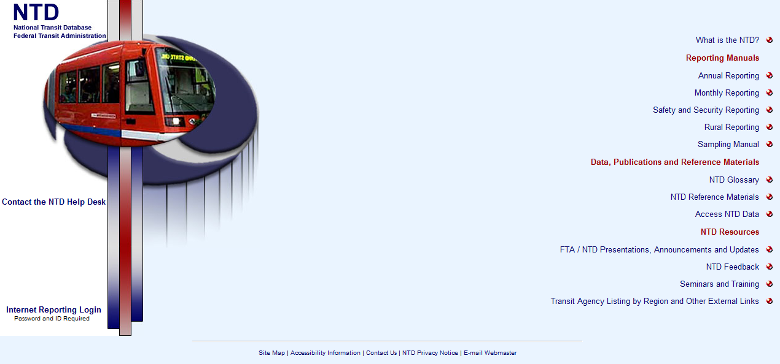
www.NTDprogram.gov
Internet Reporting

Slide 28
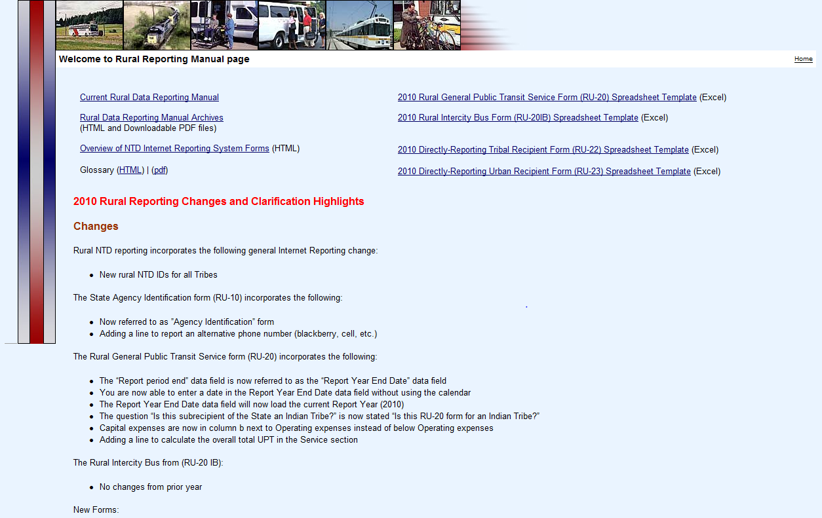
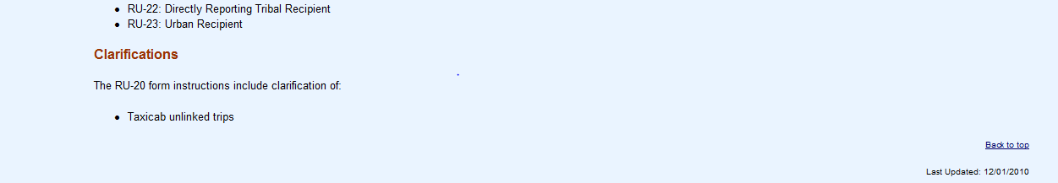
Rural Reporting
Manual
Templates
Internet Reporting

Slide 29
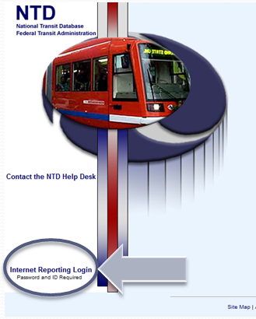
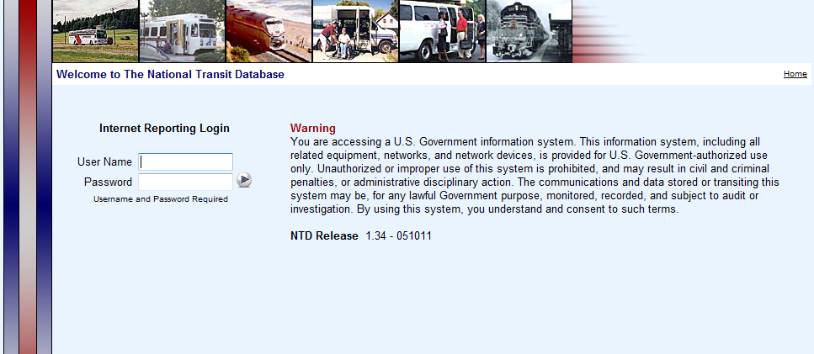
Internet Reporting Login
NTD Home: Click here to login into the system
Entering you user name and password
Internet Reporting

Slide 30



Internet Reporting Tips
Username and password are case sensitive
10 minutes inactivity – automatic login out
  Save frequently
    After each data field or section
Use Internet Reporting features to navigate the system
  Do not use your internet back and forward arrow
Internet Reporting

Slide 31
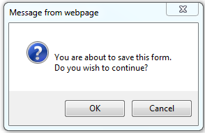
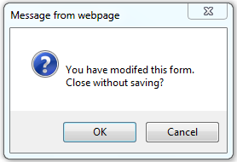

Internet Reporting Tips: Continued
Read all pop-up boxes
  They notify you of any errors
  Help to avoid closing without saving
Use Internet Explorer
Internet Reporting

Slide 32
Username and Password
Basics
Access levels
Contact your rural analyst to obtain your username and password
DIR and RUR determined by RU-10
RUR receives EDT and VRW passwords
Director of the Transit Unit
  DIR#R## or DIR#T##
Rural Contact
  RUR#R## or RUR#T##
Editor
  EDT#R## or EDT#T##
Viewer
  VRW#R## or VRW#T##
Internet Reporting

Slide 33
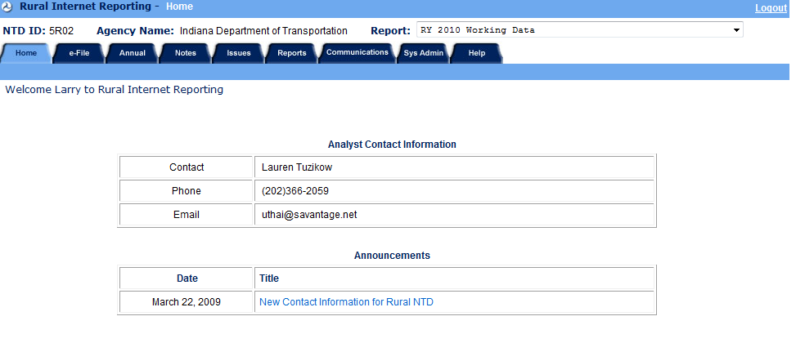
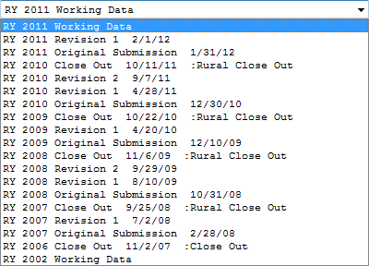
Home Tab: Overview
NTD ID
Agency Name
Report drop down
Contact info
Announcements
Logout
Navigate
Lauren.Tuzikow@dot.gov
Internet Reporting

Slide 34
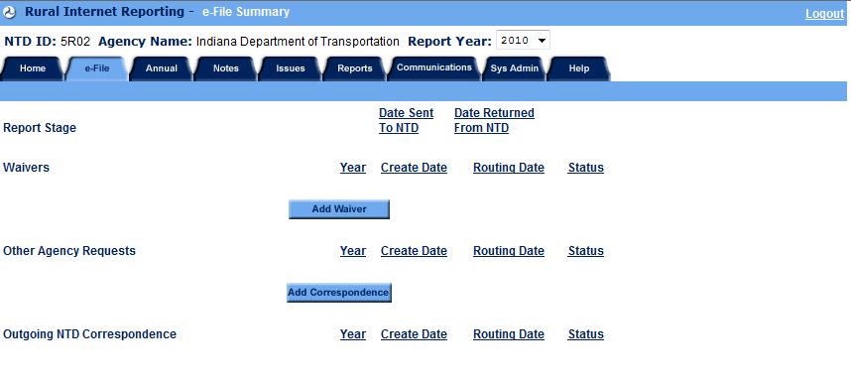
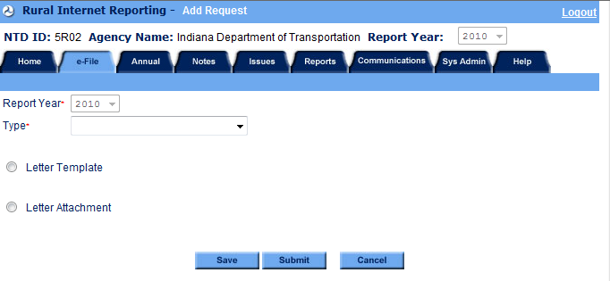
e-File Tab: Overview
Internet Reporting

Slide 35
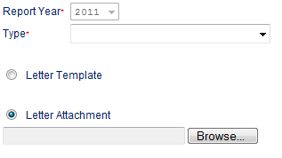
e-File: Attaching
Click under the correct section
Make a selection from the “Type” drop down
Select
Click
Select the file
  Double click or click then open
Click
  Returns to the e-file tab after saving
Internet Reporting

Slide 36
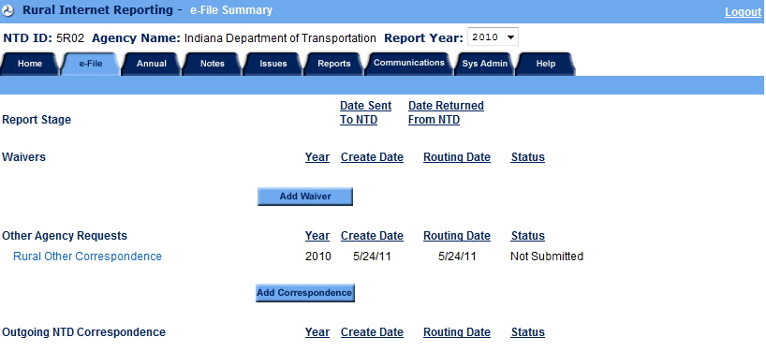
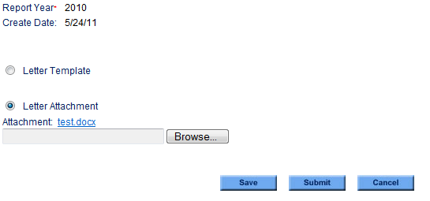
e-File: Submitting
Must login with the
DIRxxxx username
Click on the
attached
correspondence
  Below the
  section header
  In bright blue font
Click in the
middle of the screen
Internet Reporting

Slide 37
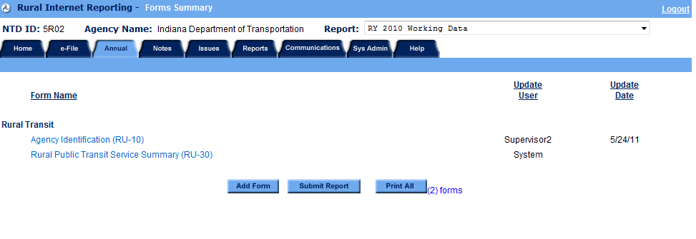
Annual Tab: Overview
Only displays the RU-10 at start of RY
System
mm/dd/yy
Add Form
Select Form
Select Subrecipient
Print All
All Forms
Submit Report
DIR
RUR
Internet Reporting

Slide 38
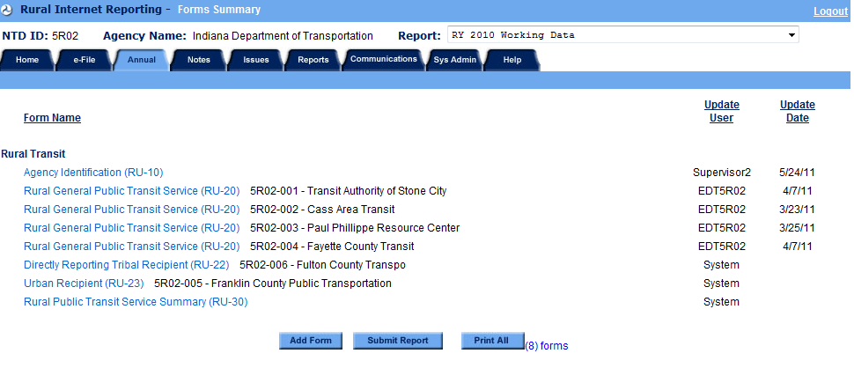
Annual Tab: Your Report
Save the RU-10 to populate 2011 closeout subrecipient forms
System
System
System
System
System
System
System
Internet Reporting

Slide 39
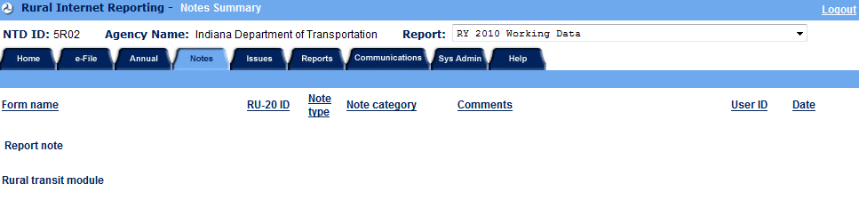
Notes Tab: Overview
Internet Reporting

Slide 40
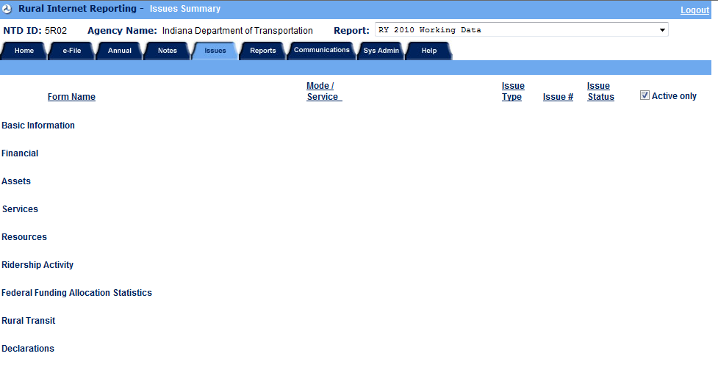
Issues Tab: Overview
No automated issue checks for the 2012 RY
Internet Reporting

Slide 41
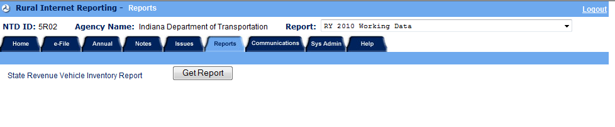
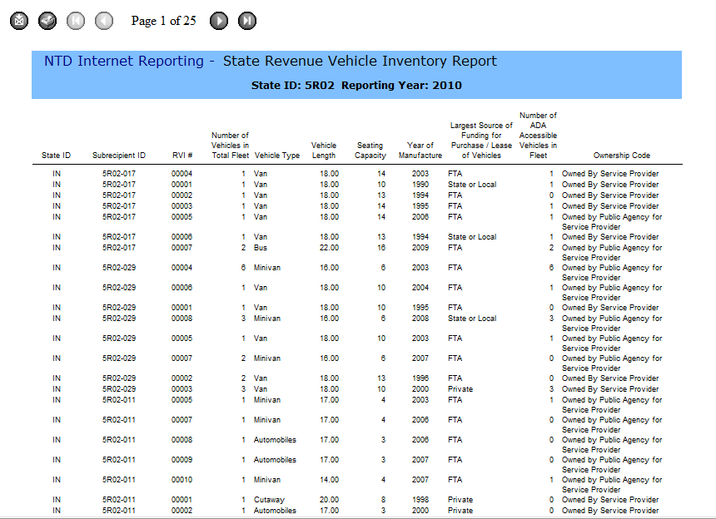
Reports Tab: Overview
Internet Reporting

Slide 42
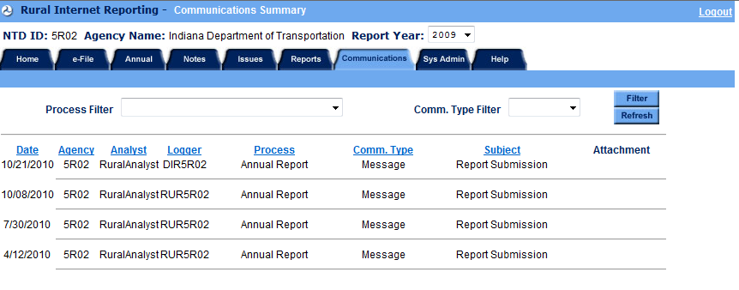
Communications Tab: Overview
Internet Reporting

Slide 43
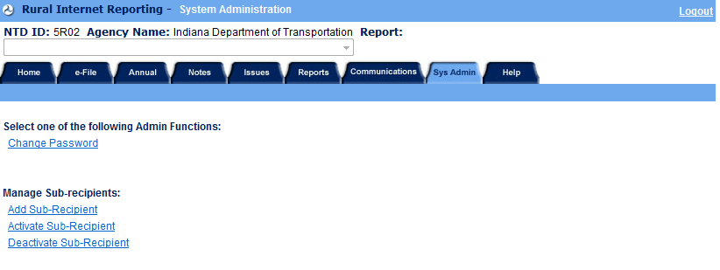
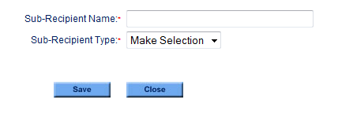
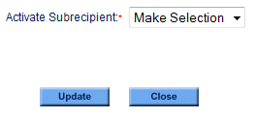
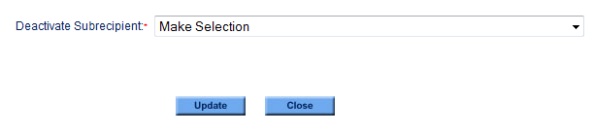
Sys Admin Tab: Overview
Internet Reporting

Slide 44
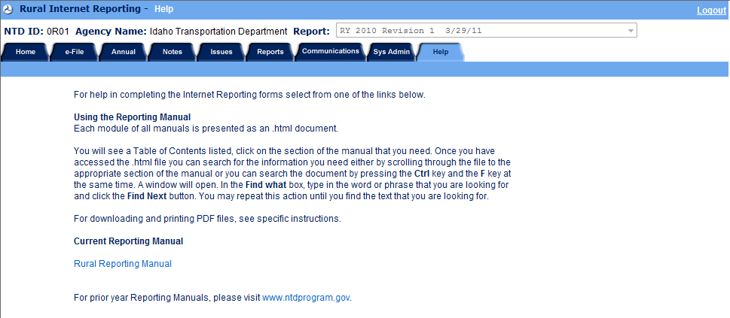
Help Tab: Overview
Internet Reporting

Slide 45
Recipient (state / Tribe)
Forms

Slide 46
RU-10
Agency Identification Form

Slide 47
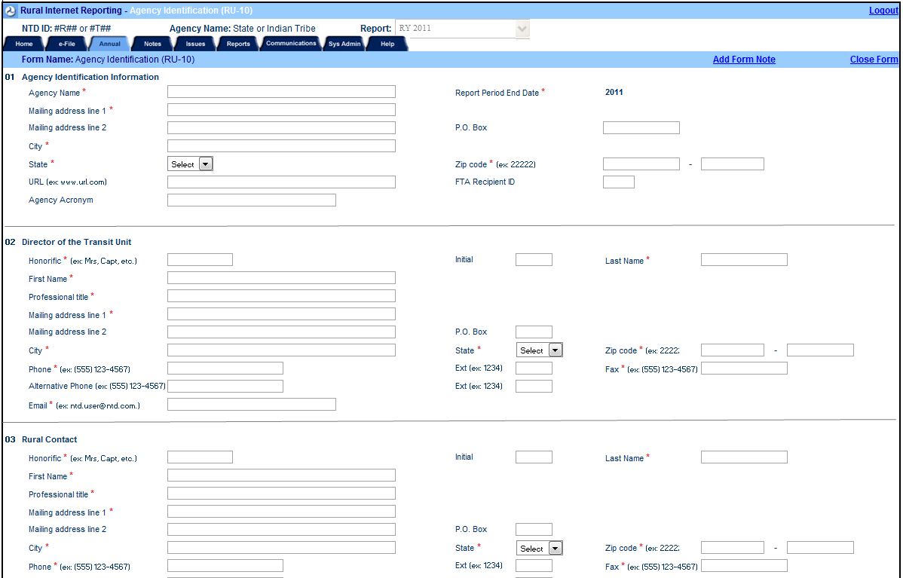
Agency Identification Form: RU-10
Pre-loaded with 2011 closeout data
RU-10

Slide 48
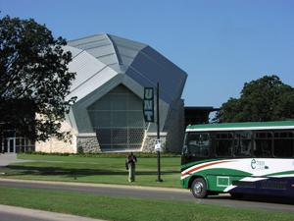
2012 Changes: RU-10
Changes
  None
Clarifications
  None
RU-10

Slide 49
RU-10: Data Fields
Update information as needed
3 sections requiring basic information
  Agency Identification Information
    Name and address
    Agency acronym, URL, FTA Recipient ID (TEAM)
  Director of the Transit Unit
    Name and title
    Mailing address and email
    Phone and fax number
  Rural Contact
    Name and title
    Mailing address and email
    Phone and fax number
RU-10

Slide 50
RU-30
Rural Public Transit Service Summary

Slide 51
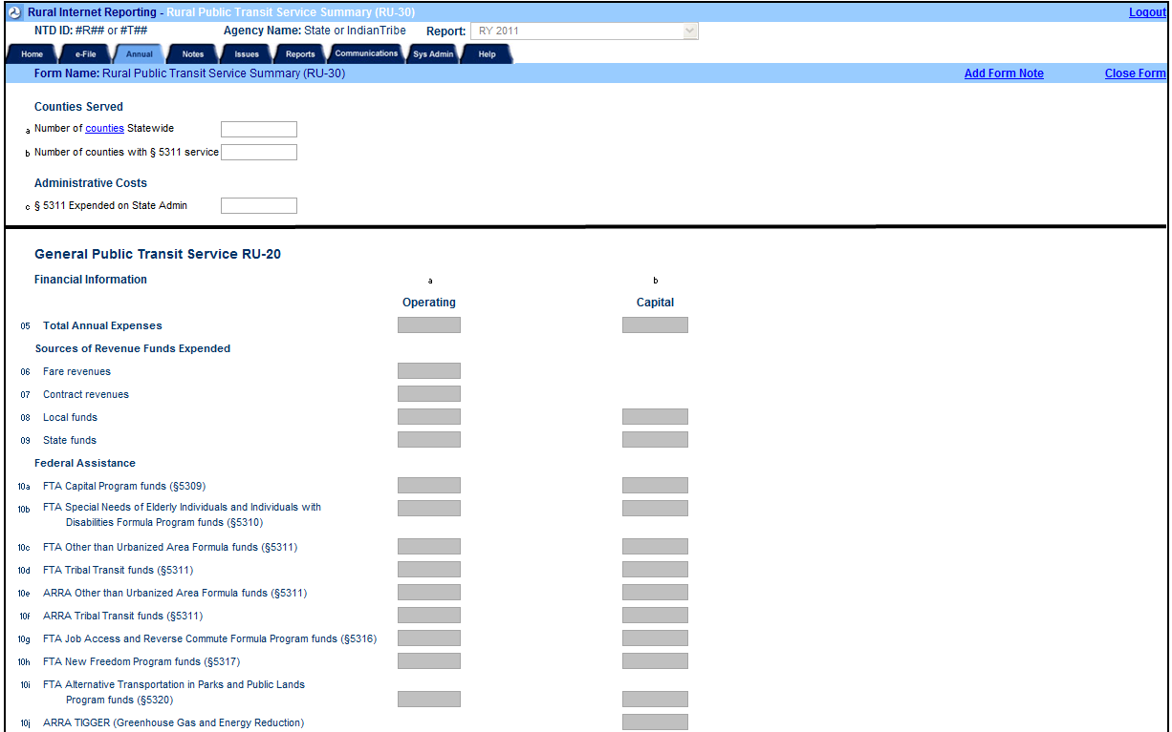
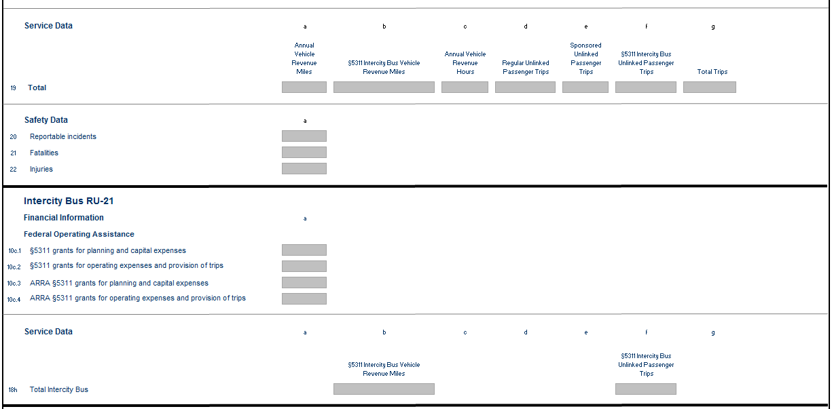
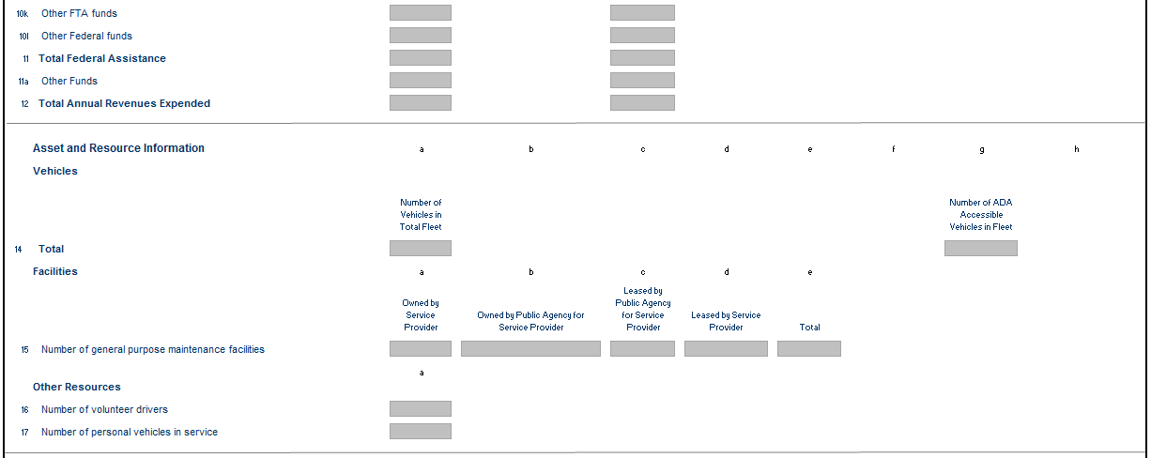
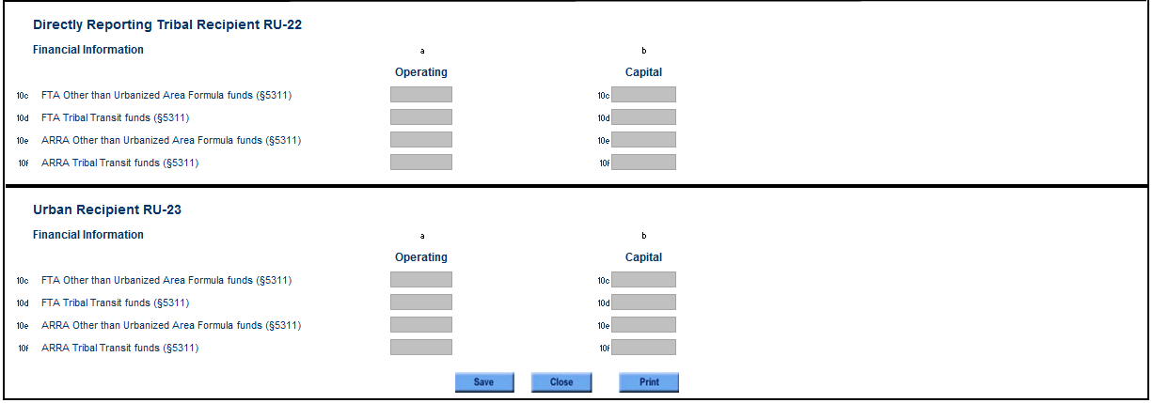
Rural Public Transit Service Summary: RU-30
RU-30

Slide 52
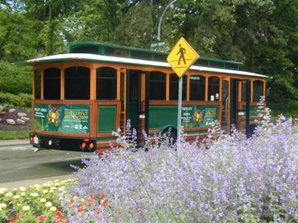
2012 Changes: RU-30
Changes
  None
Clarifications
  None
RU-30

Slide 53
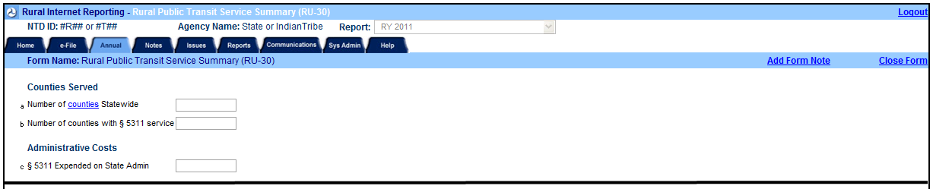
Service Summary: Lines a-c
RU-30

Slide 54
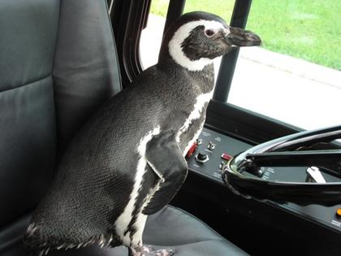
Counties: Guidelines
A County is “served” if system
picks up riders from their
residence in the County
States
  Include counties served by
  directly-reporting Tribes in your County count
Directly-reporting Tribes
  Do not complete these fields
RU-30

Slide 55
Counties and Admin Costs: Lines a-c
Line a: Number of Counties statewide,
  Report total Counties based on Counties/equivalents
  Can not be edited
Line b: Number of Counties with 5311 service
  Equivalents with 5311 service
  Tribes can not enter a value
Line c: 5311 expended on State Admin
RU-30

Slide 56
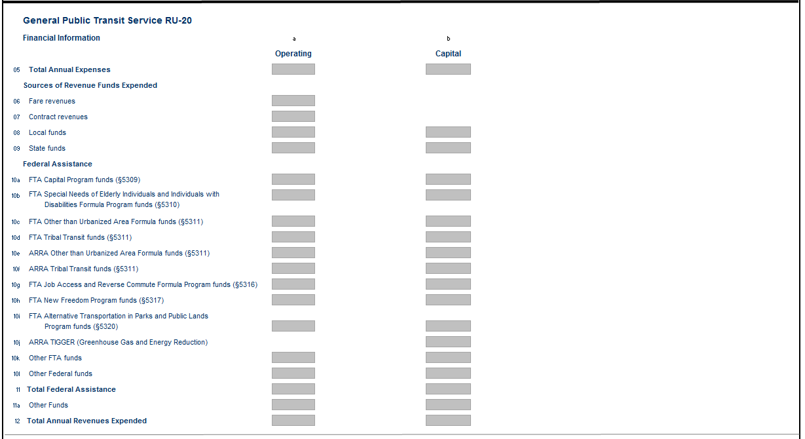
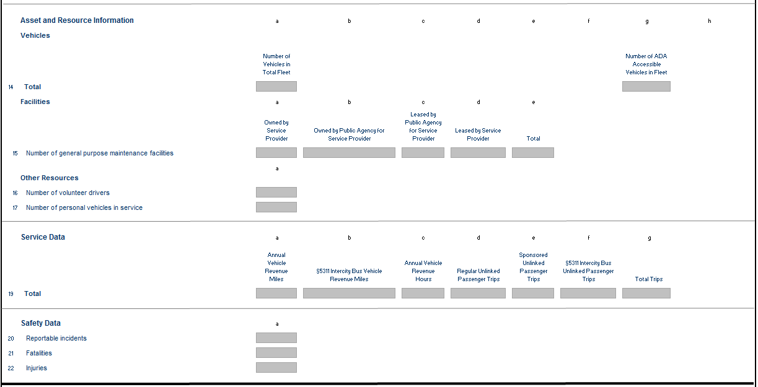
Summary: RU-20
RU-30

Slide 57

Summary: RU-21, RU-22, & RU-23
RU-30

Slide 58
Subrecipient
Forms

Slide 59
RU-20
General Public Transit Service

Slide 60




General Public Transit Service: RU-20
RU-20

Slide 61

2012 Changes: RU-20
Changes
  None
Clarifications
  None
RU-20

Slide 62

Subrecipient Description: Lines 1-4
RU-20

Slide 63

Subrecipient Description: Line 1
Name and mailing address
Report Year End Date
Agency Type
  Drop down
Counties
  Include up to 5
Acronym and URL
Indian Tribe
RU-20

Slide 64
Counties
Report total Counties based on Counties or County equivalents
  Boroughs (Alaska)
  Parishes (Louisiana)
  Independent Cities (Virginia, Nevada, etc.)
  Census Areas (Alaska)
Example with multi-State Counties
  Green (VA) and 5(VA) 2(WV)
RU-20

Slide 65

Subrecipient Description: Lines 2-3
Line 2
Line 3
Subrecipient Contact Information
  Name
  Phone number
Service Area
  County/Independent City
  Multi-county/Independent City
  Multi-State
  Municipality
  Reservation
  Other
RU-20

Slide 66



Subrecipient Description: Line 4
Mode
Bus
  Deviated fixed route
  Fixed route
  Both
Commuter Bus
Demand Response
Taxi
Vanpool
Ferryboat
Other
RU-20

Slide 67

Financial Section: Lines 5-12
RU-20

Slide 68
Funds Expended: Financial Tips
Accrual based accounting
  Report grant funds as earned
  Report expenditure when resulting in liabilities
Total Expenses should match annual audit
  Line 5 = Line 12
    Total expenses = total revenues expended
RU-20

Slide 69
Financial Section: Reporting Tips
Report based on ALL general public transit operations with a shared ride
Column a: Operating
Column b: Capital
Report Federal assistance by program
Gray fields are auto-calculated
Description boxes are for “other” fields
  Spell program out and then acronym
RU-20

Slide 70
Expenses: Lines 5-9
Line 5: Total Annual Expenses
  Annual operating expenses
  Annual capital costs
General sources of revenues
  Line 6: Fares (Operating only)
  Line 7: Contract Revenues (Operating only)
  Line 8: Local Assistance
  Line 9: State Assistance
RU-20

Slide 71
Federal Assistance: Lines 10-11
Line | Program Number | Program Name
10a | 5309 | FTA Capital Program funds
10b | 5310 | FTA Special Needs of Elderly Individuals and Individuals with Disabilities funds
10c | 5311 | FTA Other than Urbanized Area (Rural) funds (State)
10d | 5311 | FTA Tribal Transit funds
10e | ARRA 5311 | ARRA Other than Urbanized Area Formula funds (State)
10f | ARRA 5311 | ARRA Tribal Transit funds
10g | 5316 | FTA Job Access and Reverse Commute Program funds (JARC)
10h | 5317 | FTA New Freedom Program funds
10i | 5320 | FTA Alternative Transportation in Parks and Public Lands Program funds
10j | ARRA | ARRA TIGGER (Greenhouse Gas and Energy Reduction) (Capital Only)
10k |  | Other FTA funds (describe)
10l |  | Other Federal funds (describe)
11 |  | Total Federal Assistance (Auto calculating lines 10a – 10l)
RU-20

Slide 72

Other Funds and Total Expended: Lines 11a-12
Line 11a: Other Funds
Line 12: Total Annual Revenues Expended
  Auto calculating
    Line 6 (Fares)
    Line 7 (Contract revenues)
    Line 8 (Local)
    Line 9 (State)
    Line11 (Total Federal Assistance)
    Line 11a (Other)
RU-20

Slide 73

Asset and Resource Section: Lines 13-17
RU-20

Slide 74
Vehicles: Lines 13-14
Line 13: Vehicle data
  Required by SAFETEA-LU
  Vehicle data is pre-filled from prior year
  Report vehicles at the end of fiscal year
  Report identical vehicles together on same line
  Report revenue service vehicles
    Exclude taxis
    Exclude maintenance vehicles
Line 14: Total (vehicles and ADA accessible)
RU-20

Slide 75
Vehicles: Columns
Column
a | Number of vehicles in total fleet | Enter number of vehicles for this group
b | Vehicle type | Select from drop down
c | Vehicle length | Enter length to the nearest whole foot
d | Seating capacity | Enter max seating capacity, exclude driver
e | Year of Manufacture | Enter year of vehicle
f | Largest source of funding | Select from drop down
g | ADA Accessibility | Enter number, less than or equal to column a
h | Ownership code | Select from drop down
RU-20

Slide 76
Vehicles: Drop Down
Vehicle Type (column b)
Automobile (AO) | Over-the-road-bus (BR)
Bus (BU) | School Bus (SB)
Cutaway (CU) | Sports Utility Vehicle (SV)
Ferry (FB) | Van(VN)
Minivan (MV) | Other (OR)
Largest Source of Funding (column f)
FTA | State or Local
Other Federal | Private
Ownership Code (column h)
Owned by service provider | Leased by service provider
Owned by public agency for service provider | Leased by public agency for service provider
RU-20

Slide 77

Facilities: Line 15
Report number of general purpose maintenance facilities
  Report the number of facilities by ownership type at the end of the subrecipient’s fiscal year
  Garages and buildings where routine maintenance and minor repairs are performed
RU-20

Slide 78
Other Resources: Lines 16-17
Line 16: Number of volunteer drivers
  Vanpool drivers:
    Not volunteer drivers
    Count as regular unlinked passenger trip (UPT)
Line 17: Number of personal vehicles in service
  Vehicles routinely used by the agency
  Do not include taxis
RU-20

Slide 79

Service Data: Lines 18-19
RU-20

Slide 80
Service Data: Rows vs. Columns
Row
Column
Placed in ( ) on validation attachments
Line | Mode
18a | Bus
18b | Commuter Bus
18c | Demand Response
18d | Ferryboat
18e | Taxi
18f | Vanpool
18g | Other
Column | Service Data
a | Annual Vehicle Revenue Miles
c | Annual Vehicle Revenue Hours
d | Regular Unlinked Passenger Trips
e | Sponsored Unlinked Passenger Trips
f | Total
RU-20

Slide 81
Annual Vehicle Revenue: Miles/Hours
Total amount of miles/hours all vehicles travel in revenue service
  Revenue service does not mean you charge fares
Exclude
  Deadhead
  Operator training
  Vehicle maintenance testing
  School bus and charter services
RU-20

Slide 82




Unlinked Passenger Trips (UPT)
Column d – Regular
Column e – Sponsored
Normal public transit service
Open to general public
  Example: bus trip
For demand response
  Eligible ADA transit trips are public by law
Unlinked means – transfers (If any) create a new trip
Unlinked = Boardings
Excludes sponsored trips
Public transportation paid in whole or part directly to the transit provider by a third party
Sponsored by an outside organization like:
  Veteran Administration
  Medicaid
  Assisted Living Centers
  Head Start Programs
  Sheltered workshops
Only relevant to demand responses
RU-20

Slide 83

Safety Data: Lines 20-22
Line 21: Fatalities
  Death associated with transit revenue
  operations
Line 22: Injuries
  A reportable injury requires immediate
  medical transportation away from the scene
  Only include injuries associated with transit
  revenue operations
Line 20: Incidents (at least 1 of the 3)
  Any event resulting in 1 or more fatalities
  Any event resulting in 1 or more injuries
  Any event resulting in total property damage of $25,000 or more
RU-20

Slide 84
RU-21
Intercity Bus

Slide 85

Intercity Bus: RU–21
RU-21

Slide 86

2012 Changes: RU-21
Changes
  None
Clarifications
  None
RU-21

Slide 87

RU-21: Basics
Treat as a subrecipient
Identifies State 5311 funds not captured in your regular rural report
Private for profit providers
RU-21

Slide 88
RU-21: Guidelines
Use the RU-21 form
  Receives 5311(f) funding
  Private for-profit provider
  Examples: Greyhound and Peter Pan
Use the RU-20 form
  Receives 5311 and 5311(f) funding
  Not a private for-profit provider
  Possible Mode: commuter bus
RU-21

Slide 89
RU-21: Form Creation
New subrecipient for the Report Year (RY)
  System admin tab – add subrecipient
  Annual tab – add form
    Select RU-21
    Select subrecipient
Subrecipient with an RU-20 in prior RY
  System admin tab – deactivate subrecipient
  System admin tab – activate subrecipient
  Annual tab – “add form” button
    Select RU-21
    Select subrecipient
RU-21

Slide 90

Subrecipient Description: Line 1
Name and mailing address
Report Year End Date
Agency Type
  Drop down
  (Private for Profit)
Counties (include up to 5)
Acronym and URL
  N/A
Indian Tribe
RU-21

Slide 91

Subrecipient Description: Lines 2-4
Line 2: Subrecipient Contact Information
  Name
  Phone number
Line 3: Service Area
  Multi-county/Independent city
  Multi-State
Line 4: Mode
  Intercity Bus
RU-21

Slide 92
Financial Section: Lines 10.c.1-10.c.4
5311 funding including ARRA
Line | Program Number | Program Name
10.c.1 | 5311 | Grants for planning and capital expenses
10.c.2 | 5311 | Grants for operating expenses and provision of trips
10.c.3 | ARRA 5311 | Grants for planning and capital expenses
10.c.4 | ARRA 5311 | Grants for operating expenses and provision of trips
RU-21

Slide 93
Service Data: Line 18h
Row
Column
Placed in ( ) on validation attachments
Line | Mode
18h | Intercity Bus
Column | Service Data
b | Intercity Bus Vehicle Revenue Miles
f | Intercity Bus Unlinked Passenger Trips
RU-21

Slide 94
RU-22
Rural Recipient Reporting Separately

Slide 95

Rural Recipient Reporting Separately: RU-22
RU-22

Slide 96
2012 Changes: RU-22
Changes
  None
Clarifications
  None
RU-22

Slide 97

RU-22: Basics
Pre-load from the previous
year
Treat as a subrecipient
Activate and deactivate
yearly
Identifies State 5311 funds not captured in your regular rural report
Essentially only use as needed
RU-22

Slide 98
RU-22: Guidelines
When to use
States use for Tribes who are subrecipients of State 5311 funds, but report directly to the NTD
For Tribes who contract their service out with a service provider who completes a full RU-20 under a different direct report in the rural NTD
Subrecipients who receive 5311 funds from more than one State
  One State has an RU-20 and the other(s) an RU-22
RU-22

Slide 99

RU-22: Form Creation
Use one form per rural recipient
Preloaded from prior year
Creating the form for new subrecipients
  System admin tab – add subrecipient
  Annual tab – “add form” button
    Select RU-22
    Select subrecipient
RU-22

Slide 100

Subrecipient Description: Line 1
Name and mailing address
Rural NTD ID (subrecipient ID)
  xRxx-xxx or xTxx-xxx
Agency Type
  Drop down
Counties (include up to 5)
Acronym and URL
    N/A
RU-22

Slide 101


Subrecipient Description: Line 2
Name
Phone number
RU-22

Slide 102
Financial Section: Lines 10c-10f
5311 funding including ARRA
  Column a: Operating
  Column b: Capital
Line | Program Number | Program Name
10c | 5311 | FTA Other than Urbanized Area Formula funds
10d | 5311 | FTA Tribal Transit funds
10e | ARRA 5311 | Other than Urbanized Area Formula funds
10f | ARRA 5311 | Tribal Transit funds
RU-22

Slide 103
RU-23
Urban Recipient

Slide 104

Urban Recipient: RU-23
RU-23

Slide 105

2012 Changes: RU-23
Changes
  None
Clarifications
  None
RU-23

Slide 106

RU-23: Basics
Pre-load from the previous year
Treat as a subrecipient
Activate and deactivate yearly
Identifies State 5311 funds not captured in your regular rural report
Essentially only use as needed
RU-23

Slide 107
RU-23: Guidelines
When to use
  Subrecipients report directly to the urban NTD
  Subrecipients receiving
    FTA 5307 funds and FTA 5311 funds from the State
Creating the form for new subrecipients
  System admin tab – add recipient
  Annual tab – “add form” button
    Select RU-23
    Select subrecipient
RU-23

Slide 108

Subrecipient Description: Line 1
Name and mailing address
Urban NTD ID (xxxx)
  Drop Down
Agency Type
  Drop Down
Counties (include up to 5)
Acronym and URL
    N/A
RU-23

Slide 109


Subrecipient Description: Line 2
Name
Phone number
RU-23

Slide 110
Financial Section: Lines 10c-10f
5311 funding including ARRA
  Column a: Operating
  Column b: Capital
Line | Program Number | Program Name
10c | 5311 | FTA Other than Urbanized Area Formula funds
10d | 5311 | FTA Tribal Transit funds
10e | ARRA 5311 | Other than Urbanized Area Formula funds
10f | ARRA 5311 | Tribal Transit funds
RU-23

Slide 111
Contact Info
Lauren Tuzikow
  Phone
    202-366-2059
  Email
    Lauren.Tuzikow@dot.gov
  Address
    1200 New Jersey Ave, SE
    FTA (E52-208)
    Washington, DC 20590

