Slide 1
FACES User Management Training 2025

Slide 2

Training Agenda
Introduction to FACES
User Management
  Roles
  Role Hierarchy
  Recertification
  Monthly Comparison Report
Security Features
  Deactivation
FACES Demonstration
Question & Answers

Slide 3
Introduction to FACES
The FTA Access Control Entry System (FACES) is a part of FTA’s Appian platform, known as the Transit Integrated Appian Development (TrIAD) platform.
FACES provides unified user management for all applications under the TrIAD platform.
FACES enables systems in the TrIAD platform to manage and control user access through role-based authentication.

Slide 4
User Management

Slide 5
User Management
All systems on the TrIAD platform rely on FACES for user management functions. Within FACES, each system or application has its own set of user roles and access privileges.
Major functions of FACES are:
  Creating new user account(s)*
  Managing accounts through actions such as adding, deleting, and copying user role(s)
  Authenticating users when they try to log into the FTA platform
  Unlocking accounts
  Recertify / Deactivate / Reactivate users
  *NOTE: only one person should have access to an account, and unless there is a critical mission need, each person should only have one account in the TrIAD platform.
Notes:
Please note that each account is tied to only one person
Unless there is a critical mission need, each person should only have one account in the TrIAD platform

Slide 6
User Management: Roles
Applications in the TrIAD platform manage user access and user actions via “roles.”
Roles provide a way for TrIAD applications to:
  Categorize users
  Define who can access different repositories of data
  Define who can take specific actions
FACES has its own set of user roles which allow users to take user management actions.
Understanding user management responsibilities as a Global Security Manager (GSM), Local Security Manager (LSM) or User Manager (UM) is vital for managing roles and role certification.
NOTE: Previously, some user roles required a justification document. This has changed, and now instead of a justification document, all roles require a justification comment.

Slide 7
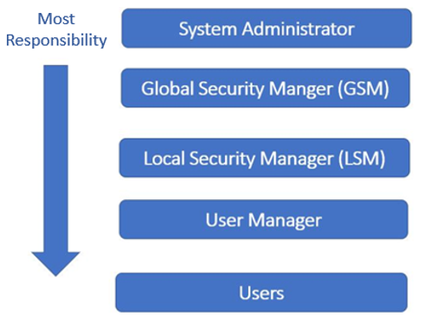
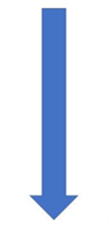
Roles Hierarchy
Who can assign other user management roles?
System Administrators can assign/manage all other roles
GSMs can assign/manage LSMs, User Managers, and Users
LSMs can assign/manage User Managers and Users
User Managers can manage Users
Please note that GSMs, LSMs, and UMs do not have the ability to approve their own user management roles. This must be done by someone in the next level up on the role hierarchy, or by the FACES System Administrators.
Most
User Management Responsibility
No
User Management Responsibility

Slide 8
User Management: Recertification
Global Security Managers (GSMs), Local Security Managers (LSMs), and User Managers (UMs) are responsible for reviewing and recertifying users who fall under their supervision. These users are all “certifiers” for the purposes of the recertification exercise.
“Recertification” is a process that requires certifiers to validate which users need access to the TrIAD Platform. This is to ensure that someone is certifying each user every year, so that the odds of an unauthorized user having access to the platform are minimal.
All users on the TrIAD platform must be recertified annually, as required in the DOT Cybersecurity Compendium.
Users who are not recertified or are specifically decertified will have their roles removed from the TrIAD Platform and are automatically locked at the end of the recertification process.
Users locked because of recertification with be automatically deactivated after two weeks, unless their accounts are unlocked by a member of the user management community.

Slide 9
User Management: Monthly User Comparison Report
The Monthly User Comparison Report displays users who appear to hold two accounts on the TrIAD platform. Note that users should only ever have one account per person.
The report compares user data across several tables, including contact and address information.
The resulting report shows a row for each pair of roles across two different accounts held by user accounts with similar data.
GSMs and System Administrators receive this report.
GSMs are expected to investigate any users that appear within the report. In any instance where the GSM can remove duplicate accounts, they should.

Slide 10
Security Features
All TrIAD users who are not FTA employees or contractors must have a login.gov account
All TrIAD users must set security questions when their accounts are created
Automated 60-day lockout:
  In adherence with the DOT Cybersecurity Compendium and the NIST Special Publication 800-53, Revision 5, users must log in at least once every 60 days to avoid deactivation.
  Users with locked accounts can still log onto the FTA platform but they will be unable to complete any actions on their account or specific to their roles
Two ways to unlock an account:
  A user may answer their security questions to unlock their account themselves
  A user may contact their User Manager, Local Security Manager, or the FTA Application Help Desk to unlock their account

Slide 11
Security Features - Deactivation
System Activity Expectations:
  Account deactivation is now the minimum required action for users who fail to meet activity standards.
  To maintain an active account, users must log in to the application themselves and demonstrate an ongoing functional need for access. Actions taken on an account by a User Manager at any tier such as Unlocking or Recertification do not qualify as “activity.”
Reactivation and User Manager Responsibilities:
  If you, as a User Manager, unlock or reactivate an account, you should remind the user to log in promptly to prevent a subsequent deactivation.
  Reactivated accounts left idle will re-enter deactivation status if the user does not long in promptly.
Valid Business Need Expectations:
  Accounts lacking a justifiable business need should be deactivated, even if technically compliant with security standards.
  This includes accounts created for “backup purposes.” While backup accounts can be approved/activated on a case-by-case basis when the need arises, creating or holding such accounts proactively is not allowed.
  For users who have been inactive for over a year, a compelling justification of business necessity is required to regain access.

Slide 12
Security Features – Deactivation Cont’d
To improve adherence to DOT policy, FTA has begun a regular process of deactivating accounts that have been inactive for more than 365 days.
If you believe an account was deactivated in error, please reach out to the FTA IT Helpdesk at FTAITHelpDesk@dot.gov.
Additionally, FTA IT Helpdesk may contact the user management community to investigate cases where users contact us with complaints about deactivations in error.

Slide 13
FACES DEMONSTRATION

Slide 14
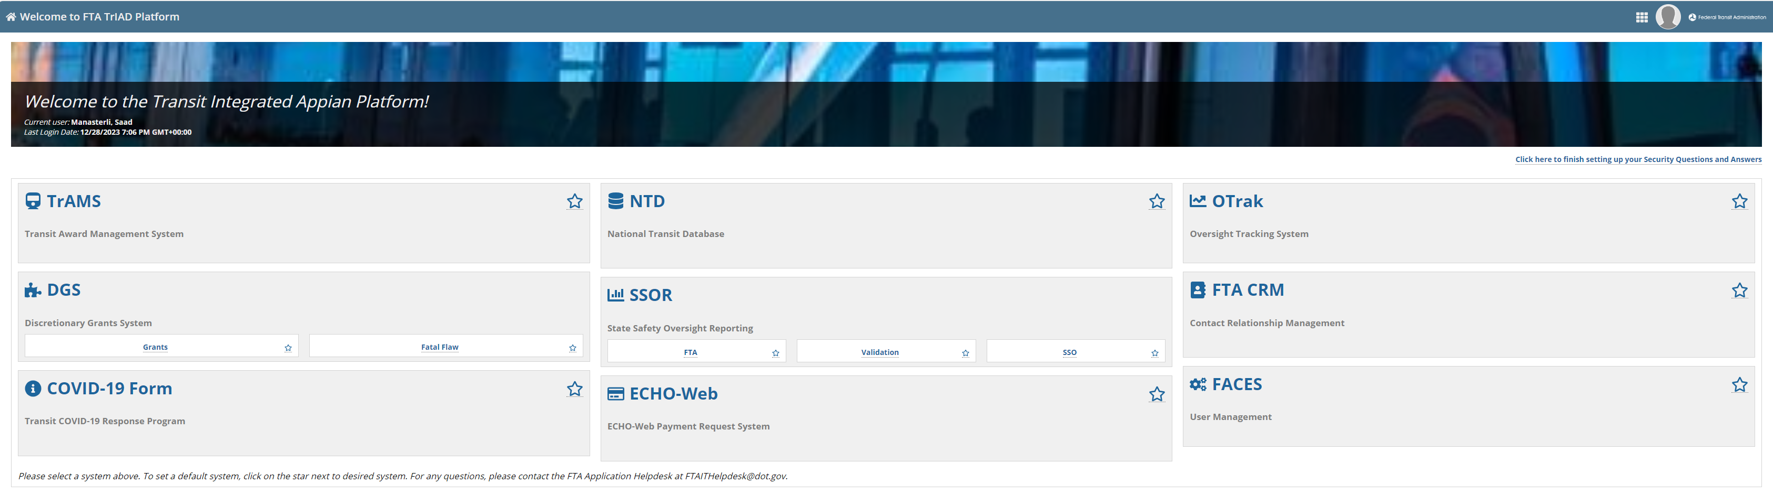
FTA TrIAD Home Page
Once the user is logged into http://faces.fta.dot.gov/, they land on the Home Page. All the FTA systems that the user can access will be displayed here.
The user can click on FACES to access user management functions.
Notes:
We have access to TRAMS at a GSM role

Slide 15
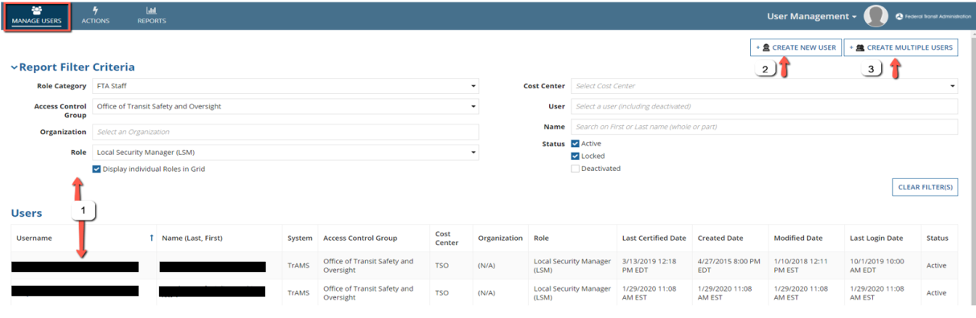
Manage Users Tab
Users who click FACES will be taken to Manage Users Page. On this page, user has option to:
  Search and Manage existing users
  Create a new user
  Create multiple users
Notes:
Review:
Mention other tabs (save create user and multiple user for last)
Discuss filtering mechanism enables the ability to filter large user population.
Discuss different fields available for filtering and that they correspond to the fields in the table
Create new user and multiple user buttons at the top of the screen
Create a new user – is exactly how it sounds, create one new user at a time. Creating multiple users however, allows you to create multiple users in bulk.
These capabilities are also featured in the Actions tab.

Slide 16
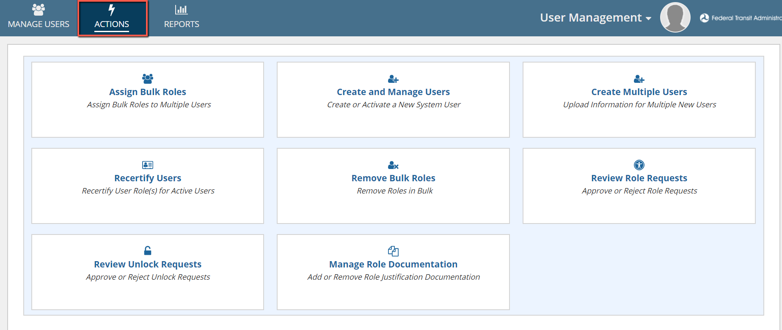
Actions Tab
User Managers, LSMs and GSMs have access to Actions tab. According to user’s access permissions it may include the following action cards:
Notes:
Lets start with Create and Manage users which of course enables us to create or activate a new system user

Slide 17
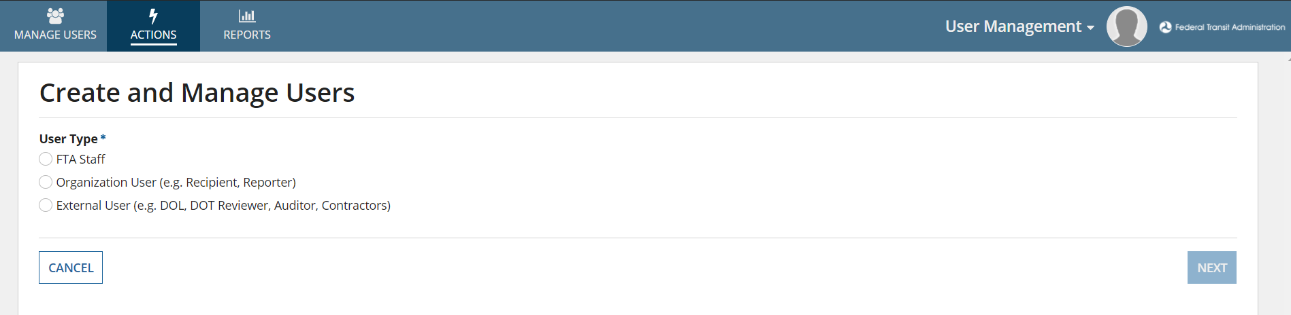
Create and Manage Users
Navigation: From the Actions tab, click Create and Manage Users.
This action allows User Managers, LSMs, and GSMs to Create new user(s) of type Recipient, FTA and External. The process for creating Recipient and External users are slightly different from the process to create FTA users.
Notes:
Talk through the user type options on the page. (including parathesis)

Slide 18
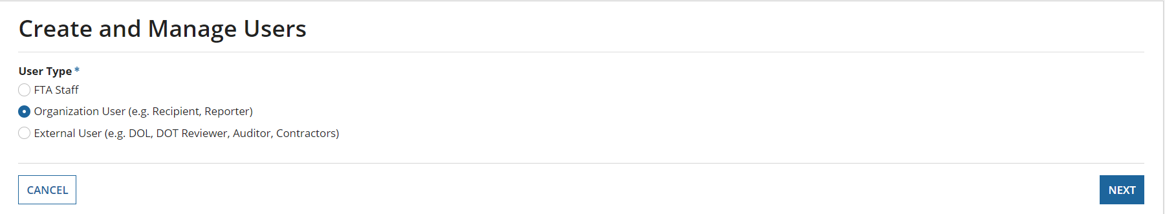
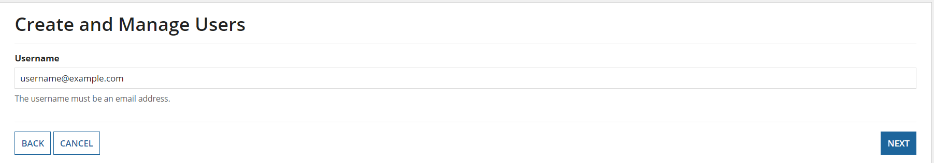
Create and Manage Users
To Create an Organization user: Select the User Type: Organization and click Next
Enter a valid email address (which will also be the username) and Click Next
Notes:
- Click Organization user for today’s demo.
- Use username@example.com

Slide 19
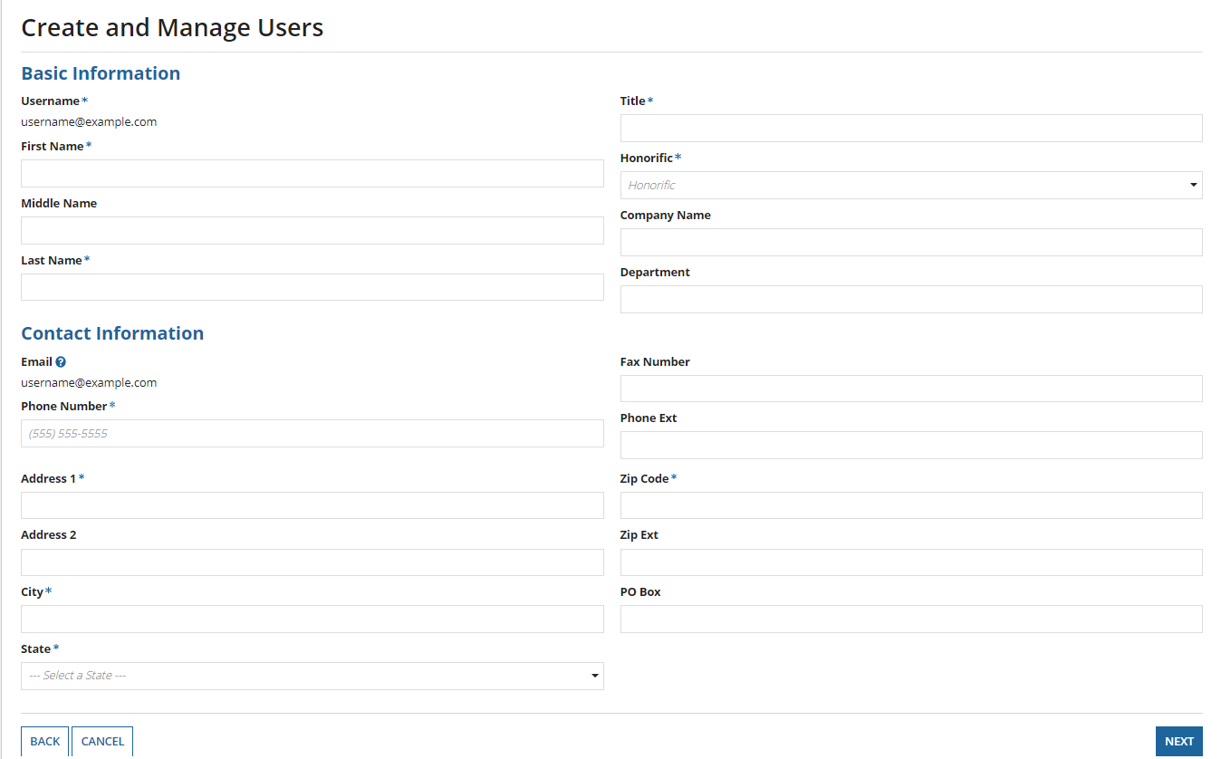
Create and Manage Users
The Username and Email fields will be pre-populated.
Enter the required Basic and Contact information. After all required details have been entered, click Next.
Notes:
Show this page during demo

Slide 20
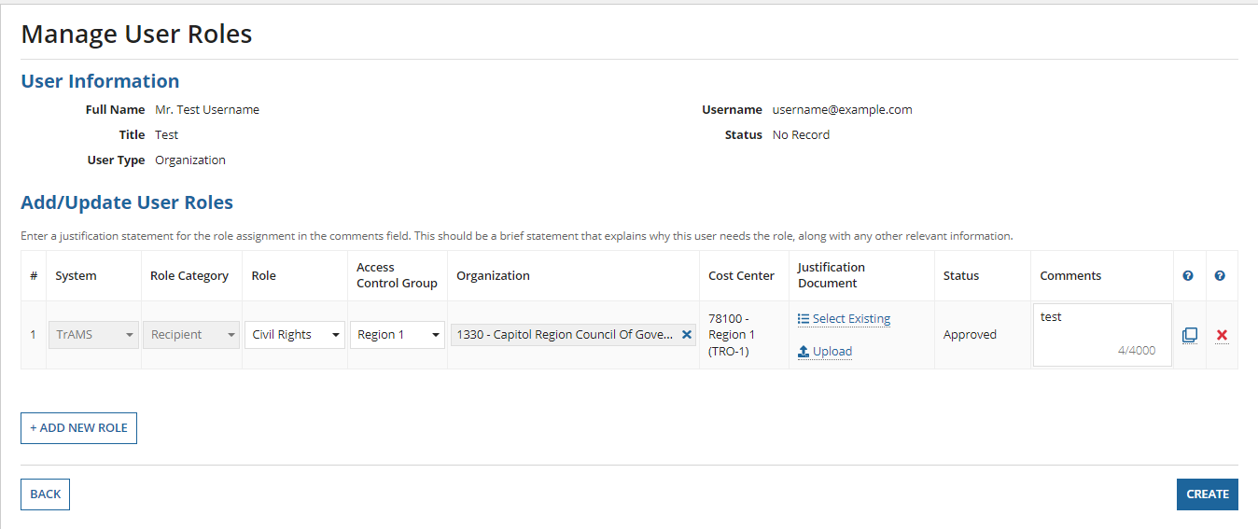
Manage User Roles
Add a new role to the user and enter a comment in the comments field and click Create.
The user will be created, and an email will be sent to the user.
Notes:
For justification document, go to next slide to show Role Documentation Slide

Slide 21
Role Documentation
Comments are required for every role. Comments should always explain why a user needs a role.
Justification documents can be uploaded for any role. Anyone who uploads justification documentation should ensure that the document is specific to both the user and the role.
  Note that justification documents are not required for any role at this time.
Notes:
Show this page during demo

Slide 22
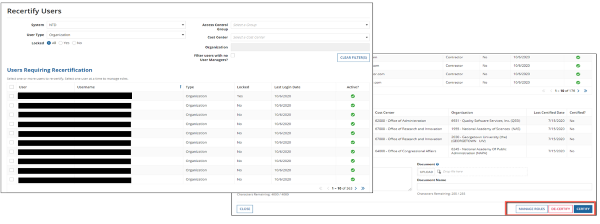
Recertify Users
Navigation: From the Actions tab, click Recertify Users.
The Certifiers (GSMs, LSMs, User Managers) are all required to recertify users annually during a specific time period.
Notes:
Talk about what they’re seeing on the screen

Slide 23
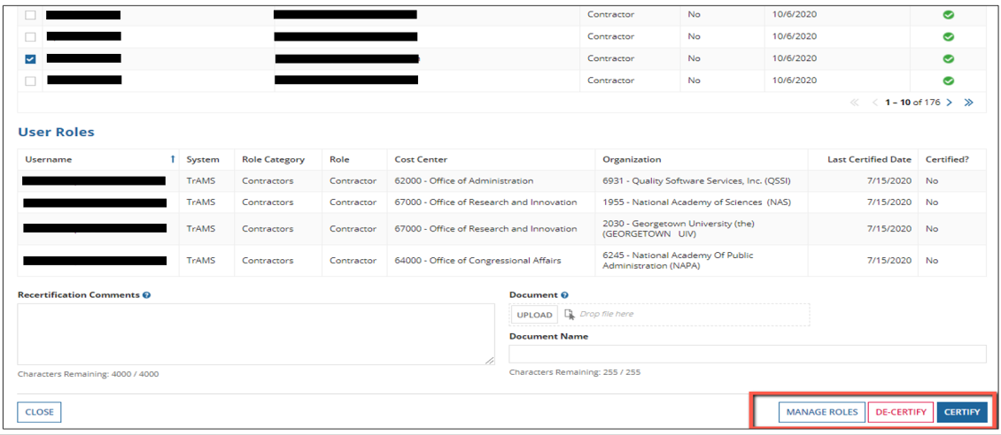
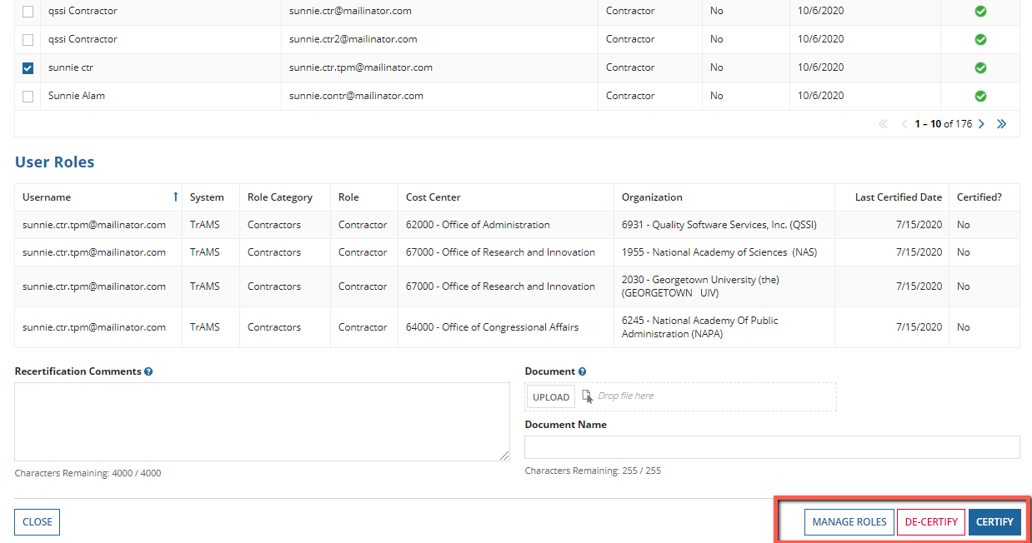
Recertify Users
When the Certifier selects a user from the list then the user details are displayed on the User Roles table. A certifier can then manage, de-certify or certify roles.
Notes:
Talk about what they’re seeing on the screen

Slide 24
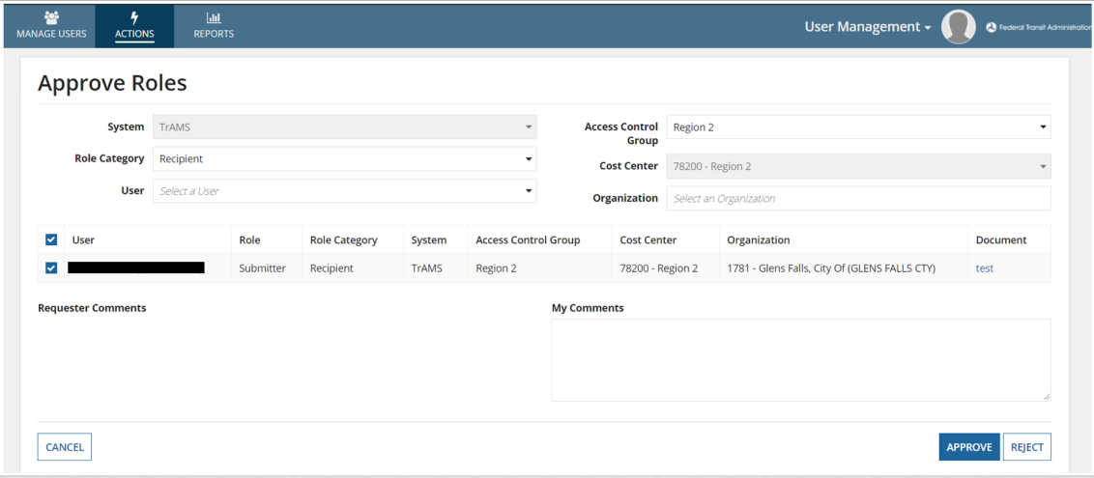
Review Role Requests
Navigation: From the Actions tab, click Review Role Requests.
Some roles require elevated approvals. For example, if a User Manager creates another User Manager role, the system would require approval from an LSM or a GSM. Role requests can be reviewed by any LSM within the same Access Control Group.
Notes:
Show slide first. Then go to Approve Roles Action. Talk through screen selection.

Slide 25
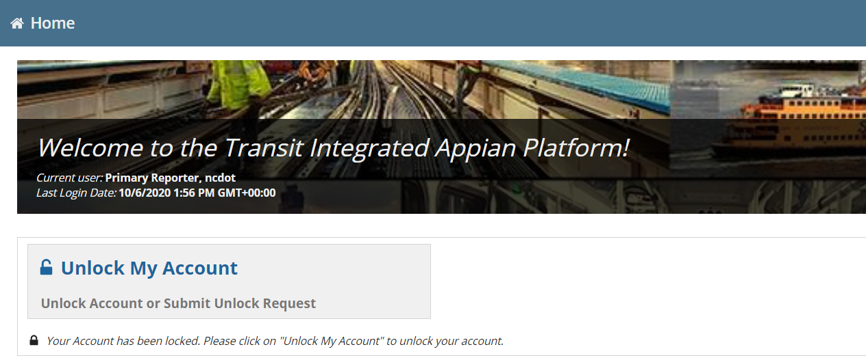
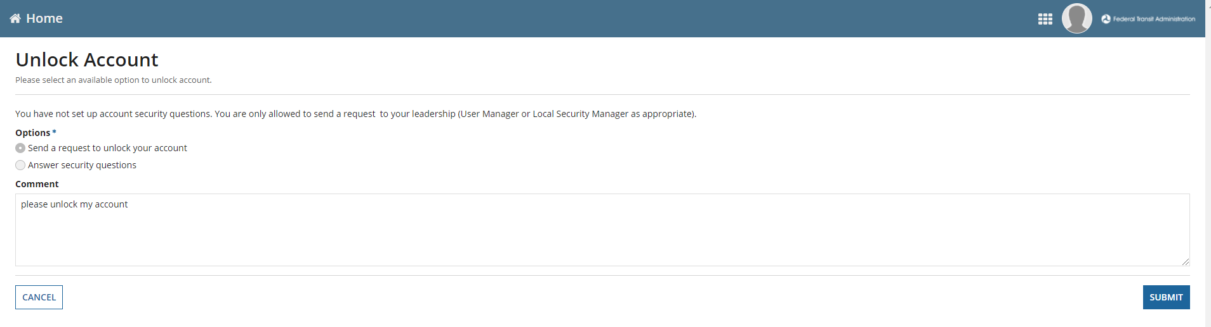
Submit Unlock Requests
When a user account is locked, users can submit an unlock request to their managers using this action. Alternatively, users can setup their security questions or answers to unlock their own accounts.
Notes:
Go to manage users
Show 377 account locked in separate browser
Then show request for unlock
From 380 account go to review unlock request (then next slide)

Slide 26
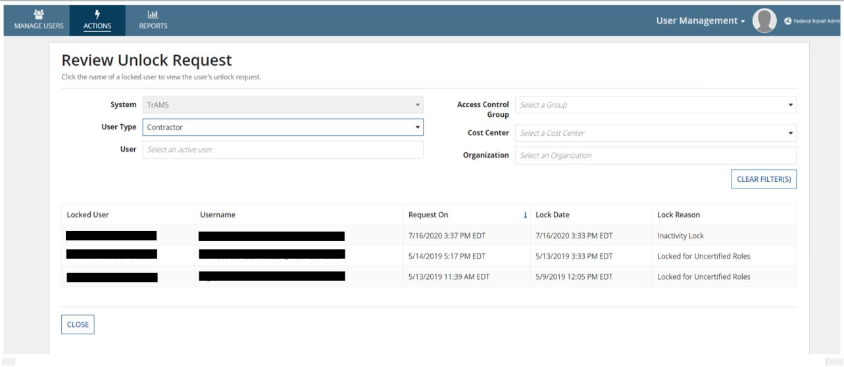
Review Unlock Requests
Navigation: From the Actions tab, click Review Unlock Requests.
This action allows UMs, LSMs, or GSMs to approve unlock requests submitted by Users. They will receive an email notification of the unlock request with a link to review the request. Approvers can either approve or deny the request.
Notes:
In 380 acct, go to review unlock requests
Unlock 377

Slide 27
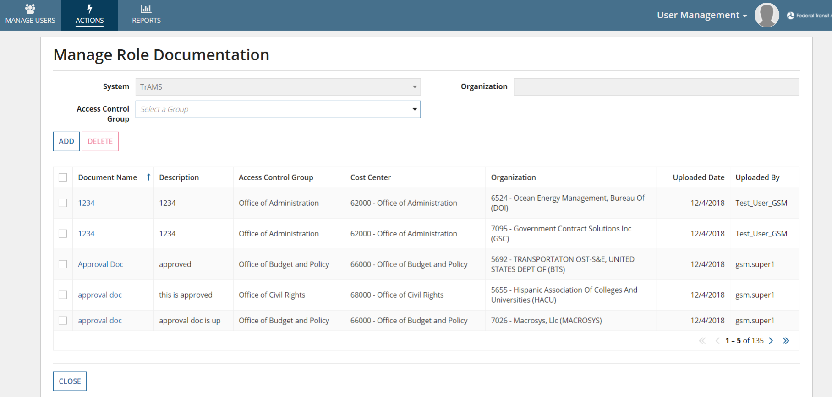
Manage Role Document
Navigation: From the Actions tab, click Manage Role Documentation.
This action allows UMs, LSMs and GSMs to Manage Role Justification Documents. Justification documentation can be uploaded in advance of role assignment via the Manage Role Documentation action or uploaded at the time the role is initially added.
Notes:
Show application screen.

Slide 28
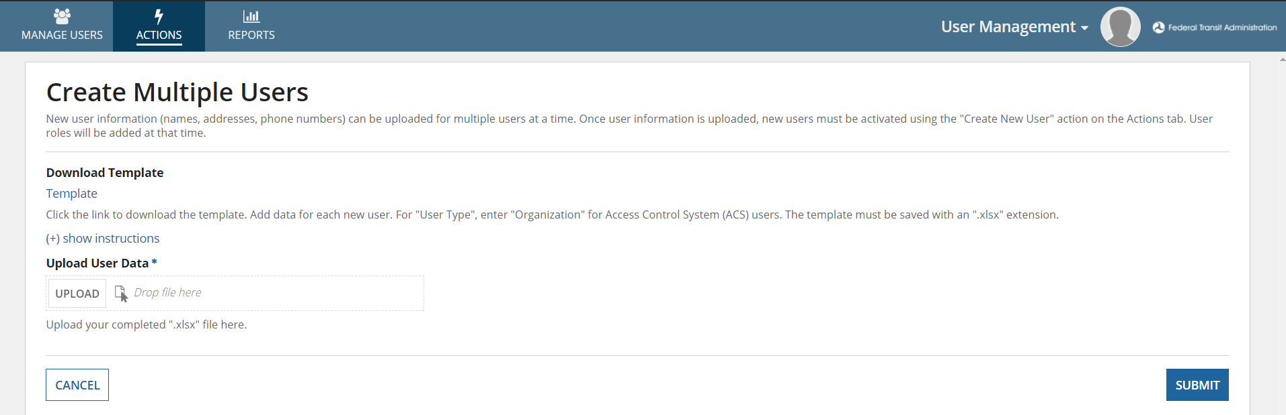
Create Multiple Users
Navigation: From the Actions tab, click Create Multiple Users.
If more than one User needs to be created, the User Managers, LSMs, or GSMs can use this action to bulk create users into the system.
Notes:
Click Create multiple users actions. And Show application screen

Slide 29
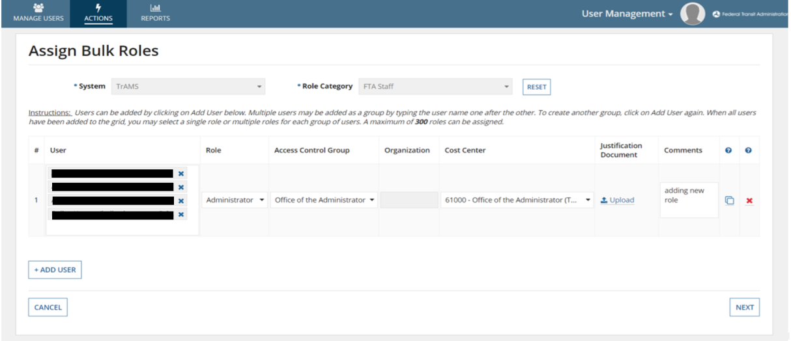
Assign Bulk Roles
Navigation: From the Actions tab, click Assign Bulk Roles.
The Assign Bulk Roles action allows GSMs/ LSMs to add roles for multiple users at a time.
Notes:
Show PPT Slide.

Slide 30
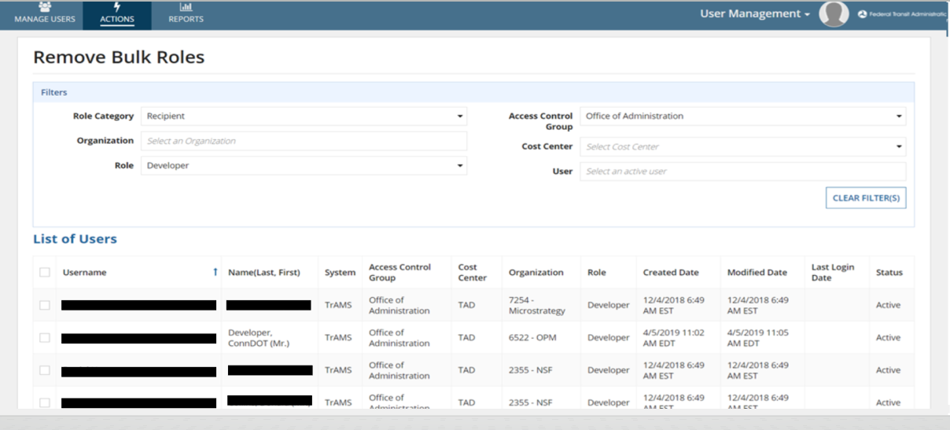
Remove Bulk Roles
Navigation: From the Actions tab, click Remove Bulk Roles.
If more than one user’s roles needs to be removed from the system, the System Admins, GSMs, or LSMs may remove user roles through this action.
Notes:
Show app screen

Slide 31
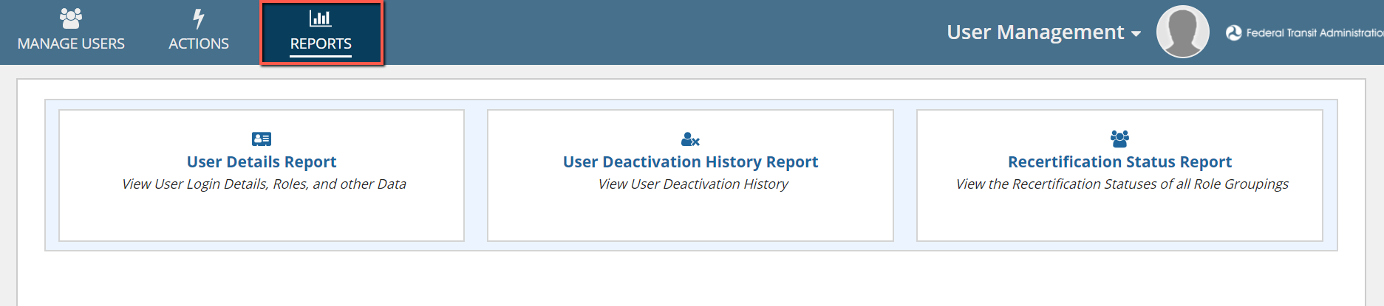
Reports
Users have access to certain Report(s) based on their user role:
Notes:
Click reports tab to Show app screen

Slide 32
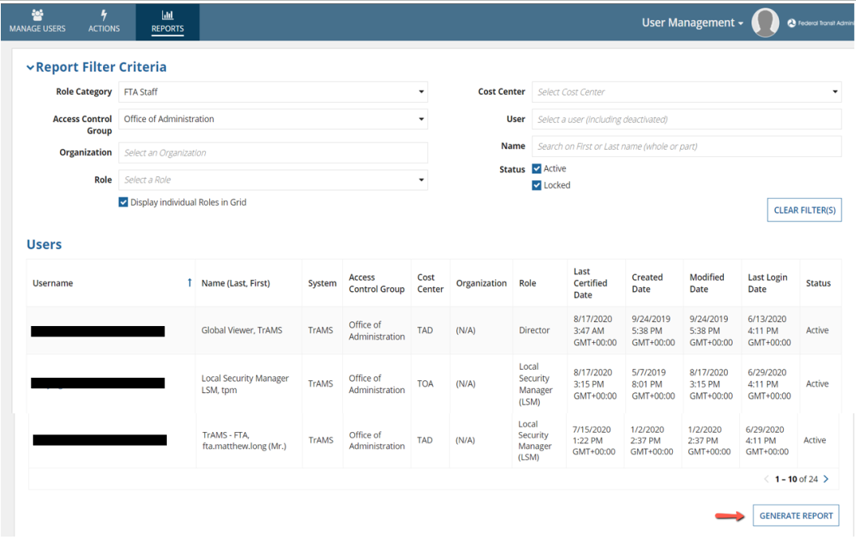
User Details Report
Navigation: From the Reports tab, click User Details Report.
Allows FACES users to find specific users and access user’s information.
Notes:
Click user details report button to Show app screen

Slide 33
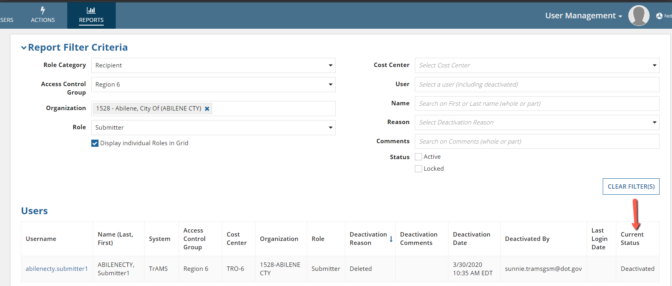
User Deactivation History Report
Navigation: From the Reports tab, click User Deactivation History Report.
Allows GSMs, LSMs, UMs to view Deactivation history for other user(s).
Notes:
Go back and Click user deactivation history report button to Show app screen.
Apply filter from the slide and show deactivation statuses

Slide 34
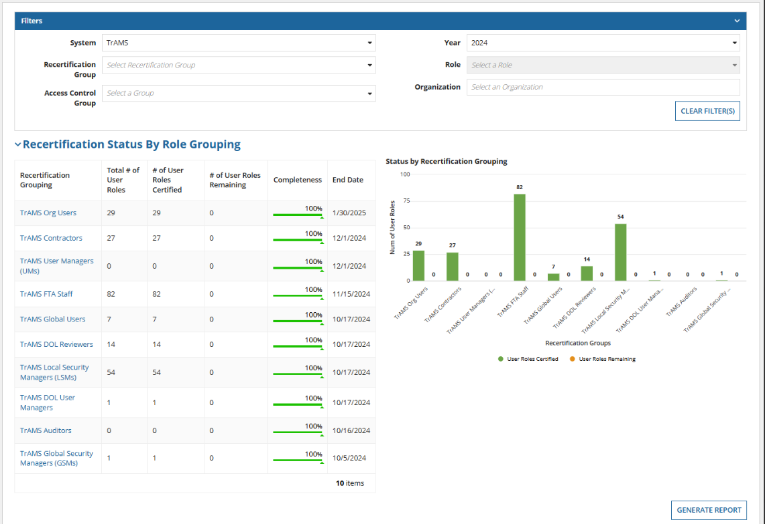
Recertification Status Report
Navigation: From the Reports tab, click Recertification Status Report.
GSMs and LSMs have access to this report. They can use the filters to view the recertification statuses of all the recertification groups.
Notes:
Show Slide.

Slide 35
Additional Information
FACES Help Tab
FACES User Guide available for more information on User Management
Training video
FAQs
FTA Applications Help Desk
If you need assistance, please contact the FTA Applications Help Desk using this address:
FTAITHelpDesk@dot.gov
FACES Website
User Guide for FTA Access Control and Entry System (FACES) | FTA (dot.gov)
Notes:
Show Slide

Slide 36

Questions?

Slide 37
Thank you!

