Slide 1
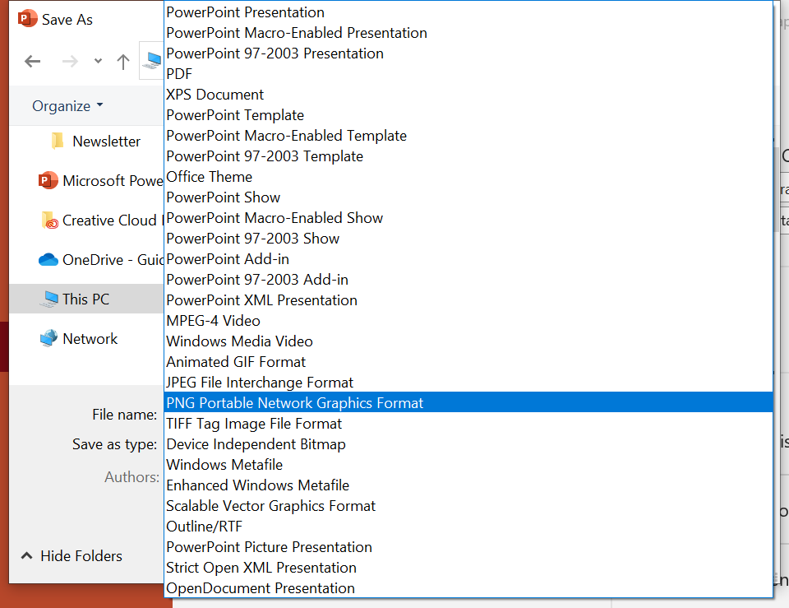
This document includes two graphic options in blue and white:
Add Your Own Logo
Pre-filled FTA Logo
Directions
Edit Slide 2, 3, or 4 with your city name and other relevant information
With slide 2, 3, or 4 selected, save and export the social media graphic
  File > Save > choose location > “Save As Type” > change to PNG or JPEG
3. You will be promoted “Which slides to do you want to export?” choose “Just This One”

Slide 2

Insert Your Photo Here (Arrange so it’s ‘Sent to back’)
[Agency] Receives [$] to Improve Transit in [Community]
Place your logo here

Slide 3

Insert Your Photo Here (Arrange so it’s ‘Sent to back’)
[Agency] Receives [$] to Improve Transit in [Community]
Notes:
If your agency does not have a graphic, consider using this pre-filled slide with FTA’s logo.

Slide 4
Insert Your Photo Here (Arrange so it’s ‘Sent to back’)
[Agency] Receives [$] to Improve Transit in [Community]
Place your logo here

Slide 5
Insert Your Photo Here (Arrange so it’s ‘Sent to back’)
[Agency] Receives [$] to Improve Transit in [Community]
Notes:
If your agency does not have a graphic, consider using this pre-filled slide with FTA’s logo.

