Slide 1
FACES User Management Training
2023
Notes:
Project Name = Use the project’s or program’s official name.
System Name = If project name is the same as the system name, then do not enter system name.

Slide 2
Training Agenda
Introduction to FACES
User management
  Roles
  Role Hierarchy
  Recertification
FACES Demonstration
Question & Answers

Slide 3

Introduction to FACES
The FTA Access Control Entry System (FACES) is a part of FTA’s Appian platform, known as the Transit Integrated Appian Development (TrIAD) platform.
FACES provides unified user management for all applications under the TrIAD platform.
FACES enables Systems in TrIAD platform to manage/control user access.

Slide 4
User Management

Slide 5
User Management
All systems on the TrIAD platform rely on FACES for user management functions. Within FACES, each system or application has its own set of user roles and access privileges.
Major functions of FACES are:
    Creating new user account(s).
    Managing such as adding, deleting, and copying user role(s).
    Authenticating users when they try to log in to the FTA platform.
    Unlocking accounts
    Recertify / Deactivate / Reactivate users

Slide 6
User Management: Roles
Applications in TrIAD platform manages user access and user actions via “roles.”
Roles provides a way for TrIAD applications to
  Categorize Users
  Define who can access the data
  Define who can take specific actions
FACES has its own set of user roles which allow users to take user management actions.
Understanding user management responsibilities as a Global Security Manager (GSM), Local Security Manager (LSM) or User Manager (UM) is vital for managing roles and role certification.

Slide 7
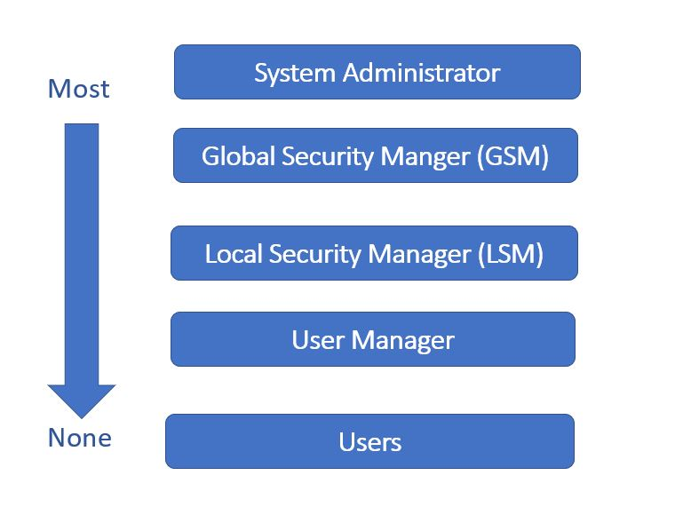
Roles Hierarchy
System Administrators:
  Assign/manage GSM roles
GSMs can manage:
  LSMs
  Global Viewers
      LSM can manage:
      Other FTA Staff
      User Managers
    User Managers can manage:
      Org Users

Slide 8
User Management: Recertification
“Recertification” is a process that requires managers to validate users who need continued access to the TrIAD Platform. The basic idea is to ensure that someone is aware of and approves of each user, so that the odds of an unauthorized user having access to the platform are minimal.
All users on the TrIAD platform require recertification annually, as required in the DOT Cybersecurity Compendium.
Global Security Managers (GSM), Local Security Managers (LSM), and User Managers (UM) are responsible for reviewing and recertifying users who fall under their supervision. These users are all “certifiers” for the purposes of the recertification exercise.
Users who are not recertified or are specifically decertified are automatically locked and removed from the TrIAD Platform at the end of the recertification process.
    Refer to Recertification Training document for more information

Slide 9
FACES demonstration

Slide 11
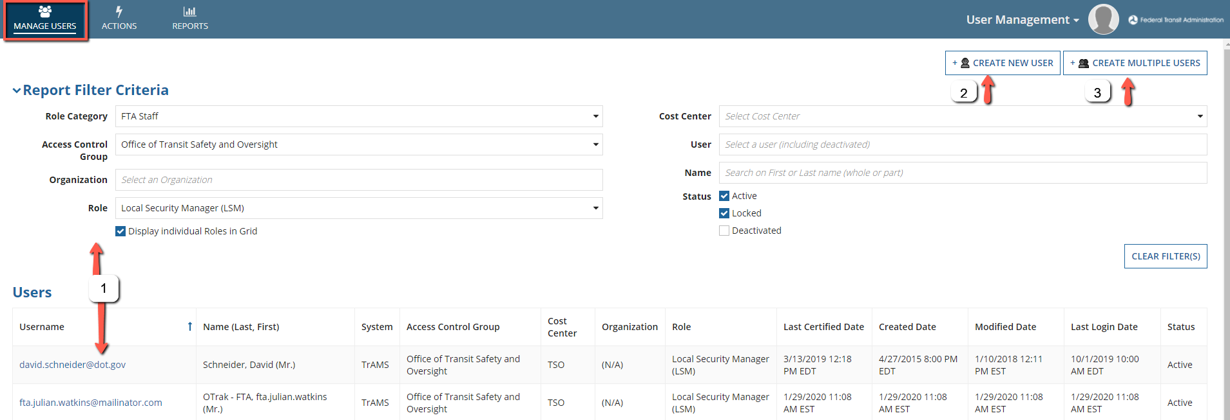
Manage Users Tab
Users who click FACES will be taken to Manage Users Page. On this page, user has option to:
Search and Manage existing users
Create a new user
Create multiple users

Slide 12
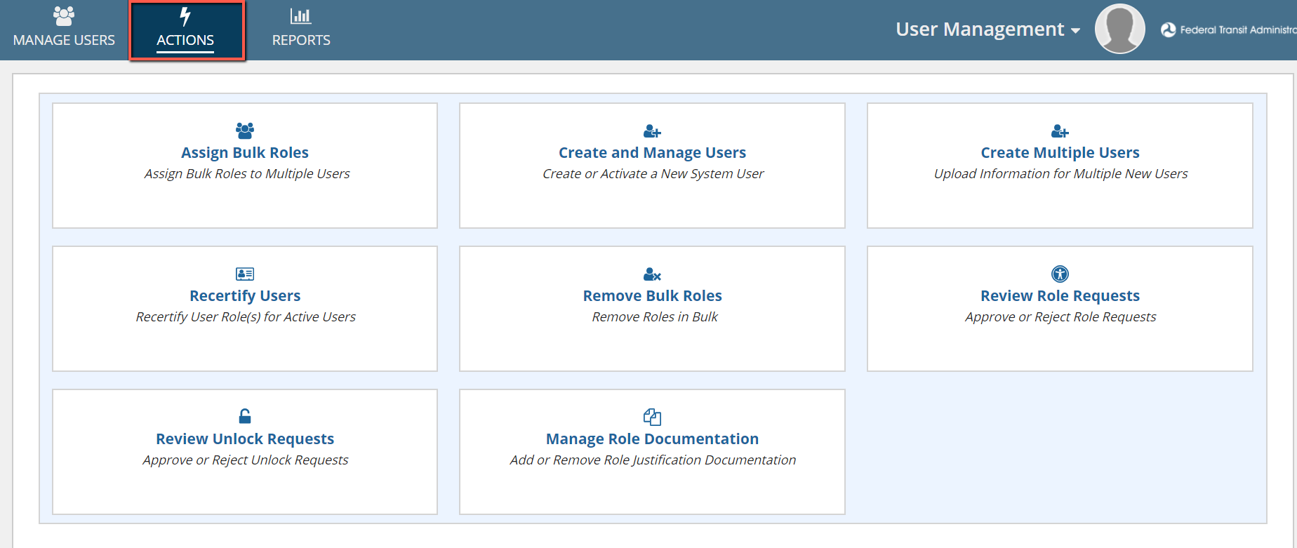
Actions Tab
User Managers, LSMs and GSMs have access to Actions tab. According to user’s access permissions it may include the following action cards:

Slide 13
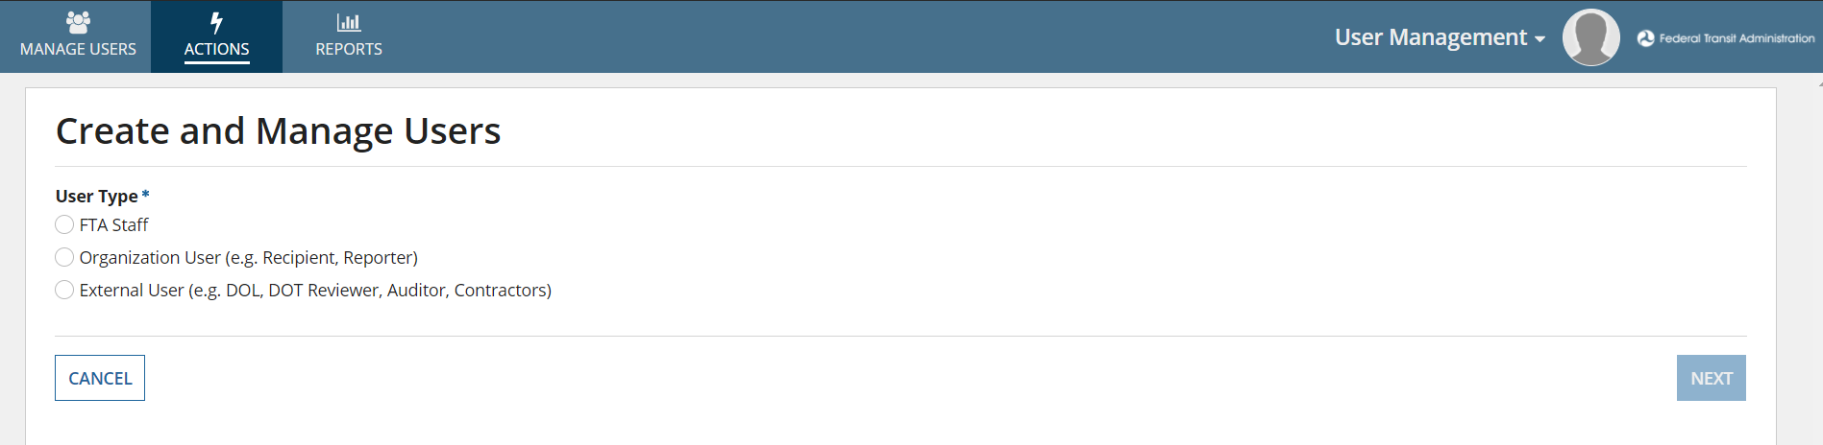
Create and Manage Users
This action allows User Managers, LSM, and GSMs to Create new user(s) of type Recipient, FTA and External. The process for creating Recipient and External users are slightly different from the process to create FTA users.

Slide 14
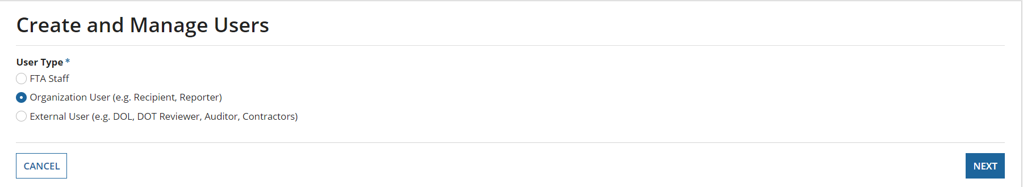
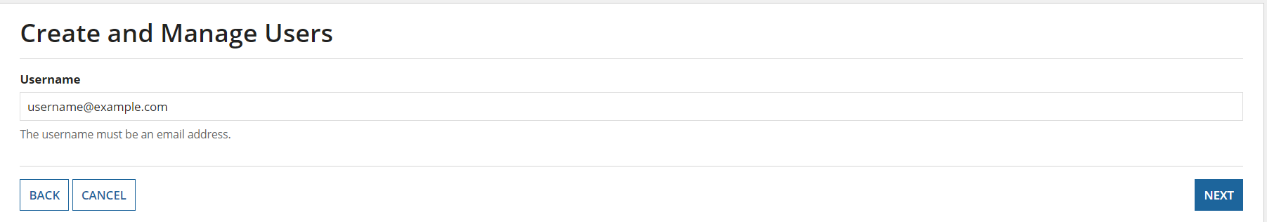
Create and Manage Users
To Create an Organization user: Select the User type: Organization and click Next
Enter a valid email address which would also be the username and Click Next

Slide 15
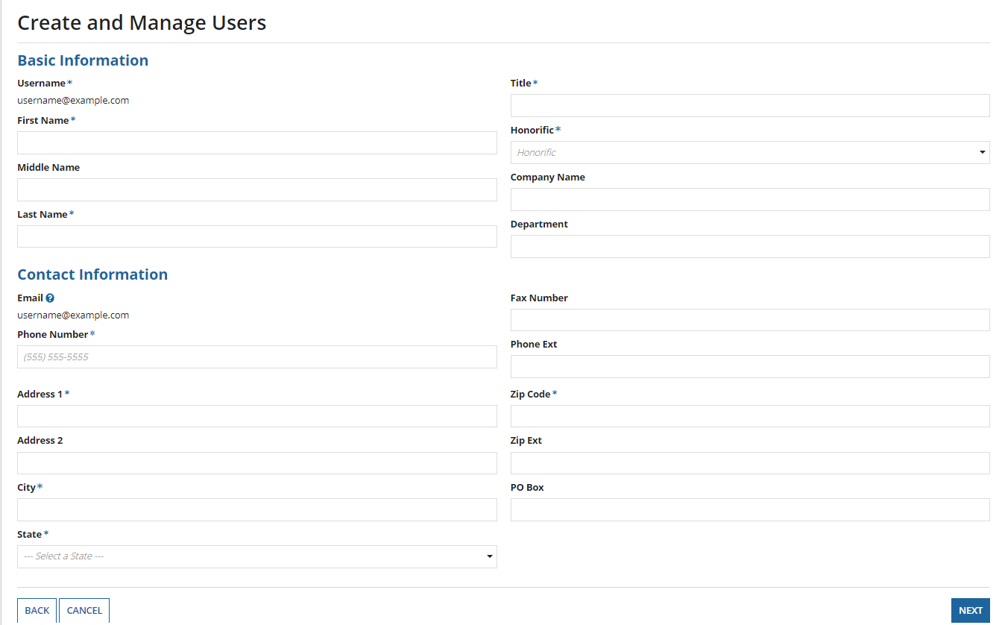
Create and Manage Users
The Username and Email fields will be pre-populated.
Enter the required Basic and Contact information. After all required details have been entered, click Next.

Slide 16
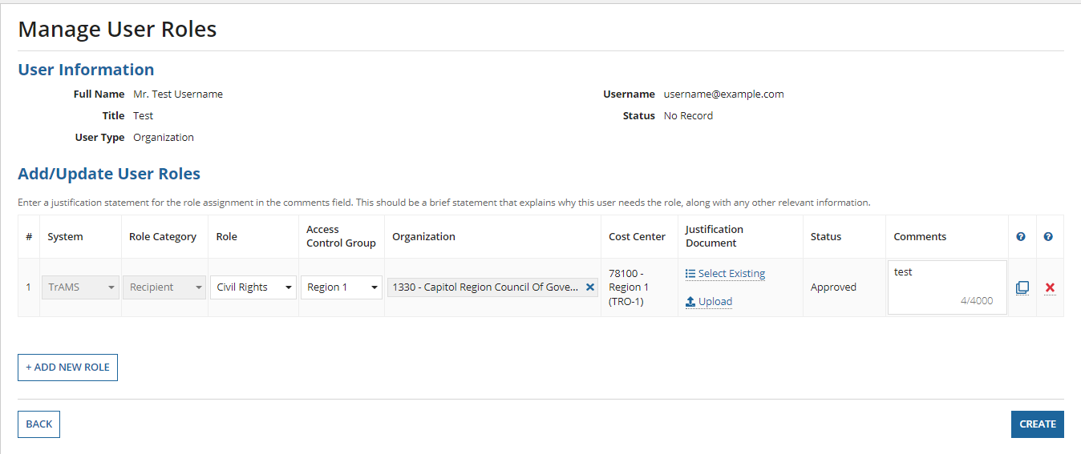
Manage User Roles
Add a new role to the user and enter a comment in the comments field and click Create.
The user will be created, and an email will be sent to the user.

Slide 17
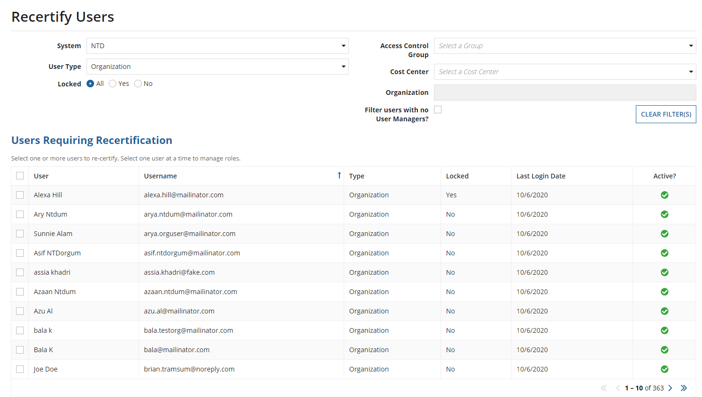
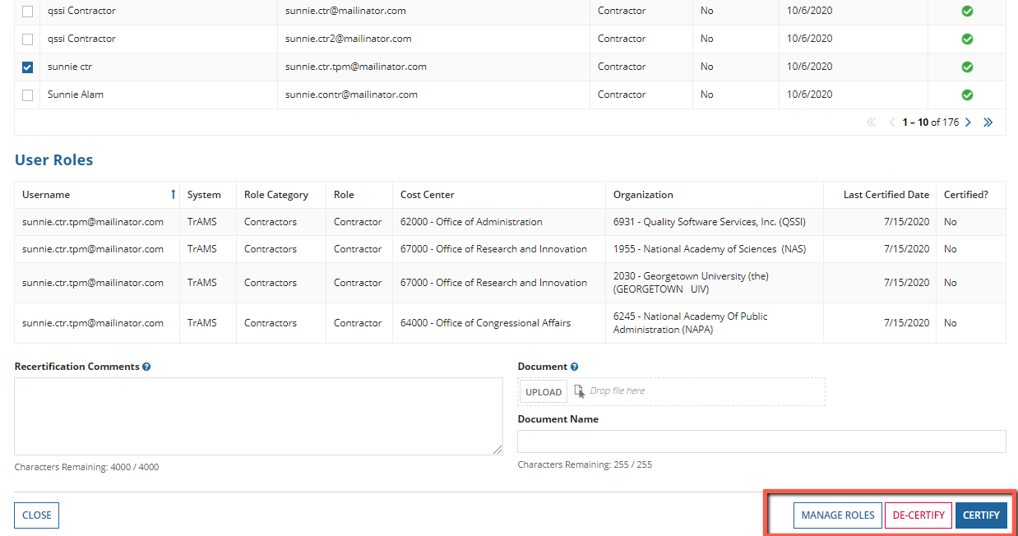
Recertify Users
The Certifiers (GSMs, LSMs, User Managers, Supervisors) are required to recertify users annually during a specific time period.

Slide 18
Recertify Users
The Certifier selects User from the list with user details is displayed on the table. User Roles are selected for the User, certifier can manage role(s), de-certify or certify the roles.

Slide 19
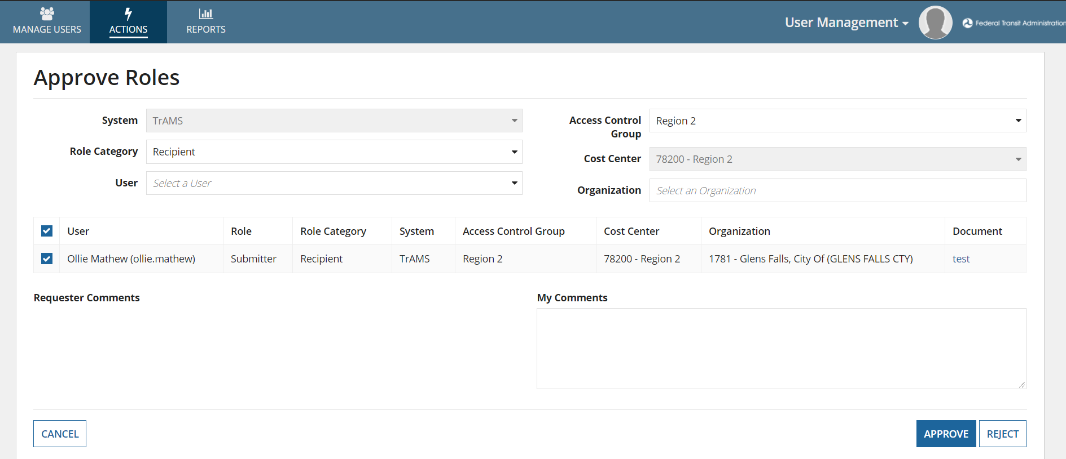
Approve Role Requests
Some roles added by User Managers require elevated approvals. For example, If User Managers create another User Manager role, System would require approval from LSM or GSM. Role requests can be reviewed by any LSM within the same Access Control Group.

Slide 20
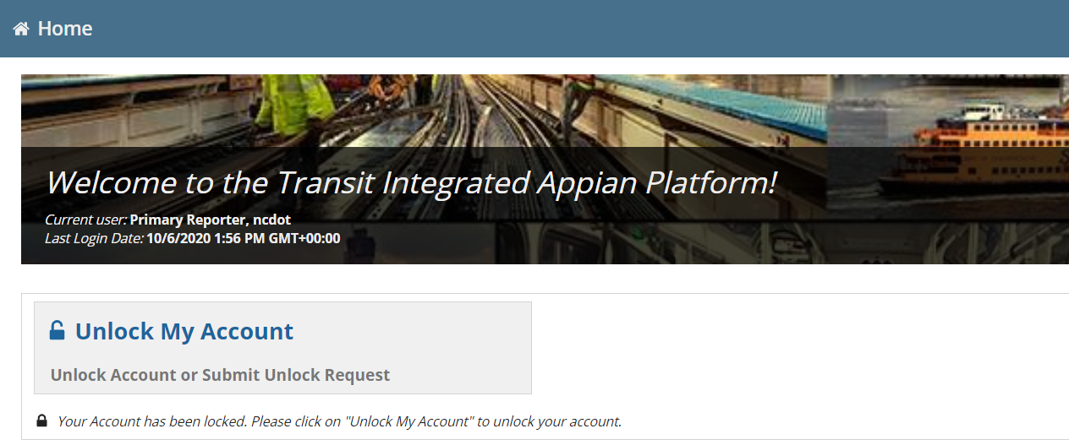
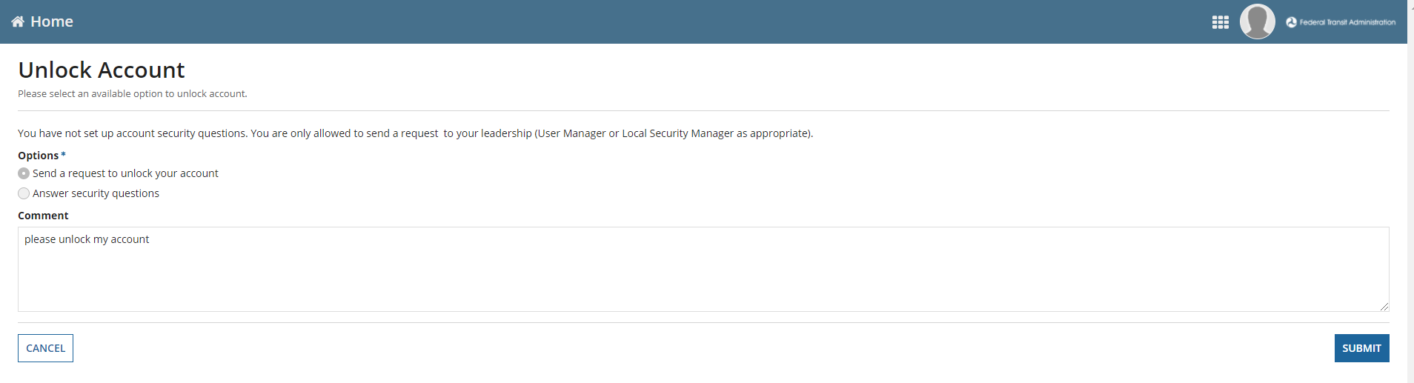
Submit Unlock Requests
When a user account is locked, user can submit unlock request to their managers using this action. Alternatively, users can setup their security questions/ answers to self unlock their accounts.

Slide 21
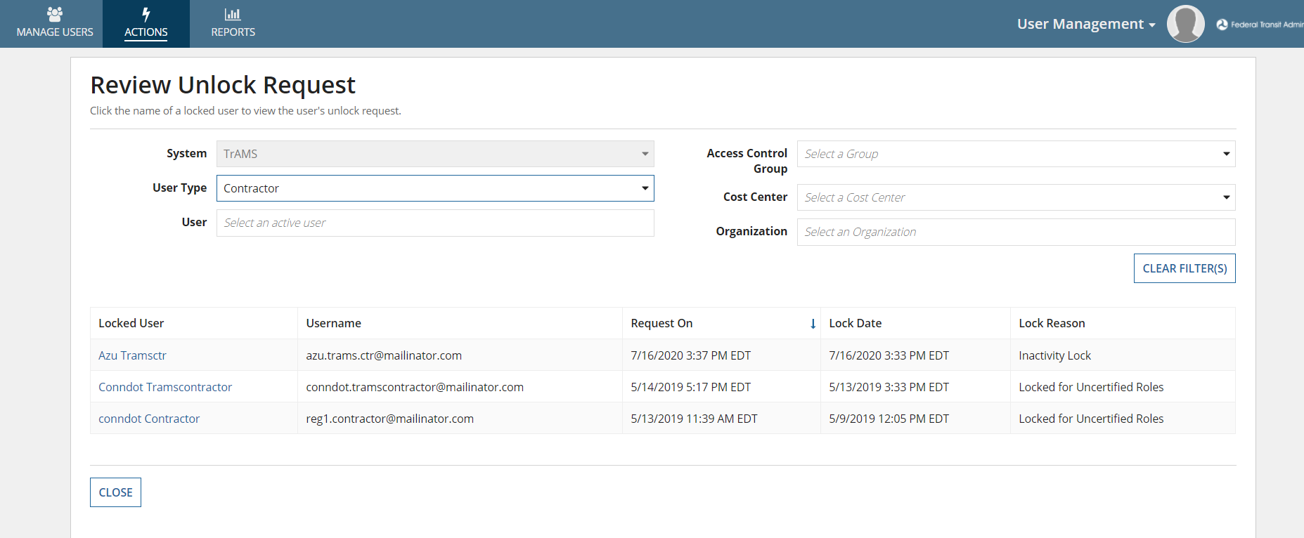
Review Unlock Requests
This action allows UM, LSM, or GSM to approve unlock requests submitted by Recipients/ Contractors. They will receive an email notification of the unlock request with a hyperlink to review the request. Approvers can either approve or deny the request.

Slide 22
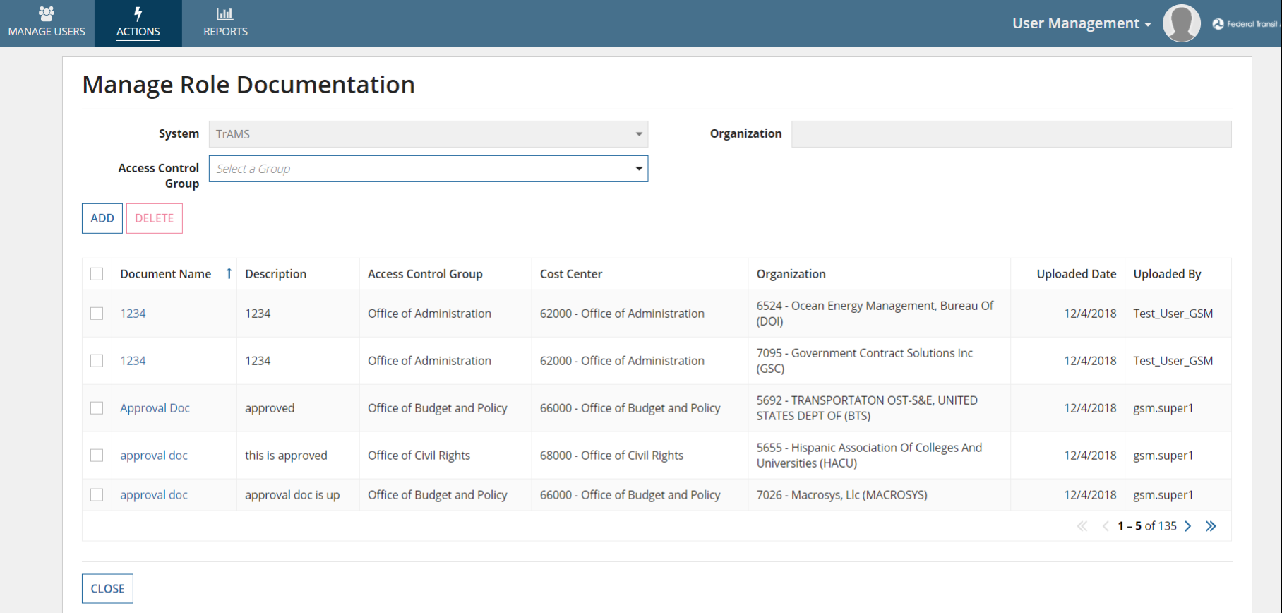
Manage Role Document
This action allows UM, LSM and GSMs to Manage Role Justification Documents. Justification documentation can be uploaded in advance of role assignment via the Manage Role Documentation action or uploaded at the time the role is added on the Manage Roles.

Slide 23
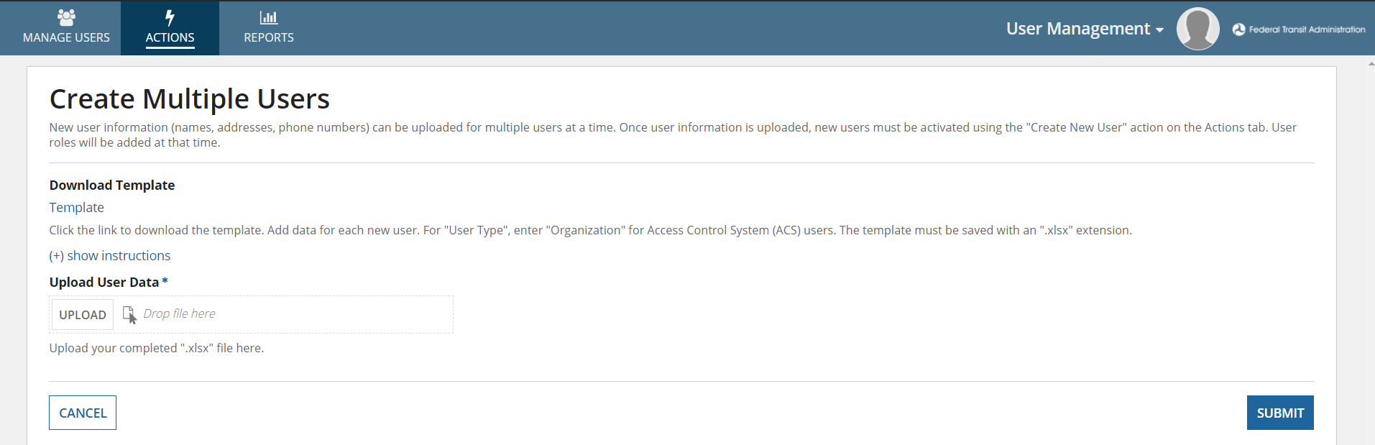
Create Multiple Users
If more than one Recipient or External users to be created, the User Manager, LSM, or GSM can use this action to bulk create users into the system.

Slide 24
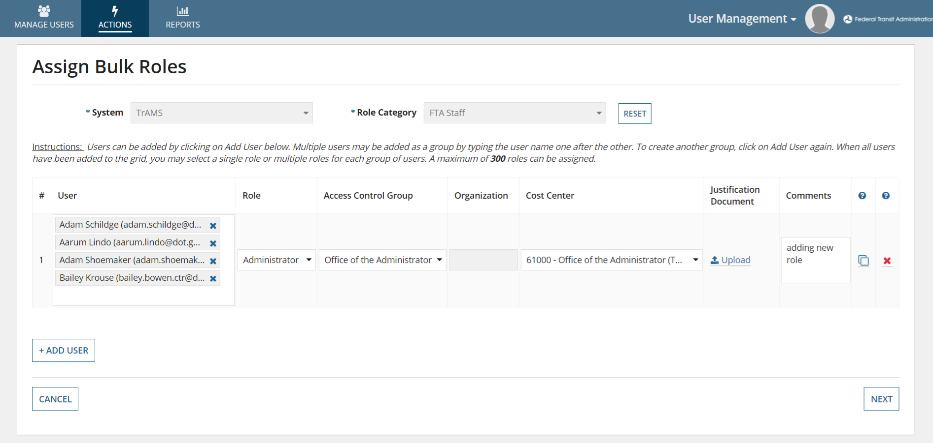
Assign Bulk Roles
The Assign Bulk Roles action allows GSM/ LSMs to add roles for multiple users at a time.

Slide 25
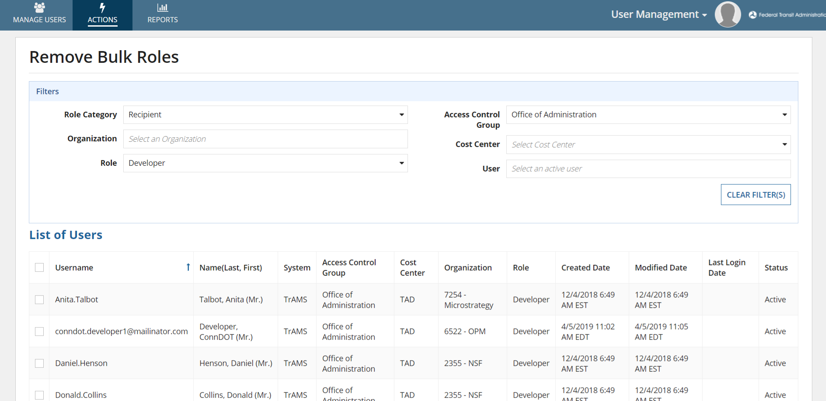
Remove Bulk Users
If more than one user or external user’s user roles needs to be removed from the system, the System Admin, Global Security Manager, LSM may remove user roles through this action.

Slide 26
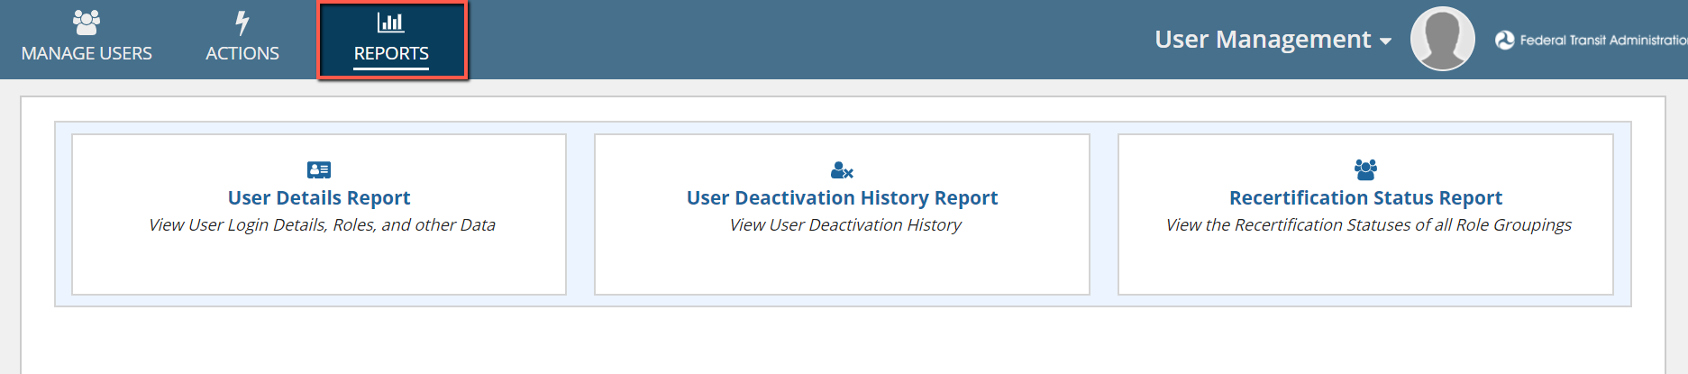
Reports Tab
Users have access to certain Report(s) based on their user role:

Slide 27
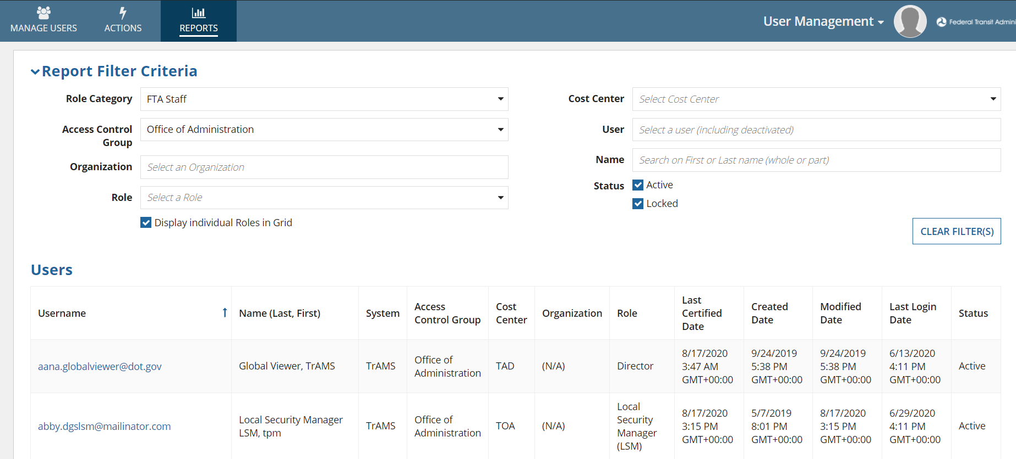
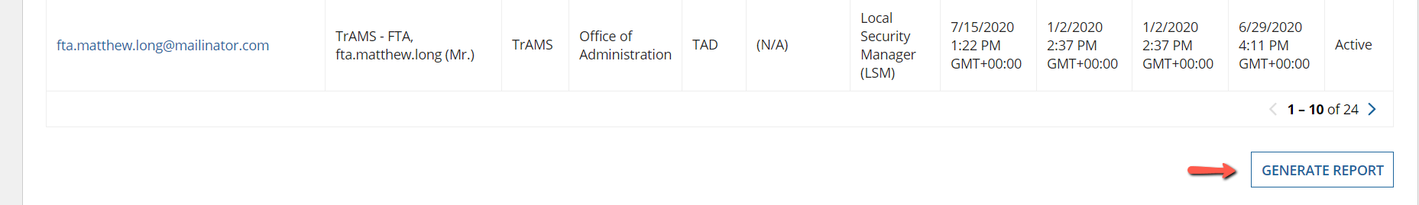
User Details Report
Allows FACES users to find specific users and access user’s information.

Slide 28
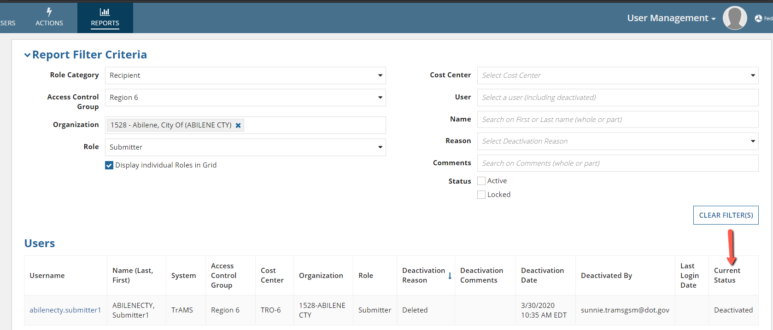
User Deactivation History Report
Allows Managers to view Deactivation history for other user(s).

Slide 29
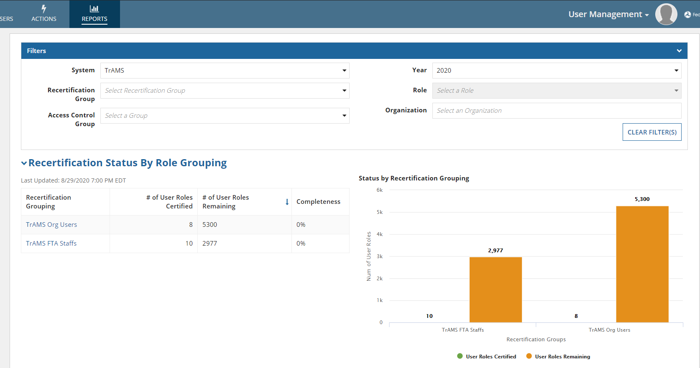
Recertification Status Report
Only GSMs and LSMs have access to report. They can user the filters to view the recertification statuses of all the role groupings.

Slide 30
More Information
FACES Training Video: See next slide
FACES User Guide available for more information on User Management
Recertification Training documents available for more information about Recertifying User(s)
Help Desk Information
If you need assistance, please call your application help desk:
FACES Help Desk at FACESHelp@dot.gov
TrAMS Help Desk Phone: 703-677-9035 Email: FTA.TrAMS.help@dot.gov
NTD Help Desk Phone: 1-888-252-0936 Email: NTDHelp@dot.gov
DGS Help Desk Email: FTA-DGS-Help@dot.gov
SSOR Help Desk Email: FTA.SSOR.HELP@dot.gov

Slide 31

Questions?

