Slide 1
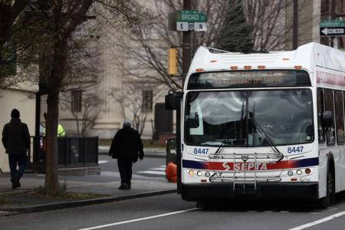
Areas of Persistent Poverty
Discretionary Grant
Webinar
February 09, 2023
Your image here
The contents of this webinar do not have the force and effect of law and are not meant to bind the public in any way. This document is intended only to provide clarity to the public regarding existing requirements under the law or agency policies. Grantees and subgrantees should refer to FTA’s statutes and regulations for applicable requirements of the Areas of Persistent Poverty Program.
Office of Planning and Environment
Federal Transit Administration

Slide 2
Background
Statutory Framework:
Consolidated Appropriations Act, 2022 (Public Law No: 117-103, March 15, 2022)
49 U.S.C. 5307 (Urbanized), 49 U.S.C. 5310 (Enhanced Mobility), or 49 U.S.C. 5311 (Rural)
Authorizes FTA to award grants to Areas of Persistent Poverty or Historically Disadvantaged Communities through a competitive process for projects
Establishes a minimum federal share of not less than 90%
Funding Available:
$20,041,870 includes $20 million (FY22) and $41,870 (FY21)
Funding supports planning, engineering, or development of technical or financing plans for projects eligible under Chapter 53 of Title 49 in Areas of Persistent Poverty or Historically Disadvantaged Communities.
Key Dates:
NOFO published 01-09-2023
Applications due 03-10-2023 (please apply early)

Slide 3
Eligibility Information
Eligible Applicants include:
Eligible entities, Recipients or Subrecipients under 49 U.S.C. 5307, 49 U.S.C. 5310, or 49 U.S.C. 5311 located in Areas of Persistent Poverty or Historically Disadvantaged Communities.
Entities that are subrecipients or indirect recipients under these programs must apply through their ordinary pass-through entities or designated recipients.
State departments of transportation may apply on behalf of eligible applicants within their states.
Applicants are also encouraged to work with non-profit organizations.

Slide 4
Eligibility Cont’d
Eligible project areas are defined as follows:
“Area of Persistent Poverty” is defined by 49 U.S.C. 6702(a)(1) as;
(1) any county (or equivalent jurisdiction) in which, during the 30-year period ending on November 15, 2021, 20 percent or more of the population continually lived in poverty, as measured by the 1990 decennial census, the 2000 decennial census, and the most recent annual small area income and poverty estimate of the Bureau of the Census;
(2) any census tract with a poverty rate of not less than 20 percent, as measured by the 5-year data series available from the American Community Survey of the Bureau of the Census for the period of 2014 through 2018; and
(3) any territory or possession of the United States.
“Historically Disadvantaged Communities” is defined by 49 U.S.C. 6702(a)(1) as;
(a) certain qualifying census tracts, (b) any Tribal land, or (c) any territory or possession of the United States.
https://usdot.maps.arcgis.com/apps/dashboards/75febe4d9e6345ddb2c3ab42a4aae85f

Slide 5
Eligible Projects
Eligible projects are planning, engineering, or development of technical or financing plans for projects eligible under Chapter 53 of title 49, U.S.C. that will assist Areas of Persistent Poverty or Historically Disadvantaged Communities.
Eligible activities include planning, engineering, or development of technical or financing plans for: (see NOFO for full list)
Improved transit services; New transit routes;
Engineering for transit facilities and improvements to existing facilities;
Innovative technologies; Low or No emissions
Ineligible activities:
Capital, maintenance, or operating costs
Procurement of vehicles or equipment
Support of the operation and maintenance of system

Slide 6
Program Goals and Priorities
Assist Areas of Persistent Poverty or Historically Disadvantaged Communities in planning, engineering, or development of technical or financing plans for improved transit services and projects that;
Address Climate Change and Sustainability:
Executive Order 13990: Protecting Public Health and the Environment and Restoring Science to Tackle the Climate Crisis, and
Executive Order 14008: Tackling the Climate Crisis at Home and Abroad
Address Racial Equity and Barriers to Opportunity:
Advance racial equity, support underserved and environmental justice populations and communities, racial equity, and barriers to opportunity
Protect public health and the environment

Slide 7
Evaluation Criteria
Applications will be evaluated on the following:
Demonstration of Need - quality and extent to which the proposed activities will support planning, engineering, or development of technical or financing plans that would result in a project eligible for funding under Chapter 53 of Title 49, U.S.C.
Demonstration of Benefits - the quality and extent to which they demonstrate how the proposed activities will support planning, engineering, or development of technical or financing plans that would result in a project eligible for funding under Chapter 53 of Title 49, United States Code.
Funding Commitments – documented sources of non-Federal cost-share and supporting evidence of the availability of funds for the project (e.g., board resolution, budget document line item or other documentation of the source of non-Federal funds).
Project Implementation Strategy - the strength of the work plan, detailed budget, schedule, and process included in an application.
Technical, Legal, and Financial Capacity – demonstration of the technical, legal, and financial capacity to undertake the project.

Slide 8
Additional Selection Criteria
Climate Change and Sustainability
Applications that create significant community benefits relating to the environment, and projects that address greenhouse gas emissions and climate change impacts.
Applicants should demonstrate how they have considered climate change and environmental justice in the transportation planning process or anticipated design components with outcomes that address climate change.
Applications should describe the specific climate change or environmental justice activities that have been incorporated, including whether a project supports a Climate Action Plan or Equitable Development Plan.
Applicants should detail whether project planning tools like EPA’s EJ Screen have been used in project planning.
https://www.epa.gov/ejscreen

Slide 9
Additional Selection Criteria Cont’d
Racial Equity and Barriers to Opportunity
Applications that advance racial equity in two areas: (1) planning and policies related to racial equity and overcoming barriers to opportunity; and (2) project investments that either proactively address racial equity and barriers to opportunity, including automobile dependence as a form of barrier, or redress prior inequities and barriers to opportunity.
Applicants should describe transportation plans or policies related to equity and barriers to opportunity they are implementing or have implemented in relation to the proposed project.
Applicants should specify project investment details necessary for FTA to evaluate if the investments are being made either proactively to advance racial equity and address barriers to opportunity or redress prior inequities and barriers to opportunity.
Applicants should consider how the project will address the challenges faced by individuals and underserved communities in rural areas.

Slide 10
Grant Conditions
Non-Federal Cost Share (Local Match) is 10 percent of Total Project Cost.
Sources of Non-Federal Cost Share are:
Cash or In-kind contributions
Transportation Development Credits (toll revenue credits)
Sale of advertising/concessions
Revenue received under service agreement
Value capture etc.
Pre-award authority guidance to be made available and described with notice of award selections.
FTA may award less than the requested amount for each applicant.
Planning Requirements apply - see 23 CFR 450.

Slide 11
Submitting an Application
Apply through Grants.gov (FTA-2023-006-TPE) with SF 424 Mandatory/Supplemental Forms with attachments. FY23 AoPP NOFO can be downloaded at: https://www.transit.dot.gov/grant-programs/areas-persistent-poverty-program
Cumulative 15-page limit for Application and all attachments. Applications will be evaluated on information provided in Supplemental Form. Attachments will be used as supporting information.
Confirmation of location in “Area of Persistent Poverty” or “Historically Disadvantaged Community” Map or Screenshot. https://usdot.maps.arcgis.com/apps/dashboards/75febe4d9e6345ddb2c3ab42a4aae85f
Confirmed eligibility, Legal, Technical, and Financial Capacity.
Documentation of availability or commitment of match (10 percent).

Slide 12
Common Questions
1. How do I determine whether my project is in an “Area of Persistent Poverty” or “Historically Disadvantaged Community”?
FTA has provided a full list and map of all Counties in Areas of Persistent Poverty or Historically Disadvantaged Communities at: https://usdot.maps.arcgis.com/apps/dashboards/75febe4d9e6345ddb2c3ab42a4aae85f
2. Can I be an eligible applicant if my project area is in an Area of Persistent Poverty and a Historically Disadvantaged Community?
Yes. Applicants can be eligible as both an Area of Persistent Poverty and a Historically Disadvantaged Community. Applicants are encouraged to note this information in their supplemental form.

Slide 13
Common Questions cont.
Is it required that a state or other designated recipient of FTA funding apply for an Areas of Persistent Poverty award in Grants.Gov on behalf of a subrecipient in either an urban or rural area?
No. Any recipient or subrecipient of Section 5307, Section 5310 or Section 5311 funding may apply
directly through Grants.Gov for an Areas of Persistent Poverty award.
However, as described above, applicants that are not direct recipients of FTA funding, or have limited
experience as a direct recipient, will need to secure the commitment of a designated recipient of FTA
funding, such as the State Department of Transportation, to apply on their behalf for funding through
TrAMS if selected for award.

Slide 14
Common Questions cont.
What should an applicant who is not an FTA direct funding recipient do to demonstrate they are eligible to receive an Areas of Persistent Poverty grant award?
Any eligible applicant and sub-recipient must provide documentation of an agreement with a current FTA direct recipient, such as the State Department of Transportation or another FTA direct recipient, to apply for funding through FTA’s Transit Awards Management System (TrAMS) on their behalf if they are selected for a funding award.
5. What is the non-federal share of the project cost (local match) funding required?
The local, non-federal share of the project cost is 10 percent of the total project cost.

Slide 15
Common Questions cont.
6. Can my transit agency propose to use “in-kind” match?
Yes. In-kind match is permissible provided the source is documented.
7. May tribal governments or rural planning organizations or economic development agencies apply for Areas of Persistent Poverty funding?
Yes, provided they coordinate with a recipient of Section 5307, 5310, or 5311 funds or with the State Department of Transportation to develop the application. If they are not a recipient or sub-recipient of Section 5307, 5310, or 5311 funds, they should obtain partnership agreements with eligible entities.

Slide 16
Common Questions cont.
8. Are private non-profit organizations that work in collaboration with public transportation service providers eligible to apply for funding under the Areas of Persistent Poverty program?
No. However, private non-profits are welcome to participate in the Areas of Persistent Program by entering into a partnership with a public transit provider whereby the non-profit would be a sub-recipient of the funding award.
9. What is the process for selecting a non-profit or other non-governmental partner?
FTA 3rd Party Procurement Rules apply. The applicant’s process for selecting the non-profit or other non-governmental partners must satisfy the requirements for a competitive procurement under 49 U.S.C. 5325(a). Applicants may undertake a competitive selection process that satisfies the requirements of 49 U.S.C. 5325(a) prior to applying for an AoPP award and name the selected entities in the application. FTA Circular (FTA C 4220.1F)

Slide 17
Common Questions cont.
10. How will projects be selected for funding?
Applications will be selected for funding based on the (5) Evaluation Criteria and the Additional Selection Criteria
Evaluation Criteria
Demonstrated Need
Demonstration of Benefits
Local Financial Commitment
Project Implementation Strategy
Technical Legal and Financial Capacity
Additional Selection Criteria
Climate Change and Sustainability
Racial Equity and Barriers to Opportunity
Justice40 and Environmental Justice

Slide 18
Common Questions cont.
11. What are the Planning Requirements for the Areas of Persistent Poverty Grant
Program?
Applicants should engage the appropriate SDOT’s, RTPO’s or MPO’s in areas likely to be served by the funds made available under this program. Selected projects must be incorporated into the long-range plans or unified planning work programs (UPWP) upon award and prior to being eligible for pre-award authority. FTA Circular (FTA C 8100.1D)
12. How do I use Pre-Award Authority?
FTA will issue specific guidance to recipients regarding Pre-Award Authority at the time of selection. FTA does not provide Pre-Award Authority for competitive funds until projects are selected and even then, there are Federal requirements that must be met before costs are incurred.

Slide 19
Common Questions cont.
13. What is the maximum amount of funding I can apply for?
Traditionally FTA has awarded the maximum amount of $850,000, but the actual award amount may be lower, so that additional projects may be funded. FTA encourages applicants to provide a scaled project amount for which the applicant can still have a viable project.
14. Can funds be used to purchase Planning Software?
Yes. AoPP funds can be used for comprehensive transportation planning purposes. Under eligible awards-- innovative technologies are considered an eligible activity to improve transit service in an Area of Persistent Poverty or Historically Disadvantaged Community. (FTA Circular C 8100.1D)

Slide 20
Common Questions cont.
15. What mapping tool do I use for what information?
FTA’s Mapping Tool to can be used to determine if your project area is in an Area of Persistent Poverty and Historically Disadvantaged Community. https://usdot.maps.arcgis.com/apps/dashboards/75febe4d9e6345ddb2c3ab42a4aae85f
EPA’s Ej Screen Mapping Tool can be used to determine your project areas Low-Income Percentile in the Environmental Justice Populations Section on the Supplemental Form.
https://www.epa.gov/ejscreen
FTA encourages applicants to utilize the provided resources however this in not required.

Slide 21
Key Takeaways
Determine your eligibility as an eligible FTA Recipient or officially partner with an FTA Recipient.
Note whether the project is in an AoPP, HDC or Both in the application.
Do not request funding for Capital, Operating, or Maintenance.
Fully address all (5) Evaluation Criteria and optional Additional Selection Criteria.
Provide a scalable amount for which the project will be viable.
Submit a map and do not wait until the last day to submit your application.
Read the NOFO.

Slide 22
Contact Us
For more information about the program, visit:
https://www.transit.dot.gov/grant-programs/areas-persistent-poverty-program
Colby McFarland
Colby.McFarland@dot.gov
202.366.1648
Program Manager
Office of Planning and Environment
Tonya Holland
Tonya.Holland@dot.gov
202.493.0283
Program Manager
Office of Planning and Environment

Slide 23
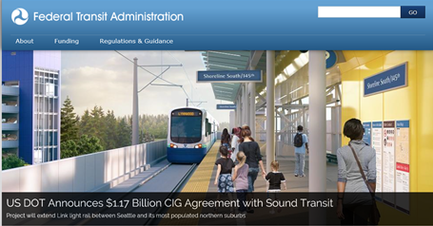
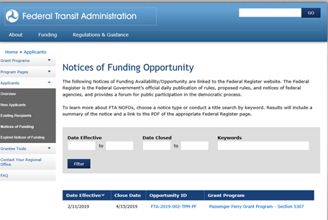
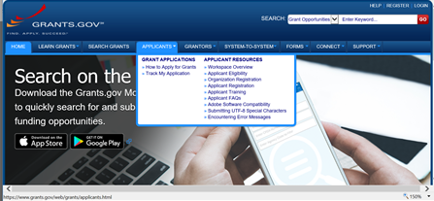
Applying for FTA Grant Opportunities in Grants.gov

Slide 24
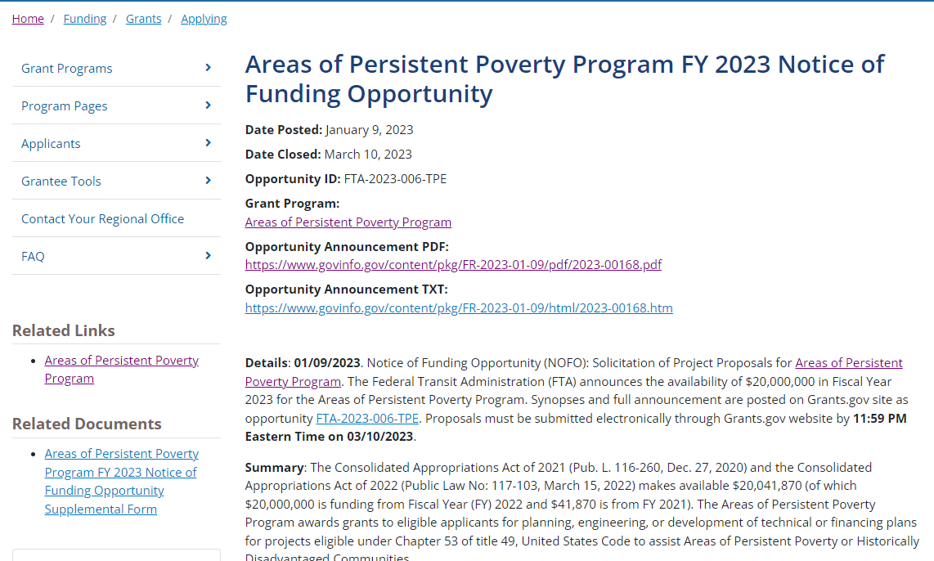
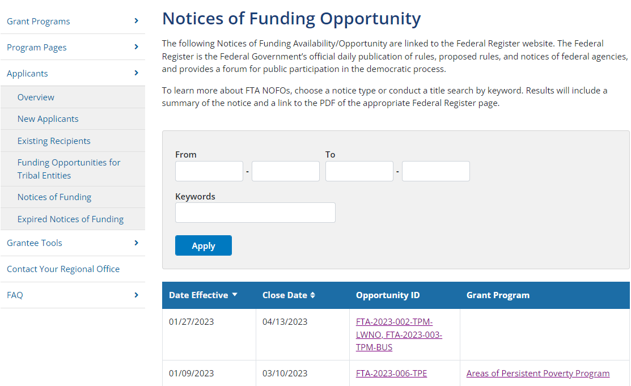
FTA Notice of Funding Opportunity
https://www.transit.dot.gov/
https://www.transit.dot.gov/funding/grants/notices

Slide 25
FTA Notice of Funding Opportunity
FTA NOFO Page contains:
Summary Description
Application requirements
Eligibility
Supplemental Form
Applicants should complete and attach this to their submission
Links to Grants.gov
Links to Program Information
Other references and links
Link to Grants.gov
FTA NOFO provides hyperlinks to Grants.gov opportunity notice, related documents, and application package.
https://www.transit.dot.gov/funding/grants/notices

Slide 26
Download Application
NOTE: Anyone can download the application package from Grants.gov. However, only “authorized organizational representatives” can submit applications in Grants.gov.

Slide 27
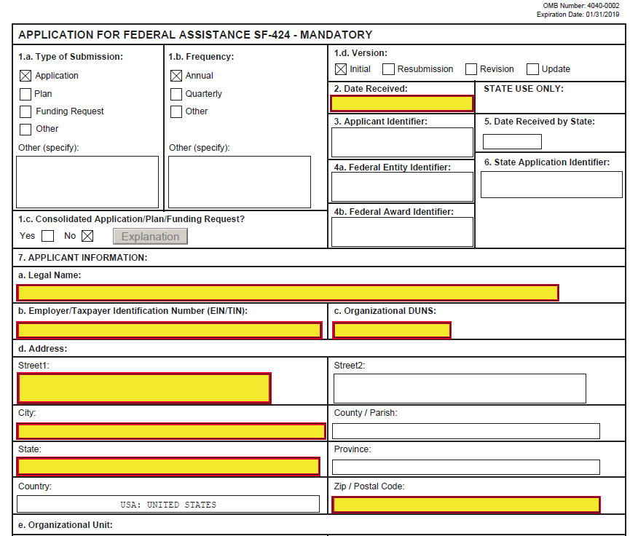
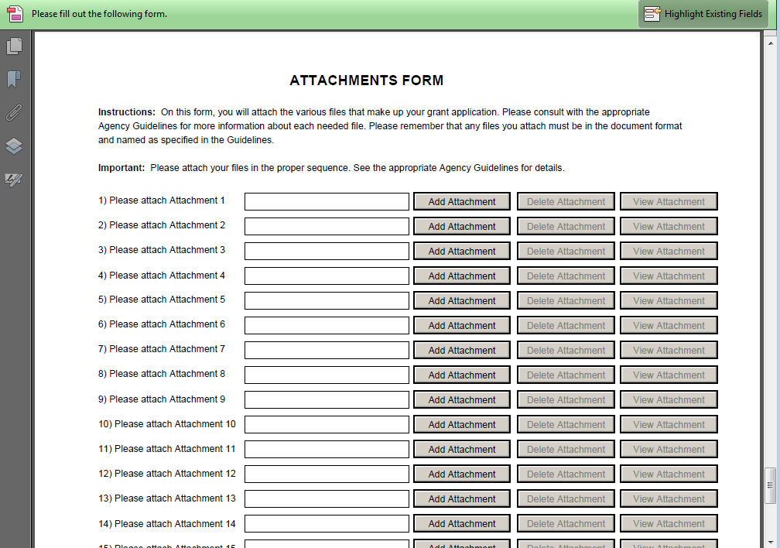
Application Package

Slide 28
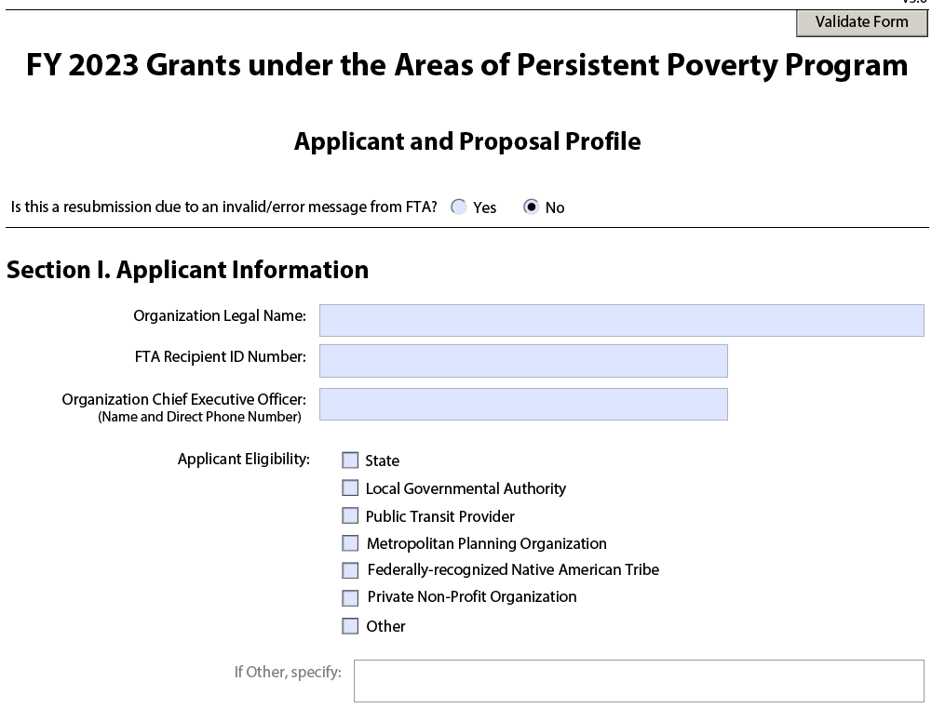
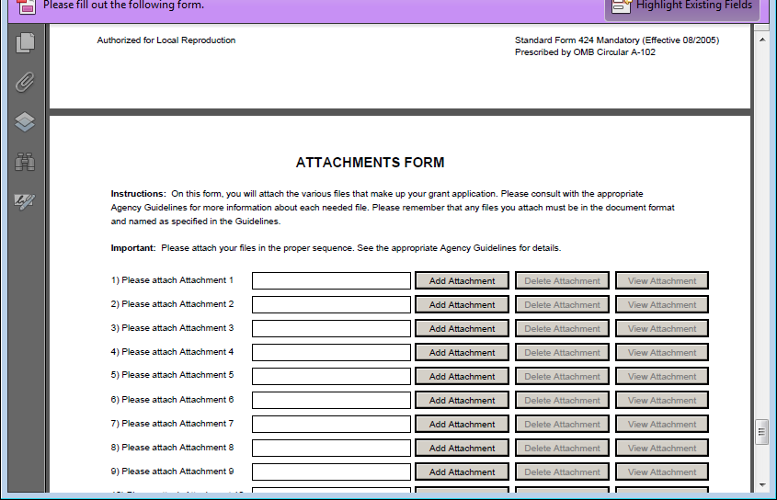
Application Package
The “Attachment Form” shown below is included in the SF-424 Grant Application Package in Grants.gov.
Please attach the FTA Supplemental Form to the Attachment Form shown below when submitting in Grants.gov.
CAUTION: Do not use “Supplemental Form” from prior years or create your own form. Please use the file provided on the FTA website.

Slide 29
Applications on Grants.gov
https://www.grants.gov/web/grants/applicants.html

Slide 30
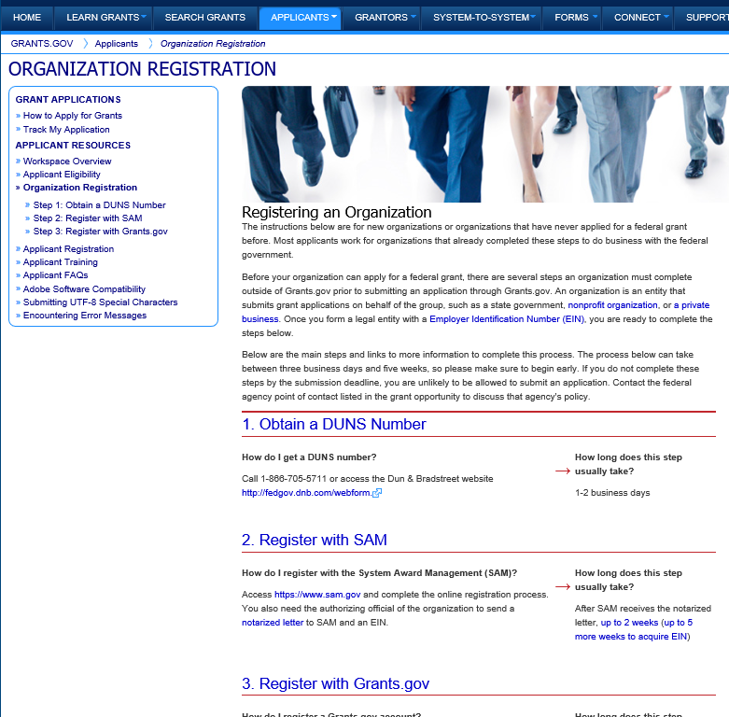
Applicant – Organization Registration
Organizations must register in Grants.gov in order to submit applications

Slide 31
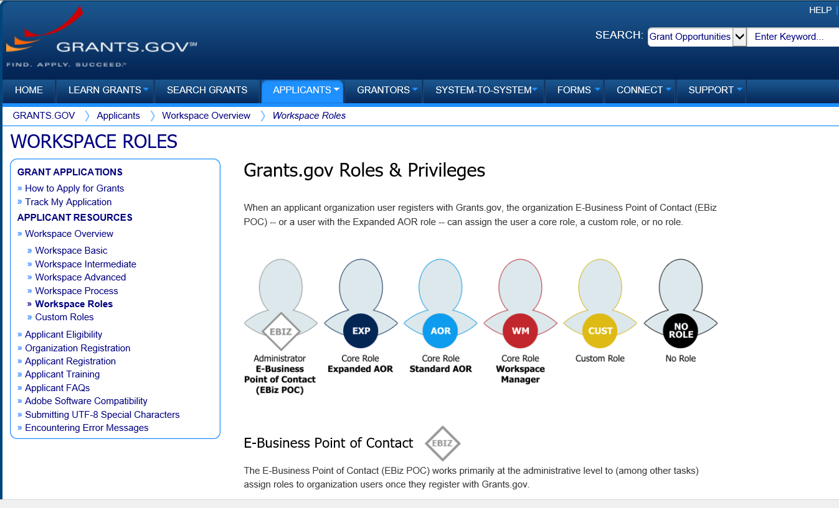
Workspace in Grants.gov

Slide 32
Web Addresses
FTA Funding Opportunities:
Grants.gov:
https://www.transit.dot.gov/funding/grants/notices
http://www.grants.gov/
http://www.grants.gov/web/grants/applicants.html
GRANTS.GOV Applicant Support 1-800-518-4726 support@grants.gov

Slide 33
FTA Mapping Tool
Areas of Persistent Poverty &
Historically Disadvantaged Communities
February 2023
Nazrul Islam
FTA, Office of Systems Planning and Analysis

Slide 34
FTA Mapping Tool
https://usdot.maps.arcgis.com/apps/dashboards/75febe4d9e6345ddb2c3ab42a4aae85f

Slide 35
User Instructions
On the list to the left, select your state use the +/- icons or mouse wheel to zoom into the map
Click and drag the map area to pan
Use the select tool at the top left of the map to select an area of interest
The number of AoPP, HDC and total Census Tracts within the selected area are shown in boxes below
The list of selected AoPP and HDC Tracts are shown on the list to the right
Zoom-in further or click on the map to read the Census Tract number

Slide 36
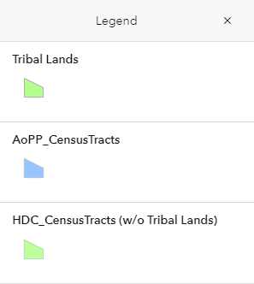
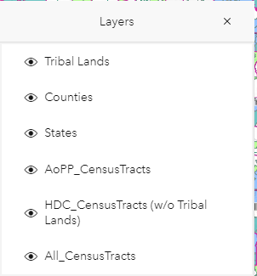
Legends & Layers

Slide 37
Selected AoPP & HDC Census Tracts

Slide 38
Live Demo
https://usdot.maps.arcgis.com/apps/dashboards/75febe4d9e6345ddb2c3ab42a4aae85f

Slide 39
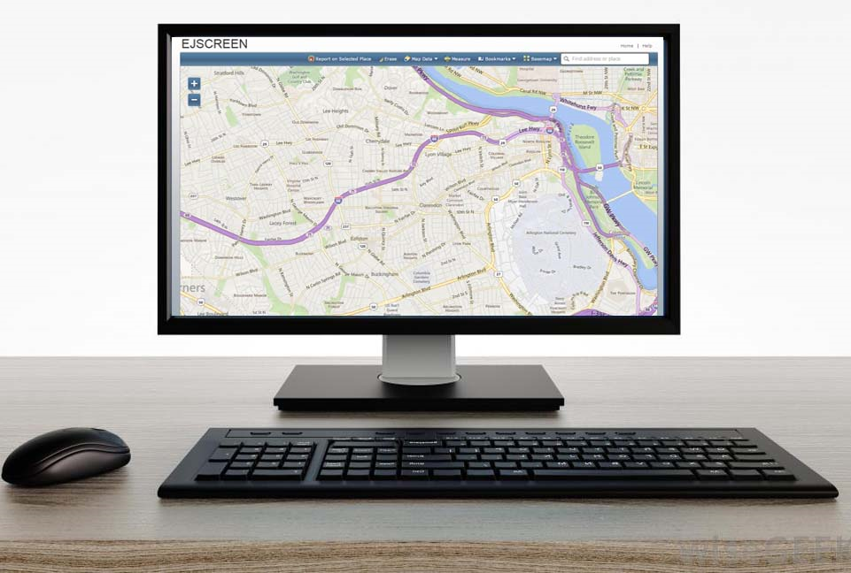
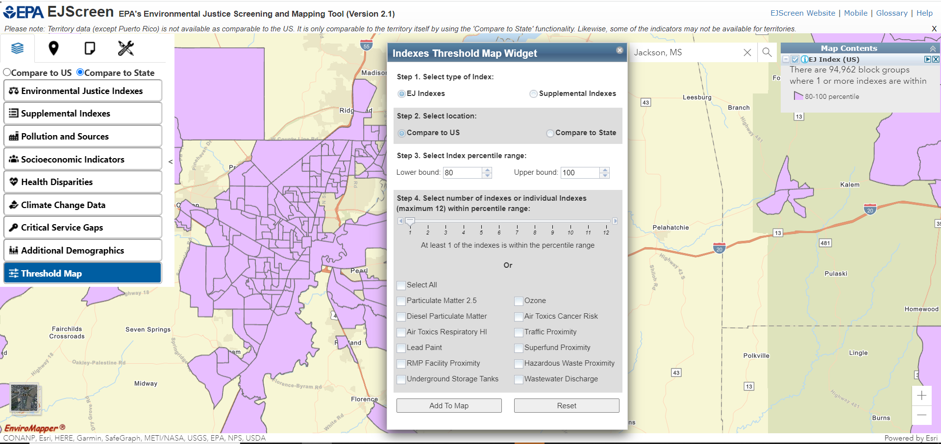
EJScreen EPA’s Environmental Justice Screening Tool

Slide 40
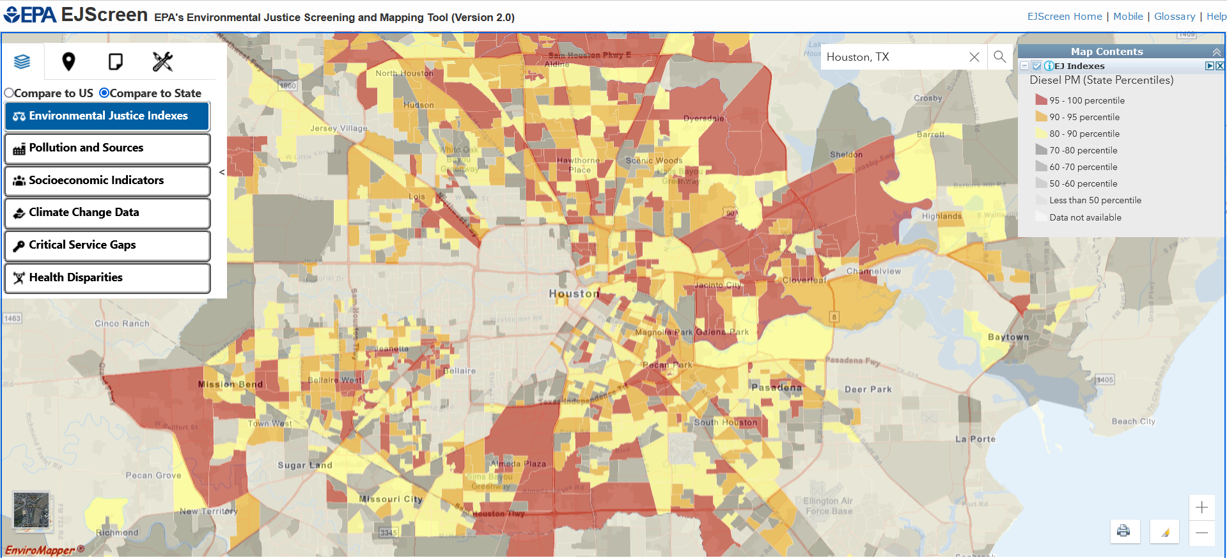
What is EJScreen?
EPA’s web-based GIS tool for nationally consistent EJ screening and mapping
Combines environmental and socioeconomic data to highlight areas where vulnerable populations may be disproportionately impacted by pollution
Starting point for agency considerations of environmental justice

Slide 41
Primary EJScreen Datasets
EJ Indexes (12)
Supplemental Indexes (12)
Environmental (12 indicators)
Socioeconomic (7 indicators)
Health (3 indicators)
Climate (6 indicators)
Critical Service Gaps (3 indicators)

Slide 42
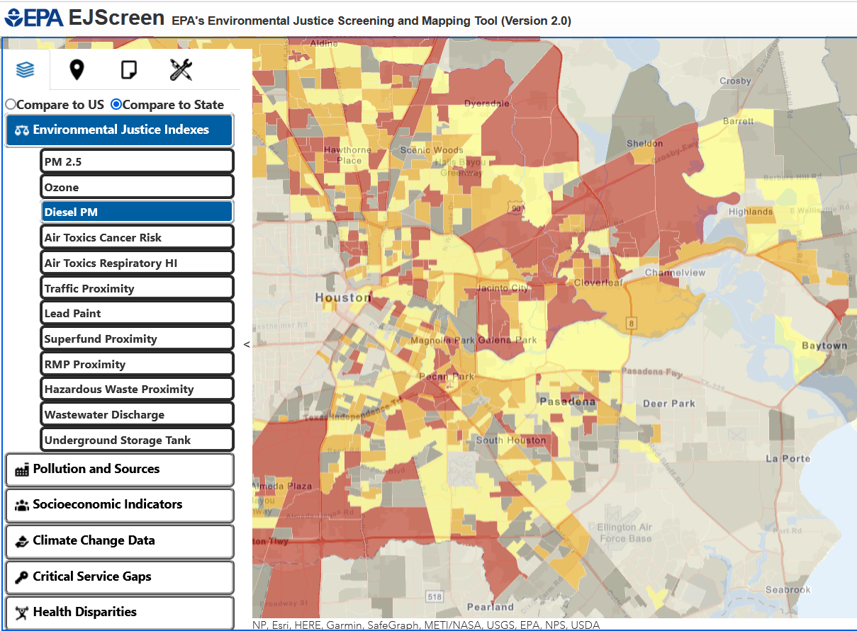
EJScreen Key Features
Annually updated environmental data
Annually updated demographics – from most recent U.S. Census Bureau American Community Survey (ACS)
Highest resolution data available
Ability to download data
Accessibility / ease of use

Slide 43
New EJSCREEN 2.1 Features Released 10/11/22
New Territory Data
Supplemental Indexes
Revised Calculations
Threshold Maps
Updated Demographic and Environmental Data

Slide 44
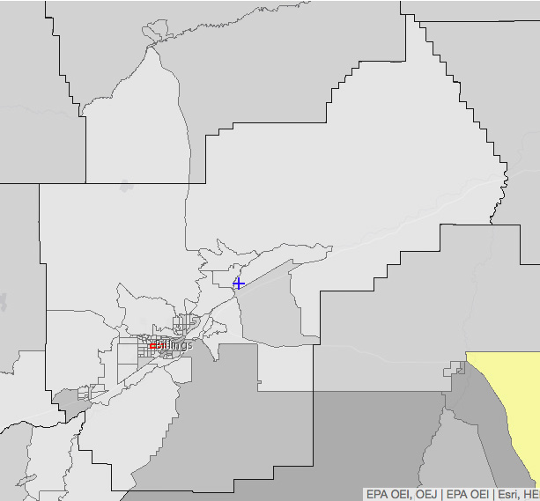
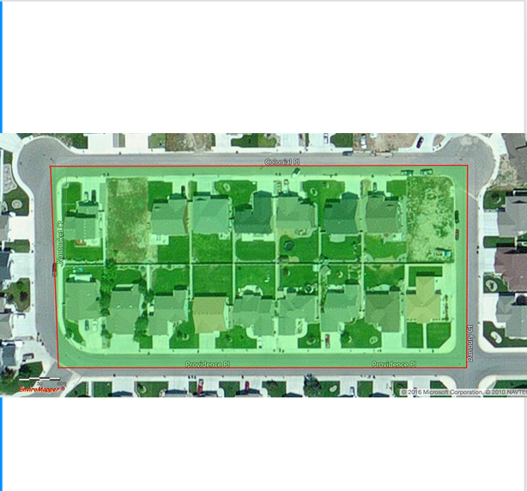
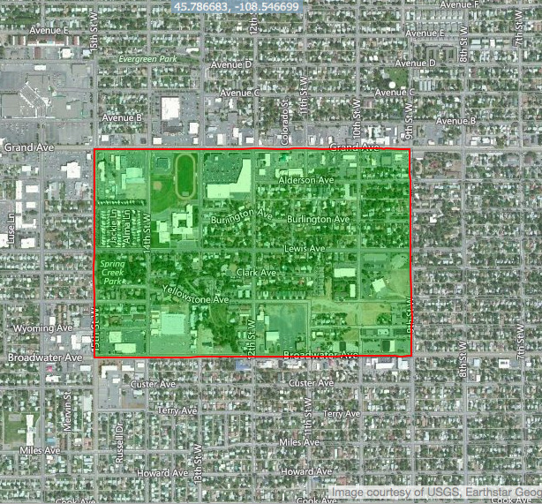
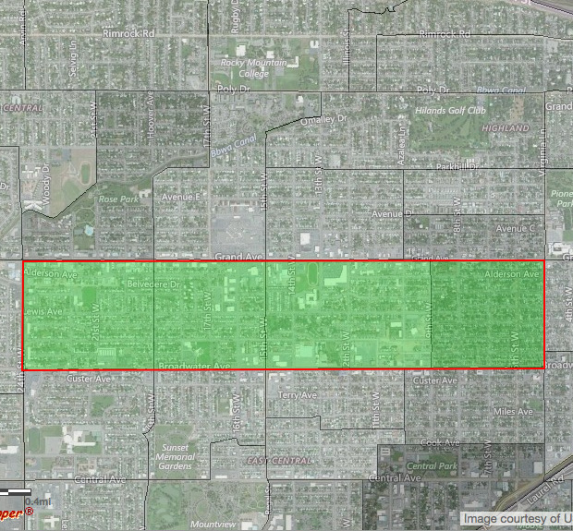
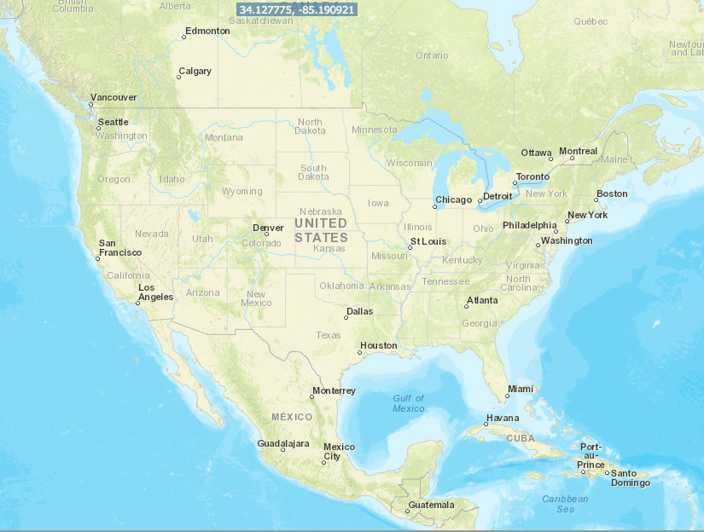
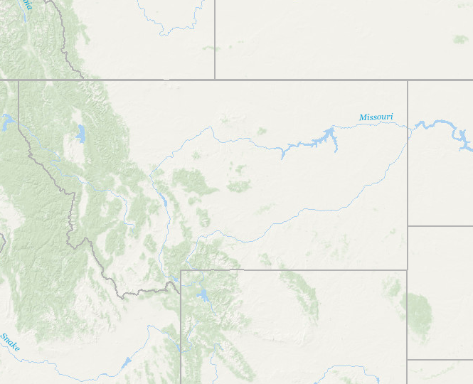
UNITS OF ANALYSIS
United States
State
primary governmental divisions of the United States.
County
Largest divisions within states.
Census Tract
Collection of Census block groups, mostly between 1,200 and 8,000 people.
Block Group
Collection of residential blocks, mostly, between 600 and 3,000 people.
Block
Residential block, bounded on all sides by streets.

Slide 45
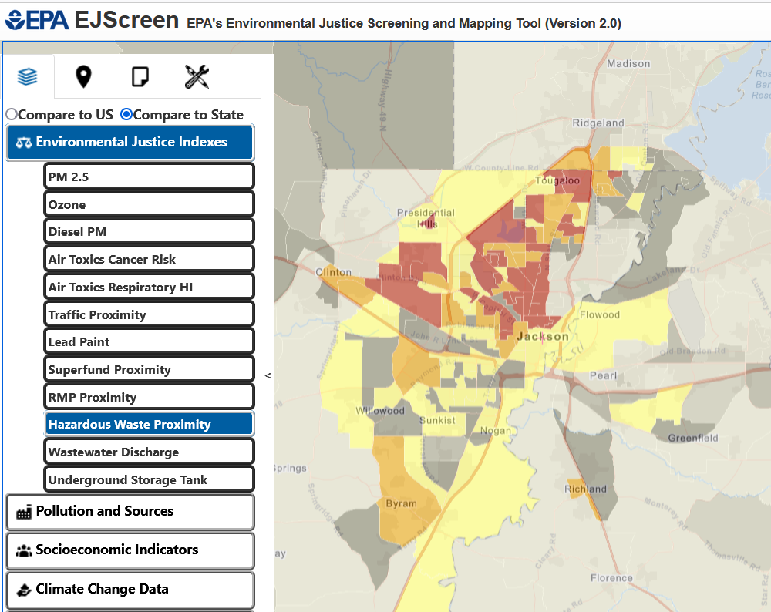
Viewing EJScreen Data
You can view the data within reports or on maps.
A map gives you one indicator at a time, for each of the block groups within a wider area (e.g. across several miles)
A standard report gives you all the indicators at once for a single specified location

Slide 46
LIVE DEMO
Live Demo
Click to access EJScreen Tool

Slide 47
EJScreen Resources
EJScreen website
Trainings and Office Hours
Recordings of EJScreen 2.1 Trainings
Public Office Hours
Feb. 15th at 12 p.m. E.T.
Click to access EJScreen Tool

Slide 48
Questions?
Contact Information
Matthew T. Lee
Office of Environmental Justice and External Civil Rights
Lee.Matthew@epa.gov

