Slide 1
How to use Login.gov Authentication FACES 6.3.0 Prepared for: FTA 08/16/2021

Slide 2
How to Register an account with Login.gov

Slide 3
Click below image to play video
Notes:
To register your account with Login.gov you will go to the FACES login page and click on the link that says, if you are an external user click this link to login.
You are then redirected to the Login.gov sign in page. Click on the link that says, create an account
And you will enter your email address.
Please note that your email address will also be your username.
Check the box that says, check this box to accept the Login.gov rules of use.
And click Submit
Login.gov will then send an email to this email address that you're trying to register.
And you will receive a confirmation link that you are going to be asked to click on.
That email looks like this.
Click on the confirm email address button.
And then in this next step you are redirected back to Login.gov and you are asked to create a password.
Click continue.
On this next screen you are then asked to create and authentication method setup.
Login.gov offers five options.
For this demonstration I will be using the authentication application option.
You can download an application to your mobile phone and use that as your application.
I'm going to give this a nickname.
And then on my application on my mobile device I will scan this QR code that I see on this screen.
And when doing that, my application on my mobile device gives me a code that I will enter here.
Then I will click submit.
And now I have created my account or registered my account with Login.gov.
I am going to click on Agree and Continue.
Then I am automatically redirected to the FACES where I can select a system to which I’d like to go to.

Slide 4
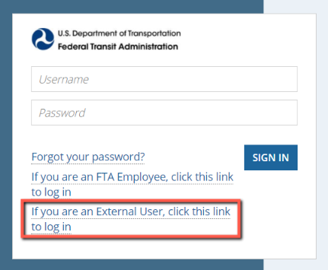
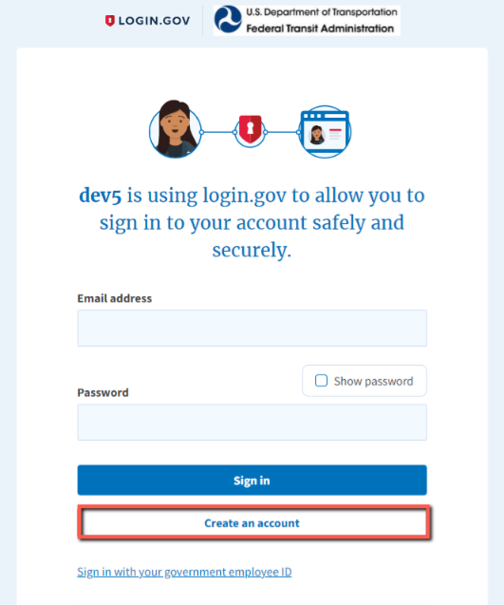
Login.gov Registration
Go to https://faces.fta.dot.gov/
Click on “If you are an External User, Click This Link to Login
3. Click on Create an account

Slide 5
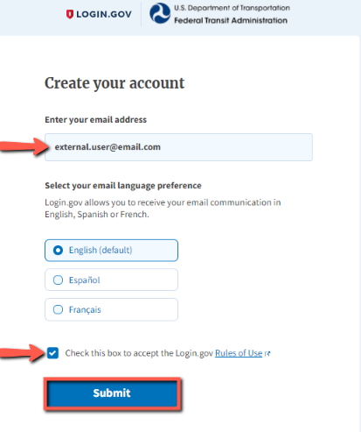
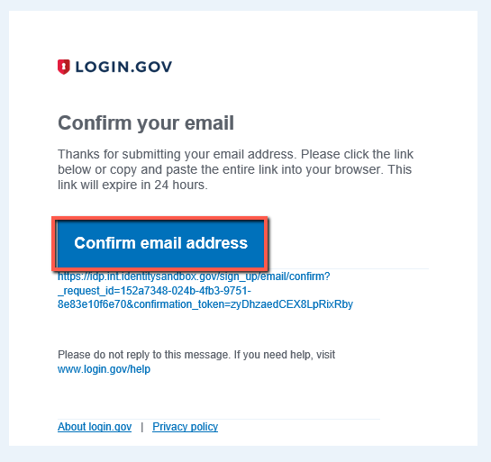
Creating Login.gov Account
4. Enter your email address and accept
the Rules of Use box
5. Look for “Confirm Your Email” email from
Login.gov and click on Confirm email address

Slide 6
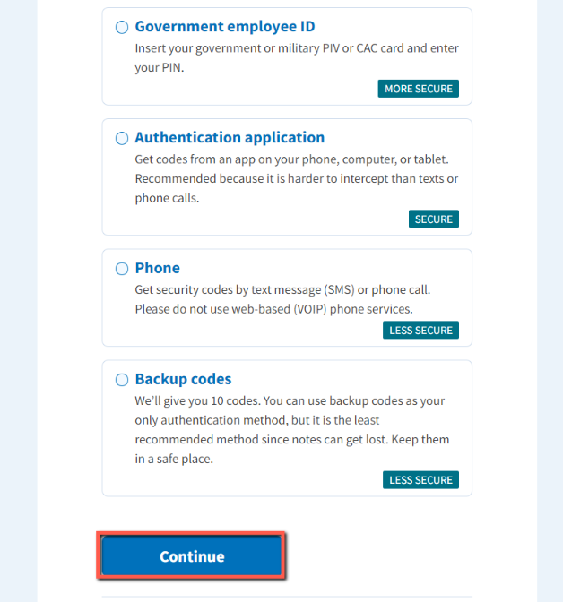
Setting up Login.gov Account
7. Select an Authentication method setup
and follow setup instructions. Slides 7-11
provide additional information for each method.
https://www.login.gov/help/get-started/authentication-options/
6. Create a strong password

Slide 7
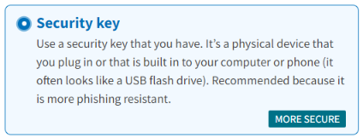
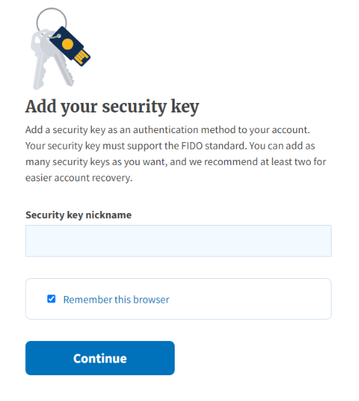
Authentication Methods – Security Key
A security key is typically an external physical device, like a USB, that you plug into your computer. The key is linked to your accounts and will only grant access to those accounts once the key is plugged in and activated.
Login.gov requires security keys that meet the FIDO (Fast Identity Online) standards.
To use this secure option for login.gov authentication, plug the key into a USB port and assign the key a name to identify it with your login.gov account. The next step will ask you to activate your key. This is generally done by pressing a button on the key itself.

Slide 8
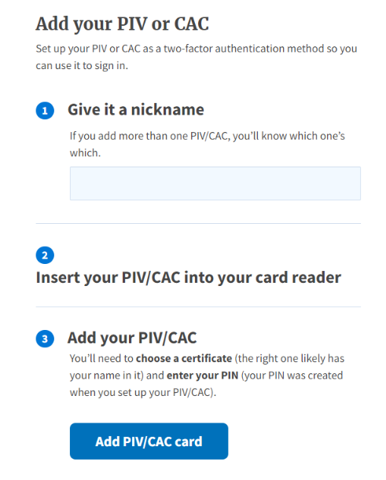
Authentication Methods – Gov’t Employee ID
Physical PIV (personal identity verification) cards or CACs (common access cards) are secure options for federal government employees and military personnel. These cards, with encrypted chip technology, are resistant to phishing and difficult to hack if stolen.

Slide 9
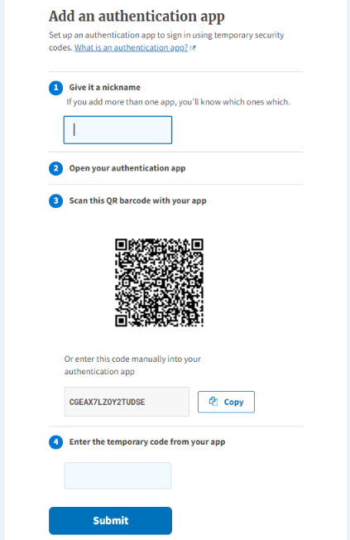
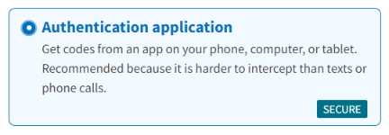
Authentication Methods – Authentication App
Authentication applications are downloaded to your device and generate secure, six-digit codes you use to sign into your accounts.
Google Authenticator
Authy
LastPass
1Password
OTP Manager
Authenticator
This method offers more security than phone calls or text messaging against phishing, hacking, or interception.
A one-time passcode generated by the application each time you sign in to login.gov.

Slide 10
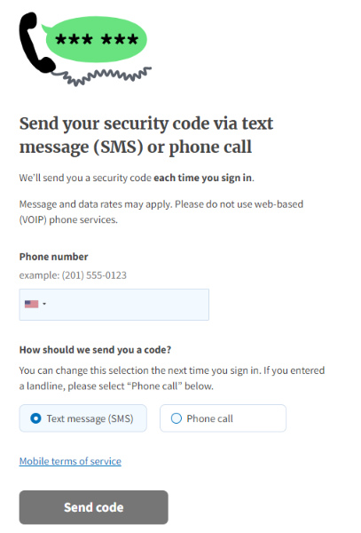
Authentication Methods – Phone
If you choose to use this less secure option, enter a phone number at which you can receive phone calls or text messages. If you only have a landline, you must receive your security code by phone call. Login.gov cannot send security codes to extensions or voicemails.
A unique security code is sent to that phone number each time you sign in to your login.gov account. Each security code expires after ten minutes and can only be used once.
After you receive the code, type it into the “one-time security code” field.
You will receive a new security code each time you sign in to your login.gov account.

Slide 11
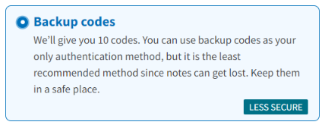
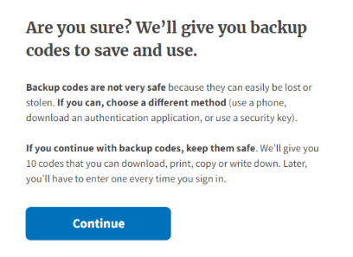
Authentication Methods – Backup Codes
Backup codes are an accessible option for users who do not have access to a phone. However, backup codes are the least secure option for two-factor authentication.
Login.gov will generate a set of ten codes. Backup codes must be printed or written down which makes them more vulnerable to theft and phishing.
After you sign in with your username and password, you will be prompted for a code. Each code may be used only once. When the tenth code has been used you will be prompted to download a new list.

Slide 12
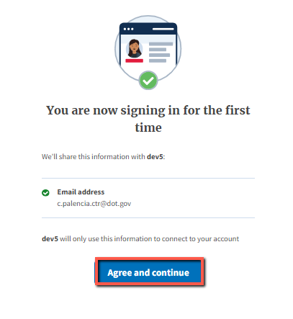
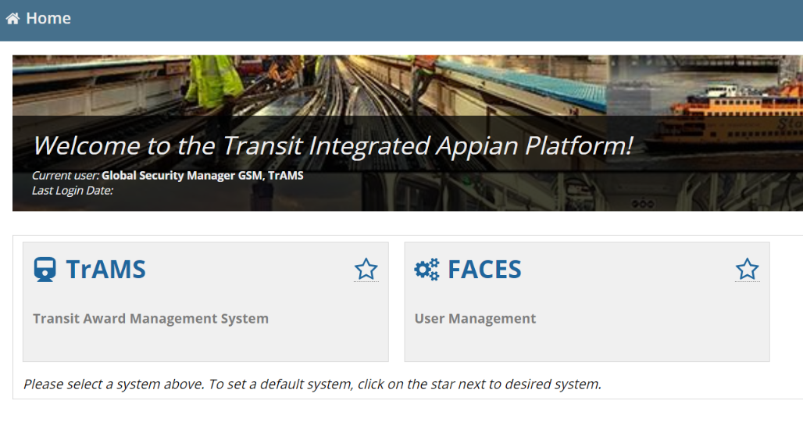
Authentication Setup Complete
8. Click on Agree and continue

Slide 13
How to Sign-in through Login.gov

Slide 14
Click below image to play video
Notes:
After you've registered your account with Login.gov the next time you go to sign in.
You will come to this login screen.
Go to or click on the link that says, If you are an external user, click this link to log in.
You are then redirected to Login.gov and you will enter your credentials that you registered the first time.
Enter the password
Click sign in
You are then asked to authenticate your account.
I use an authenticator application on my phone that I will use to authenticate myself here.
Click submit
And once I’ve been authenticated
I am then taken to the Appian home page where I can select the system I would like to use.

Slide 15
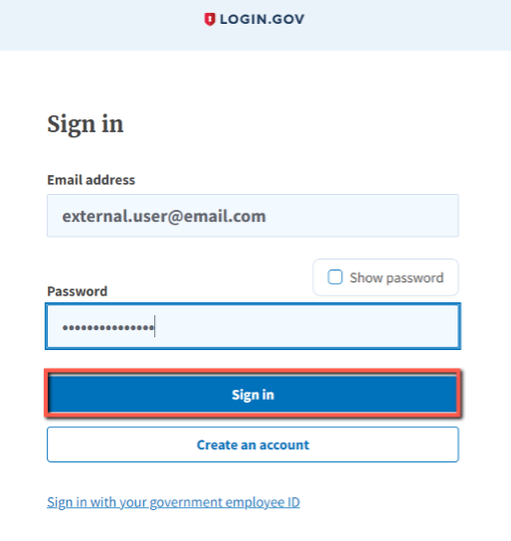
Sign In to Login.gov
Go to https://faces.fta.dot.gov/
Click on “If you are an External User, click this link to log in

Slide 16
Sign In to Login.gov
3. When you click on sign in, you will be taken to TrIAD Home page

Slide 17
Login.gov Troubleshooting

Slide 18
Forgot password
https://www.login.gov/help/trouble-signing-in/forgot-your-password/

Slide 19
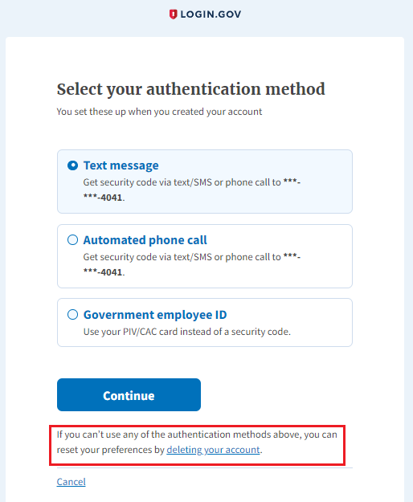
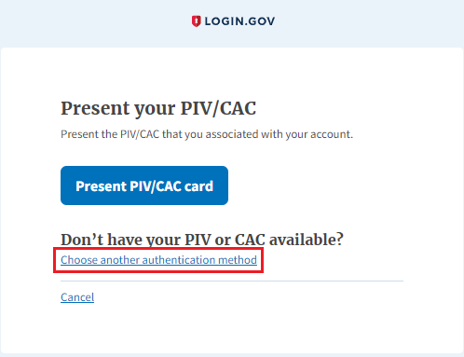
How to reset my account?
https://www.login.gov/help/manage-your-account/delete-your-account/

Slide 20
Frequently Asked Questions
Question | Answer
How do I reset my Login.gov password? | If a user forgets their password, then the user can use the “Forgot password” link in Login.gov sign-in page. Please refer at slide 18.
How do I access my account if I don’t have access to any of the multi-factor authentication methods? For ex: I changed my mobile number (or) I have uninstalled Authenticator app | If a user no longer has access to their multi-factor authentication methods, they can delete their Login.gov account and re-register at Login.gov. Please refer to slide 19 for instructions.
What happens If a user enters an incorrect password multiple times? | After 10 wrong password attempts the user will be locked out for few mins.
What happens if a user attempts an incorrect MFA authentication password multiple times? | After 3 wrong password attempts, user will be locked out for 10 mins.
Can I recover my account if I lose my MFA authentication method/ password? | If you have a secondary authentication method, you will need to use that to login. Login.gov is unable to grant you access to your account if you get locked out and/or lose your authentication method(s). You will have to reset the account by following slide 19.

Slide 21
Questions

Slide 22
